Slide 1
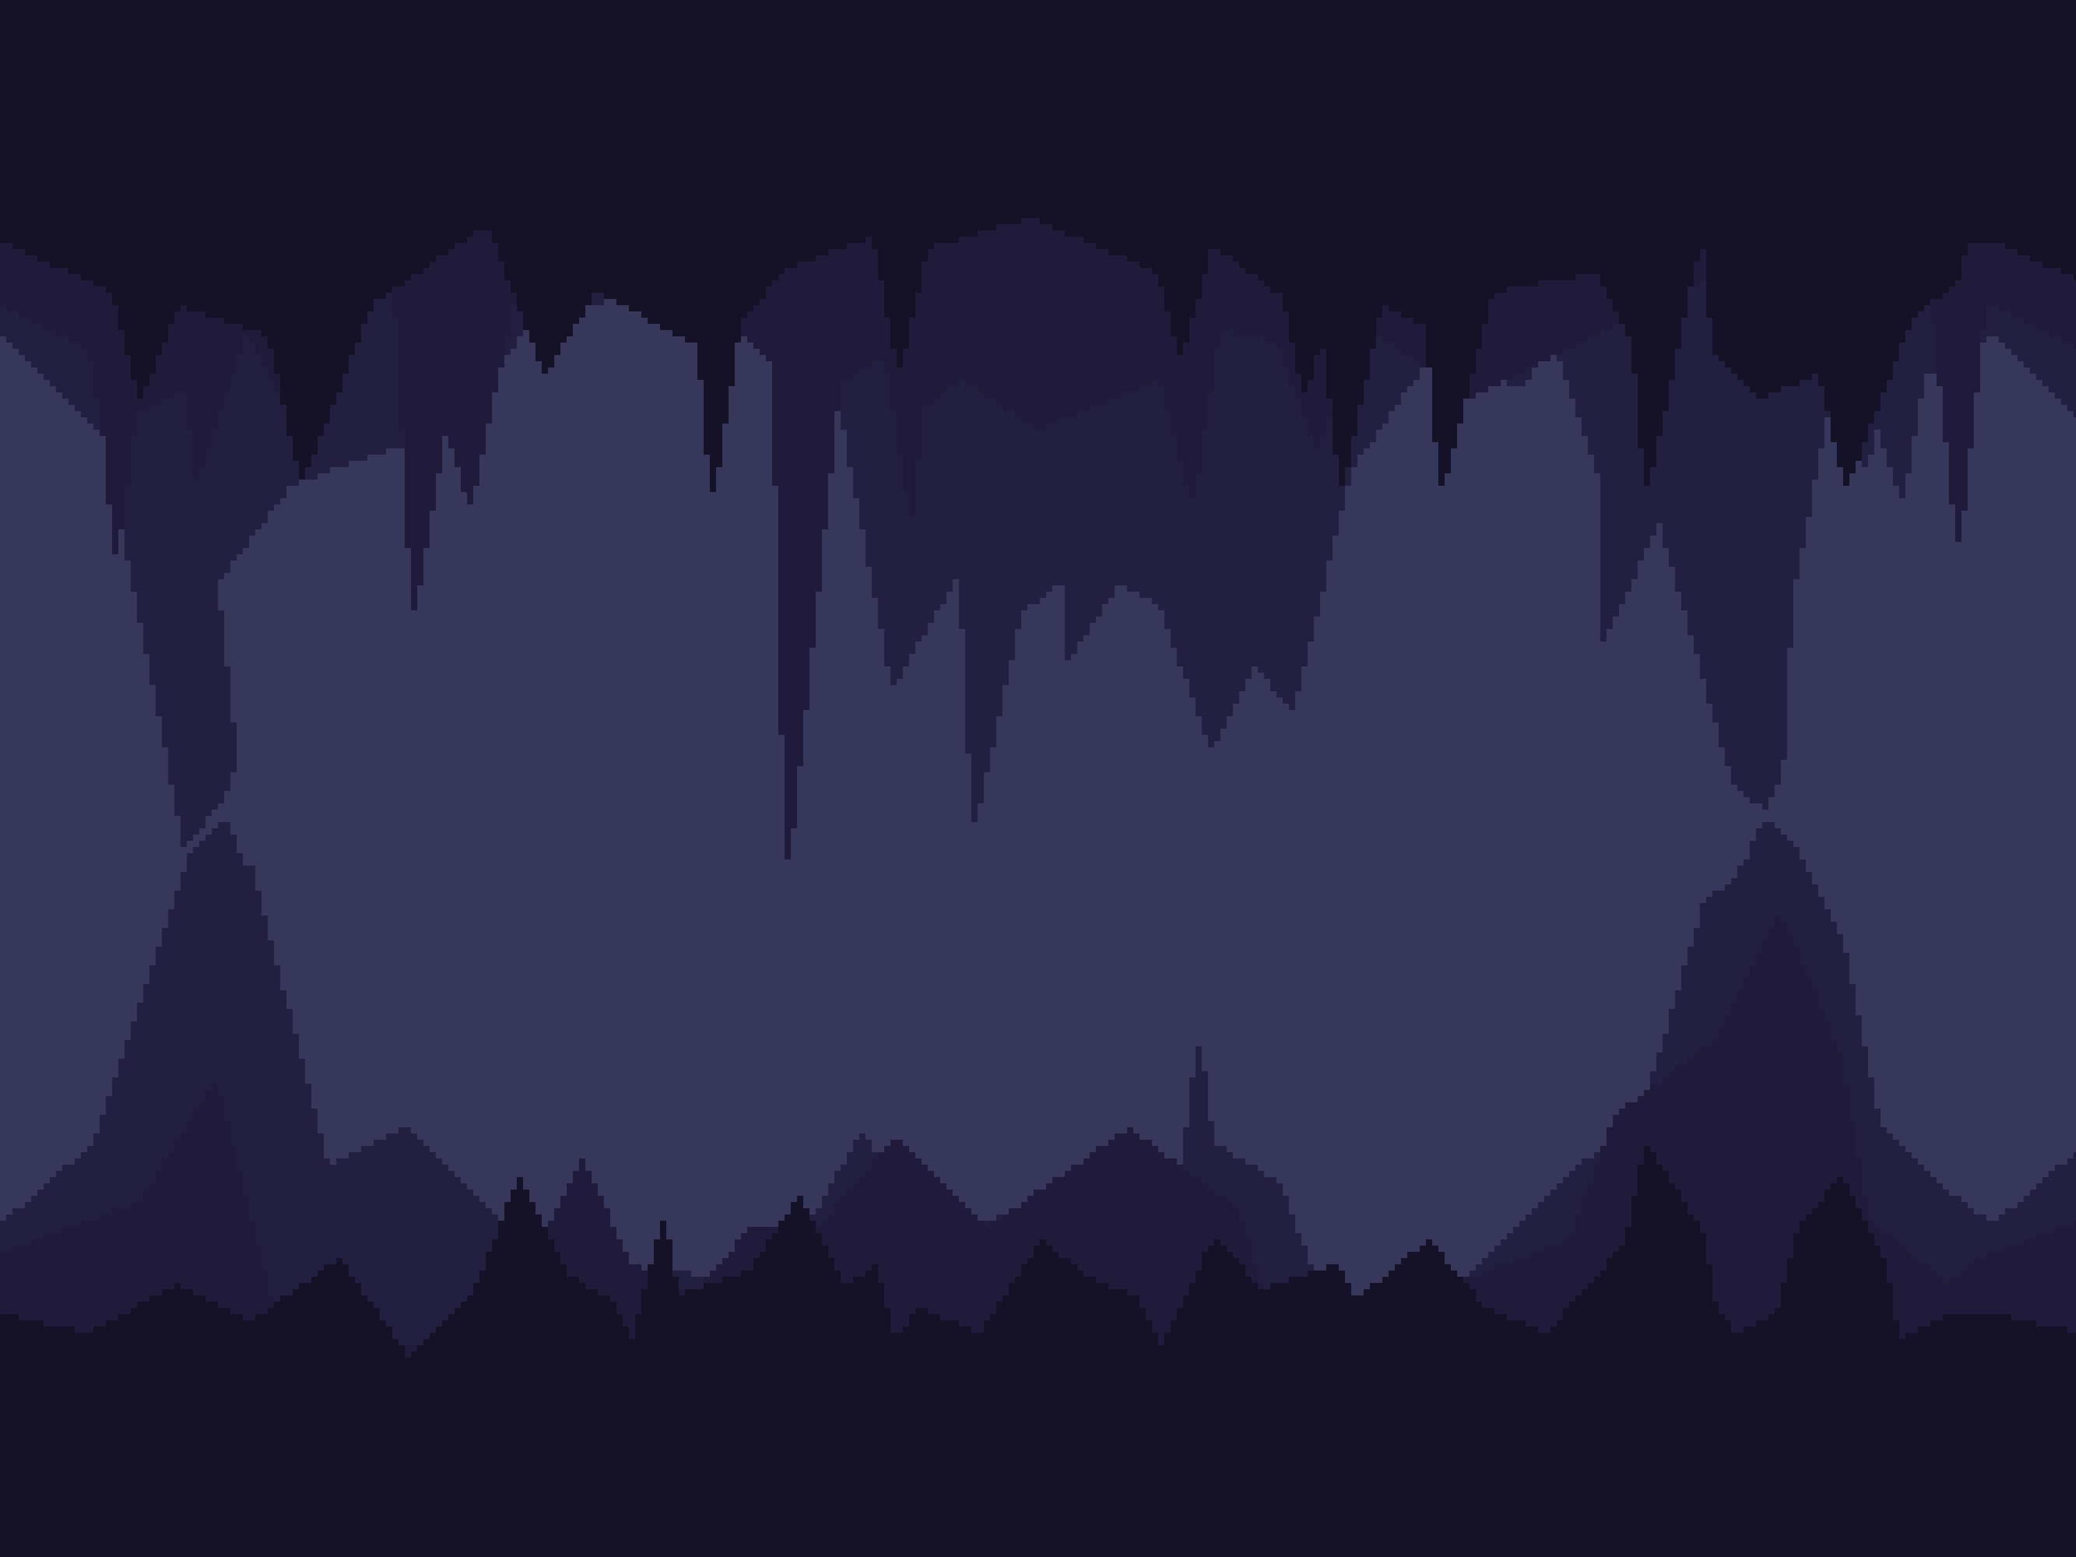
Advent of Code 2022 Day 14
Selected Fun Problems of the ACM Programming Contest
Simon Roller
University of Tübingen
28.06.2024

Slide 2
How much sand is needed to fill the cave and its surroundings?
Motivation

Slide 3
Problem Example
3/11

Slide 4
Problem Example
3/11

Slide 5
Problem Example
3/11

Slide 6
Problem Example
3/11

Slide 7
Problem Example
3/11

Slide 8
Problem Example
3/11

Slide 9
Problem Example
3/11

Slide 10
Problem Example
3/11

Slide 11
Problem Example
3/11

Slide 12
Problem Example
3/11

Slide 13
Problem Example
3/11

Slide 14
Problem Example
3/11

Slide 15
Problem Example
3/11

Slide 16
Problem Example
3/11

Slide 17
Problem Example
3/11

Slide 18
Problem Example
3/11

Slide 19
Problem Example
3/11

Slide 20
Problem Example
3/11

Slide 21
Problem Example
3/11

Slide 22
Problem Example
3/11

Slide 23
Problem Example
3/11

Slide 24
Problem Example
3/11

Slide 25
Problem Example
3/11

Slide 26
Problem Example
3/11

Slide 27
Problem Example
3/11

Slide 28
Problem Example
3/11

Slide 29

Programming Language
ease of use
4/11

Slide 30
Programming Language
ease of use
no runtime or memory constraints
4/11

Slide 31
Programming Language
ease of use
no runtime or memory constraints
me being proficient in the language
4/11

Slide 32
Input Details
1
2
498,4 -> 498,6 -> 496,6
503,4 -> 502,4 -> 502,9 -> 494,9
5/11

Slide 33
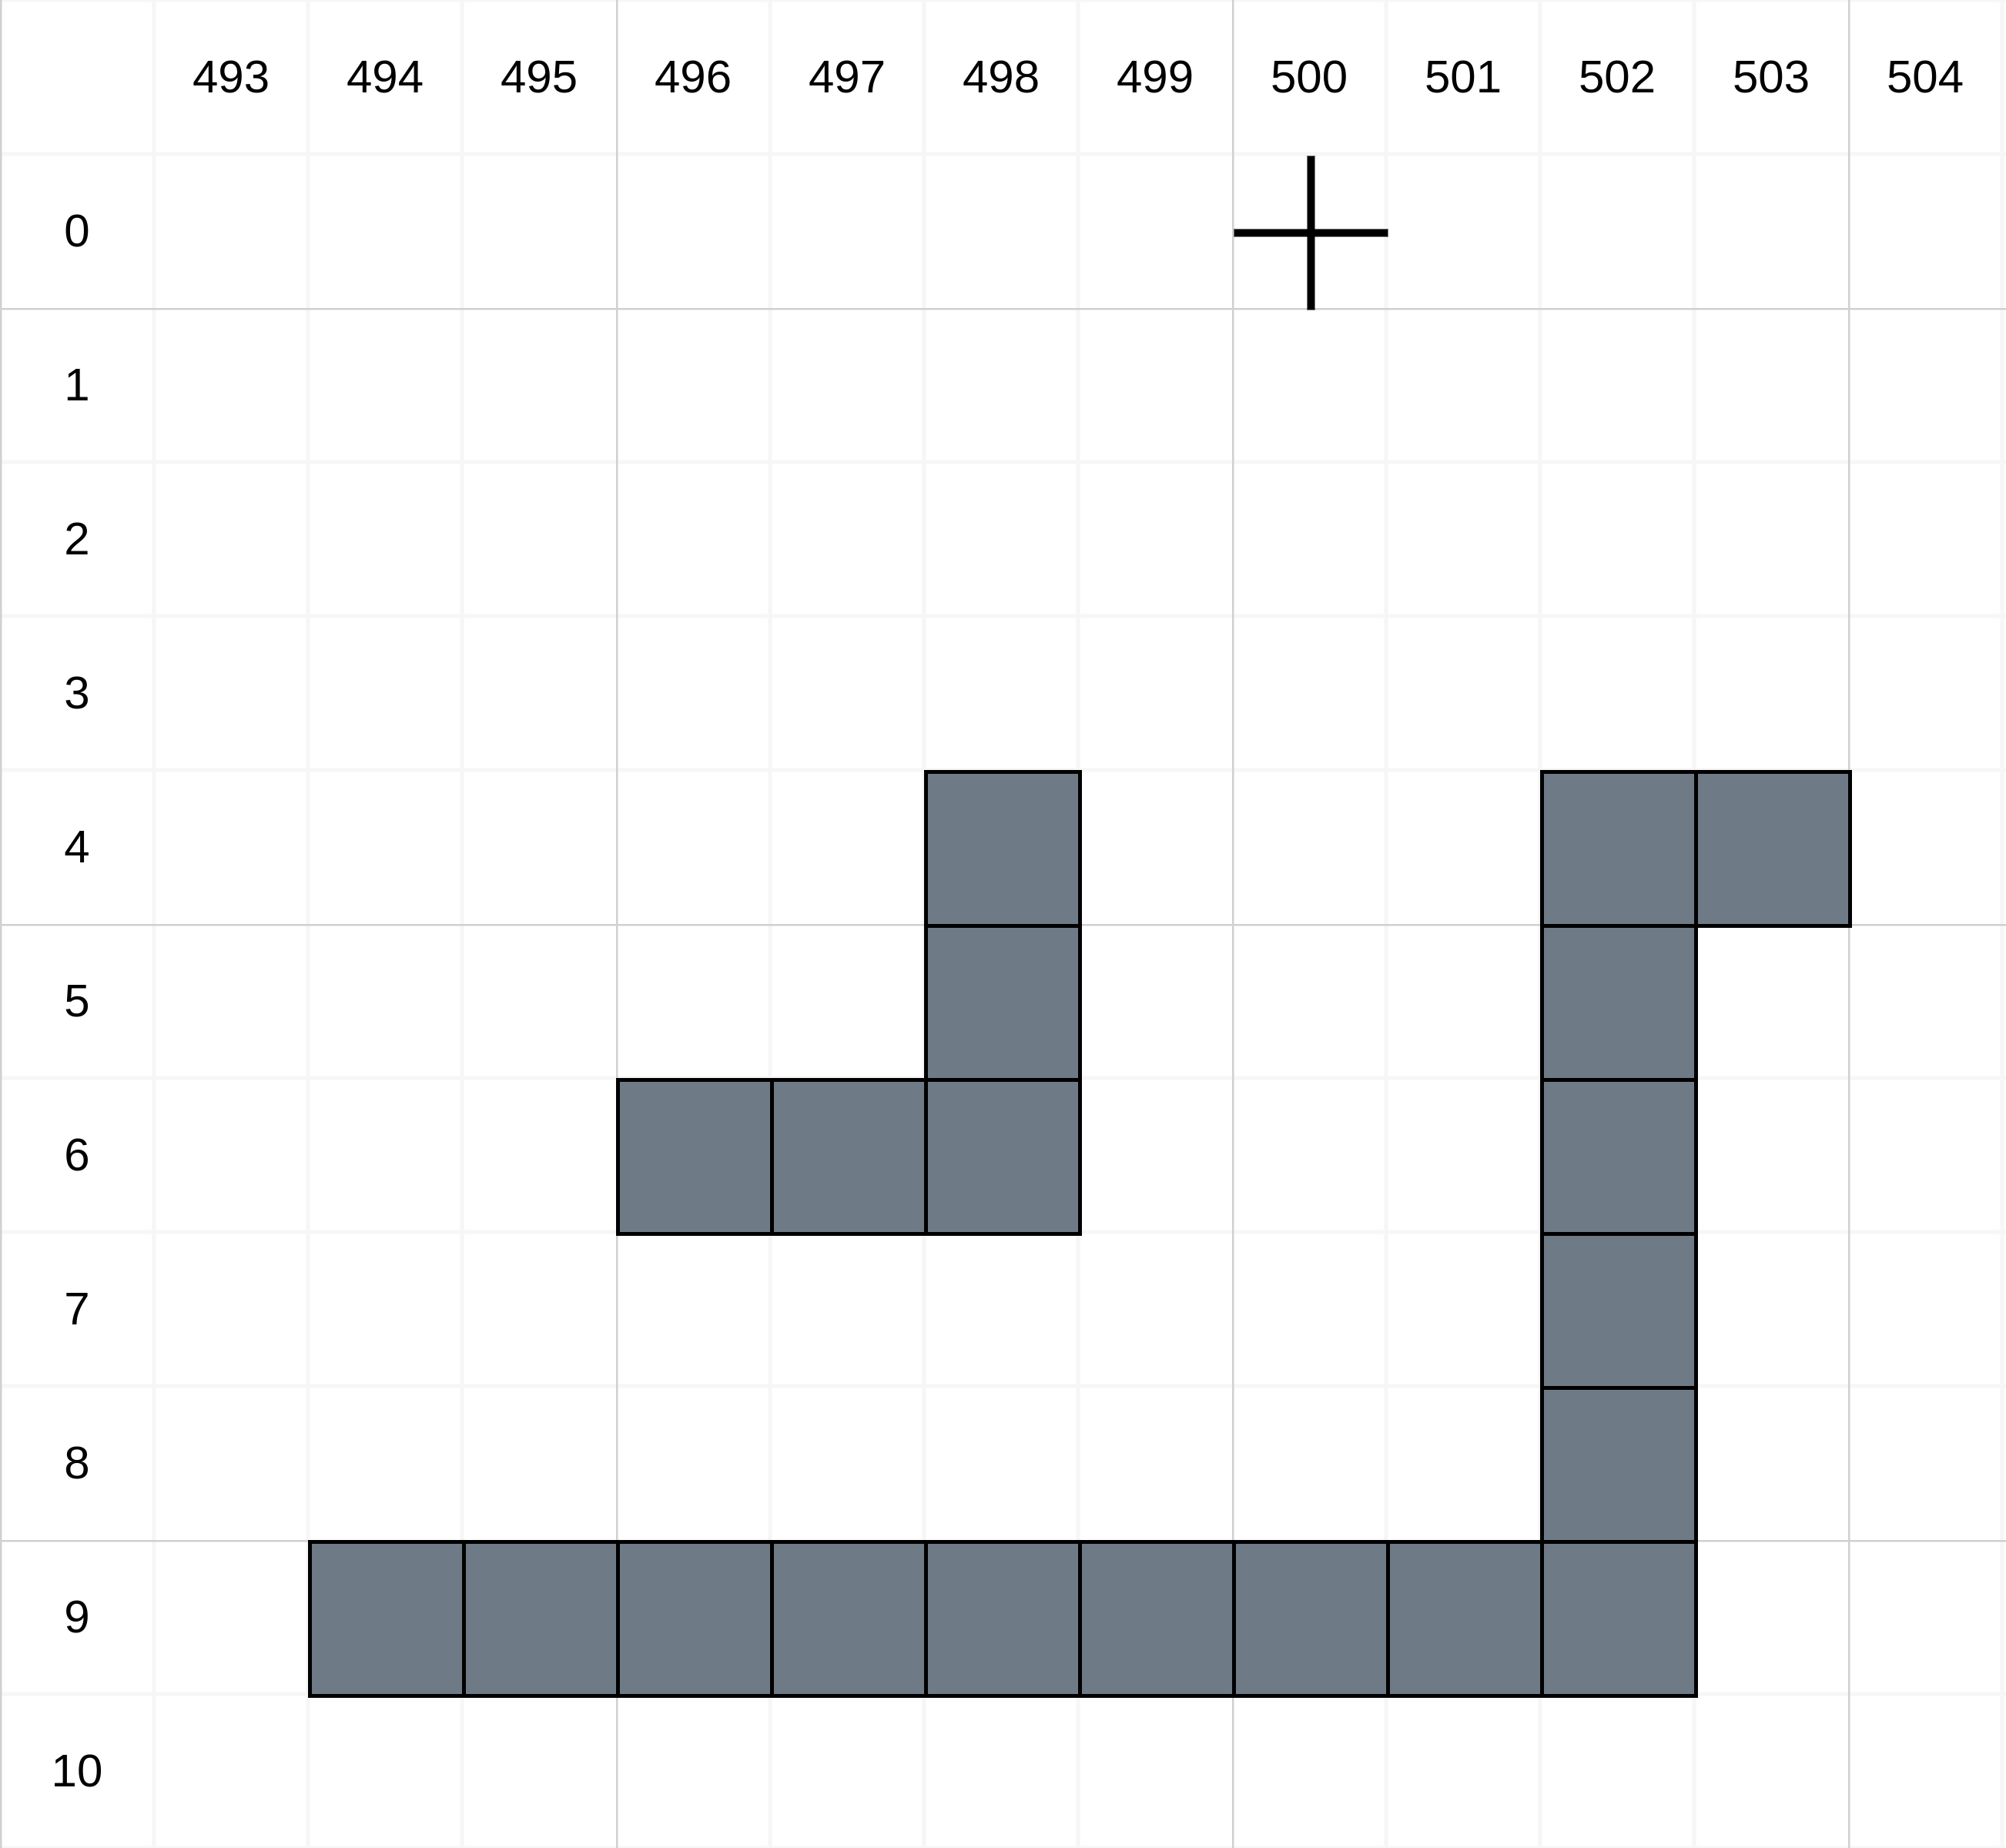
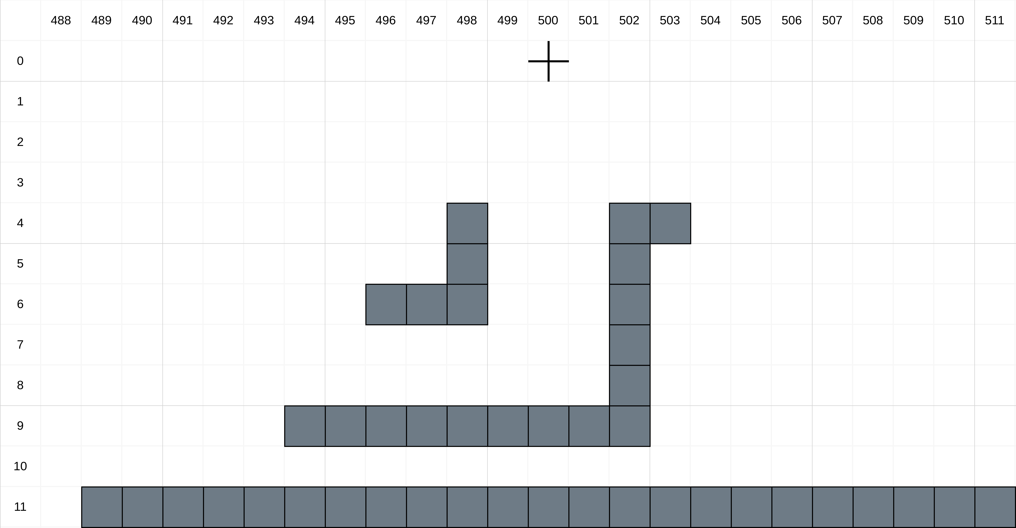
Input Details
1
2
498,4 -> 498,6 -> 496,6
503,4 -> 502,4 -> 502,9 -> 494,9
5/11

Slide 34
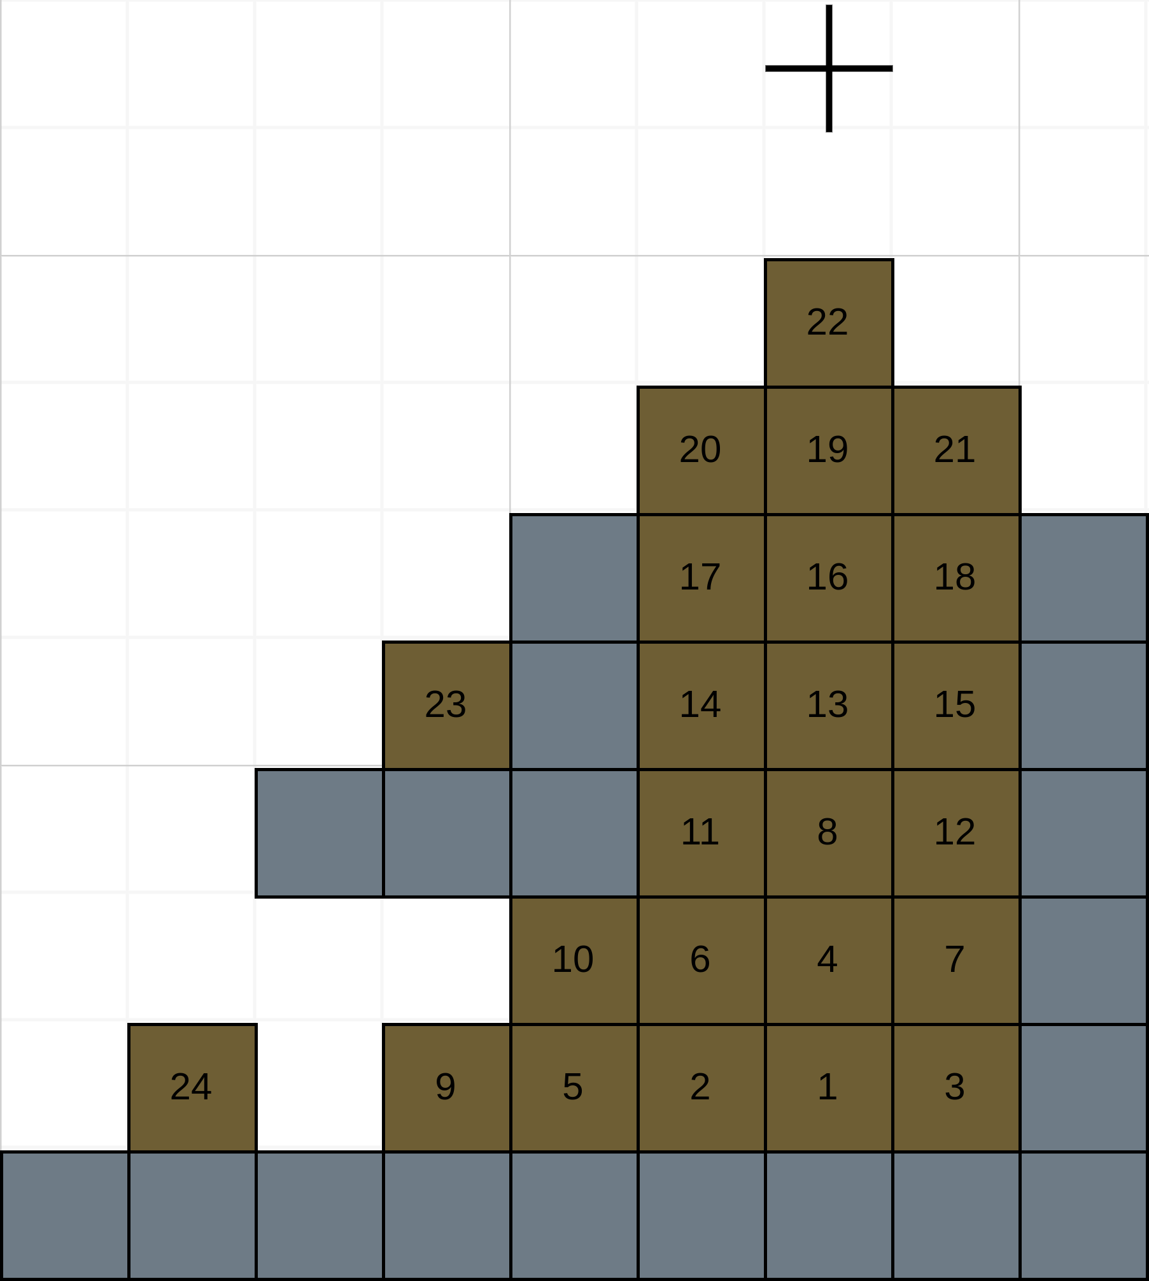
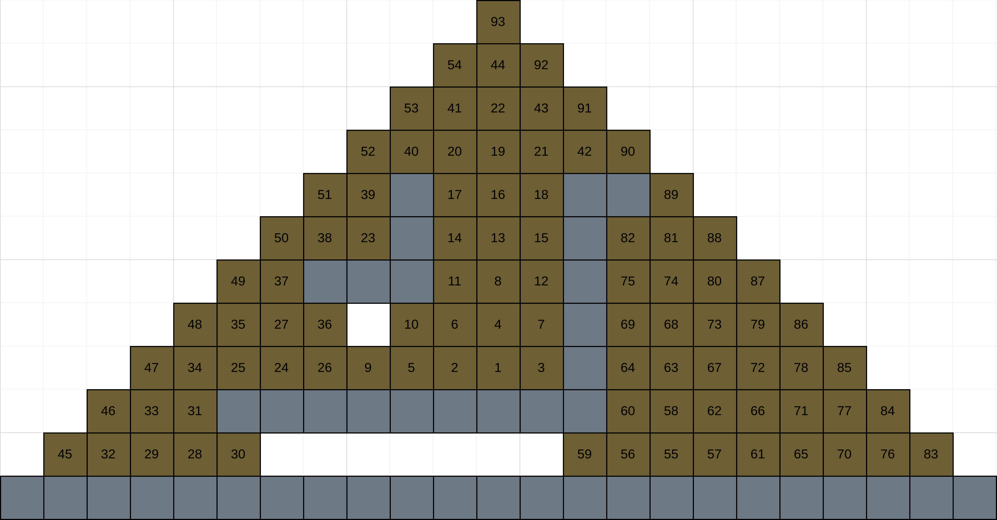
Output Details

Slide 35
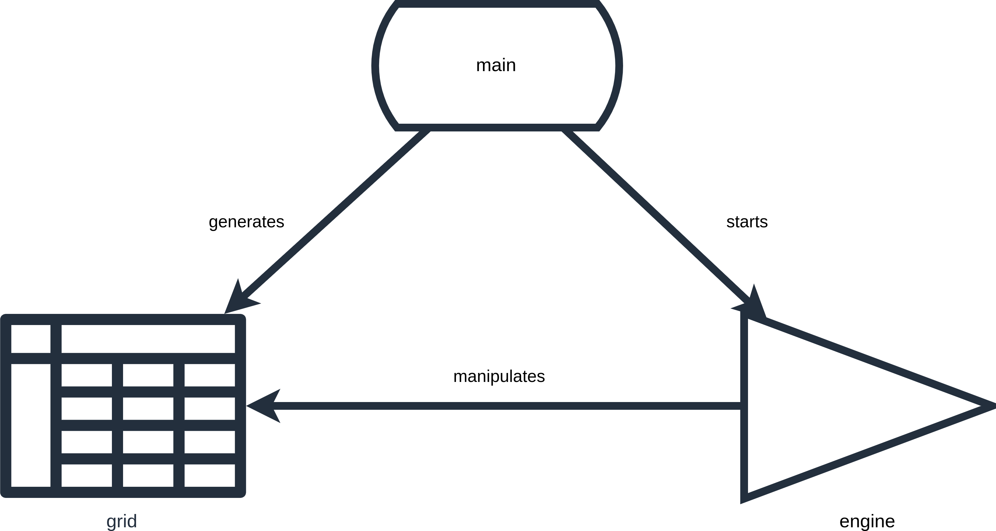
Solution Approach

Slide 36
Code Example
1
2
3
Coordinate = tuple[int, int]
Material = Enum('Material', 'air rock source solid_sand falling_sand')
Object = tuple[Material, Coordinate]

Slide 37
Code Example
1 num = 0
2 while True:
3 sand = (500, 0)
4 while True:
9/11

Slide 38
Code Example
1 num = 0
2 while True:
3 sand = (500, 0)
4 while True:
5 if self.grid.is_air_at(Coordinate((sand[0], sand[1] + 1))):
6 sand = (sand[0], sand[1] + 1)
9/11

Slide 39
Code Example
1 num = 0
2 while True:
3 sand = (500, 0)
4 while True:
5 if self.grid.is_air_at(Coordinate((sand[0], sand[1] + 1))):
6 sand = (sand[0], sand[1] + 1)
7 elif self.grid.is_air_at(Coordinate((sand[0] - 1, sand[1] + 1))):
8 sand = (sand[0] - 1, sand[1] + 1)
9/11

Slide 40
Code Example
1 num = 0
2 while True:
3 sand = (500, 0)
4 while True:
5 if self.grid.is_air_at(Coordinate((sand[0], sand[1] + 1))):
6 sand = (sand[0], sand[1] + 1)
7 elif self.grid.is_air_at(Coordinate((sand[0] - 1, sand[1] + 1))):
8 sand = (sand[0] - 1, sand[1] + 1)
9 elif self.grid.is_air_at(Coordinate((sand[0] + 1, sand[1] + 1))):
10 sand = (sand[0] + 1, sand[1] + 1)
9/11

Slide 41
Code Example
1 num = 0
2 while True:
3 sand = (500, 0)
4 while True:
5 if self.grid.is_air_at(Coordinate((sand[0], sand[1] + 1))):
6 sand = (sand[0], sand[1] + 1)
7 elif self.grid.is_air_at(Coordinate((sand[0] - 1, sand[1] + 1))):
8 sand = (sand[0] - 1, sand[1] + 1)
9 elif self.grid.is_air_at(Coordinate((sand[0] + 1, sand[1] + 1))):
10 sand = (sand[0] + 1, sand[1] + 1)
11 else:
12 self.grid.add(Object((Material.solid_sand, Coordinate(sand))))
13 break
9/11

Slide 42
Code Example
1 num = 0
2 while True:
3 sand = (500, 0)
4 while True:
5 if self.grid.is_air_at(Coordinate((sand[0], sand[1] + 1))):
6 sand = (sand[0], sand[1] + 1)
7 elif self.grid.is_air_at(Coordinate((sand[0] - 1, sand[1] + 1))):
8 sand = (sand[0] - 1, sand[1] + 1)
9 elif self.grid.is_air_at(Coordinate((sand[0] + 1, sand[1] + 1))):
10 sand = (sand[0] + 1, sand[1] + 1)
11 else:
12 self.grid.add(Object((Material.solid_sand, Coordinate(sand))))
13 break
14 if sand[1] >= self.grid.get_last_row() + 1:
15 if not part2:
16 return num
17 self.grid.add(Object((Material.solid_sand, Coordinate(sand))))
18 break
9/11

Slide 43
Code Example
1 num = 0
2 while True:
3 sand = (500, 0)
4 while True:
5 if self.grid.is_air_at(Coordinate((sand[0], sand[1] + 1))):
6 sand = (sand[0], sand[1] + 1)
7 elif self.grid.is_air_at(Coordinate((sand[0] - 1, sand[1] + 1))):
8 sand = (sand[0] - 1, sand[1] + 1)
9 elif self.grid.is_air_at(Coordinate((sand[0] + 1, sand[1] + 1))):
10 sand = (sand[0] + 1, sand[1] + 1)
11 else:
12 self.grid.add(Object((Material.solid_sand, Coordinate(sand))))
13 break
14 if sand[1] >= self.grid.get_last_row() + 1:
15 if not part2:
16 return num
17 self.grid.add(Object((Material.solid_sand, Coordinate(sand))))
18 break
19 num += 1
20 if sand == (500, 0):
21 return num
9/11

Slide 44
Live Demo

Slide 45
Key Takeaways & Outlook
rock structure is created using the input coordinates
11/11

Slide 46
Key Takeaways & Outlook
rock structure is created using the input coordinates
dynamically calculate the number of sand
11/11

Slide 47
Key Takeaways & Outlook
rock structure is created using the input coordinates
dynamically calculate the number of sand
adjust grid to be optimized for memory or computational performance
11/11

Slide 48
Key Takeaways & Outlook
rock structure is created using the input coordinates
dynamically calculate the number of sand
adjust grid to be optimized for memory or computational performance
render falling sand
11/11

