Slide 1
MIST By eric, will and zemmat

Slide 2
Agenda
Front-End
Back-End
Database
Security Threat Surfaces
Secure Coding Implementations

Slide 3

Front-End

Slide 4

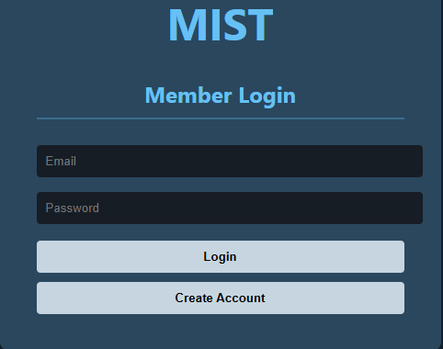
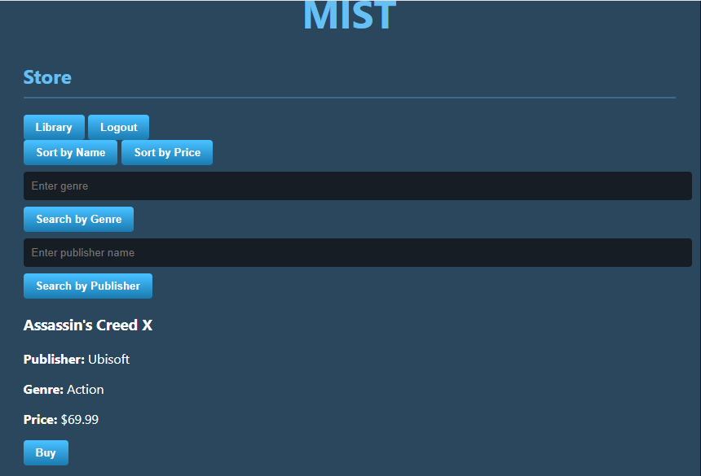
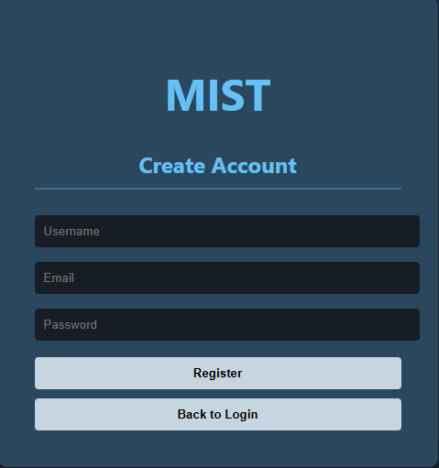
Login form:
SEARCH FORM:

Slide 5
Login form:
To ensure a secure authentication process, the login system employs comprehensive input scrubbing and output sanitization to defend against XSS and SQL injection. Additionally, integrated rate limiting protects the infrastructure from automated brute-force attacks.
search form:
The search interface maintains rigorous security standards by employing input scrubbing and output sanitization. These layers effectively mitigate XSS and SQL injection risks, ensuring a secure user experience while maintaining high-speed search performance.

Slide 6
Back-End

Slide 7
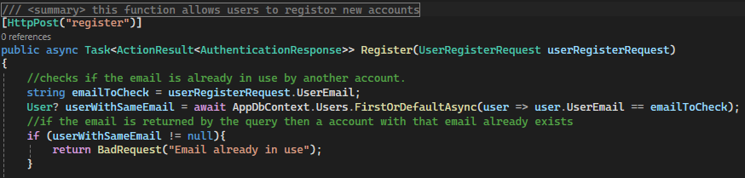
Back End
Parameterized Queries
Stops illegal user inputs from reaching database
Focusing on Zero trust ideology
Each layer of the system has security layers

Slide 8
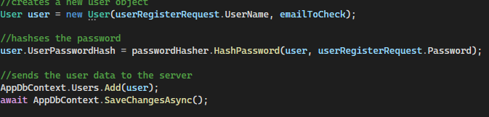
Back End - Hashing
Hashes password
Hashes password right after register was successful.
Uses built in .NET hash to keep project within time scope
Saves new account after all checks pass

Slide 9
Database

Slide 10

Database - Hashing​
Stores passwords hashed on the database
Keeps employees and attackers from easily stealing passwords

Slide 11
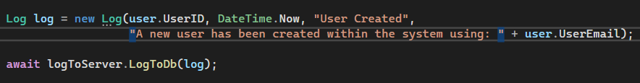
Database - Logging
This are sample code that sends small logs to the server using both nonuser tied actions
The title and description are implemented based on the location of the log and item
Allows database managers to see actions taken within the system

Slide 12
Security Threat Surfaces

Slide 13
Security Threat Surfaces
Surface | STRIDE Category | OWASP | Threat | Secure Solution
Login Fields | Information Disclosure | A03: Injection | Attacker uses ; or <> to run database commands or steal user data. | Input Scrubbing: Regex removes illegal characters.
Error Messages | Information Disclosure | A09:Security Logging/ Failures | Error messages reveal specific details about the database structure.​ | Output Sanitization: Vague "Invalid Login" messages to hide business logic.
API Endpoints | Denial of Service | A04: Insecure Design | Flooding the /login route with thousands of requests to crash the server. | Rate Limiting: 30-second lockout after 5 failed attempts.

Slide 14
Security Threat Surfaces
Surface | STRIDE Category | OWASP | Threat | Secure Solution
Password Logic | Elevation of Privilege | A07: Ident. & Auth. Failures | Using weak passwords or plain-text storage allows account takeover. | Complexity Rules: 10 chars + 5 symbols; Password hashing before DB storage.
User Session | Tampering | A01:Broken Access Control | User manually changes localStorage to "buy" games without paying. | Server-Side Validation: The API/DB should verify ownership, not the browser.
Registration Form | Spoofing | A07: Ident. & Auth. Failures | Creating fake accounts to flood the system with "Canadian" users for lower prices. | Input Validation: Verifying email formats and restricting country options.

Slide 15
THANK YOU
Eric Moutoux
Will Jessel
Zemmat Hagos

