Slide 1
MIST By eric, will and zemmat

Slide 2
Agenda
Front-End
Back-End
Database
Security Threat Surfaces
Secure Coding Implementations

Slide 3

Front-End

Slide 4

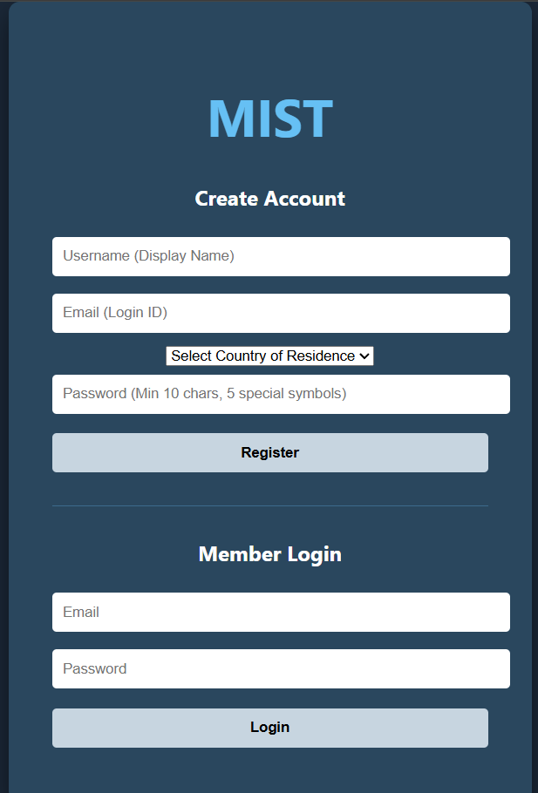
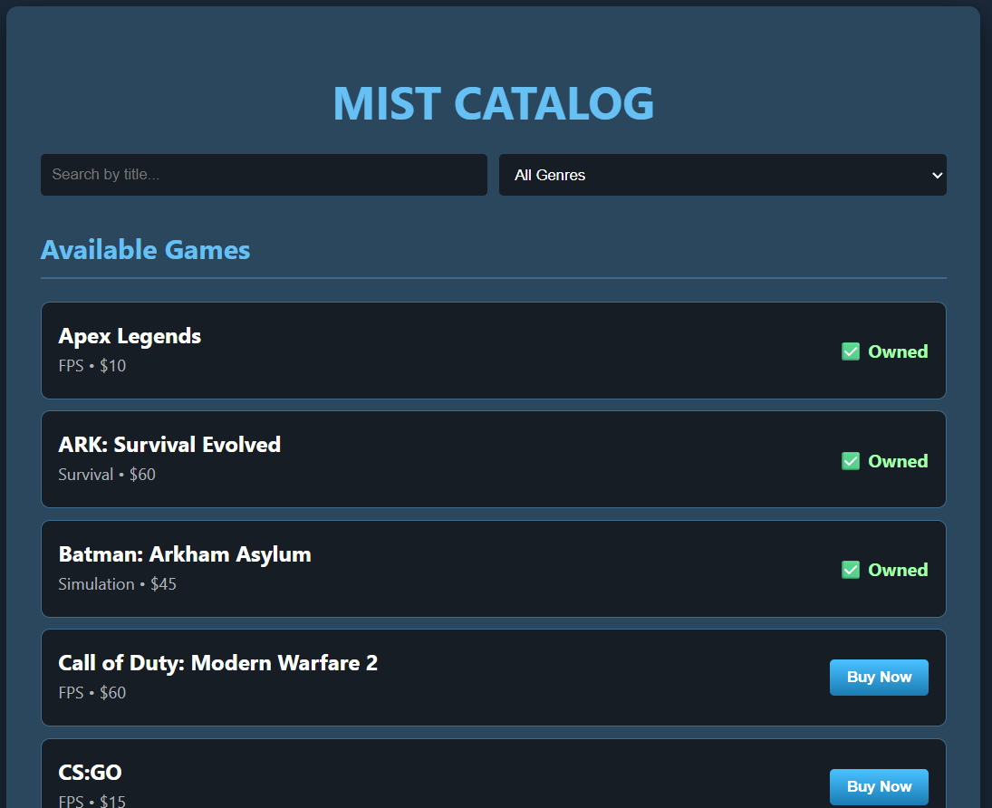
Login form:
SEARCH FORM:

Slide 5
Login form:
To ensure a secure authentication process, the login system employs comprehensive input scrubbing and output sanitization to defend against XSS and SQL injection. Additionally, integrated rate limiting protects the infrastructure from automated brute-force attacks.
search form:
The search interface maintains rigorous security standards by employing input scrubbing and output sanitization. These layers effectively mitigate XSS and SQL injection risks, ensuring a secure user experience while maintaining high-speed search performance.

Slide 6
Back-End

Slide 7
Effective delivery techniques​
Voice modulation is a powerful tool in public speaking. It involves varying pitch, tone, and volume to convey emotion, emphasize points, and maintain interest:
Pitch variation​
Tone inflection​
Volume control
Effective body language enhances your message, making it more impactful and memorable:
Meaningful eye contact
Purposeful gestures
Maintain good posture
Control your expressions

Slide 8
Navigating Q&A sessions
Know your material in advance​
Anticipate common questions​
Rehearse your responses
Maintaining composure during the Q&A session is essential for projecting confidence and authority. Consider the following tips for staying composed:​
Stay calm​
Actively listen​
Pause and reflect​
Maintain eye contact

Slide 9
Database

Slide 10

Speaking impact​
Your ability to communicate effectively will leave a lasting impact on your audience​
Effectively communicating involves not only delivering a message but also resonating with the experiences, values, and emotions of those listening

Slide 11
Dynamic delivery​
Learn to infuse energy into your delivery to leave a lasting impression​
One of the goals of effective communication is to motivate your audience
Metric​ | Measurement​ | Target​ | Actual​
Audience attendance​ | # of attendees​ | 150​ | 120​
Engagement duration​ | Minutes​ | 60​ | 75​
Q&A interaction​ | # of questions​ | 10​ | 15​
Positive feedback​ | Percentage (%)​ | 90​ | 95​

Slide 12
Security Threat Surfaces

Slide 13
Security Threat Surfaces
Surface | STRIDE Category | OWASP | Threat | Secure Solution
Login Fields | Information Disclosure | A03: Injection | Attacker uses ; or <> to run database commands or steal user data. | Input Scrubbing: Regex removes illegal characters.
Error Messages | Information Disclosure | A09:Security Logging/ Failures | Error messages reveal specific details about the database structure.​ | Output Sanitization: Vague "Invalid Login" messages to hide business logic.
API Endpoints | Denial of Service | A04: Insecure Design | Flooding the /login route with thousands of requests to crash the server. | Rate Limiting: 30-second lockout after 5 failed attempts.

Slide 14
Security Threat Surfaces
Surface | STRIDE Category | OWASP | Threat | Secure Solution
Password Logic | Elevation of Privilege | A07: Ident. & Auth. Failures | Using weak passwords or plain-text storage allows account takeover. | Complexity Rules: 10 chars + 5 symbols; Password hashing before DB storage.
User Session | Tampering | A01:Broken Access Control | User manually changes localStorage to "buy" games without paying. | Server-Side Validation: The API/DB should verify ownership, not the browser.
Registration Form | Spoofing | A07: Ident. & Auth. Failures | Creating fake accounts to flood the system with "Canadian" users for lower prices. | Input Validation: Verifying email formats and restricting country options.

Slide 15
THANK YOU
Eric Moutoux
Will Jessel
Zemmat Hagos

