Slide 1
E-COMMERCE
Sales & Customer
Intelligence Using SQL
Revenue • Customer Behaviour • Products • Regions • Returns
MySQL 8 | Python | Google Colab | Business Analytics
Portfolio Analytics Project
Sombir Singh

Slide 2
Business Problem & Analytical Objectives
Turning relational transaction data into actionable commercial intelligence
BUSINESS QUESTIONS
ANALYTICAL APPROACH
• How much measurable revenue is the business generating?
• Which categories, products and regions drive commercial performance?
• Which customers contribute the greatest historical value?
• How frequently do customers purchase and return?
• Where is return-related financial exposure concentrated?
• Relational analysis across Customers, Orders, OrderDetails, Products and Regions
• 25 validated SQL business analyses
• CTEs, joins, conditional aggregation and window functions
• Independent Python reconciliation of presentation KPIs
• Executive visualization and business recommendation layer
E-Commerce Sales & Customer Intelligence Using SQL
2

Slide 3
Database Architecture & Data Quality
Revenue metrics require available line-item details
Regions
→
Customers
→
Orders
→
OrderDetails
→
Products
10
200
1,000
2,000
100
TOTAL ORDERS
ORDERS WITH DETAILS
MISSING DETAILS
DETAIL COVERAGE
1,000
853
147
85.30%
IMPORTANT METHODOLOGICAL NOTE
Order-level metrics use all 1,000 orders. Revenue, AOV, product and unit-based metrics use the 853 orders with available OrderDetails. This distinction prevents incomplete transactions from being treated as zero-revenue orders.
E-Commerce Sales & Customer Intelligence Using SQL
3

Slide 4
Executive Performance Snapshot
Core validated commercial and customer KPIs
GROSS REVENUE
NET REVENUE
GROSS AOV
TOTAL ORDERS
$2.76M
$2.05M
$3,233
1,000
RETURN RATE
RETURNED REVENUE
REPEAT RATE
DETAIL COVERAGE
24.90%
$708.3K
95.98%
85.30%
EXECUTIVE READOUT
Measured gross revenue reaches $2.76M, but $708.3K (25.69%) is associated with returned orders. Returns therefore represent one of the clearest areas for commercial investigation.
E-Commerce Sales & Customer Intelligence Using SQL
4

Slide 5
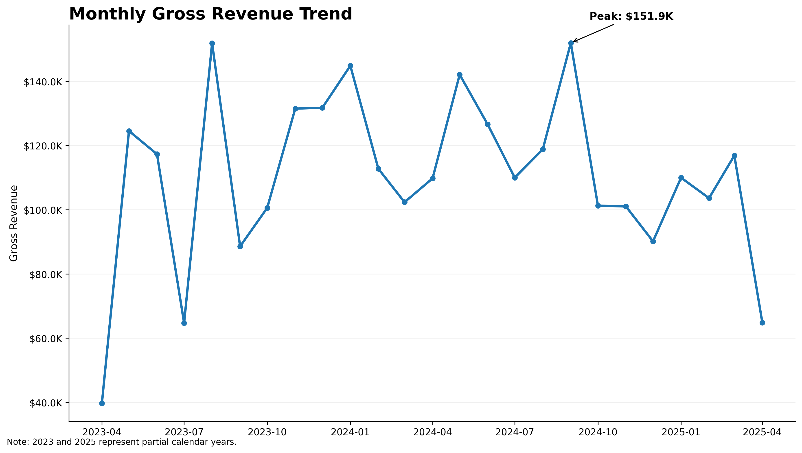
Revenue Performance Over Time
Monthly measured gross revenue across the available transaction period
PEAK MONTH
September 2024 generated the highest observed monthly gross revenue: $151.9K.
2024 PERFORMANCE
2024 generated $1.412M measured gross revenue and is the only full calendar year in the dataset.
INTERPRETATION
2023 begins in April and 2025 ends in April, so annual totals should not be treated as directly comparable full-year growth.
E-Commerce Sales & Customer Intelligence Using SQL
5

Slide 6
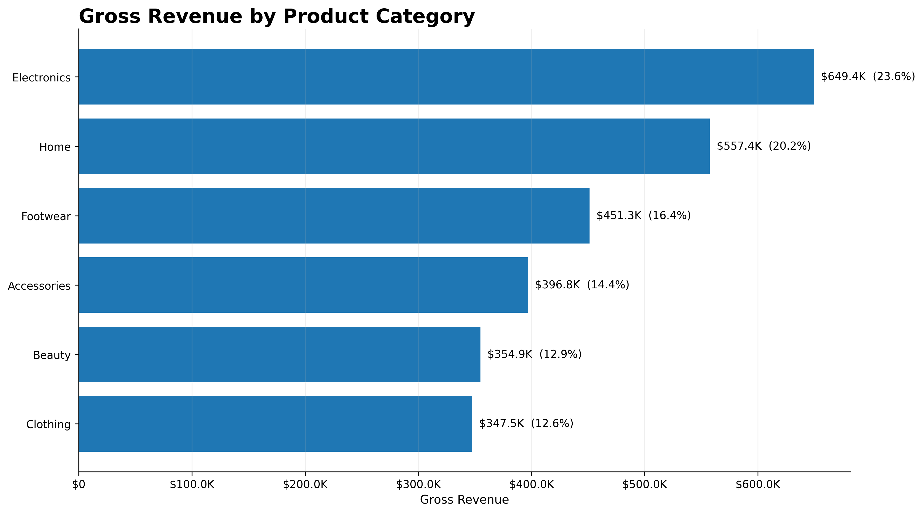
Category Performance
Revenue concentration and category contribution
LEADING CATEGORY
Electronics generated $649.4K, representing 23.55% of measured gross revenue.
SECOND-LARGEST CATEGORY
Home generated $557.4K, representing 20.21% of measured gross revenue.
CONCENTRATION
Electronics + Home contributed approximately 43.76% of measured gross revenue.
Note: Electronics contains more products than several other categories, so revenue leadership should not automatically be interpreted as superior per-product productivity.
E-Commerce Sales & Customer Intelligence Using SQL
6

Slide 7
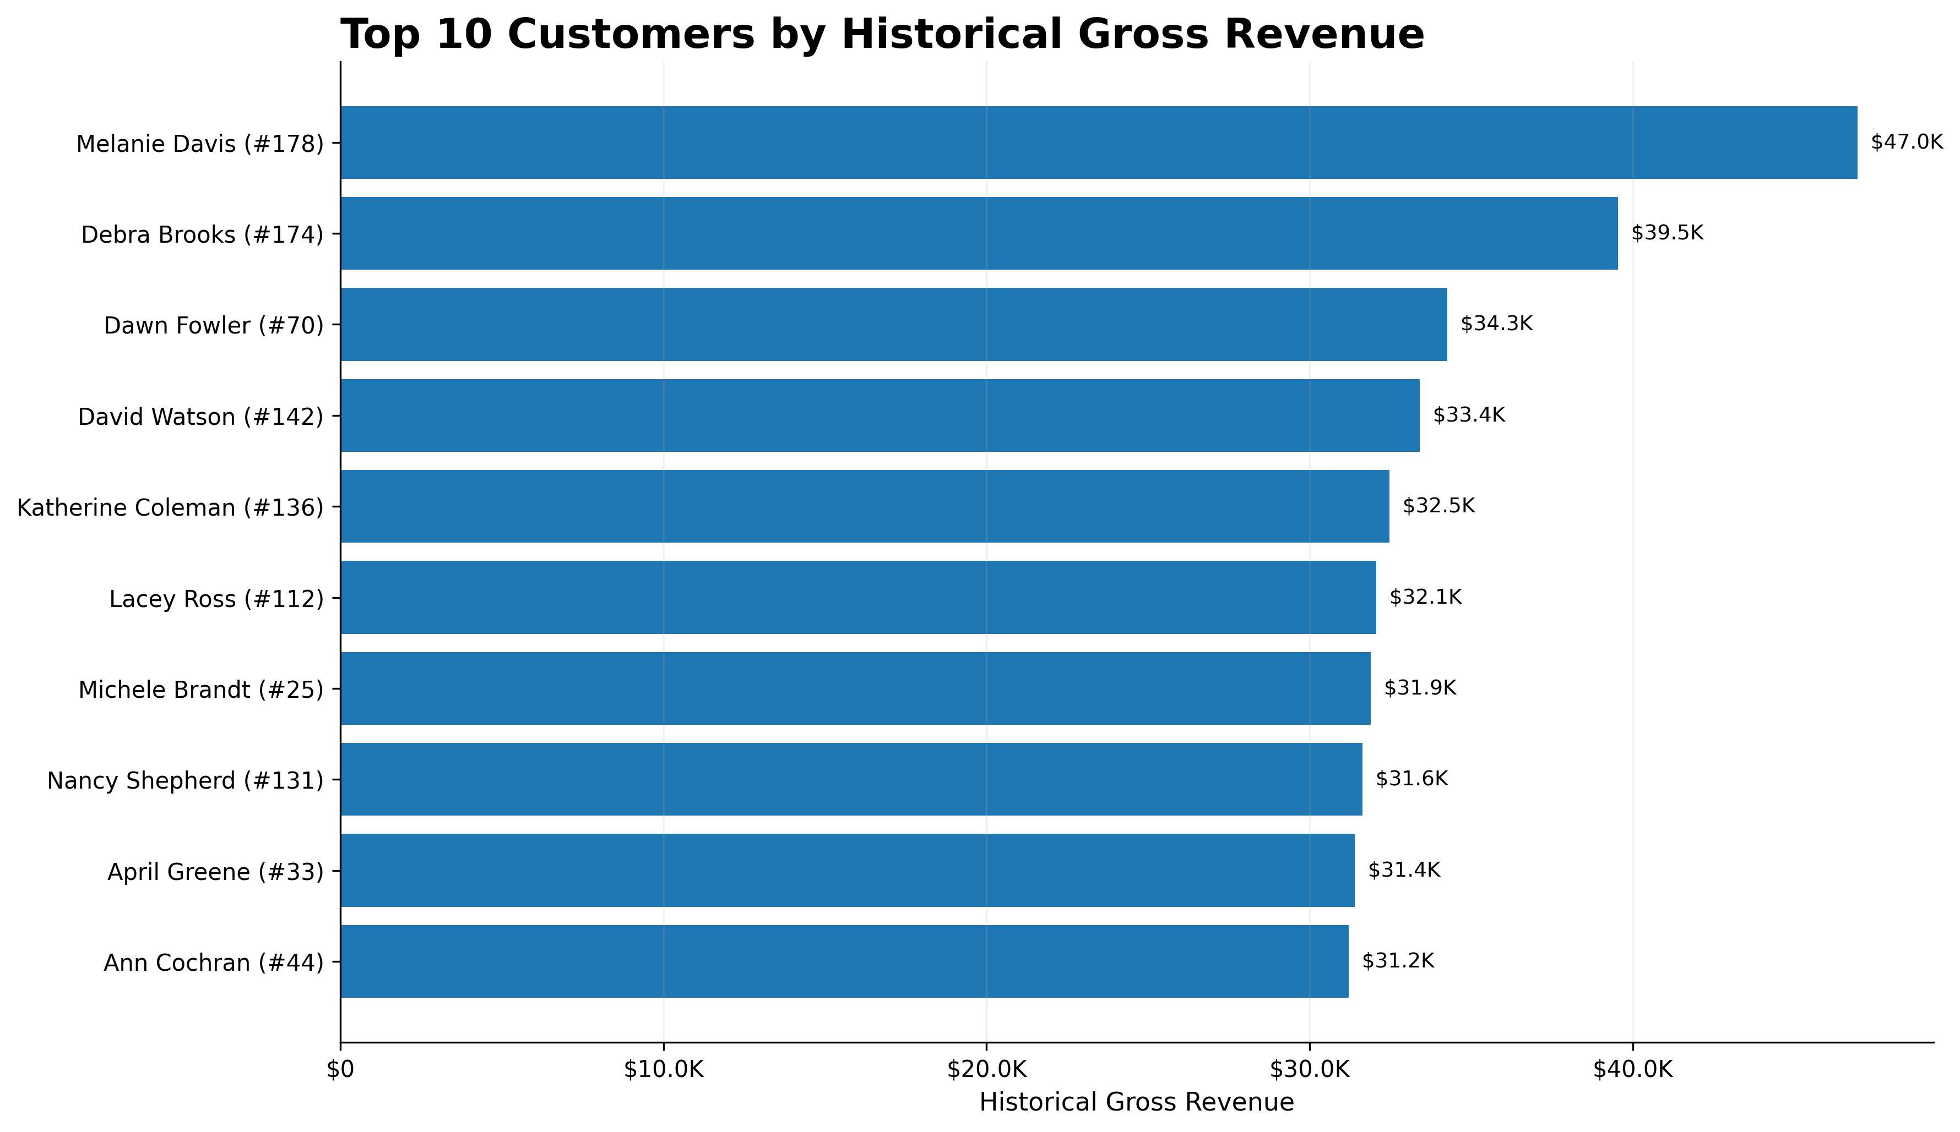
Customer Intelligence
Historical customer value, retention and segmentation
ACTIVE CUSTOMERS
REPEAT CUSTOMERS
199
191
TOP HISTORICAL VALUE
Melanie Davis generated $46,959.01 measured gross revenue across 6 revenue-bearing orders.
RETENTION SIGNAL
95.98% of active customers placed more than one order. Because the dataset is synthetic, this unusually high repeat rate should be interpreted cautiously.
E-Commerce Sales & Customer Intelligence Using SQL
7

Slide 8
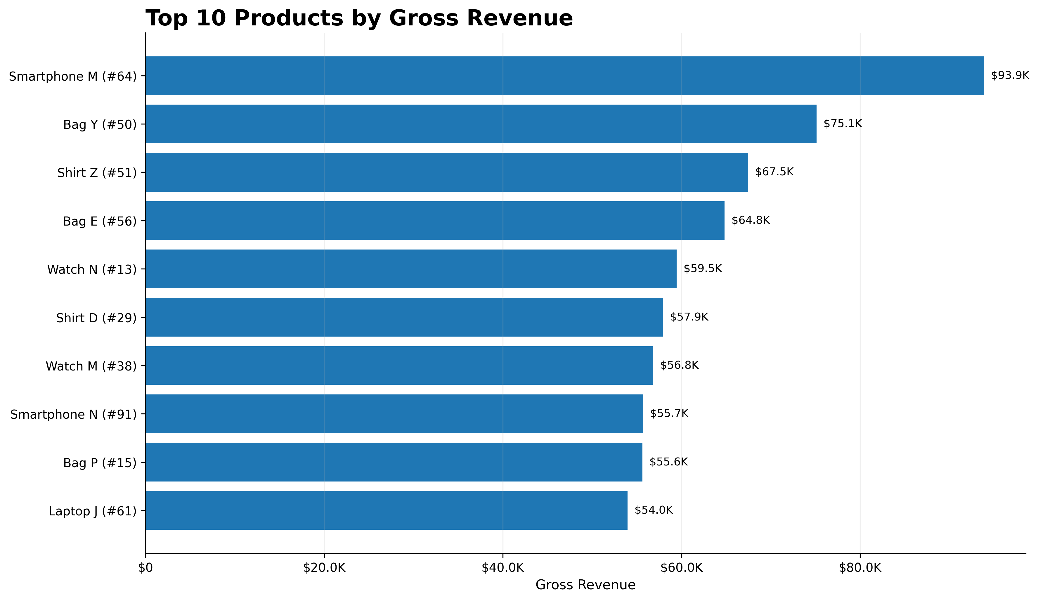
Product Performance
Top products ranked by measured gross revenue
TOP PRODUCT
Smartphone M (#64) generated $93,856 in measured gross revenue.
VOLUME LEADER
Smartphone M (#64) also sold 100 units, making it the highest-volume product.
DATA MODEL NOTE
Product names are not unique in the dataset. ProductID is therefore retained when ranking products.
E-Commerce Sales & Customer Intelligence Using SQL
8

Slide 9
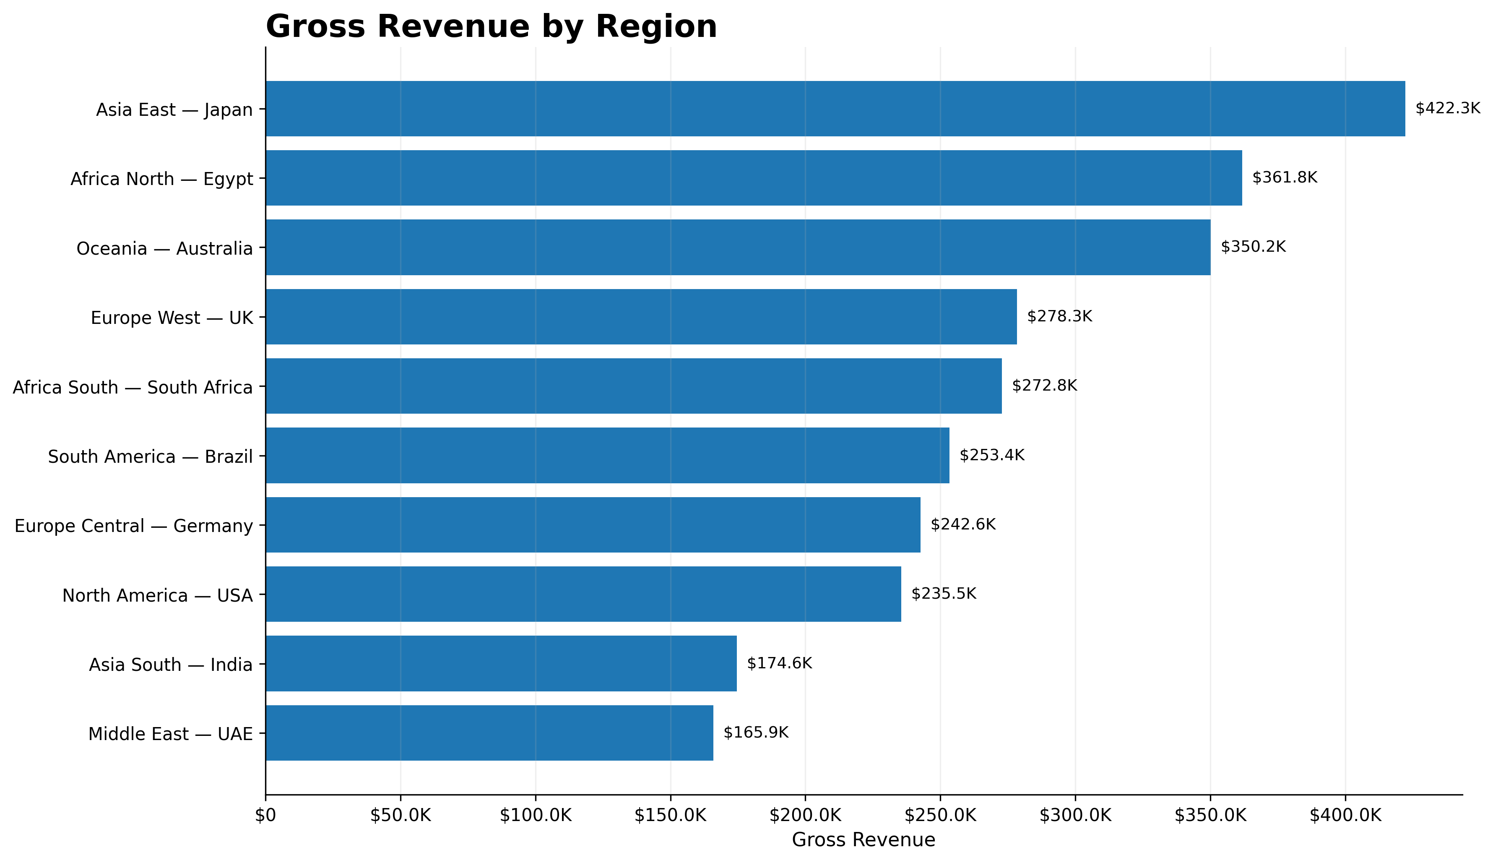
Regional Performance
Measured revenue contribution across geographic markets
REVENUE LEADER
Asia East / Japan generated the highest measured regional revenue at $422.3K.
HIGHEST AOV
Africa North / Egypt recorded the highest regional gross AOV at $3,654.24.
PURCHASE MIX
Europe Central / Germany recorded the highest weighted average purchased unit price at $491.08.
E-Commerce Sales & Customer Intelligence Using SQL
9

Slide 10
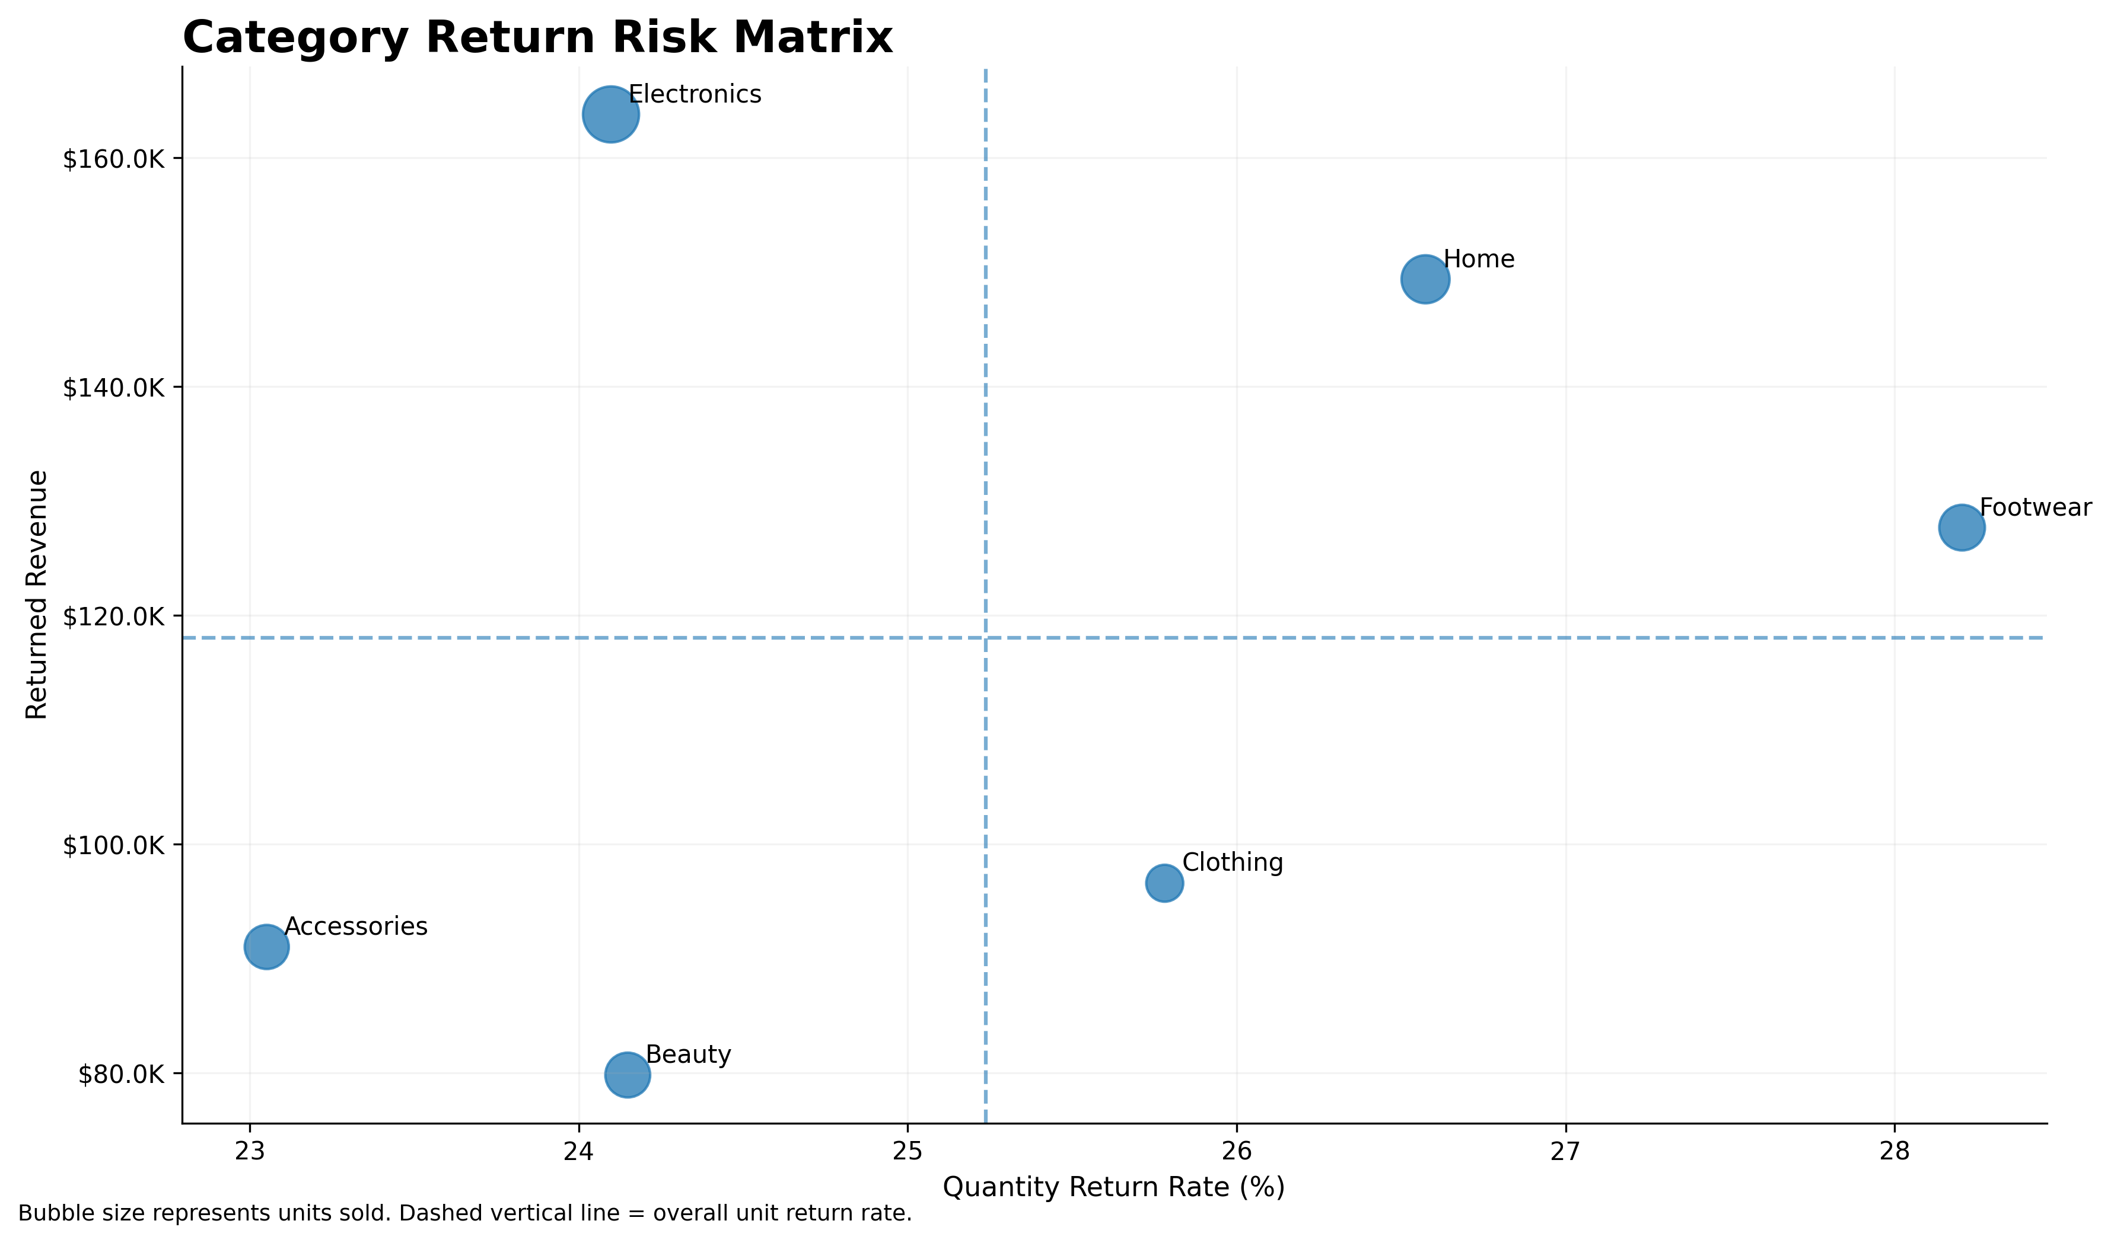
Returns & Commercial Risk
Return frequency and financial exposure reveal different risk signals
ORDER RETURN RATE
RETURNED REVENUE
24.90%
$708.3K
RATE RISK
Footwear has the highest quantity return rate at 28.21%.
FINANCIAL EXPOSURE
Electronics has the greatest returned-revenue exposure at $163.8K.
REGIONAL RISK
Africa South / South Africa has the highest regional order return rate at 31.37%.
E-Commerce Sales & Customer Intelligence Using SQL
10

Slide 11
Key Insights & Business Recommendations
Translating analytical findings into practical actions
01
Reduce return exposure
Investigate Footwear return drivers and high-value Electronics returns separately because frequency and financial exposure represent different risks.
02
Protect revenue leaders
Prioritize availability and commercial monitoring for leading categories and high-performing products.
03
Use regional targeting
Study the behaviours behind Asia East's revenue leadership, Africa North's high AOV and Africa South's elevated returns.
04
Improve customer segmentation
Replace the assignment's fixed spend thresholds with percentile or RFM-based segmentation for more actionable groups.
05
Improve data completeness
Resolve the 147 orders without OrderDetails before using monetary metrics for complete transaction reporting.
E-Commerce Sales & Customer Intelligence Using SQL
11

Slide 12
PROJECT CONCLUSION
From relational data
to business decisions.
TECHNICAL SKILLS DEMONSTRATED
• MySQL 8
• Relational joins
• CTEs
• Window functions / LAG
• Conditional aggregation
• Customer segmentation
• Temporal analysis
• Data-quality auditing
• Python / Pandas
• Executive visualization
The project combined SQL business analysis, independent Python validation and executive visualization to identify revenue drivers, customer behaviour, regional performance and return-related commercial risk.
25
100%
validated SQL analyses
core KPI reconciliation
Sombir Singh

