Slide 1
Hotel Booking Analytics
Booking Behaviour, Cancellation Risk,
Customer Segmentation & Revenue Patterns
Sombir Singh | Cohort 146
Python Data Analysis Project | October 2026

Slide 2
Executive Summary
The dataset reveals clear patterns in demand, cancellation risk and customer behaviour.
87,396
August
27.5%
106.3
Clean Bookings
Peak Booking Month
Overall Cancellation
Average ADR
Cancellation risk increases substantially as booking lead time grows.
Guests making special requests show lower cancellation rates.
Repeat guests book much closer to arrival than new guests.
Customer origin, market segment and distribution channel reveal distinct booking behaviours.
The strongest operational opportunity is to identify high-risk bookings early and respond with targeted engagement.
Hotel Booking Analytics | Cohort 146
2

Slide 3
Dataset & Data Preparation
A reproducible cleaning process created the analytical dataset used throughout the project.
119,390
31,994
87,396
Original Records
Duplicate Rows Removed
Final Analytical Records
Missing values were handled in children, country, agent and company.
Reservation status dates and numerical identifiers were converted to appropriate data types.
Exact duplicate observations were removed before analysis.
New analytical features included total stay, total guests, guest origin, arrival day and special-request indicators.
All presentation metrics are generated programmatically from the same cleaned dataset used in the analysis.
Hotel Booking Analytics | Cohort 146
3

Slide 4
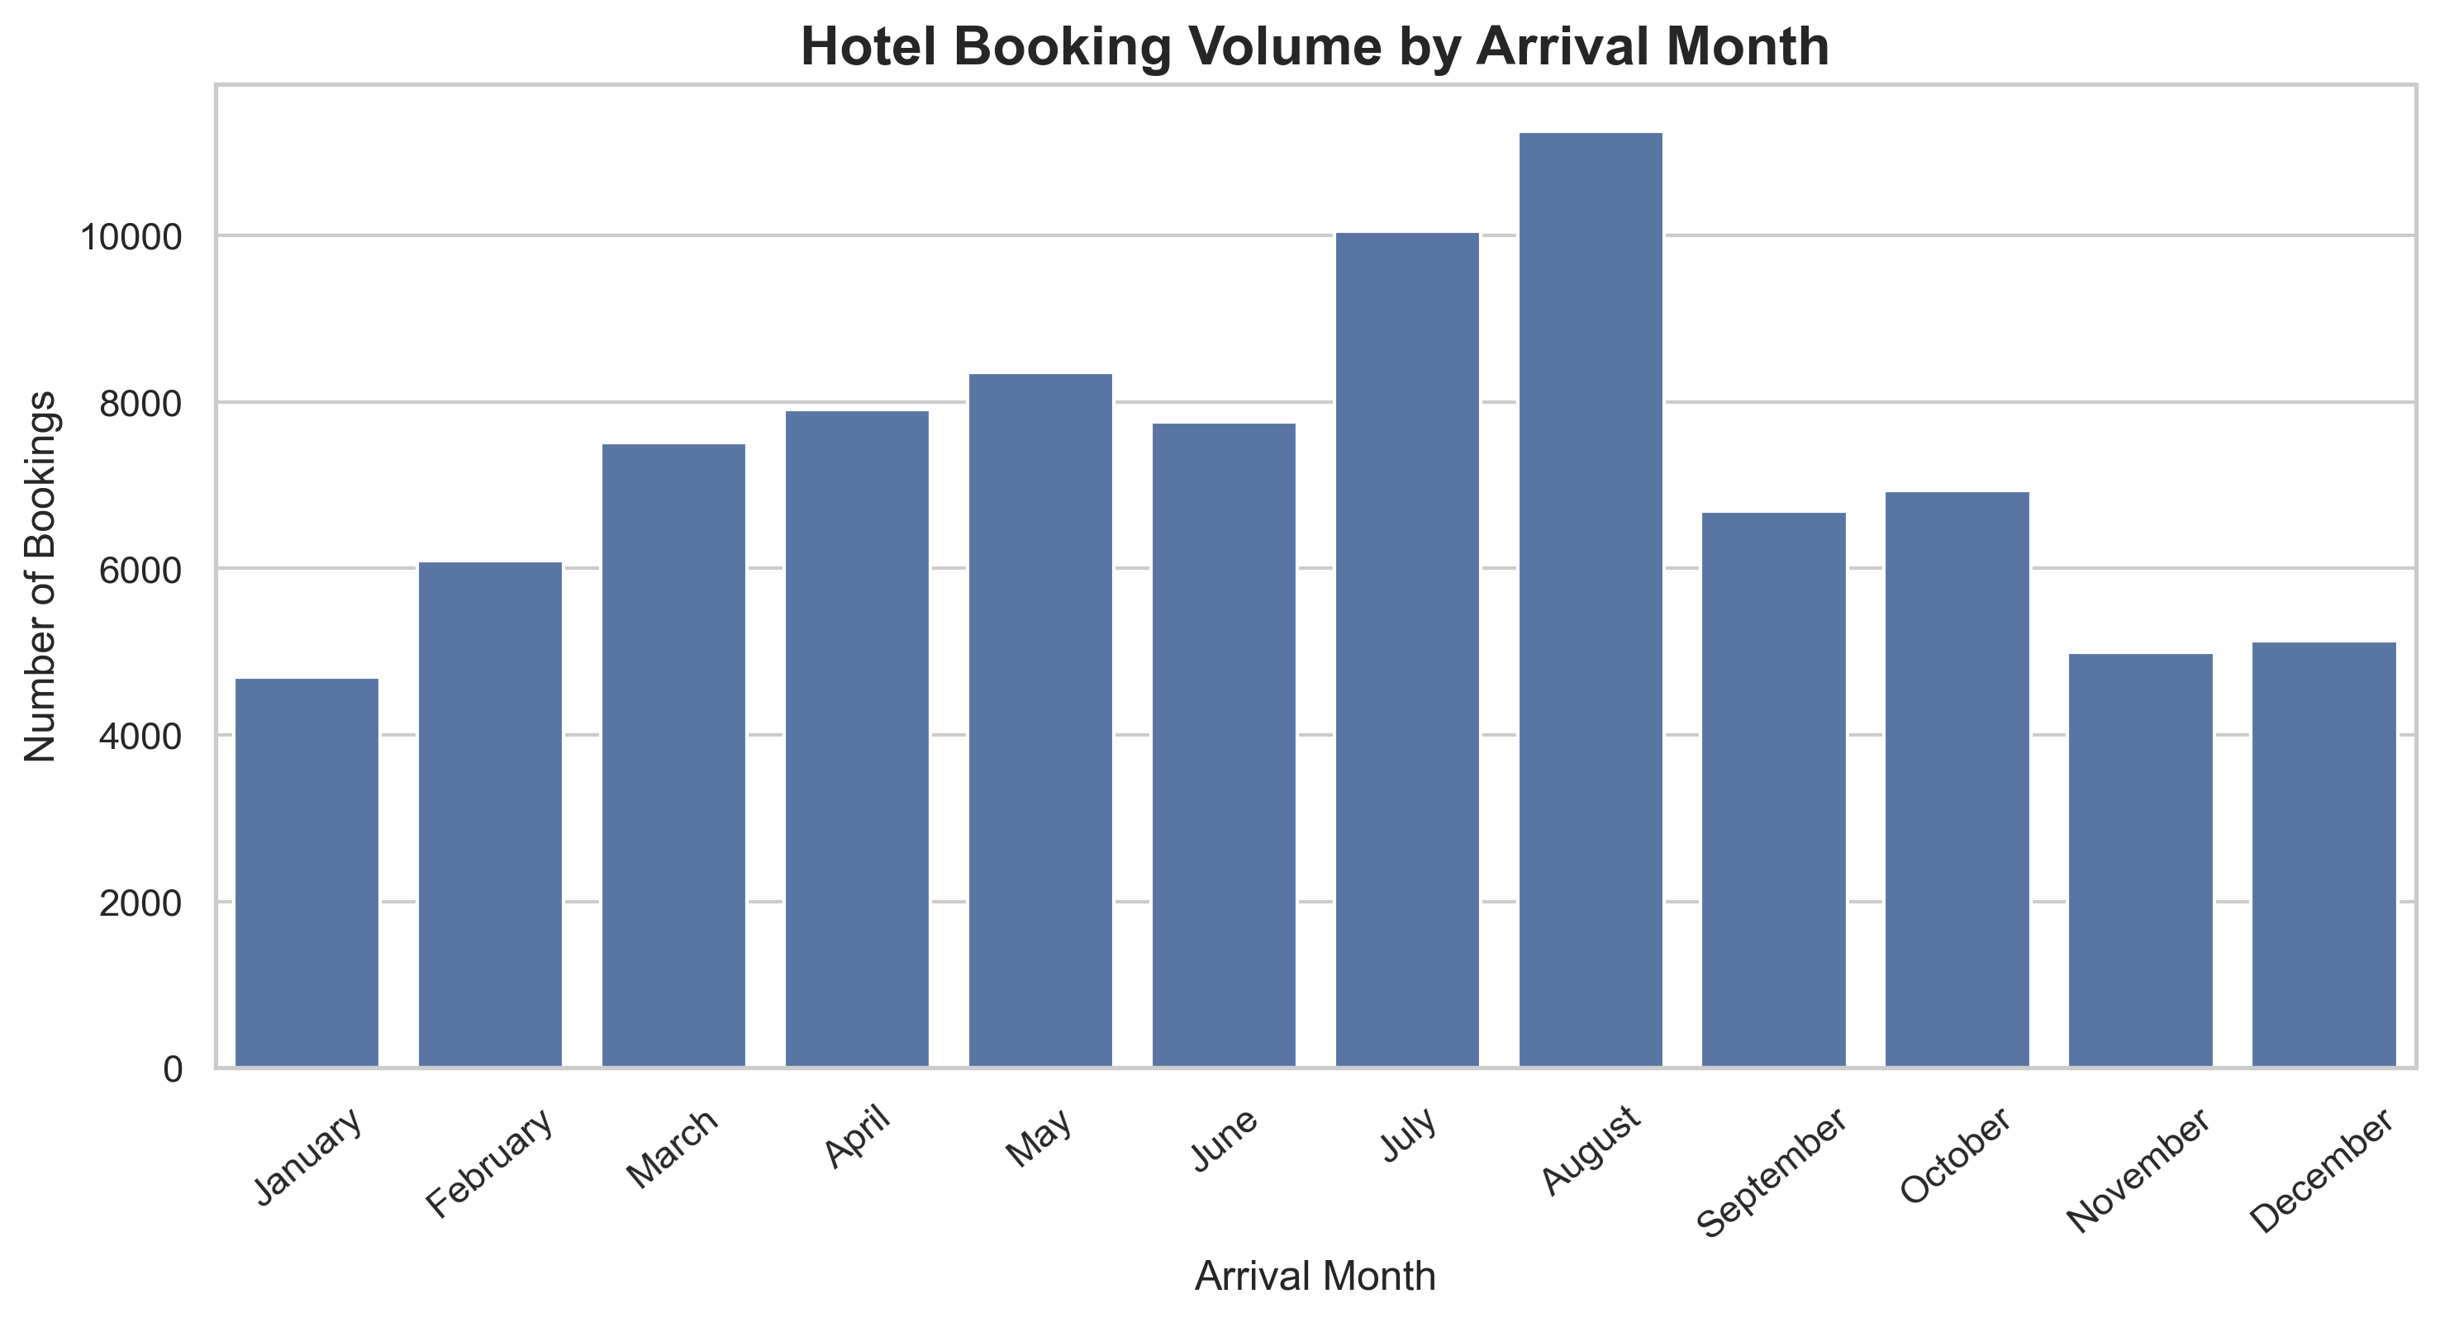
Demand Peaks During the Summer
August records the highest booking volume with 11,257 bookings.
11,257
August Bookings
Demand varies materially across arrival months.
Peak periods require proactive staffing and room-inventory planning.
Seasonality can also support dynamic pricing decisions.
Hotel Booking Analytics | Cohort 146
4

Slide 5
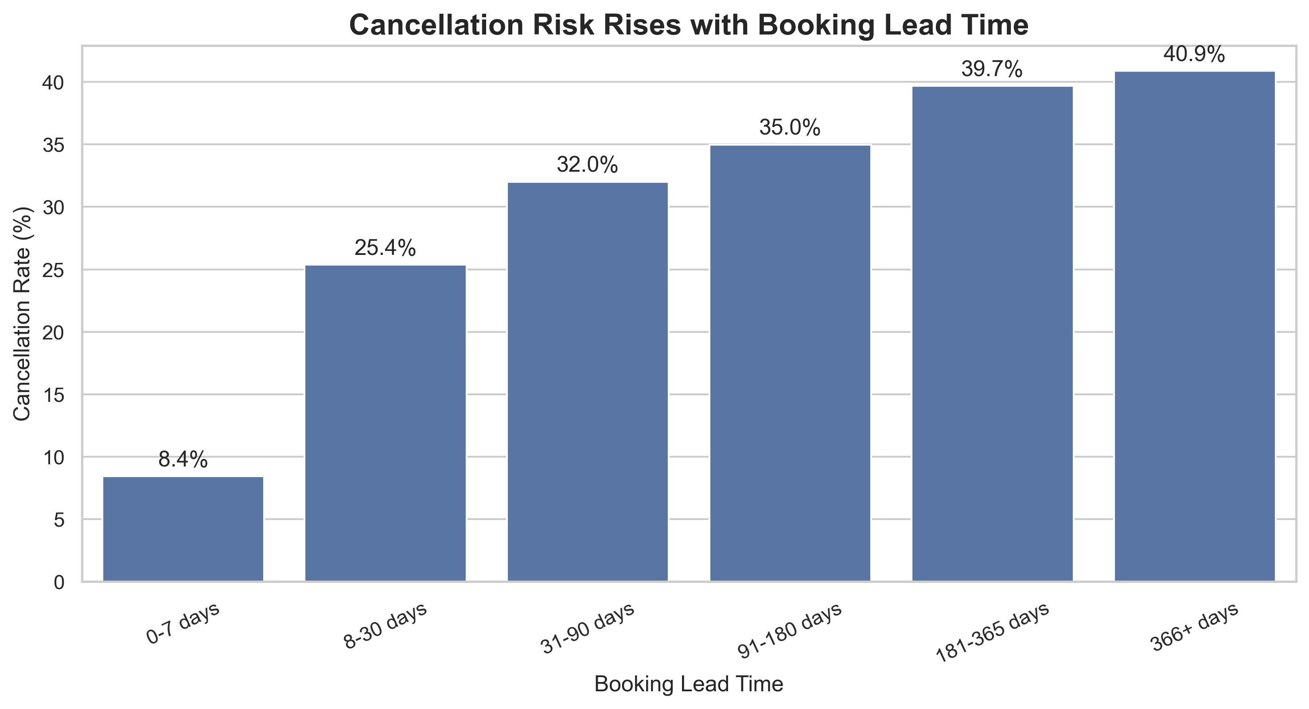
Lead Time Is a Clear Cancellation-Risk Signal
Bookings made further in advance are substantially more likely to be cancelled.
70.1
Avg. Lead Time — Retained
105.7
Avg. Lead Time — Cancelled
Action: Use long lead time as an early-warning feature for reconfirmation, reminders or deposit strategies.
Hotel Booking Analytics | Cohort 146
5

Slide 6
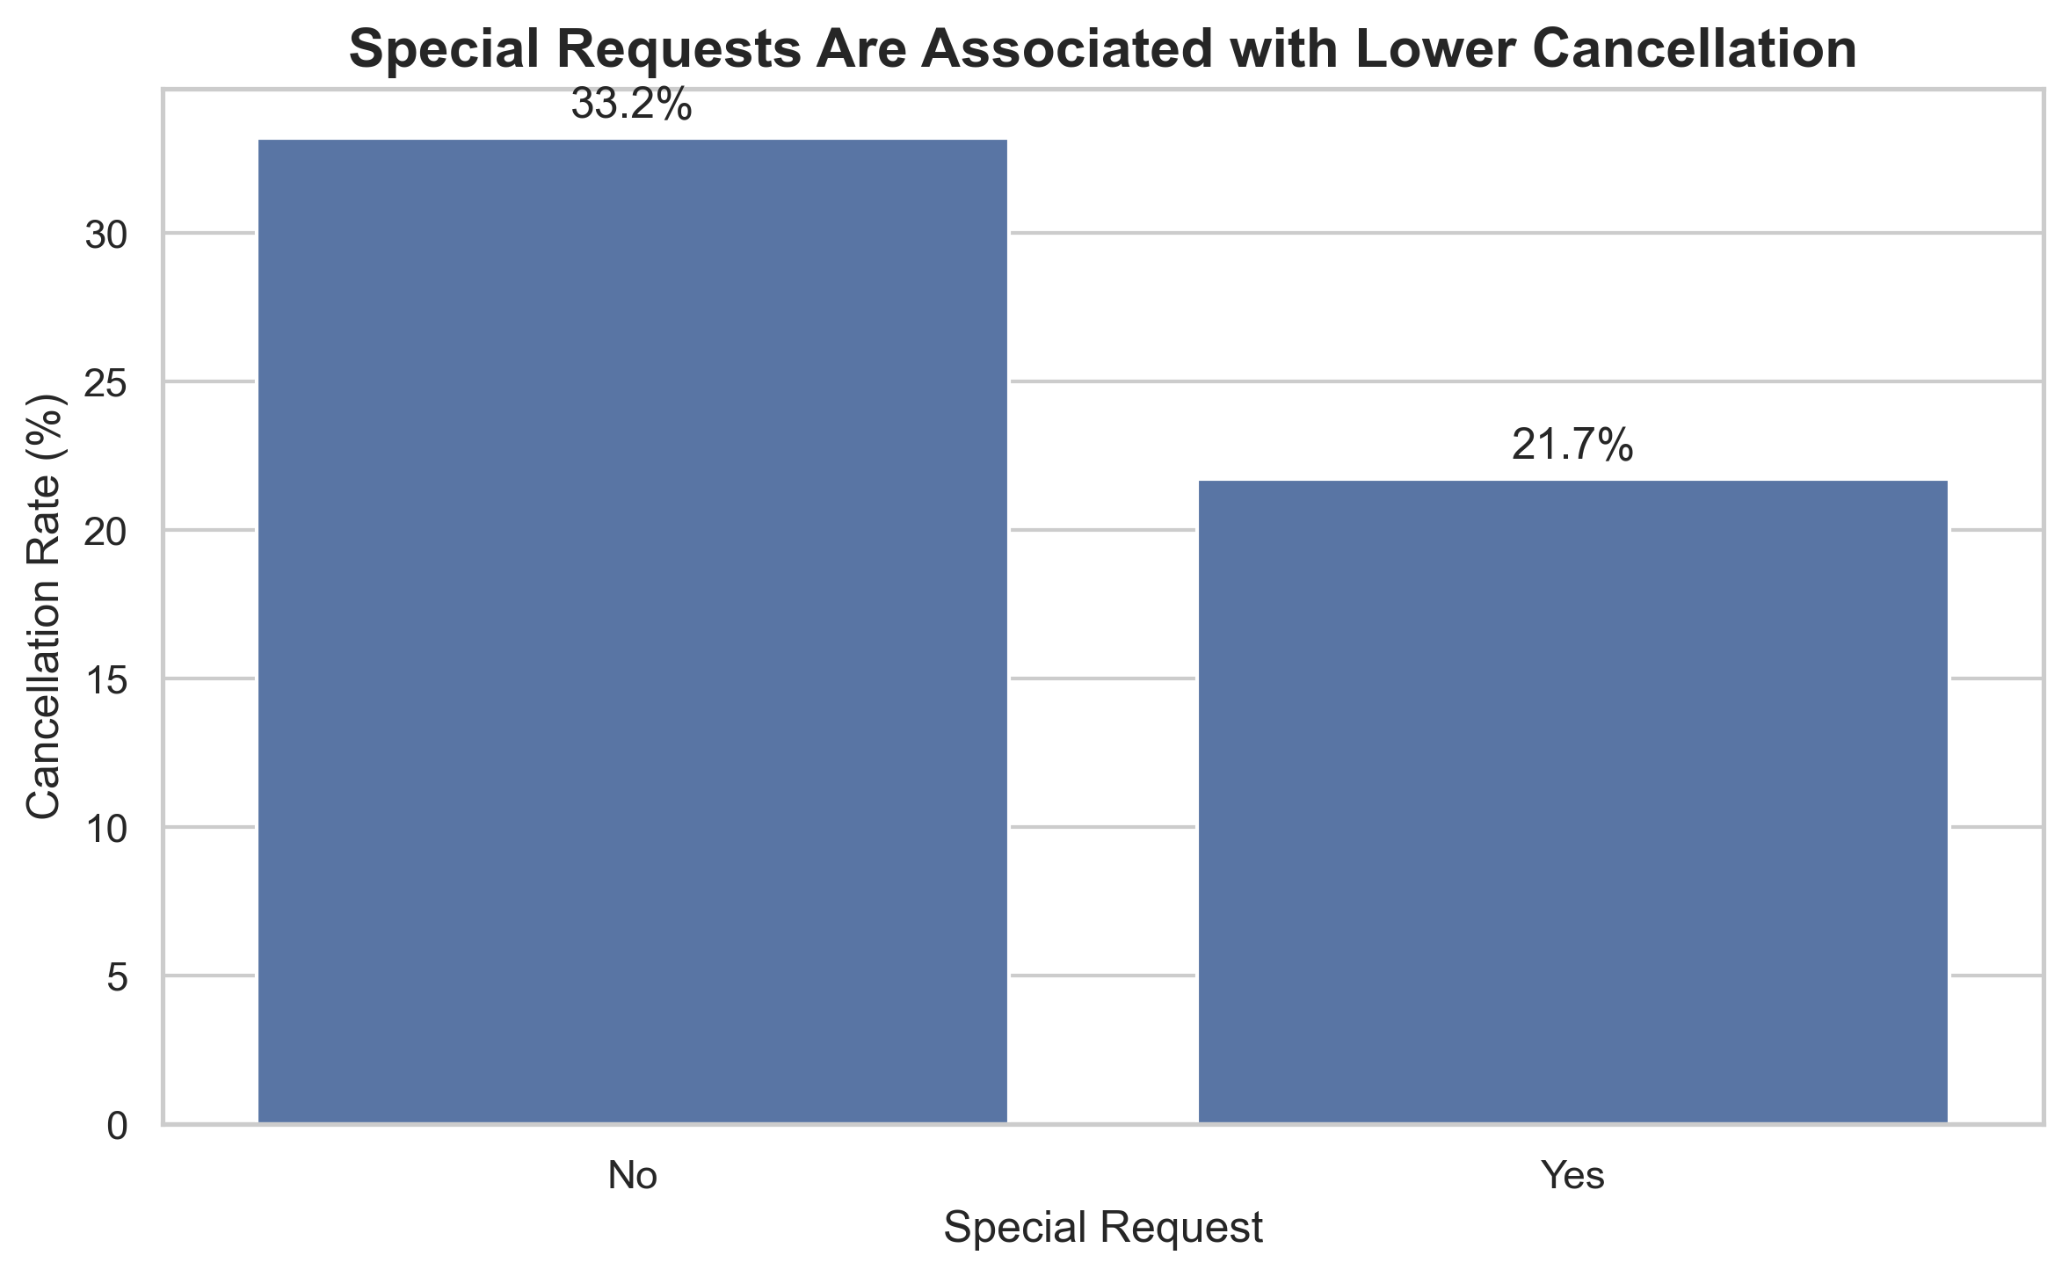
Guest Engagement Is Associated with Lower Cancellation
Bookings containing special requests demonstrate stronger booking retention.
21.7%
With Special Request
33.2%
Without Special Request
Special requests should be treated as an engagement signal—not proof of causation—but they may help identify more committed guests.
Hotel Booking Analytics | Cohort 146
6

Slide 7
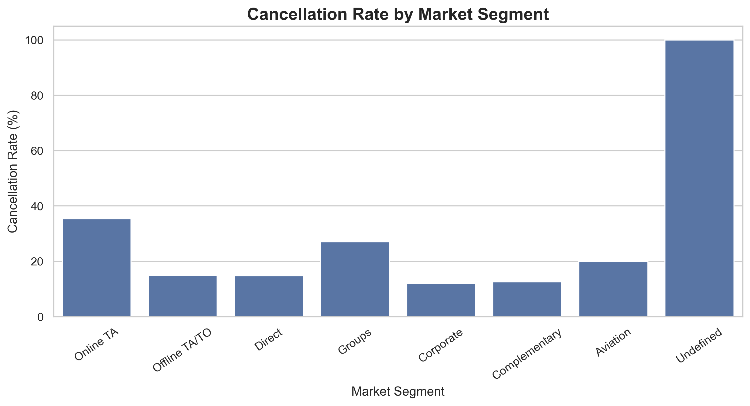
Cancellation Risk Varies by Market Segment
Booking volume alone does not indicate the quality or stability of demand.
Market segments show materially different cancellation behaviour.
High-volume segments should be evaluated alongside cancellation risk and ADR.
Channel and segment strategy should focus on profitable retained demand—not bookings alone.
Management should combine booking volume, ADR and cancellation rate when evaluating acquisition channels.
Hotel Booking Analytics | Cohort 146
7

Slide 8
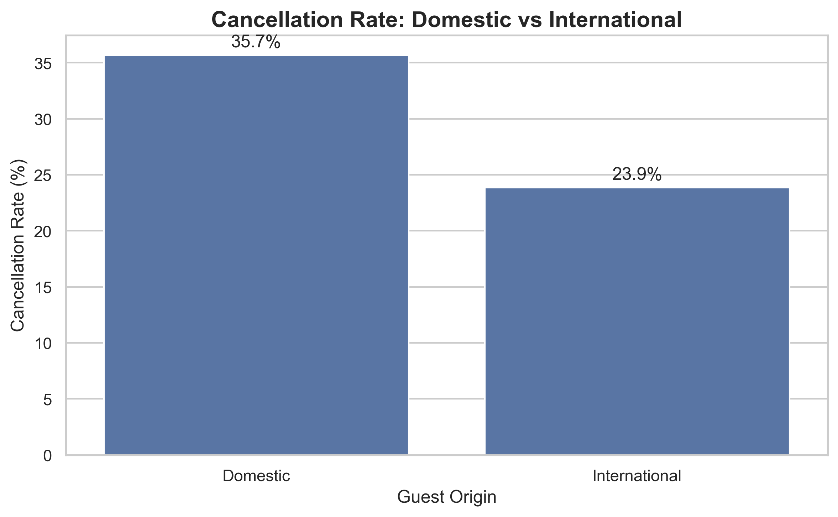
Domestic and International Guests Behave Differently
Guest origin reveals meaningful differences in cancellation behaviour and booking characteristics.
35.7%
Domestic Cancellation
23.9%
International Cancellation
Different guest-origin profiles support more targeted communication, retention and pricing strategies.
Hotel Booking Analytics | Cohort 146
8

Slide 9
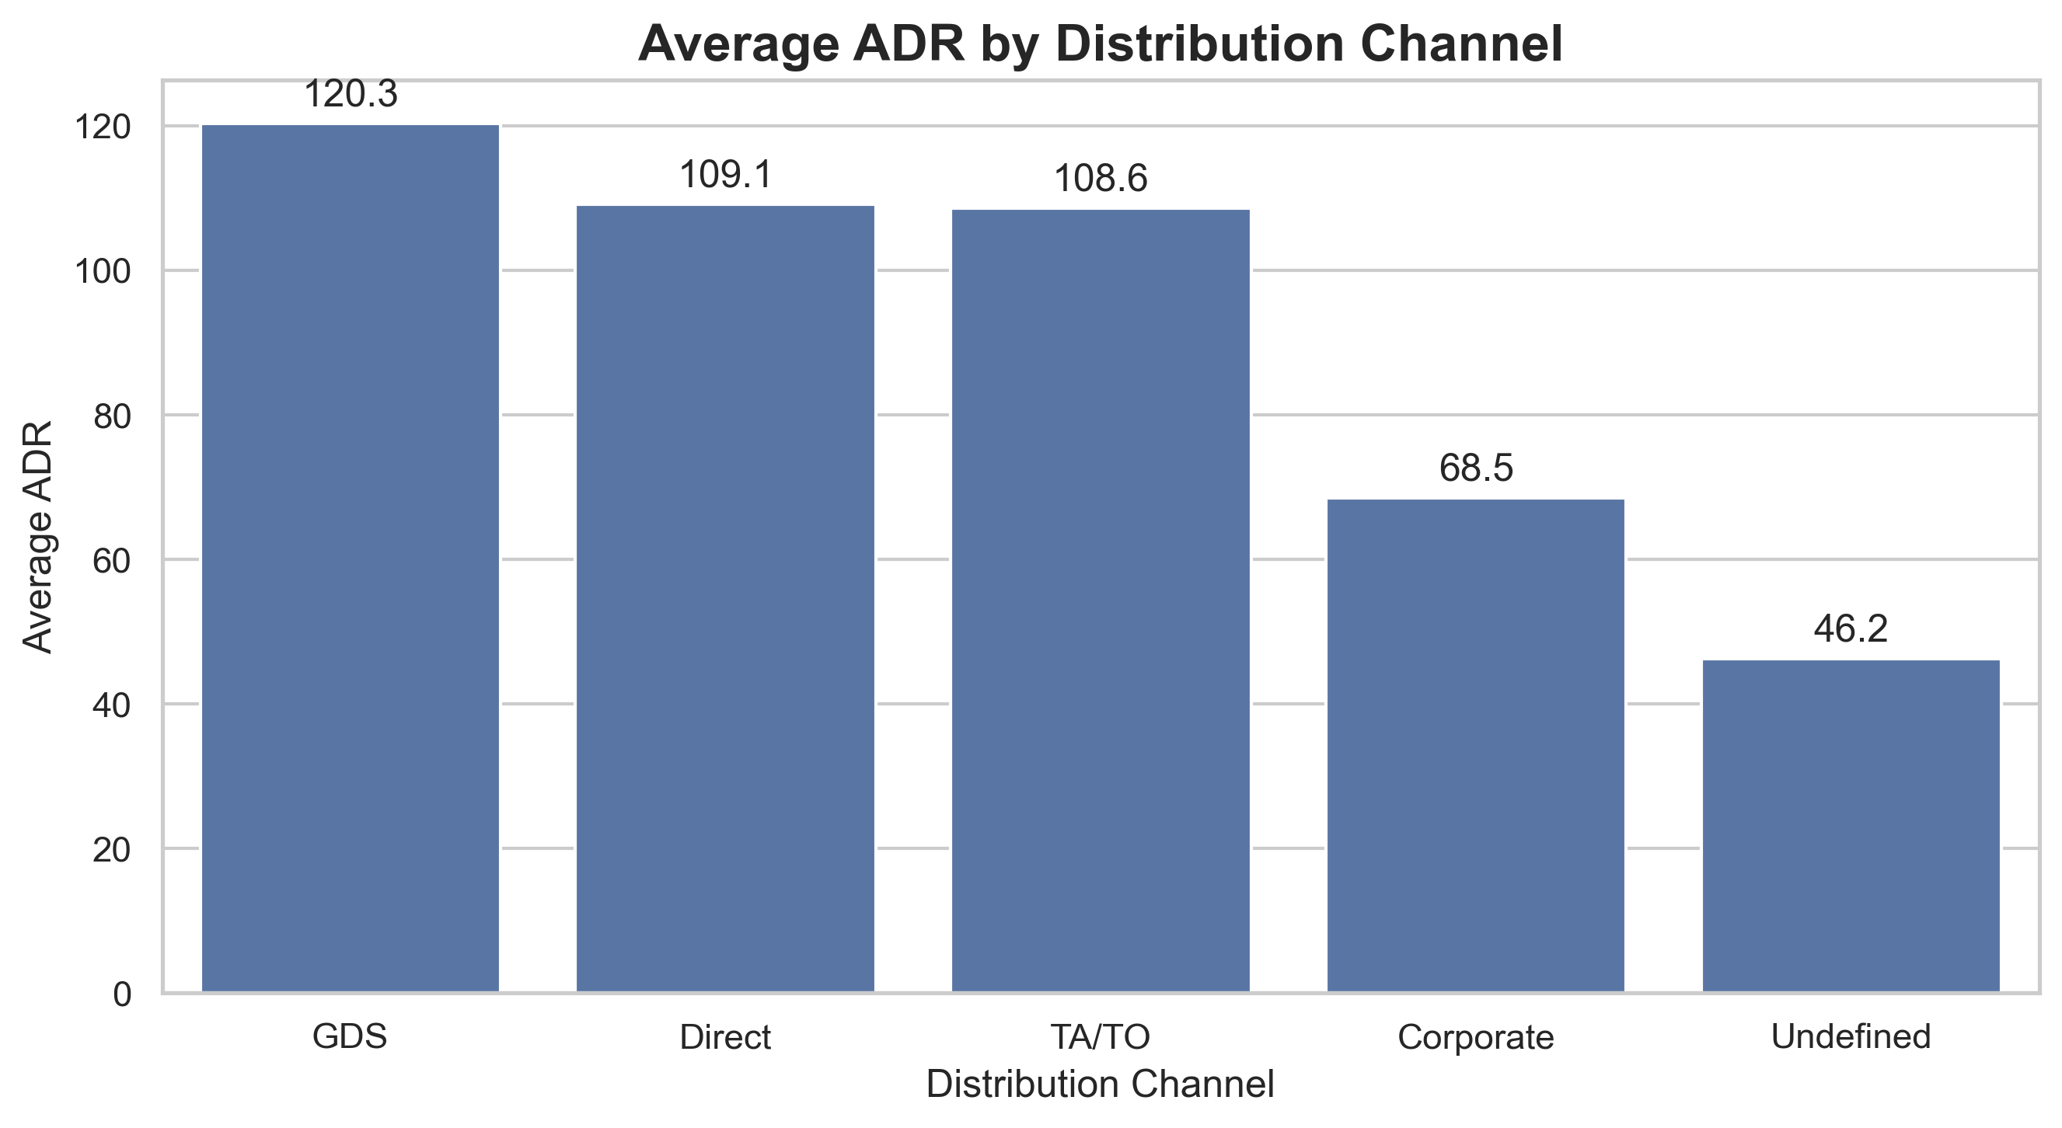
Distribution Channels Produce Different Revenue Profiles
Average Daily Rate varies considerably across booking channels.
GDS
Highest-ADR Channel
120.32
Average ADR
Channel decisions should balance ADR, booking volume, acquisition cost and cancellation risk.
Hotel Booking Analytics | Cohort 146
9

Slide 10
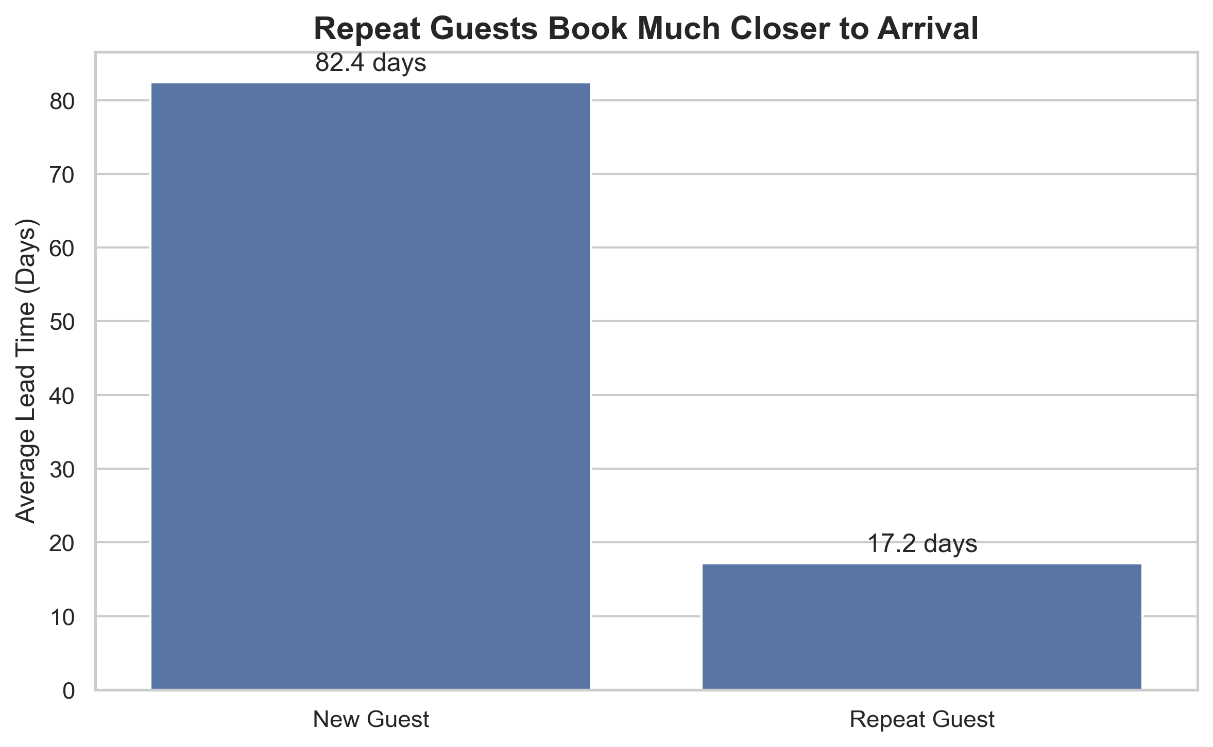
Repeat Guests Require Less Advance Planning
Returning customers book substantially closer to arrival than new customers.
82.4 days
New Guest Lead Time
17.2 days
Repeat Guest Lead Time
Loyalty campaigns and short-lead offers may be especially relevant for returning guests.
Hotel Booking Analytics | Cohort 146
10

Slide 11
Additional Operational Insights
Room allocation and family demand provide further context for hotel operations.
9,103
A → A
45,879
Bookings with Children / Babies
Most Common Room Match
Bookings in Top Room Match
Family bookings represent a distinct operational segment with different room and service requirements.
The most frequent reserved-to-assigned room combination indicates strong alignment for the dominant room category.
Room-allocation patterns can support inventory planning and help identify where upgrades or substitutions occur.
Hotel Booking Analytics | Cohort 146
11

Slide 12
Recommended Actions
Translate analytical findings into operational decisions.
01
Target long-lead bookings
Use reconfirmation messages, reminders and appropriate deposit policies for bookings made far in advance.
02
Encourage pre-arrival engagement
Use personalisation and special-request workflows to strengthen guest engagement before arrival.
03
Optimise channel mix
Evaluate distribution channels using retained revenue, ADR and cancellation behaviour—not booking volume alone.
04
Differentiate customer strategy
Use tailored communication for new, repeat, domestic and international guest segments.
05
Plan around seasonality
Prepare staffing, room inventory and pricing strategy for peak demand periods such as August.
Data-driven hotel management should focus on profitable, retained demand—not simply booking volume.

