Slide 1
Reports for Master’s Thesis and One Way DEM-FEM coupling

Slide 2
Objective
Evaluate Rotational Torque and Stress:
Investigate whether the lander experiences rotational torque or significant stress during impact, assessing the potential risks of toppling or other stability concerns.
Reconstruct Lunar Soil Profile:
Develop an accurate lunar soil model based on scientifically validated data from peer-reviewed research, ensuring realistic simulations of soil properties.
Quantify Soil-Structure Interactions:
Measure stress distributions and void fractions in the lunar soil during the impact event to deepen the understanding of soil-structure interactions and their implications for lander design and safety.

Slide 3
Why DEM
The Discrete Element Method (DEM) is ideal for modeling systems involving separate, discrete particles, such as colloids, granular materials, powders, blocky or jointed rock masses, and bulk materials in storage.
In the simulation of rocky particles, DEM accurately represents spherical particles, making it particularly suitable for studying interactions with objects like a lunar footpad. This technique excels in capturing key dynamics such as torque and normal stress, which are crucial for analyzing the mechanical impact on the lunar surface.

Slide 4
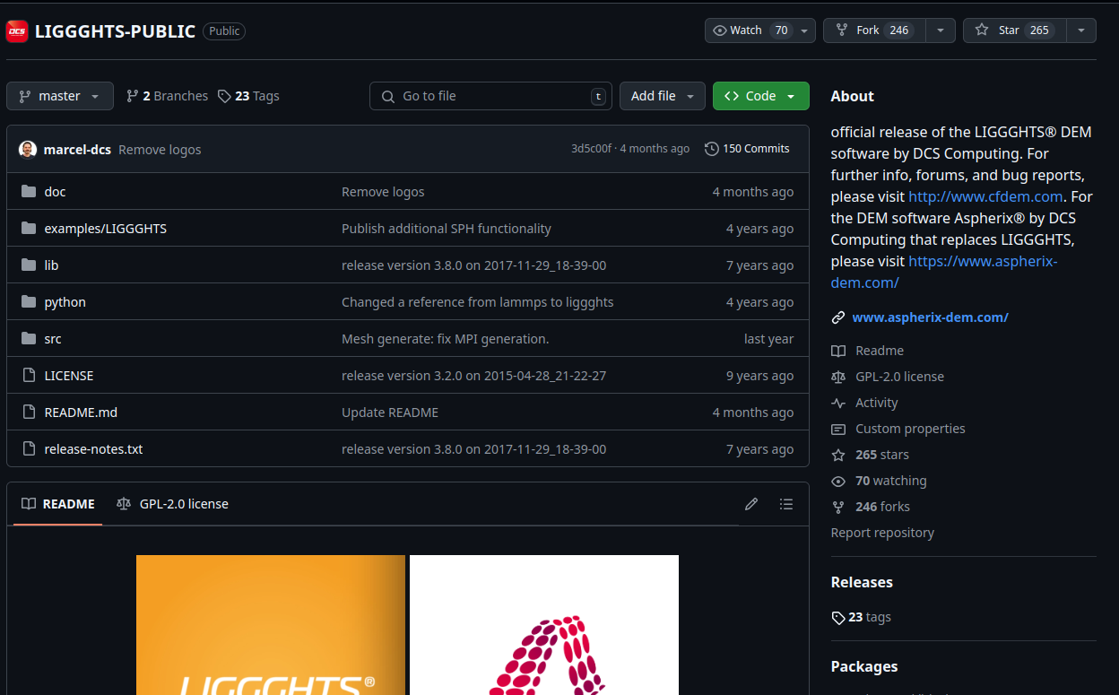
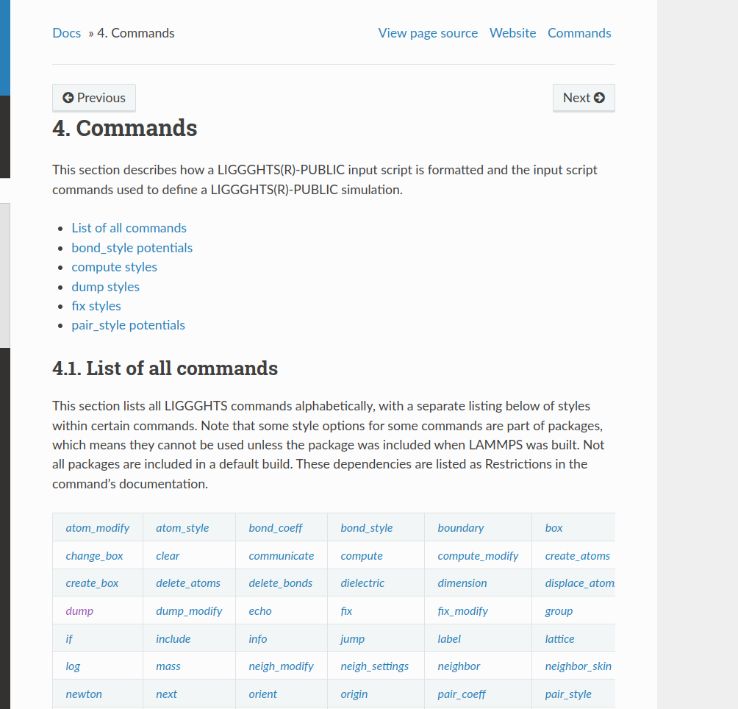
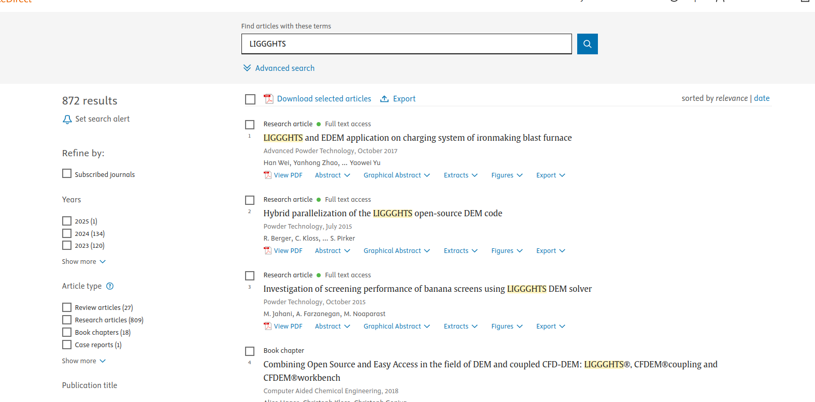
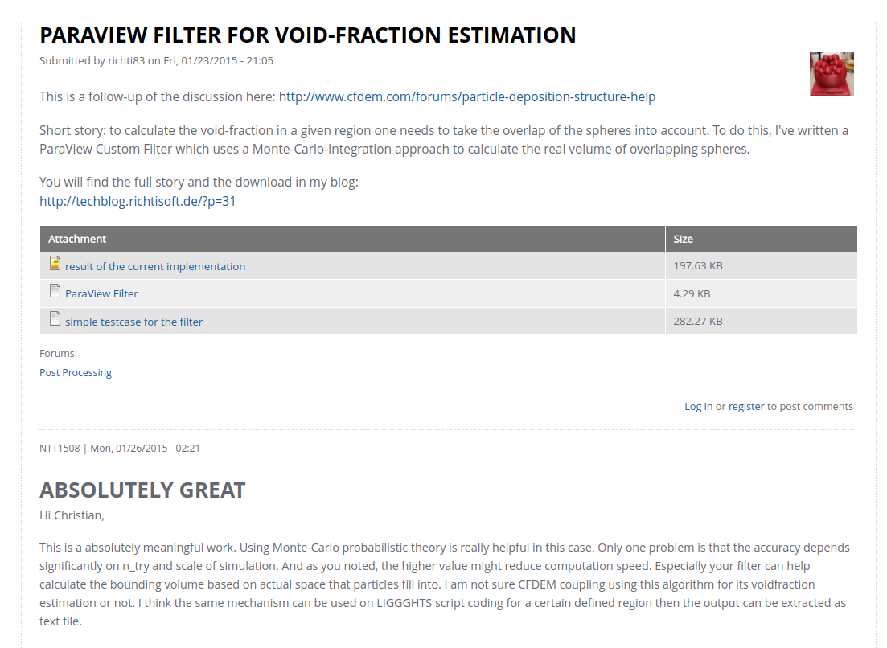
Why LIGGGHTS
Open-sourced and has parallelisable features
Easy to code Commands and Tutorials are available
Most DEM Resarch Papers relies on this
Forums are available

Slide 5
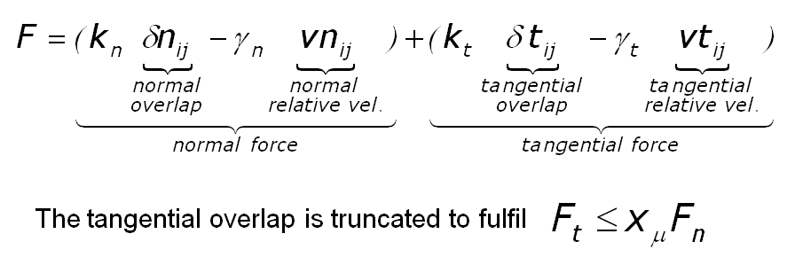
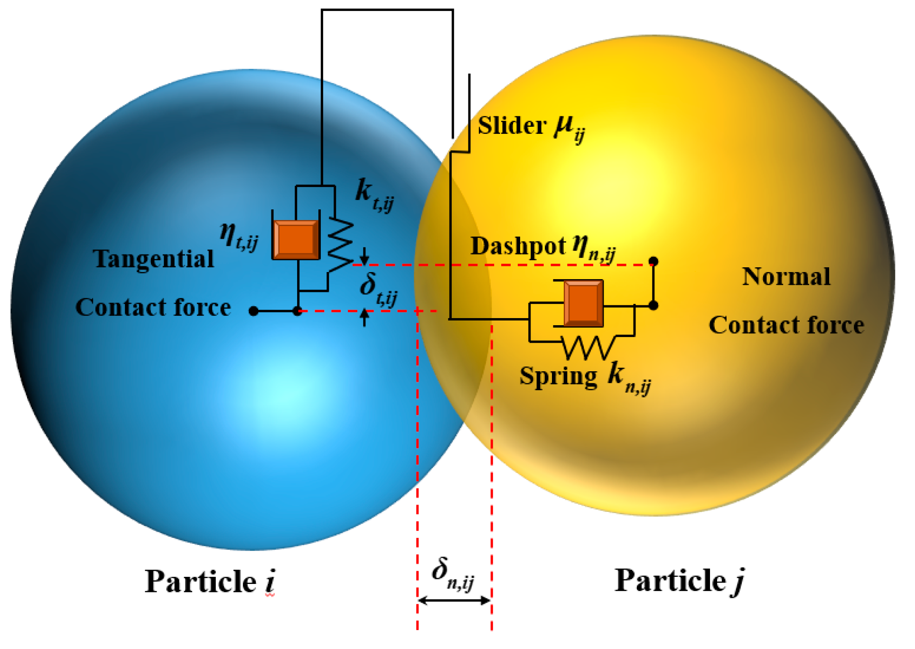
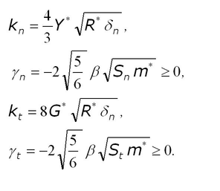
About Hertz Tangential Model

Slide 6
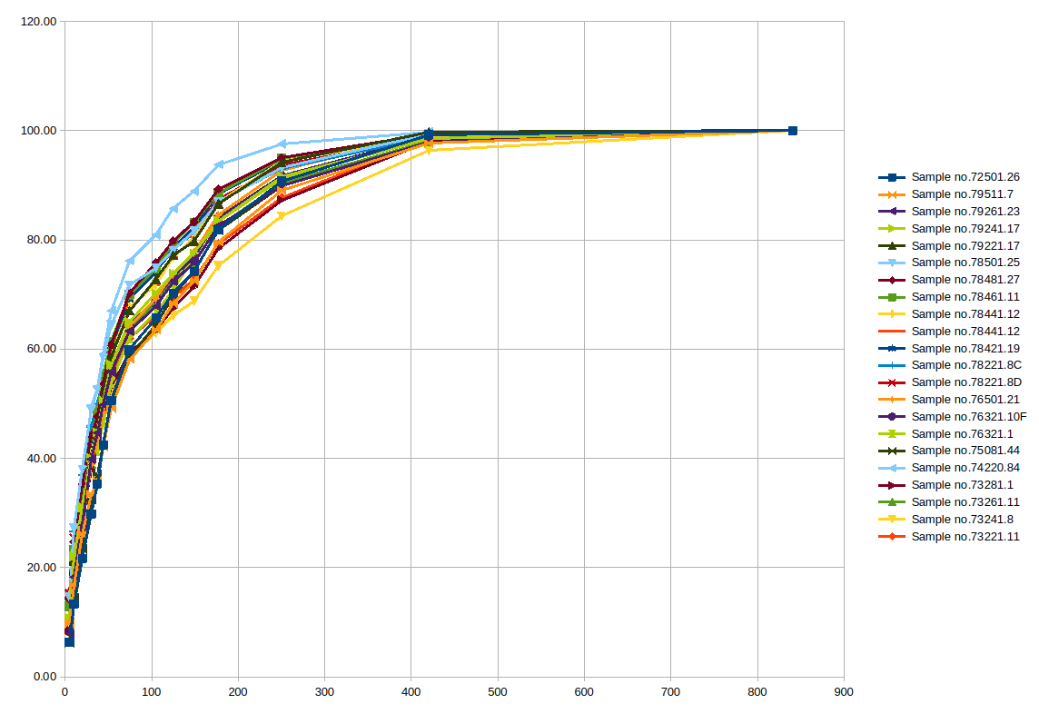
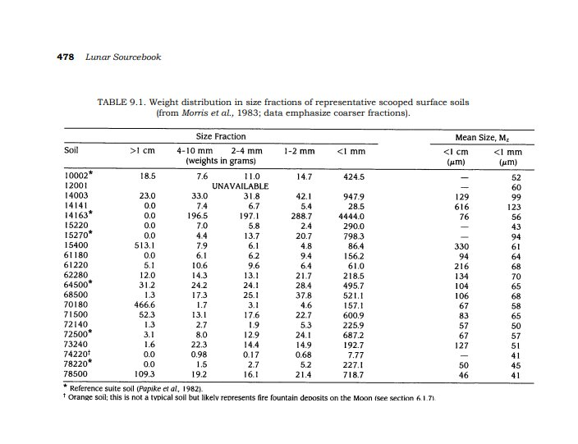
Size distribution Analysis
Cumulative %
Particle size in µm

Slide 7
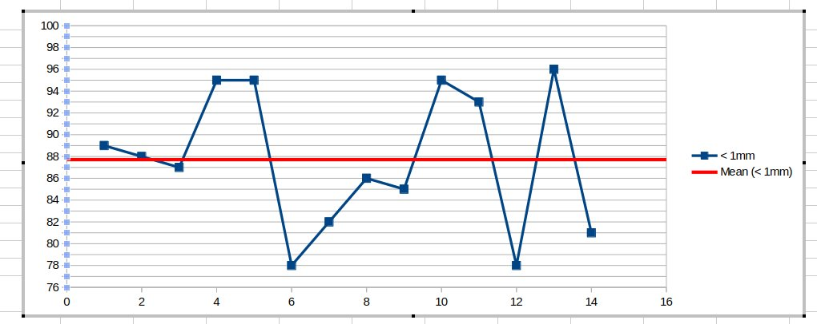
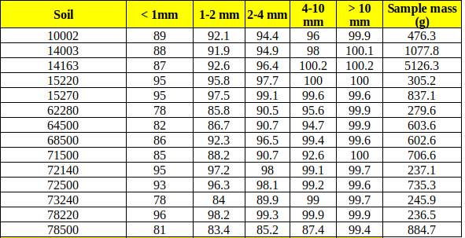
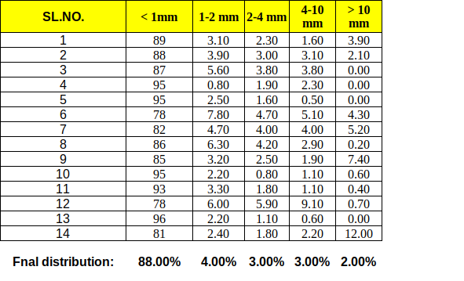
Calculation of Weight Fraction distribution of Particles
1mm | 1.5mm | 3mm | 7mm | 10mm
88% | 4% | 3% | 3% | 2%

Slide 8
Lunar Soil Properties used for DEM Simulation
Paramaters | Value
Solid Density | 3100 Kg/m²
Youngs Modulus | 20 MPa
Poisson's ratio | 0.22
Coefficient of Restitution | 0.35
Coefficient of static friction | 0.44
Pair Style | Granular model with Hertz Tangential

Slide 9
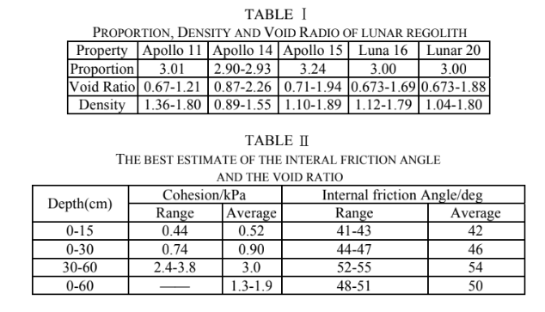
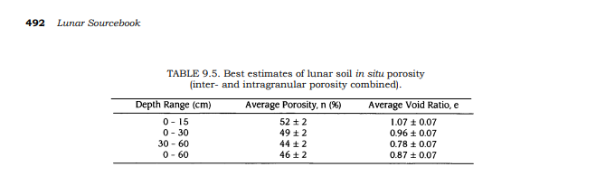
Packing Fraction Estimation

Slide 10
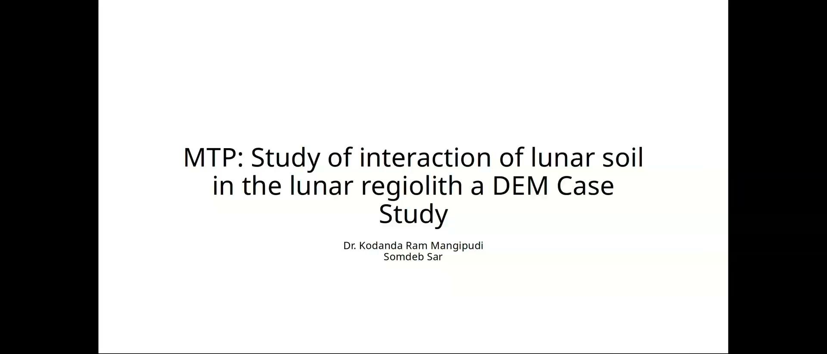
Mid Term Follow-on Report

Slide 11
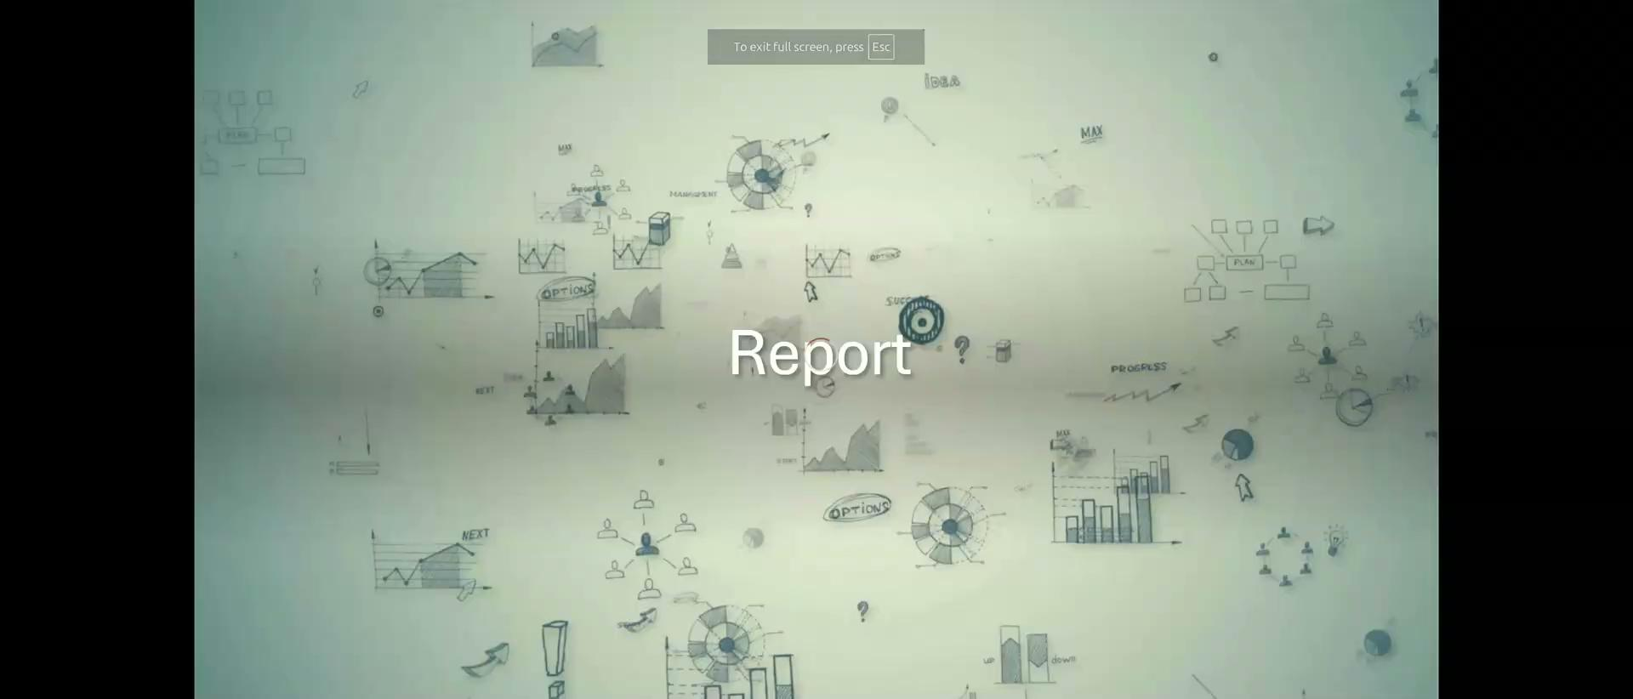
End-Mid Term Report

Slide 12
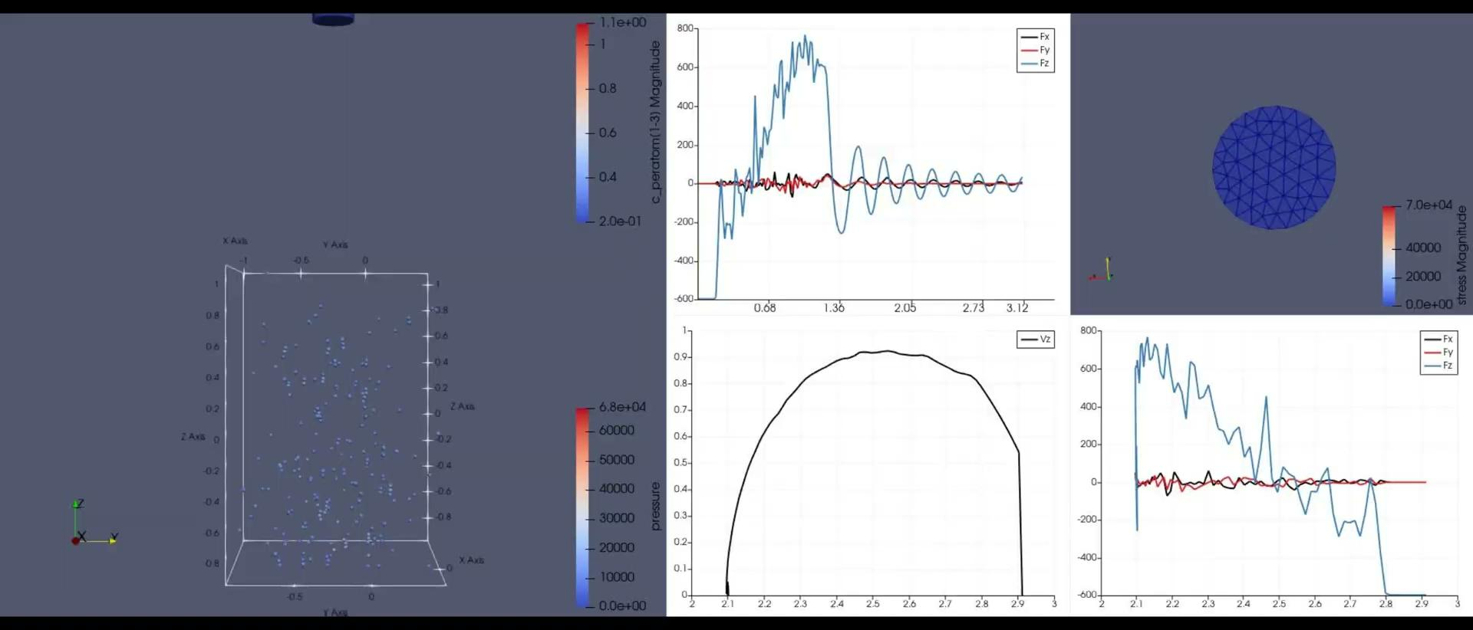
Interaction Volume under high-depth condition(For studying the effect of depth and Width)

Slide 13
Dear Sir/Ma’am/My Friend,
I Know Some of us might wonder about some important details or aspects of this Master's Thesis Report or the other. In these Cases, I am much eagerly waiting for the opportunity to answer the questions that is raised about it. I am ready to answer each and every question of this topic. Please reach out to me during the interview or via mail at 20mm02003@iitbbs.ac.in(Institute Email ID) for the same. I am waiting on the other side to connect with you in this regard.
Thanking You,
Somdeb Sar.
(A Dual Degree Student)
IIT-BBSR
School of Metallurgical Minerals and Materials Science and Engineering.

Slide 14
References
PHYSICAL PROPERTIES OF THE LUNAR SURFACE W. David Carrier III, Gary R. Olhoeft, and Wendell Mendell
Briefing Topic: Parameters of Lunar Soils David A. Kring
Physical and Mechanical Properties of the Lunar Soil (A Review) E. N. Slyuta Vernadsky Institute of Geochemistry and Analytical Chemistry, Russian Academy of Sciences, ul. Kosygina 19, Moscow, 119991 Russia
A Pre-Landing Assessment of Regolith Properties at the InSight Landing Site Paul Morgan1 · Matthias Grott2
Theoretical and discrete element simulation studies of aircraft landing impact
Simulation and Research on Landing Impact between Lander and Lunar Regolith Based on DEM Xuyan Hou, Pingping Xue, Kailiang Zhang, Kaidi Zhang, Ping Liang

