Slide 1
HOUSES FINDER

Slide 2
AGENDA
Introduction
Function
Summary

Slide 3
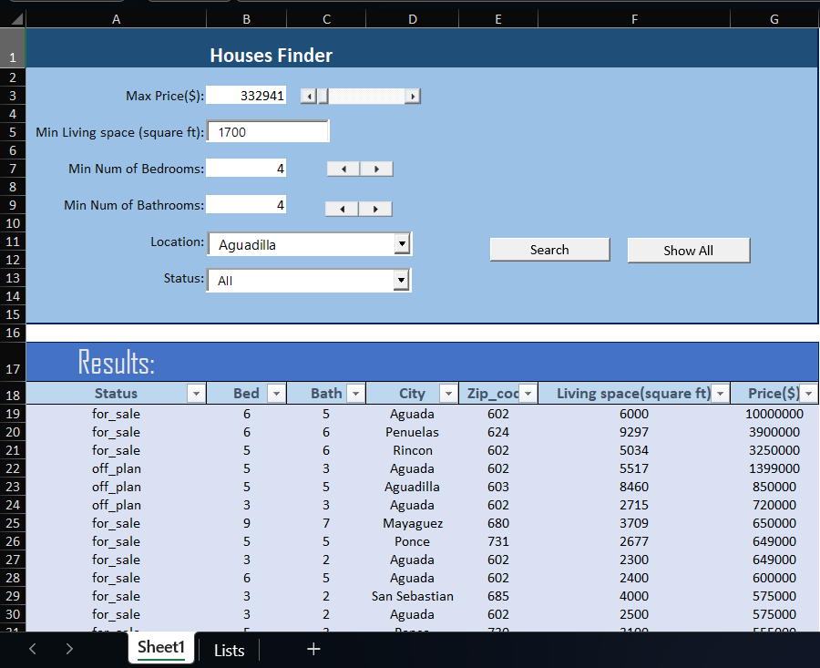
INTRODUCTION
This houses finder has been crafted with the aim of catering to the varied requirements of individuals searching for properties and real estate professionals. Furthermore, this app comes equipped with a variety of functions and options designed to aid both parties in their quest for properties and in conducting transactions.

Slide 4
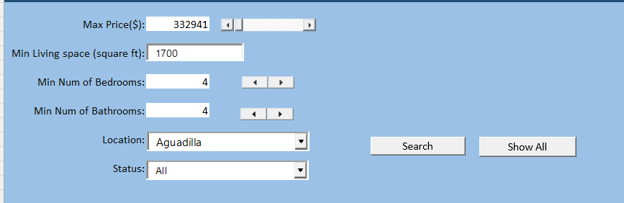
Max Price
You can either input the precise maximum price or utilize the scrollbar to determine the maximum price.
We used a scroll bar for this input. We use this instead of other kind of inputs so that the user can easily drag the value around without having to type in the prices.

Slide 5
Living Space
Filter the result by minimum living space required.
The box was a normal textbox input.

Slide 6

Minimum number of bedrooms and bathrooms
The left arrow button decreases the minimum number of bedrooms and bathrooms, while the right arrow button increases it. These buttons provide an intuitive way to adjust your bedroom and bathrooms preferences.
The spinbuttons are placed as inputs since the amount of bedrooms and bathrooms are not as much as the price of the houses. User can just change the value to desired amount with a few clicks.

Slide 7
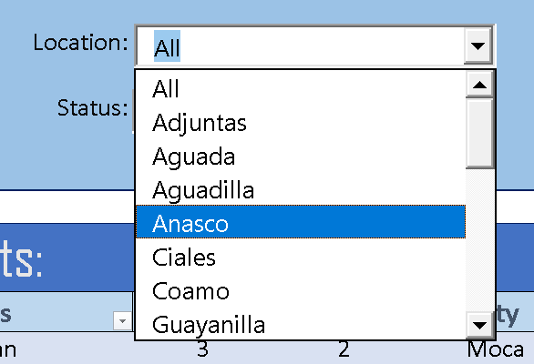
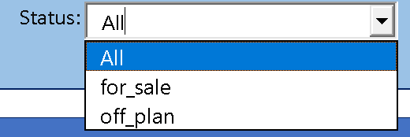
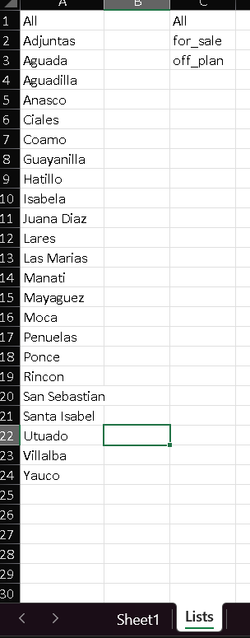
Location and status
These two selectors allow you to select the house in the area(city) you want, also to filter the ones with selected status.
We uses a combo box that recieves the list from another sheet, Lists, for the users to select.

Slide 8

Search button and show all button
After selecting the prefer attributes of the houses, you can click the search button to filter your new home. Then there's the show all button that shows all the house available on the database.

Slide 9
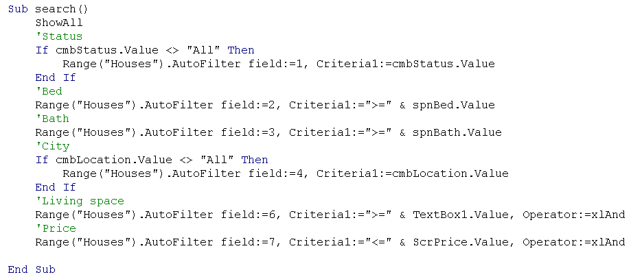
Search function
In the search function first call the function ShowAll to reset the table then apply the criteria to each column according to its control (Status, Bath, Bed, Location, Living Space, and Price).

Slide 10
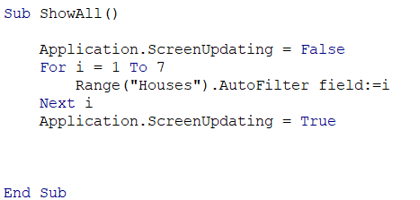




TAKUMA HAYASHI
MIRJAM NILSSON
RAJESH SANTOSHI
RAJESH SANTOSHI
President
Chief Executive Officer
Chief Operations Officer
VP Marketing
This loops through all columns and reset the filter

Slide 11
SUMMARY
House Finder is excellent for finding your dream house. Please use our service.

Slide 12
THANK YOU
Chanasorn Howattanakulphong 65011277
Phupa Denphatcharangkul 65011462
Pitiphong Kitrueangphatchara 65011472
Pochara Wiangkham 65011476
Sirapop Tuntithanakij 65011528

