Slide 1
HARDWARE PRODUCTs SEARCH

Slide 2
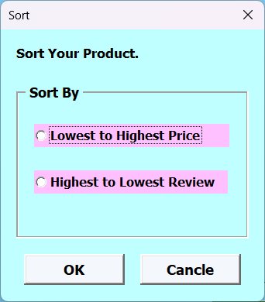
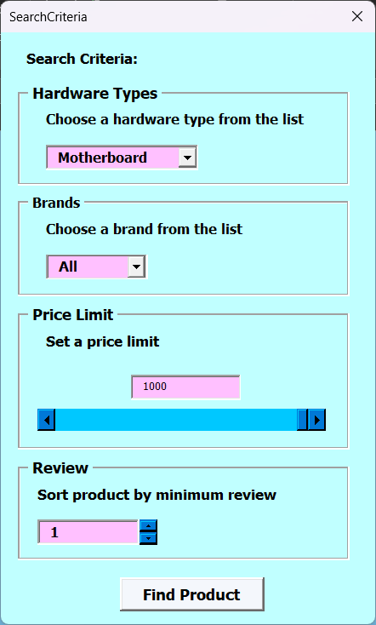
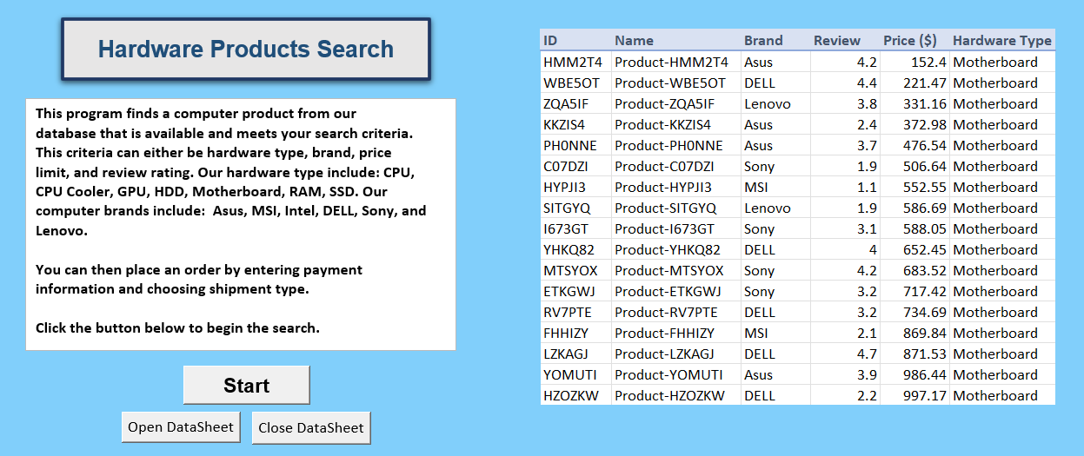
Interface

Slide 3
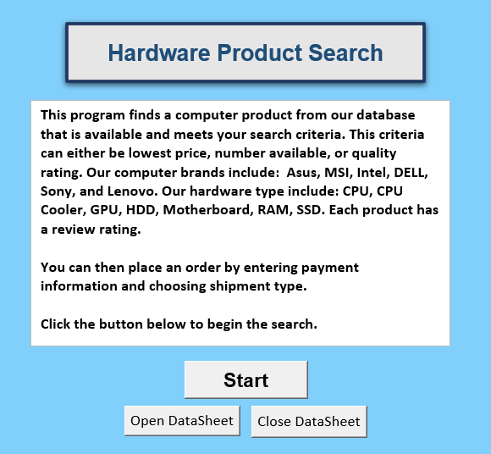
INTRODUCTION
This program finds a computer product from our database that is available and meets your search criteria. This criteria can either be hardware type, brand, price limit, and review rating. Our hardware type include: CPU, CPU Cooler, GPU, HDD, Motherboard, RAM, SSD. Our computer brands include: Asus, MSI, Intel, DELL, Sony, and Lenovo.

Slide 4
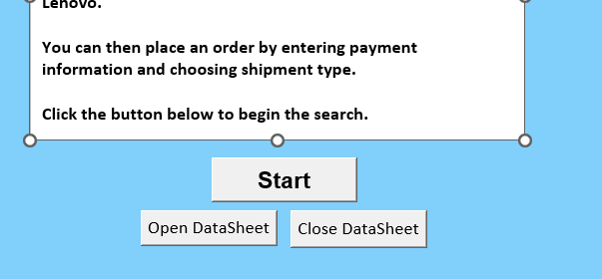
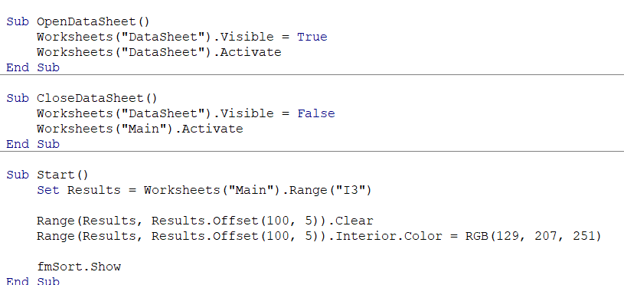
Start
The start button would clear the current displaying search result from the previous search and pop up a sort form window
Open and Close Datasheet button are for view and hide the worksheet "Database" in case the user want to make change to the dataset.

Slide 5
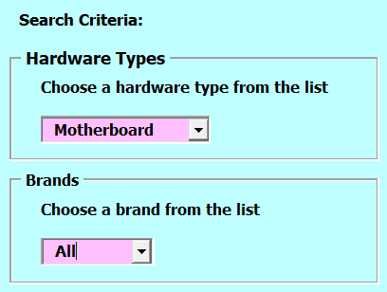
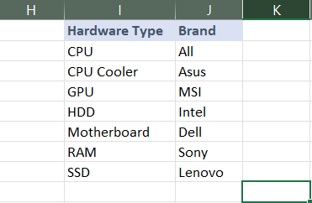
Hardware types and Brands
These two selectors allow you to select the available computer hardware product type you are looking for and you can specify your prefer brand form the lists as well.
We use a combo box that receives the list from another sheet, Lists, for the users to select.

Slide 6
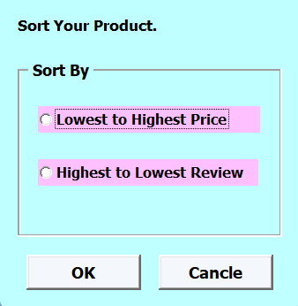
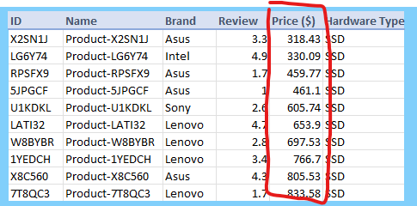
Sorting
When you click the Start Button, it will prompt a sorting form. You can sort the products from two options: Lowest to Highest Price, or Highest to Lowest Review.
We used Option Button for this input.

Slide 7
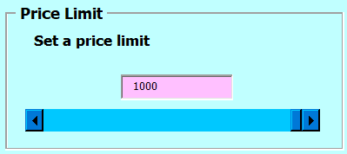
PRICE LIMIT
Set the price limit (maximum price) of the product. You can either type the number in TextBox or use the ScrollBar.

Slide 8
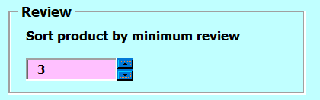
Review
Allow user to filter the product with minimum review score with a range of 1 to 5 by using SpinButton and TextBox.

Slide 9
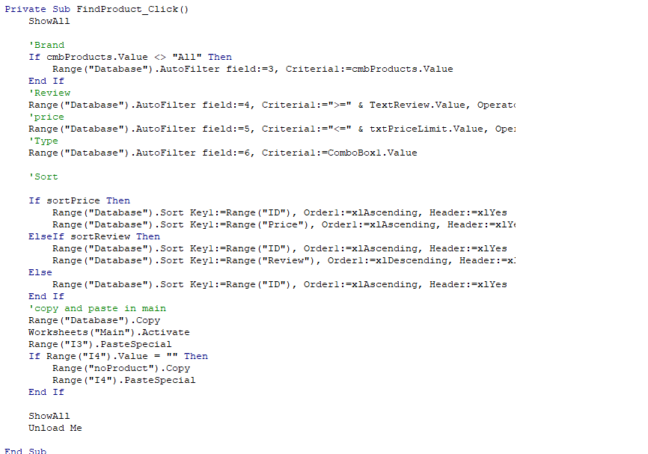
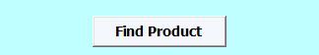
FinD Product Button
The Find Product Button filters the Database section according to user input as well as sorts the output, then it copies Database and paste to the Main Window

Slide 10

NO Product
When no product match the search criteria, the table displays "No Product Found"

Slide 11
SUMMARY
Hardware products search is an excellent way to locate items from a particular brand at the desired price point, while also ensuring they meet your specified rating criteria.

Slide 12
THANK YOU
Chanasorn Howattanakulphong 65011277
Phupa Denphatcharangkul 65011462
Pitiphong Kitrueangphatchara 65011472
Pochara Wiangkham 65011476
Sirapop Tuntithanakij 65011528

