Slide 1
Chart

Slide 2
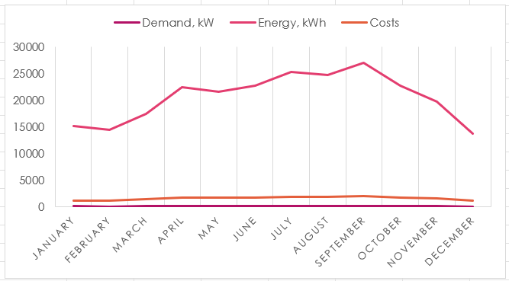
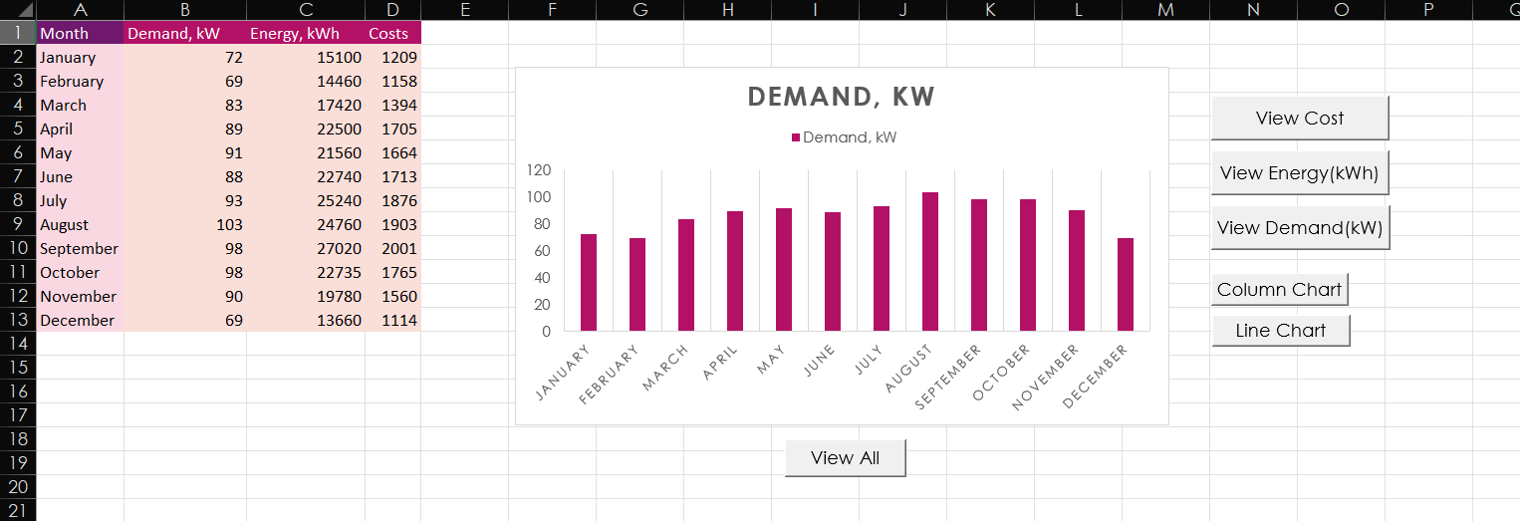
Sample

Slide 3
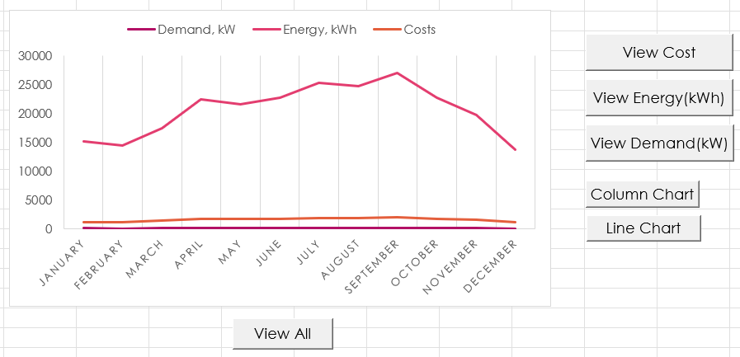
INTRODUCTION
Our program can show different type of charts such as Column chart, and Line chart. Additionally, the program can show each category, including cost, energy, and demand, separately.

Slide 4
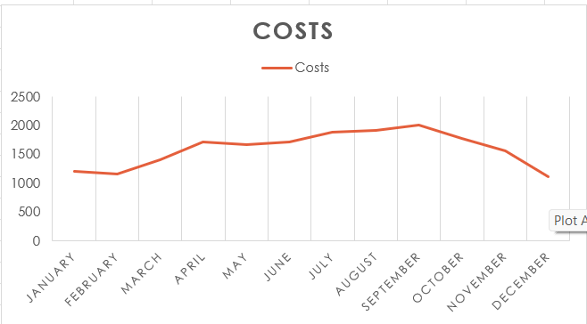
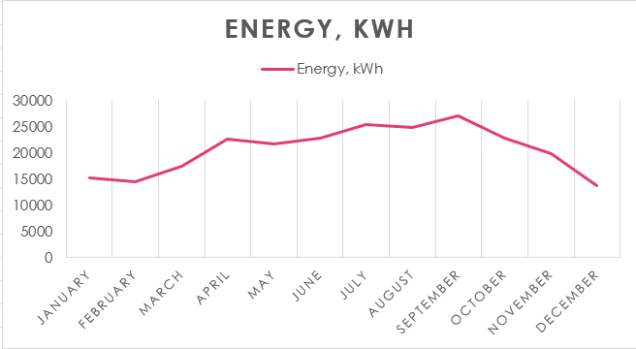
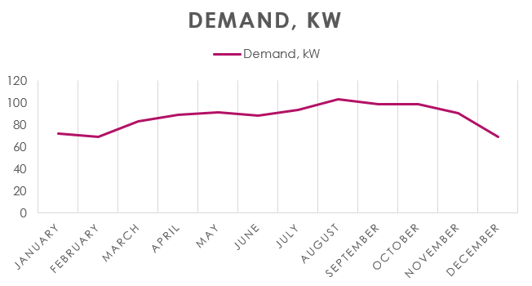
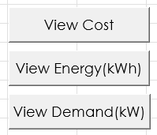
View series
The data is separated into 3 series/categories, costs, energy, and demand. The button on the right can manipulate the display chart into the preferred series.

Slide 5
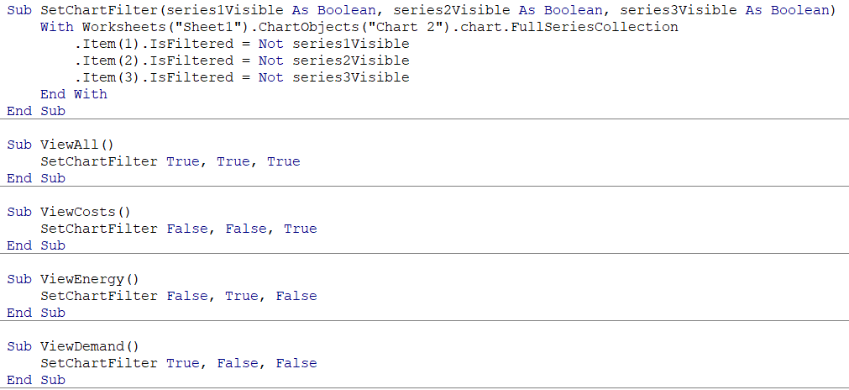
Code

Slide 6
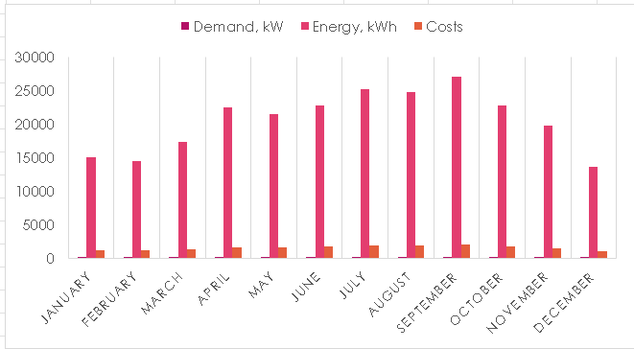
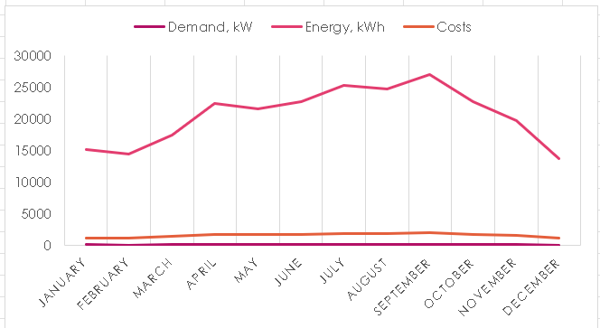

Column chart & line chart
These two buttons switches the chart type between column chart and line chart.

Slide 7
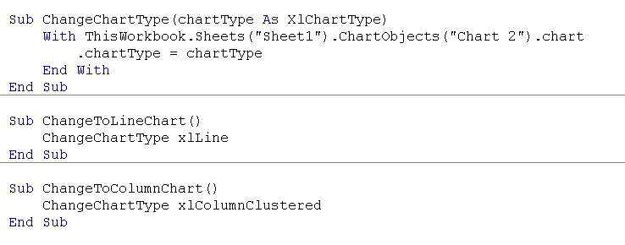
Code

Slide 8
SUMMARY
Our chart lets the user select how they want to view their data in an easy way. They can view the trend of the data with the desired type of chart.

Slide 9
THANK YOU
Chanasorn Howattanakulphong 65011277
Phupa Denphatcharangkul 65011462
Pitiphong Kitrueangphatchara 65011472
Pochara Wiangkham 65011476
Sirapop Tuntithanakij 65011528

