Slide 1
DSS

Slide 2
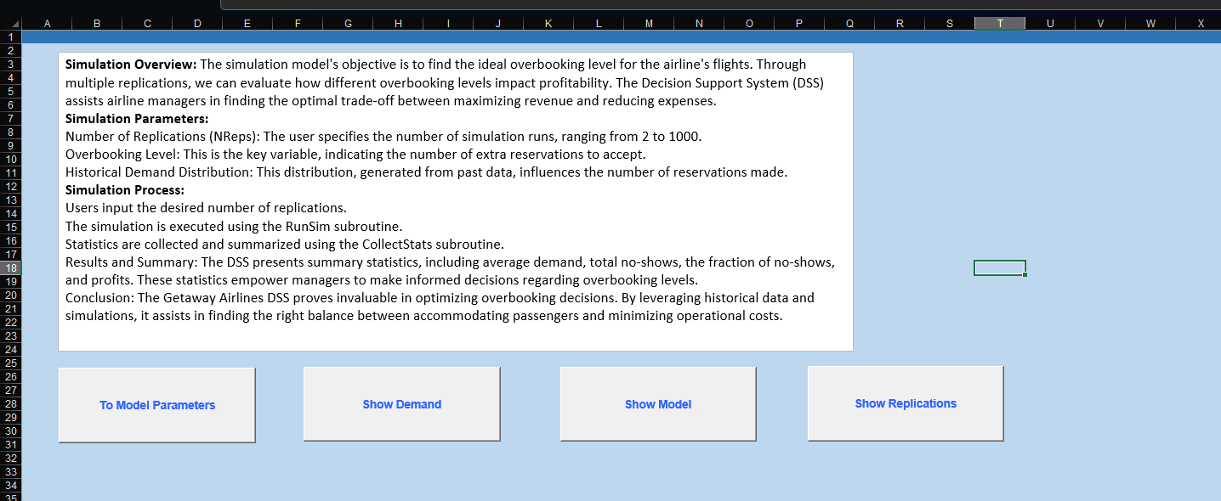
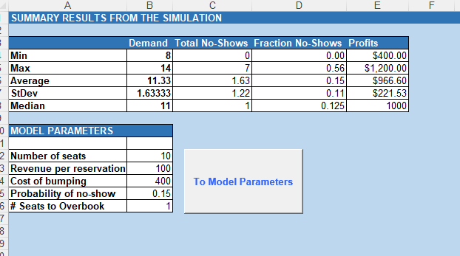
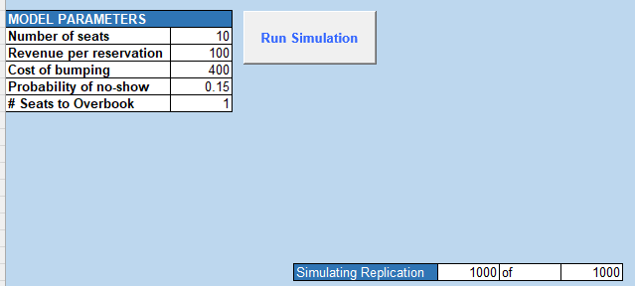
Sample

Slide 3
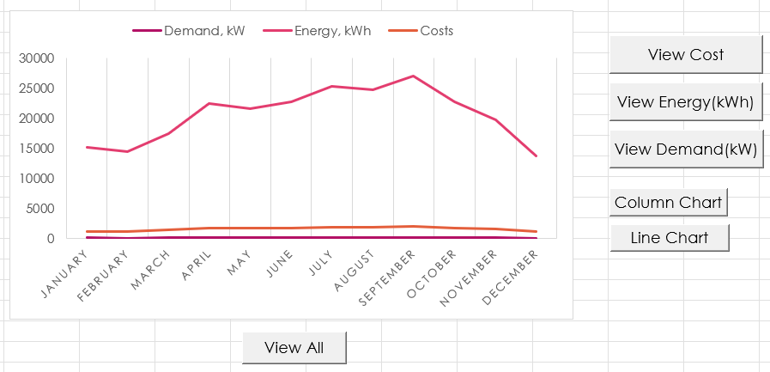
INTRODUCTION
Our program can determine the optimal number of seats to overbook by running simulation to create multiple replications. Also, the profitability is shown according to the demand.

Slide 4
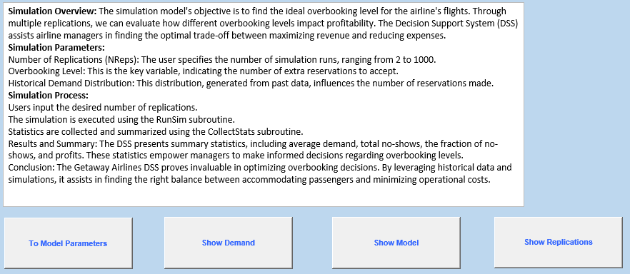
Explanation Page
The simulation's goal is to determine the best overbooking level for an airline's flights. Multiple replications help analyze how different overbooking levels impact profitability. The Decision Support System (DSS) aids airline managers in balancing revenue maximization and cost reduction.

Slide 5
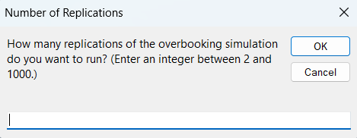
Run SImulation
The run simulation generates replications of the overbooking simulation based on the model parameters. Replication can be generated by the user input from 2 to 1000.

Slide 6
SUMMARY RESULTS From SIMULATION
This page shows the min, max, average, SD, and median for the four output measures. (Demand, Total No-Shows, Fraction No-Shows, Profits)

Slide 7
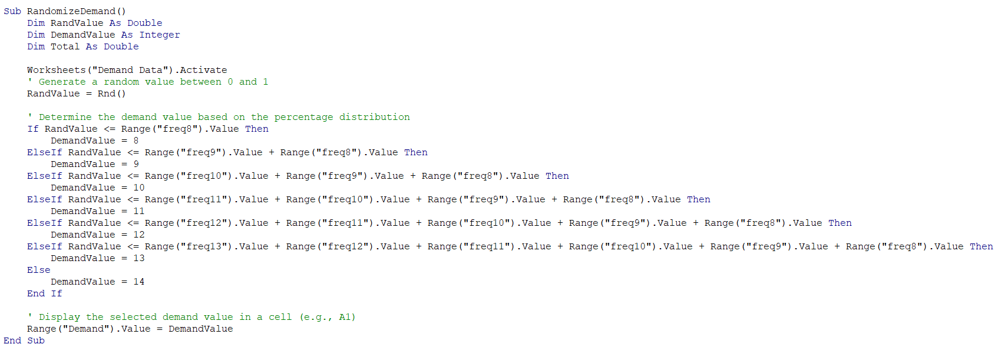
Code

Slide 8
SUMMARY
The Airlines DSS is a useful tool to help manage and optimize the overbooking seats, which result in more profits for the Airlines.

Slide 9
THANK YOU
Chanasorn Howattanakulphong 65011277
Phupa Denphatcharangkul 65011462
Pitiphong Kitrueangphatchara 65011472
Pochara Wiangkham 65011476
Sirapop Tuntithanakij 65011528

