Slide 1
FROM EXCEL TO EXCELLENT
Excel Basics I

Slide 2
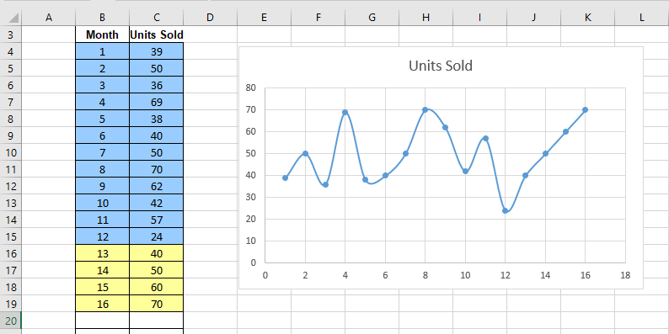
Excel Basics
Excel is all about numbers and formulas, and displaying the numbers and the results of the formulas in charts
All numbers and formulas go into cells in a worksheet

Slide 3
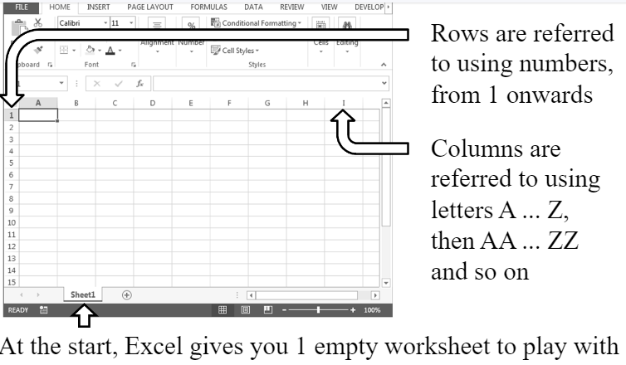
Excel Basics
Cells in an Excel worksheet are arranged in rows and columns

Slide 4
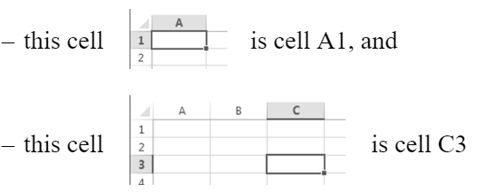
Getting Cells in a Worksheet Basics
So each cell is on a particular row and a particular column
The combination of the column letter and the row number is called cell address, or cell reference
For example,

Slide 5
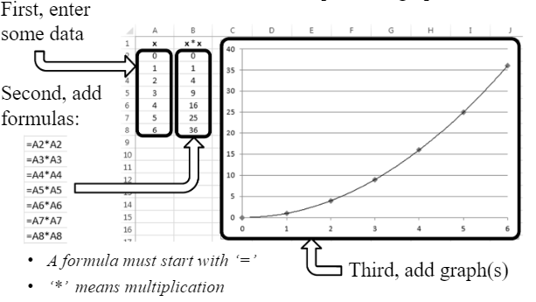
Most Common Steps
1 XX.xlsx

Slide 6
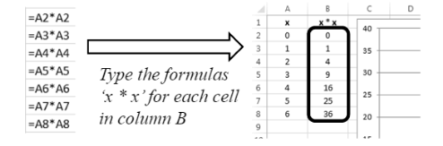
Copying and Pasting Formulas
In the previous example, you need to type every one of those formulas:
Instead of typing, Excel allows you to use copy and paste to quickly add similar formulas to your cells

Slide 7
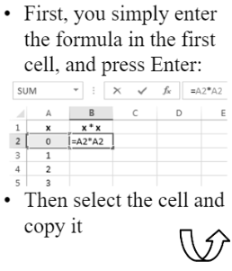
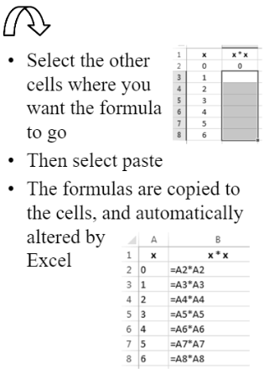
Copying and Pasting Formulas

Slide 8
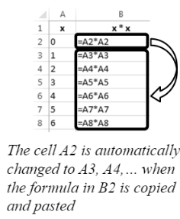
Referencing Cells
The type of cell reference we have seen so far is called ‘relative referencing’ i.e. A8
When you use relative referencing you get ‘an automatic change when pasting’ behaviour
However, sometimes you don’t want the formulas to be automatically changed

Slide 9
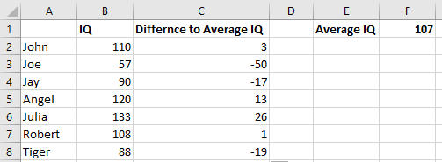
Referencing Cells Example
2 IQ.xlsx
In our next example, we will look at problems with automatic change of formulas when copying and pasting
This is our intended result:

Slide 10
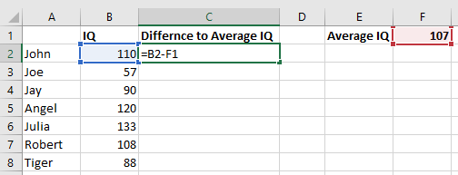
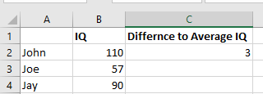
Referencing Cells Example
In the example we want to know how different the intelligence (IQ) is of some people compared to the average people
In the third column, for the first person, we could enter the formula: =B2-F1
The result for the first person is correctly shown:

Slide 11
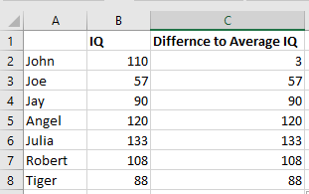
Problems with Automatic Change
But if we copy and paste that formula into the cells underneath it, we get nonsense results!
C3 to C8 are all wrong.

Slide 12
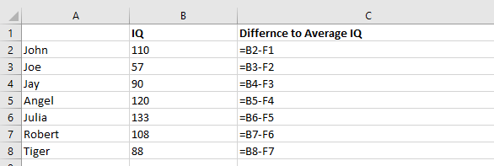
Problems with Automatic Change
But if we Press Ctrl and ` when you want to see/ hide all the formulas
You can see that the reference to cell F1 was automatically changed by Excel– but in this situation we want it to be fixed…!

Slide 13
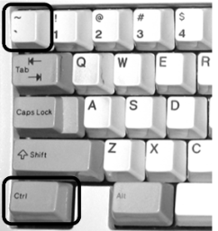
How to do Ctrl `
To show/hide all the formulas in a worksheet:
– Hold down the Ctrl key
– While the Ctrl button is being held down, press the ` key

Slide 14
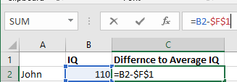
Absolute Referencing of Cells
Whenever you want the reference to a cell to be fixed, you use ‘$’
Here is an example:
Now when the cell is copied and pasted, the reference to cell F1 does not get changed by Excel

Slide 15
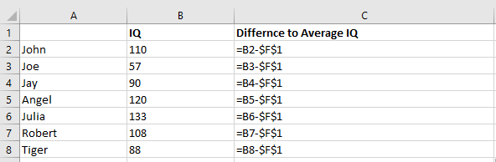
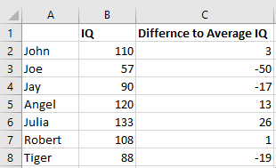
Absolute Referencing of Cells
The formula in row 2 is copied and pasted to row 3 and row 8 in the same column
You can see the second part of the formula hasn’t been changed
Referring to cells in this way is called ‘absolute referencing’

Slide 16
Writing References to Cells
When you write an Excel formula which contains a reference to a cell, you should choose the appropriate way to write it. You can choose from:
– Fixing both column and row i.e. $D$6
– Fixing only the column i.e. $D6
– Fixing only the row i.e. D$6
– Not fixing anything i.e. D6
Hit the F4 key while your cursor is on that cell reference to make different forms of absolute reference
Remember - the differences are important when you copy and paste the cell

Slide 17
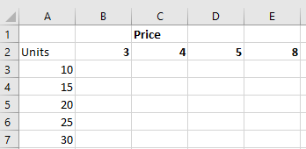
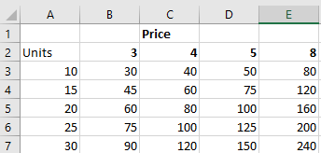
Exercise 1
3 Exercise1.xlsx
Define formula of cell B3 so that we can copy to get the result as shown:

Slide 18
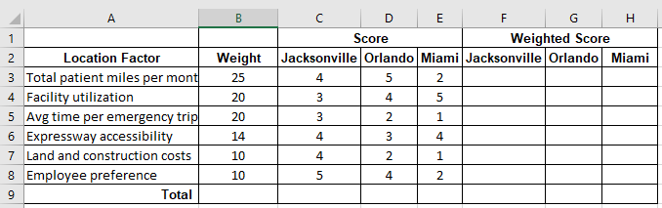
Exercise 2
3 Exercise2.xlsx
A health care center is considering locating their new facility either in Miami, Orlando or Jacksonville in Florida. In making their decision, the following factors are considered: total patient miles per month, facility utilization, average time per emergency trip, expressway accessibility, land and construction costs and employee preferences. The management evaluated each possible location using these criteria. The following table presents weight given to each factor and scores for each location.
Define formula of cell F3 so that we can copy to entire table

Slide 19
Ways to Enter Formula: Method 1
Previously we learnt you can copy formulas into lots of cells quickly by copying and pasting of a formula from one cell to the others
Writing a formula in one cell
Copying the formula from that cell i.e. right click > Copy
Selecting all other cells, pasting the formula i.e. right click > Paste

Slide 20
Ways to Enter Formula: Method 2
Select the cell you want to copy
Click on the small square in the bottom right corner of the cell without letting go of the mouse button
Drag downwards to select all the cells you want to copy the formula to
Let go of the mouse button

Slide 21
Ways to Enter Formula: Method 3
Select the cell you want to copy
Double-click on the small square in the bottom right corner of the cell
This method copies the formula to the cells underneath which have a cell to the left which is not empty

Slide 22
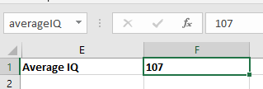
Labelling Cells
5 IQLebel.xlsx
We can make any cell easier to reference by using a label
To do that, you click on the cell and then enter a label for the cell in the name box
From now onwards that cell can be referred to by using the label “averageIQ”, without the need to type the absolute location i.e. $F$1

Slide 23
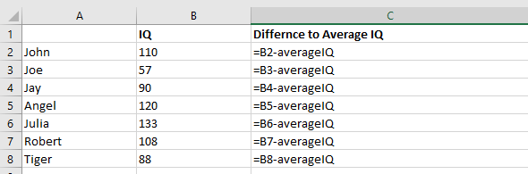
Using a Cell Label
For example, now you can enter this to C2:
=B2-averageIQ
Then copy and paste like before:
The formulas are now much easier to read

Slide 24
Making an Appropriate Chart
Let’s assume you have finished preparing the data
Usually you want to display it in a chart
Excel has lots of different types of charts
The best chart to use depends on the type of data, how much there is, and what aspect you want to show

Slide 25
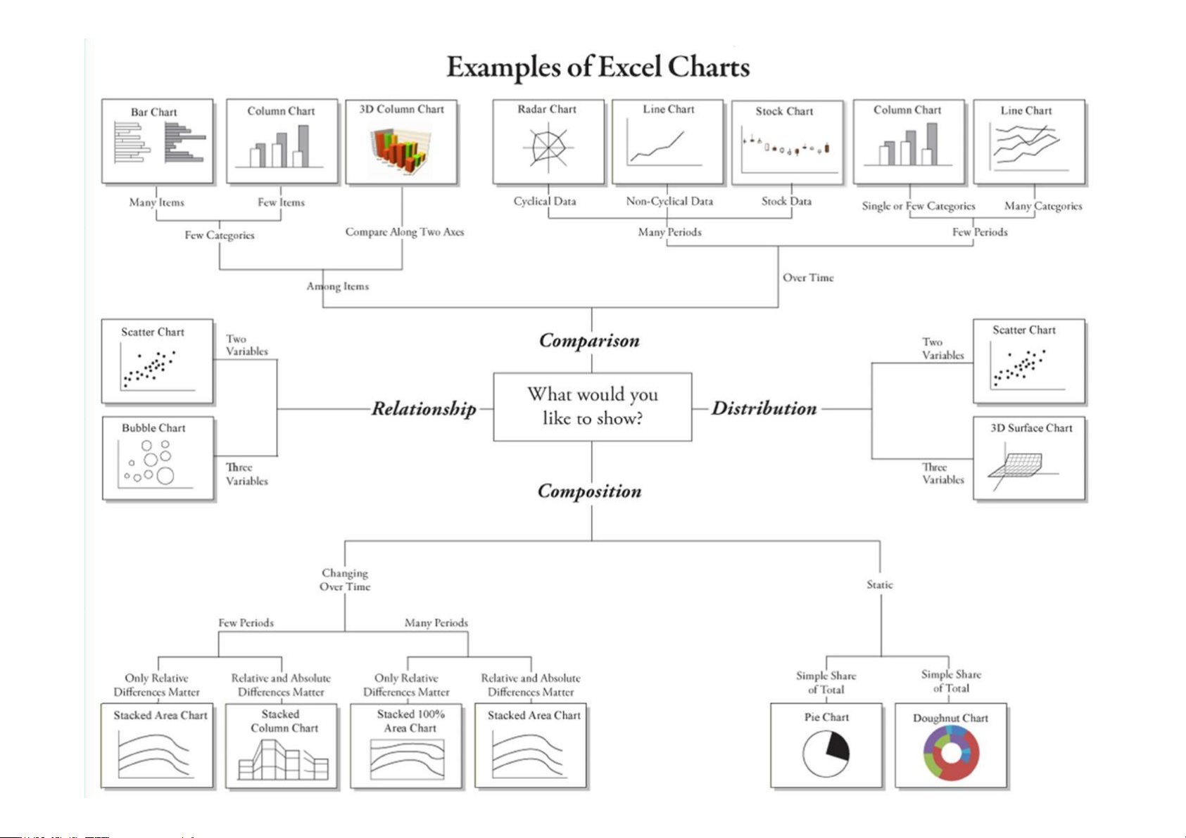
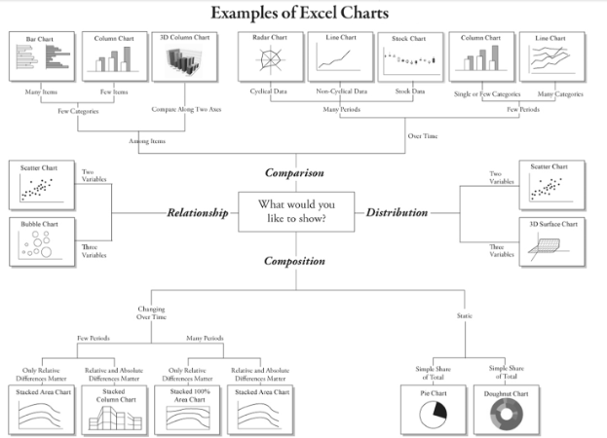

Slide 26
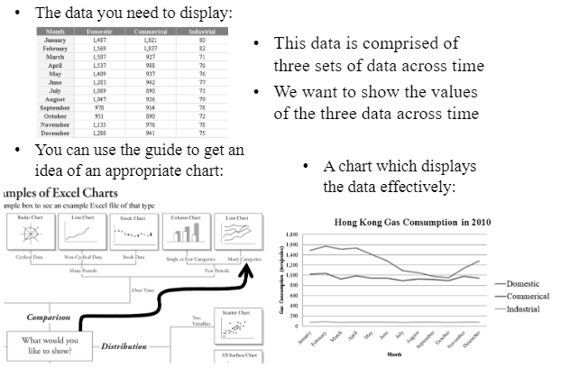
Example 1 Three Sets of Data Across Time

Slide 27
Example 2 Three Sets of Data across Categories

Slide 28
Example 3 Two Sets of Data Across Categories

Slide 29
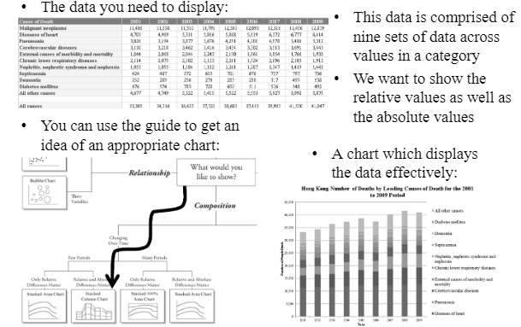
Example 4 Nine Sets of Data Across Categories

Slide 30
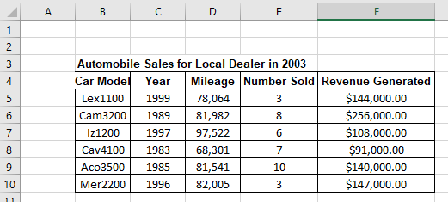
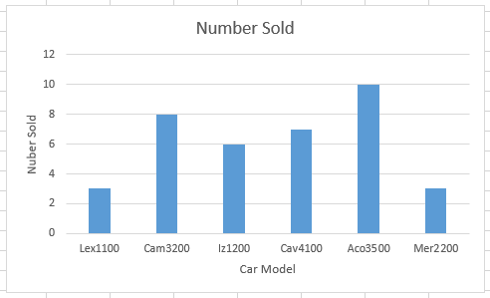
Creating Charts
6 Chartxlsx
Table of data = Number Sold and Revenue Generated from various Car Models
We want to create the bar chart showing Number Sold for each Car Model

Slide 31
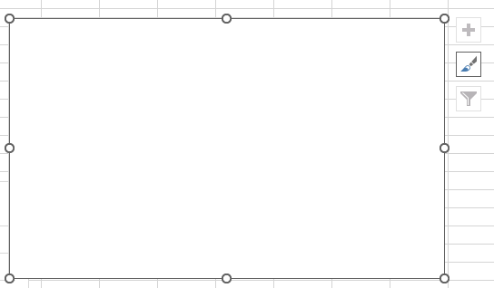
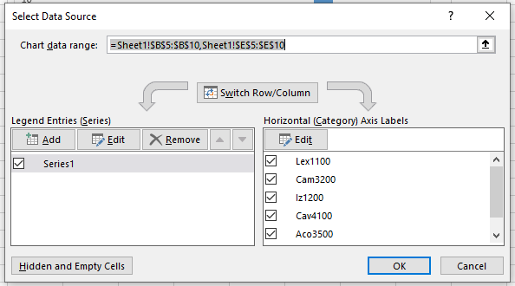
Creating Charts
Choose Insert > Column or Bar Chart
We get the following area on worksheet, right click on the area. And choose Select Data option, specify Chart data range, and click OK :

Slide 32
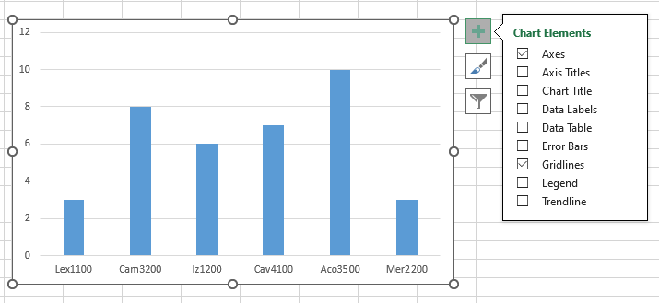
Creating Charts
Click on + to choose to specify Chart Elements such as Chart Title, Axis Title, and Data Label.
We can also specify Chart Types and Chart Filters.

Slide 33
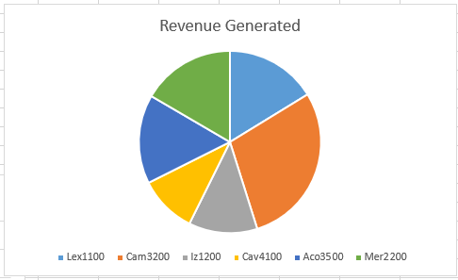
Creating Charts
Table of data = Number Sold and Revenue Generated from various Car Models
We want to create the pie chart showing Revenue Generated for each Car Model using Insert Chart > Pie Chart

Slide 34
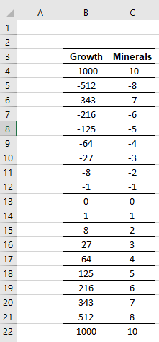
Creating Charts
7 ScatterwithSmmothChart.xlsx
Data table shows plant growth based on minerals added or removed from the ground
Insert > Scatter with Smooth Chart

Slide 35
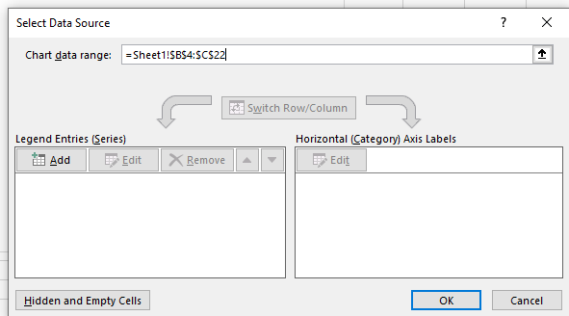
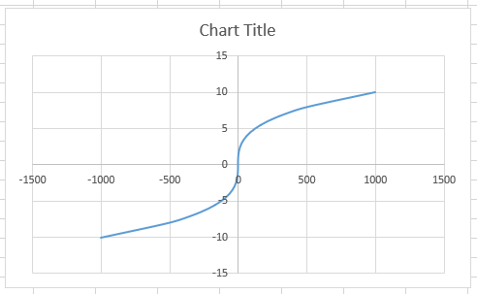
Creating Charts
Specify Data Source as shown and click OK.

Slide 36
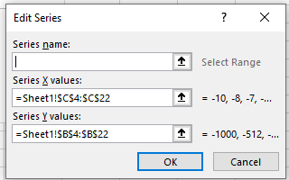
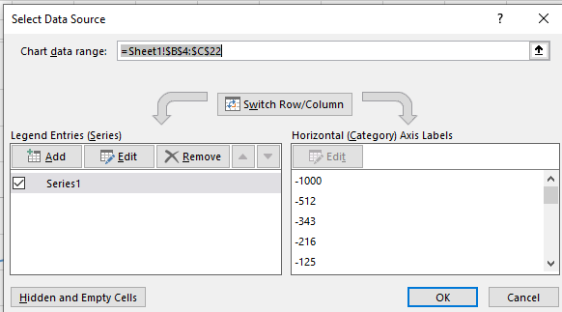
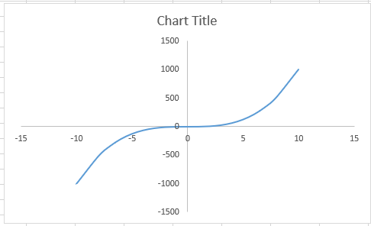
Creating Charts
Switch x and y values for better data analysis by choosing Edit from Select Data Source

Slide 37
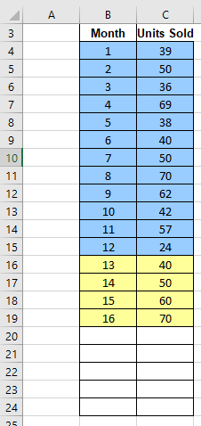
Creating Dynamic Charts
8 DynamicChart.xlsx
A dynamic chart is a special chart in Excel which updates itself when the data range of the chart is updated.
Months and Units Sold may be dynamic values in this data.

Slide 38
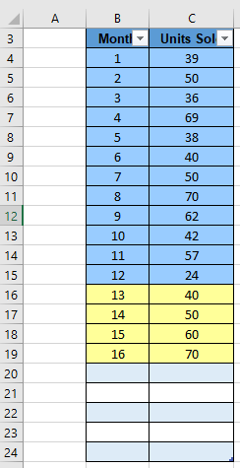
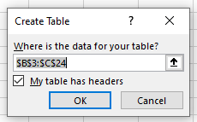
Creating Dynamic Charts
Highlight B3:C24 and choose Insert > Table
Click OK, we get the table as shown.

Slide 39
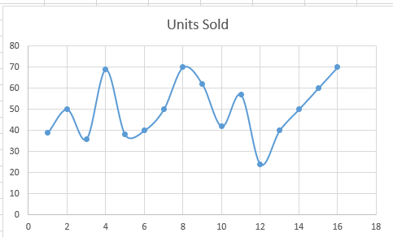
Creating Dynamic Charts
Insert > Scatter with Smooth Lines and Markers Chart.
Specify Select Data as the table, and click OK.
If we make a data change, the chart is changed accordingly.

Slide 40
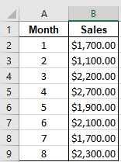

Exercise 3
9 Exercise3.xlsx
Below is a table with monthly sales for a product.
Create a dynamic chart for this data and enter the following new data points:

