Slide 1
FROM EXCEL TO EXCELLENT
Excel Basics II

Slide 2
Cell References

Slide 3
Referring to Cells
An Excel formula may contain a function such as SUM(), MAX(), and AVERAGE()
Such functions typically perform operations on several different cells i.e. SUM(A2:B4)
In Excel we use the general expression ‘a range of cells’ when referring to a group of cells

Slide 4
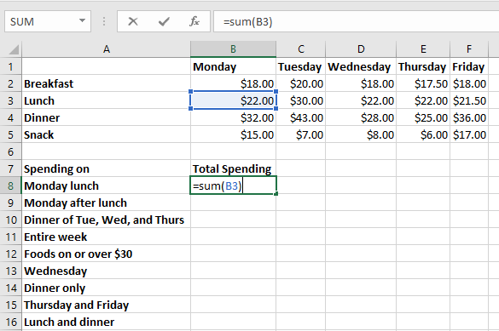
Range References –One Cell
1 Ranges.xlsx

Slide 5
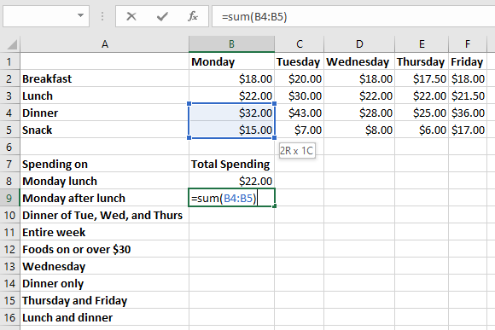
Range References –Part of a Column

Slide 6
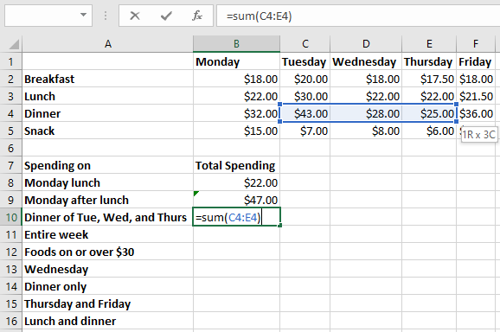
Range References –Part of a Row

Slide 7
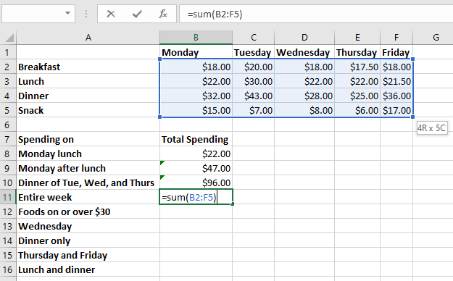
Range References –Matrix of Cells

Slide 8
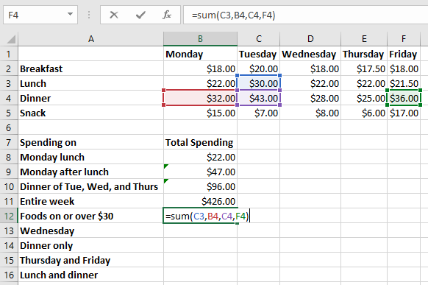
Range References –Set of Unrelated Cells

Slide 9
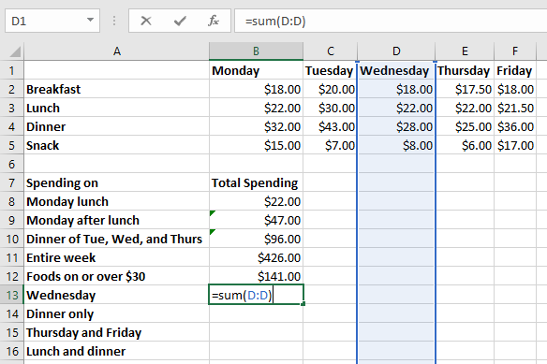
Range References –Entire Column

Slide 10
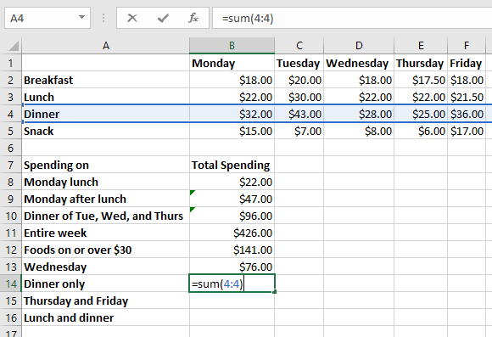
Range References –Entire Row

Slide 11
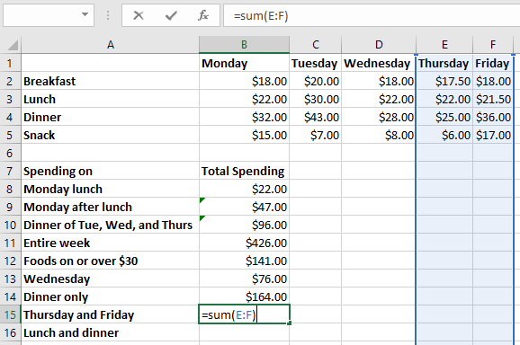
Range References –Multiple Columns

Slide 12
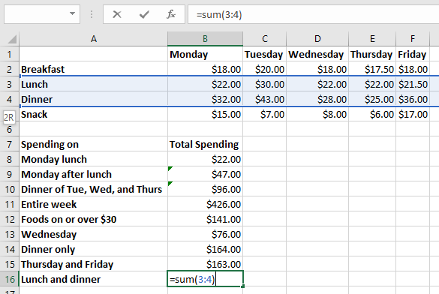
Range References –Multiple Rows

Slide 13
Cell Formula Basics

Slide 14
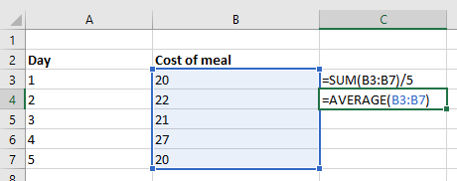
Cell Formulas
2 CostofMeals.xlsx
Every formula starts with a =
Here is a simple formula calculating the average cost of meals:

Slide 15

Arithmetic
In cell formulas you can do basic calculations like those you learned in school:
+ Addition
- Subtraction
* Multiplication
/ Division
^ Power

Slide 16
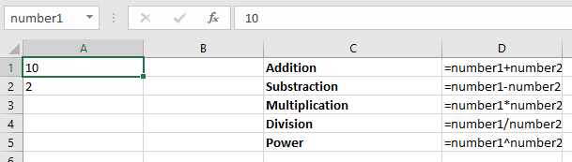
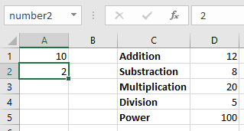
Examples Of Arithmetic
3 Arithematic.xlsx

Slide 17
Some Commonly Used Number Functions
SUM for finding the total of a group of numbers
AVERAGE for finding the average of a group of numbers
STDEV for finding the standard deviation of a group of numbers
MAX for finding the maximum in a group of numbers
MIN for finding the minimum in a group of numbers
RANK for ranking a number in a group of numbers
COUNTIF for counting the number of occurrences of a value

Slide 18
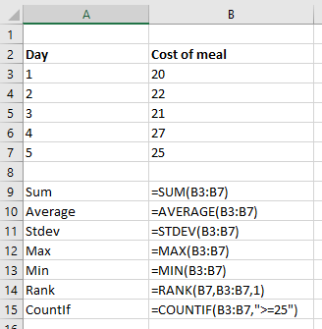
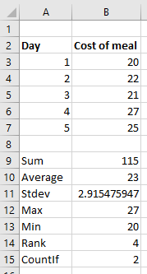
Some Commonly Used Number Functions
4 NumberFunctions.xlsx

Slide 19
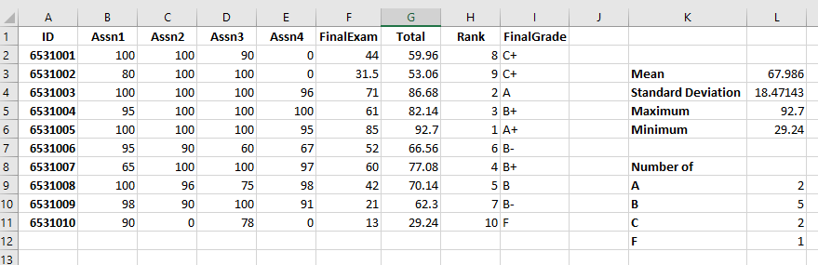
Exercise 1
5 Exercise1.xlsx
Each assignment weights 14% of total grade.
Final examination weights 44% of total grade.
Complete the worksheet with formulas so that we get the following result:

Slide 20
Comparing Things
You can do that using these:
= equal to
<> not equal to
< smaller than
<= smaller than or equal to
> larger than
>= larger than or equal to
The result of a comparison is TRUE or FALSE
For example, to test if the value in cell A4 is larger than the value in cell B6, we can write =A4 > B6

Slide 21
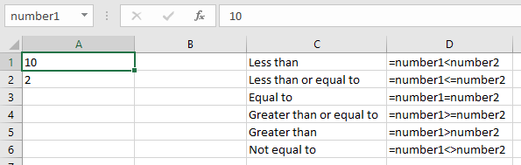
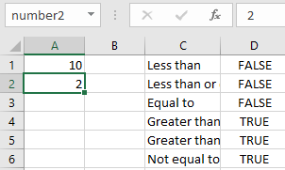
Examples Of Comparing Things
6 Comparing.xlsx

Slide 22
Comparing Things in COUNTIF
We have seen COUNTIF helps us count the number of occurrences of something,
e.g. =COUNTIF(I2:I11, "A") counts number of “A” in the range I2:I11
Instead of using an exact value we can do something like =COUNTIF(B2:B11, "<40")
This will count all the numbers less than 40 in the range B2:B11
This is also applicable in SUMIF() and AVERAGEIF().

Slide 23
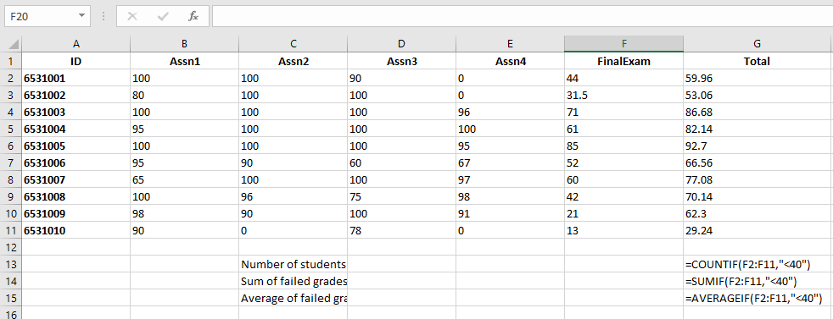
Example of Using COUNTIF
7 CountIf.xlsx

Slide 24
String Concatenation
In computer language, ‘a string’ means ‘a piece of text’
Concatenate means putting one string at the end of another string
In Excel cell formulas, you can concatenate two strings by using & or the CONCATENATE function
For example, this formula: ="Happy" & "Birthday“
and this formula:=CONCATENATE("Happy", "Birthday")
both produce the same result: HappyBirthday

Slide 25
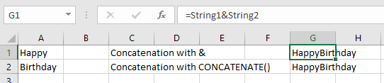
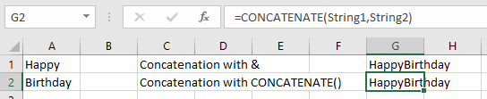
Example of String Concatenation
8 StringConcat.xlsx

Slide 26
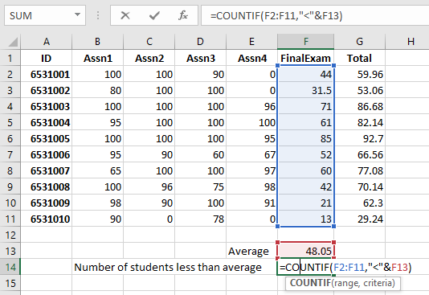
String Concatenation and the COUNTIF
9 CountIfCellReference.xlsx
If we want to include a value from reference cell in the COUNTIF().
For example: In the range F2:F11, we want to count only values > the value of cell F13.

Slide 27
Some Commonly Used String Functions
LEN Count the number of characters in a string
UPPER Convert all letters into upper case letters i.e. ABC
LOWER Convert all letters into lower case letters i.e. abc
LEFT Get the first few characters in a string
RIGHT Get the last few characters in a string
SUBSTITUTE Substitute (replace) some text in a string

Slide 28
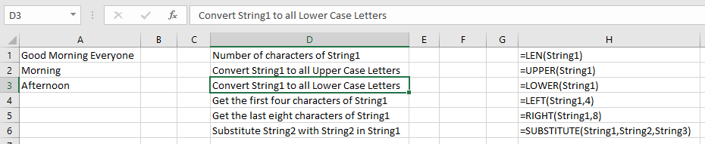
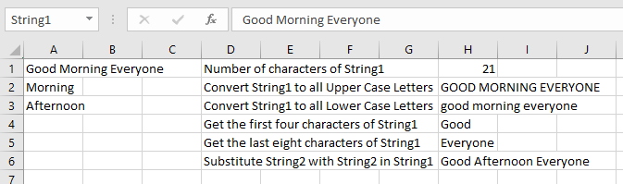
Example of Some Commonly Used String Functions
10 StringFunctions.xlsx

Slide 29
Precedence

Slide 30
What Goes First?
If you enter the following formula
=5+2*3
You may think that the answer is 21
However, Excel actually gives you the answer of 11
That is because Excel thinks that multiplication is more important than addition
Therefore 2*3 is performed first, before the addition
We say multiplication has a higher precedence than addition

Slide 31
Using Brackets
Of course, if you use brackets that ensures that part of a formula is evaluated first
Examples:
=5+2*3 gives an answer of 11
=(5+2)*3 gives an answer of 21
You can always use brackets in your cell formulas, so you don’t have to remember which things are calculated first

Slide 32
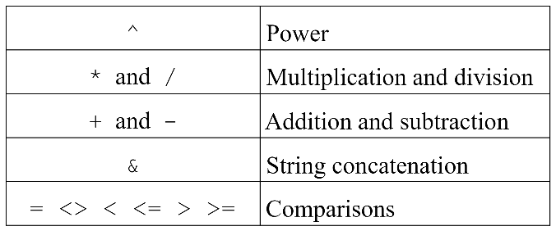
Precedence in Cell Formulas
The following table shows you the different levels of precedence, most important at the top:

Slide 33
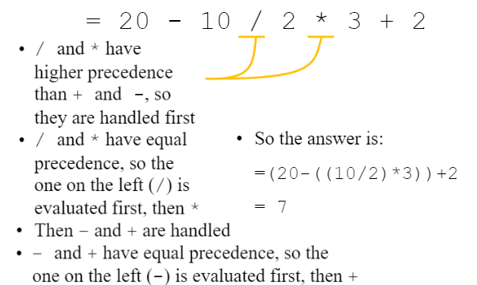
Precedence Example 1

Slide 34
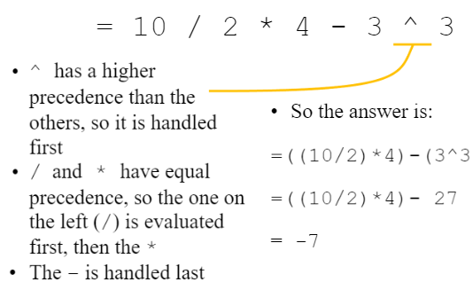
Precedence Example 2

Slide 35
Making Decisions with Excel Formulas

Slide 36
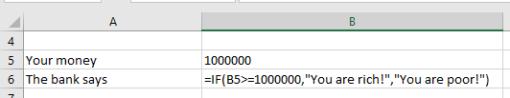
Using the IF Function
11 IF.xlsx
The IF cell function is written like this:
IF( condition , true part , false part )
It represents the following English sentence:
If condition is true, do true part;
otherwise do false part
For example, an IF cell function can be used to do this:
If you have at least one million in your account,
show “You are rich!”;
otherwise show “You are poor!”

Slide 37
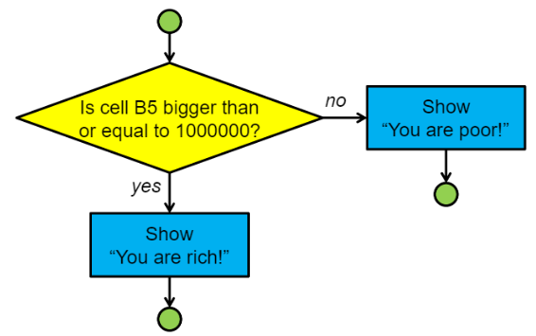
The Flow of the IF Example

Slide 38
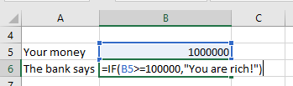
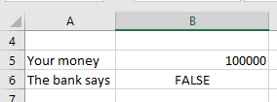
Omitting the False Part

Slide 39
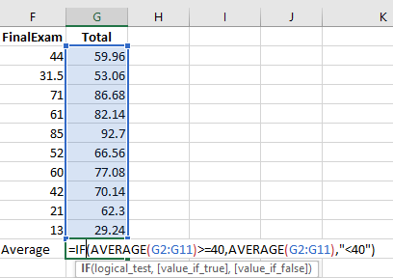
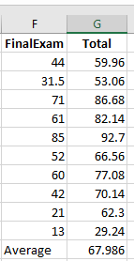
Using Formulas Inside IF Functions
12 IfwithFormula.xlsx
In addition to text, you can put formulas inside an IF function
Here is an example:
=IF(AVERAGE(G2:G11)>=40,AVERAGE(G2:G11),"<40")

Slide 40
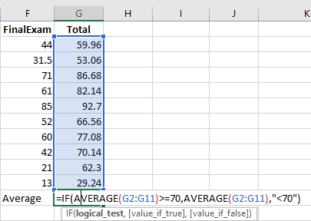
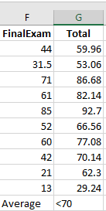
Using Formulas Inside IF Functions
=IF(AVERAGE(G2:G11)>=70,AVERAGE(G2:G11),"<70")

Slide 41
Nested IF Functions
You can put any formula inside an IF function
That means you can even put an IF function inside another IF function, like this:
IF( condition1 , result1 ,IF( condition2 , result2 , result3 ))
The IF function inside another IF function is called a nested IF

Slide 42
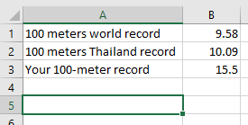
A Nested IF Example
13 WorldRecord.xlsx
The following formula is put in cell A5
=IF(B3<B1,"You are the fastest in the world!",IF(B3<B2,"You are the fastest in Thailand!", "Train harder to beat the records!"))

Slide 43
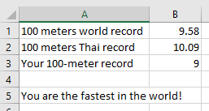
A Nested IF Example
=IF(B3<B1,"You are the fastest in the world!",IF(B3<B2,"You are the fastest in Thailand!", "Train harder to beat the records!"))
B3<B1 TRUE

Slide 44
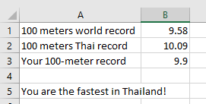
A Nested IF Example
14 Exercise2.xlsx
=IF(B3<B1,"You are the fastest in the world!",IF(B3<B2,"You are the fastest in Thailand!", "Train harder to beat the records!"))
B3<B1 FALSE and B3<B2 TRUE

Slide 45
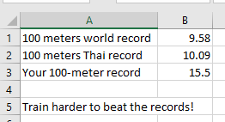
A Nested IF Example
=IF(B3<B1,"You are the fastest in the world!",IF(B3<B2,"You are the fastest in Thailand!", "Train harder to beat the records!"))
B3<B1 FALSE and B3<B2 FALSE

Slide 46

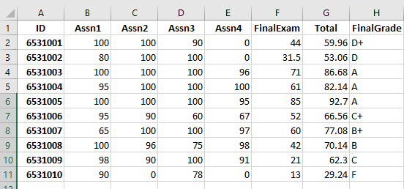
Exercise 2
Fill in H2 with the formula to determine grade and copy to the rest so the result is as shown:
Range | Grade
80-100 | A
76-79 | B+
70-75 | B
66-69 | C+
60-65 | C
56-59 | D+
50-55 | D
0-49 | F

Slide 47
Using Logic in Cell Formulas

Slide 48
Using Logic
So far, the conditions we have used have only a single condition i.e. B3>=1000000
We usually need to make a decision based on several criteria (sometimes called conditions)
For example, you may need to check if a cell is within a certain range, e.g. checking if B1 is between 1 to 10 by combining B1>=1 and B1<=10
=AND(B1>=1, B1<=10)
You will need to combine multiple conditions using these logical functions AND, OR, and NOT

Slide 49
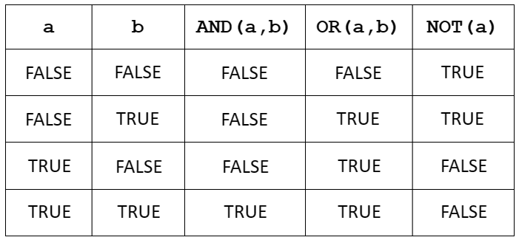
Summary of Logical Functions Logic
Here is a summary of the input and output of the three logical functions:

Slide 50
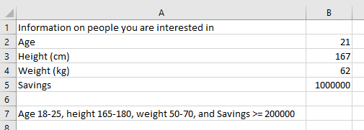
AND
15 AND.xlsx
In cell B7 we want to input the following conditions: Age 18-25, height 165-180, weight 50-70, and Savings >= 200000
=AND(B2>=18, B2<=25, B3>=165, B3<=180, B4>=50, B4<=70, B5>=200000)

Slide 51
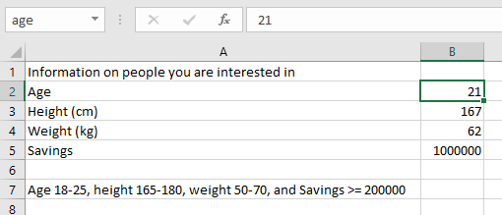
AND with Cell Names
In cell B7 we want to input the following conditions: Age 18-25, height 165-180, weight 50-70, and Savings >= 200000
=AND(age>=18, age<=25, height>=165, height<=180, weight>=50, weight<=70, savings>=200000)

Slide 52
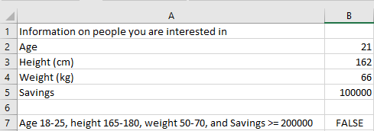
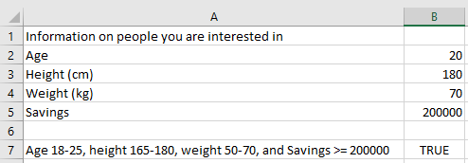
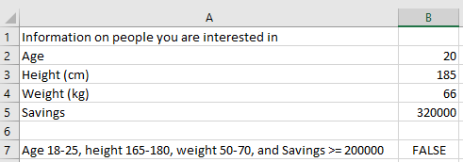

Some Results

Slide 53
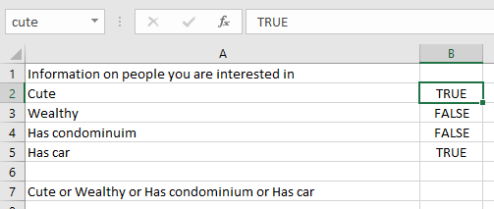
OR with Cell Names
16 OR.xlsx
In cell B7 we want to input the following conditions: Cute or Wealthy or Has condominium or Has car
=OR(cute,wealthy,condominium,car)

Slide 54
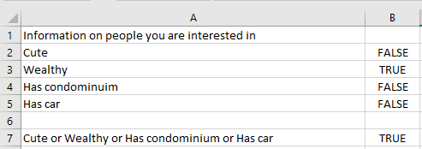
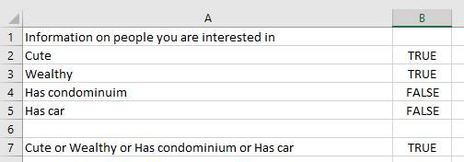
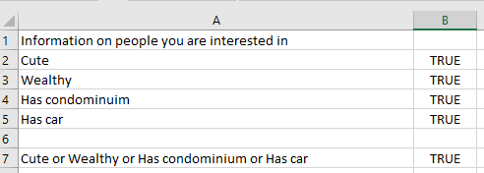
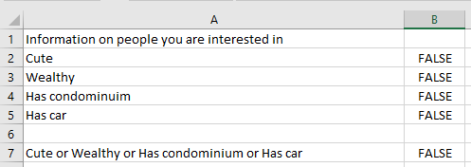
Some Results

Slide 55



NOT
17 NOT.xlsx
The result of NOT is the opposite of the input

Slide 56

Exercise 3
18 Exercise3.xlsx
A medical centre must pay close attention to several health factors to determine what type of meals patients should receive. The factors to consider include the patient’s age, weight, blood pressure, and cholesterol level. Patients should receive low sodium meals if their blood pressure is high and if they meet at least one of the following conditions: their age is at least 70 or their weight is at least 200. Patients should receive low cholesterol meals if their cholesterol level is high and if they meet one of the following conditions: their age is at least 70; their weight is at least 200; or their blood pressure is high. Patients may also have low sodium and low cholesterol meals if they satisfy the conditions for both the low sodium meal and the low cholesterol meal. If the patient does not satisfy the conditions for either the low sodium meal or the low cholesterol meal, then he or she receives a regular meal.
Using logical functions , find the type of meals each patient should receive. Results should be one of the following: “Regular Meal,” “Low Sodium Meal,” “Low Cholesterol Meal,” or “Low Sodium/Low Cholesterol Meal.”

