Slide 1
FROM EXCEL TO EXCELLENT
Excel Basics III

Slide 2
Worksheets

Slide 3
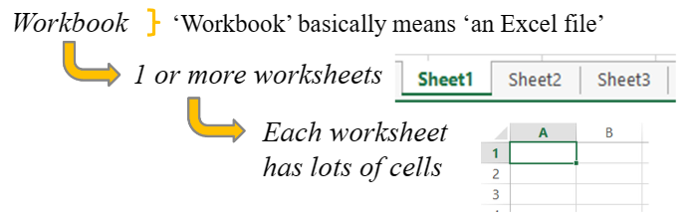
Workbook Structure
The basic ‘structure’ of an Excel file is:
You can have as many worksheets as you like
You need at least one worksheet in your Excel file, you can never have zero

Slide 4
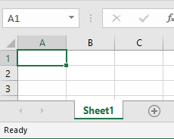
One Worksheet to Start With
1 Worksheet.xlsx
If you create a new Excel file, you are given one empty worksheet at the start
The default name (Sheet1) given to the worksheet isn’t good, it is much better to change the name to something appropriate

Slide 5
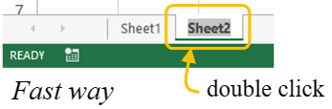
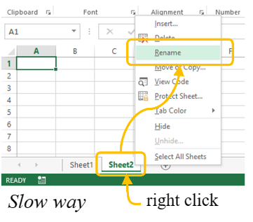
Renaming Worksheets
To change a worksheet name, the fast way is to double click on the worksheet name at the bottom, then change the text
The slow way is to right click, select ‘Rename’, then change the text

Slide 6
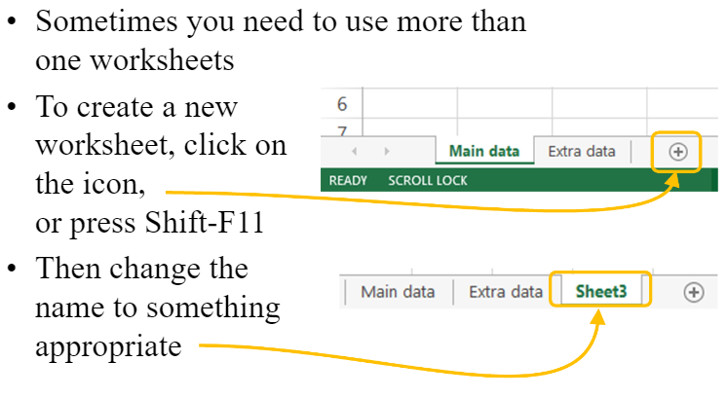
Creating a New Worksheet

Slide 7
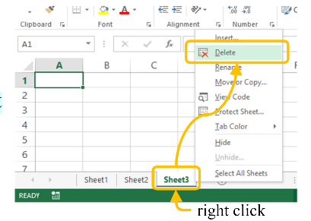
Deleting Worksheets
To delete a worksheet, right click on the worksheet name at the bottom, then select ‘delete’

Slide 8
The Active Worksheet
When you open an Excel file it shows the worksheet that was open when it was saved
So it makes sense to go to the most important/the main worksheet just before you save the file
Then when the file is opened, the main worksheet is shown

Slide 9
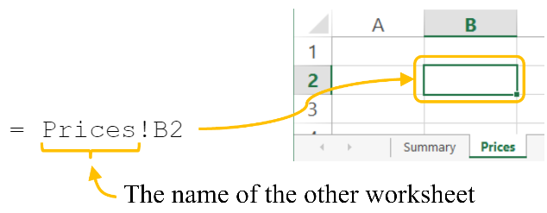

Referring to Another Worksheet
A cell formula can refer to a cell in another worksheet like this:
If the name of the worksheet includes a space, you have to use ‘ ‘, like this:

Slide 10
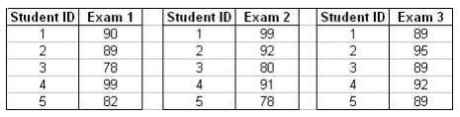
Exercise 1
2 Exercise1.xlsx
A professor saved the results from three different exams he gave in his class, in three worksheets. Create the following in the Summary worksheet:
a. A table that presents for each student the identification number, as well as the grades of the three exams.
b. A table that presents the average exam grade for each student.
c. A table that presents the maximum grade received in an exam for each student.
d. A table that presents the minimum grade received in an exam for each student.

Slide 11
Templates

Slide 12
What is a Template in Excel?
A pre-built spreadsheet or workbook that's already formatted, organized, and populated with formulas tailored for its purpose.
With templates, we don't need to recreate the basic elements every time as they are already integrated into the spreadsheet.
An extension of templates: .xltx or .xltm

Slide 13
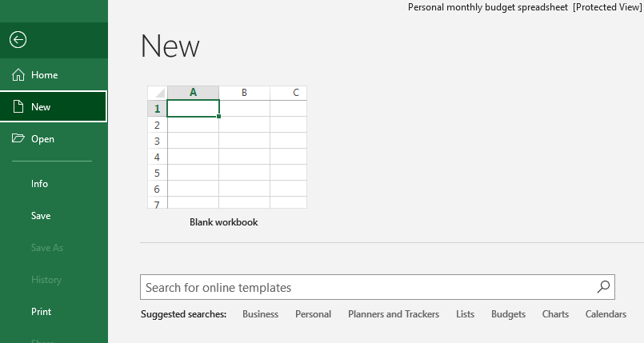
Create a Workbook from an Existing Template
Instead of starting with a blank sheet, you can quickly create a new workbook based on an Excel template.
Click File > New.

Slide 14
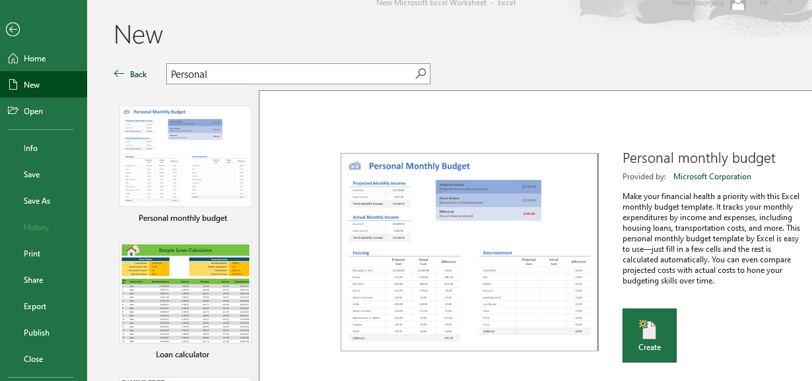
Create a Workbook from an Existing Template
Use the search box to search for online templates or click a template from one of the Office templates.
Click Create to download the template.

Slide 15
Create a Custom Excel Template
In the workbook you want to save as a template, click File > Save As
In the Save As dialogue, in the File name box, type a template name.
Under Save as type, select Excel Template (*.xltx).
If your workbook contains a macro, then choose Excel Macro-Enabled Template (*.xltm).

Slide 16
Data Validation

Slide 17
Data Validation
A feature that restricts (validates) user input to a worksheet. Technically, you create a validation rule that controls what kind of data can be entered into a certain cell.
Some few examples of what Excel's data validation can do:
Allow only numbers within a specified range.
Restrict entries to a selection from a drop-down list.
Allow only numeric or text values in a cell.
Allow data entries of a specific length.
Restrict dates and times outside a given range.

Slide 18
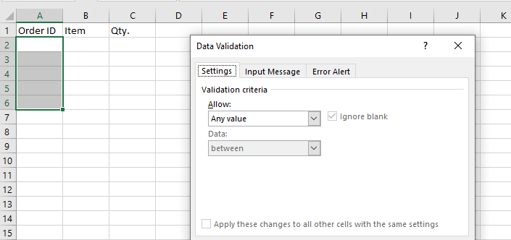
Create Data Validation
3 DataVlidation.xlsx
Select data range.
Choose Data > Data Tools > Data Validation.

Slide 19
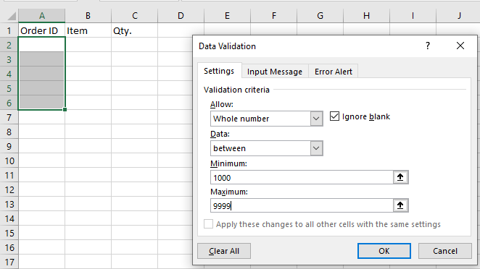
Create Data Validation
Each cell in the range must be an integer 1000 to 9999.

Slide 20
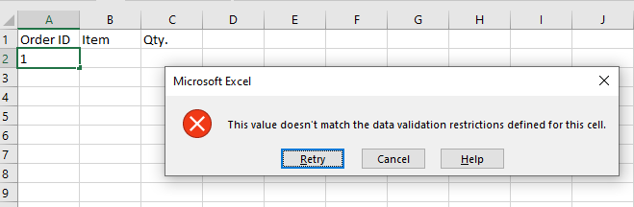
Create Data Validation
Each cell in the range must be an integer 1000 to 9999.
If we try to input an invalid, we will get the following message box.

Slide 21
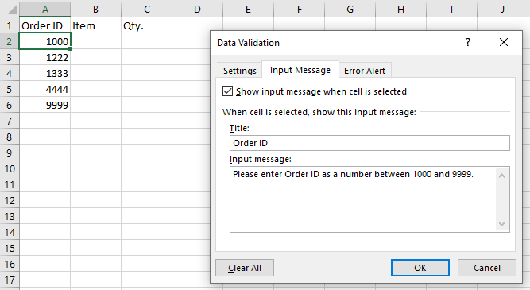
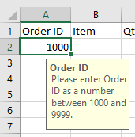
Create Data Validation
Each cell in the range must be an integer 1000 to 9999.
If we want to guide users with a valid value, we have to specify Input Message as shown.
>>

Slide 22
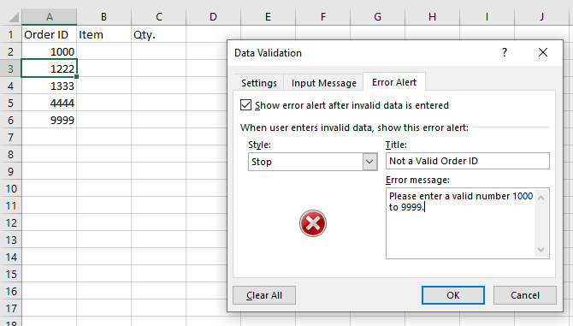
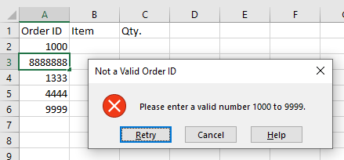
Create Data Validation
We can define an Error message for invalid input.
>>

Slide 23
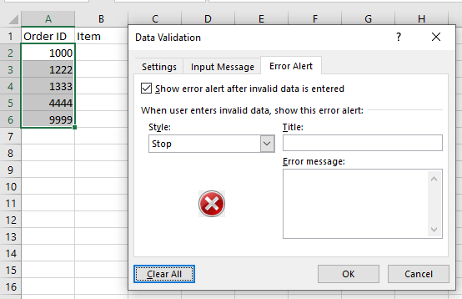
Remove Data Validation
Select data range.
Choose Data > Data Tools > Data Validation; Click Clear All in Data Validation Dialog Box.

Slide 24
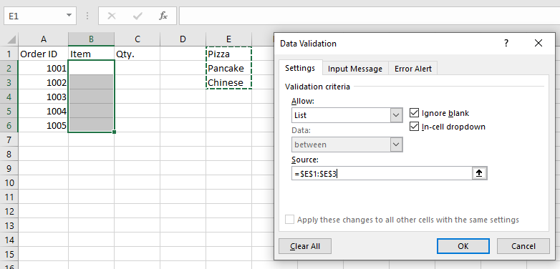
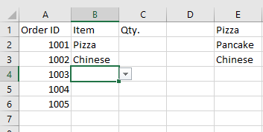
Drop-down List
4 DataValidation.xlsx
Select data range.
Choose Data > Data Tools > Data Validation and define list as shown.

Slide 25
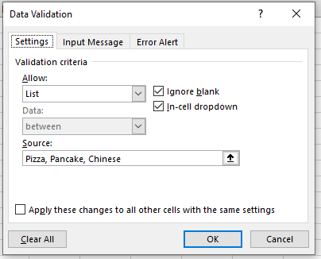
Drop-down List
Select data range.
Choose Data > Data Tools > Data Validation and define list as shown.

Slide 26
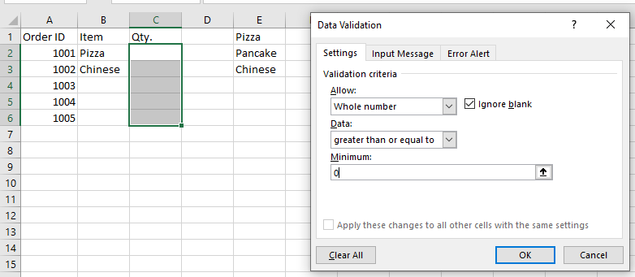
Reject Negative Integers
5 RejectNegative.xlsx
Implement rule: “quantity must be an integer greater than or equal to 0”.
Select data range.
Choose Data > Data Tools > Data Validation and define the rule as shown.

Slide 27
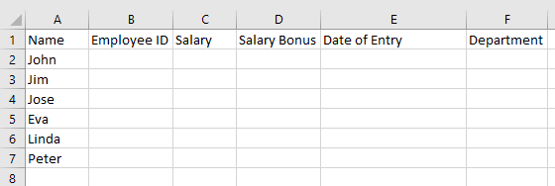
Exercise 2
6 Exercise2.xlsx
There is a list of employees. Each column in the following Excel table has a rule for entering values.
Rules
Employee number is exactly 5 characters long.
Salary can be set in the range 12000.00-20000.00.
Bonus cannot be greater than 10 % of the salary.
Date of entry can be set only as today.
Department must be one of the values from the list of Departments (IT, Logistics, or Marketing).

Slide 28
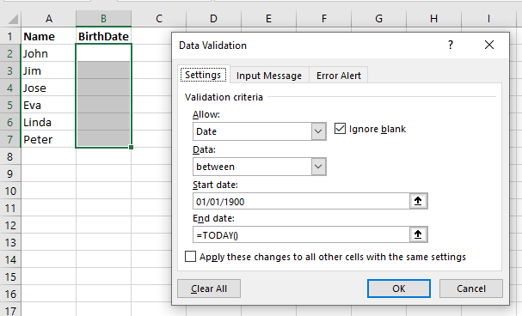
Date Range
7 DateRange.xlsx
Select data range.
Choose Data > Data Tools > Data Validation and define the date allowed between 01/01/1900 to today.
The Excel TODAY function returns the current date, updated continuously when a worksheet is changed or opened.

Slide 29
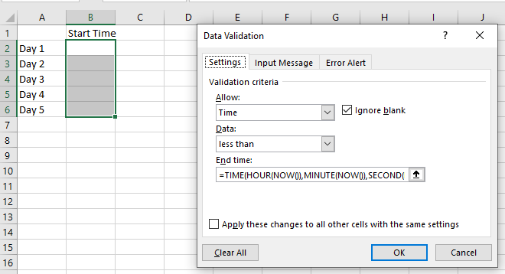
Time Range
8 TimeRange.xlsx
Select data range.
Choose Data > Data Tools > Data Validation and define the time allowed to be less than the current.
=TIME(HOUR(NOW()),MINUTE(NOW()),SECOND(NOW()))
The TIME function returns the time as a decimal given the hour, minute and second.
The HOUR function returns the hour as an integer given a date serial number.
The MINUTE function returns the minute as an integer given a date serial number.
The SECOND function returns the number of seconds given a date serial number.
The NOW function returns the serial number of the current system date and time.

Slide 30
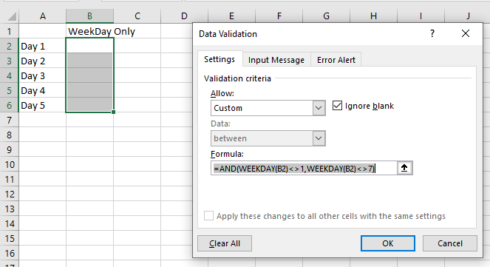
Custom Date
9 CustomDate.xlsx
Select data range.
Choose Data > Data Tools > Data Validation and define the restrict the data entered to dates that only fall on weekdays (ie not Saturdays or Sundays).
=AND(WEEKDAY(B2)<>1,WEEKDAY(B2)<>7)
The WEEKDAY function returns the day of the week for a given date.

Slide 31
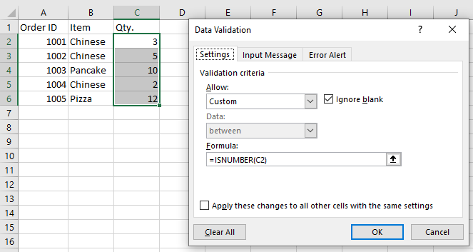
Allow Numbers Only
10 NumberOnly.xlsx
Select data range.
Choose Data > Data Tools > Data Validation and define to allow numbers only

Slide 32
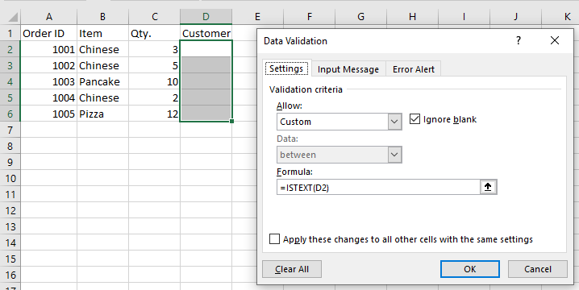
Allow Texts Only
11 TextOnly.xlsx
Select data range.
Choose Data > Data Tools > Data Validation and define to allow texts only

Slide 33
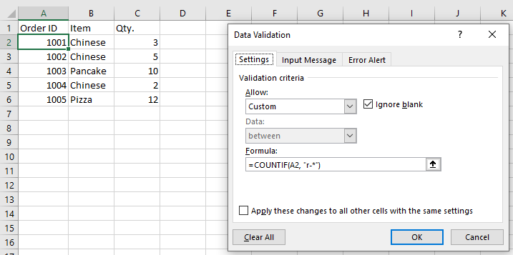
Allow Text Beginning with Specific Character(s)
12 FormattedText.xlsx
Select data range.
Choose Data > Data Tools > Data Validation and define to text format with the function COUNTIF(cell,"text*")
For example, to ensure that all order id's in column A begin with the “R-“ or “r-“ prefix (case-insensitive), define a custom rule with this data validation formula: =COUNTIF(A2,“r-*")

Slide 34
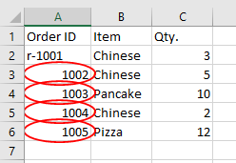
Allow Text Beginning with Specific Character(s)
12 FormattedText.xlsx
Enter “r-1001” to A2
Choose Data > Data Tools > Circle Invalid Data

Slide 35
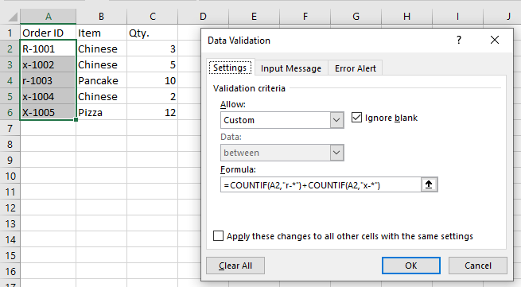
Allow formatted Text with the OR logic
13 OR.xlsx
Select data range.
Choose Data > Data Tools > Data Validation and define to text format with =COUNTIF(A2,"r-*")+COUNTIF(A2,"x-*")

Slide 36
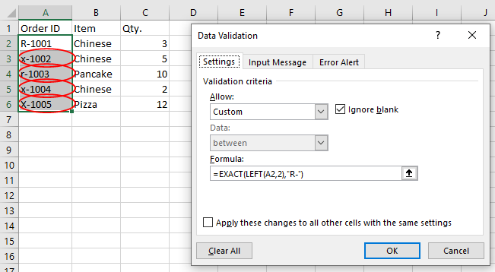
Allow formatted Case-Sensitive Texts
14 FormatCaseSensitive.xlsx
Select data range.
Choose Data > Data Tools > Data Validation and define to text format with =EXACT(LEFT(A2,2),"R-")

Slide 37
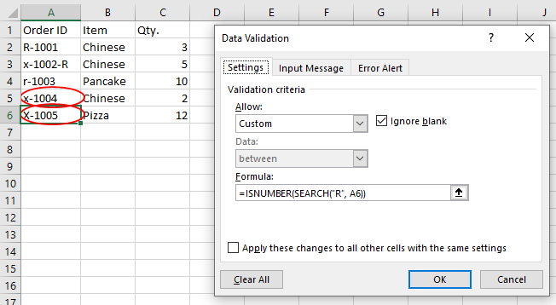
Allow Entries Containing Certain Case-Insensitive Text
15 ContainCaseInSensitive.xlsx
Select data range.
Choose Data > Data Tools > Data Validation and define to text format with =ISNUMBER(SEARCH("R", A6))
The SEARCH function in Excel is used to return the position of a specific character or substring within a text string.

Slide 38
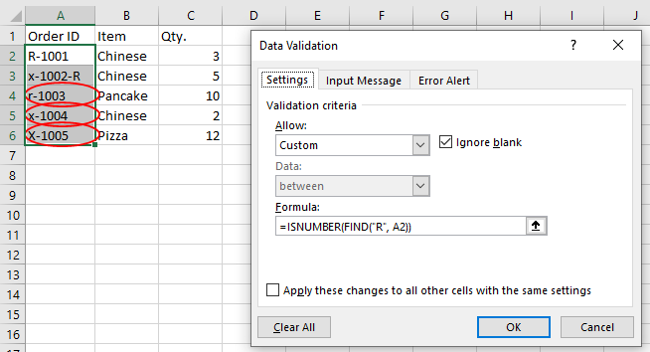
Allow Entries Containing Certain Case-sensitive Text
16 ContainCaseSensitive.xlsx
Select data range.
Choose Data > Data Tools > Data Validation and define to text format with =ISNUMBER(FIND("R", A2))
The FIND function in Excel is used to return the position of a specific character or substring within a text string.

Slide 39
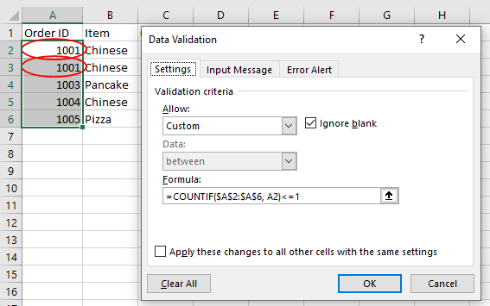
Allow only Unique Entries
17 Unique.xlsx
Select data range.
Choose Data > Data Tools > Data Validation and define to text format with =COUNTIF($A$2:$A$6, A2)<=1

Slide 40
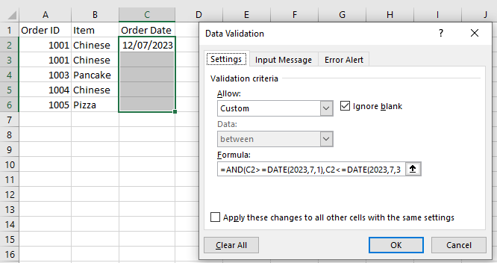
Allow Dates between Two Dates
18 TwoDates.xlsx
Select data range.
Choose Data > Data Tools > Data Validation and define to text format with =AND(C2>=DATE(2023,7,1),C2<=DATE(2023,7,31))

Slide 41
Exercise
19 Exercise3.xlsx
A retail store keeps the information about the products carried in the inventory in an excel spreadsheet. This information is presented in the table below. Use Data Validations tools to insure that:
a. The identification number for each item is a number that has exactly five digits.
b. Inventory level for each item cannot be negative.
c. The unit price for each item is at least $150.
d. A product condition should be either fair, or good, or very good.
e. The purchase date for the items in the inventory should not be less that
1/1/2023.

Slide 42
Remove Duplicates

Slide 43
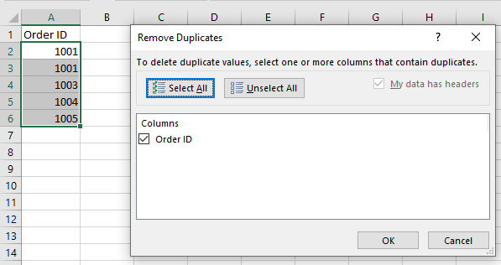
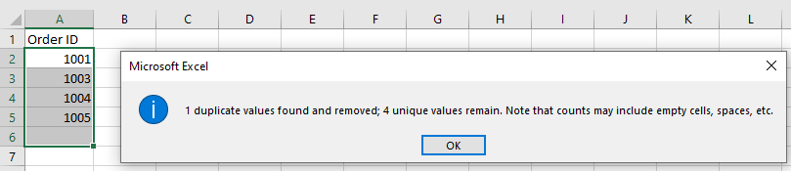
Remove Duplicates
20 RemoveDuplicates1.xlsx
A Excel tool that allows the user remove duplicates from a column or a set of columns.
Select data range.
Choose Data > Data Tools > Remove Duplicates

Slide 44
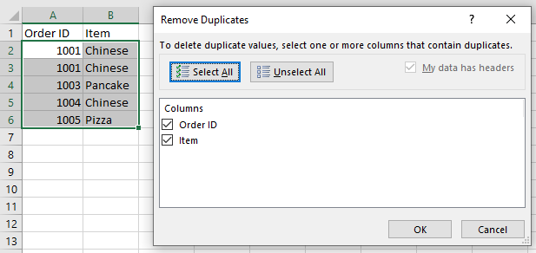
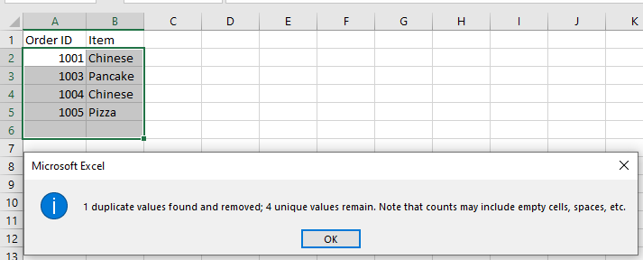
Remove Duplicates
21 RemoveDuplicates.xlsx
Select data range.
Choose Data > Data Tools > Remove Duplicates

Slide 45
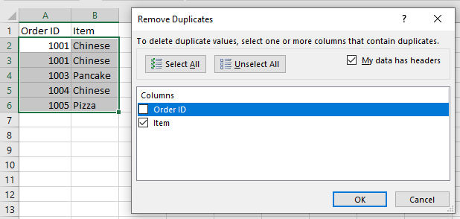
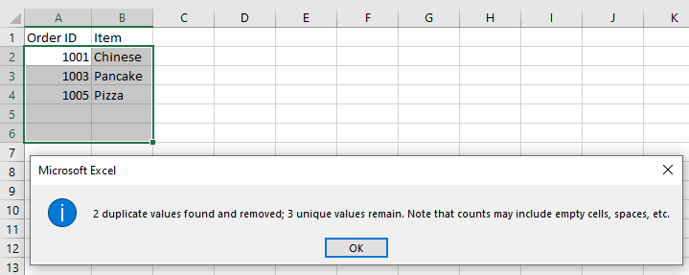
Remove Duplicates
22 RemoveDuplicates3.xlsx
Select data range.
Choose Data > Data Tools > Remove Duplicates

Slide 46
Exercise 4
23 Exercise4.xlsx
Remove entire row based on the name duplicates!
Name | State
Harry | Arizona
William | Texas
Sean | New York
Sarah | Washington
Tom | Georgia
Thomas | California
Tim | North Carolina
Sammy | Oregon
Harry | New York
Tina | Washington
Sean | Delaware
Jack | Arkansas
Jack | Florida

Slide 47
Exercise 5
24 Exercise5.xlsx
Remove duplicates only for rows where the name and the car model are the same.
Name | State | Car Model
Harry | Arizona | Toyota
William | Texas | Dodge
Sean | New York | Honda
Sarah | Washington | BMW
Tom | Georgia | Ford
Thomas | California | Lexus
Tim | North Carolina | Seat
Sammy | Oregon | VW
Harry | New York | Toyota
Tina | Washington | Audi
Sean | Delaware | Mercedes
Jack | Arkansas | Mini
Jack | Florida | Porsche

Slide 48
Flash Fill

Slide 49
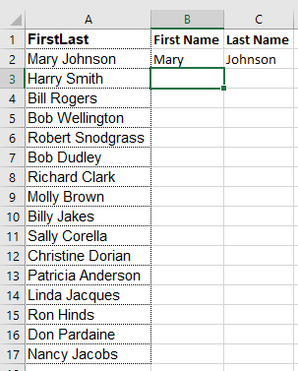
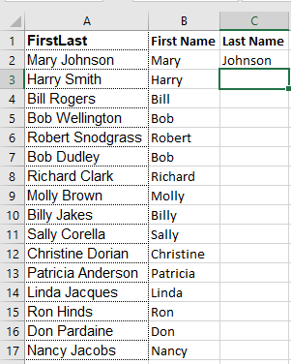
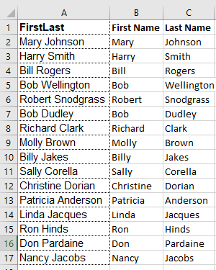
Flash Fill
25 FlashFill1.xlsx
It is used to extract data from a cell based on a pattern.
Point to B3 and Choose Data > Flash Fill or Press Ctrl-e.
Point to C3 and Choose Data > Flash Fill or Press Ctrl-e.

Slide 50
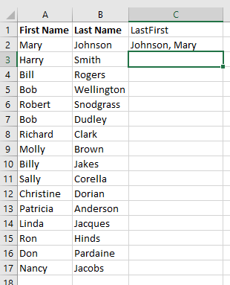
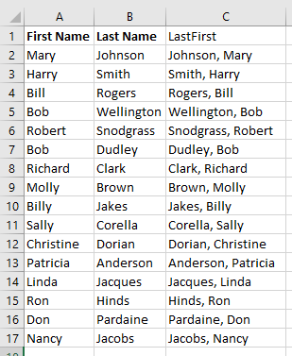
Flash Fill
26 FlashFill2.xlsx
It is used to join data from multiple cells based on a pattern
Point to C3 and Choose Data > Flash Fill or Press Ctrl-e.

Slide 51
Exercise 6
27 Exercise6.xlsx
Create an email for each student from the student name as shown:
Fortatto, Melissa => Melissa.Fo@kmitl.ac.th

Slide 52
Consolidate

Slide 53
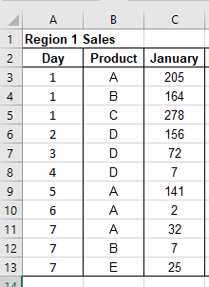
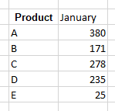
Data Consolidation
Data consolidation in Excel is the process of bringing similar data from multiple sources to one place, which can provide a unified view for better analytics.
>>>>>>>

Slide 54
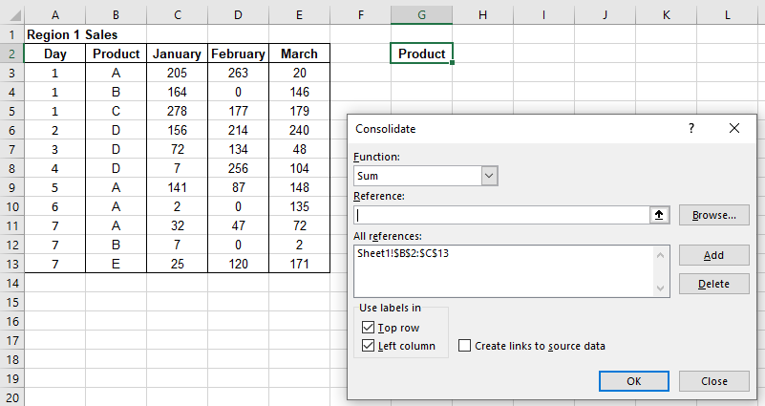
Consolidate Data from Multiple Rows
28 Consolidate1.xlsx
Point to G2 and Choose Data > Consolidate
Specify reference Sheet1!$B$2:$C$13 (including header) and add to the list
Choose Top row and Left column
>>>>>>>

Slide 55


Consolidate Data from Multiple Rows
29 Consolidate2.xlsx
Point to G3 and Choose Data > Consolidate
Specify reference Sheet1!$B$3:$C$13 (excluding header) and add to the list
Choose Left column
>>>>>>>

Slide 56


Consolidate Data from Multiple Ranges
30 ConsolidateMultipleRange.xlsx
Point to G12 and Choose Data > Consolidate
Specify reference Sheet1!$B$2:$C$13 and Sheet1!$H$2:$I$10 (including header) and add to the list
Choose Top row and Left column
>>>

Slide 57


Consolidate Data from Multiple Worksheets
31 ConsolidateMultipleWorksheet.xlsx
Point to A1 and Choose Data > Consolidate
Specify reference Region1!$B$2:$C$13 and Region2!$B$2:$C$10 (including header) and add to the list
Choose Top row and Left column
>>>

Slide 58


Consolidate Data from Multiple Workbooks
32 AllRegion.xlsx; 32 Region1.xlsx; 32 Region2.xlsx
Point to A1 the workbook AllRegion of and Choose Data > Consolidate
Specify reference [Region1.xlsx]Sheet1!$B$2:$C$13 and [Region2.xlsx]Sheet1!$B$2:$C$10 (including header) and add to the list
Choose Top row and Left column
>>>

Slide 59
Exercise 6
33 Exercise6.xlsx
The data given below presents the sales transactions for different products in two different regions. Perform the following data consolidations:
a. Identify the Max sales (over both regions) for each product in each month.
b. Count the number of sales made (over both regions) for each product during the three months period.

Slide 60
Exercise 7
34 Exercise7.xlsx
A professor saved the results from three different exams he gave in his class, in three worksheets. Use Consolidate tool to create the following in the Summary worksheet:
a. A table that presents for each student the identification number, as well as the grades of the three exams.
b. A table that presents the average exam grade for each student.
c. A table that presents the maximum grade received in an exam for each student.
d. A table that presents the minimum grade received in an exam for each student.

Slide 61
Sort and Filter

Slide 62

Sort
35 Sorting.xlsx
Sorting is the ordering of all entries in a data range by a particular column, where a column is the name of a category.
Highlight data range, including the headers, then choose Data > Sort from the menu.
The data can be sorted in Ascending or Descending order.

Slide 63

Sorted by Attendance in Descending order, with the Student Names also sorted in Ascending order
36 multipleSorting.xlsx

Slide 64

Filter
37 filtering.xlsx
Select data range
Choose Data > Filter
Click on an arrow of the column you want to filter data and specify your need

Slide 65
Protect

Slide 66

Protect
Encrypt an Excel file with a password so that it requires a password to open it.
1. Open an Excel file.
2. On the File tab, click Save As.
3. Click Browse.

Slide 67

Protect
4. Click on the Tools button and click General Options.

Slide 68


Protect
5. In the Password to open box, enter a password and click OK.
6. Reenter the password and click OK.

Slide 69

Protect
7. Enter a file name and click Save.

