Slide 1
FROM EXCEL TO EXCELLENT
Lookup Techniques

Slide 2
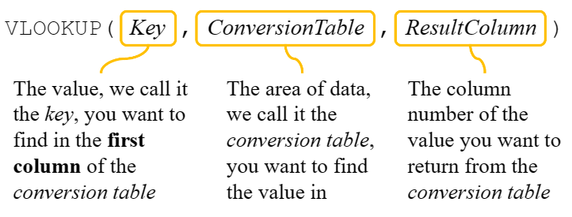
The VLOOKUP Function
The general idea of VLOOKUP is to find something inside an area of data and then return the corresponding ‘answer’
Here is the function:

Slide 3
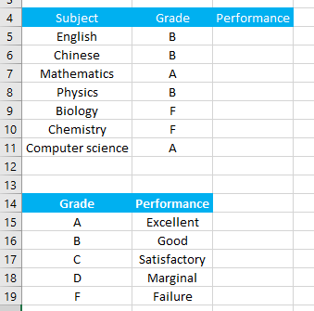
A Simple Example
1 VLOOKUP.xlsx
For example, you can use VLOOKUP to find the performance definition

Slide 4
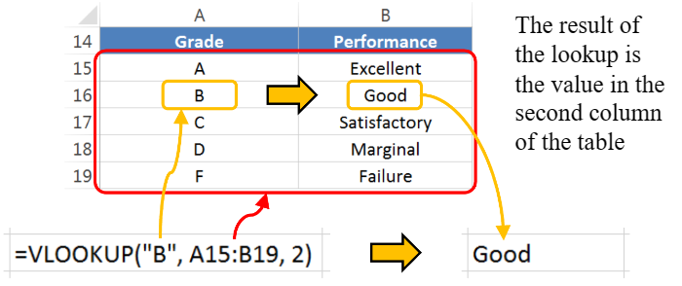
A Simple Example
You can use VLOOKUP to find the performance definition of “B” to be shown in A1 as shown:

Slide 5
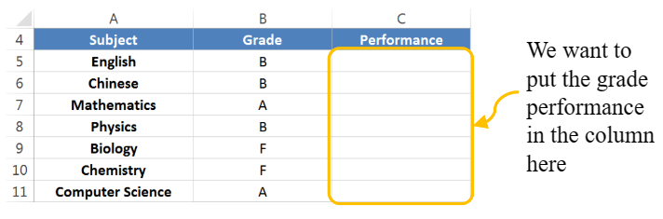
The Grade Performance Example 1/3
Let’s say we need to find the grade performance of a list of subject grades, like this:
One way to do this is to fill in the formula in cell C5 and then copy and paste it to the rest.

Slide 6
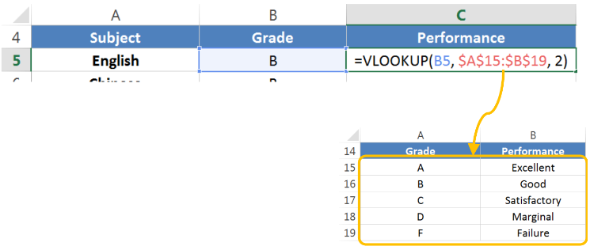
The Grade Performance Example 2/3
We first enter the formula using VLOOKUP in the first row of the subject list, like this:
Note that we need to use absolute reference for the conversion table because we don’t want it to change when the formula is copied and pasted later

Slide 7
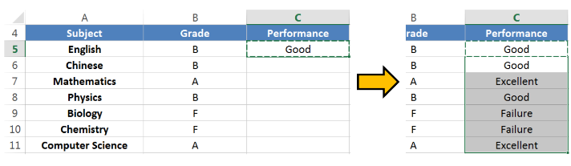
The Grade Performance Example 3/3
Then we copy and paste the formula from the first row to the rest of the column
The grade performance will be shown correctly for each subject in the list.

Slide 8
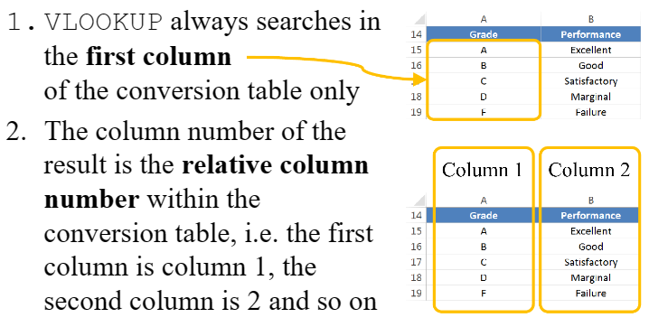
Things to Remember Using VLOOKUP

Slide 9
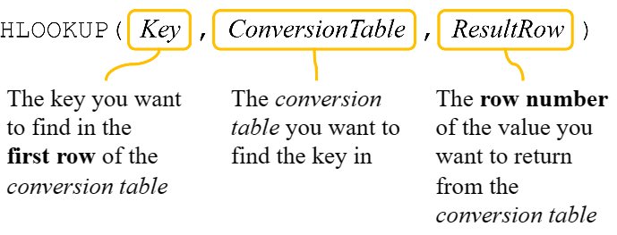
The HLOOKUP Function
HLOOKUP is very similar to VLOOKUP
The only difference is that HLOOKUP has a conversion table which is organised horizontally

Slide 10
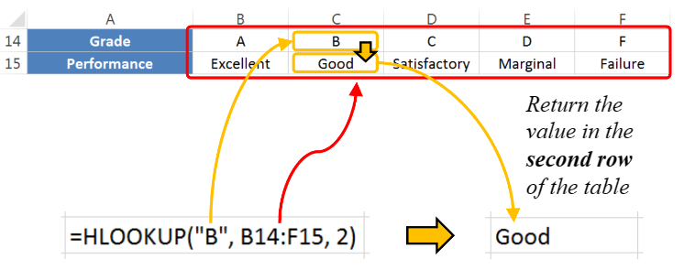
A Simple Example Using HLOOKUP
2 HLOOKUP.xlsx
Let’s use the same grade example for HLOOKUP with a different conversion table

Slide 11
Approximate Matching
Sometimes the key may not exist in the conversion table and you need the closest match
The closest match means returning a result with the closest value smaller than or equal to the value being looked up
If there isn’t a value smaller than or equal to the value being looked up, then an error is returned
This is called approximate matching

Slide 12
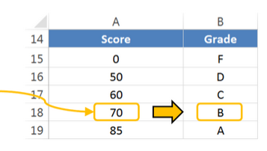
A Example Using Approximate Matching
Let’s look at an example with approximate matching
The conversion table in the example is used to determine a letter grade based on the score of a course, which is shown below:
For example, if the key value is73, the highest score less than key is 70, so ‘B’is returned as the grade
73

Slide 13
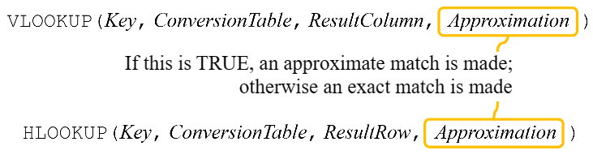
Approximate Matching in VLOOLUP and HLOOKUP
By default, both VLOOKUP and HLOOKUP use approximate matching
You can optionally turn off approximate matching using an additional fourth parameter, like this:

Slide 14
Approximate Matching in VLOOLUP and HLOOKUP
By default, both VLOOKUP and HLOOKUP use approximate matching
You can optionally turn off approximate matching using an additional fourth parameter, like this:

Slide 15
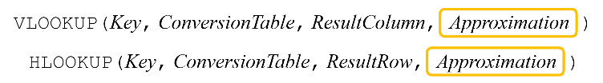
The Fourth Parameter
If this fourth parameter is missing, Excel assumes you want approximate matching anyway
However, if this parameter is FALSE then an approximate match is not made, and an error message will be produced if you try to look up something which isn’t in the conversion table
We call it exact matching if the fourth parameter is FALSE

Slide 16
For Approximate Matching, Conversion Table Must Be Sorted
There is one very important thing to remember if you want to use approximate matching: The data in the conversion table must be sorted
That means, if the conversion table uses numbers, those numbers must be in increasing order
Similarly, if the conversion table uses words, those words must be in alphabetical order (If you do exact matching, you do not need to sort the conversion table)

Slide 17
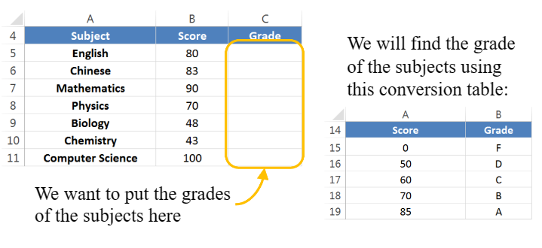
A Grading Example 1/2
3 ApproxMatching.xlsx
Let’s use approximate matching to find the grades of a list of subjects using the conversion table shown in the previous example

Slide 18
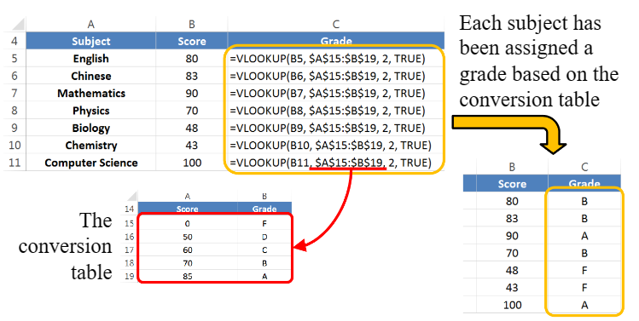
A Grading Example 2/2
We use formulas which explicitly turn on approximate matching using the fourth parameter

Slide 19
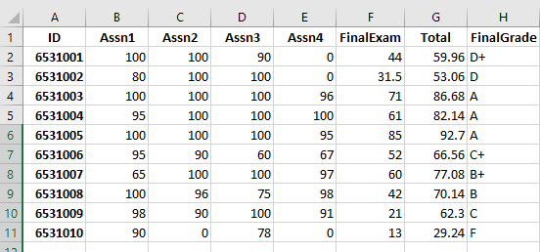
Exercise 1
4 Exercise 1.xlsx
Fill in H2 with the VLOOKUP formula to determine grade and copy to the rest so the result is as shown:
Range | Grade
80-100 | A
76-79 | B+
70-75 | B
66-69 | C+
60-65 | C
56-59 | D+
50-55 | D
0-49 | F

Slide 20
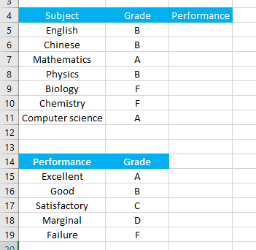
A Search Column is not the First Column
5 VLOOKUPLeft.xlsx
We want to use VLOOKUP to find the performance definition on the left column of the table

Slide 21
CHOOSE FUNCTION
=CHOOSE(ARRAY DIMENSIONS(INDEX VALUE(S)), VALUE(1), VALUE(2), VALUE(3),.....)
Array dimensions : define how many columns should the array have.
The next parameter(s) will define what value will go in the subsequent array columns, ie VALUE1 will get filled in the first column, and so on.

Slide 22
VLOOKUP with CHOOSE FUNCTION
We can define a table for VLOOKUP with CHOOSE function.
Fill B5 with the formula:
=VLOOKUP(B5,CHOOSE({1,2},$B$15:$B$19,$A$15:$A$19),2)
Array is Horizontal.
We can treat the Array {1,2} as the following range:
|1|2| ==> B15 A15
B16 A16
B17 A17
B18 A18
B19 A19

Slide 23
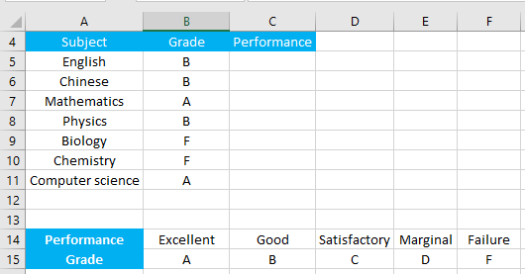
HLOOKUP with CHOOSE FUNCTION
6 HLOOKUPAbove.xlsx
We can define a table for HLOOKUP with CHOOSE function.
Fill B5 with the formula:
==HLOOKUP(B5,CHOOSE({1,2},$B$15:$F$15,$B$14:$F$14),2)
The Array {1,2} is as the following range:
B15 C15 D15 E15 F15 B14 C14 D14 E14 F14

Slide 24
HLOOKUP with CHOOSE FUNCTION
We can define a table for HLOOKUP with CHOOSE function.
Fill B5 with the formula:
=HLOOKUP(B5,CHOOSE({1;2},$B$15:$F$15,$B$14:$F$14),2)
We can treat the Array {1;2} as the following range:
|1|
|2|
B15 C15 D15 E15 F15
B14 C14 D14 E14 F14

Slide 25
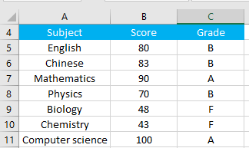
Exercise 2
7 Exercise2.xlsx
Fill in C5 with the VLOOKUP formula and CHOOSE() function to determine grade and copy to the rest so the result is as shown:

Slide 26
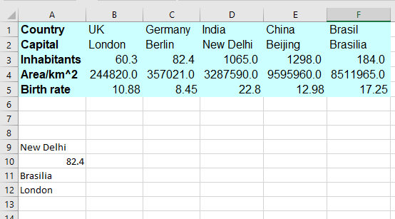
Exercise 3
8 Exercise3.xlsx
Consider the following table and complete the following formula so that the result is as shown:
A9 =HLOOKUP(”India”,A1:F5,***,FALSE)
A10 =HLOOKUP(”Berlin”,***,FALSE)
A11 =HLOOKUP(”Wales”,***,2,***)
A12 =VLOOKUP(***,A1:F5,***,FALSE)

Slide 27
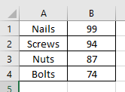
More on CHOOSE function
9 Choose.xlsx
Try the following in cell D1, D2, D3, D4, D5, respectively.
=CHOOSE(2,A1,A2,A3,A4)
=CHOOSE(4,A1,A2,A3,A4)
=CHOOSE(2,"hello",2,"world")
=SUM(B1:CHOOSE(2,B2,B3,B$4))
=SUM(CHOOSE(2,A1:A4,B1:B4))

Slide 28
INDEX and MATCH
Horizontal and vertical lookups
2-way lookups
Left lookups
Case-sensitive lookups
Lookups based on multiple criteria

Slide 29
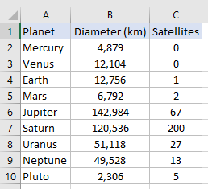
Index
10 Index.xlsx
Get a value in a list or table based on location.
=INDEX(array, row_num, [col_num], [area_num])
Fill in E1 with =INDEX(A2:A10,3).
Fill in E2 with =INDEX(A2:C10,3,2).
Fill in E3 with =INDEX((A2:C4, A5:C10),3,1,2)
Want to know the number of Satellites of the Jupiter?

Slide 30
Match
10 Index.xlsx
Get the position of an item in an array
=MATCH(lookup_value, lookup_array, [match_type])
Want to know the number of Satellites of the Jupiter?
Fill in E4 with
=INDEX(A2:C10,MATCH("Jupiter",A2:A10,0),3)

Slide 31
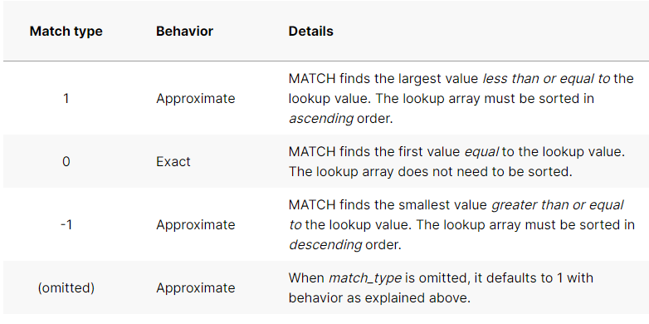
Match
=INDEX(A2:C10,MATCH("Jupiter",A2:A10,0),3)

Slide 32
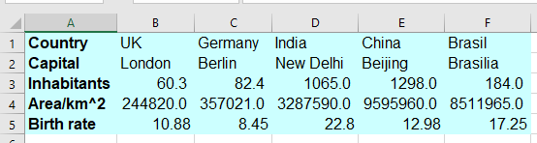
2-way Lookups
11 TwoWayLookups.xlsx
Support both horizontal and vertical ranges.
=MATCH(“Germany",B1:F1,0)
=MATCH(“Birth rate",A2:A5,0)
Find Birth rate of Germany.

Slide 33
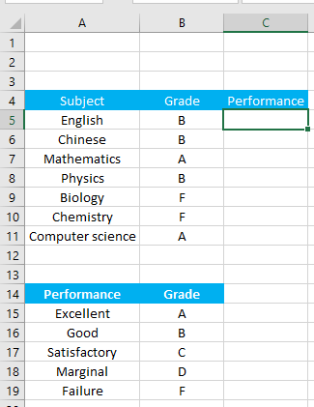
Left Lookups
12 LeftLookups.xlsx
Find the performance definition on the left column of the table with INDEX and Match.
Fill C5 with the following formula and copy to the rest.
=INDEX($A$15:$A$19,MATCH(B5,$B$15:$B$19))

Slide 34
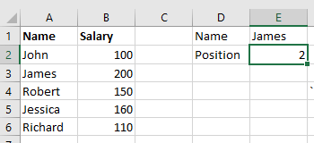
Case-sensitive Lookups
13 CaseSensitive.xlsx
The generic case-sensitive formula to match data:
MATCH(TRUE, EXACT(lookup array, lookup value), 0)
Fill E2 with the following and press Ctrl+Shift+Enter at the formula:
=MATCH(TRUE,EXACT(E1, A2:A6),0)

Slide 35
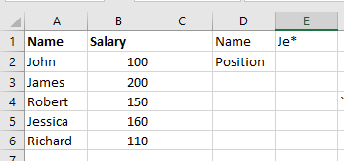
Partial Match with Wildcards
14 PartialMatch.xlsx
MATCH understands the following wildcard characters:
Question mark (?) - replaces any single character
Asterisk (*) - replaces any sequence of characters
Fill E2 with the following:
=MATCH( E1, A2:A6,0)

Slide 36
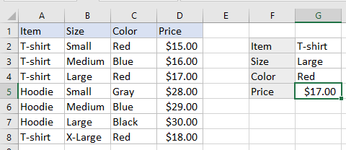
Lookups based on Multiple Criteria
15 MultiCriteria.xlsx
Fill G5 with the following and press Ctrl+Shift+Enter at the formula:
=INDEX(D2:D8,MATCH(1,(G2=A2:A8)*(G3=B2:B8)*(G4=C2:C8),0))

Slide 37
Notes on Match Function
The Match returns the relative position of the lookup value in the array.
The Match is case-insensitive.
If there are several occurrences of the lookup value, Excel returns the position of the first value.
If the lookup value is not found in the lookup array, the #N/A is return.

Slide 38
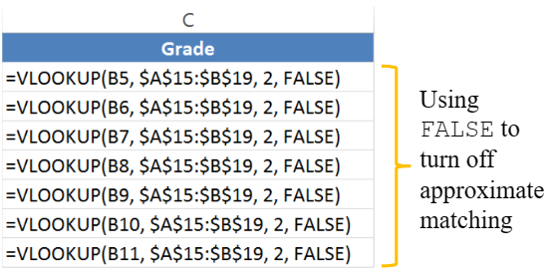
What Happens If We Turn off Approximate Matching?
16 ExactMatching.xlsx
Let’s turn off approximate matching, i.e. let’s use exact matching, in the previous example by changing the formulas so they look like this:

Slide 39
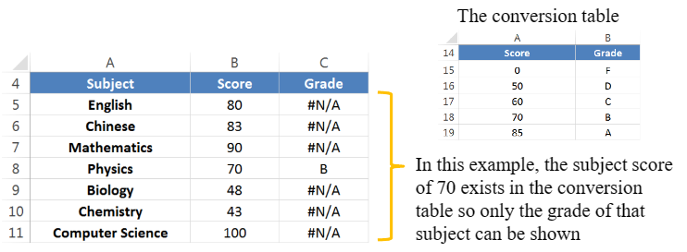
The #N/A Error
If we use exact matching any subject score which does not exist in the conversion table gives you a result of #N/A
#N/A means ‘not available’, i.e. the key that we look for is not available in the conversion table

Slide 40
Handling the #N/A Error
You can handle the ‘not available’ error using the ISNA function
The ISNA function will return TRUE if a lookup function generates the ‘not available’ error; otherwise, it will return FALSE
Typically, you combine the IF function and the ISNA function if you don’t want to show the error
Let’s try the following in cell C5 and copy to the rest: =IF(ISNA(VLOOKUP(B5,A15:B19,2,FALSE)), "-",VLOOKUP(B5,$A$15:$B$19,2))
And do the same with
= IFNA(VLOOKUP(B5,A15:B19,2,FALSE), "-“)

Slide 41
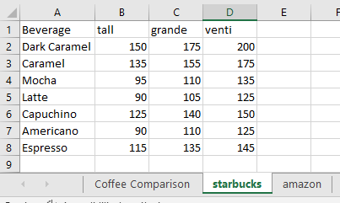
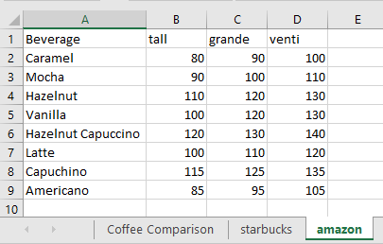
Example: Handling the #N/A Error
17 ComparePrice.xlsx
The drink prices are stored in two other separate worksheets for each of Starbucks and Amazon

Slide 42
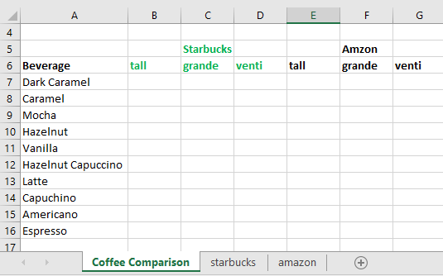
Example: Handling the #N/A Error
We want to show the price comparison of drinks between Starbucks and Amazon on the worksheet “Coffee Comparison”.

Slide 43
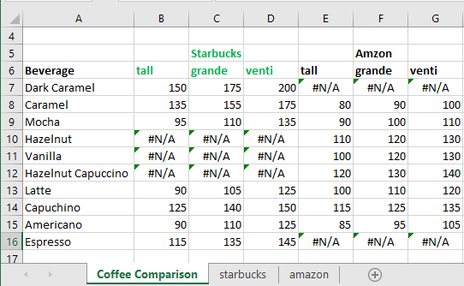
Example: Handling the #N/A Error
The prices of the drinks are then searched in the corresponding company’s worksheet using VLOOKUP, like this: =VLOOKUP($A7,starbucks!$A$2:$D$8,2, FALSE) in B7
However, if the drink is not found, #N/A will be generated:

Slide 44
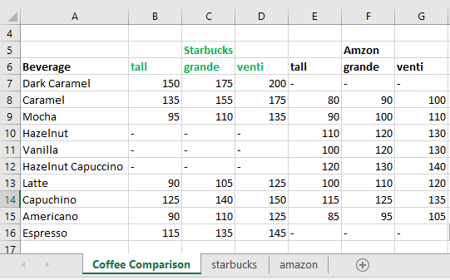
Example: Handling the #N/A Error Using ISNA
To avoid showing #N/A, the formula is changed so that a dash (a hyphen) is shown instead
We can use ISNA together with IF, like this:
=IF(ISNA(VLOOKUP($A7,starbucks!$A$2:$D$8,2, FALSE)), "-", VLOOKUP($A7,starbucks!$A$2:$D$8,2, FALSE))

Slide 45
Example: Handling the #N/A Error Using IFNA
In the previous formula, the VLOOKUP function has been entered twice, which is not very efficient
Excel gives you an alternative to write the formula efficiently using IFNA, as shown below:
=IFNA(VLOOKUP($A7,starbucks!$A$2:$D$8,2, FALSE), "-")

Slide 46
Example: Handling the #N/A Error Using ISERROR and IFERROR
We can also use ISERROR and IFERROR to handle the #N/A returned by the lookup functions
ISERROR and IFERROR work in a similar way to the ones we have learned for #N/A
=IF(ISERROR(VLOOKUP($A7,starbucks!$A$2:$D$8,2, FALSE)), "-", VLOOKUP($A7,starbucks!$A$2:$D$8,2, FALSE))
=IFERROR(VLOOKUP($A7,starbucks!$A$2:$D$8,2, FALSE), "-")
The difference is that ISERROR and IFERROR can handle all kinds of Excel formula errors

