Slide 1
FROM EXCEL TO EXCELLENT
Conditional Formatting

Slide 2

What is Conditional formatting?
1 Duplicate.xlsx
Conditional formatting allows us to highlight cells that meet a specified condition.
For example, the following highlights cells with duplicated data.

Slide 3
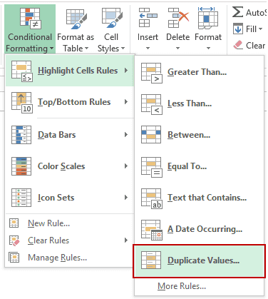
Showing Duplicate Values
Select the data range we want to highlight duplicate.
Go to Home –> Conditional Formatting –> Highlighting Cell Rules –> Duplicate Values.

Slide 4
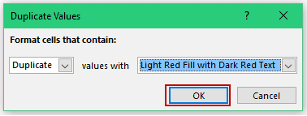
Showing Duplicate Values
Click OK.
We get the following highlighted cells.

Slide 5
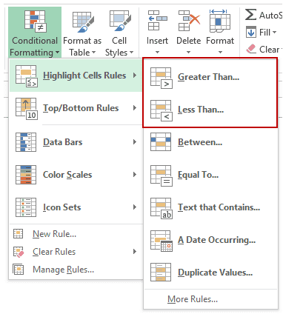
Showing Cells with Value Greater/Less than a Number
2 GreaterThan.xlsx
Select the data range.
Go to Home –> Conditional Formatting –> Highlighting Cell Rules –> Greater Than.. / Less Than..

Slide 6
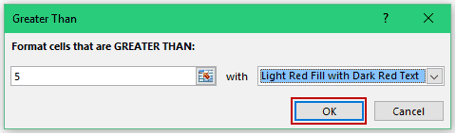
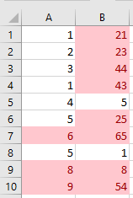
Showing Cells with Value Greater/Less than a Number
Click OK.
We get the following highlighted cells.

Slide 7
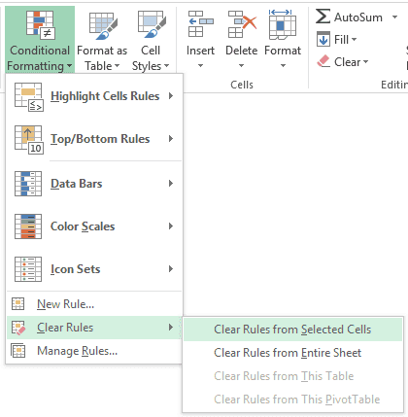
Remove Conditional Formatting
Select the data range.
Go to Home –> Conditional Formatting –> Clear Rules –> Clear Rules from Selected Cells.
If you want to remove conditional formatting from the entire worksheet, select Clear Rules from Entire Sheet.

Slide 8
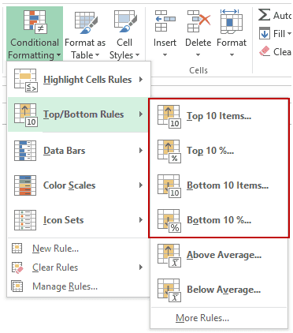
Showing Top/Bottom 10 (or 10%)
3 TopBottom.xlsx
Select the data range.
Go to Home –> Conditional Formatting –> Top/Bottom Rules –> Top 10 Items (or %) / Bottom 10 Items (or %).

Slide 9
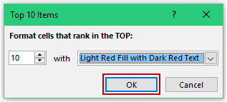
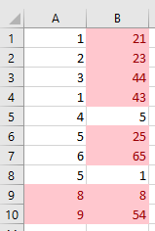
Showing Top/Bottom 10 (or 10%)
Click OK.
We get the following highlighted cells.
Try Top 10%, Bottom 10, and Bottom 10%

Slide 10

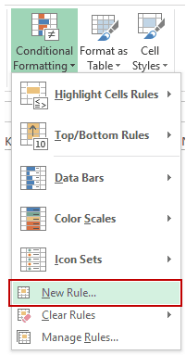
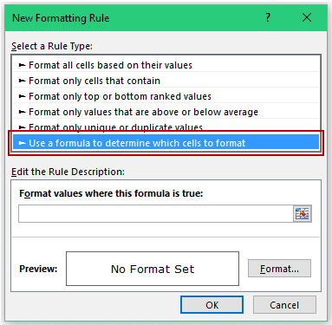
Showing Errors/Blanks
4 ShowError.xlsx
Select the data range.
Go to Home –> Conditional Formatting –> New Rule.

Slide 11
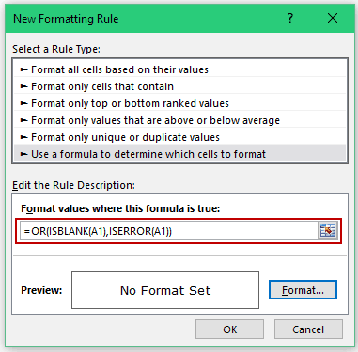
Showing Errors/Blanks
Enter the following formula in the field in the ‘Edit the Rule Description’ section:
=OR(ISBLANK(A1),ISERROR(A1))

Slide 12
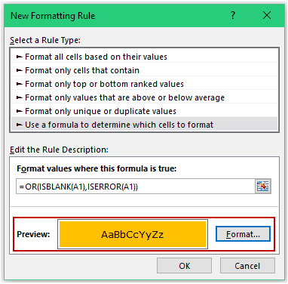
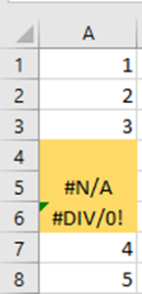
Showing Errors/Blanks
Set the format that you want to apply to the cells that are blank or have errors. To do this, click on the Format button. It will open the ‘Format Cells’ dialogue box, where you can specify the format.
Click OK.

Slide 13
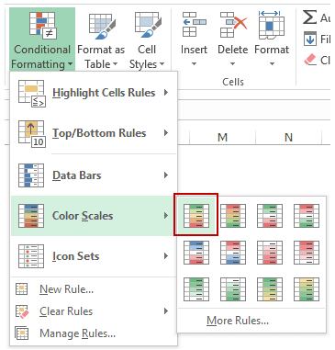
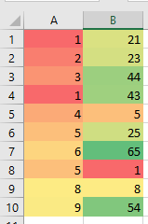
Creating Heat Maps
5 HeatMaps.xlsx
Select the data range.
Go to Home –> Conditional Formatting –> Color Scales, and choose one of the color schemes.
Try Data Bars.

Slide 14
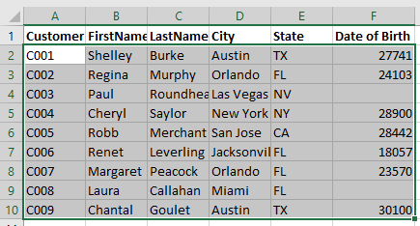
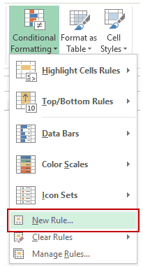
Showing Every Other Row/Column
6 HighlightRows.xlsx
Select the data range.
Open the Conditional Formatting dialogue box (Home–> Conditional Formatting–> New Rule.

Slide 15
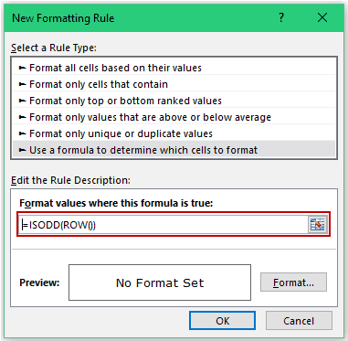
Showing Every Other Row/Column
Enter the following formula in the field in the ‘Edit the Rule Description’ section:
=ISODD(ROW())

Slide 16
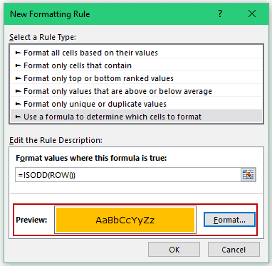
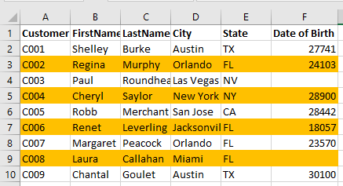
Showing Every Other Row/Column
Specify format, and click OK.
Try:
Highlight alternate even rows: =ISEVEN(ROW())
Highlight every 3rd row: =MOD(ROW(),3)=0
Can also try Column

Slide 17
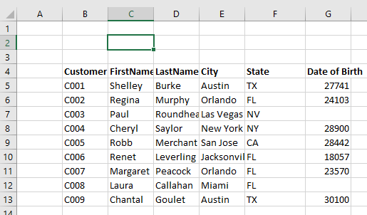
Search and Highlight Data using Conditional Formatting
7 HighlightSearch.xlsx
We want to input a string in cell C2, and if it matches with the data in any cell(s) in data range, then that should get highlighted.

Slide 18
Search and Highlight Data using Conditional Formatting
Select the data range.
Home–> Conditional Formatting–> New Rule.

Slide 19
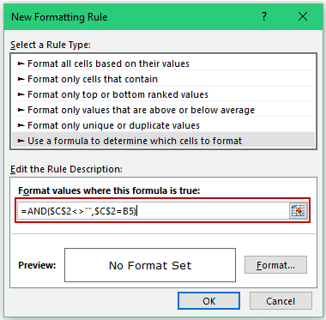
Search and Highlight Data using Conditional Formatting
Enter the following formula in the field in the ‘Edit the Rule Description’ section:
=AND($C$2<>””,$C$2=B5)

Slide 20
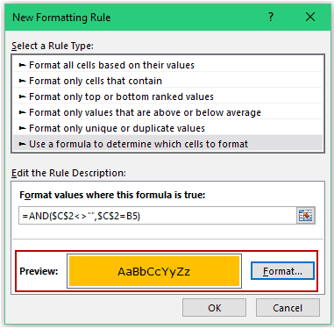
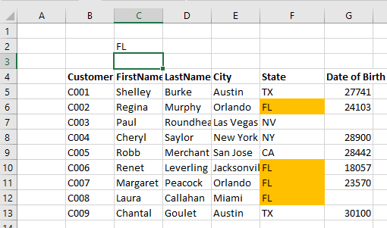
Search and Highlight Data using Conditional Formatting
Specify format, and click OK.

Slide 21
Search and Highlight Rows with Data using Conditional Formatting
8 HighlightSearchRows.xlsx
Select the data range.
Home–> Conditional Formatting–> New Rule.

Slide 22
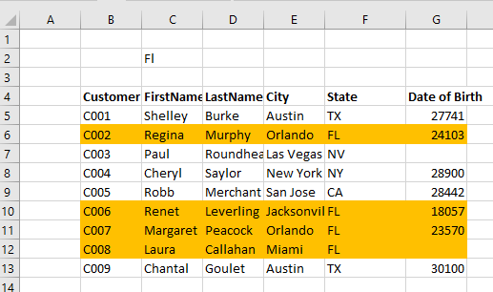
Search and Highlight Rows with Data using Conditional Formatting
Enter the following formula in the field in the ‘Edit the Rule Description’ section:
=AND($C$2<>"",OR($C$2=$B5:$G5))
Specify format, and click OK.

Slide 23
Search and Highlight Rows with Data using Conditional Formatting based on Partial Match
9 HighlightSearchRowsPartial.xlsx
Select the data range.
Home–> Conditional Formatting–> New Rule.

Slide 24
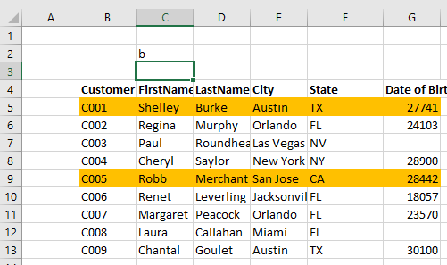
Search and Highlight Rows with Data using Conditional Formatting based on Partial Match
Enter the following formula in the field in the ‘Edit the Rule Description’ section:
=AND($C$2<>"",OR(ISNUMBER(SEARCH($C$2,$B5:$G5))))
Specify format, and click OK.

Slide 25
Search and Highlight Rows with Data using Conditional Formatting based on Partial Match
=AND($C$2<>"",OR(ISNUMBER(SEARCH($C$2,$B5:$G5))))
SEARCH function looks for the search string/keyword in all the cells in a row. It returns an error if the search keyword is not found, and returns a number if it finds a match.
ISNUMBER function converts the error into FALSE and the numeric values into TRUE.
AND function checks for an additional condition – that cell C2 should not be empty.
If you want to make the search case sensitive, use the FIND Function instead of SEARCH.

Slide 26
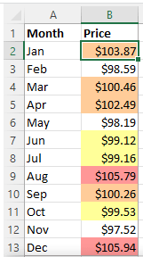
Multiple Conditional Formatting Rules
10 MultipleRules.xlsx
When using conditional formats in Excel, you are not limited to only one rule per cell. You can apply as many rules as your business logic requires.
For example, you can create 3 rules to highlight prices higher than $105 in red, higher than $100 in orange, and higher than $99 in yellow. For the rules to work correctly, you need to arrange them in the right order.

Slide 27
Multiple Conditional Formatting Rules
To re-arrange the rules, this is what you need to do:
Select any cell in your dataset covered by the rules.
Open the Rules Manager by clicking Conditional Formatting > Manage Rules…
Click the rule that needs to be applied first, and then use the upward arrow to move it to top. Do the same for the second-in-priority rule.
Select the Stop If True check box next to all but the last rule because you do not want the subsequent rules to be applied when the prior condition is met.

Slide 28
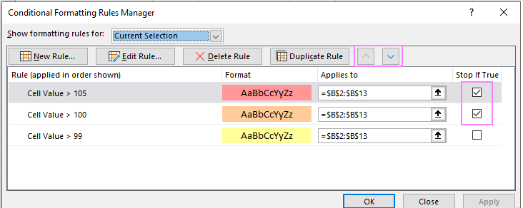
Multiple Conditional Formatting Rules

Slide 29
Exercise 1
11 Exercise1.xlsx
A professor is reviewing her students’ grades for the semester. Using conditional formatting, help her find the A’s (85 and above)by highlighting them in red, the B’s (75 to 84) by highlighting them in yellow, and the F’s (less than 75) by highlighting them in blue.
Extra points: Highlighting an entire row.

