Slide 1
FROM EXCEL TO EXCELLENT
Pivot Tables

Slide 2
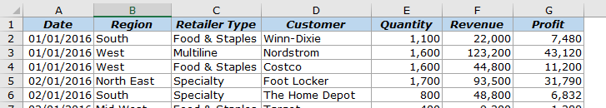
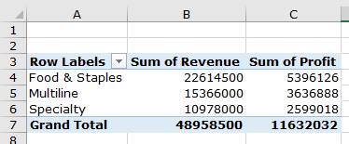
What is a Pivot Table?
A tool in Microsoft Excel that allows us to quickly summarize huge datasets.
We want to summarize revenue and profit by retailer type as shown from the sale data of 1000 rows.

Slide 3
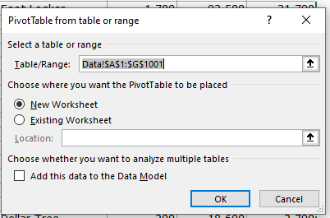
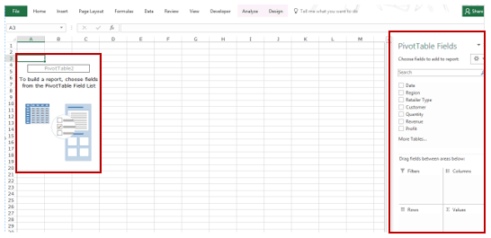
Inserting a Pivot Table
12 Pivot-Table-Data.xlsx
Click anywhere in the dataset.
Go to Insert –> Tables –> Pivot Table.
Click Ok. There are the Pivot Table name and a single line instruction on the left, and Pivot Table Fields on the right.

Slide 4
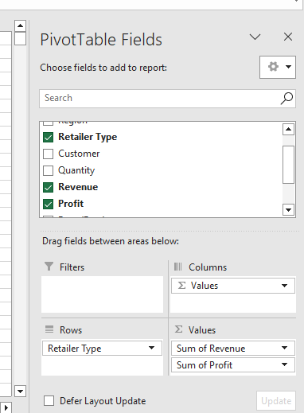
Inserting a Pivot Table
Click to choose Retailer Type, Revenue, and Profit on PivotTable Fields.

Slide 5
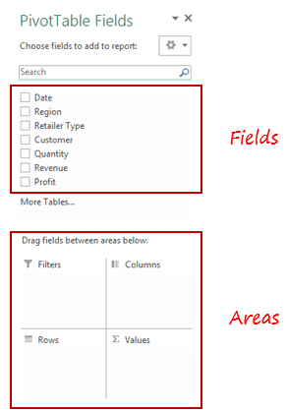
PivotTable Fields
The Fields are created based on the backend data used for the Pivot Table.
The Areas section is where you place the fields, and according to where a field goes, your data is updated in the Pivot Table.

Slide 6
Find Revenue by Region

Slide 7
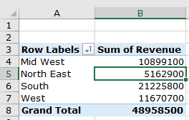
Find Revenue by Region
Drag the Region field in the Rows area and the Revenue field in the Values area.
It would automatically update the Pivot Table in the worksheet.

Slide 8
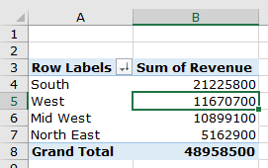
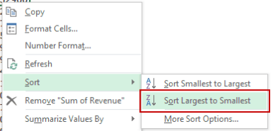
Find Revenue by Region Sorted by Total Revenue
By default, the items (in this case the Regions) are sorted in an alphabetical order.
Right-click on any cell in the Values area and choose Sort to sort based on the values.

Slide 9
Find Revenue by Customers Descending Sorted by Total Revenue
By default, the Customers are sorted in an alphabetical order.
Right-click on any cell in the Values area and choose Sort to sort based on the values.

Slide 10
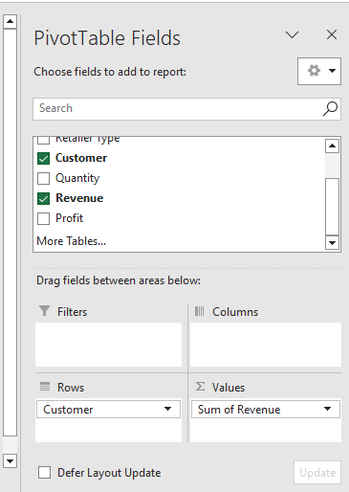
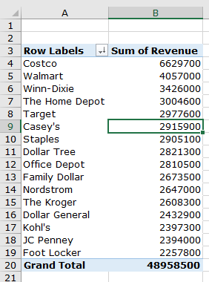
Find Revenue by Customers Descending Sorted by Total Revenue

Slide 11
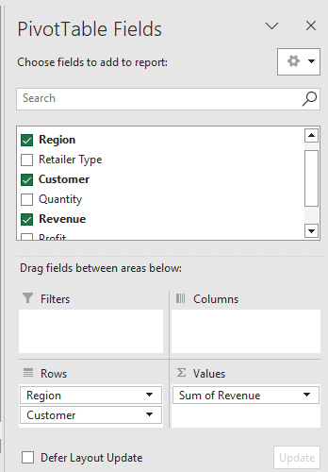
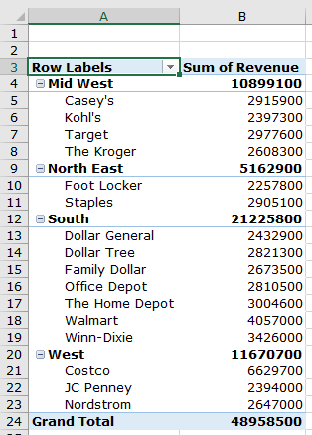
Find the Home Depot’s performance compared with other retailers in the South

Slide 12
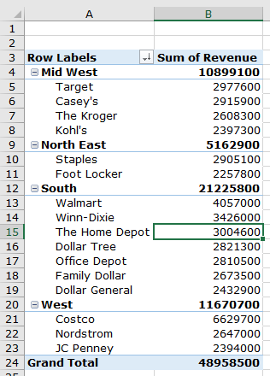
Find the Home Depot’s performance compared with other retailers in the South
Right-click on a cell that has the sales value for any retailer.
Go to Sort –> Sort Largest to Smallest.

Slide 13
Pivot Chart
A graphical representation of the data in a pivot table
Creating a Pivot Chart
Click any cell inside pivot table
Click the Insert tab on the ribbon
On the Insert tab, you can see the Charts group displaying the various types of charts you can create
Choose the chart type you would like to use for your pivot chart
Excel creates your pivot chart on the same sheet as your pivot table

Slide 14
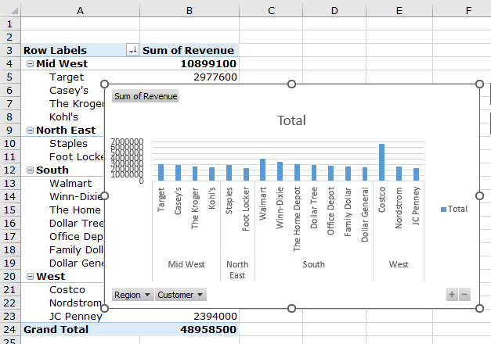
Pivot Chart
Clicking Collapse Entire Field (−) on the chart collapses the data series and aggregates the data points. You can click Expand Entire Field (+) to drill back down to the Customer level.

Slide 15
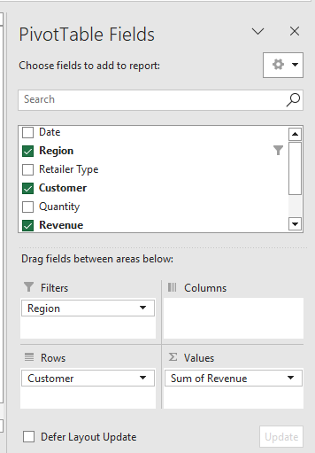
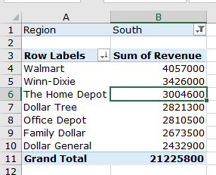
Find the Home Depot’s performance compared with other retailers in the South
Drag Region field to Filters area and choose South.

Slide 16
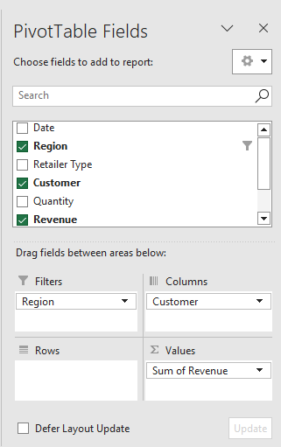
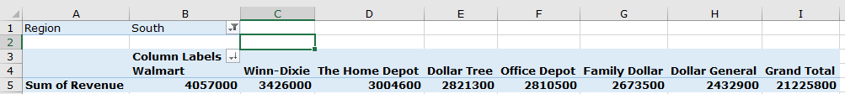
Find the Home Depot’s performance compared with other retailers in the South
Drag Customer field to Column area.

Slide 17
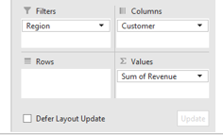
Updating PivotTable Layout
There is a check box for Defer Layout Update.
By default, it is unchecked, which means the PivotTable Layout gets updated as soon as you make changes in the PivotTable areas.
Check the option − Defer Layout Update.
The UPDATE button next to it will be enabled. If you make any changes to the PivotTable areas, the changes will be reflected only after you click on the UPDATE button.

Slide 18
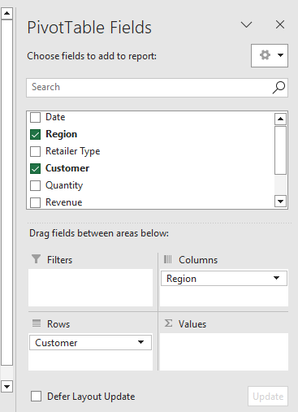
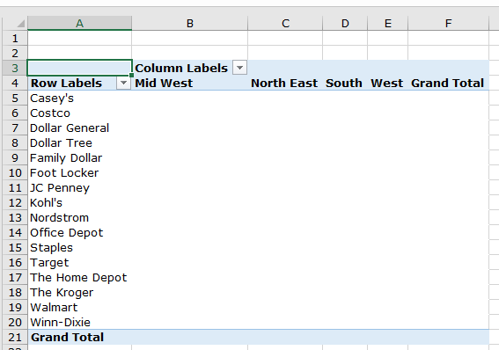
Rows Area and Columns Area

Slide 19
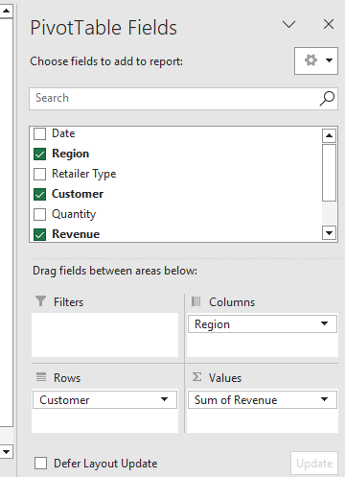
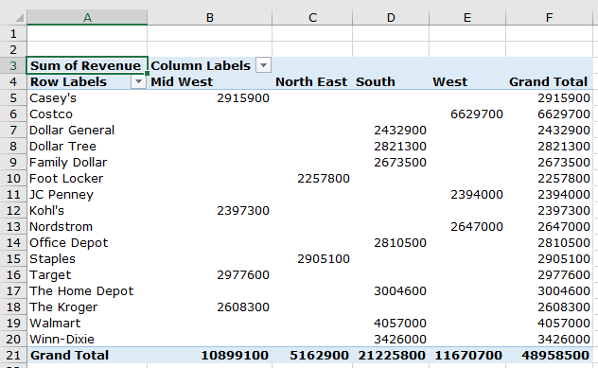
Values Area

Slide 20
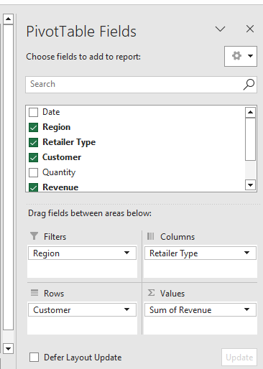
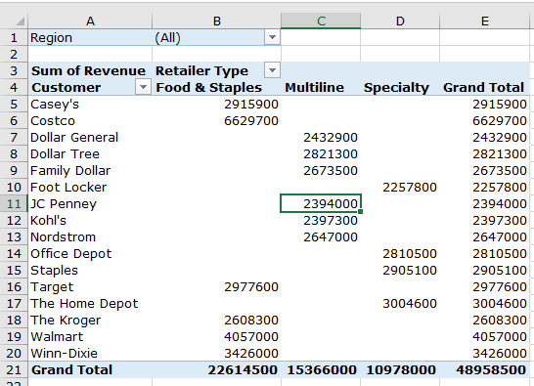
Types of Filters

Slide 21
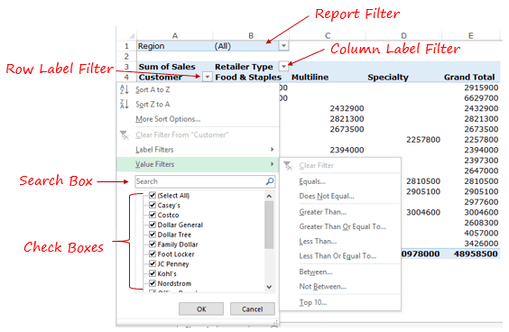
Types of Filters

Slide 22
Types of Filters
Report Filter: Allows us to drill down into a subset of the overall dataset.
Row/Column Label Filter: Allow us to filter relevant data based on the field items or the values.
Search Box: We can access this filter within the row/column label filter and this allows us to quickly filter based on the text you enter.
Check Boxes: Allow us to select specific items from a list.

Slide 23
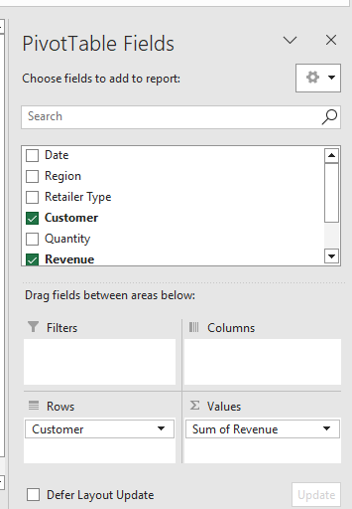
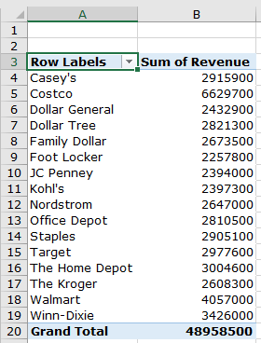
Filter Example

Slide 24
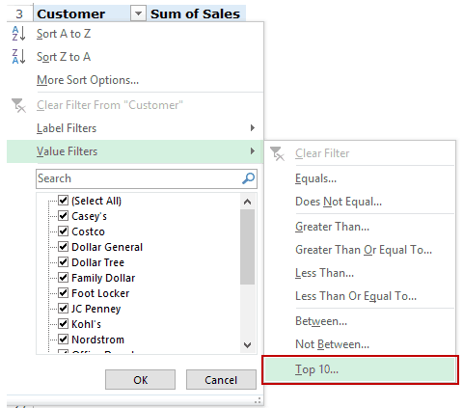
Filter Top/Bottom Items by Value
Find top 10 retailers based on the sales value.
Go to Row Label filter –> Value Filters –> Top 10.

Slide 25
Filter Top/Bottom Items by Value
Find top 10 retailers based on the sales value.
In the Top 10 Filter dialog box:
Top/Bottom: Select Top.
The Number of items you want to filter. In this case since we want to get top 10 items, this would be 10.
The third field is a drop down with three options: Items, Percent, and Sum. In this case, since we want the top 10 retailers, select Items.
The last field lists all the different values listed in the value area. In this case, since we only have the sum of sales, it shows ‘Sum of Sales’ only.

Slide 26
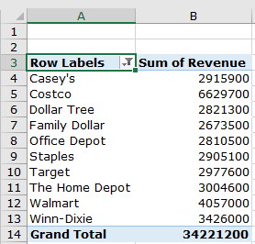
Filter Top/Bottom Items by Value
Find top 10 retailers based on the sales value.

Slide 27
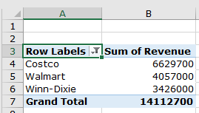
Filter Top/Bottom Items by Value
Find a list of top 25 percent of items by value.
Go to Row Label filter –> Value Filters –> Top 10.
In the Top 10 Filter dialog box:
Top/Bottom: Select Top.
The second field: Enter 25.
The third field: Select Percent.
The last field: Select Sum of Sales.

Slide 28
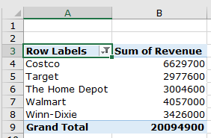
Filter Top/Bottom Items by Value
Find the top retailers that account for 20 million in sales.
Go to Row Label filter –> Value Filters –> Top 10.
In the Top 10 Filter dialog box:
Top/Bottom: Select Top.
The second field: Enter 20000000.
The third field: Select Sum.
The last field: Select Sum of Sales.

Slide 29
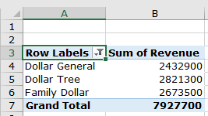
Filter Data Using Label Filters
Find all the dollar stores.
Go to Row Label filter –> Label Filters –> Contains.
In the label filter dialog box:
‘Contains’ is selected by default.
The second field: Enter ‘dollar’.
Click OK.

Slide 30
Filter Data Using Search Box
Find all the dollar stores.
Click on the Label filter drop down and then click on the search box to place the cursor in it.
Enter the search term, which is ‘dollar’.
Click OK.

Slide 31
Slicers
Slicer enables us to filter the data when you select one or more than one options

Slide 32
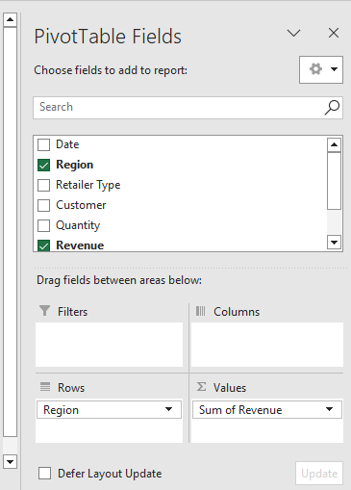
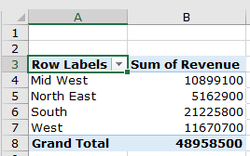
Slicer Example

Slide 33
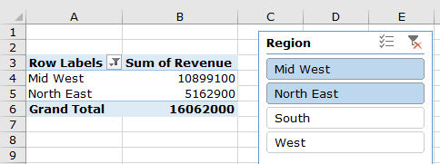
Slicer Example
Select any cell in the Pivot Table.
Go to Insert –> Filter –> Slicer.
In the Insert Slicers dialog box, select the dimension for which you the ability to filter the data. Select Region for this case.
Click OK.
To clear the selection, click on the filter icon (with a red cross) at the top right.

Slide 34
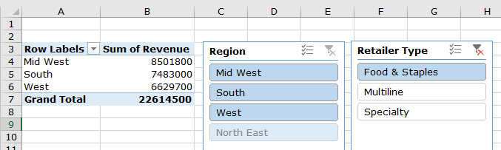
Multiple Slicers
Select any cell in the Pivot Table.
Go to Insert –> Filter –> Slicer.
In the Insert Slicers dialog box, select Region and Retailer Type.
Click OK.

Slide 35
Slicers Vs. Filters
Slicers don’t occupy a fixed cell in the worksheet. You can move these like any other object or shape. Report Filters are tied to a cell.
Report filters are linked to a specific Pivot Table. Slicers, on the other hand, can be linked to multiple Pivot.
Since a report filter occupies a fixed cell, it’s easier to automate it via VBA. On the other hand, a slicer is an object and would need a more complex code.

Slide 36
A Table of Data for a Pivot Table
To create a Pivot table, you need a table of data that complies with the following rules
No blank rows or empty columns
No total or subtotal rows
All the columns must have headers
Each header name is unique

Slide 37
Exercise 2
13 Exercise2.xlsx
A do-it-yourself retail center sells home care products in various categories, including cleaning, gardening, and hardware. The spreadsheet is used to forecast the demand of products in each of the product categories for the next four months for each of the center’s regions. Create a pivot table and a pivot chart that totals the demand for each type and category of product for each region.

