Slide 1
Seeing Through Fog
Clearer photos, so cars and people can still be found in fog
Vishal-24XV1M6606
Chetan-24XV1M6608
Sathwik-24XV1M6645
Based on: ADAM-Dehaze (arXiv:2506.15837) - our rebuild + improvement

Slide 2
Motivation
Fog hides objects in photos. Self-driving cars, traffic cameras and security systems all depend on photos.
Their object detectors were trained on clear days, so in fog they miss cars and people, or see things that aren't there.
Removing the fog is not the real goal - keeping the detector working is. In our test photo of a bus in heavy fog, it found 3 objects before dehazing and 7 after.
New application we will target
  Phone camera cleanup: one tap could clear the fog from a photo.
  Drones and security cameras could keep tracking in bad weather.

Slide 3
Objective
AIM
Rebuild the paper's fog-removal system, then improve it.
WHAT WE WILL DO
  A fog judge scores how foggy each photo is, sends it to the matching cleaner, then auto-checks the result.
  Try two cleaners side by side - the textbook recipe and the learner - and score both the same way.
OUTCOME
  We will produce cleaner photos and score them against the original clean photo.
  We want fewer missed cars and people, plus a scoreboard that compares the fixed recipe against our learner.

Slide 4
Method 1: the textbook fix (DCP)
HOW IT WORKS — Dark Channel Prior, no learning
  Step 1 finds the fog colour from the foggiest pixels.
  Step 2 guesses how much fog sits on each pixel (dark channel).
  Step 3 subtracts the fog to recover the clear photo.
GOOD AT
  Needs no training data and runs at full photo size, so details stay sharp.
WEAK AT
  One fixed recipe for every haze level (light / medium / heavy), so it leaves a grey veil in heavy fog.

Slide 5
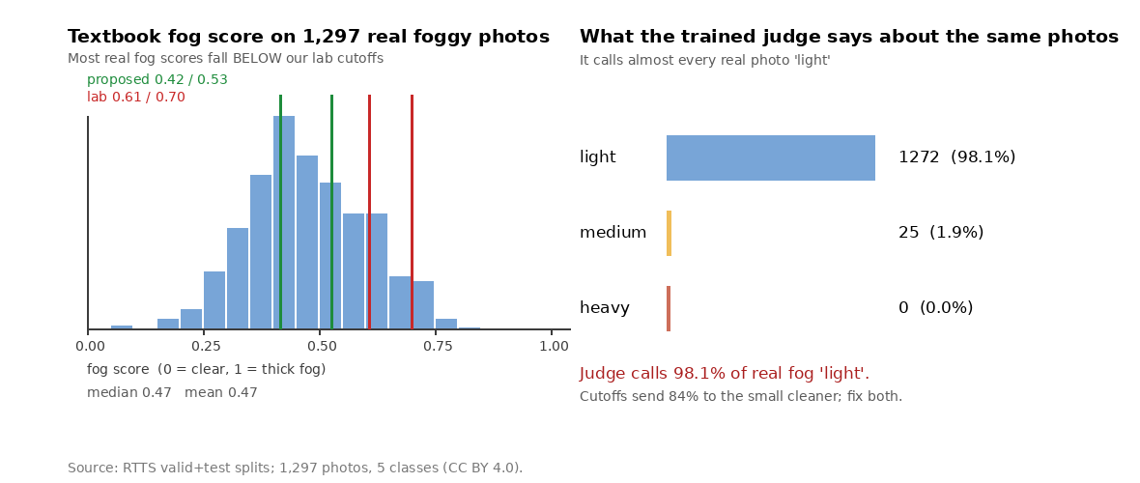
Method 2: our learning fix (HDEN + CORUN)
HOW IT WORKS, step by step
  A trained judge (HDEN) sorts each photo: light, medium, or heavy fog. Right 94% of the time in training.
  Each photo goes to its cleaner: CORUN-Light (2 steps), Medium (4), or Complex (6 + attention on the foggiest patches).
  A 3-part report card grades each result: physics, natural look, and leftover fog.
  Data plan: full Foggy Cityscapes + clear twins (5,000 streets x 3 fog); 1,297 RTTS photos for testing.
Reality check before GPU time
  The judge calls 98.1% of real fog 'light', so our cutoffs send 84% to the small cleaner. Both need fixing.
Real fog disagrees with our lab cutoffs, as measured on RTTS photos (CC BY 4.0).

Slide 6
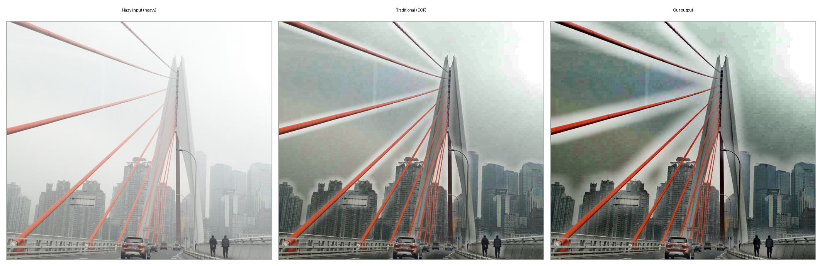
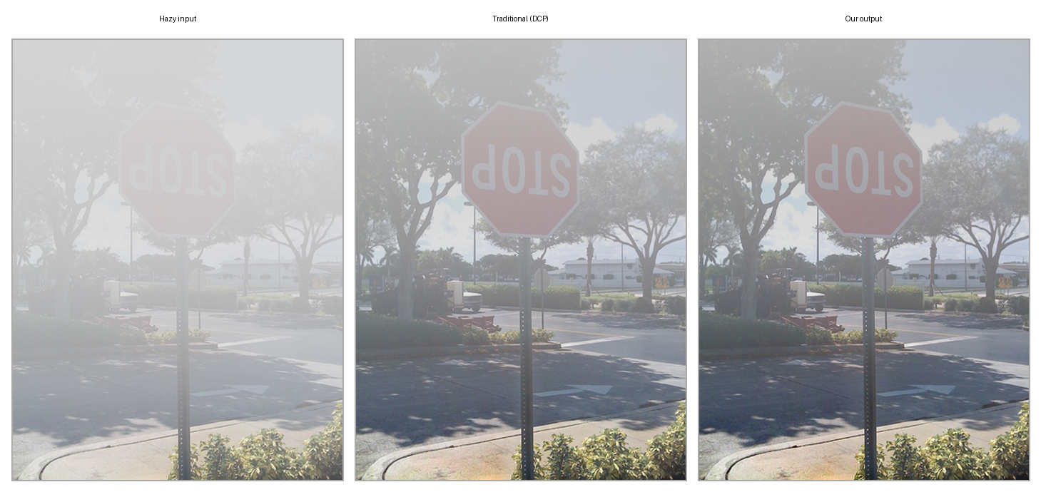
Head to head: foggy vs textbook vs ours
Same two photos, three views each: the foggy photo, the textbook result (DCP), and our fix.
Bridge in heavy fog (RTTS): foggy → textbook (DCP) → ours.
Stop-sign street (COCO, heavy fog): foggy → textbook (DCP) → ours.

Slide 7
Novelty, other uses, and final result
OUR NOVELTY (beyond the paper)
  Hybrid finish: run both cleaners and keep the sharper photo. DCP keeps full-size detail, CORUN clears fog better — the pick takes the best of both.
  Real-world routing: reset the judge cutoffs on real RTTS fog, so heavy fog actually reaches the big cleaner.
OTHER USES (same physics)
  Phone one-tap cleanup, drones and security cameras in bad weather, smoke or shallow-water footage..

Slide 8
Team members' technical contribution
Each person handles one stage of the pipeline:
  Vishal prepares the fog training data and trains the fog judge.
  Sathwik builds the three cleaners and runs the training.
  Chetan runs object finding and scores the final results.

