Slide 1
Mini compiler design
GOVIND SHARMA (215805026) ABHINAV CHANDRA(215805098)

Slide 2
OBJECTIVE
The primary objective is to design and implement a functional mini-compiler that can successfully translate source code from a simplified programming language into an intermediate representation or target code. The compiler should be capable of performing lexical analysis, parsing, semantic analysis, intermediate code
generation, optimization, and code generation

Slide 3
SHORT DESCRIPTION
Designing a mini-compiler is a complex task that involves multiple stages and components. A mini-compiler typically takes source code written in a high-level programming language and translates it into an intermediate representation or machine code that can be executed by a computer.
The compiler perform the following tasks:
1. Lexical Analysis (Tokenization):
Implement a lexer that breaks down the source code into tokens. Tokens include keywords, identifiers, literals (e.g., numbers,strings), and operators.
2. Syntax Analysis (Parsing): Create a parser that checks the syntactic correctness of the source code. This should include verifying that the code adheres to the defined grammar rules.
3. Semantic Analysis: Perform semantic checks to ensure that variables are declared before use, types are consistent, and other language-specific rules are enforced.

Slide 4
4. Intermediate Code Generation:
Translate the source code into an intermediate representation. You can use an abstract syntax tree (AST) or other intermediate representations.
5. Optimization: Implement simple optimizations to improve the efficiency of the generated code. This could include constant folding, dead code elimination, or other
optimizations of your choice.
6. Code Generation: Generate target code (e.g., assembly language or machine code) based on the intermediate representation.Ensure that the generated code is correct and efficient.

Slide 5

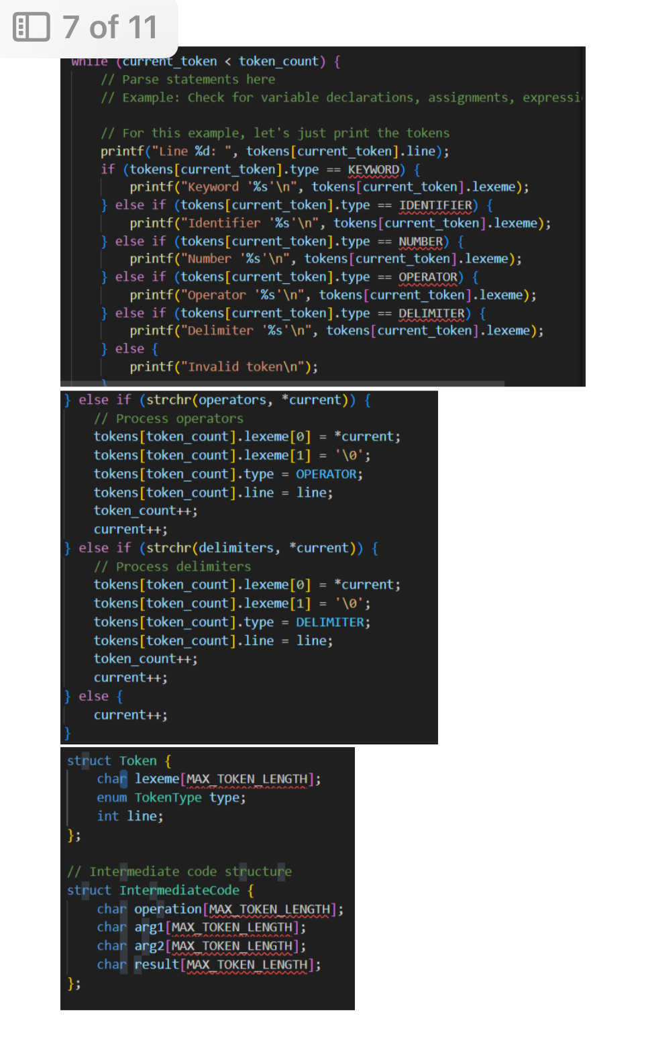
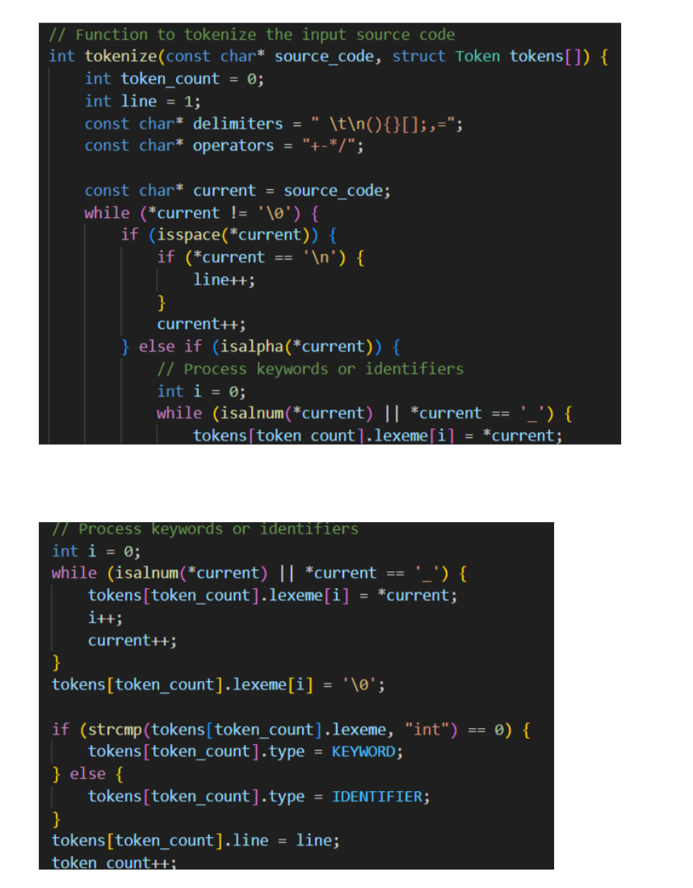
IMPLEMENTATION

Slide 6
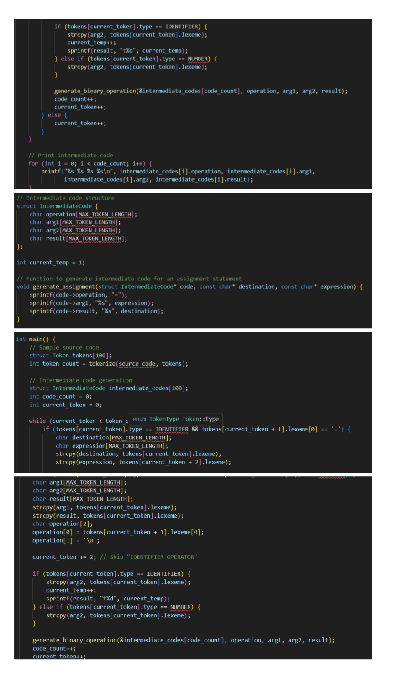
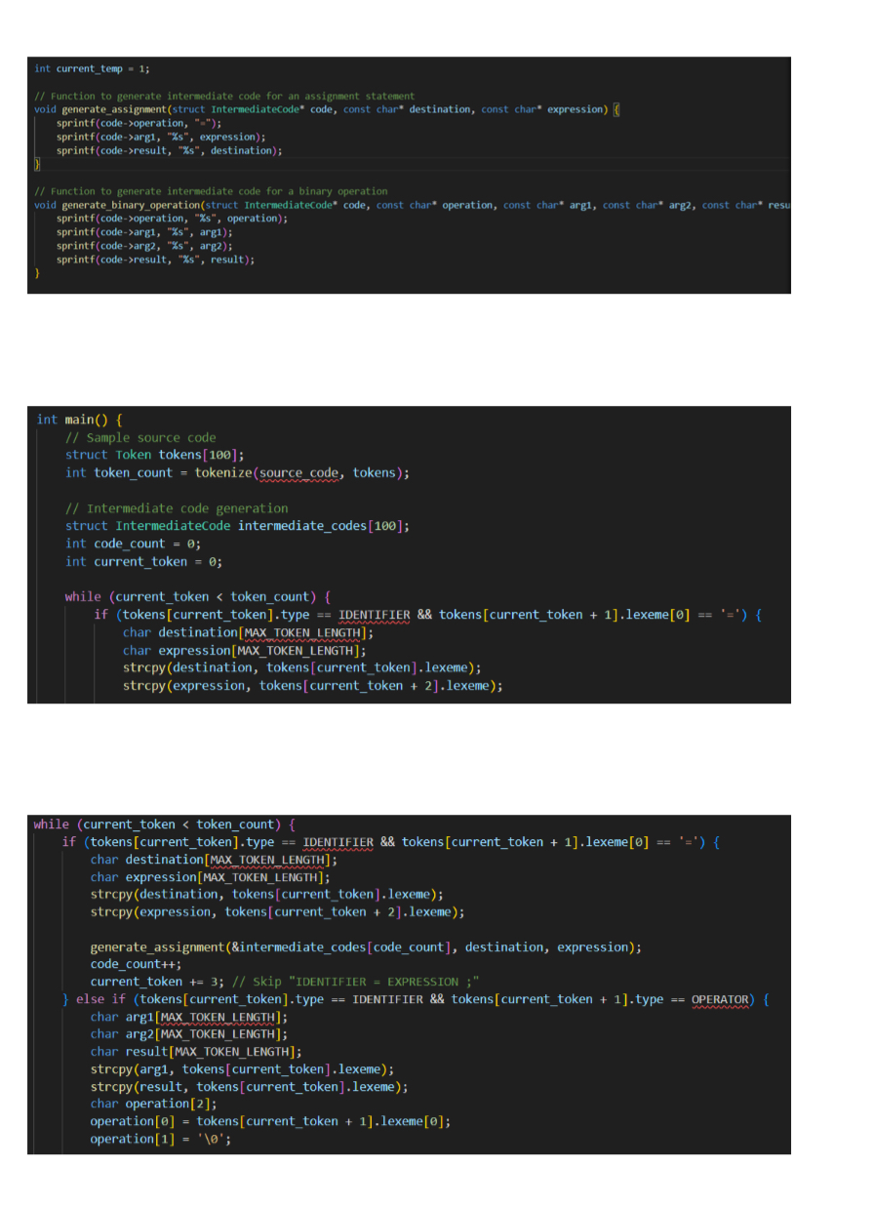
IMPLEMENTATION

Slide 7
CONCLUSION
The compiler will produce a listing file which lists and numbers each line, inter leave with any error messages following the source file. Each error message should refer to a line number. Even if errors are present in the source code, the compiler should continue to
analyze the input source code. The target code will be generated only if there are no errors.

Slide 8
Thank you

