Slide 1
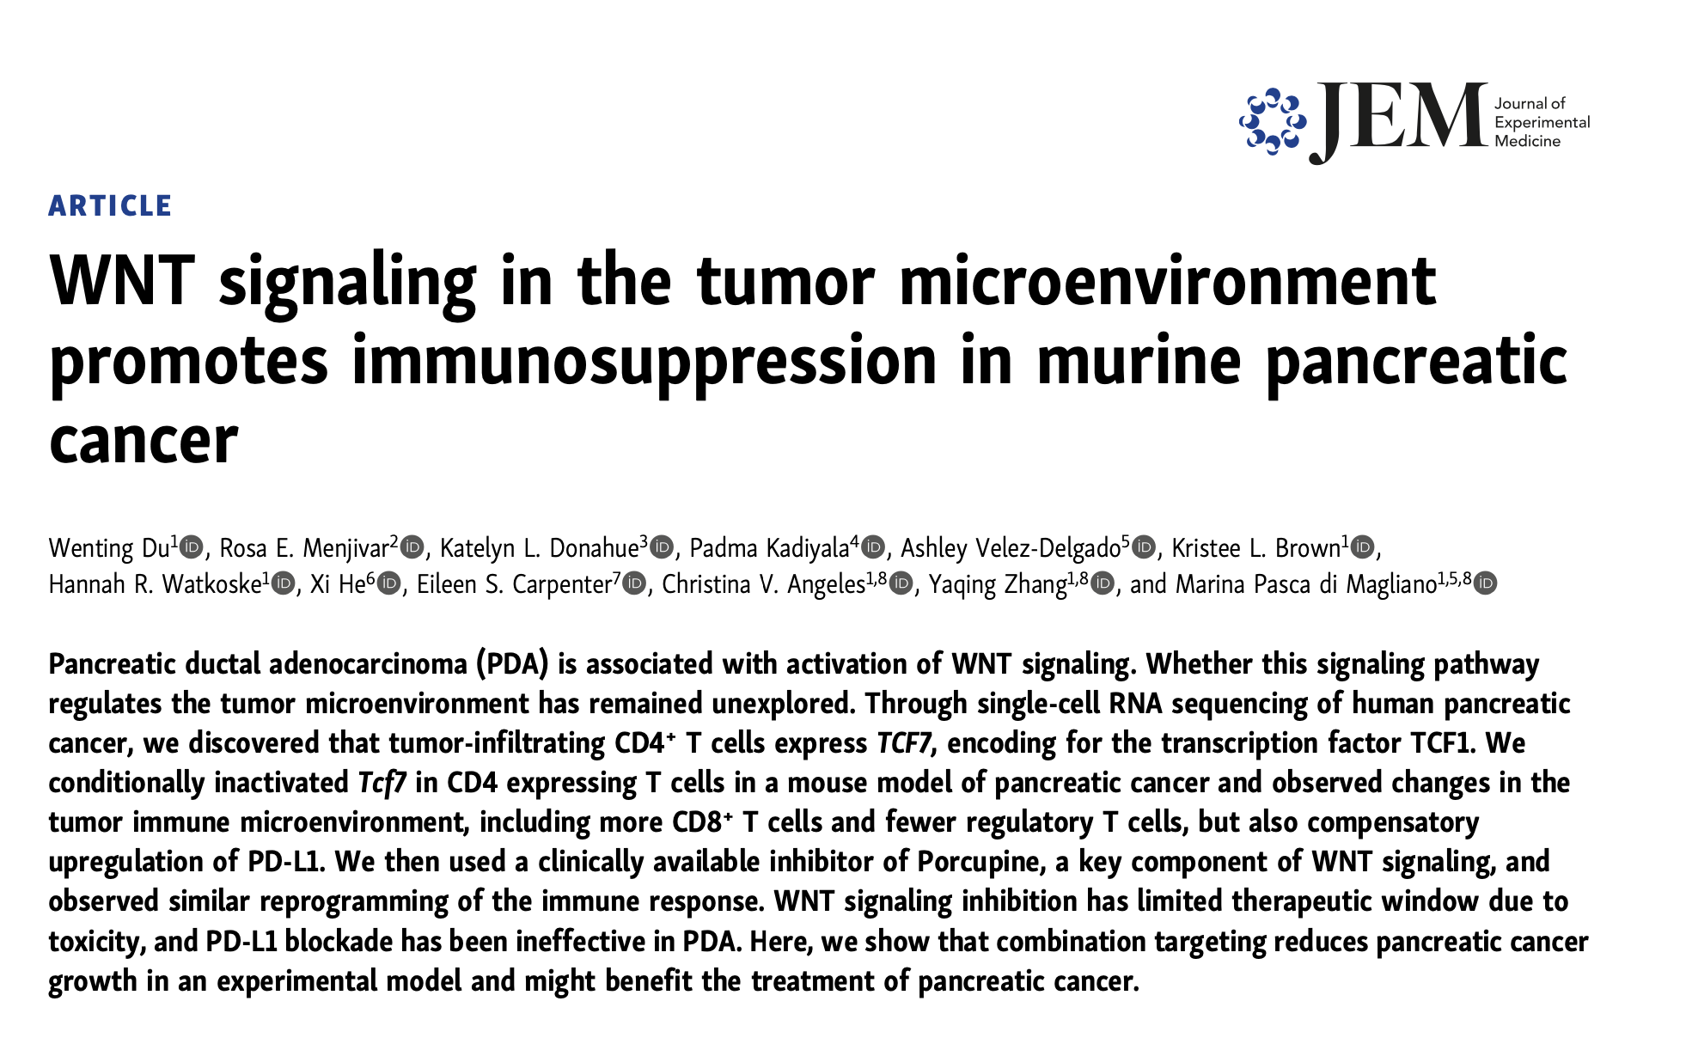

Slide 2
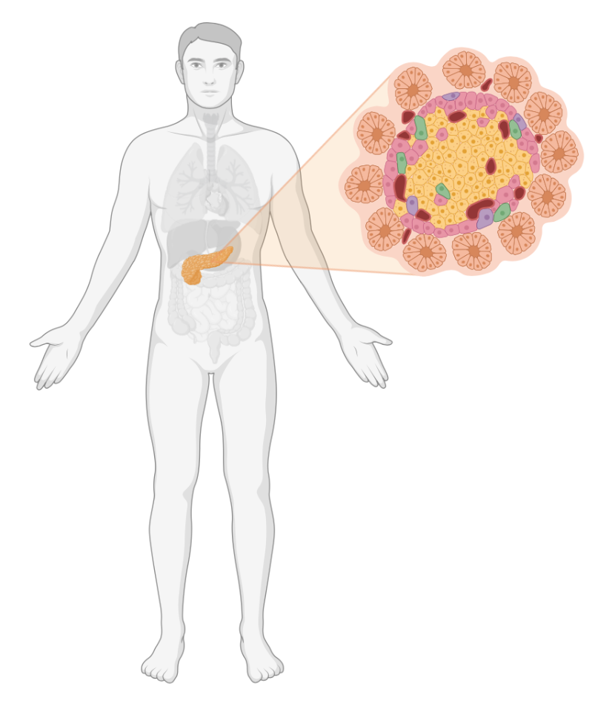
Pancreatic cancer
Pancreatic cancer is a deadly malignancy with a 5-yr survival rate of 11%.
The efficacy of current chemotherapeutic combinations provided for the treatment of pancreatic cancer is unfortunately limited.
While the advent of immunotherapy has revolutionized treatment for several solid tumors, it has yet to benefit most pancreatic cancer patients.
This may be due to the extensive tumor microenvironment (TME) in pancreatic cancer, which includes abundant immune cells mostly with immune suppressive function.
Therefore, a stronger understanding of the causes of immunosuppression in this disease is urgently needed.

Slide 3
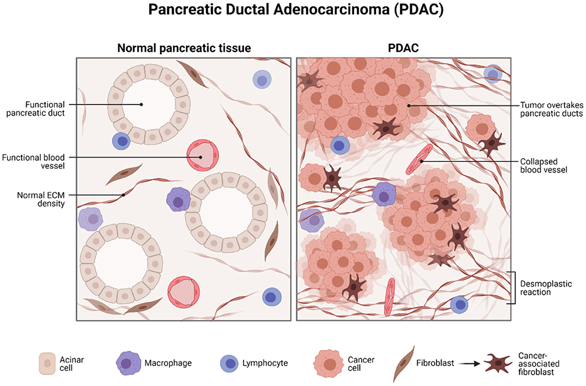
Pancreatic ductal adenocarcinoma
Pancreatic ductal adenocarcinoma (PDA), the most common type of pancreatic cancer, is almost invariably associated with oncogenic mutations in the KRAS gene.
Further, PDA is associated with inappropriate activation of embryonic signaling pathways that are normally quiescent in the adult pancreas, including Hedgehog, Notch, and WNT.
Genomic studies have also revealed consistent activation of core signaling pathways, including WNT signaling, in pancreatic cancer.
Image credit: https://doi.org/10.3389/fmed.2021.788869

Slide 4
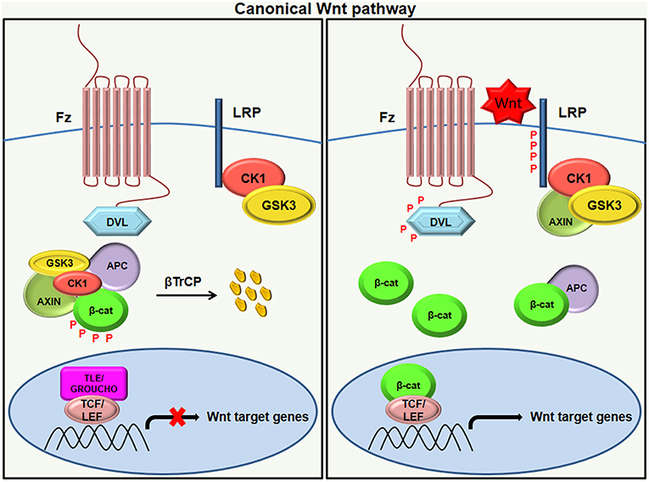
WNT signaling
WNT signaling regulates important crucial biological functions, such as organ development, cell proliferation, differentiation, apoptosis, motility, and survival.
Canonical WNT signal- ing is activated by WNT ligands binding to a Frizzled (FZD)/LRP complex, resulting in β-catenin stabilization, cytoplasmic accumulation, and nuclear translocation.
In the nucleus, β-catenin binds to transcription factors of the T cell factor (TCF)/lymphoid enhancer factor (LEF) family to form a transcriptional activator complex .
It has been demonstrated that epithelial WNT signaling is critical for pancreatic cancer progression, metastasis, and chemoresistance.
Image credit: https://doi.org/10.3389/fimmu.2019.02872

Slide 5
WNT signaling..
WNT signaling directly mediates immune evasion in melanoma.
WNT signaling regulates the recruitment and function of myeloid-derived suppressor cells (MDSCs), natural killer (NK) cells, and regulatory T cells (Tregs).
WNT signaling also regulates the expression of several immune checkpoints.
Despite the demonstrated importance of WNT signaling in Pancreatic ductal adenocarcinoma (PDAC), its potential role in the tumor microenvironment (TME) has remained unexplored.
Image credit: https://doi.org/10.3389/fmed.2021.788869

Slide 6
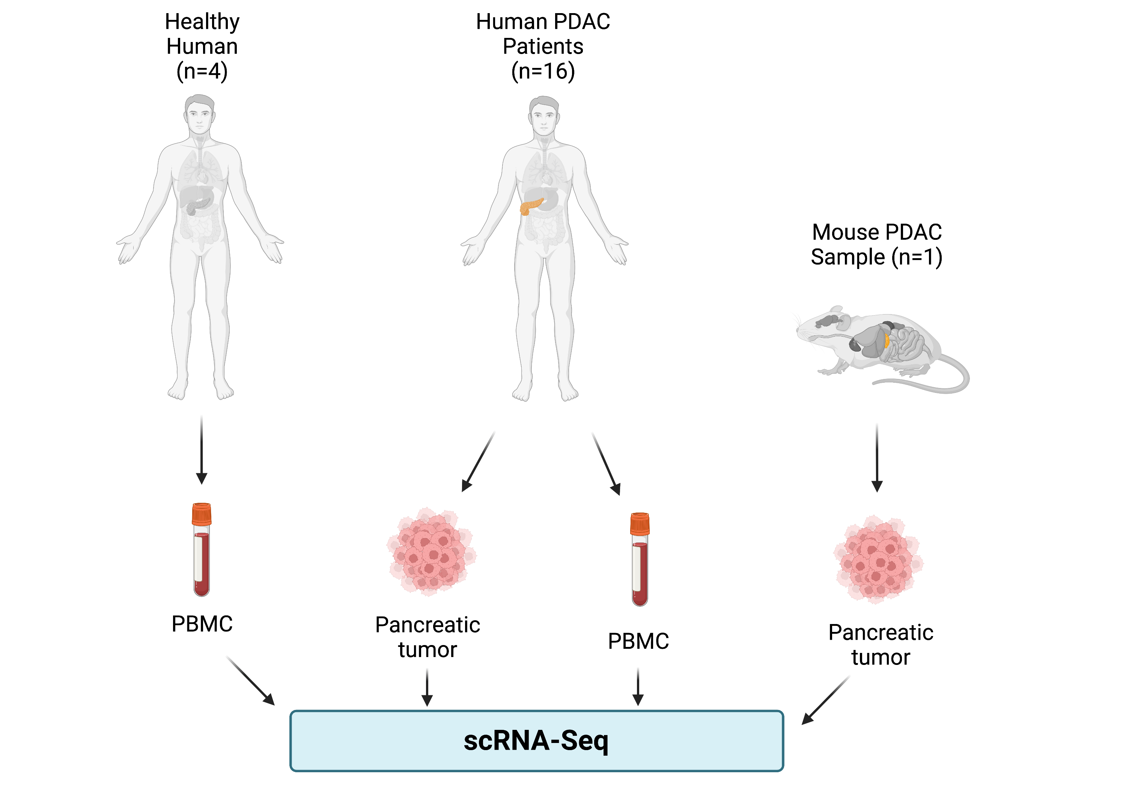
Experimental Design
PDAC = Pancreatic Ductal
Adenocarcinoma
PBMC = Human Peripheral
Blood Mononuclear
Cells

Slide 7
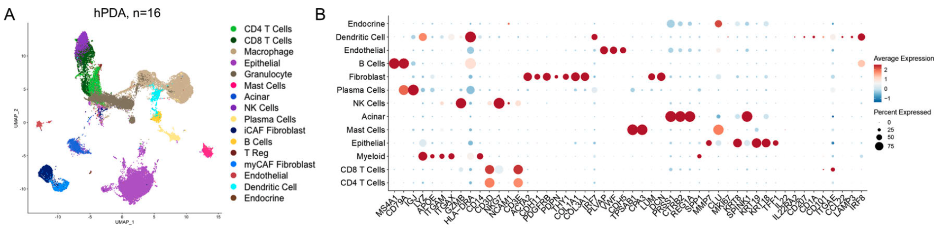
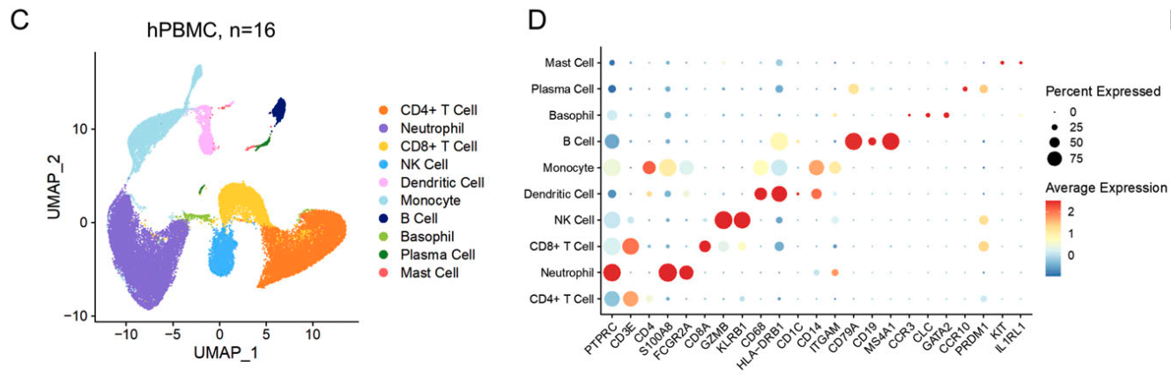
Supplemental figures
We are going to recreate this for 4 samples
You are going to recreate this for 4 samples

Slide 8
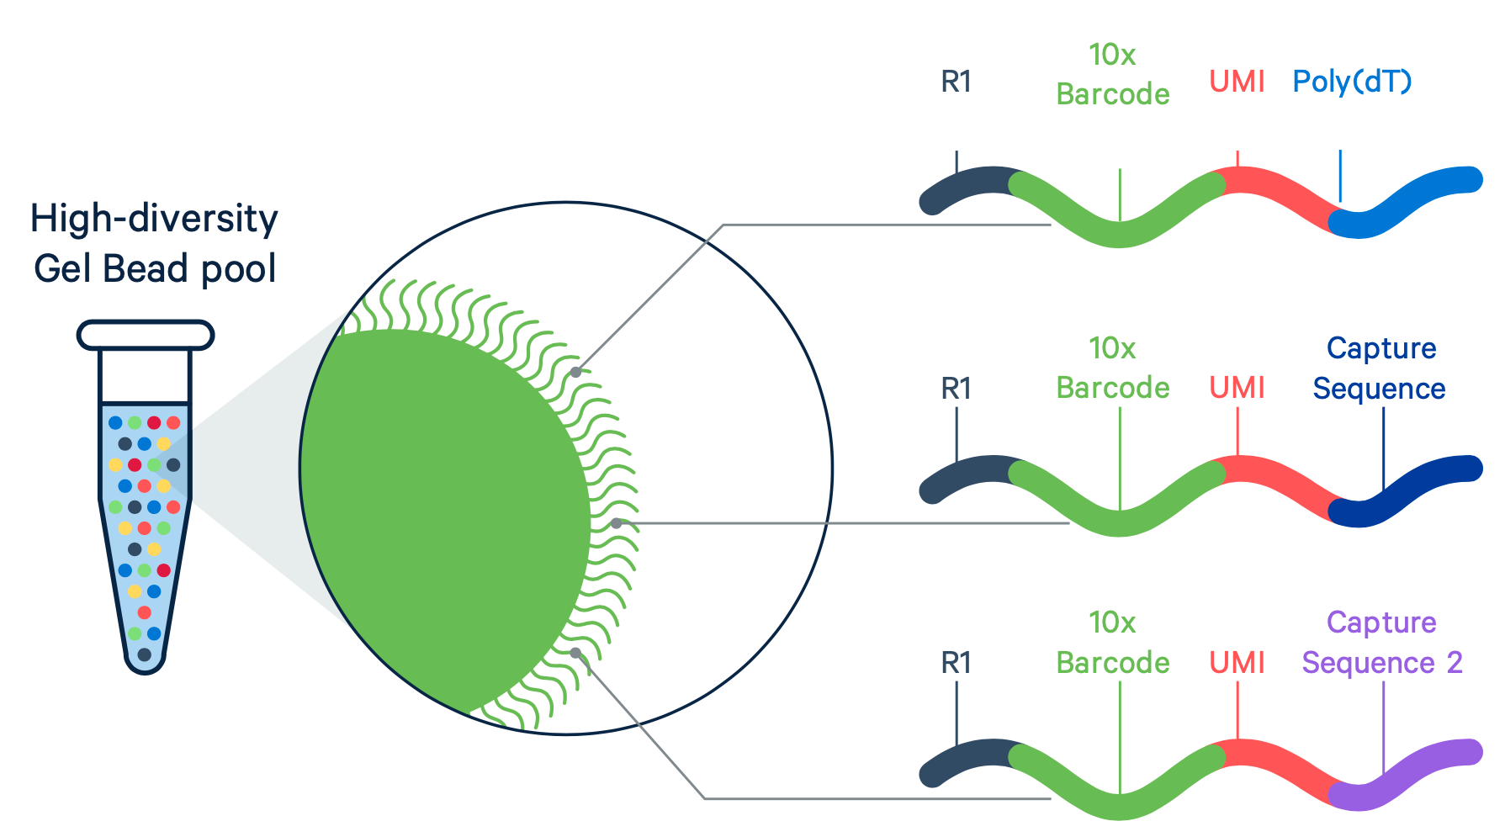
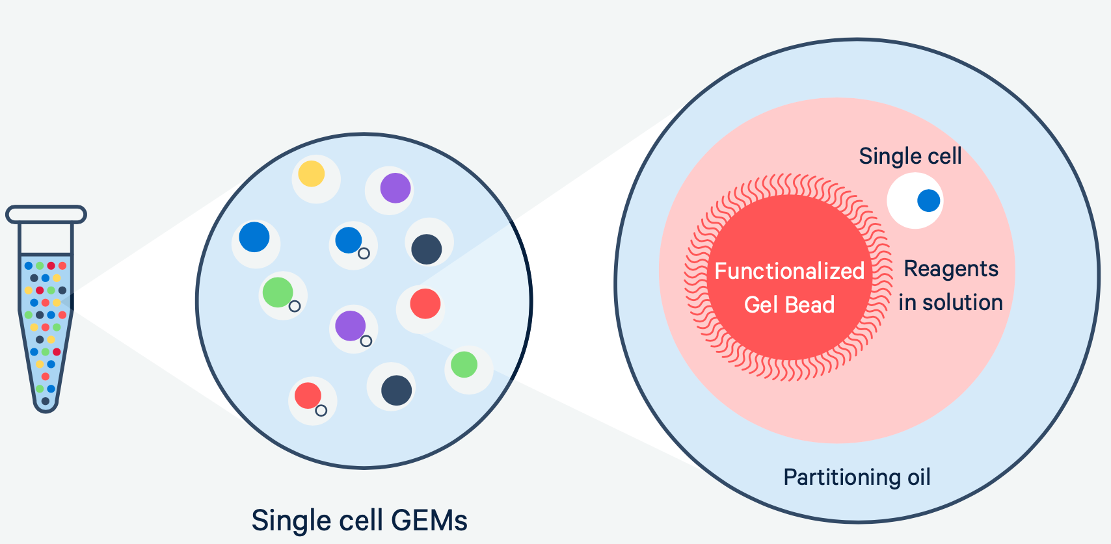

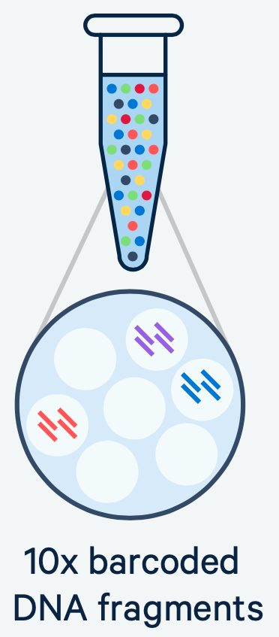
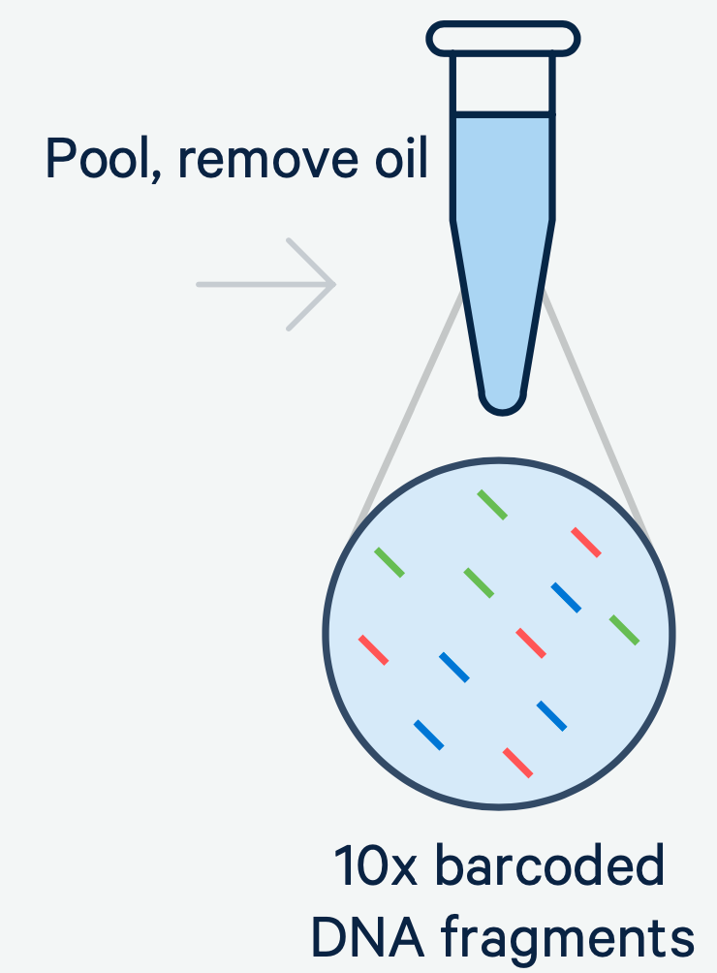
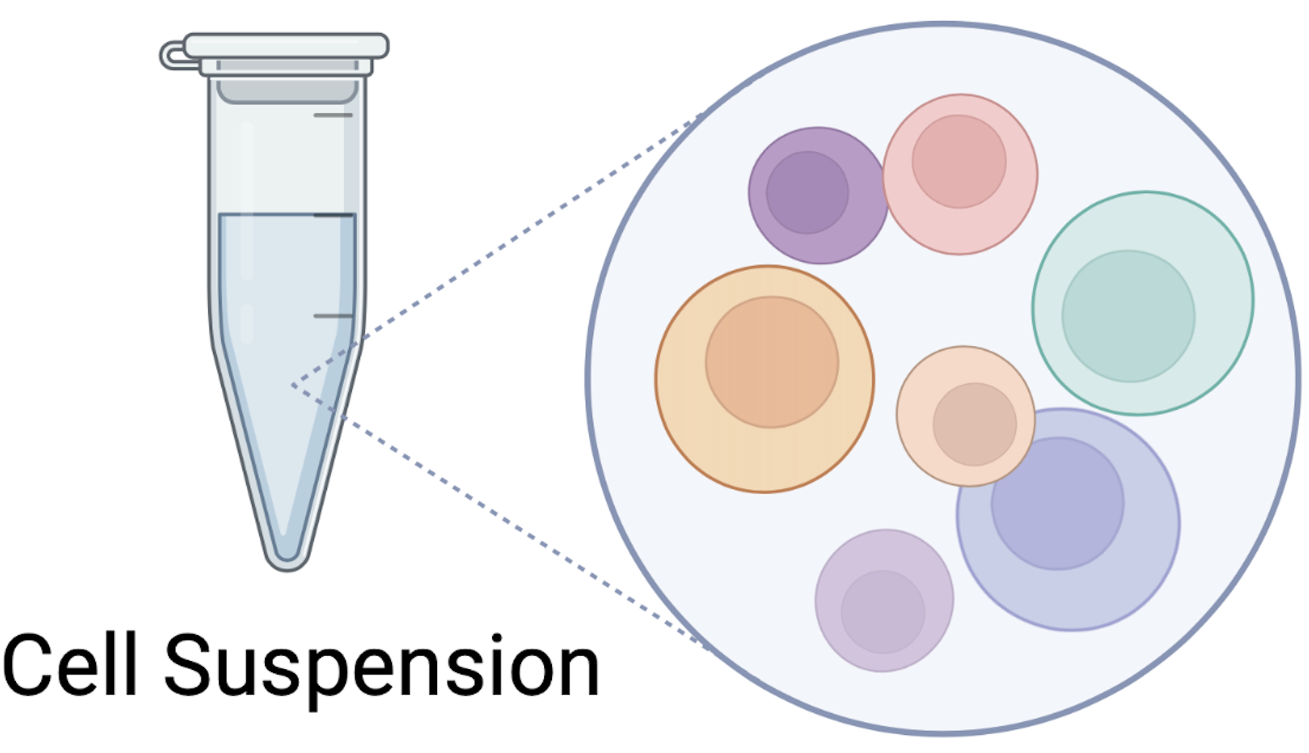
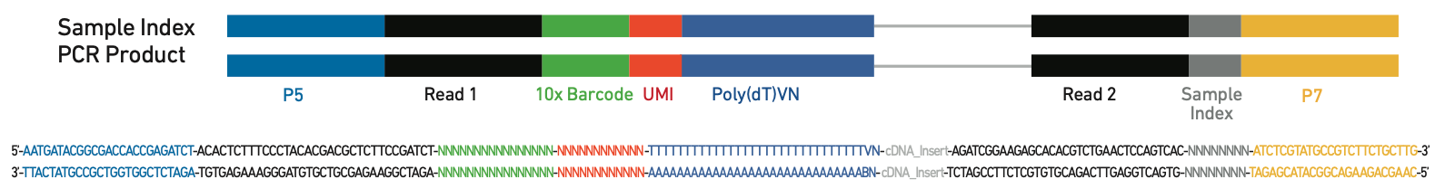
How it works: From cells to sequencing-ready libraries

