Slide 1

Advancement of Deep learning models for PCG signal analysis in real-world settings
Short-term Course on Deep Learning for Healthcare
Pratyusa Dwibedy (522CS1002)
Under the Supervision of:
Dr. Puneet Kumar Jain
Department of Computer Science and Engineering
National Institute of Technology, Rourkela

Slide 2
Content
Introduction
Heart locations & Signal representations
Time-Frequency Analysis (TFA) Overview
Short-Time Fourier Transform (STFT)
Wavelet Transform (WT) (DWT)
MFCC
Classification Techniques
Conclusion

Slide 3
Outcomes
1. Enhanced understanding of the significance of normal and abnormal heart sounds in diagnosing cardiovascular diseases.
2. Overview of how signal processing techniques have evolved, leading to more accurate and reliable heart sound analysis.
3. Establishment of the necessity for time-frequency analysis methods to effectively analyse the complex and non-stationary nature of heart sound signals.

Slide 4
Introduction
The cardiovascular system, which comprises the heart, veins, arteries, and capillaries, plays a crucial role in circulating blood throughout the body. Dysfunctions in this system can give rise to a wide range of cardiovascular diseases (CVDs).
Other disease
21%
Brain
Stroke
5%
Diabetics
10%
Cardiovascular Diseases
31%
Respiratory disease
15%
Cancer
18%
Figure 1. Global disease impact: percentages of people affected worldwide.

Slide 5
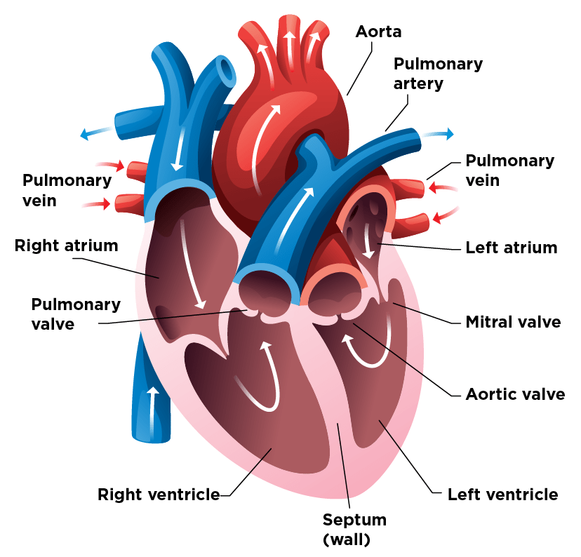
Contd..
Superior
Vena cava
Tricuspid
valve
Figure 2. Human Heart.

Slide 6
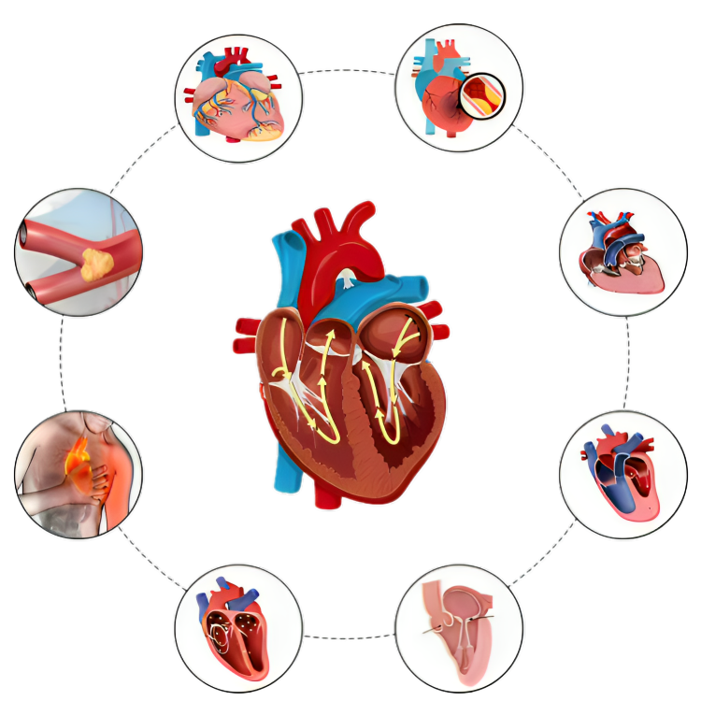
Contd..
Coronary
heart disease
Heart attack
Stroke
Heart failure
Angina
pectoris
Cardio
myopathy
Arrhythmia
Rheumatic
heart disease
Figure 3. Different cardiovascular disease.

Slide 7
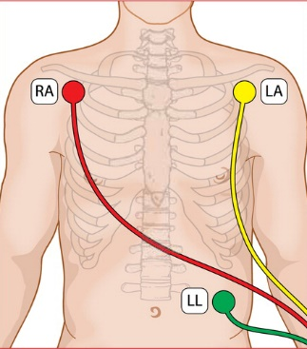
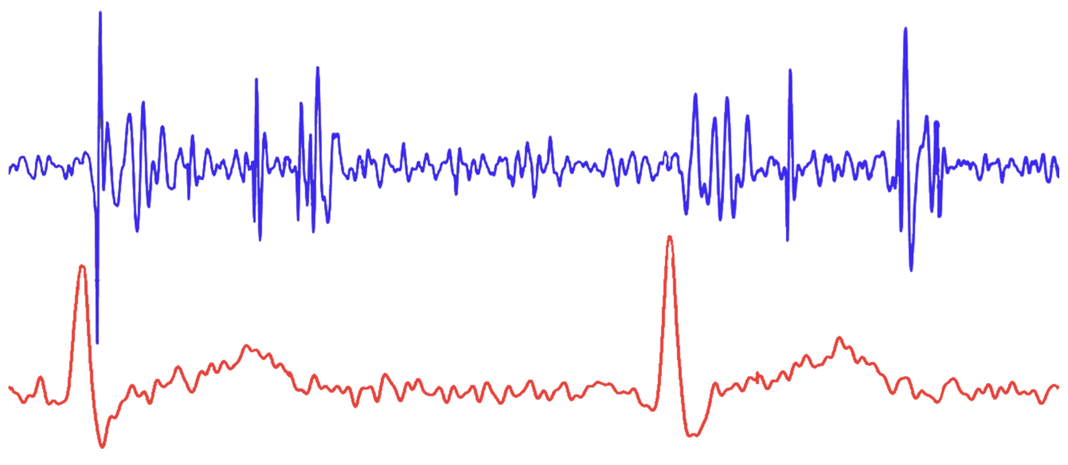
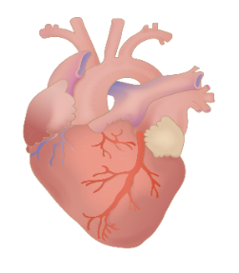

Heart locations & Signal representations
S1
Systole
S2
Diastole
S1
Systole
S2
PCG
Amplitude
R-peak
P
P
ECG
Q
T
Q
T
S
S
0
0.5
1
1.5
2
Time (s)
Figure 4. Electrode and
Stethoscope Placement on the
Human Body
Figure 5. ECG and PCG Signal Representations

Slide 8
Key point
Signal: A representation of physical quantities, typically in the form of a time-varying voltage or sound wave, used for analysis or processing.
Amplitude: The magnitude or strength of a signal, typically measured from the baseline to the peak of a wave.
Bandwidth: The range of frequencies within a signal, usually between the lowest and highest frequencies present.
Frequency: The number of cycles of a periodic signal per second, measured in Hertz (Hz).
Channel: An independent stream of audio or signal data, often referring to mono or stereo in sound processing.
Sampling Rate: The number of samples per second taken from a continuous signal to create a discrete signal, measured in Hz.
Normalization: The process of scaling a signal to a standard range, often between -1 and 1, to ensure consistency across data.
Nyquist Frequency: The highest frequency that can be accurately sampled, equal to half the sampling rate.

Slide 9
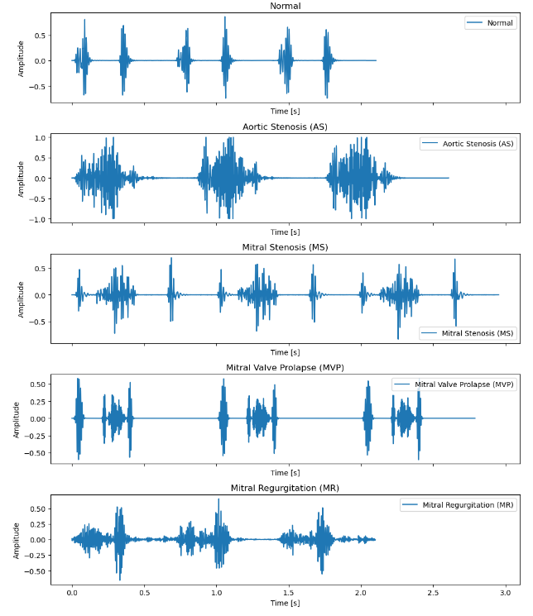
Normal And Abnormal Heart sound
Aortic Stenosis (AS): A narrowing of the aortic valve, restricting blood flow from the heart to the rest of the body.
Mitral Stenosis (MS): A narrowing of the mitral valve, impeding blood flow from the left atrium to the left ventricle.
Mitral Valve Prolapse (MVP): A condition where the mitral valve leaflets bulge into the left atrium during heart contraction.
Mitral Regurgitation (MR): A condition where the mitral valve doesn't close tightly, causing blood to flow backward into the left atrium.
Figure 6. Normal and abnormal heart sound representation

Slide 10
Time-Frequency Analysis (TFA) Overview
A technique that provides a representation of a signal in both the time and frequency domains simultaneously, allowing for the analysis of non-stationary signals.
It helps analyze signals that change, like heart sounds, giving us a clearer picture of what’s happening.
Common TFA Methods:
Short-Time Fourier Transform (STFT):
Wavelet Transform (WT)

Slide 11
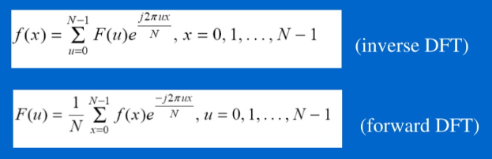
Fourier Transform
The Fourier Transform converts a time-domain signal into its frequency-domain representation. It breaks down a signal into its individual frequency components.
Forward DFT, which converts a discrete signal from the time domain into the frequency domain.
Inverse DFT, which converts a signal from the frequency domain back into the time domain.

Slide 12
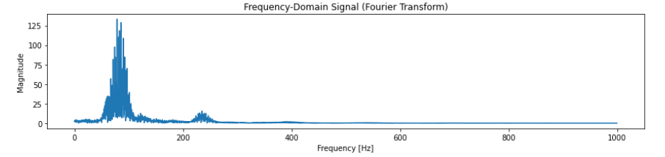
Contd..
Figure 8. magnitude of the Fourier Transform
This plot represents the magnitude of the Fourier Transform, showing how much energy or signal strength is present at different frequencies.
The x-axis represents the frequency in Hertz (Hz) and ranges from 0 Hz to 1000 Hz, which corresponds to the Nyquist frequency (half of the 2kHz sampling rate).
The strongest energy is concentrated below 200 Hz, with a sharp peak around 50-100 Hz, which likely corresponds to the fundamental frequencies of the signal.
There is some energy distributed across higher frequencies, but it gradually diminishes after 200 Hz, indicating that the signal has less energy at higher frequencies.

Slide 13
Demerits of Fourier Transform
The Fourier Transform gives you the frequency components of the entire signal, but it does not provide any information about when these frequencies occur. This is a significant limitation for non-stationary signals like heart sounds, where frequency components may change over time.
FFT assumes that the signal is stationary, meaning its frequency content does not change over time. In practical cases like heart sounds or physiological signals, the frequency characteristics often change, which FFT fails to capture.
If the signal has sudden changes or transients (like heartbeats), the FFT cannot tell when these changes occur. It only provides a global frequency content for the entire signal duration, missing crucial time-related events.
For more complex signals, like overlapping heartbeats or murmurs, FFT may fail to distinguish between overlapping frequency components or variations over time, leading to a loss of critical diagnostic information.

Slide 14
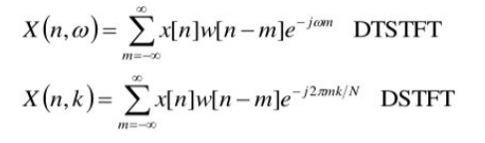
Short-Time Fourier Transform (STFT)
STFT is an extension of the Fourier Transform that analyzes small segments (windows) of the signal over time, giving both time and frequency information.

Slide 15
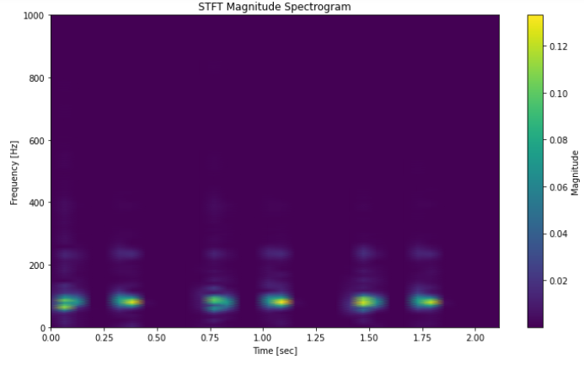
Contd..
The plot shows the STFT result, where both time (x-axis) and frequency (y-axis) are represented simultaneously. This allows you to see how the frequency components of the signal change over time.
The y-axis represents frequency in Hertz (Hz), ranging from 0 to 1000 Hz, which corresponds to half of the resampled 2kHz sampling rate (Nyquist frequency). Most of the energy is concentrated below 200 Hz, which is typical for heart sounds or other low-frequency physiological signals.
The higher frequencies (above 300 Hz) show much less energy, as indicated by the darker purple areas, meaning the signal has low-frequency content. This suggests that most of the significant information in the signal is contained in lower frequencies.
Figure 9. Spectogram image

Slide 16
Here are three concise points highlighting the demerits of STFT:
1. Fixed Time-Frequency Resolution: STFT uses a constant window size, leading to a trade-off between time and frequency resolution, which may miss critical details in non-stationary signals.
2. Windowing Effects: The choice of window function and its length can introduce artifacts that distort the signal, either by losing frequency content or by smoothing out important transient features.
3. Limited Transient Analysis: STFT may struggle to accurately capture fast-changing frequency components or short-lived events, making it less effective for analyzing rapidly varying signals.

Slide 17
Wavelet Transform
The wavelet transform offers several advantages over STFT, primarily due to its variable time-frequency resolution.
Unlike STFT's fixed window size, wavelets can provide high time resolution for high-frequency components and high frequency resolution for low-frequency components, making them more flexible for analyzing non-stationary signals.
Additionally, wavelet transforms are better suited for detecting transient events and capturing short-lived signal features. Their ability to analyze signals at multiple scales further enhances their adaptability in different applications.

Slide 18
Contd..
Types of Wavelet Transforms:
Continuous Wavelet Transform (CWT):
CWT computes the wavelet transform at every possible scale, offering a continuous, detailed time-frequency analysis of the signal.
Discrete Wavelet Transform (DWT):
DWT decomposes the signal at discrete levels, providing a compact representation, making it ideal for applications requiring reduced data while maintaining key features.

Slide 19
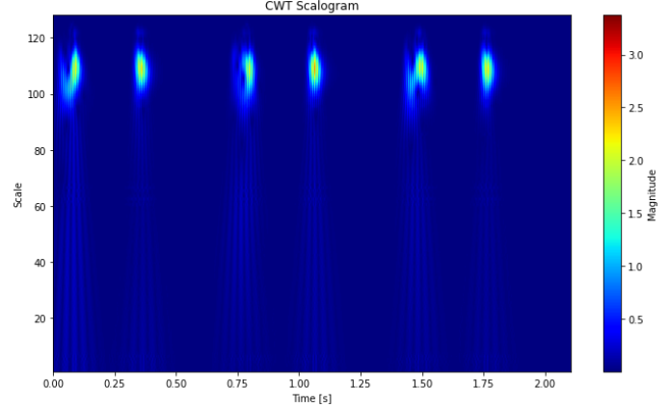
The image shows a CWT scalogram, where time is represented on the x-axis and scale (analogous to frequency) is represented on the y-axis. The color intensity represents the magnitude of the signal at different time and scale values.
The x-axis covers the entire 2-second interval of the signal. Distinct peaks are visible at approximately 0.25s, 0.75s, 1.00s, 1.50s and 1.75s, indicating the periodic events in the signal, which likely correspond to heartbeats or other repeating features.
The y-axis shows scale values ranging from 1 to 128. Scale in wavelet transform is inversely related to frequency. Higher scales correspond to lower frequencies, and lower scales correspond to higher frequencies. The most significant energy is concentrated between scals 90 and 120, indicating that the dominant features in the signal are low-frequency components.
Figure 9. Scalogram image

Slide 20
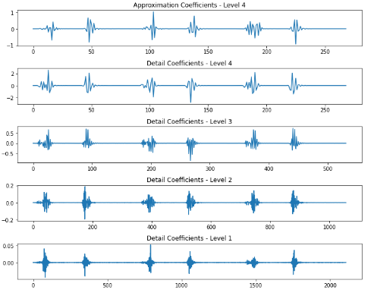
Figure 9. DWT decompose of signal
The image shows a Discrete Wavelet Transform (DWT) decomposition of the signal into four levels: one approximation coefficient (Level 4) and three detail coefficients (Levels 1-4). Each level represents a different frequency band, with lower levels capturing high-frequency details and higher levels capturing low-frequency components.

Slide 21
The top plot shows the approximation coefficients at Level 4. These coefficients represent the low-frequency components of the signal, capturing the overall trend and smooth shape. The signal’s general structure is visible, but much of the finer details have been filtered out, highlighting broader trends.
The subsequent plots show the detail coefficients at different levels. These coefficients represent the high-frequency components or details of the signal.
Level 4 (second plot): This contains the coarsest details (low-frequency details) since it corresponds to a higher level. The signal still has prominent peaks, similar to the approximation.
Level 3 (third plot): Captures more high-frequency content. The peaks in the signal are sharper, and more transient details are preserved compared to Level 4.
Level 2 (fourth plot): This level shows even finer high-frequency details. The signal begins to reveal more high-frequency components, such as sharper and more localized peaks.
Level 1 (bottom plot): This level captures the finest details or the highest-frequency content. The high-frequency transients (e.g., sharp, fast changes in the signal) are most prominent here. The signal looks more jagged, indicating higher-frequency variations.

Slide 22
Mel-frequency Cepstral Coefficients (MFCC)
MFCC is a feature extraction technique used in audio processing, particularly in the analysis of speech and music. MFCCs are based on the Mel scale, which approximates the human ear’s response to different frequencies. The Mel scale compresses the frequency range to align with human perception, allowing for a more meaningful representation of sound.
Importance of MFCC
Feature Representation: MFCCs serve as a compact representation of audio signals, effectively summarizing the important features of the sound in a lower-dimensional space.
Robustness: They are robust against noise and can effectively capture the characteristics of various audio signals, making them suitable for a wide range of applications.
Human Perception: By using the Mel scale, MFCCs align well with human auditory perception, enabling systems to analyze and recognize sounds in a way similar to human hearing.

Slide 23
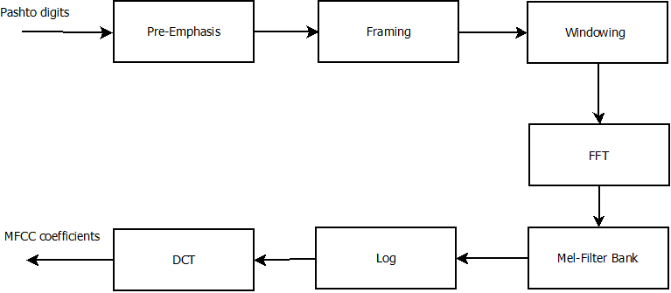
Process of MFCC
Figure 10. Process of MFCC

Slide 24
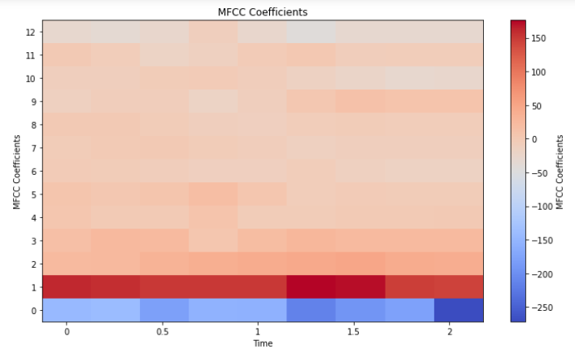
Contd..
The x-axis represents time in seconds, showing the progression of the signal over a time span of approximately 0 to 2.5 seconds.
The y-axis displays the MFCC coefficients, numbered from 0 to 12. These coefficients are features extracted from the signal that summarize its frequency content.
The bottom rows (MFCC coefficients 0-2) have more prominent variations, with alternating patches of blue and red, indicating stronger changes in frequency content in these coefficients over time.
The upper rows (MFCC coefficients 6-12) remain more neutral (light shades), suggesting lower variation or influence from these higher-order coefficients in this particular signal.
Figure 10. MFCC representation

Slide 25
Classification Techniques
Feature Extraction:
- Extract features from various time-frequency analysis methods, including STFT, DWT, and MFCC.
2. Training the different CNN classifier:
- Use the combined feature set to train different CNN, LSTM models.
3. Prediction of Heart Sounds:
- The trained model predicts normal and abnormal heart sounds, aiding in early diagnosis and monitoring.

Slide 26
Conclusion
Exploring different transform methods such as CWT, STFT, DWT and MFCC to enhances the feature extraction process for heart sound analysis.
Using a DL/ML model trained on these diverse features improves the accuracy in detecting normal and abnormal heart sounds.
This approach can significantly aid in the early diagnosis of cardiovascular diseases, improving patient outcomes through timely intervention.

Slide 27
References
https://users.rowan.edu/~polikar/WTtutorial.html
https://signalprocessingsociety.org/our-story/signal-processing-101

Slide 28
Thank You

