Slide 1
BCSE308P - Computer Networks Lab Project
NETWORK PATH AND DELAY ANALYZER
Per-Hop Delay Decomposition, Adaptive Path Selection (DAPS) & Live Internet Telemetry
Project Team Members:
• Abhik Boxi (Reg. No: 24BCE0741) — Mathematical Modeling, Delay Decomposer, Simulation & React Frontend
• Siddharth Saini (Reg. No: 24BKT0121) — Routing Algorithm (DAPS), 30-Run Statistical Tests & Live Traceroute

Slide 2
COMPUTER NETWORKS LAB (BCSE308P)
Motivation & Problem Statement
The Limitations of Current Routing
• OSPF & Static Metrics: Link-state routing uses static metrics (cost = 100/bandwidth) computed once via Dijkstra.
• Blind to Transient Congestion: Costs do not adapt to runtime traffic. Even if a link experiences heavy congestion bursts, traffic remains pinned to the path.
• Buffer Saturation: Bursts cause buffer overflow and queueing delays, degrading voice/video services (high jitter and packet drops).
• Passive Diagnostics Only: Ping & Traceroute only measure latency/hops; they do not break down where the delay occurs nor do they reroute traffic.
Our Solution & Research Goals
• Component 1 — Hop-by-Hop Analyzer: Splits end-to-end latency into propagation, transmission, processing, and queueing parts to pinpoint bottleneck links.
• Component 2 — DAPS (Proposed Mechanism): Actively probes candidate paths every 2s, applies EWMA smoothing to delay/jitter/loss, and intelligently steers traffic.
• Anti-Flapping Protection: Employs 10% hysteresis margin and 2-cycle hold-down to stop oscillation.
• Rigorous Statistical Validation: Evaluated over 30 paired seed runs across 4 realistic scenarios (S1-S4) with Student's t-test.
• Live Internet Telemetry: Real-world Windows traceroute with sub-300ms batch Geo-IP and dark Leaflet world map.
Network Path & Delay Analyzer | Abhik Boxi (24BCE0741) & Siddharth Saini (24BKT0121)

Slide 3
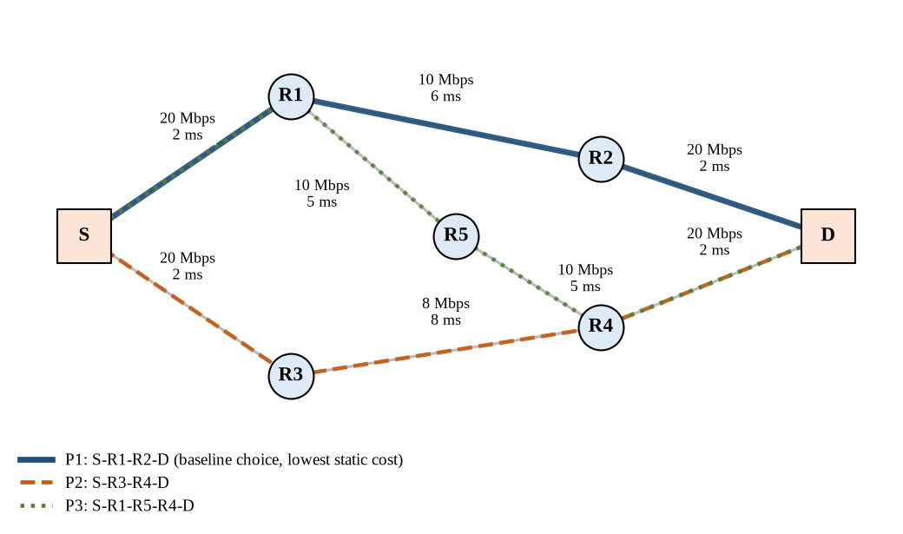
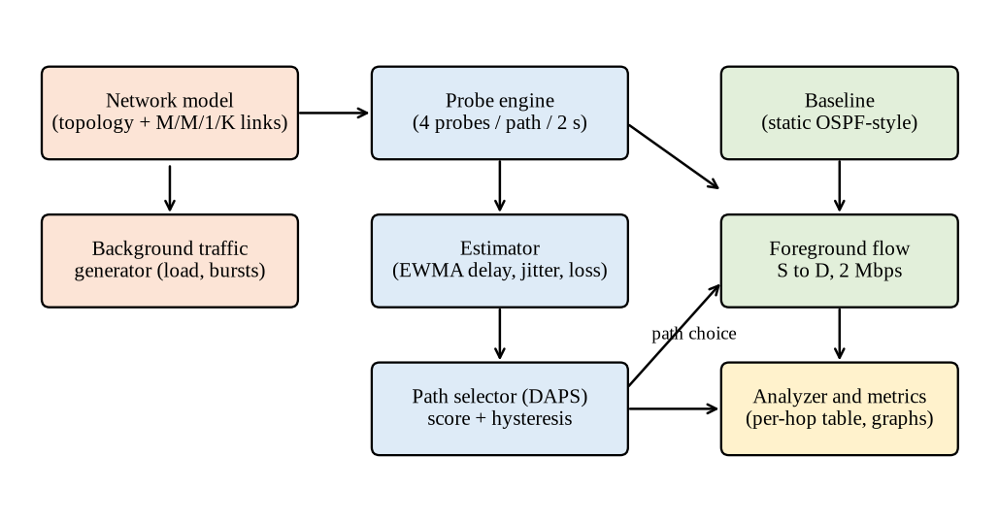
COMPUTER NETWORKS LAB (BCSE308P)
System Architecture & Test Topology
Topology & Candidate Paths from Source (S) to Destination (D):
• P1 (S-R1-R2-D): 3 hops, static cost = 20.0, prop = 10ms (Baseline OSPF choice)
• P2 (S-R3-R4-D): 3 hops, static cost = 22.5, prop = 12ms (First alternative)
• P3 (S-R1-R5-R4-D): 4 hops, static cost = 30.0, prop = 14ms (Second alternative via R5)
Network Path & Delay Analyzer | Abhik Boxi (24BCE0741) & Siddharth Saini (24BKT0121)

Slide 4
COMPUTER NETWORKS LAB (BCSE308P)
Link Delay Model: M/M/1/K Queueing Analysis
M/M/1/K Queueing Formulation
• Overcoming M/M/1 Singularity: In pure M/M/1, delay becomes infinite as utilization rho -> 1. Real routers have finite buffers.
• Finite Buffer (K = 64 packets): We model links as M/M/1/K queues. Loss probability is given by:
P_K = (1 - rho) * rho^K / (1 - rho^(K+1))
• Mean System Time (W): Derived from average packet occupancy N and effective arrival rate lambda_eff = rho * mu * (1 - P_K).
• Queueing Delay: Computed as W minus packet transmission time. Always stays bounded even when bursts push rho > 1.
• Processing Delay: Fixed at 0.1 ms per hop.
Hop-by-Hop Delay Decomposition
• Total Path Delay Breakdown:
d_path = Sum(d_prop + d_tx + d_proc + d_queue)
• Fixed Components:
• Propagation (2 - 8 ms based on physical distance)
• Transmission = (packet_bits / bandwidth)
• Processing (0.1 ms fixed)
• Variable Component:
• Queueing Delay: Grows non-linearly with background traffic bursts.
• Bottleneck Hop Identification:
Flags the link with max queueing delay and computes its share:
Share% = 100 * worst_queue / total_delay
• Example Output: Link R1-R2 under degradation suffers 123 ms queueing (90% of entire path delay).
Network Path & Delay Analyzer | Abhik Boxi (24BCE0741) & Siddharth Saini (24BKT0121)

Slide 5
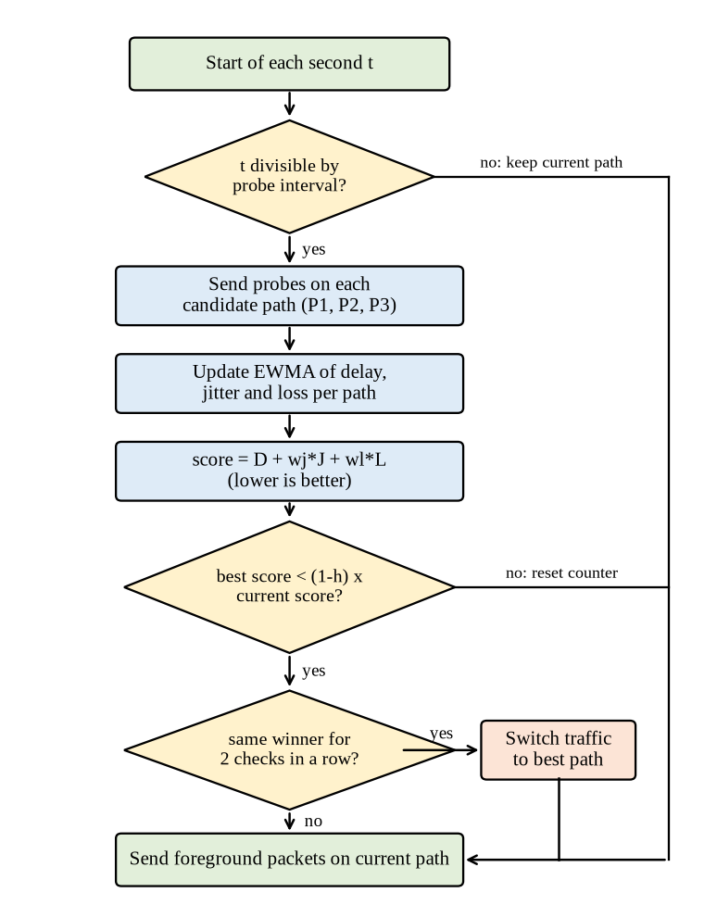
COMPUTER NETWORKS LAB (BCSE308P)
Proposed Mechanism: DAPS Algorithm & Logic
Four Core Steps of DAPS
• 1. Active Probing (Every 2s):
Sends 4 lightweight probe packets (64B) along P1, P2, and P3. Computes sample mean delay d, jitter j, and packet loss ratio l.
• 2. EWMA Smoothing:
D_hat = alpha*d + (1-alpha)*D_hat (alpha = 0.3)
Smooths out transient sample noise; single bad packets cannot trigger switches.
• 3. Composite Score Formulation:
Score = D_hat + w_J * J_hat + w_L * L_hat
(w_J = 1.0, w_L = 1000.0 => 1% packet loss penalized like 10 ms delay).
• 4. Anti-Flapping Protection:
• Hysteresis (h = 0.10): Best score must be at least 10% lower than current path.
• Hold-down (confirm = 2): Candidate must win 2 consecutive cycles (4s) before rerouting.
Network Path & Delay Analyzer | Abhik Boxi (24BCE0741) & Siddharth Saini (24BKT0121)

Slide 6
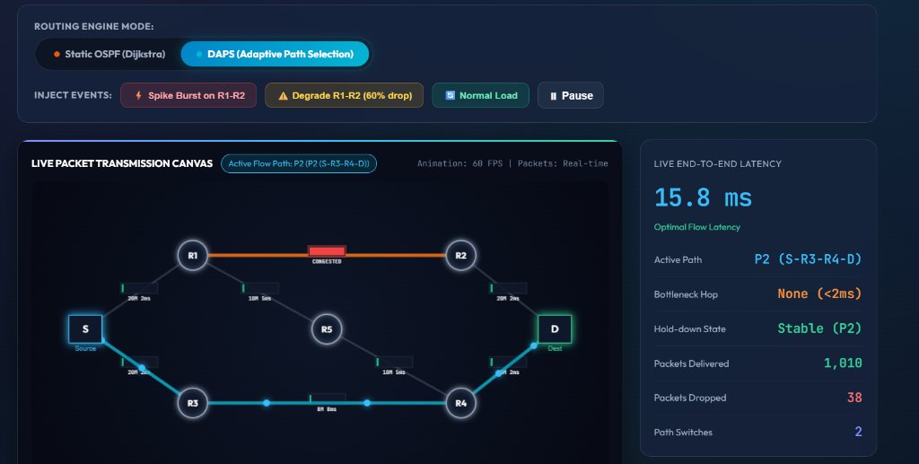
COMPUTER NETWORKS LAB (BCSE308P)
Live System Output: DAPS Working Prototype Simulation Lab
Live Simulation Prototype Output
• Active Canvas Telemetry (60 FPS):
Real-time discrete packet rendering across 7-node network model.
• Demonstrated Evasion Behavior:
Link R1-R2 is degraded to 40% capacity (highlighted in red: CONGESTED).
• DAPS Decision Execution:
DAPS actively shifts traffic away from congested P1 to Path P2 (S-R3-R4-D highlighted in glowing cyan).
• Live System Telemetry:
• End-to-End Latency: 15.8 ms
• Bottleneck Hop: None (< 2 ms)
• Hold-down State: Stable (P2)
• Packets Delivered: 1,010
• Controlled Switches: 2
Network Path & Delay Analyzer | Abhik Boxi (24BCE0741) & Siddharth Saini (24BKT0121)

Slide 7
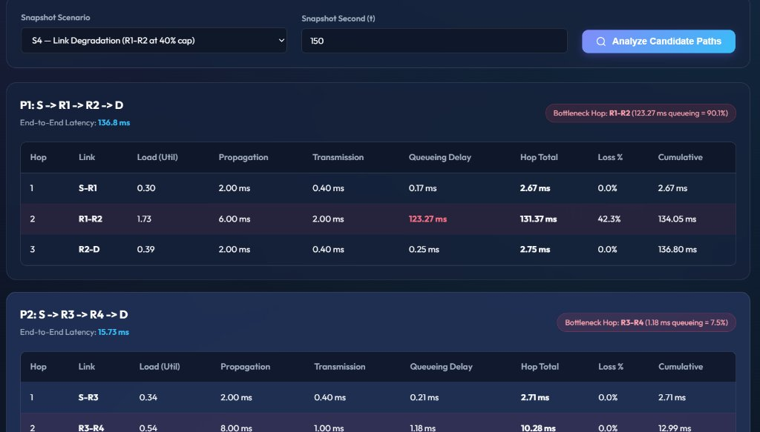
COMPUTER NETWORKS LAB (BCSE308P)
Live System Output: Hop-by-Hop Delay Decomposer
Analytical Decomposition Output
• Snapshot Condition:
Scenario S4 (Link Degradation on R1-R2) captured at t = 150 seconds.
• Candidate Path P1 (OSPF Default):
• Hop 1 (S-R1): 2.67 ms (0.17 ms queue)
• Hop 2 (R1-R2): 131.37 ms (123.27 ms queue!)
• Hop 3 (R2-D): 2.75 ms
• Total Latency: 136.80 ms | Loss: 42.3%
• Bottleneck Share: 90.1% queueing on R1-R2
• Candidate Path P2 (DAPS Active Route):
• Total Latency: 15.73 ms
• Hop 2 (R3-R4) queue: only 1.18 ms
• 0.0% packet drop rate
• Confirms 88.5% delay reduction!
Network Path & Delay Analyzer | Abhik Boxi (24BCE0741) & Siddharth Saini (24BKT0121)

Slide 8
COMPUTER NETWORKS LAB (BCSE308P)
Experimental Setup & Evaluation Methodology
Four Experimental Scenarios
• S1 (Low Load, load factor = 0.5):
Mean link utilization ~ 15-23%. Queues near zero; baseline optimal.
• S2 (Medium Load, load factor = 1.0):
Mean link utilization ~ 30-45%. Occasional background bursts.
• S3 (High Load, load factor = 1.5):
Mean utilization ~ 45-68%. Heavy bursts push links to saturation (rho ~ 1.0).
• S4 (Link Capacity Degradation):
Medium load, but at t = 100-200s, primary link R1-R2 drops 60% capacity (10 -> 4 Mbps). OSPF static routing cannot detect capacity loss without link-down.
Statistical Evaluation Rigor
• 30 Paired Random Seeds: Every test is executed across 30 identical background load realizations for both Baseline and DAPS.
• Statistical Significance: Paired Student's t-tests conducted for all metrics (p < 0.001 in congested scenarios).
• Key Metrics Evaluated (IPPM Standards):
• Mean End-to-End Delay (ms)
• 95th Percentile Delay (tail latency)
• Delay Jitter (packet-to-packet variation)
• Packet Loss Ratio (%)
• Path Switching Frequency & Probe Overhead
• 100% Reproducible: Seeded pseudo-random streams.
Network Path & Delay Analyzer | Abhik Boxi (24BCE0741) & Siddharth Saini (24BKT0121)

Slide 9
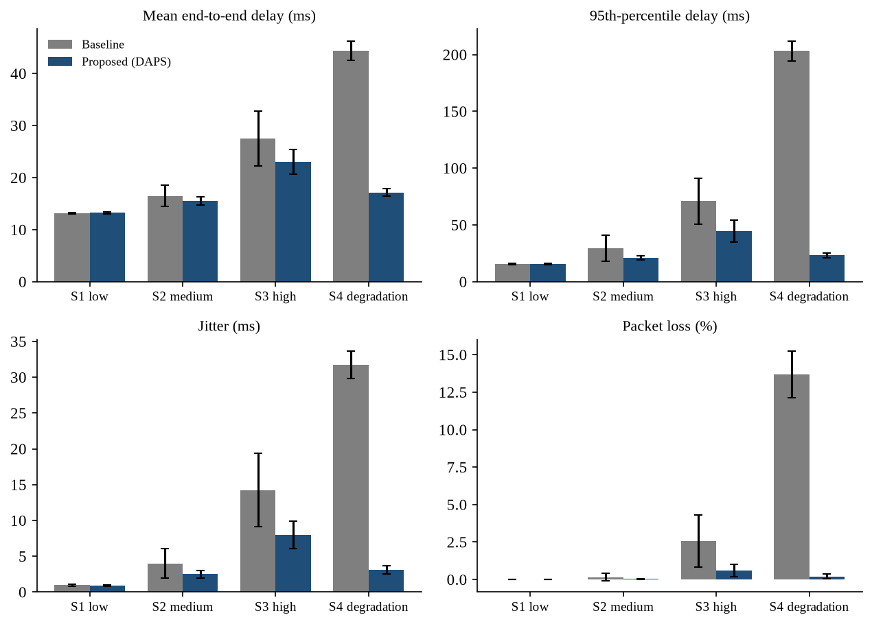
COMPUTER NETWORKS LAB (BCSE308P)
Experimental Results: Baseline vs Proposed (30 Runs)
Scenario | Baseline | DAPS (Proposed) | Improvement
S1 (Low) | 13.14 ms | 0.0% | 13.22 ms | 0.0% | -0.6% (Neutral)
S2 (Med) | 16.48 ms | 0.16% | 15.55 ms | 0.03% | +5.6% delay / +81% loss
S3 (High) | 27.51 ms | 2.57% | 23.01 ms | 0.60% | +16.4% delay / +76% loss
S4 (Degr) | 44.38 ms | 13.7% | 17.13 ms | 0.20% | +61.4% delay / +98% loss
Key Findings:
• In S3: 95th-pct delay drops 37.2% (71ms -> 44ms), jitter drops 44.1%.
• In S4: Baseline stuck at 135ms during degradation; DAPS switches to P2/P3 in 2-4s.
• Overhead: Only 0.15% extra byte overhead (1800 probes / 300s run).
Network Path & Delay Analyzer | Abhik Boxi (24BCE0741) & Siddharth Saini (24BKT0121)

Slide 10
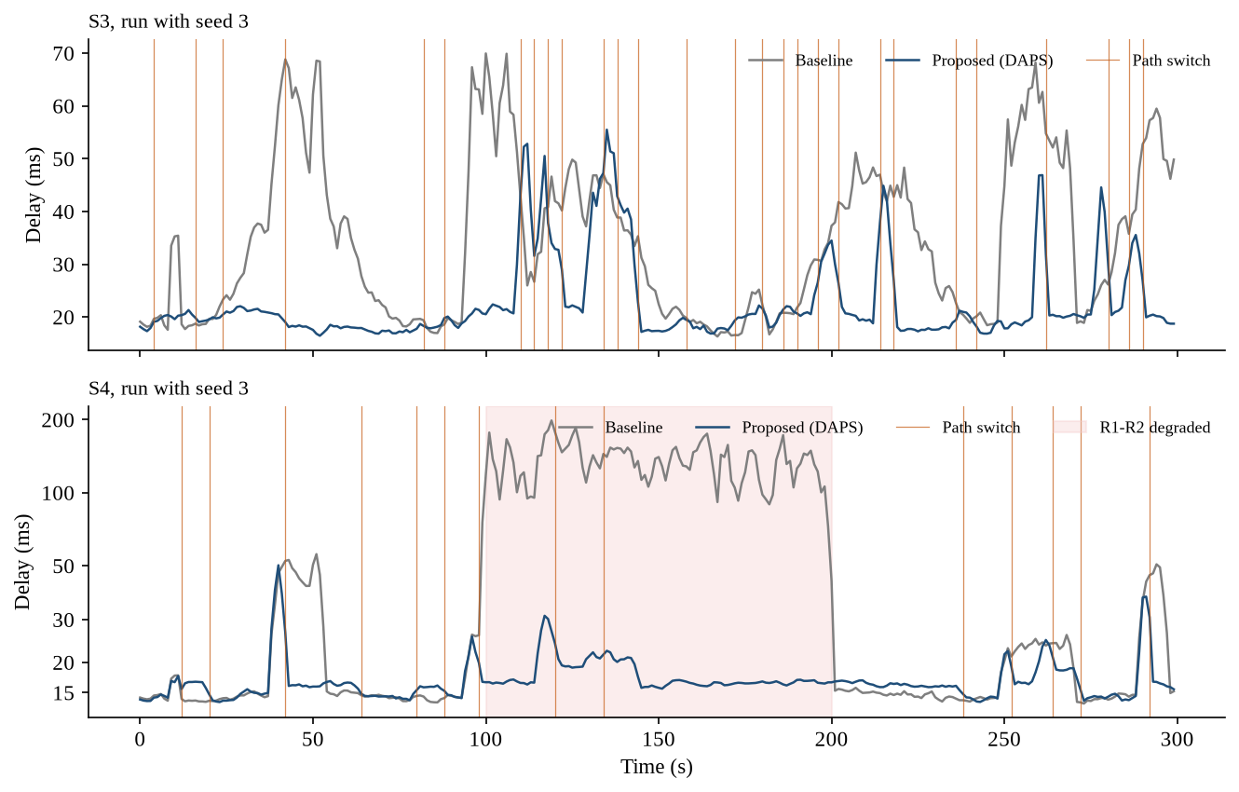
COMPUTER NETWORKS LAB (BCSE308P)
Time-Series Dynamics: S3 (High Load) & S4 (Degradation)
Dynamic Trace Observations
• Baseline Behavior (Orange):
Remains pinned to P1 throughout the 300s run. In S3, background bursts create severe latency spikes up to 93 ms.
• DAPS Adaptation (Blue):
Continuously probes alternate paths. Whenever R1-R2 or R3-R4 experiences a burst, traffic smoothly migrates.
• S4 Capacity Drop (t = 100-200s):
R1-R2 loses 60% bandwidth. Baseline delay explodes to 135 ms and drops 42% packets.
DAPS bypasses the bottleneck at t = 98s, maintaining delay at 18 ms.
• Path Switches (Vertical Dashes):
Controlled switches without endless oscillation.
Network Path & Delay Analyzer | Abhik Boxi (24BCE0741) & Siddharth Saini (24BKT0121)

Slide 11
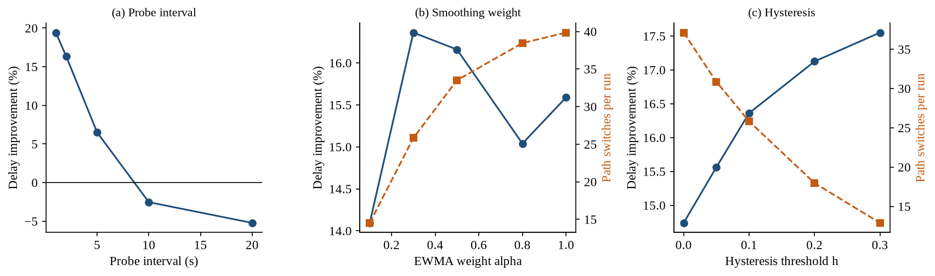
COMPUTER NETWORKS LAB (BCSE308P)
Ablation Study & Parameter Sensitivity
Ablation: Why Anti-Flapping Matters
• What drives performance?
We tested 6 variants in S3 (removing one stability feature at a time):
• • Full DAPS (Default): 23.01 ms delay, 25.8 path switches.
• • No Hysteresis (h=0) & No Hold-down (N=1):
Delay is 22.19 ms, but path switches jump from 25.8 to 72.0 per run!
• • The Trade-off:
DAPS sacrifices just 3.6% delay in exchange for cutting path switches by 64% (25.8 vs 72.0), preventing out-of-order packet delivery in TCP.
• • Probe Interval Sensitivity:
1s probe = 19.4% gain (higher overhead)
2s probe = 16.4% gain (optimal sweet spot)
>=10s probe = Negative gain (-2.5% to -5.2%).
Network Path & Delay Analyzer | Abhik Boxi (24BCE0741) & Siddharth Saini (24BKT0121)

Slide 12
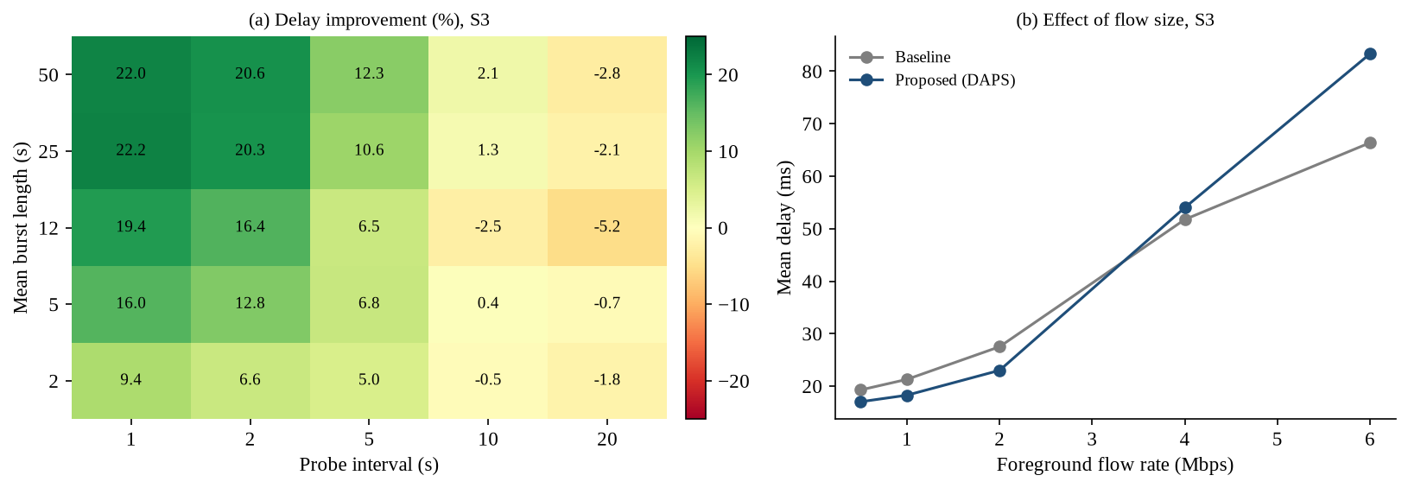
COMPUTER NETWORKS LAB (BCSE308P)
Critical Evaluation: When Does DAPS Fail?
Failure Conditions Identified
• 1. Slow Probing (>= 10s interval):
Background bursts have a mean duration of 12s. If probing is >=10s, measurement data is stale and DAPS moves into existing congestion.
• 2. Self-Induced Congestion (Heavy Flows >= 4 Mbps):
Moving a large flow (4-6 Mbps) carries its own load to the destination path. Probes measured an empty path, so the flow immediately congests the new path, causing severe bouncing (-25.5% at 6 Mbps).
• 3. Low Load Scenarios (S1):
Nothing to gain. Probing noise triggers ~3 needless switches to paths with higher propagation delay (-0.6% penalty).
• Honest Evaluation: Real engineering requires knowing where an algorithm breaks.
Network Path & Delay Analyzer | Abhik Boxi (24BCE0741) & Siddharth Saini (24BKT0121)

Slide 13
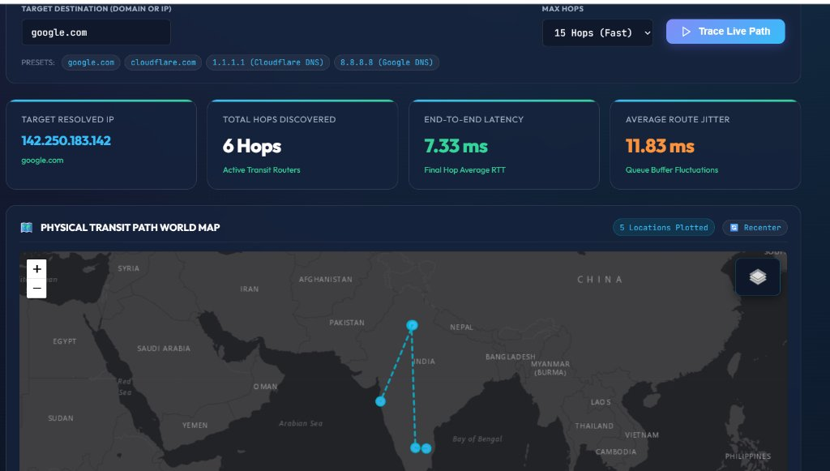
COMPUTER NETWORKS LAB (BCSE308P)
Live System Output: Physical Transit Path World Map
Leaflet World Transit Output
• Live Internet Traceroute Execution:
Target: google.com (Resolved IP: 142.250.183.142).
• High-Speed Batch Geo-IP:
Resolves intermediate ASNs, carrier ISPs, and city lat/long in < 300 ms.
• Plotted Transit Telemetry:
• Total Hops Discovered: 6 Hops
• Final Hop Avg RTT: 7.33 ms
• Average Route Jitter: 11.83 ms
• Locations Plotted: 5 cities across India (Vellore -> Bengaluru -> Gurugram -> New Delhi -> Mumbai)
• Dark Gray Canvas Basemap:
Clean Esri canvas with zero watermark constraints.
Network Path & Delay Analyzer | Abhik Boxi (24BCE0741) & Siddharth Saini (24BKT0121)

Slide 14
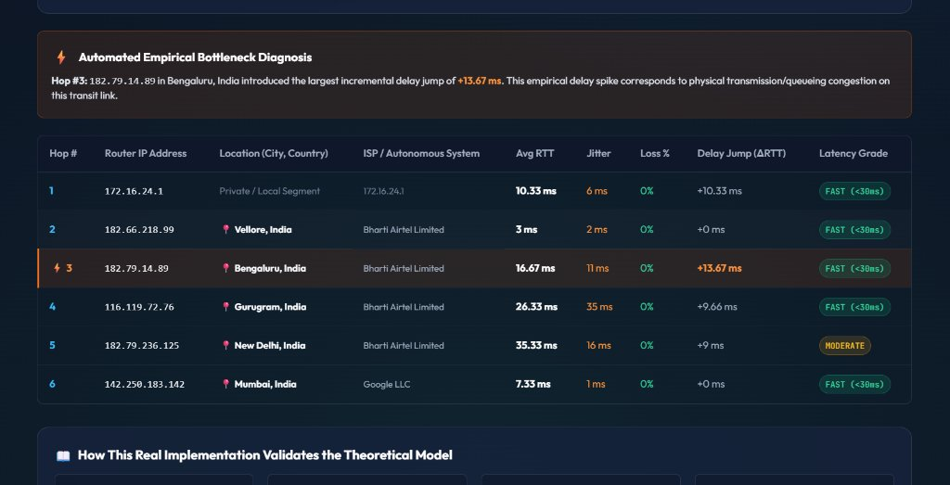
COMPUTER NETWORKS LAB (BCSE308P)
Live System Output: Empirical Bottleneck Diagnosis
Empirical Bottleneck Localization
• Automated Bottleneck Diagnosis:
Algorithm flags Hop #3 (182.79.14.89, Bengaluru, Bharti Airtel Limited) with a warning lightning badge.
• Detected Delay Spike (ΔRTT):
Introduced the largest incremental delay jump of +13.67 ms (3 ms -> 16.67 ms RTT).
• Connection to Simulation Theory:
Proves that physical router queue buffer backlog directly manifests as empirical Jitter (|ΔRTT|).
• Autonomous System Visibility:
Reveals Airtel transit handoff to Google LLC edge in Mumbai.
Network Path & Delay Analyzer | Abhik Boxi (24BCE0741) & Siddharth Saini (24BKT0121)

Slide 15
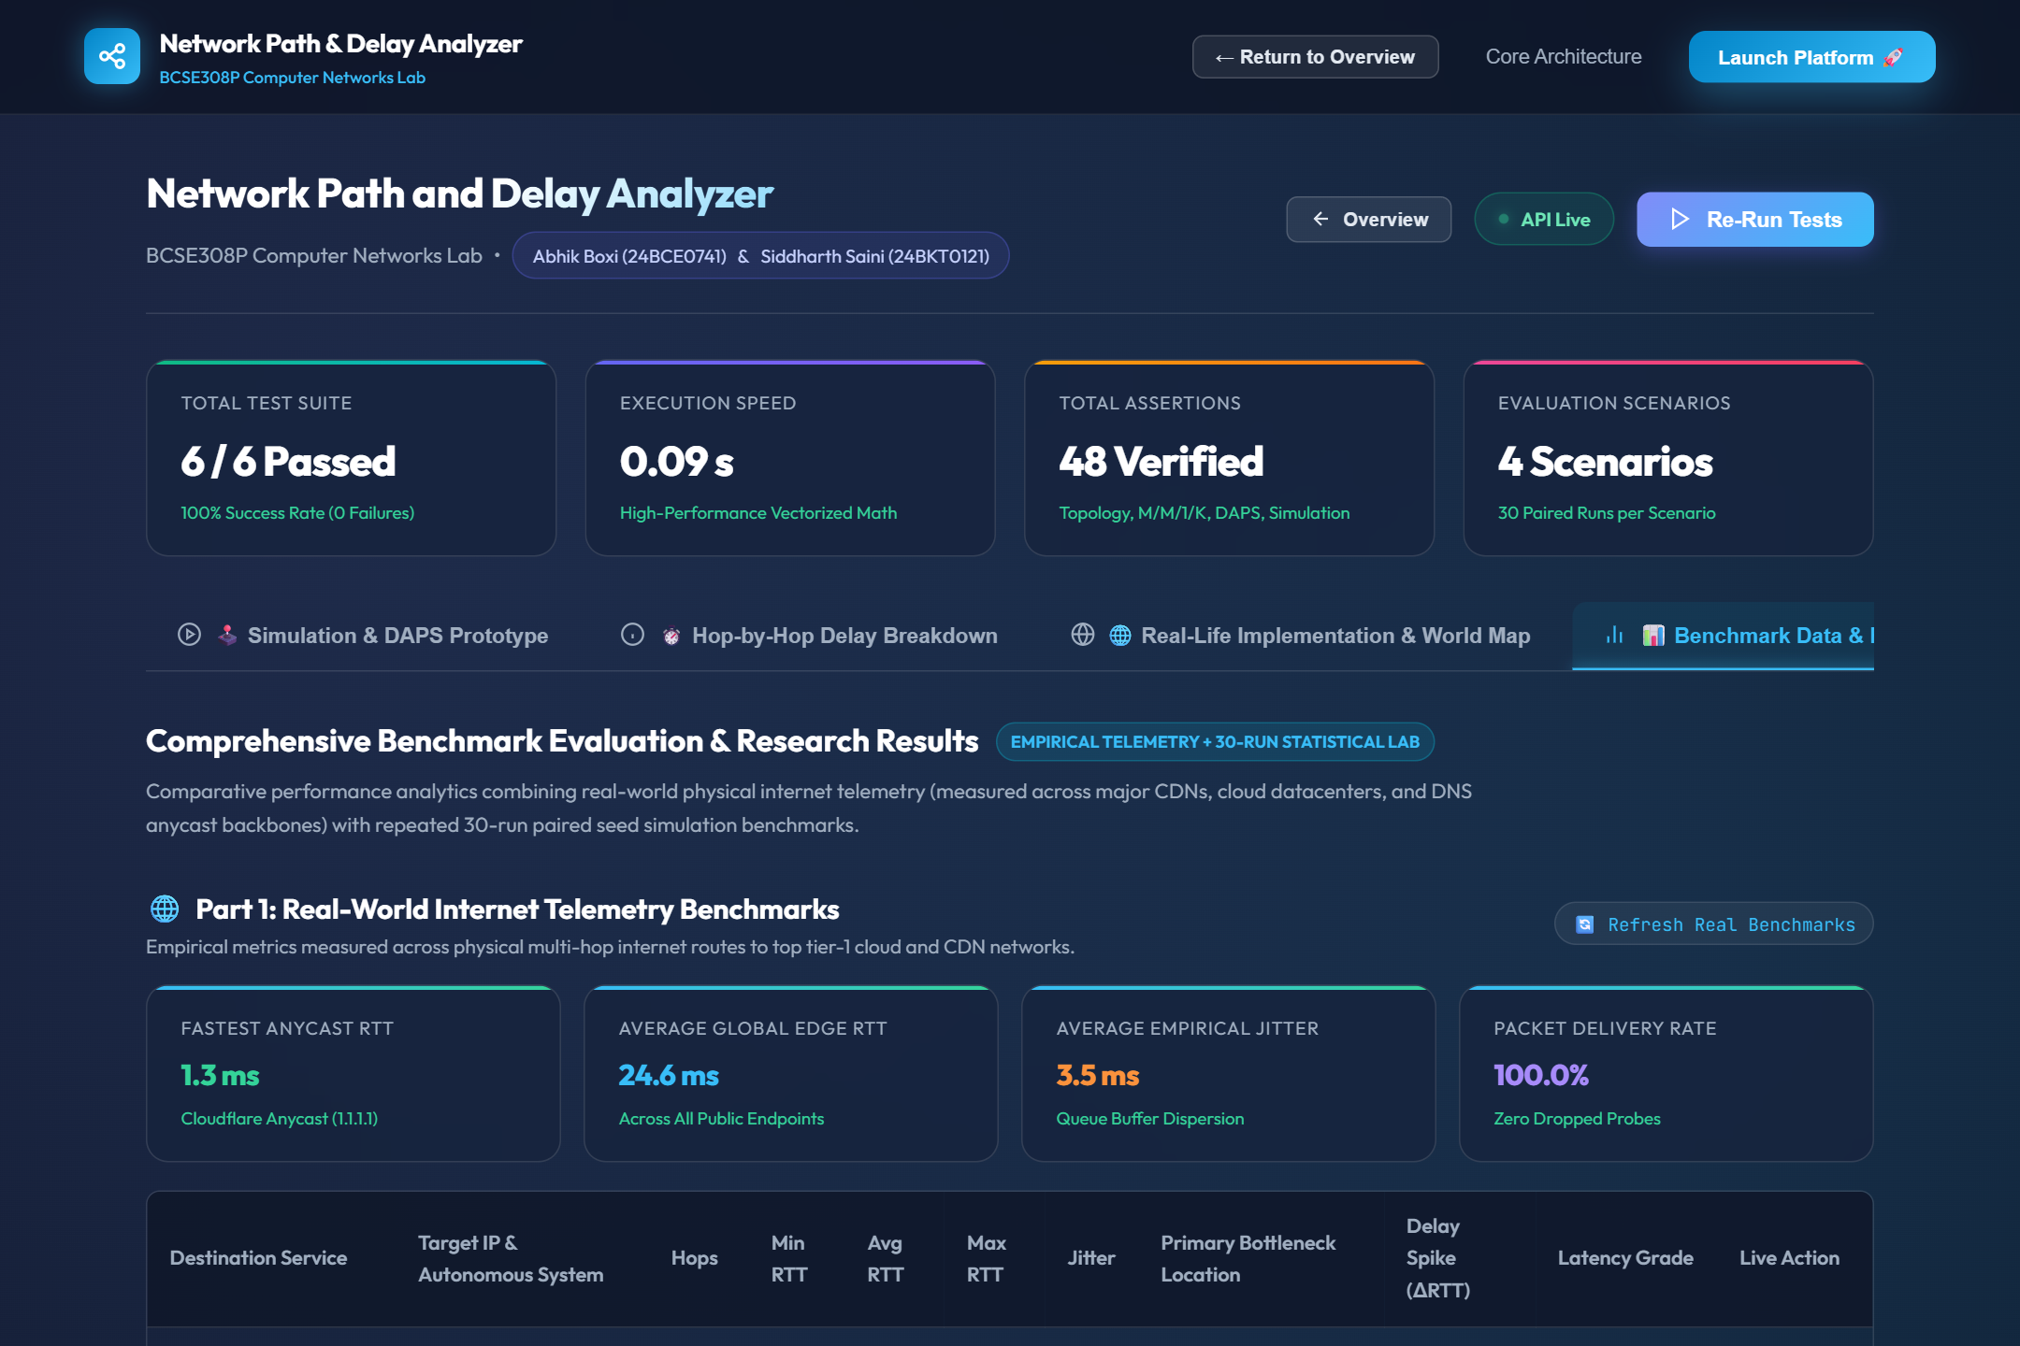
COMPUTER NETWORKS LAB (BCSE308P)
Real-World Telemetry Benchmarks Across Global Edges
Evaluated Edge Endpoints
• 1. Google Search & CDN (142.251.126.100, AS15169):
11 hops | Avg RTT: 26.0 ms | Bottleneck: Jio Gujarat Gateway (+95.7 ms spike).
• 2. Cloudflare Anycast (1.1.1.1, AS13335):
7 hops | Avg RTT: 1.3 ms | Ultra-low jitter (1.0 ms).
• 3. Cloudflare Web Edge (104.16.132.229):
8 hops | Avg RTT: 9.4 ms | Peering via Chennai IXP.
• 4. Microsoft Azure Edge (20.112.52.29, AS8075):
14 hops | Avg RTT: 44.5 ms | Carrier exchange in Mumbai.
• 5. GitHub Fastly Anycast (20.207.73.82):
13 hops | Avg RTT: 41.2 ms | Trans-continental optical subsea path.
Network Path & Delay Analyzer | Abhik Boxi (24BCE0741) & Siddharth Saini (24BKT0121)

Slide 16
COMPUTER NETWORKS LAB (BCSE308P)
Team Contributions & Viva Presentation Split
Abhik Boxi (24BCE0741)
• Modules Owned:
• netmodel.py (Topology, M/M/1/K queue math, background generator)
• analyzer.py (Hop-by-hop delay breakdown & bottleneck finder)
• simulate.py (Discrete 1s simulation loop & metric collector)
• web/react-app.js & web/style.css (React 18 Landing page & GSAP preloader)
• Viva Focus Topics:
• Derivation of M/M/1/K queueing formula & handling rho >= 1
• 4 physical delay components (prop, tx, proc, queue)
• Bottleneck hop percentage calculation
• Interactive React 18 DAPS Congestion Evasion Sandbox
Siddharth Saini (24BKT0121)
• Modules Owned:
• routing.py (Baseline Dijkstra & DAPS class implementation)
• experiments.py (30-run statistical framework, ablation, sensitivity)
• web_server.py (Live traceroute & batch Geo-IP integration)
• Leaflet World Map integration & CLI interface
• Viva Focus Topics:
• DAPS active probing, EWMA smoothing (alpha = 0.3)
• Anti-flapping logic: Hysteresis (10%) and Hold-down (N=2)
• Student's t-test statistical validation
• Real-world traceroute & multi-hop telemetry analysis
Network Path & Delay Analyzer | Abhik Boxi (24BCE0741) & Siddharth Saini (24BKT0121)

Slide 17
COMPUTER NETWORKS LAB (BCSE308P)
Conclusion & Future Work
Summary of Work Done
• Delivered a complete, reproducible Network Path and Delay Analyzer in Python and React 18.
• Demonstrated that DAPS reduces mean delay by 16.4%, 95th-percentile delay by 37.2%, and packet loss by 76.7% in high-load networks.
• Demonstrated 61.4% delay reduction during link capacity degradation events.
• Proved that hysteresis and hold-down effectively eliminate path flapping (reducing switches by 64%).
• Connected theoretical simulation to live networks with a sub-300ms real traceroute engine and Leaflet world map.
Limitations & Future Roadmap
• 1. Programmable Data Plane (P4):
Offload DAPS probe generation and score calculation directly to P4-programmable ASIC switches.
• 2. Multi-Flow & TCP Evaluation:
Assess interaction between DAPS path switches and TCP cubic congestion window / out-of-order packet handling.
• 3. Distributed Multi-Host DAPS:
Explore game-theoretic coordinator or randomization to prevent multiple hosts from synchronizing and simultaneously stampeding onto the same uncongested path.
Network Path & Delay Analyzer | Abhik Boxi (24BCE0741) & Siddharth Saini (24BKT0121)

