Slide 1
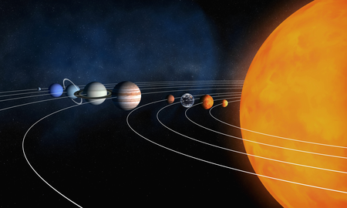
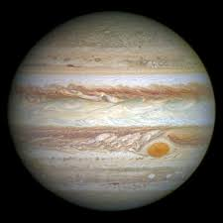
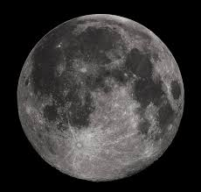
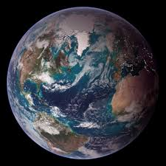
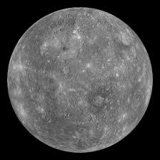
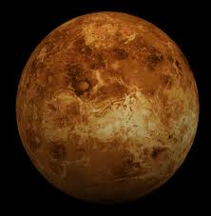
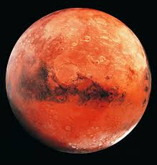

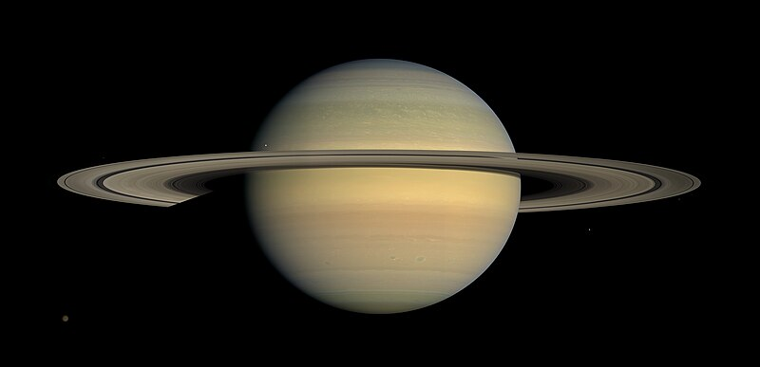
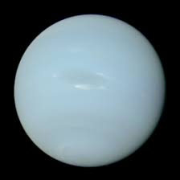
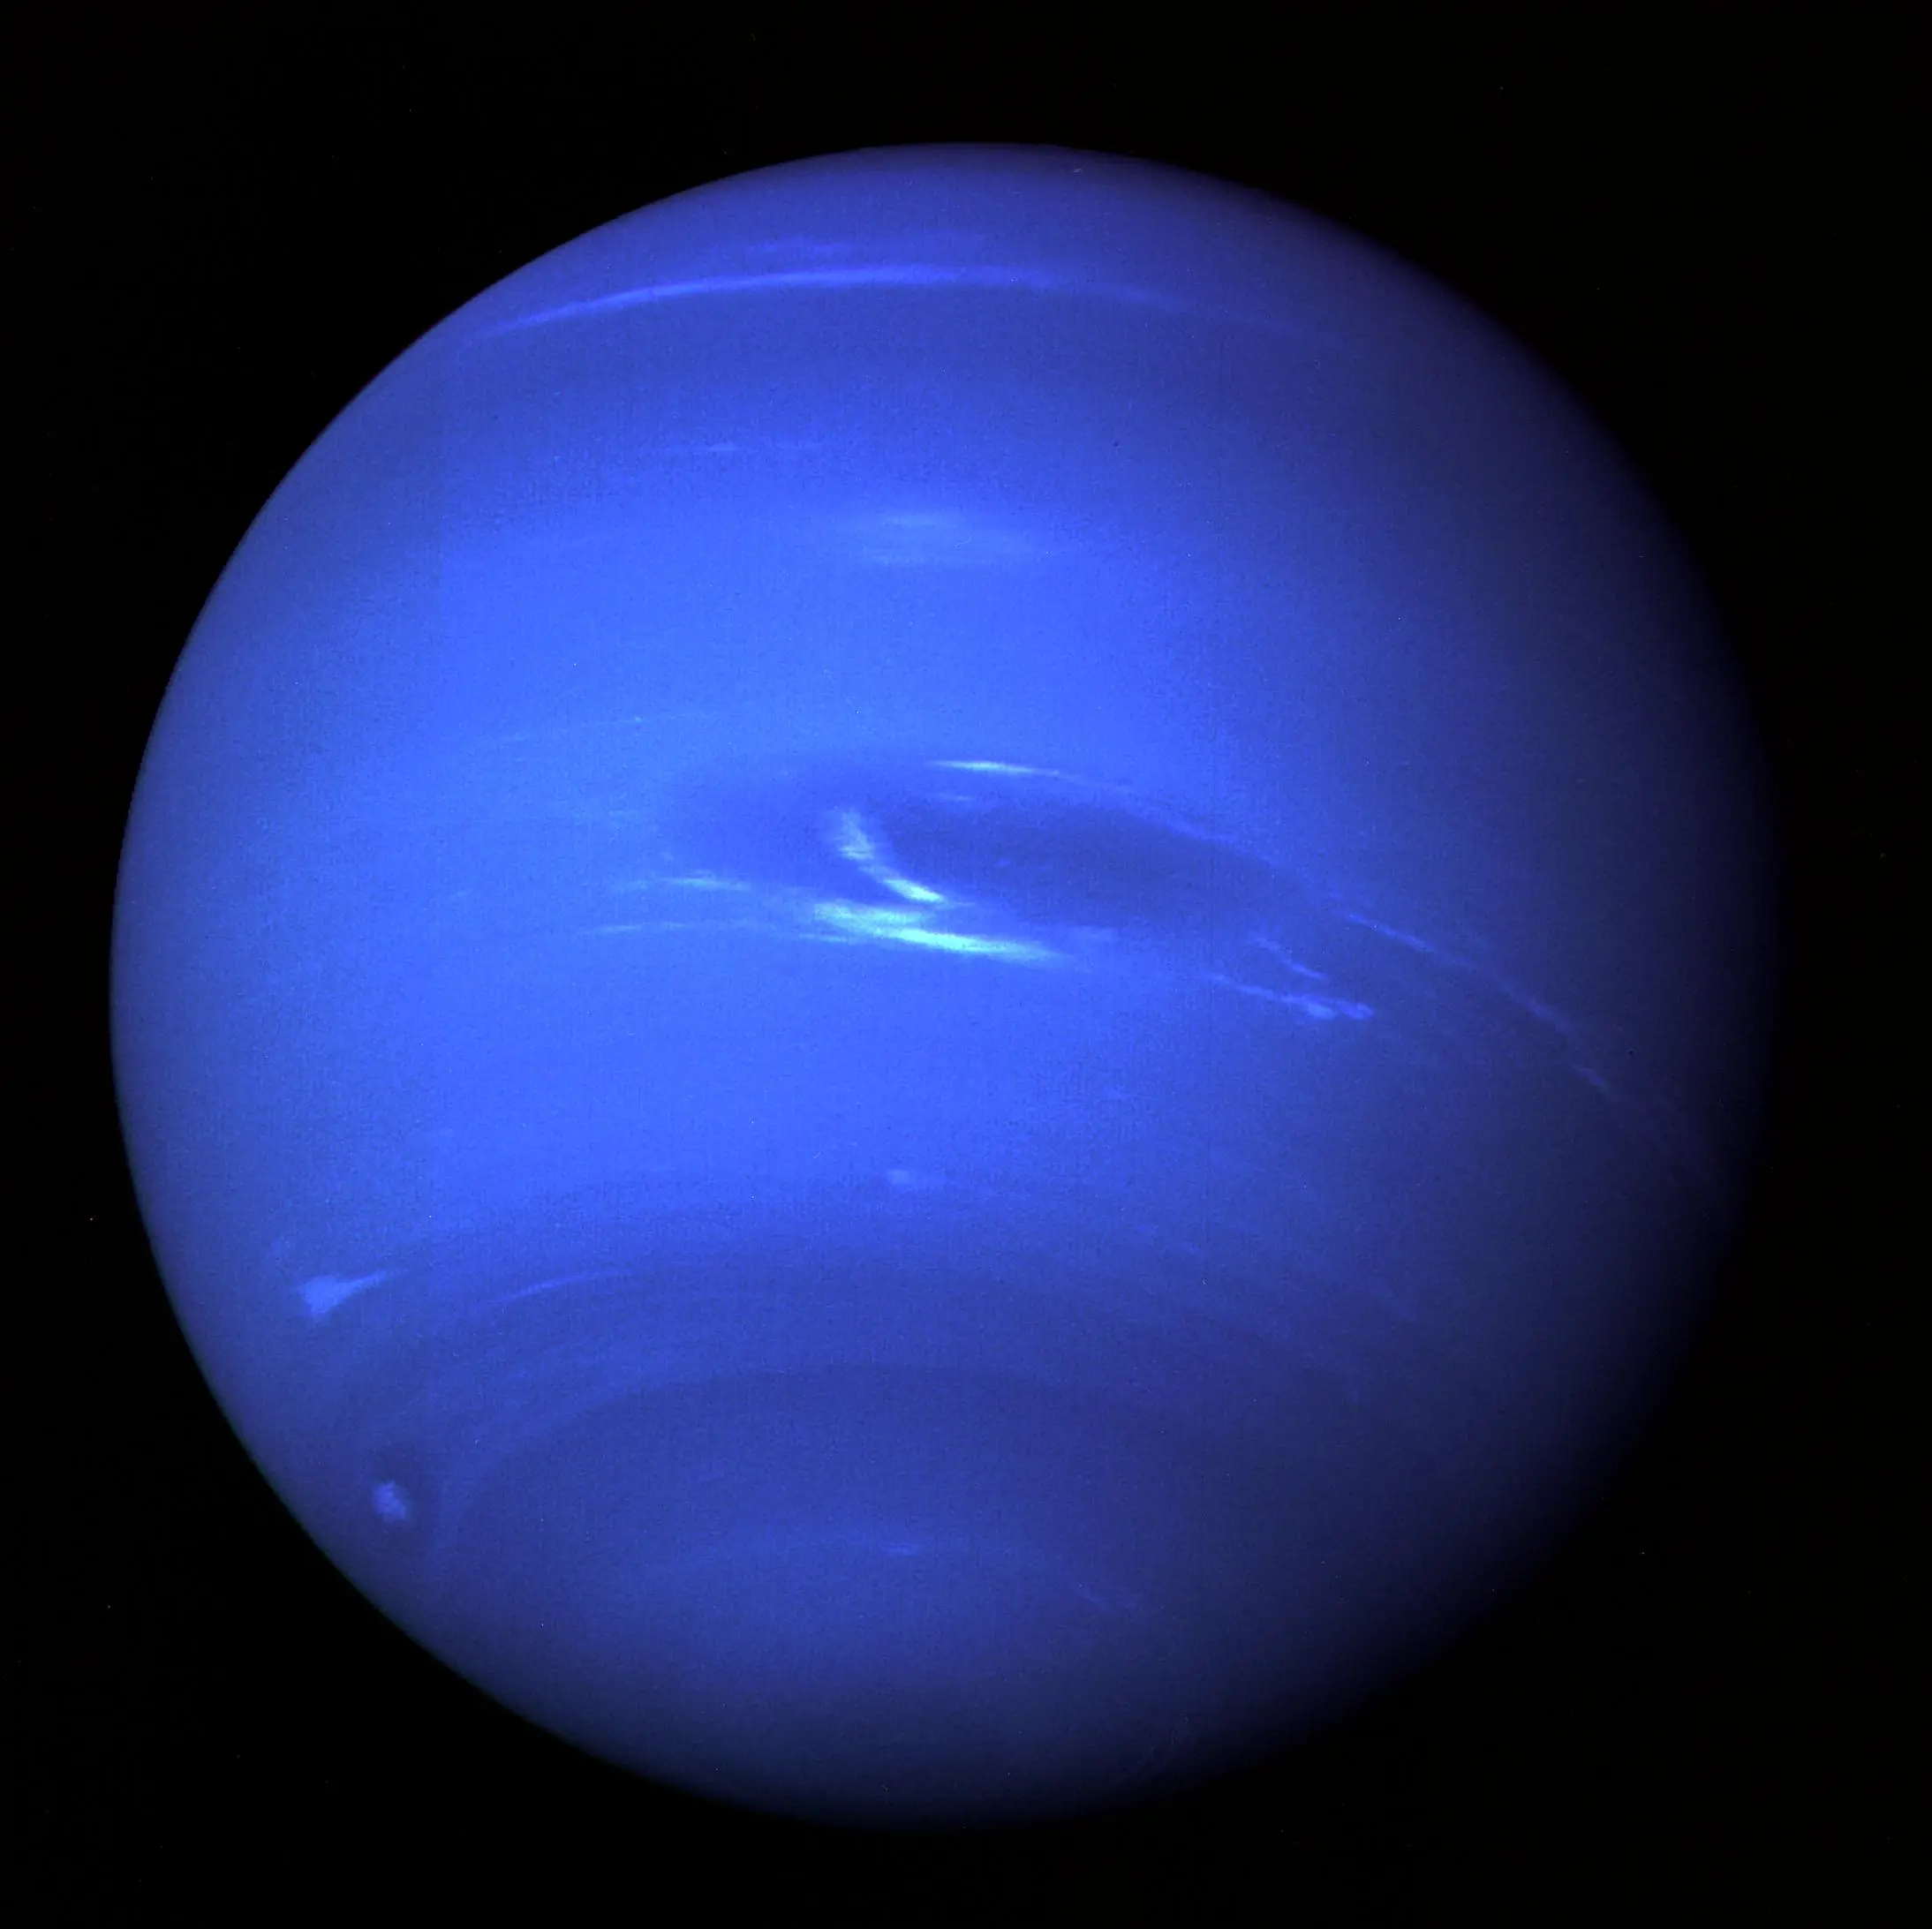
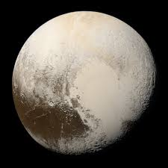
DIGITAL ORRERY

Slide 2
ABOUT US
FRIENDSHIP
PERSEVERENCE
AMBITION
DETERMINATION
HARD WORK
These are the five values we followed to achieve our goal

Slide 3
MERCURY
- Is the closest planet to the Sun
-Is named after the Roman god Mercury
-Is the fastest planet
-Doesn’t have any moons or rings
-Your weight on Mercury would be 38% of your weight on Earth.
-In 1974 and 1975, Mercury was studied for the first time with the help of the Mariner 10 probe
-In 2011, the MESSENGER probe started studying the chemical composition, magnetic field and geology.

Slide 4
VENUS
-Is also called “The Evening Star”
-Is named after the Roman goddess of love, Venus
-Is the most bright object in the sky
- Rotates in the opposite direction to other planets(from west to east)

Slide 5
EARTH
-Is also called “The Blue Planet”
-Is the only known planet to have the perfect conditions for life
-life appeared 4.1 billion years ago
-Earth’s gravity interacts with other objects in space like the Moon and the Sun

Slide 6
THE MOON
-Is the 5th biggest satellite in the Solar System
-Is rotates at the same time with the Earth, showing the same face all the time
-In 1969, NASA reached the Moon with the Apollo 11 aircraft

Slide 7
MARS
-Is named after the Roman god of war, Mars
-Has two moons: Phobos and Demios
-Has the biggest mountain in the Solar System, Olympus Mons
-Has no magnetic field
-Has an orange-red appearance

Slide 8
JUPITER
-Is named after the Roman god of lightning, Jupiter
-Is the biggest planet in the Solar System
-Has rings, but you can’t see them because they are too faint
-Is a gas giant
-A year on Jupiter is the same as 11.8 Earth years

Slide 9
SATURN
-You can’t stand on Saturn
-It’s very windy on Saturn
-Has the most moons in the Solar System
-Has a moon bigger than Mercury
-Is the flattest planet
-Saturn’s upper atmosphere is divided into bands of clouds
Is also known as “The Ringed Planet”

Slide 10
URANUS
-Is named after the Greek god of the sky
-Is 4 times wider than Earth
-Is an ice giant
-Rotates at a nearly 90-degree angle from the plane of its orbit
-Hits the coldest temperatures of any planet

Slide 11
NEPTUNE
-Is named after the Roman god of the sea, Poseidon
-Is the only planet you can’t see from the Earth with the naked eye
-Is an ice giant
-Hits very cold temperatures

Slide 12
PLUTO
-Is named after the Roman god of the dead
-Was considered a planet until 2006
-Is smaller than the moon
-Is sometimes closer to the Sun than to Neptune

Slide 13
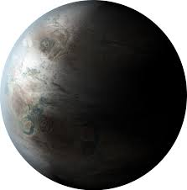
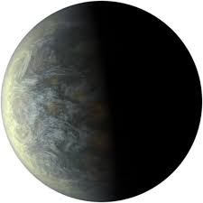
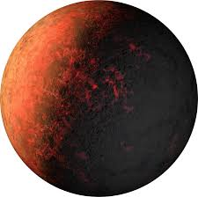
EARTH’S MOST FAMOUS EXOPLANETS:
KEPLER-452b
KEPLER-20f
KOI-961.01
KOI-961.02
KOI-961.03

Slide 14
KEPLER-452b
-Is 60% larger in diameter than Earth and is considered a super-Earth-size planet
-Scientists believe that Kepler-452b is rocky
-Has a habitable zone
EARTH’S MOST FAMOUS EXOPLANETS:
KEPLER-452b
KEPLER-20f
KOI-961.01
KOI-961.02
KOI-961.03

Slide 15
KEPLER-20f
-Was discovered on the 20th of December 2011
-A year on Kepler-20f only lasts 6 days
EARTH’S MOST FAMOUS EXOPLANETS:
KEPLER-452b
KEPLER-20f
KOI-961.01
KOI-961.02
KOI-961.03

Slide 16
KOI-961.01, KOI-961.02
KOI-961.03
-The KOI-961 planetary system hosts the three smallest planets known to orbit a star beyond our sun
-KOI-961.03 is about the same size as Mars
EARTH’S MOST FAMOUS EXOPLANETS:
KEPLER-452b
KEPLER-20f
KOI-961.01
KOI-961.02
KOI-961.03

Slide 17
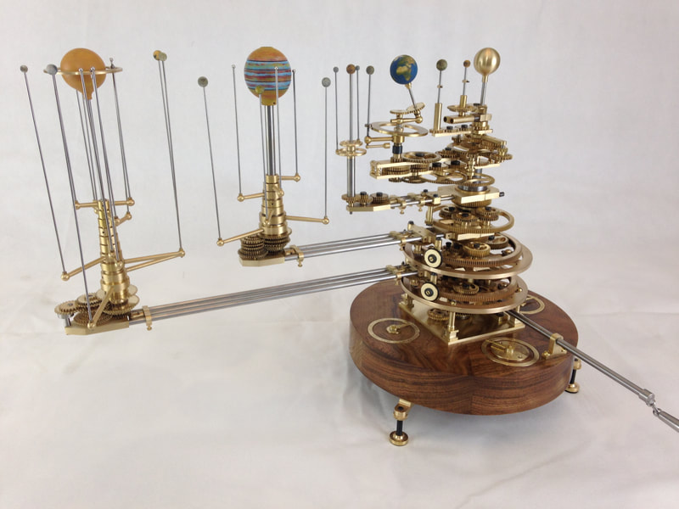
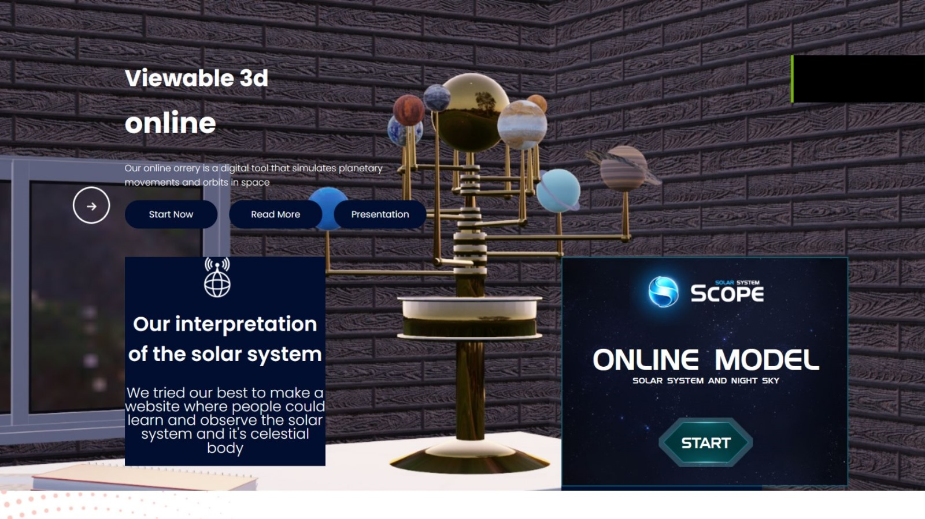
THE ORRERY
Although the ancient greeks to makde a layout of the Solar System, the first orrery, or the modern layout of the Solar System, was built in 1704 by clockmakers George Graham and Thomas Tompion. The name of the instrument came from Charles Boyle, 4th Earl of Orrery, who commissioned one of the earliest models.
An orrery is a mechanical model of the Solar System that shows the relative positions and motions of the planets and moons according to the heliocentric (Sun-centered) model. The first planets in the orrery were made from ivory, which made them very valuable at the time
We developed this idea and upgraded it so anyone can access it whenever they want and uncover the mysteries of the Solar System.
KOI-961.01, KOI-961.02
KOI-961.03
-The KOI-961 planetary system hosts the three smallest planets known to orbit a star beyond our sun
-KOI-961.03 is about the same size as mars
EARTH’S MOST FAMOUS EXOPLANETS:
KEPLER-452b
KEPLER-20f
KOI-961.01
KOI-961.02
KOI-961.03

Slide 18
OUR WEBSITE
We have put all of our info and details on our site, which is called YH_orrery. Our hub contains the PowerPoint, the trailer of the project and the piece of resistance:
The Solar Scope layout
KOI-961.01, KOI-961.02
KOI-961.03
-The KOI-961 planetary system hosts the three smallest planets known to orbit a star beyond our sun
-KOI-961.03 is about the same size as mars
It resembles a very developed model of the Solar System, which can be used for research and fun at the same time!
We found it as a result of our research process, in which we found out the mysteries of the Solar System and got the desire to share it all with the world and you.
EARTH’S MOST FAMOUS EXOPLANETS:
KEPLER-452b
KEPLER-20f
KOI-961.01
KOI-961.02
KOI-961.03

Slide 19
SOURCES
-History of Science Museum
-Britannica
-The Observatory Science Centre
-NASA.gov
KOI-961.01, KOI-961.02
KOI-961.03
-The KOI-961 planetary system hosts the three smallest planets known to orbit a star beyond our sun
-KOI-961.03 is about the same size as mars
EARTH’S MOST FAMOUS EXOPLANETS:
KEPLER-452b
KEPLER-20f
KOI-961.01
KOI-961.02
KOI-961.03

Slide 20
THANK YOU FOR YOUR ATTENTION!
KOI-961.01, KOI-961.02
KOI-961.03
-The KOI-961 planetary system hosts the three smallest planets known to orbit a star beyond our sun
-KOI-961.03 is about the same size as mars
EARTH’S MOST FAMOUS EXOPLANETS:
KEPLER-452b
KEPLER-20f
KOI-961.01
KOI-961.02
KOI-961.03

