Slide 1
Crash Course in Python; Unit 1
Procedural Python
Notes:
Voiceover: This module will introduce you to using Python to calculate various descriptive statistics for a data set, as well as creating some basic plots.

Slide 2
Learning Outcomes
By the end of the module, you will be able to:
  Create re-usable blocks of code
  Create code which can change how it runs during runtime
  Devise code capable of iterating through collections of data
  Terminate these iterations conditionally
  Create custom collections of data within Python
All Python code described and used in this slideshow will be provided in a Jupyter Notebook file, which you can run on TALC to further experiment with. A (non-runnable) PDF version of said code will also be available for reference.
Notes:
Voiceover (VO):
Read each line one by one, finishing on the final remark

Slide 3

What Does it Mean to be Procedural?
Procedural processes are those which work through a list of instructions (procedures) in a specified order
Each of these process can update the state of the system, allowing for future instruction to react to and revise their procedures in response
Most programming languages are procedural in some capacity, though exceptions (like Haskell) do exist
https://theoldmotor.com/wp-content/uploads/2016/02/1932-Ford-Chasiss-Assembly-Line.jpg
Notes:
Python was originally developed in 1990, being named after the comedy group Monty Python.
In contrast to most other languages of the time, it was designed to work at a high level, automating many things that these other languages expected coders to directly manage.
Focus was made to make the language easy to understand, portable across multiple machines, and easily extendable through the use of packages. This has made it incredibly popular for nearly every field, including website management, data science, cryptography, and even game design!

Slide 4
Procedural Programming Terminology, Part 1
Statement: An instruction representing an action to be taken by the computer (such as ‘print’). They are often used alongside arguments, and statements can use and reference other statements
Argument: A value passed to a statement when it is called. For example, with the ‘print’ statement, the string we ask it to print is its only argument
Call: A request to run a statement with a set of defined arguments
Notes:
The second category of statistical analysis is inferential statistics. Inferential statistics are used to make inference, or in other words to draw conclusions, about a population by using data that has been collected on a sample of the population. In order for an inferential statistical analysis to be accurate, the sample that data is collected on must be random and representative of the overall population. Another key aspect of inferential statistics that differs from descriptive statistics is that there must be an expression of the uncertainty surrounding estimates made about the population. Often, you will see this uncertainty expressed with standard error or as a confidence interval.
Inferential analyses are generally more difficult to conduct than descriptive analyses, and require much more planning and thought. It is especially difficult to ensure that a sample is truly a good representation of the population you wish to draw inference about.

Slide 5
Procedural Programming Terminology, Part 2
Block: A group of statements which always run together, forming a chain of instructions which itself can be treated as as statement
  In Python, these are denoted using indentation (via tabs or spaces) underneath the block-defining statement
Scope: The current level of accessibility that a statement or variable has. Python has two categories of scope:
  Global: Element defined globally can be accessed and modified anytime during the program
  Local: Elements created locally within a block can only be accessed by other elements within the same block.
Notes:
The second category of statistical analysis is inferential statistics. Inferential statistics are used to make inference, or in other words to draw conclusions, about a population by using data that has been collected on a sample of the population. In order for an inferential statistical analysis to be accurate, the sample that data is collected on must be random and representative of the overall population. Another key aspect of inferential statistics that differs from descriptive statistics is that there must be an expression of the uncertainty surrounding estimates made about the population. Often, you will see this uncertainty expressed with standard error or as a confidence interval.
Inferential analyses are generally more difficult to conduct than descriptive analyses, and require much more planning and thought. It is especially difficult to ensure that a sample is truly a good representation of the population you wish to draw inference about.

Slide 6
Flow Control

Slide 7

Python Flow Control
Flow control allows a program to dynamically change how it functions
Python has three main forms of flow control:
  Functions: Named blocks of code which can be re-used as needed
  Conditionals: Blocks of code bound to only run under certain conditions
  Loops: Blocks of code which will cycle repeatedly until some condition is met
https://momentum.vicc.org/wp-content/uploads/2011/06/decisiontree.jpg
Notes:
The second category of statistical analysis is inferential statistics. Inferential statistics are used to make inference, or in other words to draw conclusions, about a population by using data that has been collected on a sample of the population. In order for an inferential statistical analysis to be accurate, the sample that data is collected on must be random and representative of the overall population. Another key aspect of inferential statistics that differs from descriptive statistics is that there must be an expression of the uncertainty surrounding estimates made about the population. Often, you will see this uncertainty expressed with standard error or as a confidence interval.
Inferential analyses are generally more difficult to conduct than descriptive analyses, and require much more planning and thought. It is especially difficult to ensure that a sample is truly a good representation of the population you wish to draw inference about.

Slide 8
Functions
Defined in Python with the ‘def’ keyword:
  ~ def test(arg1, arg2):
  ~ print(f”{arg1} - {arg2}”)
The name of a function can be anything which abides by variable naming rules
Functions can have one, many, or no arguments
  Each argument’s names must also abide by the same variable naming rules
Code placed within the function must be indented by some white space (usually a tab or set of spaces) to be recognized as part of that function
  Any code within the function can use the values passed in as arguments, treating them as variables that share their name
Notes:
The second category of statistical analysis is inferential statistics. Inferential statistics are used to make inference, or in other words to draw conclusions, about a population by using data that has been collected on a sample of the population. In order for an inferential statistical analysis to be accurate, the sample that data is collected on must be random and representative of the overall population. Another key aspect of inferential statistics that differs from descriptive statistics is that there must be an expression of the uncertainty surrounding estimates made about the population. Often, you will see this uncertainty expressed with standard error or as a confidence interval.
Inferential analyses are generally more difficult to conduct than descriptive analyses, and require much more planning and thought. It is especially difficult to ensure that a sample is truly a good representation of the population you wish to draw inference about.

Slide 9
Declaring and Calling a Function
The following is a function declaration, which declares a function named “double_val”, which takes one argument (val) and doubles it, reporting the result
  ~ def double_val(val):
  ~ ret_val = val * 2
  ~ print(ret_val)
Now that the function has been , it can be called by its name to run, allowing us to re-use the code within the function alongside different values:
  ~ double_val(2)
  > 4
  ~ double_val(6)
  > 12
Notes:
The second category of statistical analysis is inferential statistics. Inferential statistics are used to make inference, or in other words to draw conclusions, about a population by using data that has been collected on a sample of the population. In order for an inferential statistical analysis to be accurate, the sample that data is collected on must be random and representative of the overall population. Another key aspect of inferential statistics that differs from descriptive statistics is that there must be an expression of the uncertainty surrounding estimates made about the population. Often, you will see this uncertainty expressed with standard error or as a confidence interval.
Inferential analyses are generally more difficult to conduct than descriptive analyses, and require much more planning and thought. It is especially difficult to ensure that a sample is truly a good representation of the population you wish to draw inference about.

Slide 10
Variable Access and Functions
Variables declared in the global scope can be accessed within a function, but variables declared within a function are local within it and cannot be accessed outside of it!
  ~ foo = 4
  ~ def bar(baz):
  ~ # This does not raise an error; ‘foo’ is globally scoped
  ~ bing = baz * foo
  ~ print(bing)
  ~ bar(3)
  > 12
  ~ # This will raise an error; 'bing' is locally scoped in 'bar' and
  ~ # cannot be accessed outside of it
  ~ print(bing)
  > NameError Traceback (most recent call last)
  > ...
  > NameError: name 'bing' is not defined
Notes:
The second category of statistical analysis is inferential statistics. Inferential statistics are used to make inference, or in other words to draw conclusions, about a population by using data that has been collected on a sample of the population. In order for an inferential statistical analysis to be accurate, the sample that data is collected on must be random and representative of the overall population. Another key aspect of inferential statistics that differs from descriptive statistics is that there must be an expression of the uncertainty surrounding estimates made about the population. Often, you will see this uncertainty expressed with standard error or as a confidence interval.
Inferential analyses are generally more difficult to conduct than descriptive analyses, and require much more planning and thought. It is especially difficult to ensure that a sample is truly a good representation of the population you wish to draw inference about.

Slide 11
Returning Data from a Function
We can return local-scope data from a function using the ‘return’ statement, allowing data generated within a function to be accessed outside of it
  ~ def triple_plus_two(val):
  ~ result = val * 3
  ~ result += 2
  ~ return result
  ~ new_val = triple_plus_two(4)
  ~ print(new_val)
  > 14
These returned value(s) can be immediately passed to another function as well
  ~ def minus_3(val):
  ~ return val - 3
  ~ val = minus_3(triple_plus_two(2))
  ~ print(val)
  > 5
Notes:
The second category of statistical analysis is inferential statistics. Inferential statistics are used to make inference, or in other words to draw conclusions, about a population by using data that has been collected on a sample of the population. In order for an inferential statistical analysis to be accurate, the sample that data is collected on must be random and representative of the overall population. Another key aspect of inferential statistics that differs from descriptive statistics is that there must be an expression of the uncertainty surrounding estimates made about the population. Often, you will see this uncertainty expressed with standard error or as a confidence interval.
Inferential analyses are generally more difficult to conduct than descriptive analyses, and require much more planning and thought. It is especially difficult to ensure that a sample is truly a good representation of the population you wish to draw inference about.

Slide 12
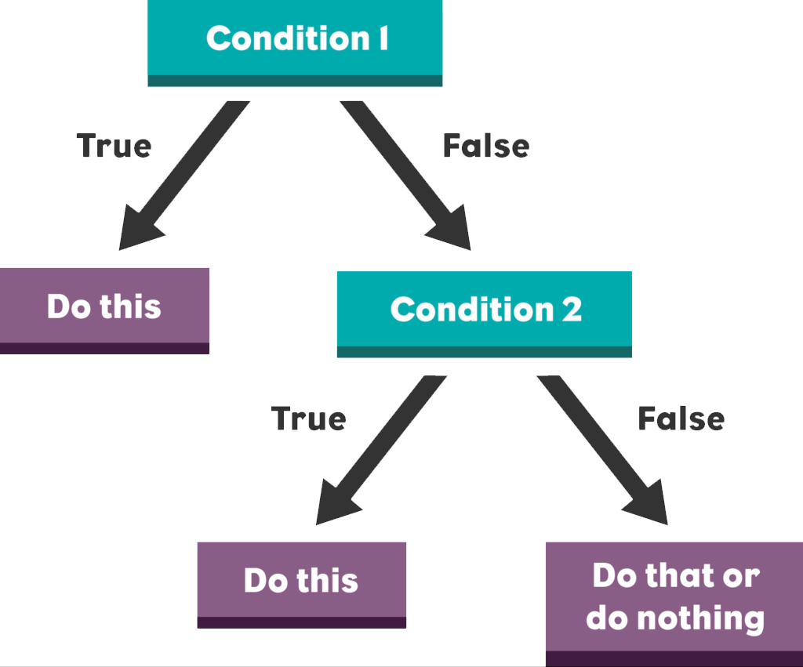
Conditionals
Allows blocks of code to be run conditionally, as specified using either a boolean (true/false) value or statements which return a boolean value
Python has three conditional statements:
  ‘if’: Runs the code within its block if the statement its bound to is ‘true’
  ‘elif’: Runs if the boolean statement provided evaluates to true and the prior ‘if’ or ‘elif’ statement failed to run
  ‘else’: Runs if the prior ‘if’ or ‘elif’ statement failed
https://technovationchallenge.org/wp-content/uploads/2019/03/if-else-if-chart.png
Notes:
The second category of statistical analysis is inferential statistics. Inferential statistics are used to make inference, or in other words to draw conclusions, about a population by using data that has been collected on a sample of the population. In order for an inferential statistical analysis to be accurate, the sample that data is collected on must be random and representative of the overall population. Another key aspect of inferential statistics that differs from descriptive statistics is that there must be an expression of the uncertainty surrounding estimates made about the population. Often, you will see this uncertainty expressed with standard error or as a confidence interval.
Inferential analyses are generally more difficult to conduct than descriptive analyses, and require much more planning and thought. It is especially difficult to ensure that a sample is truly a good representation of the population you wish to draw inference about.

Slide 13
An Example Conditional
Below is a simple if-elif-else chain, which will check and report whether two entered values are greater than, less than, or equal to one another:
  ~ def compare_values():
  ~ val1 = input(“Enter a number:”)
  ~ val2 = input(“Enter another number:”)
  ~ if val1 > val2:
  ~ print(“The first value is greater than the second”)
  ~ elif val1 < val2:
  ~ print(“The first value is less than the second”)
  ~ else:
  ~ print(“The two values are equal”)
  ~ compare_values()
  > Enter a number: 4
  > Enter another number: 5
  > The first value is less than the second
Notes:
The second category of statistical analysis is inferential statistics. Inferential statistics are used to make inference, or in other words to draw conclusions, about a population by using data that has been collected on a sample of the population. In order for an inferential statistical analysis to be accurate, the sample that data is collected on must be random and representative of the overall population. Another key aspect of inferential statistics that differs from descriptive statistics is that there must be an expression of the uncertainty surrounding estimates made about the population. Often, you will see this uncertainty expressed with standard error or as a confidence interval.
Inferential analyses are generally more difficult to conduct than descriptive analyses, and require much more planning and thought. It is especially difficult to ensure that a sample is truly a good representation of the population you wish to draw inference about.

Slide 14
Nested Conditionals
Conditionals can be nested within one another to form branching decision structures:
  ~ def evaluate_program_language(value):
  ~ if value == “Python”:
  ~ print(“Good choice!”)
  ~ elif value == “R”:
  ~ response = input(“Are you a statistician?”)
  ~ # lower() just forces the response to lower case
  ~ if response.lower() == “yes”:
  ~ print(“Reasonable choice”)
  ~ else:
  ~ print(“Bad choice”)
  ~ evaluate_program_language(“Python”)
  > Good choice!
  ~ evaluate_program_language(“R”)
  > Are you a statistician? No
  > Bad choice
Notes:
The second category of statistical analysis is inferential statistics. Inferential statistics are used to make inference, or in other words to draw conclusions, about a population by using data that has been collected on a sample of the population. In order for an inferential statistical analysis to be accurate, the sample that data is collected on must be random and representative of the overall population. Another key aspect of inferential statistics that differs from descriptive statistics is that there must be an expression of the uncertainty surrounding estimates made about the population. Often, you will see this uncertainty expressed with standard error or as a confidence interval.
Inferential analyses are generally more difficult to conduct than descriptive analyses, and require much more planning and thought. It is especially difficult to ensure that a sample is truly a good representation of the population you wish to draw inference about.

Slide 15

Loops
Structures which repeat a block of code until some condition is met
Python has two loop structures:
  ‘while’: repeats the block of code until an if-like statement fails to be met. This can result in the loop repeating indefinitely
  ‘for’: repeats the block of code once for every element within an iterable (an object which can be iterated through)
https://www.onlinewebfonts.com/icon/477127
Notes:
The second category of statistical analysis is inferential statistics. Inferential statistics are used to make inference, or in other words to draw conclusions, about a population by using data that has been collected on a sample of the population. In order for an inferential statistical analysis to be accurate, the sample that data is collected on must be random and representative of the overall population. Another key aspect of inferential statistics that differs from descriptive statistics is that there must be an expression of the uncertainty surrounding estimates made about the population. Often, you will see this uncertainty expressed with standard error or as a confidence interval.
Inferential analyses are generally more difficult to conduct than descriptive analyses, and require much more planning and thought. It is especially difficult to ensure that a sample is truly a good representation of the population you wish to draw inference about.

Slide 16
‘While’ Loops
Like an ‘if’ statement, ‘while’ statements require a single statement which evaluates to a boolean value (true/false). This condition is evaluated once every loop, before the loop’s code block is run.
  This means the block of code can also never run, if the condition is false when the ‘while’ statement is encountered
  ~ i = 0
  ~ while i < 5:
  ~ print(i)
  ~ i += 1
  > 0
  > 1
  > 2
  > 3
  > 4
Notes:
The second category of statistical analysis is inferential statistics. Inferential statistics are used to make inference, or in other words to draw conclusions, about a population by using data that has been collected on a sample of the population. In order for an inferential statistical analysis to be accurate, the sample that data is collected on must be random and representative of the overall population. Another key aspect of inferential statistics that differs from descriptive statistics is that there must be an expression of the uncertainty surrounding estimates made about the population. Often, you will see this uncertainty expressed with standard error or as a confidence interval.
Inferential analyses are generally more difficult to conduct than descriptive analyses, and require much more planning and thought. It is especially difficult to ensure that a sample is truly a good representation of the population you wish to draw inference about.

Slide 17
‘For’ Loops
For loops use an iterable to determine when to terminate, running their block of code once per iteration. The element being used within the iterable for each iteration can be labelled as a variable, being treated like a function’s argument:
  ~ # Note: ‘range’ provides the range of numbers
  ~ # between 0 and the specified value
  ~ for i in range(5):
  ~ print(i)
  > 0
  > 1
  > 2
  > 3
  > 4
Notes:
The second category of statistical analysis is inferential statistics. Inferential statistics are used to make inference, or in other words to draw conclusions, about a population by using data that has been collected on a sample of the population. In order for an inferential statistical analysis to be accurate, the sample that data is collected on must be random and representative of the overall population. Another key aspect of inferential statistics that differs from descriptive statistics is that there must be an expression of the uncertainty surrounding estimates made about the population. Often, you will see this uncertainty expressed with standard error or as a confidence interval.
Inferential analyses are generally more difficult to conduct than descriptive analyses, and require much more planning and thought. It is especially difficult to ensure that a sample is truly a good representation of the population you wish to draw inference about.

Slide 18
Terminating Loops Prematurely
Loops can also be terminated explicitly using the ‘break’ statement:
  ~ for i in range(5):
  ~ if i > 1:
  ~ break
  ~ print(i)
  > 0
  > 1
Alternatively, a single cycle (rather than the entire loop) can be skipped using the ‘continue’ statement:
  ~ for i in range(3):
  ~ if i == 1:
  ~ continue
  ~ print(i)
  > 0
  > 2
Notes:
The second category of statistical analysis is inferential statistics. Inferential statistics are used to make inference, or in other words to draw conclusions, about a population by using data that has been collected on a sample of the population. In order for an inferential statistical analysis to be accurate, the sample that data is collected on must be random and representative of the overall population. Another key aspect of inferential statistics that differs from descriptive statistics is that there must be an expression of the uncertainty surrounding estimates made about the population. Often, you will see this uncertainty expressed with standard error or as a confidence interval.
Inferential analyses are generally more difficult to conduct than descriptive analyses, and require much more planning and thought. It is especially difficult to ensure that a sample is truly a good representation of the population you wish to draw inference about.

Slide 19

Lists
Lists are collections of data which can be iterated through in order, and are declared using square brackets.
Lists are iterable, and thus can be used as part of a ‘for’ loop:
  ~ list1 = [1, True, ‘F’, “Hello World!”]
  ~ for i in list1:
  ~ print(i)
  > 1
  > True
  > F
  > Hello World!
http://4.bp.blogspot.com/-8HfLPbR1n0M/VLREeYjL0pI/AAAAAAAAAb8/CxNo7Qn3vG0/s1600/To-Do%2BList.png
Notes:
The second category of statistical analysis is inferential statistics. Inferential statistics are used to make inference, or in other words to draw conclusions, about a population by using data that has been collected on a sample of the population. In order for an inferential statistical analysis to be accurate, the sample that data is collected on must be random and representative of the overall population. Another key aspect of inferential statistics that differs from descriptive statistics is that there must be an expression of the uncertainty surrounding estimates made about the population. Often, you will see this uncertainty expressed with standard error or as a confidence interval.
Inferential analyses are generally more difficult to conduct than descriptive analyses, and require much more planning and thought. It is especially difficult to ensure that a sample is truly a good representation of the population you wish to draw inference about.

Slide 20

Selecting List Elements
Lists are queried identically to strings. This is because strings are actually just collections of characters, and both use the same querying syntax:
  ~ list1 = [1, 4, 9, 16]
  ~ print(list1[0])
  > 1
  ~ list2 = list1[2:]
  ~ print(list2)
  > [9, 16]
  ~ print(list1[1:3])
  > [4, 9]
Notes:
The second category of statistical analysis is inferential statistics. Inferential statistics are used to make inference, or in other words to draw conclusions, about a population by using data that has been collected on a sample of the population. In order for an inferential statistical analysis to be accurate, the sample that data is collected on must be random and representative of the overall population. Another key aspect of inferential statistics that differs from descriptive statistics is that there must be an expression of the uncertainty surrounding estimates made about the population. Often, you will see this uncertainty expressed with standard error or as a confidence interval.
Inferential analyses are generally more difficult to conduct than descriptive analyses, and require much more planning and thought. It is especially difficult to ensure that a sample is truly a good representation of the population you wish to draw inference about.

Slide 21
Updating Existing Lists
To add an element to an existing list, we can use the ‘append’ function of the list:
  ~ list1 = [‘a’]
  ~ list1.append(‘b’)
  ~ print(list1)
  > [‘a’, ‘b’]
Note that appending a list to another will append the (new) list itself, not its contents. If you want to extent a list with another’s contents, use the ‘extend’ list function:
  ~ list1 = [‘a’]
  ~ list2 = [‘b’]
  ~ list1.append(list2)
  ~ print(list1)
  > [‘a’, [‘b’]]
  ~ list1 = [‘a’]
  ~ list1.extend(list2)
  ~ print(list1)
  ~ [‘a’, ‘b’]
Notes:
The second category of statistical analysis is inferential statistics. Inferential statistics are used to make inference, or in other words to draw conclusions, about a population by using data that has been collected on a sample of the population. In order for an inferential statistical analysis to be accurate, the sample that data is collected on must be random and representative of the overall population. Another key aspect of inferential statistics that differs from descriptive statistics is that there must be an expression of the uncertainty surrounding estimates made about the population. Often, you will see this uncertainty expressed with standard error or as a confidence interval.
Inferential analyses are generally more difficult to conduct than descriptive analyses, and require much more planning and thought. It is especially difficult to ensure that a sample is truly a good representation of the population you wish to draw inference about.

Slide 22
Removing Elements from Lists
We can delete an element based on its location using the ‘pop’ function. If we do not pass an index, it will always delete the last element in the list instead:
  ~ num_list = [0, 2, 4]
  ~ num_list.pop(1)
  ~ print(num_list)
  > [0, 4]
  ~ num_list.pop()
  ~ print(num_list)
  > [0]
Alternatively, an element can be removed based on it’s value with the ‘remove’ function. This will only delete the first instance of said element, however:
  ~ char_list = [‘A’, ‘B’, ‘C’, ‘B’]
  ~ char_list.remove(‘B’)
  ~ print(char_list)
  > [‘A’, ‘C’, ‘B’]
Notes:
The second category of statistical analysis is inferential statistics. Inferential statistics are used to make inference, or in other words to draw conclusions, about a population by using data that has been collected on a sample of the population. In order for an inferential statistical analysis to be accurate, the sample that data is collected on must be random and representative of the overall population. Another key aspect of inferential statistics that differs from descriptive statistics is that there must be an expression of the uncertainty surrounding estimates made about the population. Often, you will see this uncertainty expressed with standard error or as a confidence interval.
Inferential analyses are generally more difficult to conduct than descriptive analyses, and require much more planning and thought. It is especially difficult to ensure that a sample is truly a good representation of the population you wish to draw inference about.

Slide 23
Putting it All Together!

Slide 24
Lets Test your Learning!
You have been tasked to create another Python program. This one should:
  Greet the user
  Request numbers from the user until:
    The sum of all collected absolute values exceeds 100, or...
    The user enters “done”
  Using the set of numbers collected prior, report the following for each:
    The number, plus 2
    The cumulative product of all numbers up to and including this new number.
      Said cumulative product should be initialized with a value of 1
An incomplete Python script file has been provided with comment hints for each of the above steps for you to test your learning. A key for this document has also been provided, should you want to check your answer
Notes:
The second category of statistical analysis is inferential statistics. Inferential statistics are used to make inference, or in other words to draw conclusions, about a population by using data that has been collected on a sample of the population. In order for an inferential statistical analysis to be accurate, the sample that data is collected on must be random and representative of the overall population. Another key aspect of inferential statistics that differs from descriptive statistics is that there must be an expression of the uncertainty surrounding estimates made about the population. Often, you will see this uncertainty expressed with standard error or as a confidence interval.
Inferential analyses are generally more difficult to conduct than descriptive analyses, and require much more planning and thought. It is especially difficult to ensure that a sample is truly a good representation of the population you wish to draw inference about.

Slide 25
Thank you!
Please send inquiries to kalum.ost@ucalgary.ca

