Slide 1
Crash Course in Python; Unit 3
Plotting Data with MatPlotLib
Notes:
Voiceover: This module will introduce you to using Python to calculate various descriptive statistics for a data set, as well as creating some basic plots.

Slide 2
Learning Outcomes
By the end of the module, you will be able to:
  Using matplotlib, plot pandas data using the following plot types:
    Line
    Scatter
    Bar/Histogram
  Customize plots
    Figure and axis titles
    Element coloration and style
  Display multiple plots simultaneously with overlays and sub-figures
All Python code described and used in this slideshow will be provided in a Jupyter Notebook file, which you can run on TALC to further experiment with. A (non-runnable) PDF version of said code will also be available for reference.
Notes:
Voiceover (VO):
Read each line one by one, finishing on the final remark

Slide 3
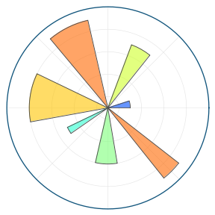
MatPlotLib
MatPlotLib is a Python library which allows for the generation of custom defined plots, primarily for use in data visualization and publication
Based on the plotting library for the MatLab language, using similar syntax and structure.
While it can plot most data faithfully, other libraries exist which extend it’s capabilities to other plots (such as for geography plots using geopandas)
https://matplotlib.org/stable/gallery/misc/logos2.html
Notes:
Python was originally developed in 1990, being named after the comedy group Monty Python.
In contrast to most other languages of the time, it was designed to work at a high level, automating many things that these other languages expected coders to directly manage.
Focus was made to make the language easy to understand, portable across multiple machines, and easily extendable through the use of packages. This has made it incredibly popular for nearly every field, including website management, data science, cryptography, and even game design!

Slide 4
Importing PyPlot
PyPlot is MatPlotLib’s Python-oriented component, which allows for fast and easy plotting of numerical data, including Pandas DataFrame data.
It can be imported using a combination of the import commands we discussed in the prior lecture, like so:
  ~ from matplotlib import pyplot
Like Pandas and Numpy, Pyplot is often imported with the pseudonym ‘plt’:
  ~ from matplotlib import pyplot as plt
Notes:
The second category of statistical analysis is inferential statistics. Inferential statistics are used to make inference, or in other words to draw conclusions, about a population by using data that has been collected on a sample of the population. In order for an inferential statistical analysis to be accurate, the sample that data is collected on must be random and representative of the overall population. Another key aspect of inferential statistics that differs from descriptive statistics is that there must be an expression of the uncertainty surrounding estimates made about the population. Often, you will see this uncertainty expressed with standard error or as a confidence interval.
Inferential analyses are generally more difficult to conduct than descriptive analyses, and require much more planning and thought. It is especially difficult to ensure that a sample is truly a good representation of the population you wish to draw inference about.

Slide 5
Basic Plots

Slide 6
Basics of Data Plotting; the Plotting Workspace
PyPlot works within a plotting workspace, where ‘paint’ our desired plot elements one by one. This allows for a number of handy utilities:
  Plotting multiple datasets on the same plot with different settings (i.e. color-coding)
  Renaming axes labels/titles without re-plotting everything from scratch
  Shared workspace accessible to all functions, enabling extensions with external libraries
Notes:
The second category of statistical analysis is inferential statistics. Inferential statistics are used to make inference, or in other words to draw conclusions, about a population by using data that has been collected on a sample of the population. In order for an inferential statistical analysis to be accurate, the sample that data is collected on must be random and representative of the overall population. Another key aspect of inferential statistics that differs from descriptive statistics is that there must be an expression of the uncertainty surrounding estimates made about the population. Often, you will see this uncertainty expressed with standard error or as a confidence interval.
Inferential analyses are generally more difficult to conduct than descriptive analyses, and require much more planning and thought. It is especially difficult to ensure that a sample is truly a good representation of the population you wish to draw inference about.

Slide 7
Basics of Data Plotting; Saving and Clearing Plots
To save a plot you have generated, the ‘plt.savefig’ function can be used to save it to a file of the desired name and format.
  We recommend saving plots as SVG files, as they can be re-scaled to any size without issues; other common image formats (such as PNG) are also supported, however:
  ~ # NOTE: As we haven’t plotted anything,
  ~ # this just saves a blank image
  ~ plt.savefig(‘my_plot.svg’)
If you want to start a new plot and clear the plotting workspace, the ‘plt.close’ function should be used before doing so:
  ~ plt.close()
Notes:
The second category of statistical analysis is inferential statistics. Inferential statistics are used to make inference, or in other words to draw conclusions, about a population by using data that has been collected on a sample of the population. In order for an inferential statistical analysis to be accurate, the sample that data is collected on must be random and representative of the overall population. Another key aspect of inferential statistics that differs from descriptive statistics is that there must be an expression of the uncertainty surrounding estimates made about the population. Often, you will see this uncertainty expressed with standard error or as a confidence interval.
Inferential analyses are generally more difficult to conduct than descriptive analyses, and require much more planning and thought. It is especially difficult to ensure that a sample is truly a good representation of the population you wish to draw inference about.

Slide 8
Basics of Data Plotting; Plotting Function Structure
Nearly all of PyPlot’s 2D plotting functions take two arguments, which represent the following in some manner:
  x: The positions along the x-axis that the plot’s elements should be placed at
  y: The positions along the y-axis that the plot’s elements should be placed at
Both of these must be a collection of some kind, and be of the same length. Thankfully, columns and rows taken from the same Pandas DataFrame satisfy both of these for us:
  ~ # Load the iris data we want to plot
  ~ df = pd.read_csv(‘iris_data.tsv’, sep=’\t’)
Notes:
The second category of statistical analysis is inferential statistics. Inferential statistics are used to make inference, or in other words to draw conclusions, about a population by using data that has been collected on a sample of the population. In order for an inferential statistical analysis to be accurate, the sample that data is collected on must be random and representative of the overall population. Another key aspect of inferential statistics that differs from descriptive statistics is that there must be an expression of the uncertainty surrounding estimates made about the population. Often, you will see this uncertainty expressed with standard error or as a confidence interval.
Inferential analyses are generally more difficult to conduct than descriptive analyses, and require much more planning and thought. It is especially difficult to ensure that a sample is truly a good representation of the population you wish to draw inference about.

Slide 9
The Jack-of-All-Trades; Scatter Plots with ‘plt.scatter’
Pyplot’s simplest plot is a scatter plot, characterized by it’s elements being ‘scattered’ across the plot’s area without any connection to one another.
We can plot data in this way using the ‘scatter’ function of PyPlot. Plotting data in this way will plot one point on the plot per pair of x and y co-ordinates, without any connection to one another:
  ~ # Plot sepal length against sepal width
  ~ plt.scatter(
  ~ x=df.loc[:, ‘Sepal Length’],
  ~ y=df.loc[:, ‘Sepal Width’]
  ~ )
Notes:
The second category of statistical analysis is inferential statistics. Inferential statistics are used to make inference, or in other words to draw conclusions, about a population by using data that has been collected on a sample of the population. In order for an inferential statistical analysis to be accurate, the sample that data is collected on must be random and representative of the overall population. Another key aspect of inferential statistics that differs from descriptive statistics is that there must be an expression of the uncertainty surrounding estimates made about the population. Often, you will see this uncertainty expressed with standard error or as a confidence interval.
Inferential analyses are generally more difficult to conduct than descriptive analyses, and require much more planning and thought. It is especially difficult to ensure that a sample is truly a good representation of the population you wish to draw inference about.

Slide 10
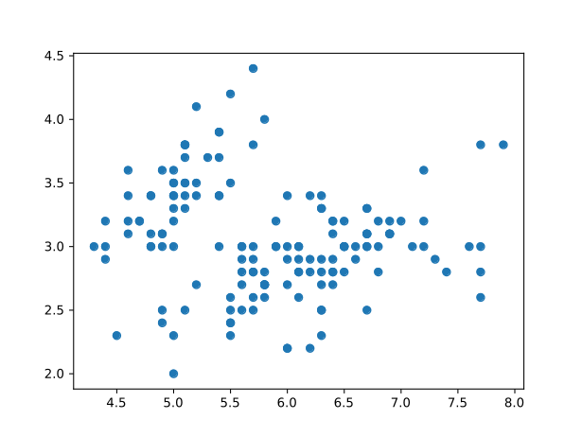
The Resulting Plot
Notes:
The second category of statistical analysis is inferential statistics. Inferential statistics are used to make inference, or in other words to draw conclusions, about a population by using data that has been collected on a sample of the population. In order for an inferential statistical analysis to be accurate, the sample that data is collected on must be random and representative of the overall population. Another key aspect of inferential statistics that differs from descriptive statistics is that there must be an expression of the uncertainty surrounding estimates made about the population. Often, you will see this uncertainty expressed with standard error or as a confidence interval.
Inferential analyses are generally more difficult to conduct than descriptive analyses, and require much more planning and thought. It is especially difficult to ensure that a sample is truly a good representation of the population you wish to draw inference about.

Slide 11
For Shifting Trends; Line-based Plots with ‘plt.plot’
Pyplot’s ‘default’ plot is a line plot, characterized by it’s elements being connected in the order they were provided via a line.
  This means that, if the data along the x-axis is not sorted, the line can go “backwards” in places!
Plotting data in this way uses the ‘plot’ function. Said data will be plotted as one point on the plot per pair of x and y co-ordinates, connecting them to each other in the order they were specified:
  ~ # Plot sepal length against width again
  ~ plt.plot(
  ~ df.sort_values(by=‘Sepal Length’)
  ~ .loc[:, ‘Sepal Length’],
  ~ df.sort_values(by=‘Sepal Length’)
  ~ .loc[:, ‘Sepal Width’]
  ~ )
Notes:
The second category of statistical analysis is inferential statistics. Inferential statistics are used to make inference, or in other words to draw conclusions, about a population by using data that has been collected on a sample of the population. In order for an inferential statistical analysis to be accurate, the sample that data is collected on must be random and representative of the overall population. Another key aspect of inferential statistics that differs from descriptive statistics is that there must be an expression of the uncertainty surrounding estimates made about the population. Often, you will see this uncertainty expressed with standard error or as a confidence interval.
Inferential analyses are generally more difficult to conduct than descriptive analyses, and require much more planning and thought. It is especially difficult to ensure that a sample is truly a good representation of the population you wish to draw inference about.

Slide 12
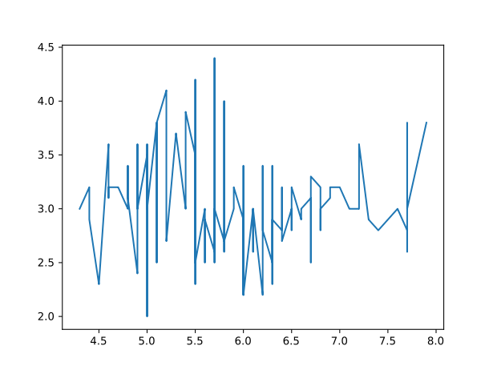
The Resulting Plot
Notes:
The second category of statistical analysis is inferential statistics. Inferential statistics are used to make inference, or in other words to draw conclusions, about a population by using data that has been collected on a sample of the population. In order for an inferential statistical analysis to be accurate, the sample that data is collected on must be random and representative of the overall population. Another key aspect of inferential statistics that differs from descriptive statistics is that there must be an expression of the uncertainty surrounding estimates made about the population. Often, you will see this uncertainty expressed with standard error or as a confidence interval.
Inferential analyses are generally more difficult to conduct than descriptive analyses, and require much more planning and thought. It is especially difficult to ensure that a sample is truly a good representation of the population you wish to draw inference about.

Slide 13
For Comparisons; Bar Plots with ‘plt.bar’
Bar plots are characterized by their “bars” of data, making them useful for visualizing differences in the values of our data
To plot data in this way, the ‘bar’ function is used. It takes an ‘x’ and ‘height’ argument as it’s x and y equivalents; the latter, as the name implies, specifies the height of the bars:
  ~ # Compare mean petal lengths across species
  ~ plt.bar(
  ~ # We have 3 species, thus we want 3 positions
  ~ x=[1, 2, 3],
  ~ # The mean length for each species, using ‘groupby’
  ~ height=df.groupby(“Species”)
  ~ .apply(np.mean).loc[:, “Petal Length”]
  ~ )
Notes:
The second category of statistical analysis is inferential statistics. Inferential statistics are used to make inference, or in other words to draw conclusions, about a population by using data that has been collected on a sample of the population. In order for an inferential statistical analysis to be accurate, the sample that data is collected on must be random and representative of the overall population. Another key aspect of inferential statistics that differs from descriptive statistics is that there must be an expression of the uncertainty surrounding estimates made about the population. Often, you will see this uncertainty expressed with standard error or as a confidence interval.
Inferential analyses are generally more difficult to conduct than descriptive analyses, and require much more planning and thought. It is especially difficult to ensure that a sample is truly a good representation of the population you wish to draw inference about.

Slide 14
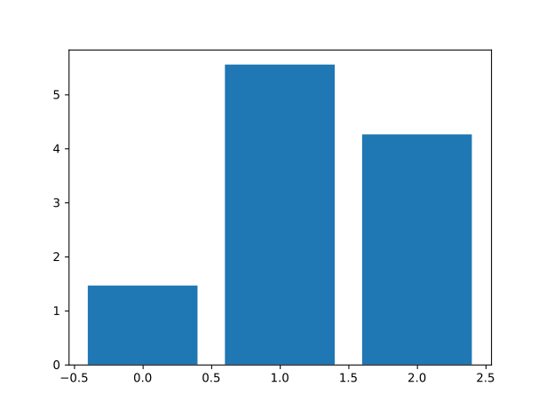
The Resulting Plot
Notes:
The second category of statistical analysis is inferential statistics. Inferential statistics are used to make inference, or in other words to draw conclusions, about a population by using data that has been collected on a sample of the population. In order for an inferential statistical analysis to be accurate, the sample that data is collected on must be random and representative of the overall population. Another key aspect of inferential statistics that differs from descriptive statistics is that there must be an expression of the uncertainty surrounding estimates made about the population. Often, you will see this uncertainty expressed with standard error or as a confidence interval.
Inferential analyses are generally more difficult to conduct than descriptive analyses, and require much more planning and thought. It is especially difficult to ensure that a sample is truly a good representation of the population you wish to draw inference about.

Slide 15
For Distributions; Histograms with ‘plt.hist’
Like bar plots, histograms plot data using “bars”. However, instead of plotting raw values, they instead plot how many values fall within a given range of values, specified as a proportion of the total range from the minimum to maximum value in the overall dataset.
We can plot data in this way using the ‘hist’ function of PyPlot. Unlike the others, it does not have a y equivalent; instead, we specify the data with ‘x’, and the number of bins (and thus, bars to be plotted) with ‘bins’:
  ~ # Plot the distribution of Petal Width in 10 bins
  ~ plt.hist(
  ~ x=df.loc[:, “Petal Width”],
  ~ bins=10
  ~ )
Notes:
The second category of statistical analysis is inferential statistics. Inferential statistics are used to make inference, or in other words to draw conclusions, about a population by using data that has been collected on a sample of the population. In order for an inferential statistical analysis to be accurate, the sample that data is collected on must be random and representative of the overall population. Another key aspect of inferential statistics that differs from descriptive statistics is that there must be an expression of the uncertainty surrounding estimates made about the population. Often, you will see this uncertainty expressed with standard error or as a confidence interval.
Inferential analyses are generally more difficult to conduct than descriptive analyses, and require much more planning and thought. It is especially difficult to ensure that a sample is truly a good representation of the population you wish to draw inference about.

Slide 16
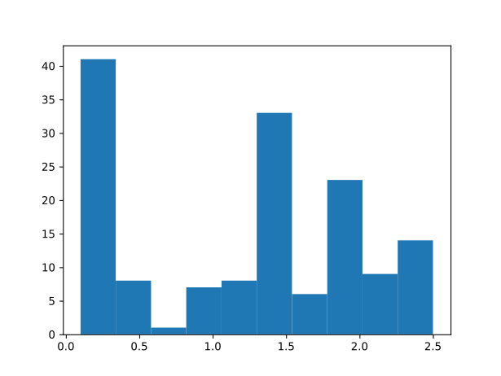
The Resulting Plot
Notes:
The second category of statistical analysis is inferential statistics. Inferential statistics are used to make inference, or in other words to draw conclusions, about a population by using data that has been collected on a sample of the population. In order for an inferential statistical analysis to be accurate, the sample that data is collected on must be random and representative of the overall population. Another key aspect of inferential statistics that differs from descriptive statistics is that there must be an expression of the uncertainty surrounding estimates made about the population. Often, you will see this uncertainty expressed with standard error or as a confidence interval.
Inferential analyses are generally more difficult to conduct than descriptive analyses, and require much more planning and thought. It is especially difficult to ensure that a sample is truly a good representation of the population you wish to draw inference about.

Slide 17
Adding in Details

Slide 18
Axes Labels and Titles
Axes labels can be added to a plot using the ‘xlabel’ and ‘ylabel’ functions for the x and y axes, respectively:
  ~ plt.hist(...) # Same command as before
  ~ plt.xlabel(“Petal Width (Inches)”)
  ~ plt.ylabel(“Count”)
Likewise, the title of a plot can be specified with the ‘title’ function:
  ~ plt.title(“Distribution of Petal Width in Various Iris Species”)
Notes:
The second category of statistical analysis is inferential statistics. Inferential statistics are used to make inference, or in other words to draw conclusions, about a population by using data that has been collected on a sample of the population. In order for an inferential statistical analysis to be accurate, the sample that data is collected on must be random and representative of the overall population. Another key aspect of inferential statistics that differs from descriptive statistics is that there must be an expression of the uncertainty surrounding estimates made about the population. Often, you will see this uncertainty expressed with standard error or as a confidence interval.
Inferential analyses are generally more difficult to conduct than descriptive analyses, and require much more planning and thought. It is especially difficult to ensure that a sample is truly a good representation of the population you wish to draw inference about.

Slide 19
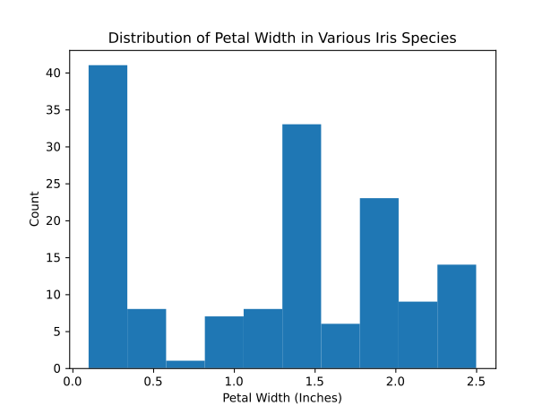
The Resulting Plot
Notes:
The second category of statistical analysis is inferential statistics. Inferential statistics are used to make inference, or in other words to draw conclusions, about a population by using data that has been collected on a sample of the population. In order for an inferential statistical analysis to be accurate, the sample that data is collected on must be random and representative of the overall population. Another key aspect of inferential statistics that differs from descriptive statistics is that there must be an expression of the uncertainty surrounding estimates made about the population. Often, you will see this uncertainty expressed with standard error or as a confidence interval.
Inferential analyses are generally more difficult to conduct than descriptive analyses, and require much more planning and thought. It is especially difficult to ensure that a sample is truly a good representation of the population you wish to draw inference about.

Slide 20
Colouration
Most plots can specify a ‘c’ argument which designates the colour of the plotted elements. Bar plots instead use ‘color’. Both can take any of the following:
  A single colour or colour format string (i.e. “red”, “#00ff00”, etc.)
  A list of the prior strings, one per data point (or bin, with histograms)
  A list of numbers, to be automatically evaluated as colors within a colour-map’s gradient. In this case, a colormap ‘cmap’ can also be specified. The full list can be found at https://matplotlib.org/stable/tutorials/colors/colormaps.html
Notes:
The second category of statistical analysis is inferential statistics. Inferential statistics are used to make inference, or in other words to draw conclusions, about a population by using data that has been collected on a sample of the population. In order for an inferential statistical analysis to be accurate, the sample that data is collected on must be random and representative of the overall population. Another key aspect of inferential statistics that differs from descriptive statistics is that there must be an expression of the uncertainty surrounding estimates made about the population. Often, you will see this uncertainty expressed with standard error or as a confidence interval.
Inferential analyses are generally more difficult to conduct than descriptive analyses, and require much more planning and thought. It is especially difficult to ensure that a sample is truly a good representation of the population you wish to draw inference about.

Slide 21
Coloration Coding Example
Let’s re-do the scatter plot we did prior, color coding each data point by the species it was used in:
  ~ # A function to map species to a number
  ~ def color_species(val):
  ~ if val == “Setosa”:
  ~ return 0
  ~ elif val == “Verginica”:
  ~ return 1
  ~ elif val == “Versicolour”:
  ~ return 2
  ~ return -1
  ~ # Build a colour column using the prior function
  ~ colour_vals = df.loc[:, “Species”].apply(color_species)
  ~ # Plot the data, building on the prior scatter function
  ~ plt.scatter(..., c=colour_vals, cmap=”Accent”)
Notes:
The second category of statistical analysis is inferential statistics. Inferential statistics are used to make inference, or in other words to draw conclusions, about a population by using data that has been collected on a sample of the population. In order for an inferential statistical analysis to be accurate, the sample that data is collected on must be random and representative of the overall population. Another key aspect of inferential statistics that differs from descriptive statistics is that there must be an expression of the uncertainty surrounding estimates made about the population. Often, you will see this uncertainty expressed with standard error or as a confidence interval.
Inferential analyses are generally more difficult to conduct than descriptive analyses, and require much more planning and thought. It is especially difficult to ensure that a sample is truly a good representation of the population you wish to draw inference about.

Slide 22
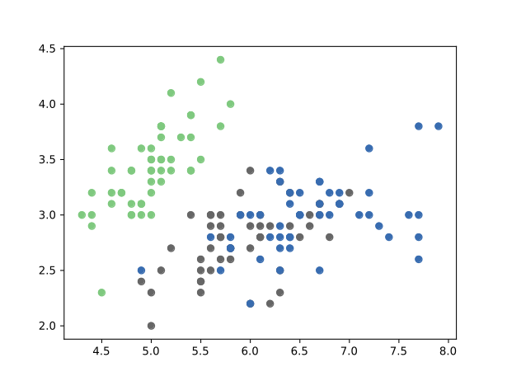
The Resulting Plot
Notes:
The second category of statistical analysis is inferential statistics. Inferential statistics are used to make inference, or in other words to draw conclusions, about a population by using data that has been collected on a sample of the population. In order for an inferential statistical analysis to be accurate, the sample that data is collected on must be random and representative of the overall population. Another key aspect of inferential statistics that differs from descriptive statistics is that there must be an expression of the uncertainty surrounding estimates made about the population. Often, you will see this uncertainty expressed with standard error or as a confidence interval.
Inferential analyses are generally more difficult to conduct than descriptive analyses, and require much more planning and thought. It is especially difficult to ensure that a sample is truly a good representation of the population you wish to draw inference about.

Slide 23
Element Sizes
Most plots can specify arguments which effect the size of their elements:
  Scatter plots can specify an ‘s’ argument, which can be a single number or a list of numbers, one per plotted value. The default value is 20.
  Line-based plots can specify the ‘lw’ parameter instead, which has a value of 1.0
  Bar plots use the ‘width’ argument instead; a width of 0.8 is the default.
  Histograms instead use ‘rwidth’ (short for ‘relative width’), which defaults to ‘1/{no. Bins}’. Smaller values will leave gaps between each bar in the plot.
Notes:
The second category of statistical analysis is inferential statistics. Inferential statistics are used to make inference, or in other words to draw conclusions, about a population by using data that has been collected on a sample of the population. In order for an inferential statistical analysis to be accurate, the sample that data is collected on must be random and representative of the overall population. Another key aspect of inferential statistics that differs from descriptive statistics is that there must be an expression of the uncertainty surrounding estimates made about the population. Often, you will see this uncertainty expressed with standard error or as a confidence interval.
Inferential analyses are generally more difficult to conduct than descriptive analyses, and require much more planning and thought. It is especially difficult to ensure that a sample is truly a good representation of the population you wish to draw inference about.

Slide 24
Scatter Plot Example Extended
Let’s extend the colored plot with size to demonstrate:
  ~ # A function to map species to a number
  ~ def size_species(val):
  ~ if val == “Setosa”:
  ~ return 3
  ~ elif val == “Verginica”:
  ~ return 6
  ~ elif val == “Versicolour”:
  ~ return 9
  ~ return 0
  ~ # Build a size list using the prior function
  ~ size_vals = df.loc[:, “Species”].apply(size_species)
  ~ # Plot the data, building on the prior scatter function
  ~ plt.scatter(..., s=size_vals)
Notes:
The second category of statistical analysis is inferential statistics. Inferential statistics are used to make inference, or in other words to draw conclusions, about a population by using data that has been collected on a sample of the population. In order for an inferential statistical analysis to be accurate, the sample that data is collected on must be random and representative of the overall population. Another key aspect of inferential statistics that differs from descriptive statistics is that there must be an expression of the uncertainty surrounding estimates made about the population. Often, you will see this uncertainty expressed with standard error or as a confidence interval.
Inferential analyses are generally more difficult to conduct than descriptive analyses, and require much more planning and thought. It is especially difficult to ensure that a sample is truly a good representation of the population you wish to draw inference about.

Slide 25
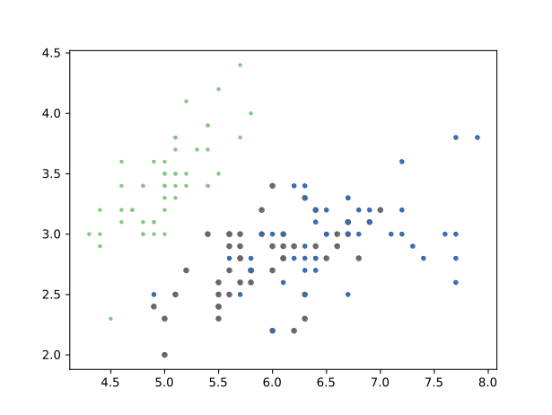
The Resulting Plot
Notes:
The second category of statistical analysis is inferential statistics. Inferential statistics are used to make inference, or in other words to draw conclusions, about a population by using data that has been collected on a sample of the population. In order for an inferential statistical analysis to be accurate, the sample that data is collected on must be random and representative of the overall population. Another key aspect of inferential statistics that differs from descriptive statistics is that there must be an expression of the uncertainty surrounding estimates made about the population. Often, you will see this uncertainty expressed with standard error or as a confidence interval.
Inferential analyses are generally more difficult to conduct than descriptive analyses, and require much more planning and thought. It is especially difficult to ensure that a sample is truly a good representation of the population you wish to draw inference about.

Slide 26
Marker Styles
Scatter plots can also specify how each point should appear, specifying the appearance those markers with the ‘marker’ argument:
The marker can be any marker specified by a MarkeStyle, common ones of which include:
  ‘o’; Circles
  ‘v’, ‘^’, ‘>’, ‘<’; Triangles (oriented to match the symbol)
  ‘x’: Xs
  ‘*’: Star
  ‘h’, ‘H’: Hexagon (of two differing styles)
  ‘d’, ‘D’: Diamond (of two differing styles)
Example:
  ~ plt.scatter(..., marker=‘d’)
Notes:
The second category of statistical analysis is inferential statistics. Inferential statistics are used to make inference, or in other words to draw conclusions, about a population by using data that has been collected on a sample of the population. In order for an inferential statistical analysis to be accurate, the sample that data is collected on must be random and representative of the overall population. Another key aspect of inferential statistics that differs from descriptive statistics is that there must be an expression of the uncertainty surrounding estimates made about the population. Often, you will see this uncertainty expressed with standard error or as a confidence interval.
Inferential analyses are generally more difficult to conduct than descriptive analyses, and require much more planning and thought. It is especially difficult to ensure that a sample is truly a good representation of the population you wish to draw inference about.

Slide 27
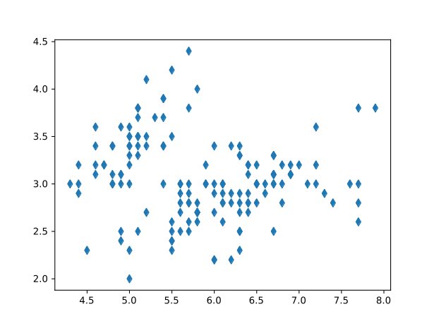
The Resulting Plot
Notes:
The second category of statistical analysis is inferential statistics. Inferential statistics are used to make inference, or in other words to draw conclusions, about a population by using data that has been collected on a sample of the population. In order for an inferential statistical analysis to be accurate, the sample that data is collected on must be random and representative of the overall population. Another key aspect of inferential statistics that differs from descriptive statistics is that there must be an expression of the uncertainty surrounding estimates made about the population. Often, you will see this uncertainty expressed with standard error or as a confidence interval.
Inferential analyses are generally more difficult to conduct than descriptive analyses, and require much more planning and thought. It is especially difficult to ensure that a sample is truly a good representation of the population you wish to draw inference about.

Slide 28
Simultaneous Plots
Multiple plots can be plotted on the same space as well, allowing for multiple different styles of plots to be used simultaneously. We can use this to stack all of our prior tools into one plot:
  ~ # Specify the variants we need to iterate through
  ~ species = ['Setosa', 'Verginica', 'Versicolour']
  ~ colours = ['red', 'green', 'blue']
  ~ symbols = ['^', '<', '>']
  ~ # Plot each species one by one using the variants above
  ~ for i in range(3):
  ~ # Isolate the data for our species of interest
  ~ sub_df = df[df.loc[:, “Species”] == species[i]]
  ~ # Plot the data
  ~ plt.scatter(
  ~ x=sub_df.loc[:, “Sepal Length”],
  ~ y=sub_df.loc[:, “Sepal Width”],
  ~ c=colours[i], marker=symbols[i]
  ~ )
Notes:
The second category of statistical analysis is inferential statistics. Inferential statistics are used to make inference, or in other words to draw conclusions, about a population by using data that has been collected on a sample of the population. In order for an inferential statistical analysis to be accurate, the sample that data is collected on must be random and representative of the overall population. Another key aspect of inferential statistics that differs from descriptive statistics is that there must be an expression of the uncertainty surrounding estimates made about the population. Often, you will see this uncertainty expressed with standard error or as a confidence interval.
Inferential analyses are generally more difficult to conduct than descriptive analyses, and require much more planning and thought. It is especially difficult to ensure that a sample is truly a good representation of the population you wish to draw inference about.

Slide 29
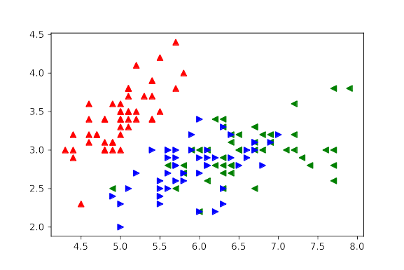
The Resulting Plot
Notes:
The second category of statistical analysis is inferential statistics. Inferential statistics are used to make inference, or in other words to draw conclusions, about a population by using data that has been collected on a sample of the population. In order for an inferential statistical analysis to be accurate, the sample that data is collected on must be random and representative of the overall population. Another key aspect of inferential statistics that differs from descriptive statistics is that there must be an expression of the uncertainty surrounding estimates made about the population. Often, you will see this uncertainty expressed with standard error or as a confidence interval.
Inferential analyses are generally more difficult to conduct than descriptive analyses, and require much more planning and thought. It is especially difficult to ensure that a sample is truly a good representation of the population you wish to draw inference about.

Slide 30
Legends with Multiple Plots
Plotting multiple plots in the same space also allows for legends to be added to differentiate between each dataset. To do so, we simply add the ‘label’ argument to our plots, and call ‘plt.legend’ to generate a legend based on these labels:
  ~ # Extending the prior code with a legend:
  ~ for i in range(3):
  ~ ...
  ~ # Plot the data
  ~ plt.scatter(
  ~ ...
  ~ label = species[i]
  ~ )
  ~ plt.legend()
Notes:
The second category of statistical analysis is inferential statistics. Inferential statistics are used to make inference, or in other words to draw conclusions, about a population by using data that has been collected on a sample of the population. In order for an inferential statistical analysis to be accurate, the sample that data is collected on must be random and representative of the overall population. Another key aspect of inferential statistics that differs from descriptive statistics is that there must be an expression of the uncertainty surrounding estimates made about the population. Often, you will see this uncertainty expressed with standard error or as a confidence interval.
Inferential analyses are generally more difficult to conduct than descriptive analyses, and require much more planning and thought. It is especially difficult to ensure that a sample is truly a good representation of the population you wish to draw inference about.

Slide 31
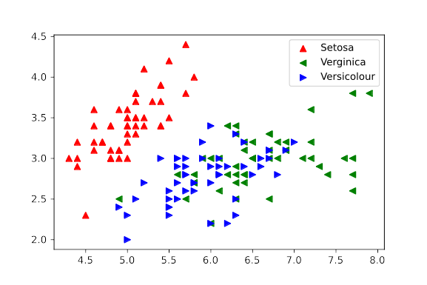
The Resulting Plot
Notes:
The second category of statistical analysis is inferential statistics. Inferential statistics are used to make inference, or in other words to draw conclusions, about a population by using data that has been collected on a sample of the population. In order for an inferential statistical analysis to be accurate, the sample that data is collected on must be random and representative of the overall population. Another key aspect of inferential statistics that differs from descriptive statistics is that there must be an expression of the uncertainty surrounding estimates made about the population. Often, you will see this uncertainty expressed with standard error or as a confidence interval.
Inferential analyses are generally more difficult to conduct than descriptive analyses, and require much more planning and thought. It is especially difficult to ensure that a sample is truly a good representation of the population you wish to draw inference about.

Slide 32
Putting it All Together!

Slide 33
Lets Test your Learning!
You have been tasked again to create a Python program which can:
  Load the data contained in ‘iris_data.tsv’ into a DataFrame
  Plot each of the following, with appropriate title and axis labels for each:
    Petal Length as a function of Petal Width for all samples as a scatter plot
      Each species should have a unique marker (optionally a unique colour as well)
      A legend should denote each species present in the resulting plot
    Max Sepal Length per species as a bar plot with a legend
      Species should be colour coded
      A legend should identify the species for each bar in the plot
  Save each plot to an SVG file, named to your preference
An incomplete Python script file has been provided with comment hints for each of the above steps for you to test your learning. A key for this document has also been provided, should you want to check your answer
Notes:
The second category of statistical analysis is inferential statistics. Inferential statistics are used to make inference, or in other words to draw conclusions, about a population by using data that has been collected on a sample of the population. In order for an inferential statistical analysis to be accurate, the sample that data is collected on must be random and representative of the overall population. Another key aspect of inferential statistics that differs from descriptive statistics is that there must be an expression of the uncertainty surrounding estimates made about the population. Often, you will see this uncertainty expressed with standard error or as a confidence interval.
Inferential analyses are generally more difficult to conduct than descriptive analyses, and require much more planning and thought. It is especially difficult to ensure that a sample is truly a good representation of the population you wish to draw inference about.

Slide 34
Thank you!
Please send inquiries to kalum.ost@ucalgary.ca

