Slide 1
Pocket Calculator using Python Tkinter
A Simple GUI Project in Python

Slide 2
Introduction
• This is a GUI-based calculator developed in Python.
• It uses the Tkinter library for the graphical interface.
• Supports basic operations: addition, subtraction, multiplication, division.

Slide 3
Importing Libraries
from tkinter import *
# from unittest import result (Not needed and can be removed)

Slide 4
Calculator Logic - Functions
• buttonClick(number): Adds digit/operator to the expression
• buttonClear(): Clears the display
• buttonEqual(): Evaluates the expression and shows the result

Slide 5
GUI Setup
• main = Tk()
• main.title("Pocket Calculator")
• input_value = StringVar()
• Entry widget is used to display the input and output

Slide 6
Button Layout - Rows 1 & 2
• Row 1: 7, 8, 9, +
• Row 2: 4, 5, 6, -
• Buttons styled with font, color, and grid positions

Slide 7
Button Layout - Rows 3 & 4
• Row 3: 1, 2, 3, *
• Row 4: 0, C, =, /
• Each button has a command linked to a function

Slide 8
Final Execution
• mainloop() is called to start the GUI event loop
• The calculator window remains open until closed by the user

Slide 9
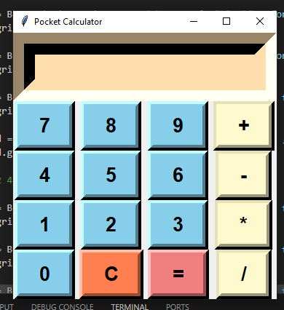

Slide 10
Thank You

