Slide 1
Identifying Medical Supply Zones in Delhi
Capstone final project: Battle of neighborhood

Slide 2
INTRODUCTION
As we all know that Coronavirus disease (COVID-19) is an infectious disease caused by a newly discovered coronavirus. The outbreak was declared a Public Health Emergency of International Concern on 30 January 2020.
In this situation our aim is to provide suggestions for medical check-up booths and medicines supplies amid COVID-19 based on the areas, population, total number of cases in that area, hospitals in that area (to check the current medical facility status etc)

Slide 3
Target Audience: Government, medical agencies, NGOs and all related to COVID-19
Observed Problem: During the prime time of COVID-19, there was a requirement to identify the places where the medical and food supply is less, and cases are more. Due to panic situation, a lot number of small industries are shut down and due to which there is lack of medicine and food. So, I planned to identify the areas district wise in Delhi where proper supply of medicine and food is not there.

Slide 4
Description of data:
Call the Foursquare API to get the details of Hospitals in Delhi
Collect the information about the hospitals with proper address, Pin code, sub-districts etc
Collect the information about each district such as population, area, density etc.
Lastly collect the information about the current COVID-19 cases in each district.

Slide 5
Approach to solve this problem:
Algorithm used: KMeans Clustering
We will combine the data which we have collected district wise.
Then we will analyse the data based on parameters such as population, density, current cases etc.
Then from FourSquare we will try to get the information about the hospitals such as ratings etc.
Lastly we will make clusters where we need to provide the medicines and other basic amenities.

Slide 6

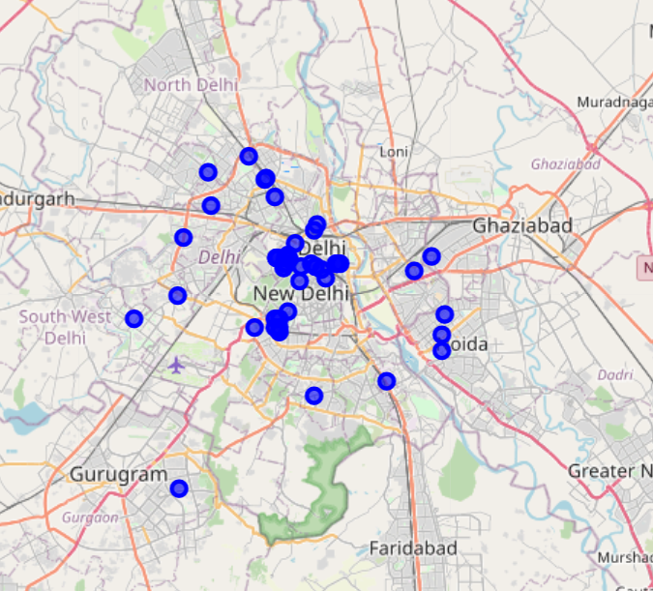
Exploratory Analysis: Coordinates
These coordinates we are covering for the analysis.

Slide 7
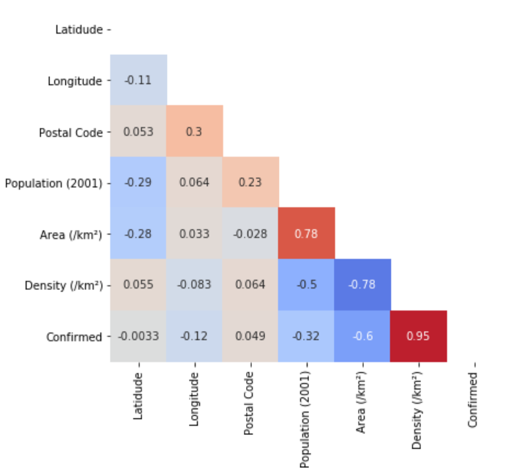
Relation between all features
Correlation between all the features, we can see that density and confirmed are highly related to each other.

Slide 8
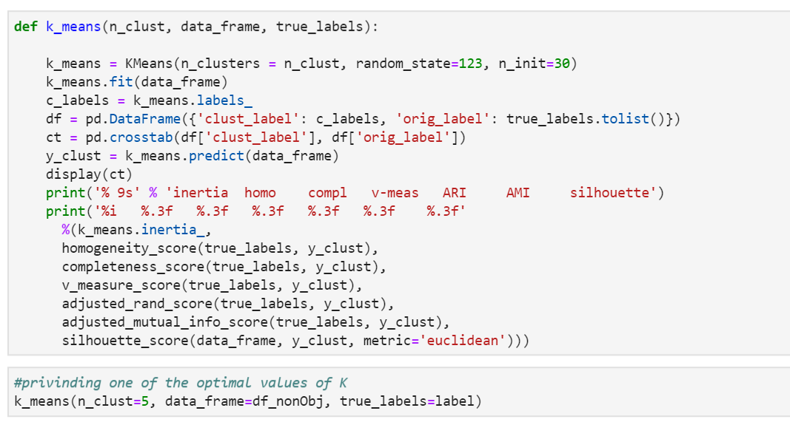
Code for KMeans Cluster Algorithm

Slide 9
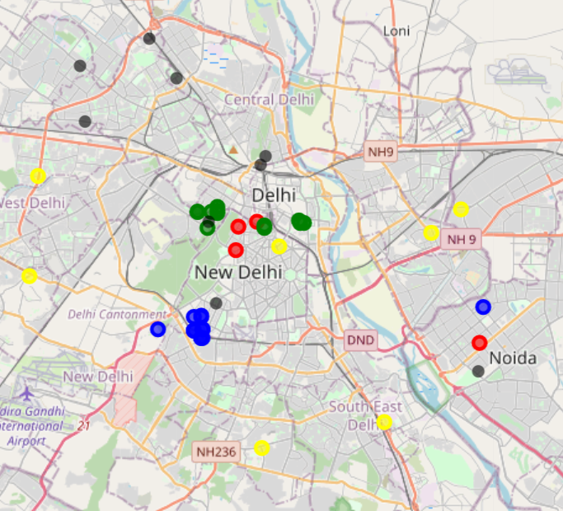
Mapping of clusters using Folium
We have found that using value of k as 5 is giving optimum result.

Slide 10
Below are the results which we have observed:
Blue cluster which are near New Delhi have low cases (at around 42 per district) and having low density of 4430 per square kms. Also, this cluster have higher number of hospitals.
Green cluster have highest cases of 184 and high density of around 25759 per square kms. This cluster have comparatively medium number of hospitals.
Yellow cluster have moderate cases of 70 and density of 9033 per square kms. This cluster have low number of hospitals.
Now red cluster have low cases of 37 per district and density of 13477 per square kms. This cluster have low number of hospitals.
Now Violet cluster have moderate cases of around 60 per district and density of 13000 square kms. Also having moderate number of hospitals.

Slide 11
Few recommendations:
Green cluster (mostly areas nearby Karol Bagh) needs to get more medical supplies in comparison to other clusters.
After green cluster, yellow cluster needs to be taken care because of low hospitals and high cases.
Then violet cluster (areas in north Delhi) needs supply of medicines and other amenities based on all the parameters.

Slide 12
Conclusion:
So, this concludes our observation. I hope these observations can help the required agencies. If we have more data about Delhi and COVID-19, then we can provide more accurate predictions.

