Slide 1
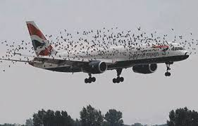
Data Visualization of Bird Strikes between 2000-2011

Slide 2
Project Detail
Project Title | Data Visualization of Bird Strikes between 2000-2011
Technology | Business Intelligence
Domain | Transportation and Communication
Project Difficulty Level | Advanced
Programming Language Used | R Programming
Tools used | Jupyter Notebook, MS-Excel, MS-PowerBI

Slide 3
Objective
Transport and communication is one of the crucial domain in field of analytics. Environmental impacts and safety are, nowadays, two major concerns of the scientific community with respect to transport scenarios and to the ever-growing urban areas. These issues gain more importance due to the increasing amount of vehicles and people. Seeking for new solutions is reaching a point where available technologies and artificial intelligence, especially MAS, are being recognized as ways to cope and tackle these kinds of problems in a distributed and more appropriate way.
A bird strike is strictly defined as a collision between a bird and an aircraft which is in flight or on a take-off or landing roll. The term is often expanded to cover other wildlife strikes - with bats or ground animals. Bird Strike is common and can be a significant threat to aircraft safety. For smaller aircraft, significant damage may be caused to the aircraft structure and all aircraft, especially jet-engine ones, are vulnerable to the loss of thrust which can follow the ingestion of birds into engine air intakes. This has resulted in several fatal accidents. Bird strikes may occur during any phase of flight, but are most likely during the take-off, initial climb, approach and landing phases due to the greater numbers of birds in flight at lower levels

Slide 4

Problem Statement
The goal of this project is to analyse the bird strike incidents happened between 2000-2011. To achieve the goal, we used a data set that is collected by FAA during 2000-2011. The objective of the project is to perform data visualization techniques to understand insights of the data. This project aims apply various Business Intelligence tools such as Tableau or Power BI to get a visual understanding of the data.

Slide 5
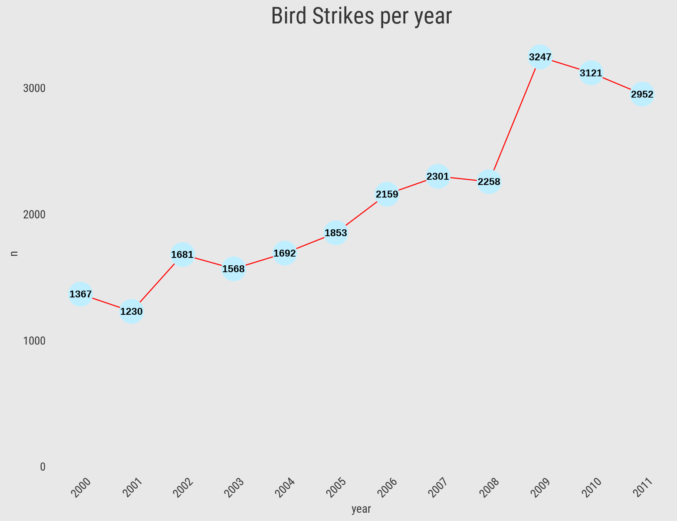
Insights
Total Number of Bird Strikes Incidents per Year
We can see that Bird Strikes Incidents have an upward trend
2009 has the highest number of incidents.

Slide 6
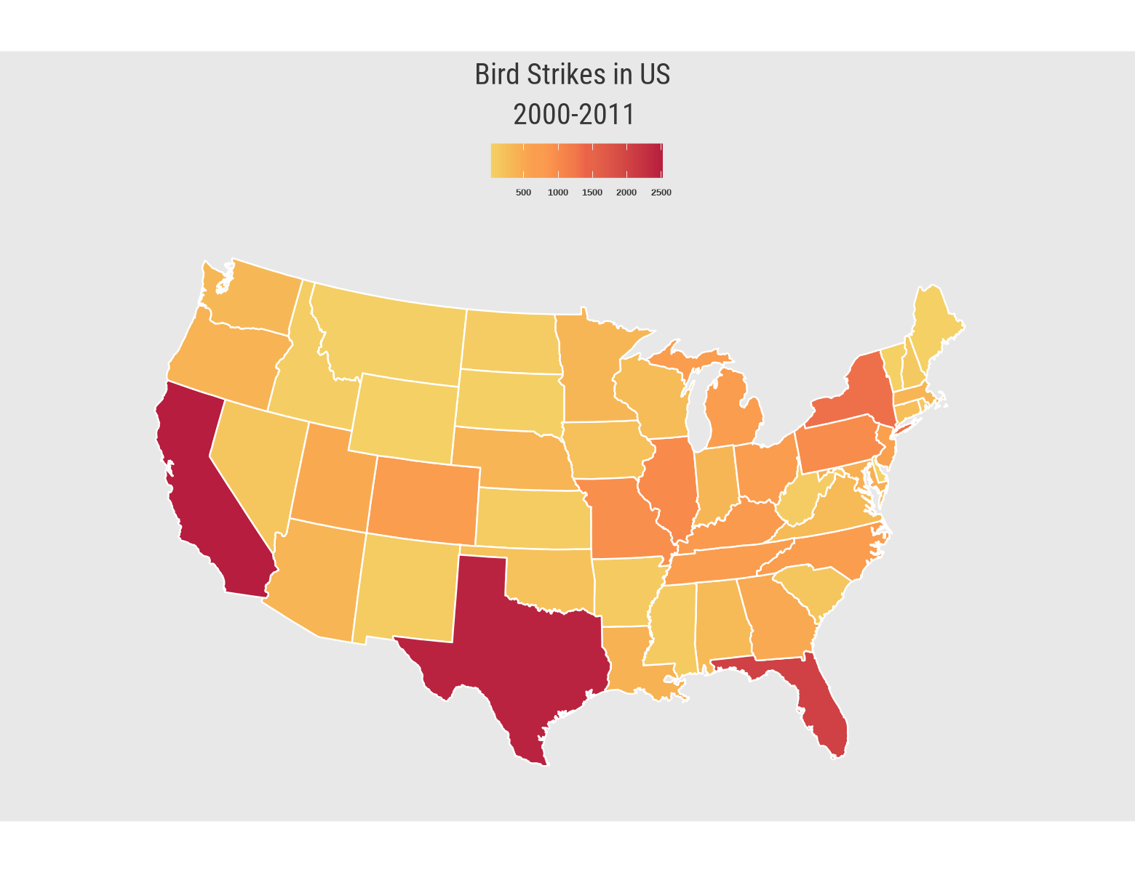
Bird Strikes Incidents in US
California, Texas and Florida has the highest number of bird strike incidents.

Slide 7
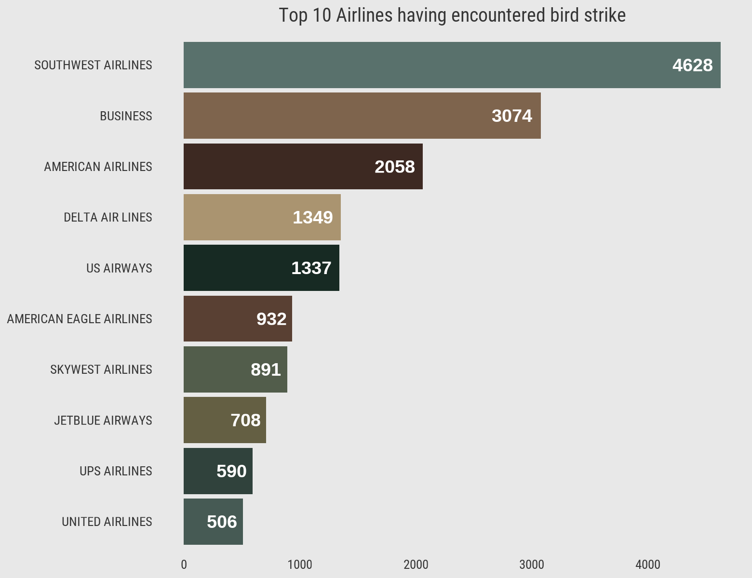
Top 10 Airlines having encountered most number of bird strikes
Southwest airlines has encountered most number of bird strike followed by business and American airlines

Slide 8
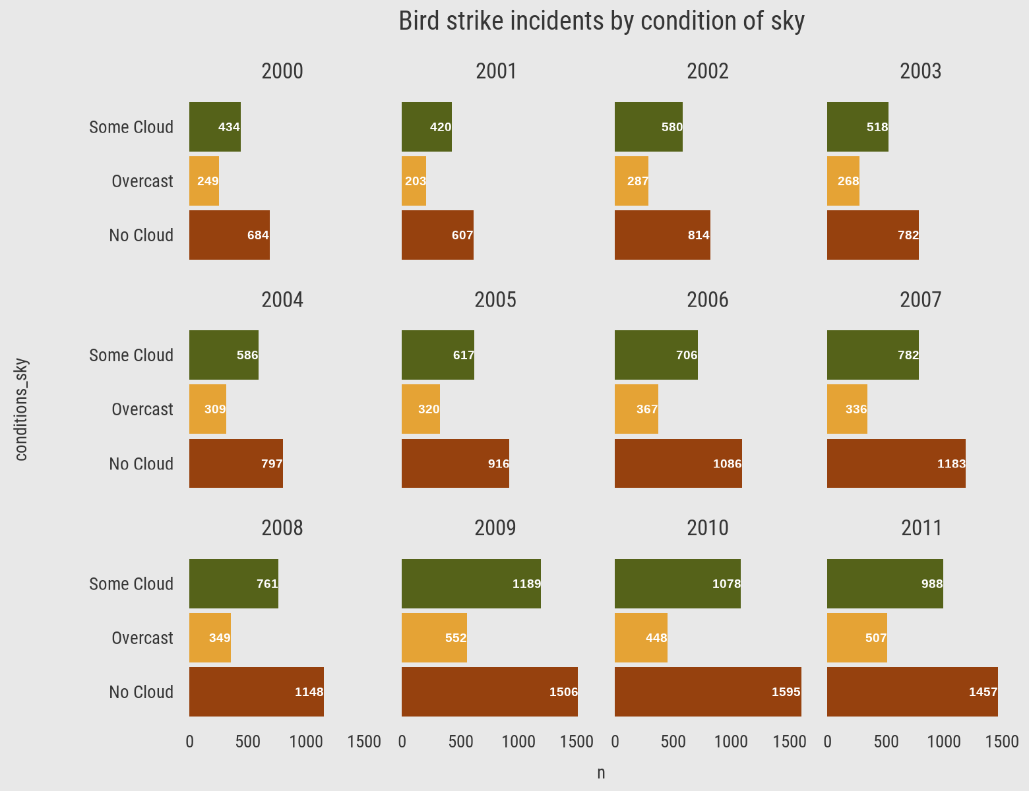
When do most bird strike incidents occur?
Most of the incidents have happened when there was no cloud in each year

Slide 9
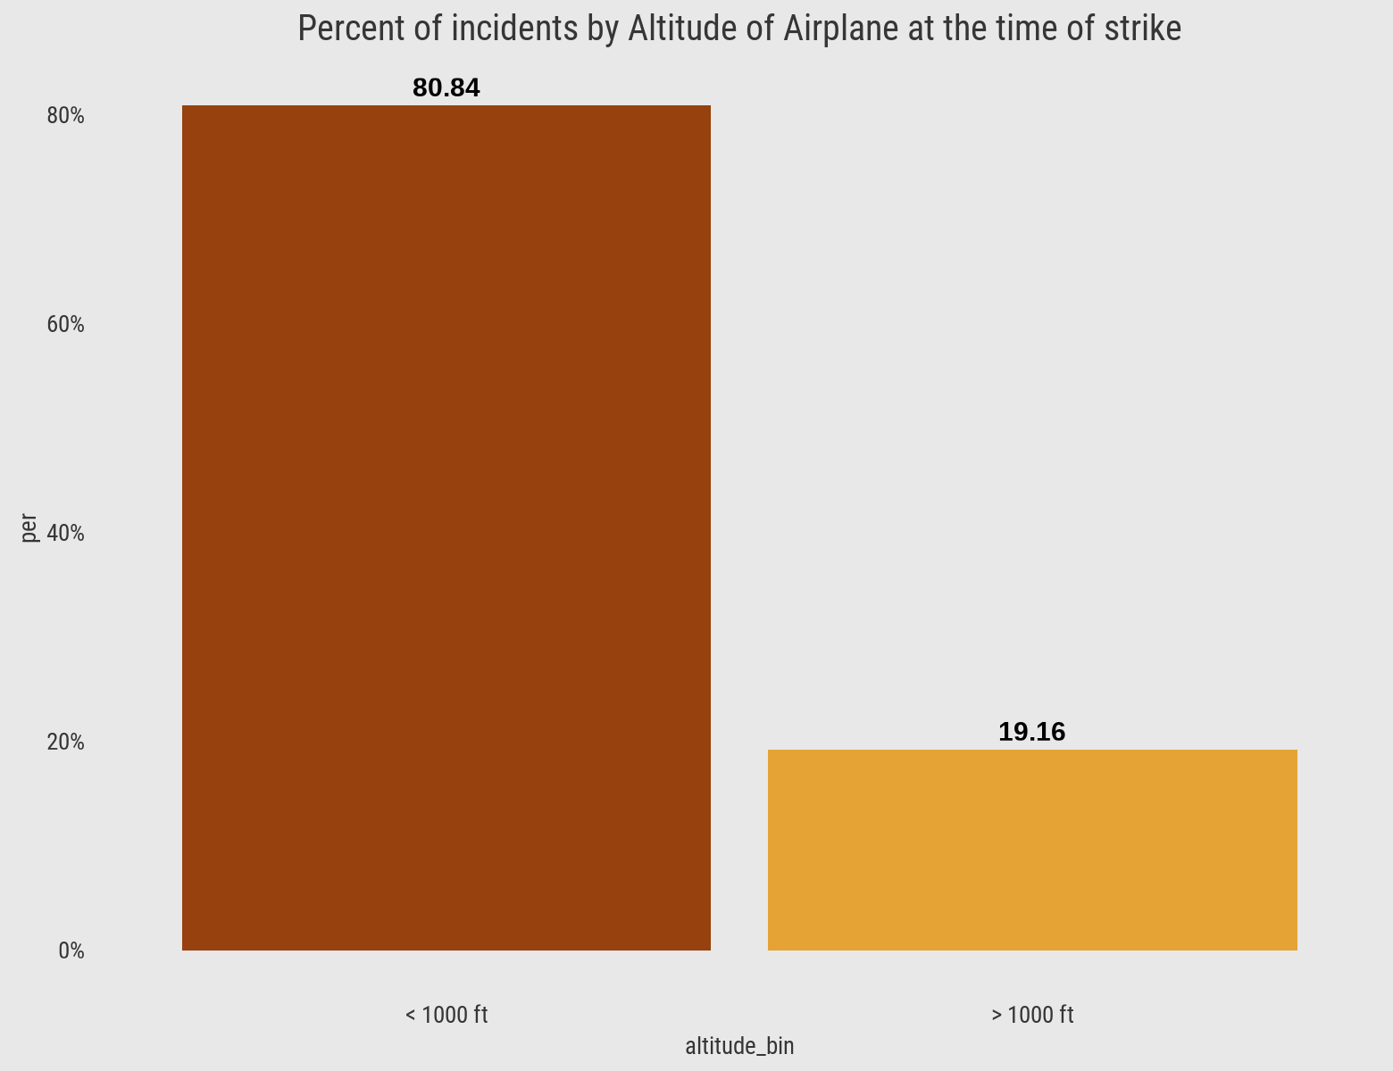
Altitude of Airplane at the time of bird strike
80.84% of bird strike incidents have happened when the altitude of airplane was <1000 ft and 19.16% have happened when altitude was >1000 ft.

Slide 10
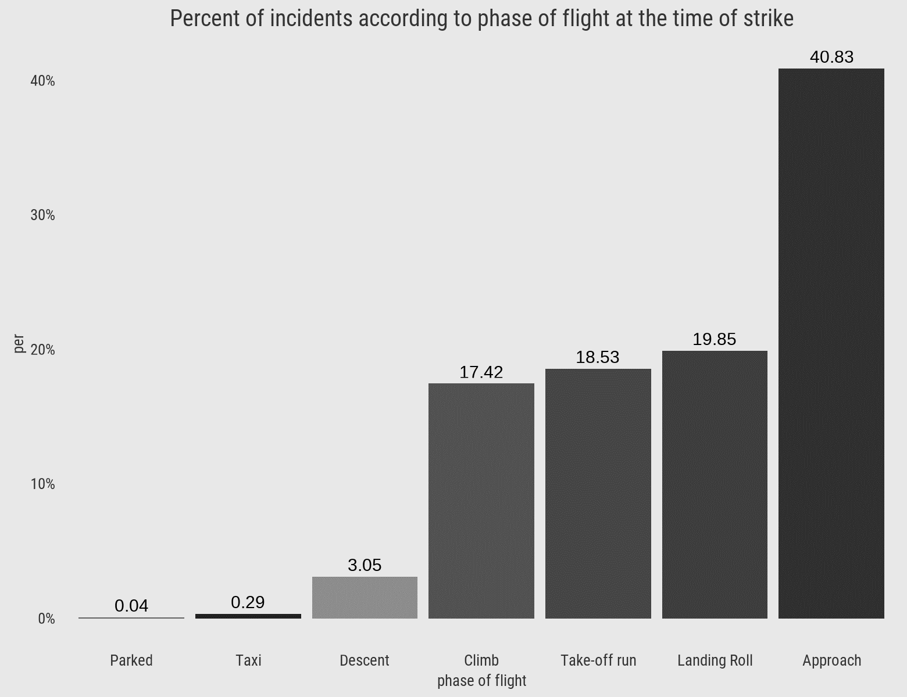
Phase of Flight at the time of strike
Highest number of strikes during Approach followed by Landing Roll and Take-off run

Slide 11
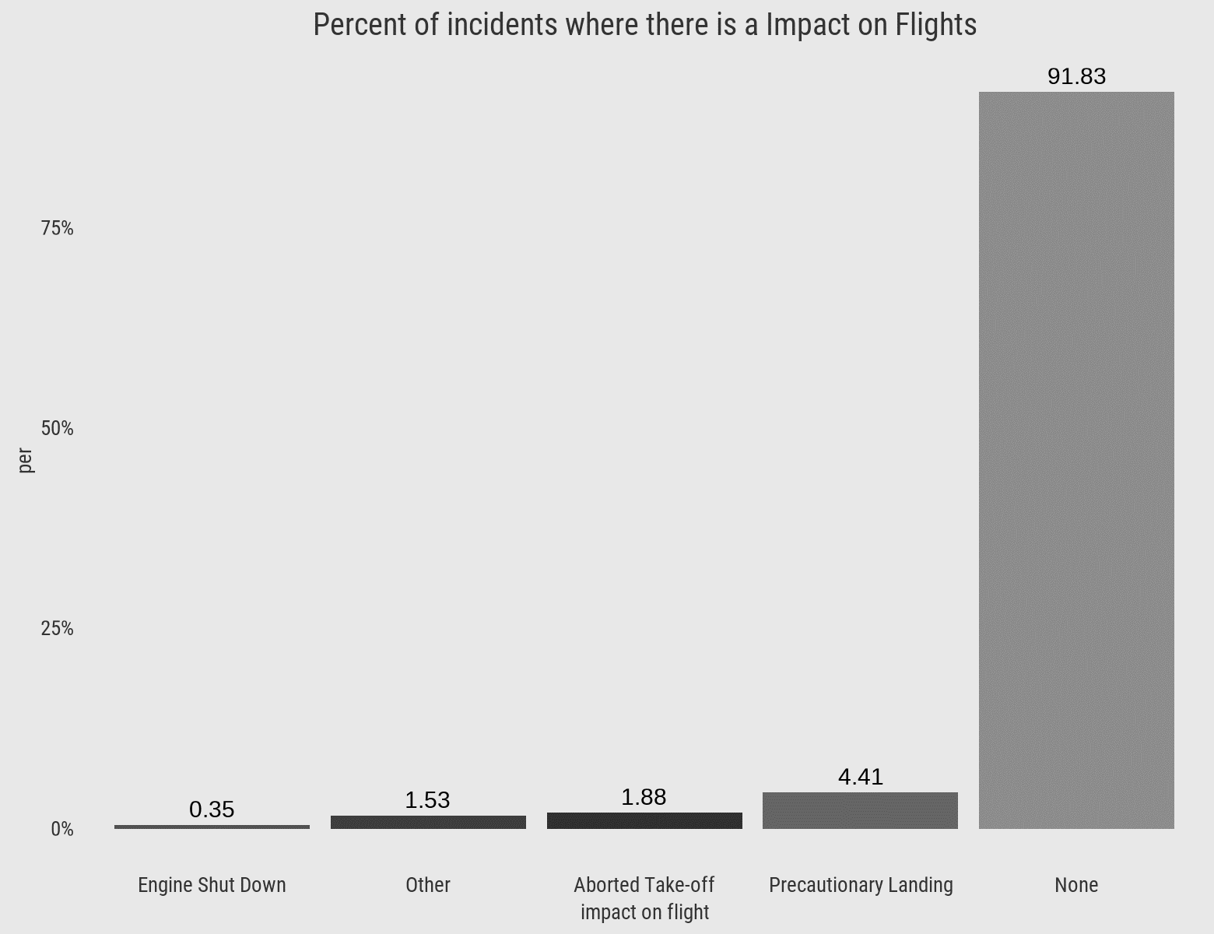
Impact on Flights
91.83% incidents where there was no impact on flights

Slide 12
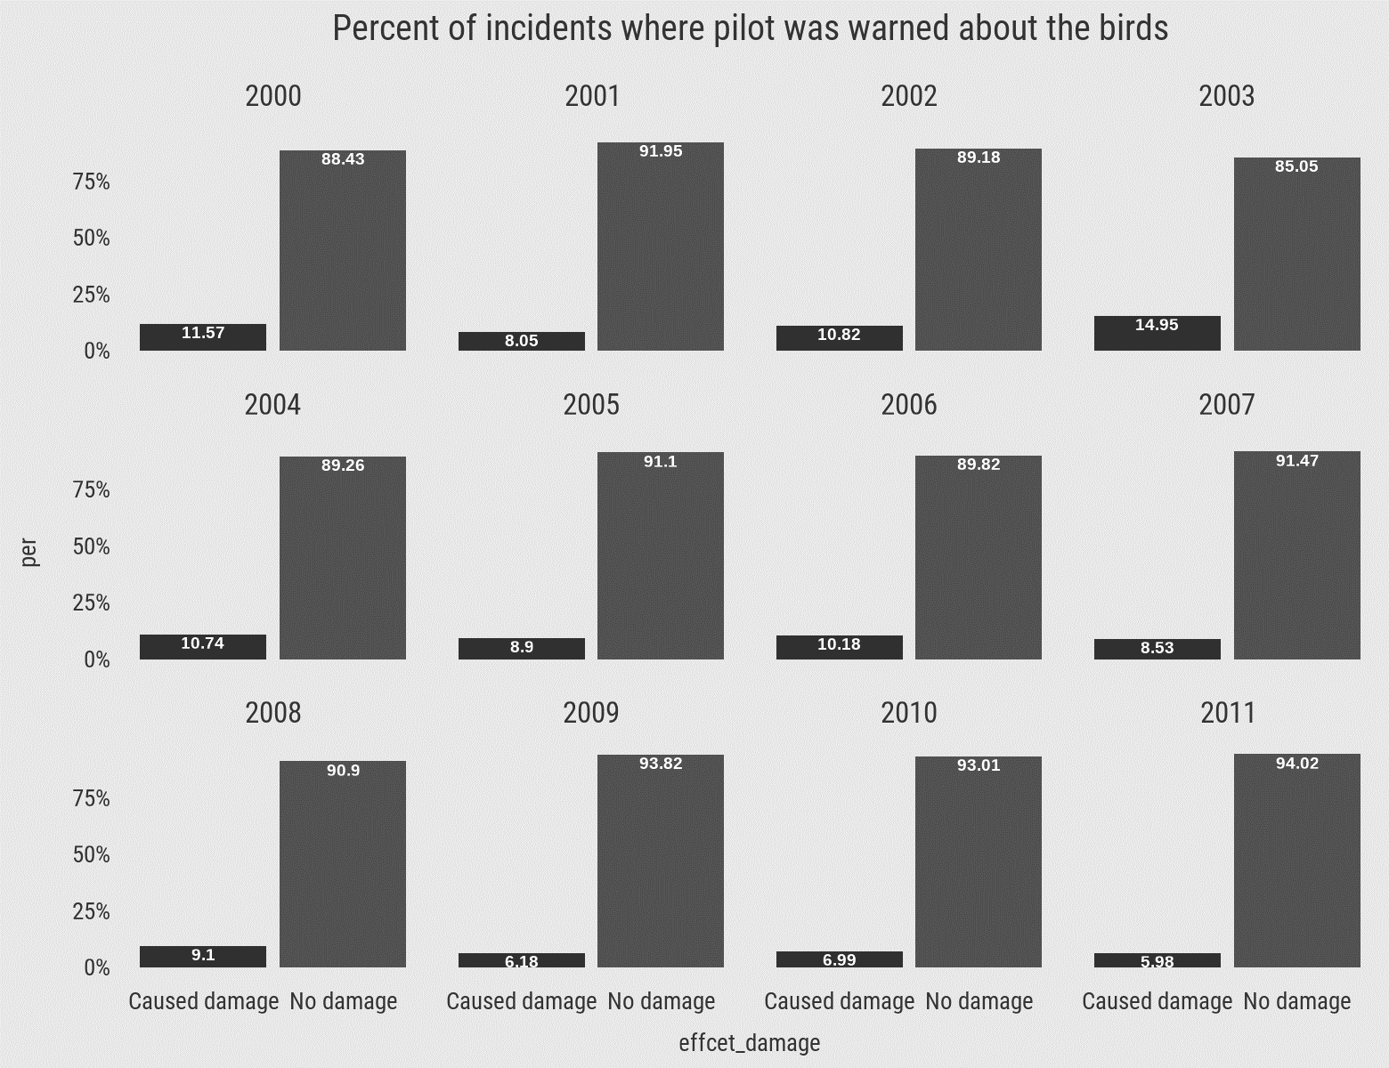
Does prior warning reduces the effect of damage?
Prior warning to the pilot reduces the effect of damage to the aeroplane. In 80% of the incidents, there was no damage to the aeroplane.

Slide 13
Key Metrics and Insights
1. Timeline of Bird Strikes:
The number of bird strikes increased significantly over the years, starting from 1,367 in 2000 and peaking at 3,012 in 2011.
Notable spikes in incidents were observed in 2006, 2008, and 2011, suggesting possible changes in reporting procedures, migration patterns, or environmental factors during these years.
2. Top States with Bird Strikes:
Texas, Florida, California, and New York had the highest number of bird strike incidents.
Factors like geography, proximity to bird migration routes, and weather patterns likely contribute to the high numbers in these states.
3. Altitude Distribution:
The majority (80.84%) of bird strikes occurred below 1,000 feet, indicating that strikes are most common during takeoff and landing.
A smaller portion (19.16%) occurred above 1,000 feet, which is more typical of the cruise or climb phases of flight.

Slide 14
4. Wildlife Size:
Small birds accounted for 68.47% of incidents, medium birds 23.35%, and large birds 8.18%.
Certain airports near forests or water bodies are more prone to larger bird strikes, which pose greater risks.
5. Communication and Pilot Awareness:
In 57.28% of the incidents, pilots were not informed about the potential for a bird strike.
In contrast, 42.72% of the incidents involved prior warnings, highlighting potential communication gaps that could be addressed to mitigate risks.
6. Impact on Flights:
91.83% of the bird strikes had no effect on flight operations, but 4.41% led to precautionary landings, and 3.76% had minor effects (e.g., damage to the aircraft but no safety risk).
A deeper analysis into the strikes that affected flights could help design specific intervention strategies.
7. Airline Operators:
Southwest Airlines encountered the highest number of bird strikes with 4,028, followed by Business Airlines (3,074), American Airlines (2,058), and Delta Air Lines (1,349).
These airlines, especially those with larger flight volumes, may need targeted wildlife management strategies to reduce risks.

Slide 15
8. Airports Most Affected:
Dallas/Fort Worth International Airport saw the highest number of bird strikes (803), with other notable airports including Sacramento International (676), Salt Lake City International (479), and Denver International (476).
Airports near wetlands or agricultural lands tend to have a higher risk of bird activity, which should be mitigated through effective wildlife control.
9. Phase of Flight:
The approach phase saw the highest percentage of bird strikes (40.83%), followed by landing roll (19.85%), take-off run (18.53%), climb (17.42%), and descent (3.05%).
Bird strikes are especially dangerous during critical phases of flight like takeoff and landing, when pilots have less time to react.

Slide 16
Conclusion
42.72% incidents where the pilot was warned about the birds
Prior warning to the pilot reduces the risk of damage to the aircraft
52.78% of incidents have happened due to some small unknown bird.
72.9% of incidents have happened when there is 1 bird/wildlife is struck in the aeroplane and caused damage.
90.31% of incidents caused no damage while 9.69% of incidents caused damage
80.84% of bird strike incidents have happened when the altitude of airplane was <1000 ft and 19.16% have happened when the altitude was >1000 ft.
Most of the incidents have happened when there is no cloud in each year

