Slide 1

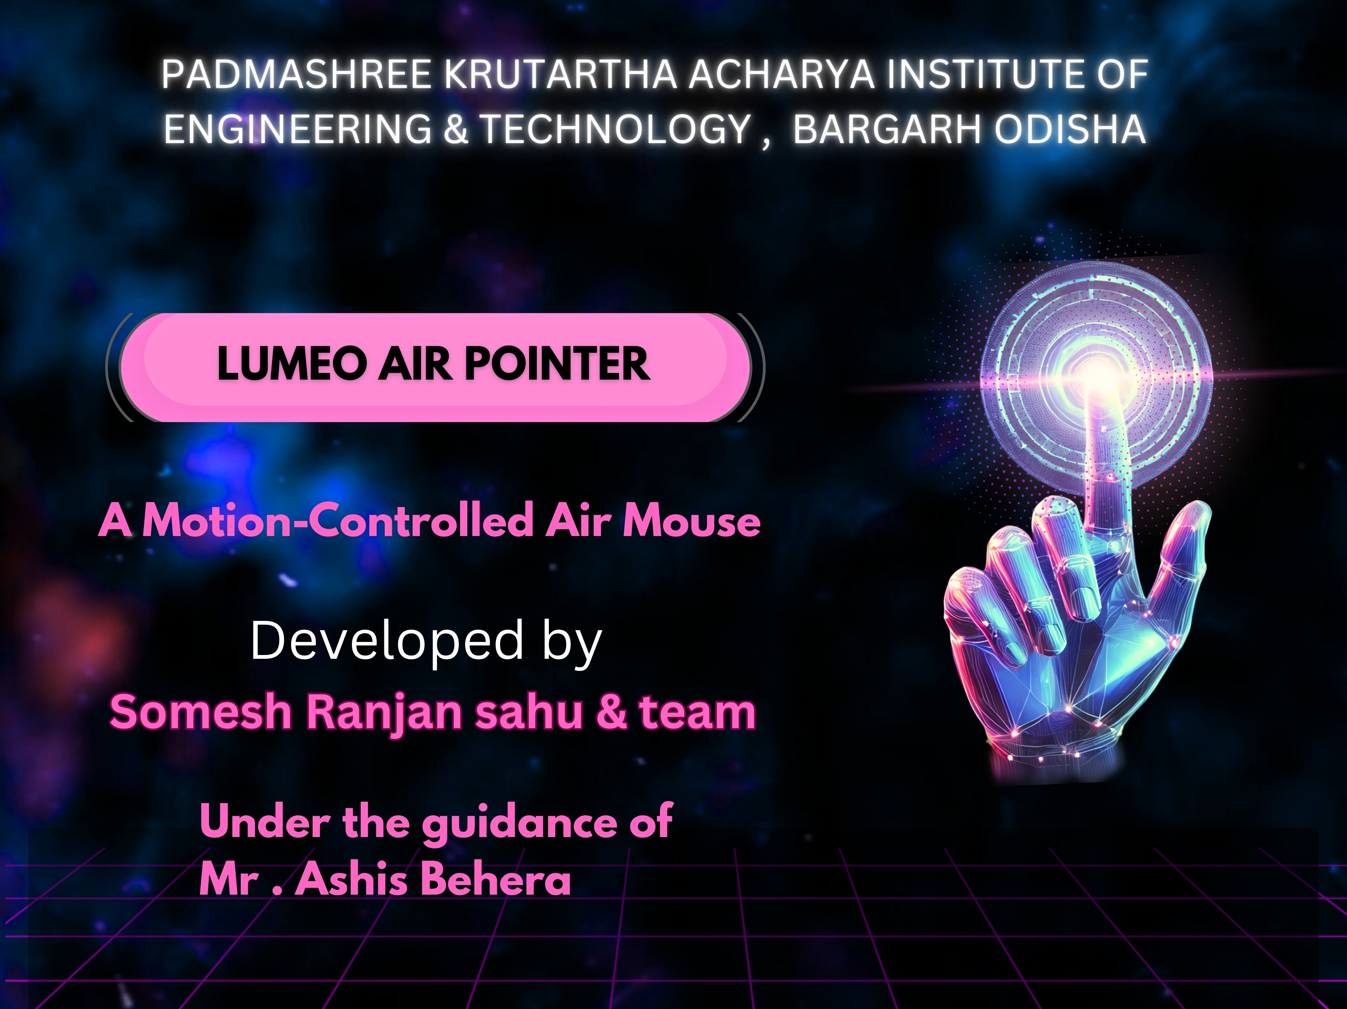
Lumeo Air Pointer - A Motion-Controlled Air Mouse
A Wireless Gesture-Based Input Device
Prepared by: Somesh Ranjan Sahu & Team

Slide 2
Abstract
The Lumeo Air Pointer is a wireless motion-controlled input device using an Arduino Nano, MPU6050 IMU. It tracks hand movements to enable gesture-based cursor control .
This technology enhances user experience by allowing seamless, hands-free interaction.

Slide 3
Key Components
1. Microcontroller: Arduino Nano - Handles sensor data & communication.
2. Motion Sensor: MPU6050 (6-axis IMU) - Tracks motion & gestures.
3. Click Buttons: Two tactile push buttons for left & right clicks.

Slide 4
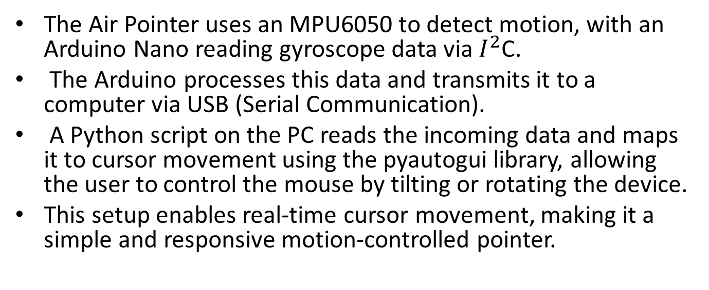
WORKING
The Air Pointer uses an MPU6050 to detect motion, with an Arduino Nano reading gyroscope data via $I^{2}$C.
The Arduino processes this data and transmits it to a computer via USB (Serial Communication).
A Python script on the PC reads the incoming data and maps it to cursor movement using the pyautogui library, allowing the user to control the mouse by tilting or rotating the device.
This setup enables real-time cursor movement, making it a simple and responsive motion-controlled pointer.

Slide 5
Future implementation
1. Enhanced Motion Sensing & Accuracy
IMU Fusion Algorithms: More advanced sensor fusion using Kalman filters and AI-based algorithms could improve motion tracking accuracy.
2. AI-Based Gesture Recognition
Machine Learning (ML) Integration: AI could enhance gesture recognition, allowing the air pointer to adapt to a user's natural movements.
Context-Aware Gestures: The pointer could understand complex gestures (e.g., drawing in 3D space) using AI.

Slide 6
Conclusion
The Lumeo Air Pointer represents the future of gesture-based interaction. It provides a intuitive alternative to traditional input devices. With advancements in AI, motion tracking, and AR, the technology could integrate seamlessly into smart environments and next-gen computing platforms.

Slide 7
Prepared By
Somesh Ranjan Sahu (F22008007029)
Abhilash Kumar Sahu (F22008007001)
Manash Podh (F22008007011)
Sandhya Rani Suna (F2200800702)
Rahul Chouhan (F22008007021)

