Slide 1

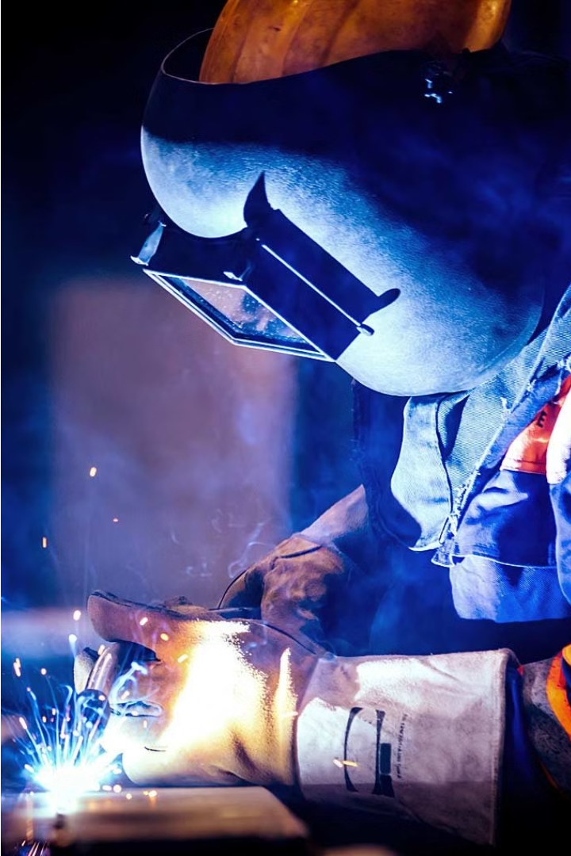
Welders Recruiting Website

Slide 2
Inroduction
The welding industry is experiencing a high demand for skilled professionals, yet the recruitment process faces challenges such as delayed hiring, mismatched skills, and limited specialized platforms. To address these issues, we propose the development of a dedicated welders recruitment website.

Slide 3
Literature Survey
Existing System
Proposed System
Feasibility Study
Traditional welding job postings often lack a comprehensive view of the industry and candidate needs. Recruiting processes can be time-consuming and inefficient.
Our website aims to streamline the welding recruitment process, providing a centralized platform for employers and job seekers to connect. We offer advanced search and matching capabilities.
The Welder recruiteing Portal's feasibility study highlights market demand, technical compatibility, legal compliance, user acceptance, and environmental considerations.

Slide 4
System Requirements
1
Secure User Authentication
2
User Interface
Implement robust security measures to protect user accounts and sensitive information.
Develop a user-friendly platform with clear navigation and seamless job search and application processes.
3
Welding Job Database
4
Filtering and Sorting
Maintain and up-to-date database of welding job opportunities across various cities
Provide users with the ability to filter and sort job listings based on location, job type, salary range, and other relevant criteria.

Slide 5
Tools and Technology
Software
Hardware
Frontend: HTML5, CSS,Bootstrap
Development Machines:
Backend: Django
Minimum: Dual-core processor, 4GB RAM, 128GB SSD
Database: Sqlite
IDE:Visual Studio Code
Recommended: Quad-core processor, 16GB RAM, 512GB SSD

Slide 6

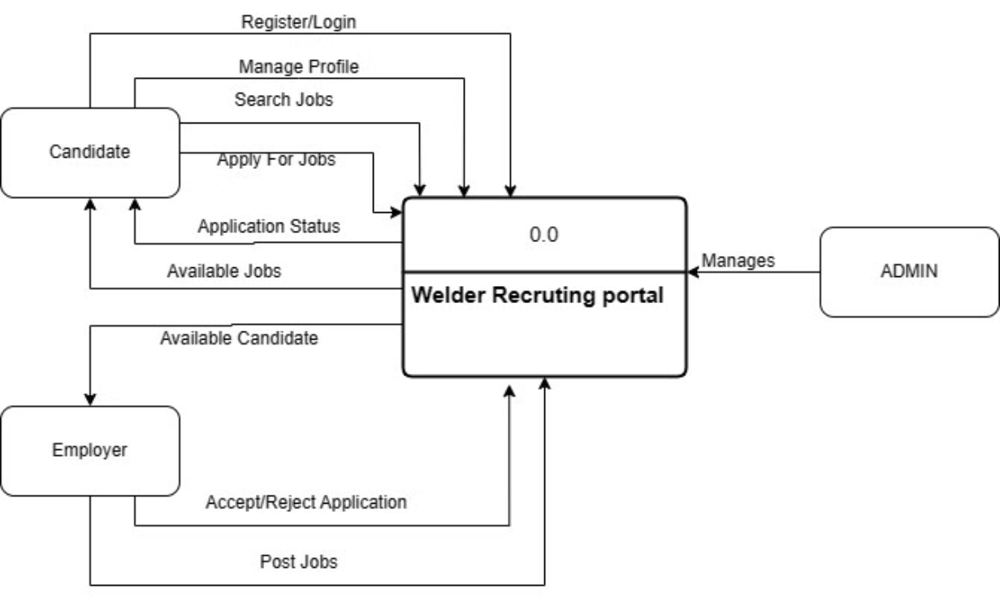
Data Flow Diagram

Slide 7
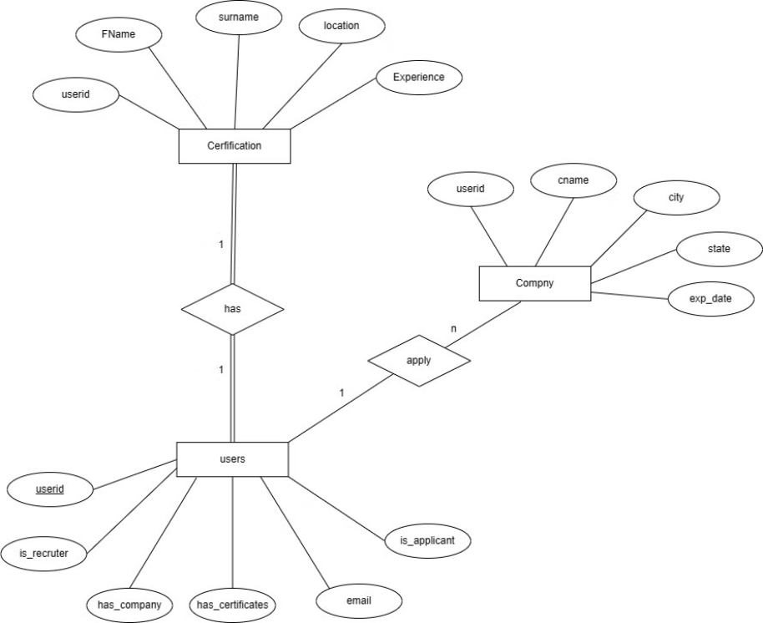
Data Flow Diagram

Slide 8
Thank You

