Slide 1
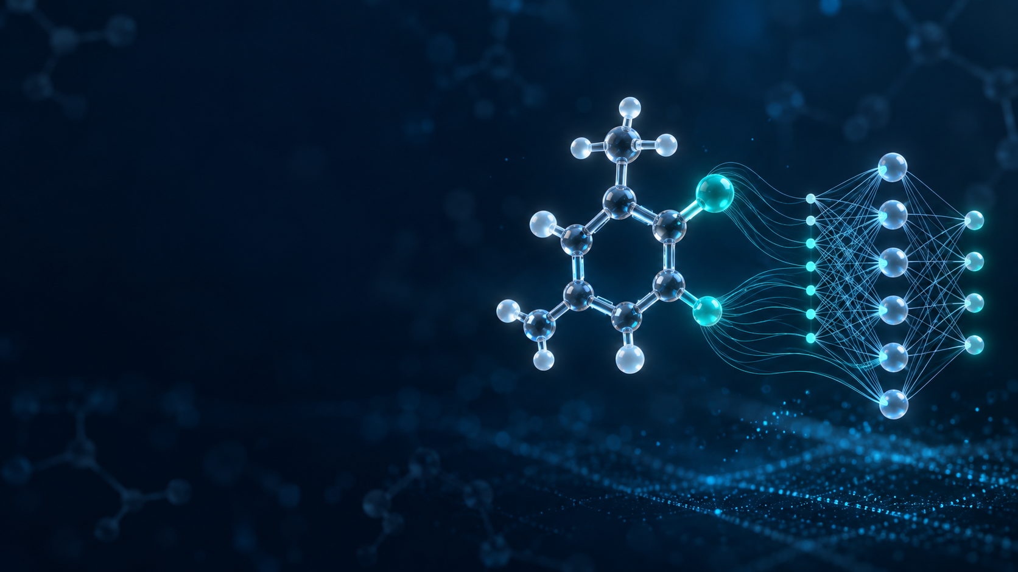
Multi-Task Prediction of
Tox21 Assay Activity
AI for early toxicity screening from molecular structure
Somesh Jaiswal
CO23BTECH11022
BT5230 AI for Drug Discovery
Notes:
Introduce yourself and the project. State that the model predicts activity in 12 Tox21 pathway assays from a SMILES string. Clarify that this is an educational early-screening model, not a clinical toxicity decision tool. Cover image was generated for this presentation using OpenAI image generation and carries no factual claim.

Slide 2
Project overview
02
Research question
Input: one SMILES string
Output: 12 assay activity probabilities
Data: 7,823 valid Tox21 molecules
Main model: shared multi-task neural network
Evaluation: scaffold split with ROC-AUC and PR-AUC
Interface: Streamlit web application
Can one molecular model predict activity across 12 related toxicity assays?
Goal
Prioritise compounds for further testing before expensive laboratory work.
BT5230 | Somesh Jaiswal | CO23BTECH11022
Notes:
Use this slide as the map of the talk. The project starts with a SMILES string and returns 12 assay-specific probabilities. The main scientific question is whether sharing information among assays improves performance over separate models.

Slide 3
The screening problem
03
Experimental testing
Computational screening
Reliable biological evidence
Requires time, reagents and equipment
Difficult to run every compound in every assay
Ranks candidates before experiments
Uses molecular structure alone
Cannot replace experimental validation
Problem statement
Predict the probability that a molecule is active in each Tox21 assay while handling missing and imbalanced labels.
BT5230 | Somesh Jaiswal | CO23BTECH11022
Notes:
Explain the role of computation as a prioritisation layer. Laboratory assays remain necessary. The machine-learning problem is multi-label and partially labelled because each molecule may have several activities and many assay entries are blank.

Slide 4
Tox21 dataset
04
7,831
8
7,823
12
raw rows
invalid SMILES removed
valid molecules
assay tasks
Nuclear receptor assays
Stress response assays
AR, AR-LBD, AhR, Aromatase, ER,
ER-LBD and PPAR-gamma
ARE, ATAD5, HSE, MMP and p53
Blank label = not measured. It must not be treated as inactive.
BT5230 | Somesh Jaiswal | CO23BTECH11022
Notes:
The public Tox21/MoleculeNet CSV contained 7,831 rows. RDKit rejected eight SMILES, leaving 7,823 valid molecules. Explain the two assay families. Source: Huang et al. 2016; MoleculeNet; project results/data_summary.json.

Slide 5
Existing approaches
05
01
02
03
04
Experimental assays
Rule-based alerts
Single-task QSAR
Deep learning
Direct biological measurement
Strong evidence
Higher cost and slower throughput
Known toxicophores and expert rules
Easy to explain
Limited to recognised patterns
One model for each assay
Simple and fast
Does not share information
Learns nonlinear structure patterns
Can share representations
Needs careful validation
This project compares a shared multi-task neural network with 12 separate logistic-regression models.
BT5230 | Somesh Jaiswal | CO23BTECH11022
Notes:
Describe the progression from experimental testing to computational prediction. The fair comparison in this project is the single-task logistic baseline, not every published toxicity model. Source: project methodology and Huang et al. 2016.

Slide 6
Proposed workflow
06
Tox21 CSV
Clean molecules
Scaffold split
Build features
Train model
Use app
Structures and sparse assay labels
Validate and canonicalise SMILES
80% train, 10% validation, 10% test
ECFP4 plus 8 descriptors
Shared MLP with 12 outputs
SMILES to assay probabilities
Test set remains untouched until final evaluation
The same feature calculation and saved scaler are used during training and Streamlit prediction.
BT5230 | Somesh Jaiswal | CO23BTECH11022
Notes:
Walk through the end-to-end pipeline from left to right. Emphasise that the validation set selects the model and the test set is used only for the final reported result.

Slide 7
Molecular representation
07
ECFP4 fingerprint
Molecular descriptors
2,048 binary bits
8 scaled values
+
Captures local atom environments
Represents structural fragments
Used for model input and similarity
Molecular weight
logP and TPSA
H-bond donors and acceptors
Rotatable bonds
Ring count and heavy atoms
Final input size: 2,056 features per molecule
BT5230 | Somesh Jaiswal | CO23BTECH11022
Notes:
Explain that ECFP4 encodes substructure presence while the eight descriptors provide global physicochemical information. The StandardScaler fits only on training descriptors to avoid data leakage. RDKit calculates all features.

Slide 8
Multi-task neural network
08
Assays
Input
Output
Hidden layer
NR-AR
NR-AhR
...
SR-p53
Hidden layer
2,056 features
12 logits
256 units
ReLU + BatchNorm
128 units
ReLU + Dropout
Shared hidden layers learn patterns that may be useful across related assays.
Sigmoid converts each output logit into an activity probability.
BT5230 | Somesh Jaiswal | CO23BTECH11022
Notes:
Explain shared representation learning. All 12 tasks use the same feature extractor but have separate output neurons. Architecture: 2056 to 256 to 128 to 12, ReLU activations, batch normalisation and dropout.

Slide 9
Training strategy
09
Missing labels
Class imbalance
L = sum(mask x BCE) / sum(mask)
positive weight = inactive / active
A blank assay label contributes zero loss.
Each assay receives its own positive-class weight.
Scaffold split
Train 6,258
Val
Test
AdamW | batch 128 | learning rate 0.001 | early stopping
BT5230 | Somesh Jaiswal | CO23BTECH11022
Notes:
Describe two central technical decisions: label masking and per-task class weighting. The scaffold split holds related cores together, making the test harder and closer to prediction on new chemistry. Training completed 13 epochs and saved the checkpoint with the best validation mean ROC-AUC.

Slide 10
Overall test performance
10
+0.025
mean ROC-AUC
+0.035
mean PR-AUC
Held-out scaffold test set
BT5230 | Somesh Jaiswal | CO23BTECH11022
Notes:
The multi-task model achieved mean ROC-AUC 0.741 and mean PR-AUC 0.342. The single-task logistic baseline achieved 0.716 and 0.307. State the absolute improvements, not percentages. Source: results/metrics_scaffold.csv.

Slide 11
Per-assay ROC-AUC
11
9 of 12
assays improved
Largest gains
NR-PPAR-gamma
SR-HSE
Baseline wins
NR-AR
NR-AR-LBD
NR-Aromatase
BT5230 | Somesh Jaiswal | CO23BTECH11022
Notes:
Point out that multi-task learning helps 9 of 12 assays but not all of them. The baseline remains stronger for NR-AR, NR-AR-LBD and NR-Aromatase, which may indicate negative transfer or limited task-specific signal. Source: results/metrics_scaffold.csv.

Slide 12
Why the proposed approach helps
12
Single-task logistic baseline
Proposed multi-task MLP
Fits each assay independently
Linear decision boundary
Fast and easy to explain
Higher ROC-AUC on 3 assays
Shares chemical patterns across assays
Learns nonlinear relationships
Masks missing labels during training
Improves mean ROC-AUC and PR-AUC
Measured conclusion: better average performance on this scaffold split, not universal superiority.
BT5230 | Somesh Jaiswal | CO23BTECH11022
Notes:
Use precise wording. The project demonstrates better average performance than its controlled baseline on one scaffold split. It does not prove superiority to every published Tox21 system or to laboratory assays.

Slide 13
Streamlit prediction interface
13
1. Enter SMILES
2. Calculate features
3. Predict
4. Explain output
Example: aspirin
Fingerprint and descriptors
Load saved scaffold model
12 probabilities and similarity
Example run
Nearest training similarity
1.00
Assay activity does not equal clinical toxicity.
BT5230 | Somesh Jaiswal | CO23BTECH11022
Notes:
Demonstrate the app live if time permits. The example values shown here come from the saved scaffold model for aspirin. Explain the nearest-neighbour similarity warning. Do not interpret the probabilities as organ toxicity or patient risk. Source: app.py and saved model inference.

Slide 14
Conclusion and limitations
14
Conclusion
Limitations
A shared model predicted 12 Tox21 assays and improved average scaffold-test performance over the single-task baseline.
In-vitro pathway assays are not human toxicity outcomes
Sparse and imbalanced labels limit some tasks
Only 2D structure information is used
One dataset and split require external validation
Similarity warning is not calibrated uncertainty
Next step: external validation and uncertainty calibration before practical safety use.
BT5230 | Somesh Jaiswal | CO23BTECH11022
Notes:
Finish with the measured contribution and the limitations. Future work could test graph neural networks, calibration and external datasets, but the present project already provides a complete reproducible baseline-to-app workflow.

Slide 15
References
15
[1]
Huang, R. et al. (2016). Tox21Challenge to Build Predictive Models of Nuclear Receptor and Stress Response Pathways. Frontiers in Environmental Science, 3:85.
[2]
Wu, Z. et al. (2018). MoleculeNet: a benchmark for molecular machine learning. Chemical Science, 9, 513-530.
[3]
Tox21 Data Challenge, National Institutes of Health. tripod.nih.gov/tox21/challenge/data.jsp
[4]
RDKit: Open-source cheminformatics. rdkit.org
[5]
PyTorch documentation. pytorch.org
[6]
Streamlit documentation. docs.streamlit.io
Project data source
deepchemdata.s3-us-west-1.amazonaws.com/datasets/tox21.csv.gz
BT5230 | Somesh Jaiswal | CO23BTECH11022
Notes:
Full DOI links: Huang et al. https://doi.org/10.3389/fenvs.2015.00085; MoleculeNet https://doi.org/10.1039/C7SC02664A. Tox21 official challenge page: https://tripod.nih.gov/tox21/challenge/data.jsp. RDKit: https://www.rdkit.org/. PyTorch: https://pytorch.org/. Streamlit: https://docs.streamlit.io/.

