Slide 1
A Comparative Study on Orchestration tools for DevOps
Somesh Rao Coka

Slide 2
Agenda
Introduction
Problem Statement
Objectives & Scope
Orchestration Tools
Experiment Results
Summary

Slide 3
Introduction
Over the previous 5-10 years, the Agile technique and culture have grown at a faster pace, exposing the need for a more robust approach to the current software development life cycle.
Many say, DevOps is an offspring of agile methodology which was born to keep up with the
needs and demands.
DevOps is a set of practices that combines software development (Dev) and IT operations (Ops). It aims to shorten the systems development life cycle and provide continuous delivery with high quality

Slide 4
Problem Statement
Choose a cloud container-based orchestration framework

Slide 5
A DevOps engineer working for a Medium-scale company migrating its applications to the cloud, is responsible for deploying and managing a new containerized application.
These containers perform Mission critical tasks for the company’s business. The application is composed of hundreds of containers.
The engineer must choose a cloud container-based orchestration framework to deploy and manage the application.
They are considering Kubernetes, Docker Swarm, and Apache Mesos.

Slide 6
Objectives
Make it clear how to use them effectively

Slide 7
Cloud container-based orchestration frameworks are becoming increasingly popular for deploying and managing containerized applications. However, it is not always clear how to use them effectively.
What is the working architecture of orchestration tools?
How can DevOps teams use these frameworks to ensure successful deployments of new software solutions?
To perform a performance analysis to choose the optimum orchestration tool for quick deployment.

Slide 8
Scope
This study focuses specifically on three container orchestration tools

Slide 9
This study focuses specifically on three container orchestration tools: Docker Swarm, Kubernetes, and Apache Mesos.
The study aims to provide an in-depth analysis of each tool's capabilities to recommend a specific tool for a particular use case.
This study is intended for readers who are interested in learning about container orchestration tools and their use in DevOps processes. software developers, system administrators, and IT professionals might find it useful as well.
Notes:
Additionally, while the study provides an overview of DevOps methodologies, it does not aim to provide an exhaustive analysis of all available methodologies.

Slide 10
Orchestration Tools
Frameworks designed to streamline and automate complex workflows

Slide 11
Orchestration Tools
What is it?
How it is benificial ?
Where is it used ?
Orchestration tools are pieces of software that automate the configuration, coordination, integration, and data management procedures for a variety of applications and systems.
Supports a DevOps approach that allows teams to develop and deploy in rapid, iterative cycles.
Ensures systems are always ready for new technologies.
Improves Service Level Agreement execution.
Automated parts can be managed at vast scales.
Closed-loop change and configuration management.
Unified IT workflow automation.
DevOps & cloud orchestration.
Platform expansions.
Notes:
A service-level agreement (SLA) sets the expectations between the service provider and the customer and describes the products or services to be delivered,

Slide 12
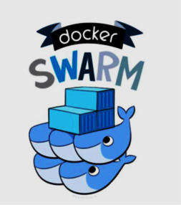
Docker Swarm
Docker Swarm is Docker's native clustering and orchestration solution.
It is essentially a kind of tool that allows us to create and schedule multiple docker nodes.
Each Node in the docker swarm is itself a docker daemon.
A demon can interact with the Docker API.
There are two types of services in docker swarm: replicated and global
In replicated mode, Docker Swarm will deploy the containers based on the no. of replicas required for you.
In global mode, It will maintain the replicas of containers in all the nodes which are available in the cluster.
Notes:
Replicated : If you required 3 replicas it will deploy the containers based on the node availability.
Global : Docker Swarm will maintain containers in all the slave nodes and master nodes.

Slide 13
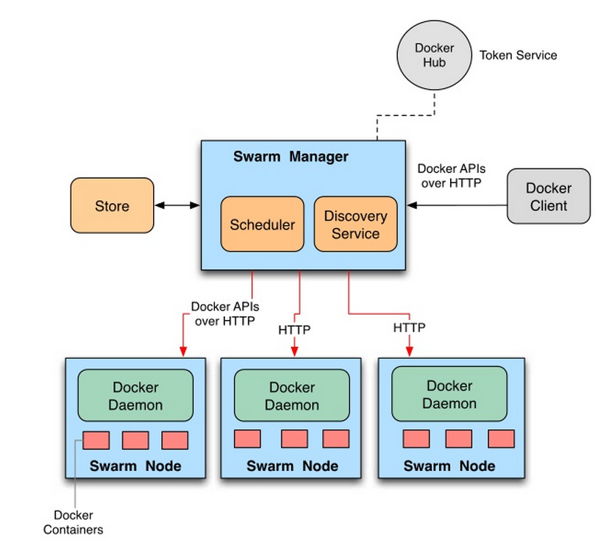
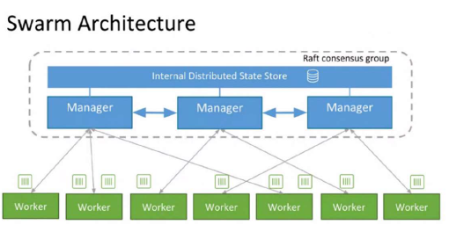
Working Architecture
Notes:
Docker Swarm follows a master-worker architecture where the master node manages the worker nodes.
they keep the cluster running and handle failover in the event of a node failure.
It is possible for the swarm architecture to have multiple manager nodes controlled by one manager node that is elected with the help of the Raft algorithm.
a manager node cannot be configured to work as both a manager and worker node at the same time.
Worker Nodes: These are the nodes that carry out the tasks that the manager node assigns to them. They oversee running the containers and supplying the resources required to operate the services.
Service discovery: In Docker Swarm, service discovery is the mechanism Docker uses to route a request from your service’s external clients to an individual swarm node, It’s like a layer of abstraction, the work gets done without the client needing to know how many nodes are participating in the service.

Slide 14
Features of Docker Swarm
Docker Swarm is a good choice for
Companies that adopted swarm
Load Balancing Built-in
Self-healing
Scalability and Availability.
Ease of Use
Small to medium-sized deployments.
Applications that need to be highly available.
Applications that need to be scaled out.
Shopify uses to deploy its e-commerce platform.
Pinterest uses to deploy its image-sharing platform.
Lockheed Martin uses Docker Swarm to deploy its Orion platform, which is a cloud-based platform for managing military operations.

Slide 15
Kubernetes
Often known as K8s, is an open-source container orchestration technology that automates containerized application deployment, scaling, and management.
Google created it, and the Cloud Native Computing Foundation (CNCF) now maintains it.

Slide 16
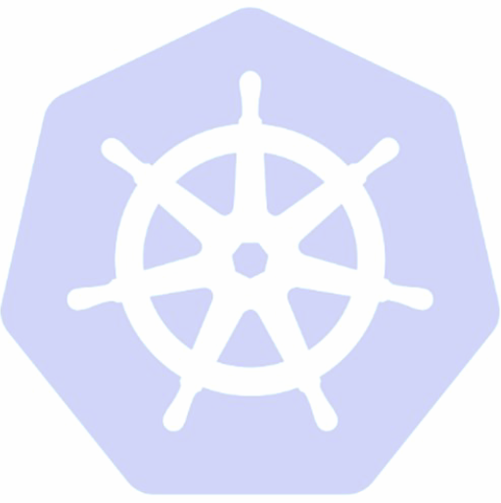
Kubernetes is a distributed system. Meaning, it has multiple components spread across different servers over a network. These servers could be Virtual machines or bare metal servers. We call it a Kubernetes cluster
A Kubernetes Cluster consists of Worker Machines known as Nodes and a Control Plane.

Slide 17
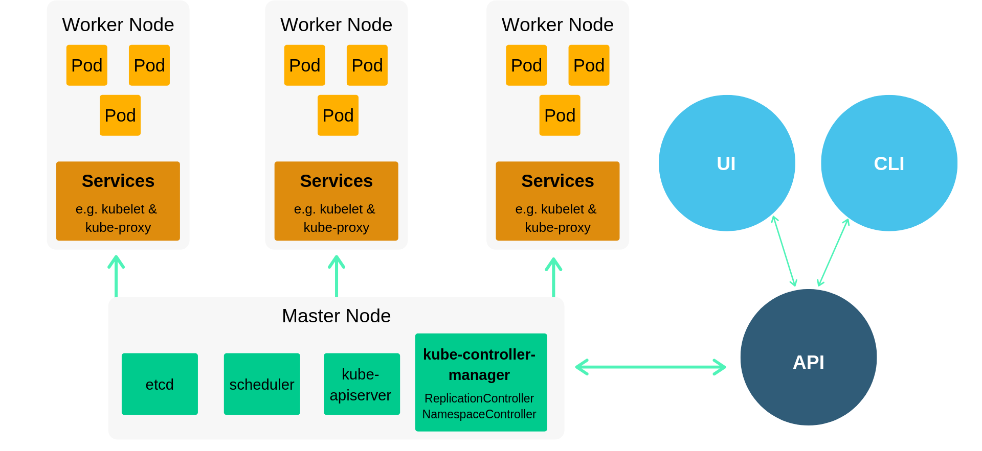
Working Architecture
Notes:
This is the working architecture of Kubernetes. In the outer layer, we can see a master node and a worker node.
There are different ways to interact with the cluster that is through API calls either by GUI or CLI.
The architecture could be explained by explaining KUBLET, KUBE-PROXY, CONTROLER Plane AND POD.
Let’s start with the Master Node. It is in charge of monitoring the Kubernetes cluster
The API server is the cluster's central control point for administering and controlling it. It makes the Kubernetes API available to users, allowing them to communicate with the cluster.
The Scheduler manages Workloads such as containers that are assigned to worker nodes. It does this based on resource availability, limitations, and other policies.
The controller manager to keep it simple about control manager it manages the cluster-level functions of node and pod lifecycle management, scaling, and monitoring.
Lastly, etcd: etcd is a distributed key-value store that serves as the data store for the cluster. It stores the cluster’s setup, state, and other metadata.
Now The worker Node. These are the machines that deploy and run containers.
A kubelet is a worker node agent that communicates with the master node. It is in charge of container management, initiating and stopping pods, and reporting the node's status.
Another interesting yet Important component in worker node is Container Runtime: Kubernetes supports many container runtimes, including Docker. The container runtime is in charge of fetching and running container images.
The component that handles the Network component in the cluster is kube-proxy it is in charge of network proxying and distributing load inside the cluster. It controls network rules and ensures service communication.
Lastly, The smallest and most fundamental unit of Kubernetes is called a pod. A pod is a collection of one or more containers that are co-located and share resources such as network and storage.

Slide 18
Features of Kubernetes
Kubernetes is a good choice for
Companies that adopted K8s
Built-in Service Discovery and Load Balancing.
Rolling updates and rollbacks.
Declarative Configuration.
Large-scale deployments.
Applications with complex requirements.
Companies that want to use the latest technologies.
Companies that need to ensure that their applications are always available
PayPal uses it to deploy its payment processing service.
eBay uses it to deploy its e-commerce platform.
The New York Times uses it to deploy its news website. It helps to handle heavy volumes of traffic.
Netflix uses Kubernetes to deploy its streaming service.
Notes:
Kubernetes assigns each service a stable IP address and DNS name, allowing other services to discover and communicate with them. Along with that the Traffic is distributed across service replicas using the built-in load balancer
Kubernetes allows you to change containers and applications without downtime. It progressively swaps out old containers with new ones. In the event of a problem, Kubernetes allows for simple rollbacks to prior versions.
To define the desired state of the system, Kubernetes uses declarative YAML or JSON configuration files.

Slide 19

Apache Mesos
Apache Mesos is an open-source cluster manager that handles workloads in a distributed environment through dynamic resource sharing and isolation.
Mesos brings together the existing resources of the machines/nodes in a cluster into a single pool from which a variety of workloads may utilize.
This removes the need to allocate specific machines for different workloads.
Notes:
(after the points on the screen)
Now you might think who will use Apache Mesos but There was a specific need for Mesos and that is:
Many resource manager exists today like Hadoop, batch scheduler(like Torque), and VM Scheduler (like Eucalyptus) but the problem with Hadoop-like workload is data locality, Data locality is the process of moving the computation close to where the actual data resides on the node, instead of moving large data to computation. This minimizes network congestion and increases the overall throughput of the system.
Data locality was compromised because of static partitioning of nodes in other orchestration tools and since the job holds nodes for a full duration of time, utilization of the system was affected. These drawbacks were solved in Mesos with the help of Fine-grained Sharing and Two-level scheduling.

Slide 20
Working Architecture
Notes:
The master node guarantees that the cluster will be highly available. It hosts the primary user interface that provides information about the resources available in the cluster.
The master is a central source of all running tasks, it stores in memory all the data related to the task.
Zookeeper is used for leader election and cluster state storage. It contributes to the Mesos master’s high availability and fault tolerance.
In its framework, there is a scheduler and executor. Where Schedulers register with the Mesos master to get resources and executors launch the program that runs tasks on the slaves.
The Mesos Agent holds and manages the container that hosts the executor. the agent acts as an intermediate between executor and Mesos master.
It guarantees the delivery of status update of the tasks to the schedulers.

Slide 21
Features of Apache Mesos
Apache Mesos is a good choice for
Companies that adopted Mesos
Dynamic Resource Allocation.
Heterogeneous Workload Support.
Fault Tolerance.
Flexible Scheduling.
Providing a common platform for heterogeneous workloads.
Running distributed applications.
Scaling to large clusters.
Managing containerized workloads.
Apple uses Apache Mesos to run its Siri backend.
Twitter uses Apache Mesos to run its Hadoop and Spark clusters.
Airbnb uses Apache Mesos to manage its distributed infrastructure.
The Walt Disney Company uses Apache Mesos to run its streaming media infrastructure.

Slide 22
Experiment Results
The performance metrics for container orchestration tools.

Slide 23
Provisioning time of the cluster
Cluster provisioning time is the amount of time it takes to create a cluster of computing resources, such as virtual machines or containers.
This includes the time it takes to launch the services, install the software, and configure the cluster.

Slide 24
Test Environment
The Test was done in a Cloud environment; AWS Cloud I used Virtual machines (EC2 instances) and configured them as follows:
OS: Ubuntu 22.04 LTS,
CPUs count 2,
Memory: 4 GB,
Storage: 15 GB
Storage type: EBS.

Slide 25
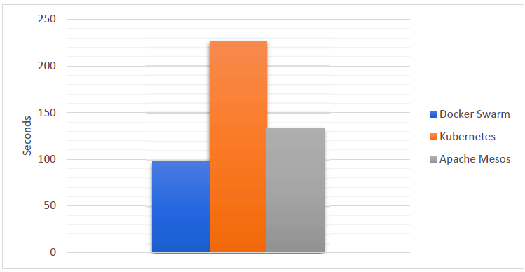
Results
Notes:
The time required to deploy container orchestration tools is depicted in this chart. The x-axis represents the amount of time these container orchestration tools are used for setup and deployment. Where Y-axis represents the tools.
During my testing, I discovered that Docker Swarm with its less complexity and has managed to have less provisioning time in comparison to the other two tools.
This is Because the entire architecture is optimized here to execute deploying, the Docker swarm tool takes less time to deploy an application. Mesos framework takes longer than Docker Swarm, but it takes less time to deploy an application than Kubernetes.
it can be concluded that Kubernetes requires a longer provisioning time than any other peer framework, this is because of its architecture, which is one of the most complicated in nature.

Slide 26
Why Kubernetes Took more time?
This is because of its architecture, which is one of the most complicated in nature.
Docker Swarm on the other hand with its less complexity has managed to have less provisioning time in comparison to the other two tools
This is Because the entire architecture is optimized here to execute deploying, the Docker swarm tool takes less time to deploy an application.

Slide 27
Time taken for each component in K8s
Component | Time Taken
Master node | 76 seconds
Worker node(s) | 40 seconds per node
Node components (Pod, kubelet) | 46 seconds
Control plane components (Service) | 57 seconds
Ingress | 13 seconds
Total | 232 seconds

Slide 28
Time taken for each component in Mesos
Component | Time Taken
Master node | 24 seconds
Worker node(s) | 11 seconds per node
Node components | 41 seconds
Service | 46 seconds
Ingress | 11 seconds
Total | 133 seconds

Slide 29
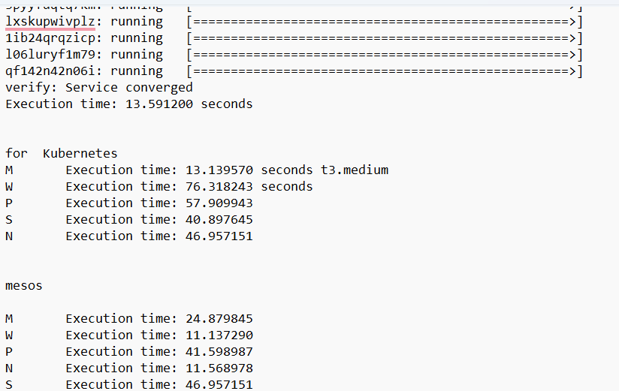

Slide 30
Summary
This study compares container orchestrators' capabilities, as well as the container orchestration structure.
A thorough set of metrics has also been developed in order to compare their outcomes.
Both Kubernetes and Mesos aim to simplify application deployment and management in data centers or cloud containers.
They both offer great support to businesses of various sizes.
Kubernetes is an excellent option if you are starting from scratch. If you have legacy applications, Mesos is the superior choice.

Slide 31
Thank you
Somesh Rao Coka
ST122892
cokasomeshrao@outlook.com

