Slide 1

Basic Details of the Team and Problem Statement
Ministry/Organization Name/Student Innovation:
Government of Gujarat
PS Code: SIH1363
Problem Statement Title: Self-identifying mental health status and get guidance for support.
Team Name: Magic Moments
Team Leader Name: Shubham Tiwary
Institute Code (AISHE): U-0750
Institute Name: Uttaranchal University
Theme Name: Mental Stress Diagnosis

Slide 2
Mann Shakti
A Mental Stress
Personal Assistant
- Self-identifying Mental Stress state
- Guidance for support & controlling under a caretaker

Slide 3
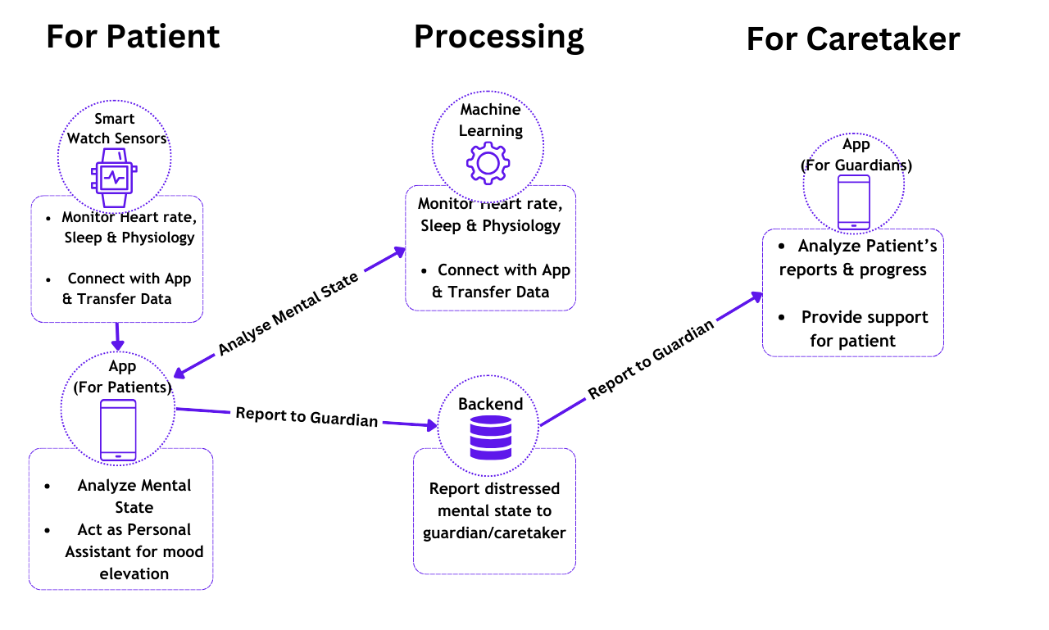

Slide 4
Mental Stress from a
Top-bottom Approach
What is mental stress?
3) Stress Among the different ages
2) Symptoms of Mental Stress? You’ve probably
experienced it for yourself

Slide 5
Everyone Experiences Stress
Teens & Adolescent
(12-19)
Young Adults
Seniority
As a matter of fact
- Unhealthy Lifestyles
- Family issues
All age groups have experienced stress, in some sort of way!
- Academic Demands
- Changes in themselves
- More responsibilities
- Increasing Works

Slide 6
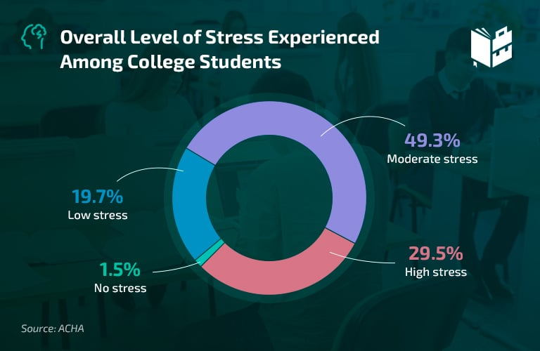
Overall, 88 percent of college students
reported their college life to be stressful

Slide 7
Our solution to this
problem

Slide 8
Process
Caretaker Interface
Sensors (Input)
Processing
Monitor the mental state of patients via Smart-watch Sensors
Machine Learning Algorithms to classify the mental state
External support from caretakers
When patient is distressed
1
Patient Interface
Storing Data
Mobile Application as a personal assistant for mood elevation.
Analyze the progress over time

Slide 9
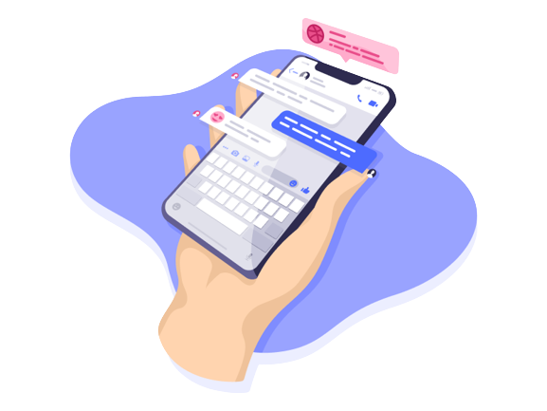





Tech Stacks Used
Java
TensorFlow
React Native
Machine
Learning
Watch App
Mobile App
Node.js
MongoDB
Backend
Database

Slide 10
Understanding Sensors and the Watch Application

Slide 11
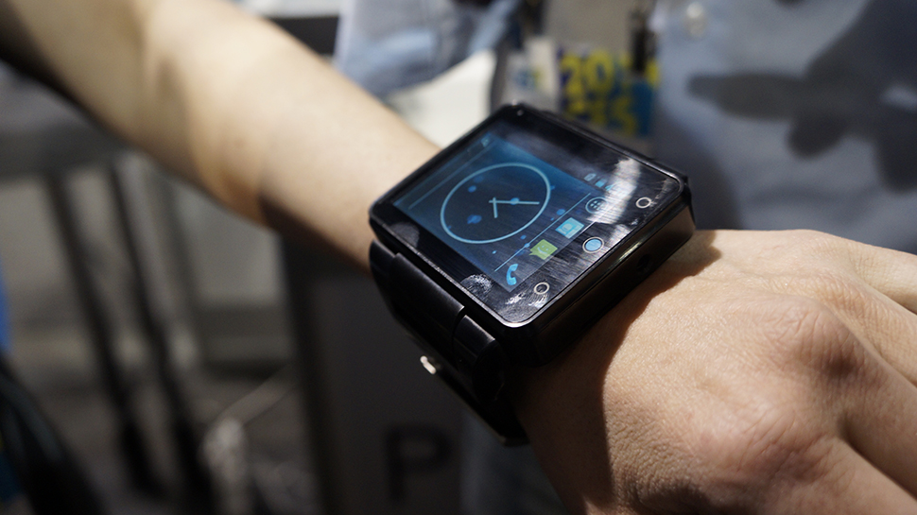
Most Smart Watches have in-built
basic sensors
that provide necessary functions for
creating a
basic monitoring system.

Slide 12
Sensors Used
01
Accelerometer
Vibration, Acceleration
02
Heart Rate
Changes In heart rate(bpm)
03
Gyroscope
Angular Velocity
04
Sleep Cycle
Changes in Sleep Patterns

Slide 13
The data is sensed from the device at some set intervals on two Modes:
Active Mode : 2-3 seconds
Passive Mode : 5-7 seconds
- It is then sent to user’s mobile App via short range wireless Network
(Bluetooth or Wi-Fi)

Slide 14
Understanding the
Mobile Application
The Mobile Application has two components or set of access:

Slide 15
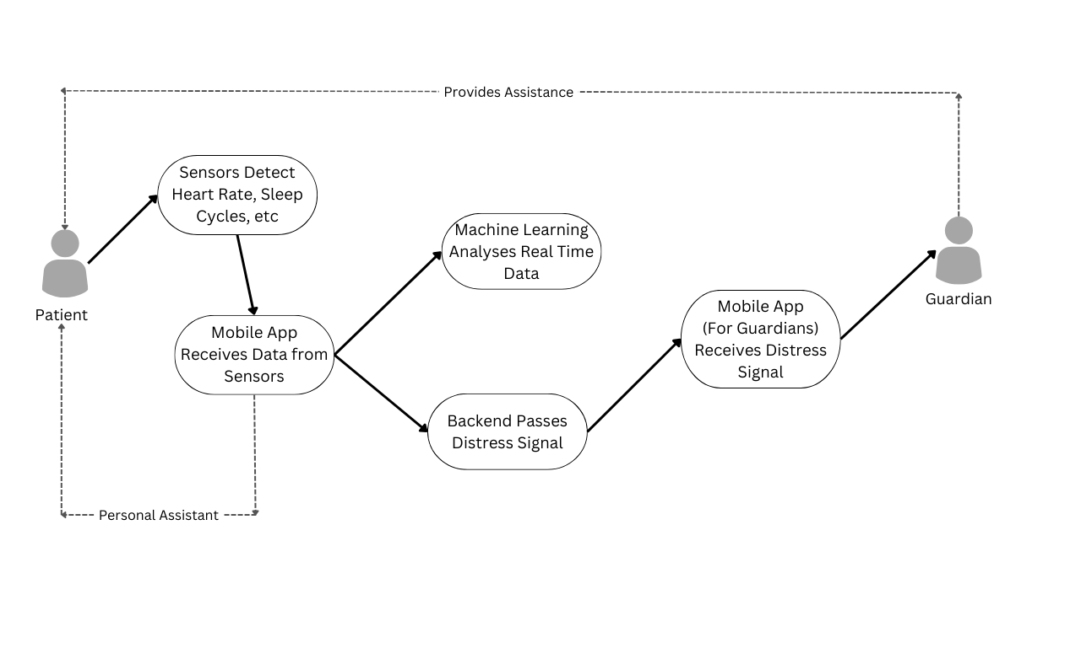

Slide 16
For Patient
05
04
03
Contact with Guardian
02
01
Shows a more detailed view of the patient’s analytics
The ML model classifies the mood into four categories
Pass the sensory data onto a ML model to analyze the mood
Fetch data from the wireless network connected to the watch
.

Slide 17
For Caretaker
04
03
02
01
Set alerts when patient’s mood elevates to threshold
Interact With Patients
Add or Remove Patients for monitoring
Fetch data of patients
.

Slide 18
Understanding the Machine Learning
Algorithm

Slide 19
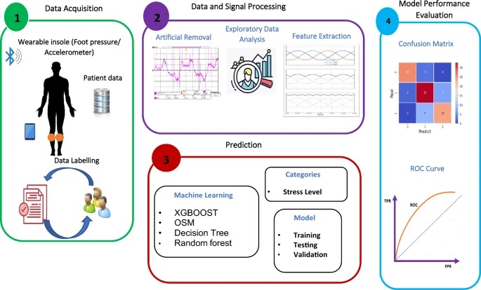

Slide 20
Steps Involved in Stress Analysis
1. Data Collection: Data are collected from the wearable sensors, which include physiological signals such as heart rate variability (HRV), Accelerometer(Motion Sensing)
2. Data Processing: Preprocessing of the data, feature extraction & feature selection.

Slide 21
3. Prediction: Use machine learning algorithms to predict the stress levels of the individual.
4. Model Evaluation: Performance of the model is evaluated

