Slide 1

Basic Details of the Team and Problem Statement
Ministry/Organization Name/Student Innovation:
Government of Gujarat
PS Code: SIH1363
Problem Statement Title: Self-identifying mental health status and get guidance for support.
Team Name: Magic Moments
Team Leader Name: Shubham Tiwary
Institute Code (AISHE): U-0750
Institute Name: Uttaranchal University
Theme Name: Mental Stress Diagnosis

Slide 2
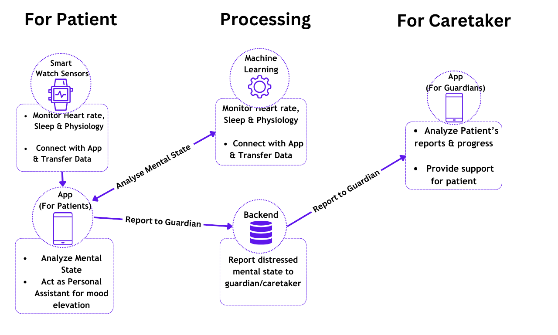
Idea/Approach Details
- Monitor the mental state of patients via Smart-watch Sensors with Mobile Application as a personal assistant for mood elevation.
- Use of Machine Learning Algorithms to classify the mental state and analyze the progress over time.
- Provide External support from caretakers when recorded mental state is highly distressed
Smart Watch App: Java (Android)
Mobile App: React Native
Machine Learning Model : TensorFlow
Backend: Node.js + Express
Database: Mongo DB

Slide 3
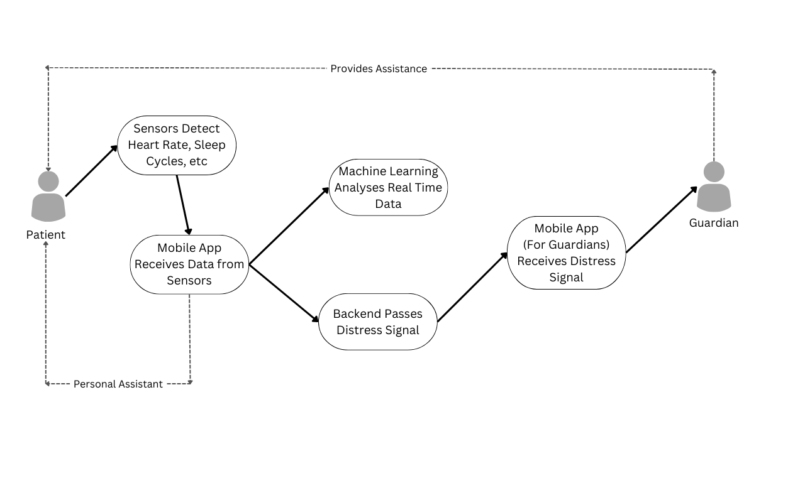
Idea/Approach Details
Use Cases
Dependencies / Show Stopper
- Health Services API (For Wear OS Devices)
- Open AI API (Language Generation)
- Google Speech to Text API
- Amazon AWS Elastic Beanstalk(For hosting Node.js Backend Application)

Slide 4
Team Member Details
Team Leader Name: Shubham Tiwary
Branch (Btech/Mtech/PhD etc.): B.Tech Stream (ECE, CSE etc): CSE
Team Member 1 Name: : Somesh Tiwari
Branch (Btech/Mtech/PhD etc.): B.Tech Stream (ECE, CSE etc): CSE
Team Member 2 Name: : Shruti Soumya
Branch (Btech/Mtech/PhD etc.): B.Tech Stream (ECE, CSE etc): CSE
Team Member 3 Name: : Shivam Saklani
Branch (Btech/Mtech/PhD etc.): B.Tech Stream (ECE, CSE etc): CSE
Team Member 4 Name: : Harsh Singla
Branch (Btech/Mtech/PhD etc.): B.Tech Stream (ECE, CSE etc): CSE
Team Member 5 Name: Shivam Kumar
Year (I,II,III,IV): 2nd(II)
Year (I,II,III,IV): 2nd(II)
Year (I,II,III,IV): 2nd(II)
Year (I,II,III,IV): 2nd(II)
Year (I,II,III,IV): 2nd(II)
Branch (Btech/Mtech/PhD etc): B.Tech
Stream (ECE, CSE etc): AE
Year (I,II,III,IV): 2nd(II)

