Slide 1




DEPARTMENT OF COMPUTER SCIENCE AND ENGINEERING

Slide 2
1

Slide 3

FA to RE Equivalence: There are many method for the conversion of Finite automata to regular expressions
One method for such conversion to be considered here is called State Elimination Method
State Elimination Method as the name suggest involves elimination of all finite states in the automata except the initial states and the final states
Algebraic rules of the regular expressions are utilized to combine the inputs of the eliminated states into the equivalence RE between the initial and final states

Slide 4
1. Union (+)
0,1
0
(0+1)
𝑞₀
𝑞₁
(0+1)
𝑞₀
𝑞₁
1
2. Concatenation (.)
0
1
(01)
𝑞
0
𝑞
1
𝑞
2
0
3. Star closure (*)
(0)*
𝑞₀

Slide 5
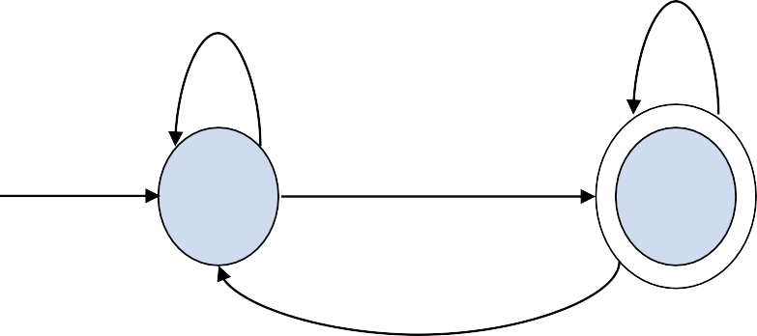
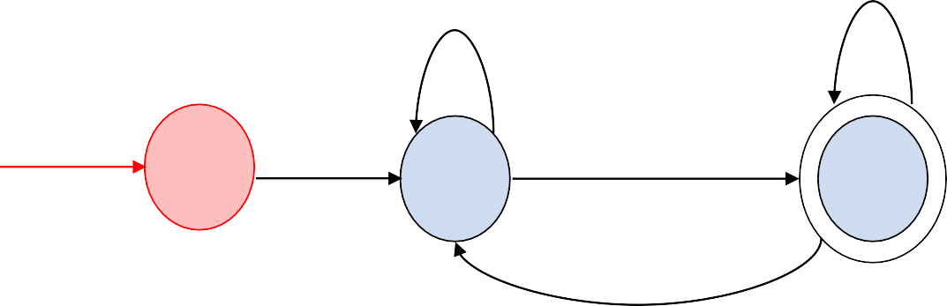
Rule 1
Initial state must not contain incoming input from another
state.
1
1
𝑞₀
0
𝑞₁
0
Transformation: If initial state 𝑞₀ in the FA has any input from another state (incoming input), a new initial state 𝑞_{𝑠} is created with epsilon move to the old initial state
1
1
𝑞_{𝑠}
∈
𝑞₀
0
𝑞₁
0

Slide 6
Rule 2
Final state must not contain outgoing move to another state.
•
1
1
0
0
𝑞₂
𝑞₀ 𝑞₁
Transformation: If final state (i.e. 𝑞₁ ) in the FA has any output going to another state, a new final state (i.e. 𝑞_{𝑓}) is
created with epsilon move from the old final state which is
transformed to non-final state
1
1
𝑞₀
0
𝑞₁
∈
0
𝑞₂
𝑞_{𝑓}

Slide 7
Rule 3
1
Only one Final state is allowed:
𝑞₁
1
𝑞₀
0
𝑞₁
Transformation: If final state in the FA has more than one final state (i.e. 𝑞₁, 𝑞₂ ), a new final state (i.e. (i.e. 𝑞_{𝑓} ) is
created and the old final states are connected to the new
final states and then tra1nsformed to non-final states
𝑞₁
∈
1
𝑞_{𝑓}
𝑞₀
0
∈
𝑞₁

Slide 8
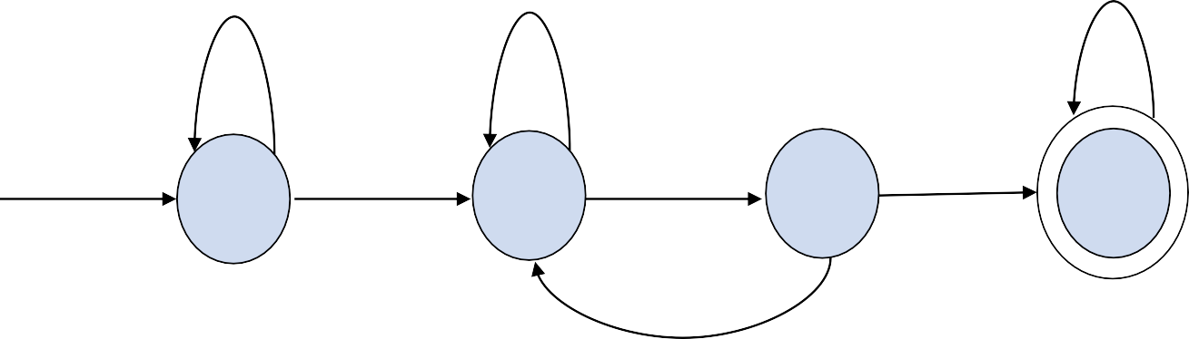
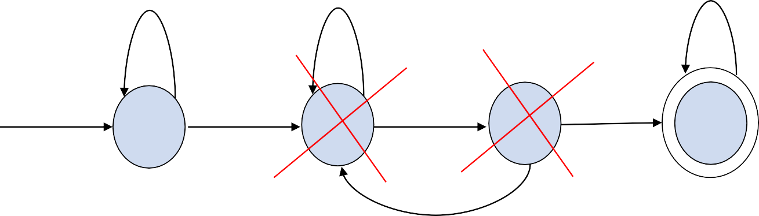
Rule 4
All states must be eliminated with exception of initial and
final states.
0,1
1
0
0
1
1
Start
𝑞
𝑞
𝑞
𝑞
0
1
2
3
0
Transformations:
0,1
1
0
0
1
1
Start
𝑞
𝑞
𝑞
𝑞
0
1
2
3
0

Slide 9
Examples 1: Convert the following FA to RE using state elimination
b
a
c
𝑞
0
𝑞
1
𝑞
2
Solution:
Eliminate 𝑞₁
𝑞₀
a(b)*c
𝑞₂
RE=a(b)*c

Slide 10
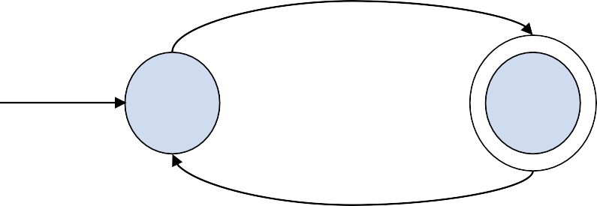
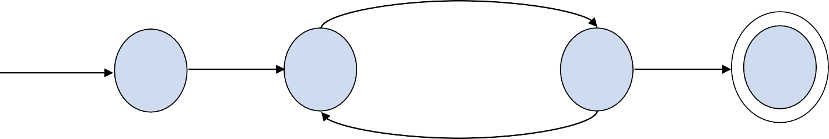
Examples 2: Convert the following FA to RE using state
elimination
0
𝑞₀
𝑞₁
Solution:
1
Clear Incoming input at initial state and outgoing output at final state
0
∈
∈
𝑞_{𝑓}
𝑞
𝑠
𝑞
0
𝑞
1
1

Slide 11
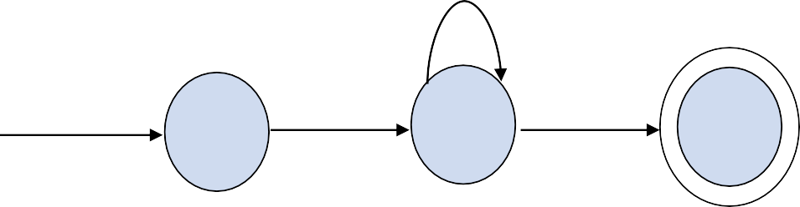
Eliminate 𝑞₀
10
0
𝑞₁
∈
𝑞_{𝑓}
𝑞
𝑠
Eliminate 𝑞₁
0(10)*
𝑞
𝑠
𝑞
𝑓
RE=0(10)*

Slide 12
Examples 3: Convert the following FA to RE using state elimination
𝑞₂
b
a
c d
𝑞₀ 𝑞₁
𝑞₃
𝑞₄
Solution:
Clear multiple final states
𝑞₂
∈
b
a
c
d
∈
𝑞
0
𝑞
1
𝑞
3
𝑞
𝑓
∈
𝑞₄

Slide 13
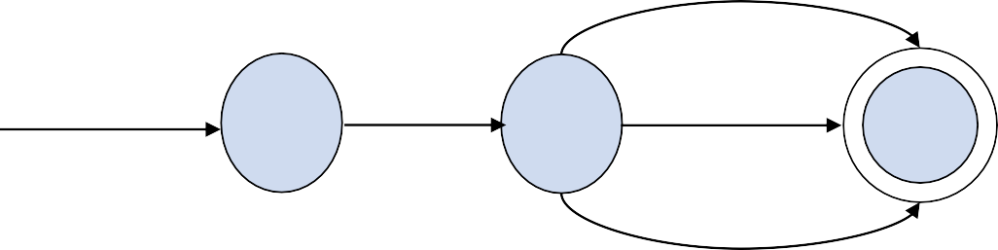
Eliminate 𝑞₂ 𝑞₃ 𝑞₄
b
𝑞₀
a
𝑞₁
c
𝑞_{𝑓}
d
Eliminate 𝑞₁
𝑞₀
a(b+c+d)
𝑞_{𝑓}
RE=a(b+c+d)

Slide 14
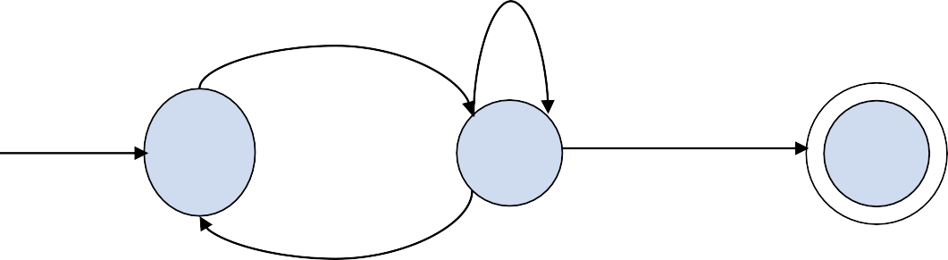
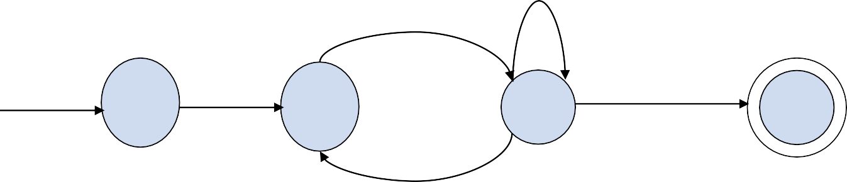
Examples 4: Convert the following FA to RE using state
elimination
c
a
d
𝑞₀
𝑞₂
𝑞₃
b
Solution:
Clear incoming input to initial state
c
a
∈
d
𝑞
𝑠
𝑞
𝑞
𝑞
0
2
3
b

Slide 15
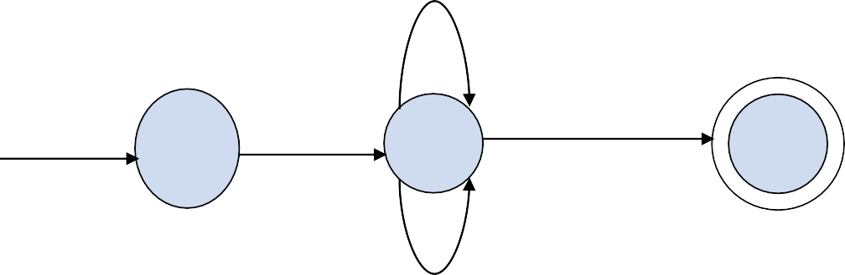
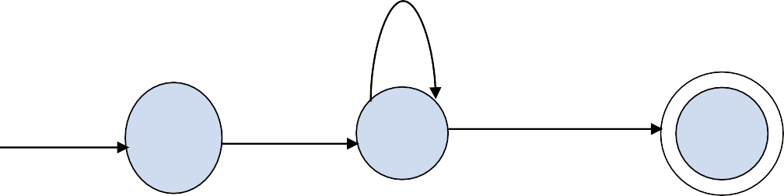
Eliminate 𝑞₀
c
a
d
𝑞_{𝑠}
𝑞
2
𝑞
3
c+ba
ba
a
d
𝑞_{𝑠}
𝑞
2
𝑞
3
Eliminate 𝑞₂
a(c+ba)*d
𝑞_{𝑠}
𝑞₃
RE=a(c+ba)*d

Slide 16
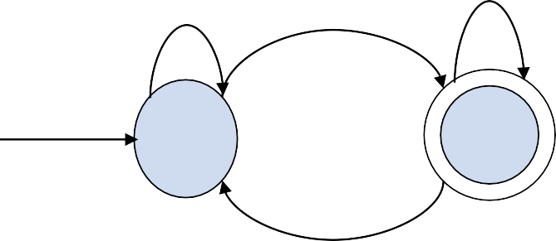
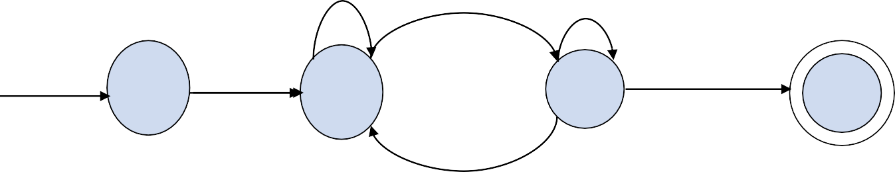
Examples 5: Convert the following FA to RE using state
elimination
d
c
a
𝑞₀
𝑞₁
b
Solution:
Clear incoming input to initial state and outgoing output at final state
a
c
d
∈
∈
𝑞
𝑠
𝑞
𝑞
1
𝑞
0
𝑓
b

Slide 17
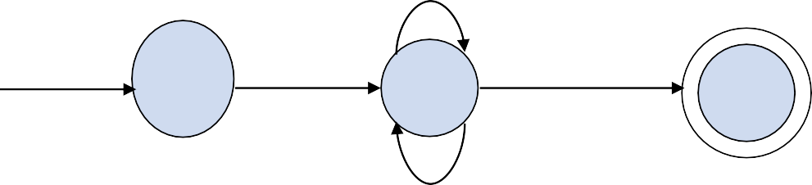
Eliminate 𝑞₀
d
𝑞_{𝑠}
c*a
∈
𝑞
1
𝑞
𝑓
bc*a
d+bc*a
𝑞_{𝑠}
c*a
∈
𝑞
1
𝑞
𝑓
Eliminate 𝑞₁
𝑞_{𝑠}
c*a(d+bc*a)*
𝑞
𝑓
RE=c*a(d+bc*a)*

Slide 18
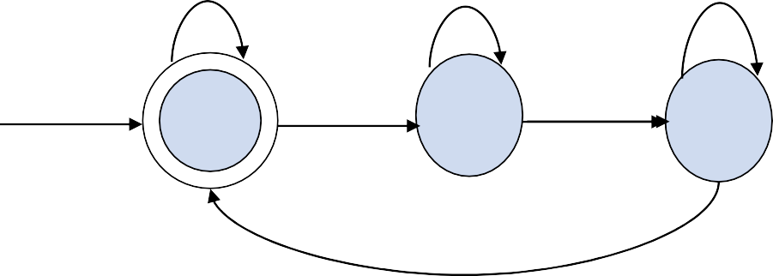
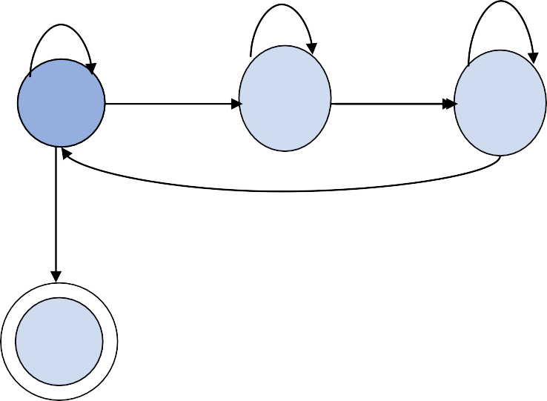
Examples 5: Convert the following FA to RE using state
elimination
0
0
0
1
1
𝑞
𝑞
1
𝑞
0
2
1
Solution:
Clear incoming input to initial state and outgoing output at final state
0
0
0
∈
1
1
𝑞
𝑠
𝑞𝑞
𝑞
1
𝑞
𝑓0
2
∈
1
𝑞_{𝑓}

Slide 19
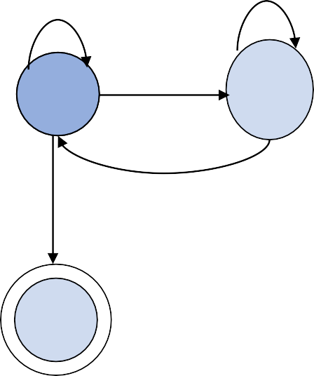
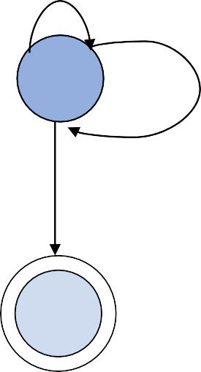
Eliminate 𝑞₂
0
0
𝑞_{𝑠}
∈
1
𝑞₁
𝑞
𝑓0
∈
10*1
𝑞_{𝑓}
Eliminate 𝑞₁
0
∈
10*10*1
𝑞
𝑠
𝑞
𝑓0
∈
𝑞_{𝑓}

Slide 20
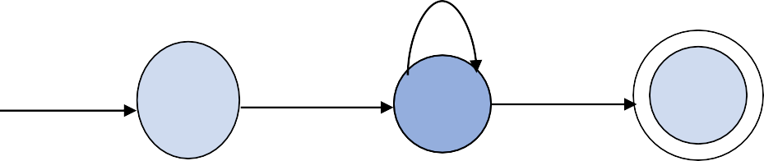
Union on operation on 𝑞₀
(0+10*10*1)
∈
𝑞
∈
^{𝑞}𝑓0
𝑞
𝑓
𝑠
Eliminate 𝑞₀
(0+10*10*1)*
𝑞_{𝑠}
𝑞_{𝑓}
RE=(0+10*10*1)*

Slide 21
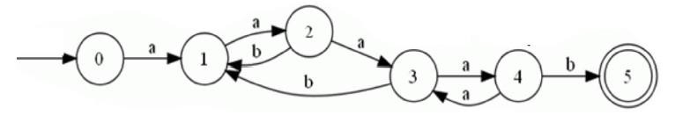
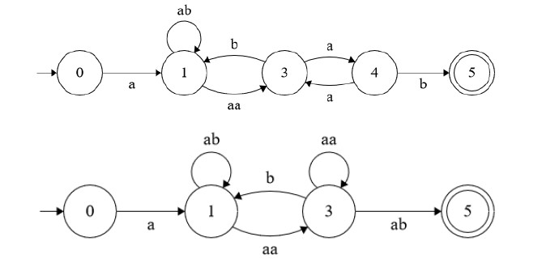
Examples 6: Convert the following FA to RE using state elimination
Solution:

Slide 22
