Slide 1


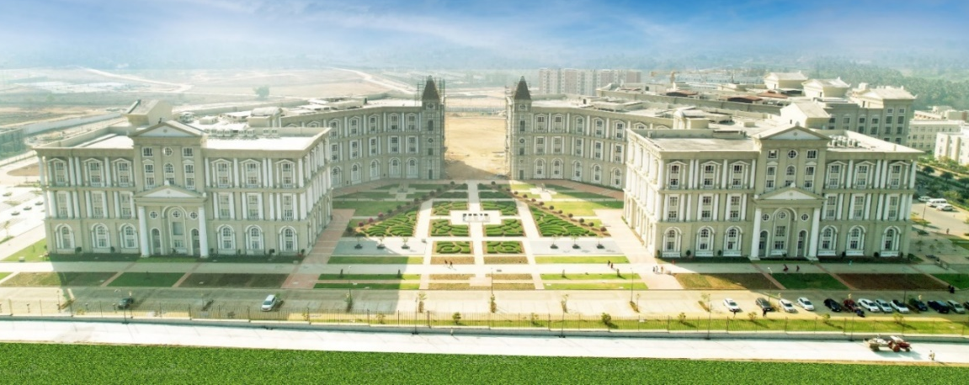

DEPARTMENT OF COMPUTER SCIENCE AND ENGINEERING

Slide 2
Module 2
Regular expression and languages: Regular expressions, finite automata and regular expressions, algebraic laws of regular expressions. applications of regular expressions such as Grep, and Lex etc.. Properties of Regular Languages: closure properties of regular languages, Pumping Lemma, equivalence and minimization of automata

Slide 3
Equivalence of Two States
Two states p and q of a DFA are equivalent (or indistinguishable) if and only if δ(p,w) and δ(q,w) are final states or both are non final states for all w є ∑*
If δ(p,w) є F and δ(q,w) є F then p and q are indistinguishable
If δ(p,w) є F and δ(q,w) є F then p and q are indistinguishable
If δ(p,w) є equivalent)
If there is at least one string w such that from δ(p,w) and δ(q,w) , one is final and another is non final state then p and q are not equivalent and are called distinguishable states.
F and δ(q,w) є F then p and q are distinguishable (not

Slide 4
Ex-
q1
1
(q0,0) and (q1,0) є F
(q0,1) є F and (q1,1) є F
so q0 and q1 are not equivalent
(q0,0) and (q2,0) є F
(q0,1) є F and (q2,1) є F
so q0 and q2 are not equivalent
(q1,0) and (q2,0) є F
(q1,1) and (q2,1) є F
so q0 and q2 are equivalent
0
q0
0
q3
1
1
0
q2

Slide 5
Minimization of DFA

Slide 6
Procedure
Suppose there is a DFA D < Q, Σ, q0, δ, F > which recognizes a language L. Then the minimized DFA D < Q’, Σ, q0, δ’, F’ > can be constructed for language L as:
Step 1 - Draw a table for all pairs of states (Q_{i}, Q_{j}) not necessarily connect directly [All are unmarked initially] [vertically skip 1st state and horizontally last state]
Step 2 − Consider every state pair (Q_{i}, Q_{j}) in the DFA where Q_{i} F and Q_{j} F or vice versa and mark them. [Here F is the set of final states]
Step 3 − Repeat this step until we cannot mark anymore states −
If there is an unmarked pair (Q_{i}, Q_{j}), mark it if the pair {δ (Q_{i}, A), δ (Q_{i}, A)} is marked for some input alphabet.
Step 4 − Combine all the unmarked pair (Q_{i}, Q_{j}) and make them a single state in the reduced DFA.
// remove dead state or unreachable state then after go with procedure

Slide 7
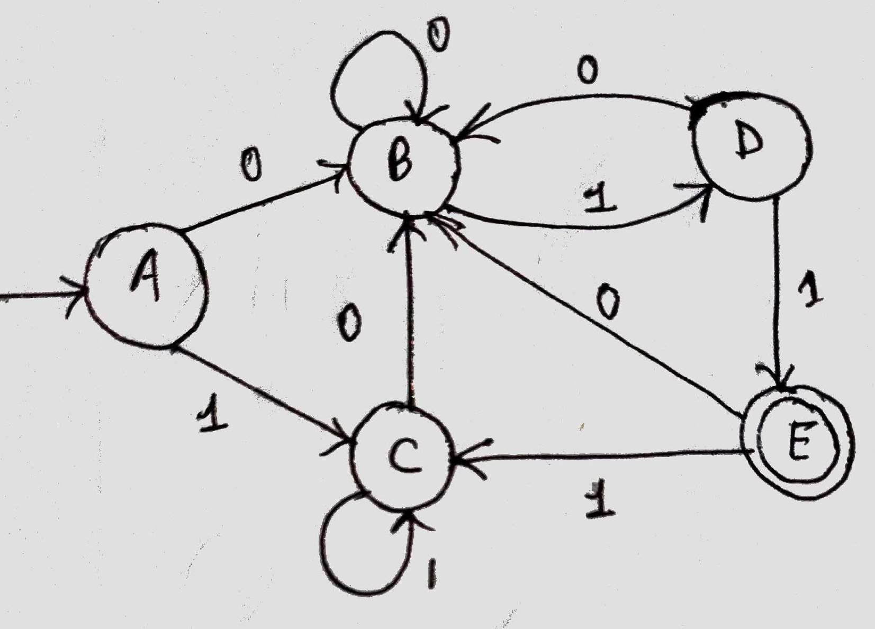
Minimize the given DFA
Let given DFA D = (Q, Σ, A, δ, F) where Q = {A,B,C,D,E}
Σ = {0,1}, A is initial State, F = {E}
minimized DFA D’ = (Q’, Σ, A, δ’, F’)
Procedure for minimization:
Step1- Draw the table for all pair of states [vertically skip 1st state and horizontally last state]
B
C
D
E
 | A | B | C | D

Slide 8
Step2- Mark X in all pair (p,q) where one is final and other is non final
B
C
D
E | x | x | x | x
 | A | B | C | D
Step3- Repeat this step till we cannot mark anymore states.
Check for all unmarked pair of states
1. Pair (B,A)
δ (B,0) = B δ (A,0) = B | δ(B,1) = D δ(A,1) = C | (D,C) is unmarked so leave (B,A) also unmarked
2. Pair (C,A) δ (C,0) = B | δ(C,1) = C
δ (A,0) = B | δ(A,1) = C | so leave (C,A) also unmarked

Slide 9
3. Pair (D,A) δ (D,0) = B δ (A,0) = B | δ(D,1) = E δ(A,1) = C | (E,C) is marked so mark (D,A)
4. Pair (C,B) δ (C,0) = B | δ(C,1) = C
δ (B,0) = B | δ(B,1) = D | (C,D) is unmarked so leave (C,B) also unmarked
5. Pair (D,B) δ (D,0) = B | δ(D,1) = E
δ (B,0) = B | δ(B,1) = D | (E,D) is marked so mark (D,B)
 |  | B
6. Pair (D,C) |  | C
δ (D,0) = B | δ(D,1) = E | D | x | x | x
δ (C,0) = B | δ(C,1) = C | (E,C) is marked so mark (D,C) _{E} | x | x | x | x
 |  |  | A | B | C | D

Slide 10
Repeat the process again for unmarked block
1. Pair (B,A)
δ (B,0) = B
δ (A,0) = B
δ(B,1) = D
δ(A,1) = C
(D,C) is marked so mark (B,A)
2. Pair (C,A)
δ (C,0) = B
δ (A,0) = B
δ(C,1) = C
δ(A,1) = C
so leave (C,A) also unmarked
3. Pair (C,B)
δ (C,0) = B
δ (B,0) = B
δ(C,1) = C
δ(B,1) = D (C,D) is marked so mark (C,B)
B | x
C |  | x
D | x | x | x
E | x | x | x | x
 | A | B | C | D
So, (C,A) is only unmarked that is not depend on any marked block So (C,A) are equivalent and merge them in single state

Slide 11
So (C,A) are equivalent and merge them in single state Minimized DFA D’ = (Q’, Σ, A, δ’, F’) where
Q’ = {{A,C}, B, D, E}
{A,C} is the initial state F = {E}
δ’ define as table and diagram
1
0
0
B
1
D
δ’ | 0 | 1
{A,C} | B | {A,C}
B | B | D
D | B | E
*E | B | {A,C}
{A,C}
0
0
1
1
E

Slide 12
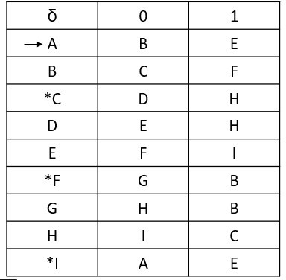
Minimize the given DFA
Let given DFA D = (Q, Σ, A, δ, F) where Q = {A,B,C,D,E,F,G,H,I}
Σ = {0,1}, A is initial State, F = {C,F,I}
minimized DFA D’ = (Q’, Σ, A, δ’, F’)
Procedure for minimization:
Step1- Draw the table for all pair of states [vertically skip 1st state and
horizontally last state]
B
C
D
E
F G
H I
A
B
C
D
E
F
G
H

Slide 13
Step2- Mark X in all pair (p,q) where one is final and other is non final
B
C | x | x
D |  |  | x
E |  |  | x
F | x | x |  | x | x
G |  |  | x |  |  | x
H |  |  | x |  |  | x
I | x | x |  | x | x |  | x | x
 | A | B | C | D | E | F | G | H
Step3- Repeat this step till we cannot mark anymore states.
Check for all unmarked pair of states
1. Pair (B,A)
δ (B,0) = C
δ (A,0) = B
δ(B,1) = F
δ(A,1) = E (C,B) is marked so mark (B,A)

Slide 14
2. Pair (D,A)
δ (D,0) = E
δ (A,0) = B
δ(D,1) = H
δ(A,1) = E
Both (E,B) & (H,E) are unmarked so leave (D,A) also unmarked
3. Pair (E,A)
δ (E,0) = F
δ (A,0) = B
4. Pair (G,A)
δ (G,0) = H
δ (A,0) = B
δ(E,1) = I
δ(A,1) = E
(F,B) is marked so mark (E,A)
B | x
C | x | x
D |  |  | x
E | x |  | x
F | x | x |  | x | x
G |  |  | x |  |  | x
H | x |  | x |  |  | x
I | x | x |  | x | x |  | x | x
 | A | B | C | D | E | F | G | H
δ(G,1) = B
δ(A,1) = E
Both (H,B) & (B,E) are unmarked so leave (G,A) also unmarked
5. Pair (H,A)
δ (H,0) = I
δ (A,0) = B
δ(H,1) = C
δ(A,1) = E
(I,B) is marked so mark (H,A)

Slide 15
6. Pair (D,B)
δ (D,0) = E
δ (B,0) = C
7. Pair (E,B)
δ (E,0) = F
δ (B,0) = C
δ(D,1) = H
δ(B,1) = F
(E,C) is marked so mark (D,B)
δ(E,1) = I
δ(B,1) = F
Both (F,C) & (I,F) are unmarked so leave (E,B) also unmarked
8. Pair (G,B)
δ (G,0) = H
δ (B,0) = C
B | x
C | x | x
D |  | x | x
E | x |  | x
F | x | x |  | x | x
G |  | x | x |  |  | x
H | x |  | x |  |  | x
I | x | x |  | x | x |  | x | x
 | A | B | C | D | E | F | G | H
δ(G,1) = B
δ(B,1) = F
(H,C) is marked so mark (G,B)
9. Pair (H,B)
δ (H,0) = I
δ (B,0) = C
δ(H,1) = C
δ(B,1) = F
Both (I,C) & (C,F) are unmarked so leave (H,B) also unmarked

Slide 16
10. Pair (F,C)
δ (F,0) = G
δ (C,0) = D
δ(F,1) = B
δ(C,1) = H
Both (G,D) & (B,H) are unmarked so leave (F,C) also unmarked
11. Pair (I,C)
δ (I,0) = A
δ (C,0) = D
δ(I,1) = E
δ(C,1) = H
Both (A,D) & (E,H) are unmarked so leave (I,C) also unmarked
12. Pair (E,D)
δ (E,0) = F
δ (D,0) = E
B | x
C | x | x
D |  | x | x
E | x |  | x | x
F | x | x |  | x | x
G |  | x | x |  |  | x
H | x |  | x |  |  | x
I | x | x |  | x | x |  | x | x
 | A | B | C | D | E | F | G | H
δ(E,1) = I
δ(D,1) = H
(F,E) is marked so mark (E,D)
13. Pair (G,D)
δ (G,0) = H
δ (D,0) = E
δ(G,1) = B
δ(D,1) = H
Both (H,E) & (B,H) are unmarked so leave (G,D) also unmarked

Slide 17
14. Pair (H,D)
δ (H,0) = I | δ(H,1) = C
δ (D,0) = E | δ(D,1) = H | (I,E) is marked so mark (H,D)
15. Pair (G,E)
δ (G,0) = H | δ(G,1) = B
δ (E,0) = F | δ(E,1) = I | (H,F) is marked so mark (G,E)
16. Pair (H,E)
δ (H,0) = I
δ (E,0) = F
δ(H,1) = C
δ(E,1) = I
B | x
C | x | x
D |  | x | x
E | x |  | x | x
F | x | x |  | x | x
G |  | x | x |  | x | x
H | x |  | x | x |  | x
I | x | x |  | x | x |  | x | x
 | A | B | C | D | E | F | G | H
Both (I,F) & (C,I) are unmarked so leave (H,E) also unmarked
17. Pair (I,F)
δ (I,0) = A
δ (F,0) = G
δ(I,1) = E
δ(F,1) = B
Both (A,G) & (E,B) are unmarked so leave (I,F) also unmarked

Slide 18
18. Pair (H,G)
δ (H,0) = I | δ(H,1) = C
δ (G,0) = H | δ(G,1) = B | (I,H) is marked so mark (H,G)
Repeat the process again for unmarked block
1. Pair (D,A)
δ (D,0) = E
δ (A,0) = B
δ(D,1) = H
δ(A,1) = E
Both (E,B) & (H,E) are unmarked so leave (D,A) also unmarked
2. Pair (G,A)
δ (G,0) = H
δ (A,0) = B
B | x
C | x | x
D |  | x | x
E | x |  | x | x
F | x | x |  | x | x
G |  | x | x |  | x | x
H | x |  | x | x |  | x | x
I | x | x |  | x | x |  | x | x
 | A | B | C | D | E | F | G | H
δ(G,1) = B
δ(A,1) = E
Both (H,B) & (B,E) are unmarked so leave (G,A) also unmarked
3. Pair (E,B)
δ (E,0) = F
δ (B,0) = C
δ(E,1) = I
δ(B,1) = F
Both (F,C) & (I,F) are unmarked so leave (E,B) also unmarked

Slide 19
4. Pair (H,B)
δ (E,0) = I
δ (B,0) = C
δ(E,1) = C
δ(B,1) = F
Both (I,C) & (C,F) are unmarked so leave (H,B) also unmarked
5. Pair (F,C)
δ (F,0) = G
δ (C,0) = D
δ(F,1) = B
δ(C,1) = H
Both (G,D) & (B,H) are unmarked so leave (F,C) also unmarked
6. Pair (I,C)
B | x
C | x | x
D |  | x | x
E | x |  | x | x
F | x | x |  | x | x
G |  | x | x |  | x | x
H | x |  | x | x |  | x | x
I | x | x |  | x | x |  | x | x
 | A | B | C | D | E | F | G | H
δ (I,0) = A
δ (C,0) = D
δ(I,1) = E
δ(C,1) = H
Both (A,D) & (E,H) are unmarked so leave (I,C) also unmarked

Slide 20
7. Pair (G,D)
δ (G,0) = H
δ (D,0) = E
δ(G,1) = B
δ(D,1) = H
Both (H,E) & (B,H) are unmarked so leave (G,D) also unmarked
8. Pair (H,E)
δ (H,0) = I
δ (E,0) = F
δ(H,1) = C
δ(E,1) =
Both (I,F) & (C,I) are unmarked so leave (H,E) also unmarked
9. Pair (I,F)
δ (I,0) = A
δ (F,0) = G
B
x
δ(I,1) = E
δ(F,1) = B
C | x | x
D |  | x | x
E | x |  | x | x
F | x | x |  | x | x
G |  | x | x |  | x | x
H | x |  | x | x |  | x | x
I | x | x |  | x | x |  | x | x
 | A | B | C | D | E | F | G | H
Both (A,G) & (E,B) are unmarked so leave (I,F) also unmarked
No changes in the 2nd Process so stop calculation

Slide 21
Unmarked blocks are (D,A),(G,A),(E,B),(H,B),(F,C),(I,C),(G,D),(H,E),(I,F)
So merge (D,A),(G,A),(G,D) and make one state {A,D,G}
merge (E,B),(H,B),(H,E) and make one state {B,E,H}
merge (F,C),(I,C),(I,F) and make one state {C,F,I}
Minimized DFA D’ = (Q’, Σ, A, δ’, F’) where Q’ = {{A,D,G}, {B,E,H}, {C,F,I}}
Σ = {0,1}
{A,D,G} is the initial state
{B,E,H}
0,1
F = {C,F,I}
δ’ define as diagram
{A,D,G}
0,1
1
0
{C,F,I}

Slide 22
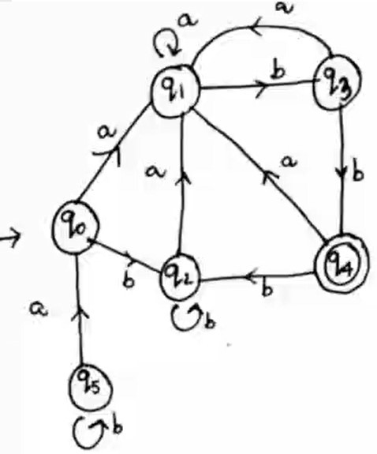
Minimize the given DFA
Let given DFA D = (Q, Σ, A, δ, F) where Q = {q0,q1,q2,q3,q4,q5}
Σ = {a,b}, q0 is initial State, F = {q4}
minimized DFA D’ = (Q’, Σ, A, δ’, F’)
Procedure for minimization:
Remove the dead or unreachable state, so remove q5
Step1- Draw the table for all pair of states [vertically skip 1st state and horizontally last state]

Slide 23
Minimize the given DFA
q1 | x
q2 |  | x
q3 | X | x | x
q4 | X | x | x | x
 | q0 | q1 | q2 | q3

Slide 24
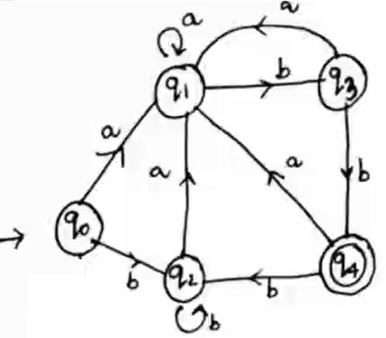
Step2- Mark X in all pair (p,q) where one is final and other is non final
Step3- Repeat this step till we cannot mark anymore states.
Check for all unmarked pair of states
1. Pair (q1,q0)
δ (q1,a) = q1 δ (q0,a) = q1
δ(q1,b) = q3 δ(q0,b) = q2
(q3,q2) is unmarked so leave (q1,q0) also unmarked
2. Pair (q2,q0) δ (q2,a) = q1 δ (q0,a) = q1
δ(q2,b) = q2 δ(q0,b) = q2
q1
q2
q3 | x
q4 | x | x | x | x
 | q0 | q1 | q2 | q3
so leave (q2,q0) also unmarked
3. Pair (q3,q0) δ (q3,a) = q1 δ (q0,a) = q1
δ(q3,b) = q4
δ(q0,b) = q2 (q4,q2) is marked so mark (q3,q0)

Slide 25
4. Pair (q2,q1) δ (q2,a) = q1 δ (q1,a) = q1
δ(q2,b) = q2 δ(q1,b) = q3
(q2,q3) is unmarked so leave (q2,q1) also unmarked
5. Pair (q3,q1) δ (q3,a) = q1 δ (q1,a) = q1
δ(q3,b) = q4 δ(q1,b) = q3
(q4,q3) is marked so mark (q3,q1)
6. Pair (q3,q2) δ (q3,a) = q1 δ (q2,a) = q1
δ(q3,b) = q4
δ(q2,b) = q2 (q4,q2) is marked so mark (q3,q2)
q1 | x
q2
q3 | x | x | x
q4 | x | x | x | x
 | q0 | q1 | q2 | q3
Repeat the process again for unmarked block
1. Pair (q1,q0) δ (q1,a) = q1 δ (q0,a) = q1
δ(q1,b) = q3 δ(q0,b) = q2
(q3,q2) is marked so mark (q1,q0)

Slide 26
2. Pair (q2,q0) δ (q2,a) = q1 δ (q0,a) = q1
3. Pair (q2,q1) δ (q2,a) = q1 δ (q1,a) = q1
δ(q2,b) = q2 δ(q0,b) = q2
so leave (q2,q0) also unmarked
δ(q2,b) = q2
δ(q1,b) = q3 (q2,q3) is marked so mark (q2,q1)
So, (q2,q0) is only unmarked that is not depend on any marked block So (q2,q0) are equivalent and merge them in single state
Minimized DFA D’ = (Q’, Σ, A, δ’, F’) where Q’ = {{q0,q2}, q1, q3, q4}
{q0,q2} is the initial state F = {q4}
δ’ define as table and diagram
q1 | x
q2 |  | x
q3 | x | x | x
q4 | x | x | x | x
 | q0 | q1 | q2 | q3

Slide 27
δ’ define as table and diagram
a
q1 a
b
b
a
{q0,q2}
b
q4
a
b
q3
δ’ | a | b
{q0,q2} | q1 | {q0,q2}
q1 | q1 | q3
q3 | q1 | q4
*q4 | q1 | {q0,q2}

