Slide 2
Cyber: The word cyber originally came from cybernetics ,before becoming a stand alone word Cybernatics :Technology related to computers & internet. Internet :The Internet is generally defined as a global network connecting millions of computers. More than 190 countries are linked into exchanges of data, news and opinions. is the global system of interconnected computer networks that use the Internet protocol suite (TCP/IP) to link devices worldwide Security: The state of being free from danger or threat. IT security is a set of cybersecurity strategies that prevents unauthorized access to organizational assets such as computers, networks, and data.

Slide 3
Cyber Security
Cybersecurity is the practice of protecting systems, networks, and programs from digital attacks.
Cybersecurity is the protection of internet-connected systems, including hardware, software and data, from cyberattacks.
Implementing effective cybersecurity measures is particularly challenging today because there are more devices than people, and attackers are becoming more innovative.

Slide 4


Slide 5
Types of cybersecurity threats
Ransomware: is a type of malicious software. It is designed to extort money by blocking access to files or the computer system until the ransom is paid.
Malware :is a type of software designed to gain unauthorized access or to cause damage to a computer.
Phishing is the practice of sending fraudulent emails that resemble emails from reputable sources. The aim is to steal sensitive data like credit card numbers and login information.

Slide 6
vulnerability
In computer security, a vulnerability is a weakness which can be exploited by a Threat ,
such as an attacker, to perform unauthorized actions within a computer system.

Slide 7
Vulnerability scanner
What does Vulnerability Scanning mean
Vulnerability scanning is a security technique used to identify security weaknesses in a computer system.
Vulnerability scanning can be used by individuals or network administrators for security purposes,
or it can be used by hackers attempting to gain unauthorized access to computer systems.
A vulnerability scanner is software application that assesses security vulnerabilities in networks or host systems and produces a set of scan results

Slide 8
Types of vulnerability scanners include:
Port Scanner: Probes a server or host for open ports
Network Enumerator: A computer program used to retrieve information
about users and groups on networked computers
Network Vulnerability Scanner: A system that proactively scans for network
Vulnerabilities
Web Application Security Scanner: A program that communicates with a Web
application to find potential vulnerabilities within the application or its architecture
Computer Worm: A type of self-replicated computer malware, which can be
used to find out vulnerabilities

Slide 9
Benefits of vulnerability
A vulnerability scanner allows early detection and handling of known security problems.
A new device or even a new system may be connected to the network without authorisation.
A vulnerability scanner helps to verify the inventory of all devices on the network.
The inventory includes the device type, operating system version and patch level, hardware configurations and other relevant system information.

Slide 10

Why Use a Vulnerability Scanner
Functions of Vulnerability Scanner are far different from firewall or intrusion detection system.
Vulnerability scanning tools helps you in protecting your organization from any kind of security risks or threats.
The prime aim of running a vulnerability scanner is to identify the devices that are open for vulnerabilities.

Slide 11
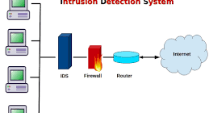
Intrusion Detection System is a-system that monitors network traffic for suspicious activity and issues alerts when such activity is discovered.

Slide 12
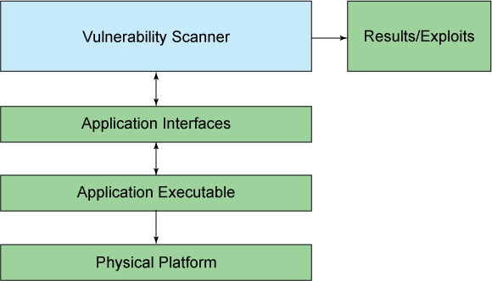

How Vulnerability Scanning Works
The work of vulnerability scanner is same as other antivirus which uses databases that store description of different types of vulnerability.
A vulnerability scanner collects all of this information from network and then scans for network system ports, identifying any password breaches
PROMISEC

Slide 13
Types of Vulnerability Scanner
Port scanner
Network vulnerability scanner
Web application security scanner
Database security scanner.
Host based vulnerability scanner
PROMISEC

Slide 14
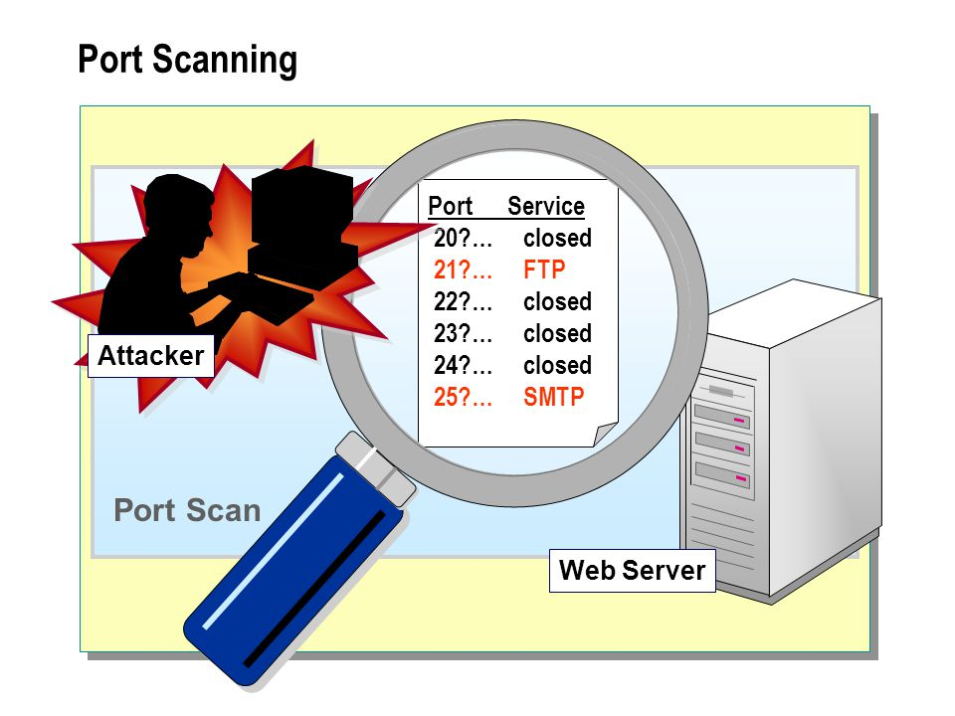
Port scanner
Port Scanner is often used by administrators and the test by port scanner will tell the services running on your network and detect the vulnerabilities.
Example of Port Scanner: Nmap
PROMISEC

Slide 15

Network vulnerability scanner
Network Vulnerability Scanner is used to scans a computer and inform if any vulnerabilities found that malicious hackers might use to gain access to any computer you are connected with.
Example of Network Vulnerability Scanner:
Promisec, Nessus, SAINT, OpenVAS, INFRA Scan, Nexpose
PROMISEC

Slide 16

Web application security scanner
Web application security scanner is used to find vulnerabilities by means of automated crawling and testing of custom web applications.
Example of Web application security Scanner:
Promisec, Nikto, Acunetix, Burp Suite, OWASP ZAP, w3af
PROMISEC

Slide 17
Tools Available for Vulnerability Scanning
There are many tools available for Vulnerability Scanning that some are come with paid and some are free. One of the best scanning tools available for vulnerability scanning is “Promisec’s Vulnerability Scanning Tools”.
About Free network, these are the tools which come free to use.
Scan my server
SSL Labs
Detectify
PROMISEC

Slide 18

Scan my server
It is quite relevant in providing the most comprehensive varieties of security tests like Cross site scripting, SQL injection, PHP Code injection, Blind SQL injection, HTTP header injection, Source disclosure and much more.
The reports based on scan will be notified with the vulnerability summary. It is the most unique vulnerability scanner.
PROMISEC

Slide 19

SUCURI
It is the most popular malware and security scanner. Through this you could do a quick test of website blacklisting, malware, defacement, Injected SPAM. It protects and cleans your website from all the online threats and it works on any website platforms like Word Press, PHP AND many more.
PROMISEC

Slide 20

SSL Labs
It is one of the most used and preferred tool to scan the web server. It also provides a very deep analysis of the https URL including the overall rating, the expiry day, TLS version, Cipher, Protocol details and many more. Thus if you are running any HTTP website you do not need to wait anymore for doing the test.
PROMISEC

Slide 21

Quttera
It keeps a check on the website for vulnerabilities and malware exploits. It completely scans your website from suspicious files, malicious files, phish Tank, potentially suspicious files and the malware domain list. This vulnerability scanning tool has contributed a lot to the websites to protect them from malware.
PROMISEC

Slide 22

Detectify
Detective is a website security scanner based on SaaS. This has got more than 100 automated security tests and it also includes OWASP Top 10 malware and many more. It provides 21 days trial and you need to get registered so as to perform the security scan.
PROMISEC

Slide 23

Siteguarding
It will help you to scan your domain for website blacklisting, malware, injected spam, defacement and much more. It is quit compatible for Magneto and Word Press. If your website is affected by virus then also Siteguarding proves to be much helpful.
PROMISEC

Slide 24

Promisec Vulnerability Scanner
Promisec Vulnerability Scanning Tools
At Promisec, we are focused on providing Endpoint Management services with the highest levels of customer satisfaction – we will do everything we can to meet your expectations.
End point vulnerability scanning and detection through Promisec takes an entirely different approach.
Leveraging our patented agentless technology, we can inspect an endpoint completely in 10 seconds or less and determine immediately any known CVE’s for the installed applications running on that endpoint.
This allows customers to run Promisec technology across their entire enterprise, during business hours including their production environments.
By being fast, unobtrusive, remote but application focused, we believe you can achieve true endpoint vulnerability detection at scale.
Promisec provides Vulnerability Scanning Tools to secure your data and endpoints. It is easy to operate.
PROMISEC

Slide 25
Open port:
In security parlance, the term open port is used to mean a TCP or UDP port number that is configured to accept packets.
In contrast, a port which rejects connections or ignores all packets directed at it is called a closed port.
Ports are an integral part of the Internet's communication model — they are the channel through which applications on the client computer can reach the software on the server.
Services, such as web pages or FTP, require their respective ports to be "open" on the server in order to be publicly reachable.

Slide 26
Introduction
Port Forwarding
Opening a port in a router or firewall residing in a private network in order to let a parlty from the outside world contact a user inside.
For example, opening ports for videoconferencing traffic makes two-way communications easier no matter which side initiates the call.
Also called "port mapping," port forwarding can be done by manual configuration or by software.

Slide 27
Ports
What is a port?
represents an endpoint or "channel" for network communications
One computer sends data from port of one IP address to another
Port numbers can theoretically range from 0 to 65535
Only one application can be used at a time on any given port
Why forward a port?
With routers, firewalls prevent direct comm. between IPs

Slide 28
A Few Common Ports
21 – FTP
22 – Secure Shell (SSH)
23 – Telnet
80 – HTTP
110 – POP3 mail
3389 – Remote Desktop Protocol (RDP)
6112 – Blizzard’s Battle.net gaming service (Unofficial)
*Unofficial – not registered with IANA (Internet Assigned Numbers Authority)

Slide 29
Some Familiar Concepts
TCP – Transfer Control Protocol - 2 computers directly connect, and remain connected for duration of session *similar to a telephone call
UDP – User Datagram Protocol – sends data and relies on devices in between to deliver properly. Not as reliable *like putting mail in mailbox
NAT – Network Address Translation – determines destination of packets sent to network. This is where port forwarding comes into play.

Slide 30
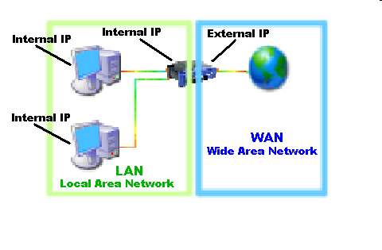

Slide 31
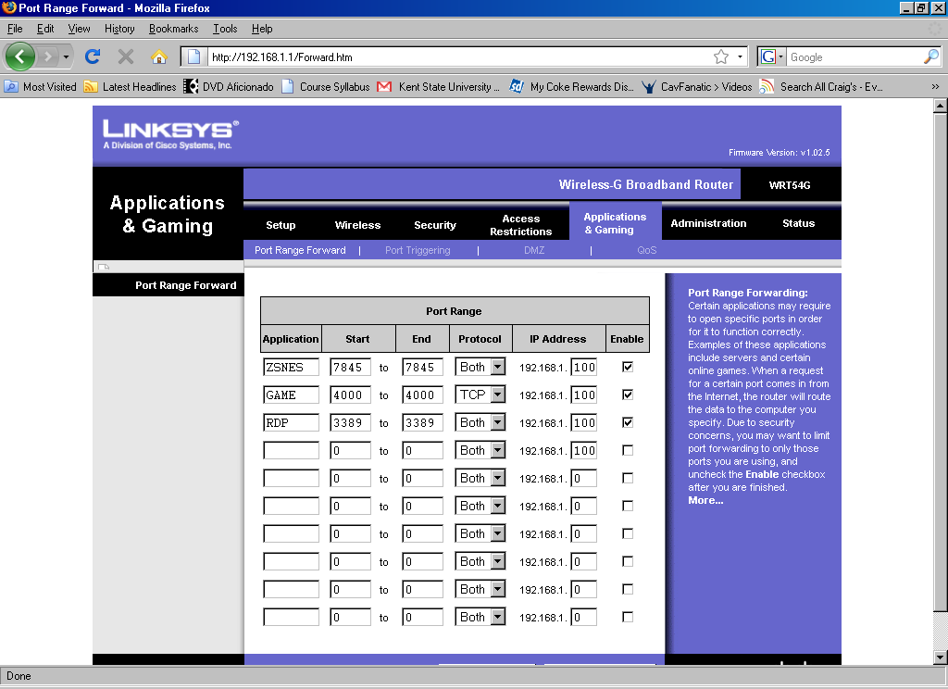

Slide 32
Open Port/Service Identification
Some services are inherently insecure.
Telnet (port 23) is notorious for its lack of encryption that exposes passwords. Fortunately, the widespread adoption of Secure Shell (SSH) has diminished the presence of telnet on the Internet.
However, it still lurks in large private networks. Services do not always run on default ports; hence the scanner must rely on banners and “nudges” to elicit a response from a listening port.
A telnet service could be configured to listen on port 24601,services do not always announce themselves. Telnet and SMTP (port 25) are promiscuous services;
They return text-based banners upon receiving a connection, without waiting for any particular incoming data on that connection

Slide 33
Banner/Version Check
Some services announce information about themselves without being prompted by any data from a client.
Try connecting to an SSH service, and you’ll immediately receive a prompt along the lines of
$ nc -v localhost 22
Connection to localhost 22 port [tcp/ssh] succeeded!
SSH-2.0-OpenSSH_5.9
System administrators usually remove or change banners to make them less verbose. This doesn’t remove the vulnerability, but it does make detections based only on this technique unreliable.
In the worst case, a naive scanner could be misdirected to believe the service is another type of software or operating system altogether.

Slide 34
Traffic Probe
Services aren’t always so extroverted that they immediately announce themselves. However, lots of them will if you just ask. For example, a web service will not respond until it receives data from the client.
The following command makes a valid HTTP request using the HEAD method:
$ echo -e "HEAD / HTTP/1.0\r\n\r\n" | nc -v localhost 80
Connection to localhost 80 port [tcp/http] succeeded!
HTTP/1.1 200 OK
Date: Mon, 12 Nov 2012 21:15:58 GMT
Server: Apache/2.2.11 (Unix) mod_ssl/2.2.11 OpenSSL/1.0.1c DAV/2 PHP/5.3.14
Last-Modified: Sat, 20 Nov 2004 20:16:24 GMT
ETag: "eb879f-2c-3e9564c23b600“
Accept-Ranges: bytes Content-Length: 44
Connection: close
Content-Type: text/html; charset=utf-8
We glean several bits of useful information from the previous output.
The web site indicates Apache/2.2.11 in its Server header. You could infer from this that the web site is prone to certain denial of service (DoS) attacks (based on known vulnerabilities in the CVE database, which is described a bit later in the section “Vulns Are Everywhere”). It also reports a version of PHP that likely has vulns.

Slide 35
Vulnerability Probe
Some security bugs can’t be identified without sending a payload that exploits a suspected vulnerability.
These types of probes are more accurate—they rely on direct observation as opposed to inferring problems based on port numbers or service banners.
But they also carry more risk of interrupting the service, because the test payload must be trying to either produce or take advantage of an error in the service’s code.
An easy-to-understand example of a vulnerability probe is an HTML injection check for a web application.
Imagine a web app that has a search box for users to find text within its pages. Typically, such apps report the search term in the web page, such as “Results for ‘zombies’...”. A snippet of HTML might look like
<div id="search"><span class="results">Results for 'zombies'...</span>

Slide 36
There’s nothing inherently insecure in the word “zombies” appearing in this page (assuming we’re not looking at real-time updates from Atlanta’s Centers for Disease Control). In order to see if the web site has an HTML injection vuln, we need to use a payload that gives a hint about the app’s security mechanisms. So, instead of searching for “zombies” we try searching for “<xss>”. The web app’s HTML now looks like
<div id="search"><span class="results">Results for '<xss>'...</span>
When a web app reflects user-supplied text (such as the search term in the previous example), and that text contains characters that are important to the syntax of HTML (such as the angle brackets used to define tags like <script>), then it’s likely that the app has a vulnerability that would enable an attacker to actually rewrite portions of the web page. An attacker who exploits an HTML injection vulnerability like this could steal data from the user or deface the web site. The reason we care about vulnerabilities is exploits. An exploit exercises a vulnerability to produce some advantage to a hacker. The outcome may be to crash the software, causing a denial of service, or retrieve data, like pulling usernames and passwords from a database, or completely compromise the operating system by gaining root or administrator access. Exploits take many shapes, from binary shellcode to clever bits of text appended to URL parameters. Discovering a vulnerability typically just means exposing a software flaw. Developing an exploit means taking advantage of that software flaw to give the attacker an advantage against the system. Developing exploits is an art unto itself. Good ones should be reliable (they work when you want them to), robust (they leave the vulnerable software in a good working state), and useful (they provide privileged access, extract data, etc.). We’ll revisit these ideas later in this chapter. Before we dive into scanners and the characteristics of good exploits, I’ll illustrate a few kinds of software flaws that lead to vulnerabilities.

