Slide 1
CAPSTONE PROJECT Library Agent
Presented By : Somesh Nema
Student name : Somesh Nema
College Name : Kalaniketan Polytechnic College, Jabalpur
Department : Computer Science And Engineering

Slide 2
OUTLINE
Problem Statement
Technology used
Wow factor
End users
Result
Conclusion
Git-hub Link
Future scope
IBM Certifications

Slide 3
Problem Statement
AI library agents leverage AI and automation to enhance library services. They are used for tasks like automating responses to frequently asked questions, curating personalized reading recommendations, and assisting with tasks such as document summarization and research organization. These agents streamline library workflows, improve user experience, and free up librarians for more complex tasks.
Enhancing User Experience
Streamlining Library Operations
Supporting Library Staff.

Slide 4
TECHNOLOGY USED
IBM Cloud Lite Services – Cloud platform used to build and deploy the AI agent
Watsonx.ai Studio – For creating and managing the agent project
Granite– Foundation language models used for conversation
Retrieval-Augmented Generation (RAG) – For fetching context-relevant eco information.

Slide 5
IBM cloud services used
IBM Cloud Watsonx AI Studio
IBM Cloud Watsonx AI runtime
IBM Cloud Agent Lab
IBM Granite foundation model.

Slide 6
WOW FACTORS
Integration and Versatility
Reasoning and Problem-Solving
User Experience
Real-World Applications

Slide 7
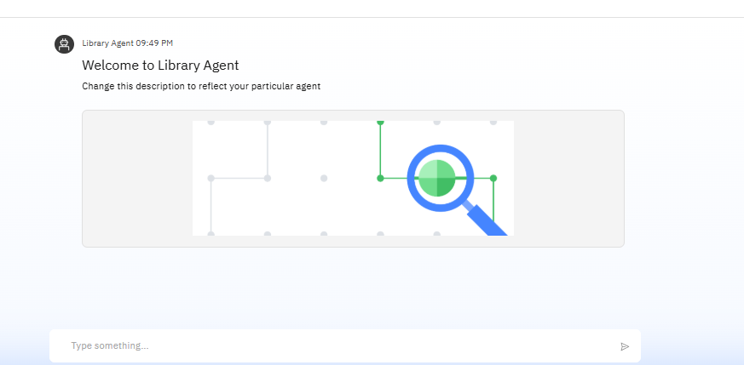
RESULTS

Slide 8
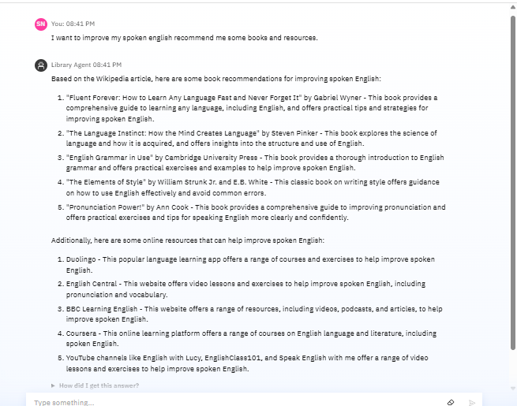
RESULTS

Slide 9
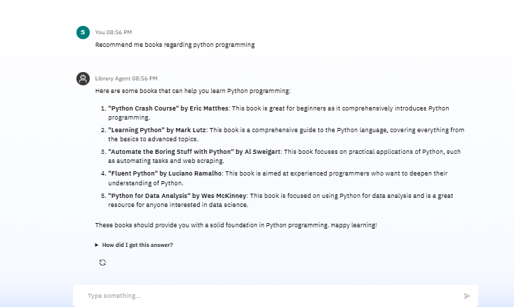
RESULTS DEPLOYED AI AGENT

Slide 10
CONCLUSION
Context
Learn from interactions
Handle a wider range of tasks
Making them powerful allies in the digital workplace

Slide 11
FUTURE SCOPE
Transforming every customer touchpoint from automated yet deeply human-sounding support calls to real-time personalization in eCommerce

Slide 12
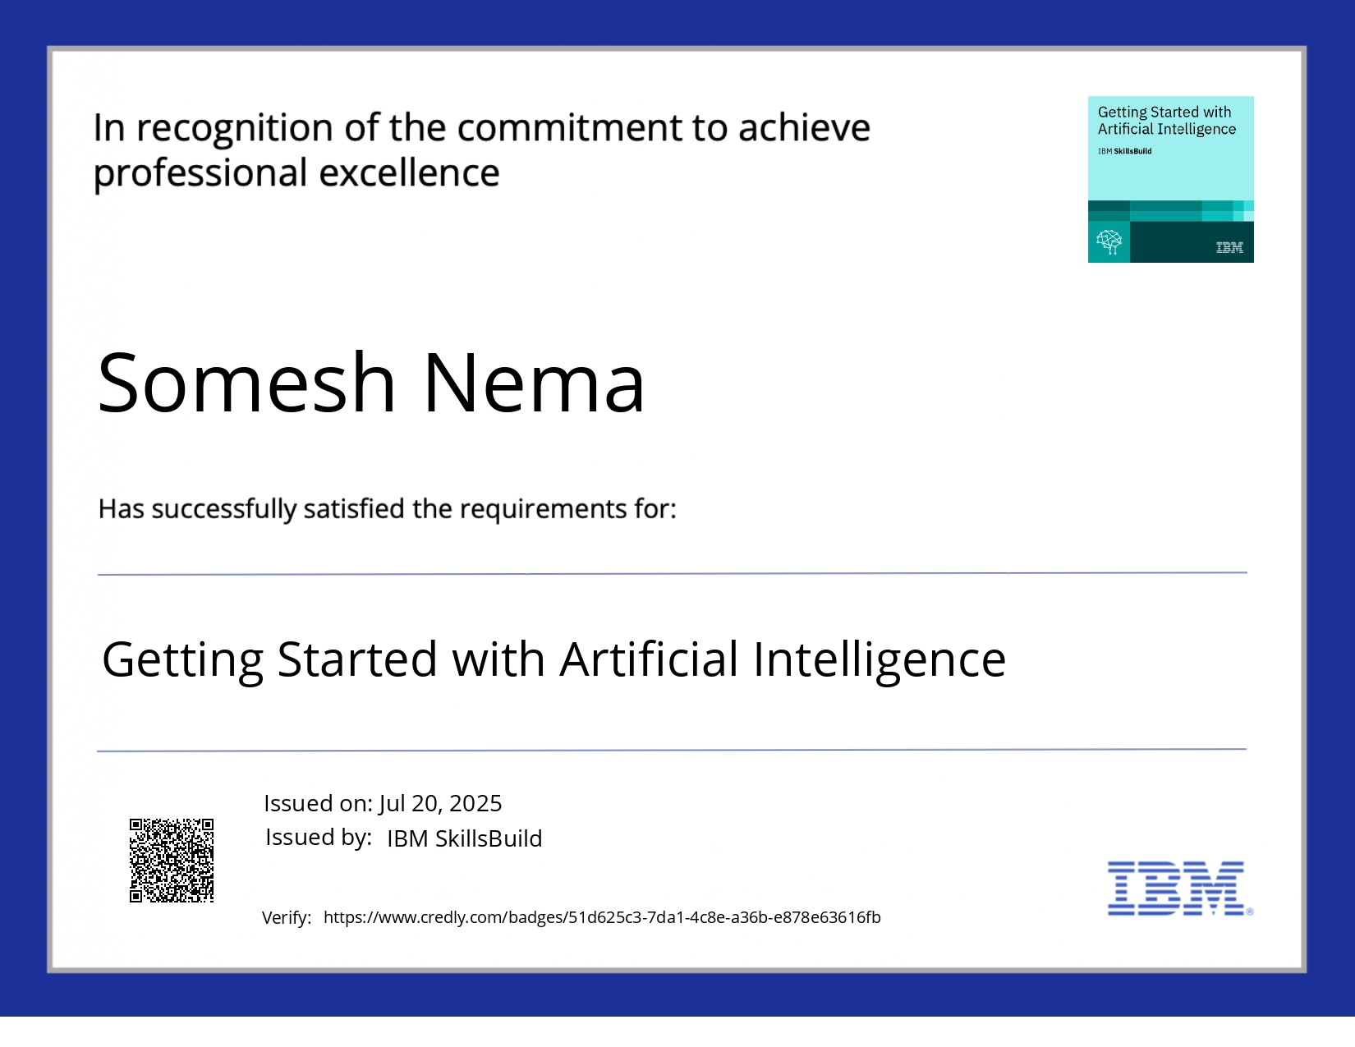
IBM Certifications
Screenshot/ credly certificate( getting started with AI)

Slide 13
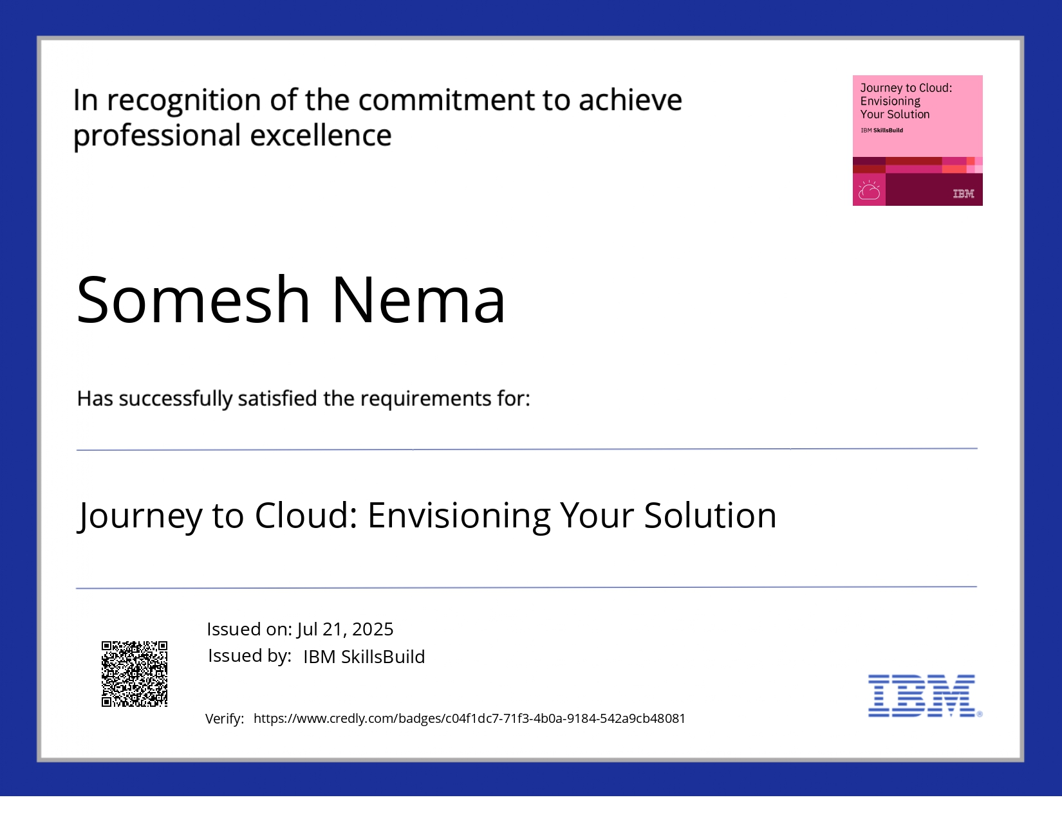
IBM Certifications
credly certificate (Journey to Cloud: Envisioning Your Solution)

Slide 14
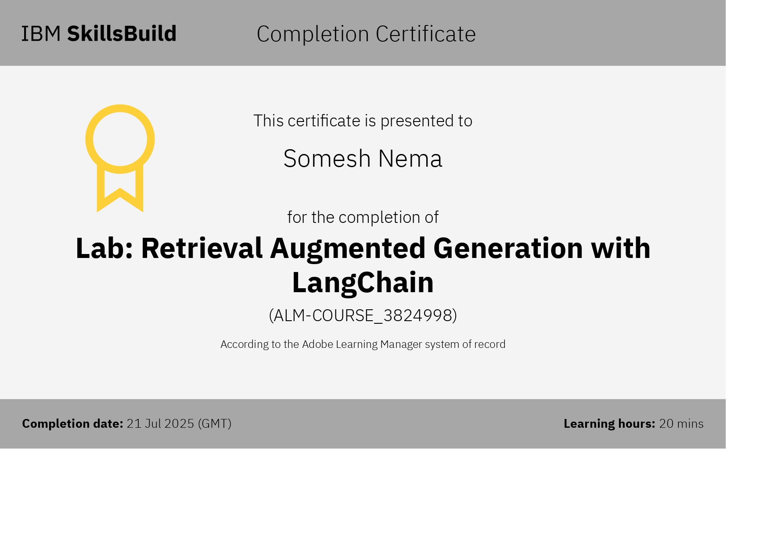

Slide 15
GitHub Link
Github link: https://github.com/Someshnema/Library-Agent

Slide 16
THANK YOU

