Slide 1


CGB1201 – JAVA PROGRAMMING
PROJECT REVIEW-2
Department of Computer Science and Engineering
Academic Year: 2024 – 2025 (Odd Semester)
Register Number :2303811710421153
Name :SOMESHVAR S
Year :II
Semester :III
Section :C
Date :6.12.2024

Slide 2
TITLE OF THE PROJECT
Weather Watch: Real-Time Forecasting and Alerts

Slide 3
AGENDA
Abstract
Introduction
Java Programming – Concepts Used
Proposed Architecture
Module Description
Result and Discussion
Conclusion

Slide 4
ABSTRACT
The Real-Time Weather Forecasting and Alert System is an advanced software application designed to provide accurate and timely weather predictions to users. Leveraging real-time data from a trusted external API, such as OpenWeatherMap, the system allows users to obtain current weather conditions, detailed forecasts, and receive alerts for extreme weather events.

Slide 5
INTRODUCTION
The Real-Time Weather Forecasting and Alert System aims to address this need by providing an integrated platform for accessing current weather conditions, forecasting future weather trends, and receiving alerts for potential weather hazards. Using real-time data from trusted weather APIs such as OpenWeatherMap, this system provides users with key weather parameters, including temperature, humidity, wind speed, and atmospheric pressure, all while ensuring user-friendly interfaces for both general and specialized needs.

Slide 6
JAVA PROGRAMMING - CONCEPTS USED
Classes and Objects: Classes like WeatherDataFetcher, WeatherData, and WeatherForecastingSystem are created to encapsulate specific functionalities and data.
Encapsulation: The system hides implementation details and only exposes essential functionality via methods. For example, weather data like temperature, humidity, and weather description are encapsulated within the WeatherData class.
Hardcoded Location: The location is set to "Tiruchirappalli" in the variable location. This could be replaced with dynamic user input using the Scanner class if needed.

Slide 7
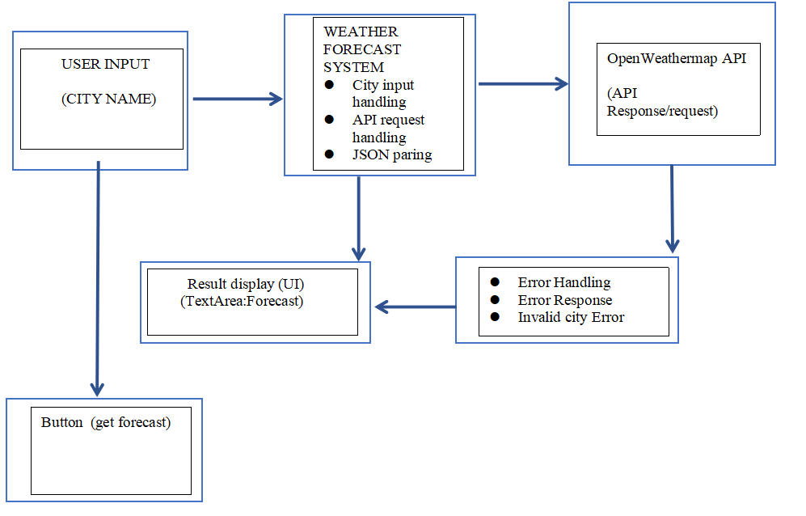
PROPOSED ARCHITECTURE

Slide 8
MODULE DESCRIPTION
1.. User Interface:
The GUI is created using AWT components such as Frame, Label, TextField, Button, and TextArea.
The user enters the name of the city in the TextField.
When the user clicks the Get Forecast button, the application fetches the weather data for that city.
2.Weather Data Fetching:
The program sends a GET request to the OpenWeatherMap API with the entered city and the API key (replace with your own API key).
The fetchWeatherData method sends the HTTP request, retrieves the response, and returns the response body if the request is successful (response code 200).
3.Parsing the Weather Data:
The response from the API is in JSON format. The code extracts temperature, humidity, and weather conditions by finding the relevant indices and substring values.
This data is displayed in the TextArea with a simple message about the weather, including the temperature, humidity, and condition.
4.Handling Errors:
If the user doesn't enter a city or if an error occurs while fetching the data, an appropriate error message is shown in the TextArea.

Slide 9
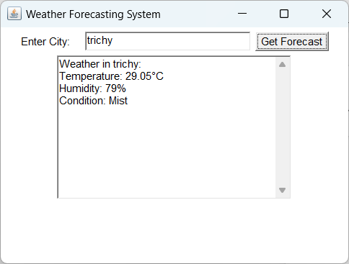
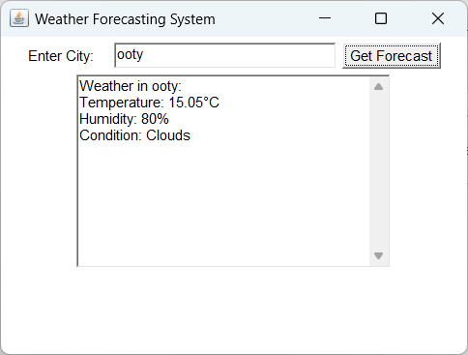
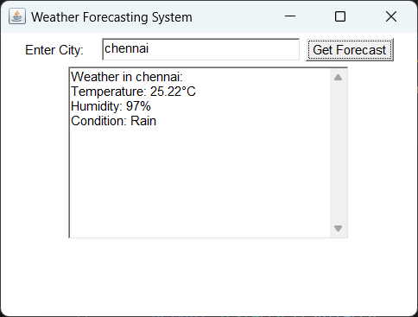
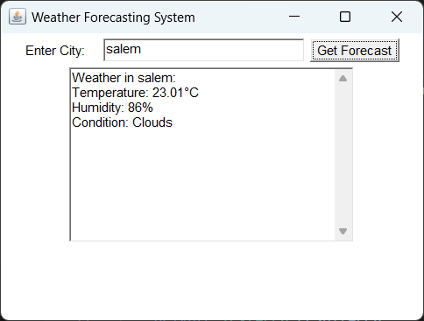
RESULTS AND DISCUSSION

Slide 10
CONCLUSION
In conclusion, the Real-Time Weather Forecasting and Alert System provides an effective solution for delivering accurate weather data, forecasts, and timely alerts to users based on their location and preferences. By integrating external weather APIs and offering a flexible notification system, it ensures users are kept informed of critical weather conditions.

Slide 11
THANK YOU

