Slide 1
Formal Languages
Context-Free Languages

Slide 2
Context-Free Grammars
The productions in a regular grammar are restricted in two ways:
→ The left side must be a single variable,
→ The right side has a special form.
To create grammars that are more powerful, we
must relax some of these restrictions.
By retaining the restriction on the left side, but permitting anything on the right, we get
“context-free grammars”

Slide 3
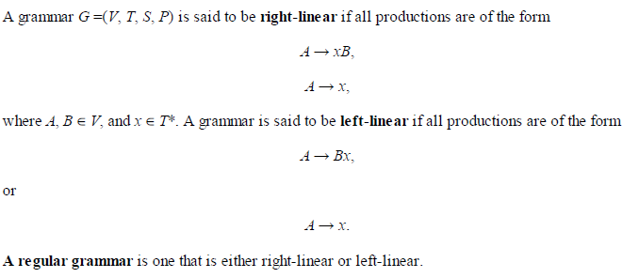
Regular Grammar – It is either Right Linear or Left Linear

Slide 4
Context-free Grammars
Definition: A grammar G = (V, T, S, P) is said to be context-free if all production rules in P have the form
A → x
where A ∈ V and x ∈ (V ∪ T)*
A language is said to be context-free iff there is a context free grammar G such that L = L(G).

Slide 5

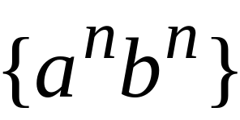


Context-Free Languages
All Regular Grammar is Context Free
Context-Free Languages
Regular Languages

Slide 6
Non regular languages like
and can be generated by Context Free languages.
Family of regular languages is a proper subset of family of context free languages.

Slide 7
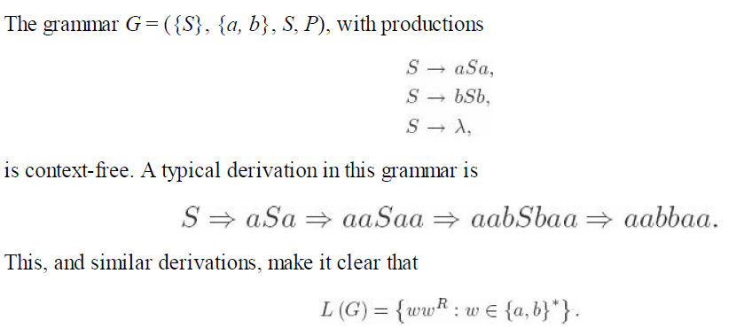
Example of Context Free Languages
Example 1:

Slide 8
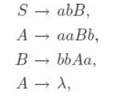
Example 2:
The Grammar with productions
Find out the language generated by the above
language

Slide 9

Language generated is…..
Regular grammars and linear grammars
are context free but context free grammar
are not necessarily linear.

Slide 10





Example of Context Free Languages
Grammar:
Derivation of sentence :

Slide 11



Grammar:
Derivation of sentence :

Slide 12

Other derivations:

Slide 13

Language of the grammar

Slide 14





More Notation
Grammar
Set of variables
Set of terminal symbols
Start variable
Set of Production rules

Slide 15




Example
Grammar :

Slide 16
More Notation
Sentential Form:
A sentence that contains
variables and terminals
Example:
Sentential Forms
sentence

Slide 17

We write:
Instead of:

Slide 18

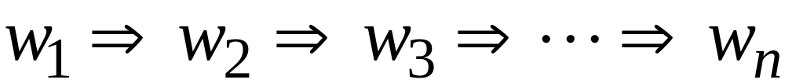
In general we write:
If:

Slide 19
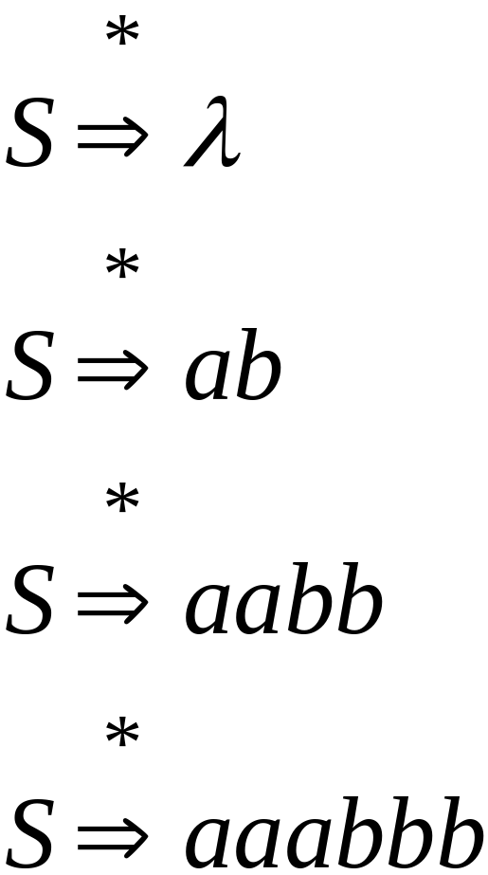
Example
Grammar
Derivations

Slide 20
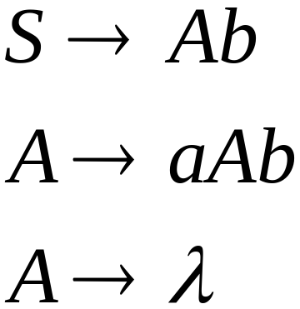
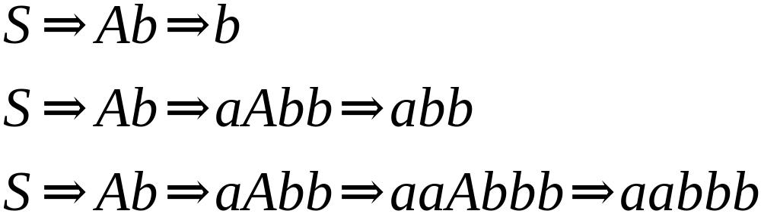
Another Grammar Example
Grammar :
Derivations:

Slide 21
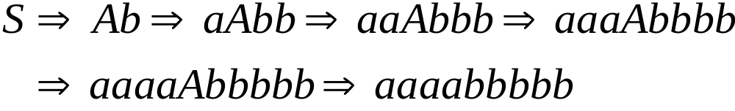
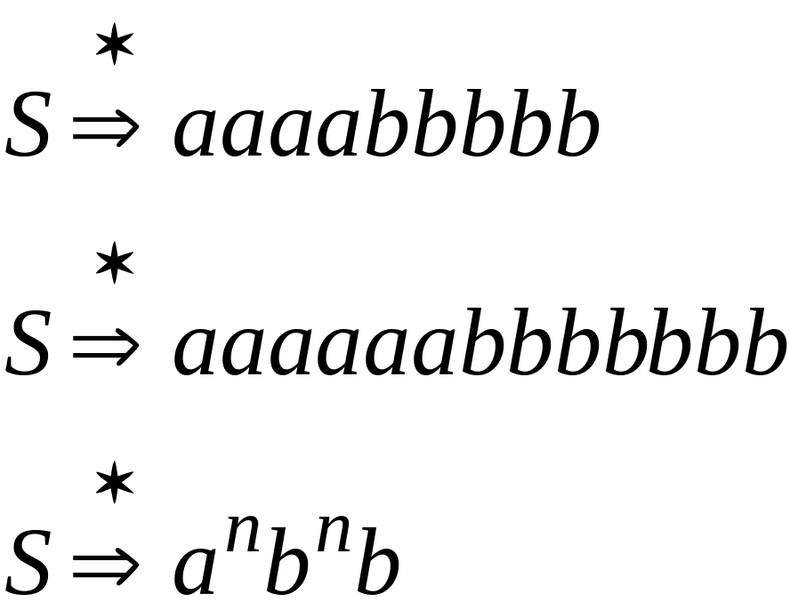
More Derivations

Slide 22

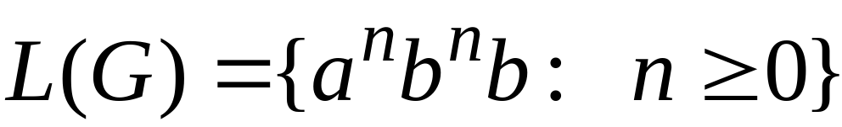
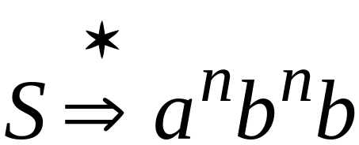
Example
For grammar :
Since:

Slide 23
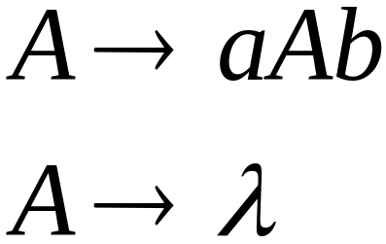
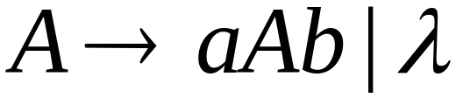
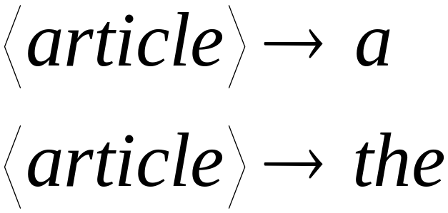
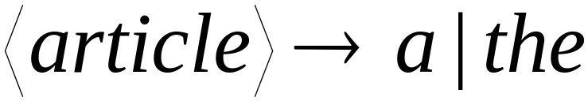
A Convenient Notation

Slide 24
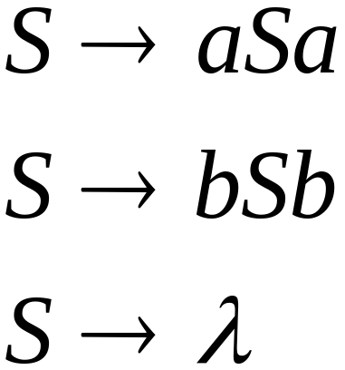
Example
A context-free grammar :
A derivation:

Slide 25
A context-free grammar :
Another derivation:

Slide 26



Slide 27
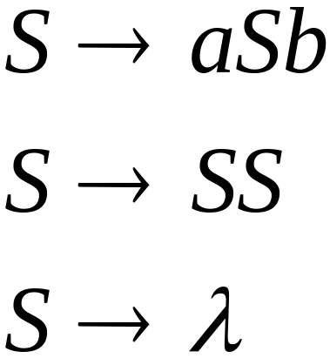
Example
A context-free grammar :
Find out the language generated by this
grammar…

Slide 28

Language generated by
the production

Slide 29

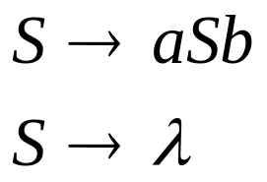
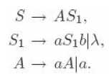
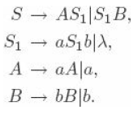
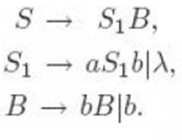
The Language is context free
Case 1: n = m :
Case 2 and 3 can be
combined as
Case 2: n > m :
Case 3: n < m :

Slide 30


Definition: Context-Free Grammars
Grammar
Variables
Terminal
symbols
Start
variable
Productions of the form:
Variable
String of variables
and terminals

Slide 31

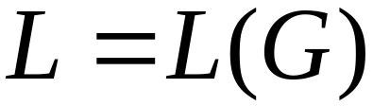

Definition: Context-Free Languages
A language is context-free
if and only if
there is a context-free grammar
with where

Slide 32

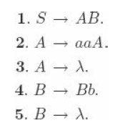
Example 1:
A derivation is said to be leftmost if in each step the leftmost variable in the sentential form is replaced.
If in each step the rightmost variable is replaced, we call the derivation rightmost.

Slide 33
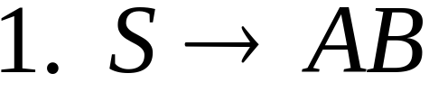
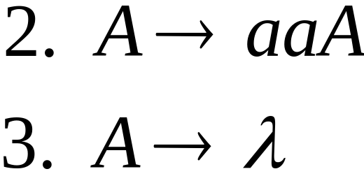
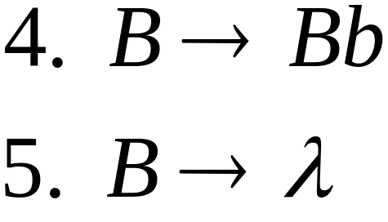


Derivation Order
Leftmost derivation:
Rightmost derivation:

Slide 34


Slide 35
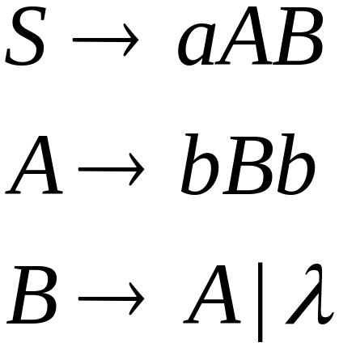
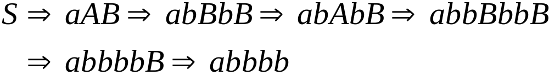
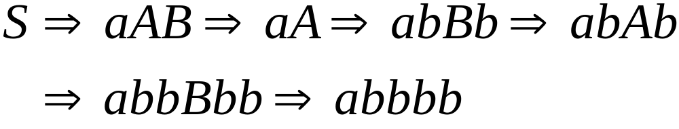
Example 2:
Language ???
Leftmost derivation:
Rightmost derivation:

Slide 36
Derivation Trees

Slide 37
Derivation Tree
A second way of showing derivations, independent of the order in which productions are used, is by a derivation or parse tree.
A derivation tree is an ordered tree in which nodes are labeled with the left sides of productions .
The children of a node represent its corresponding right sides.

Slide 38
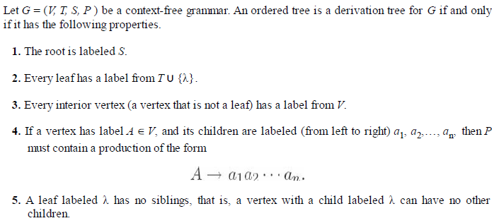
If every leaf has a label from V ∪ T ∪ {λ},is said to be a partial derivation tree.

Slide 39
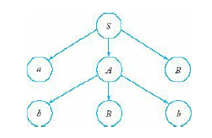

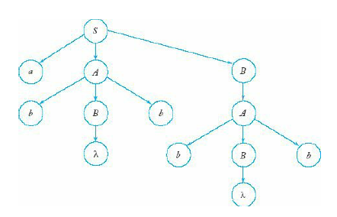
Partial Derivation tree
For the CFG…
Derivation tree

Slide 40

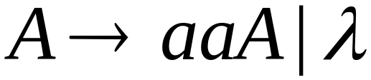
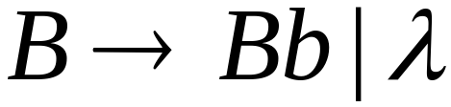





Slide 41



Slide 42


Slide 43


Slide 44
Derivation Tree

Slide 45
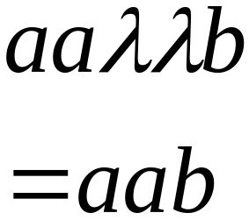
Derivation Tree
yield

Slide 46
Partial Derivation Trees
Partial derivation tree

Slide 47
Partial derivation tree

Slide 48

sentential
form
Partial derivation tree
yield

Slide 49
Sometimes, derivation order doesn’t matter
Leftmost:
Rightmost:
Same derivation tree

Slide 50
Ambiguity

Slide 51





leftmost derivation

Slide 52

leftmost derivation

Slide 53
Two derivation trees

Slide 54
The grammar
is ambiguous:
string
has two derivation trees

Slide 55
The grammar
is ambiguous:
string
has two leftmost derivations

Slide 56

Definition:
A context-free grammar is ambiguous
if some string has:
two or more derivation trees

Slide 57
In other words:
A context-free grammar is ambiguous
if some string has:
two or more leftmost derivations
(or rightmost)

Slide 58

Why do we care about ambiguity?
take

Slide 59



Slide 60






Slide 61
Correct result:

Slide 62
Ambiguity is bad for programming languages
We want to remove ambiguity

Slide 63
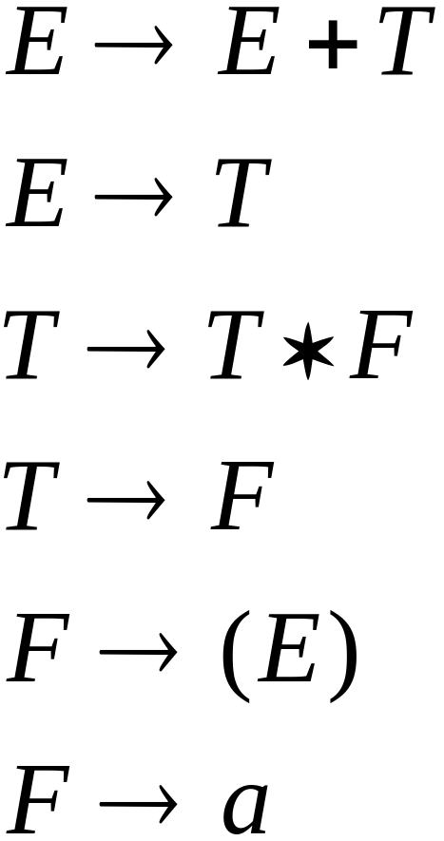
We fix the ambiguous grammar:
New non-ambiguous grammar:

Slide 64




Slide 65
Unique derivation tree

Slide 66
The grammar :
is non-ambiguous:
Every string has
a unique derivation tree

Slide 67
Check for ambiguous grammar
Example 1: for string aaaa
S → aS | X
X → aX |a
Example 2: for string aabbab
S → aB | bA
A → aS |bAA|a
B → bS|aBB|b

Slide 68
Example 3: for string aababb
S → aSbS
S→ bSaS
S → λ
Example 4: for the strings aab and aaabb
Equivalent unambiguous grammar
S → aS | aSbS | λ
S → aS | aAbS | λ
A → aAbA | λ

Slide 69
Find the unambiguous grammar for the following
S → S + S | a
Let w = a+a+a

Slide 70
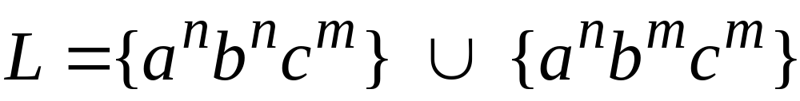

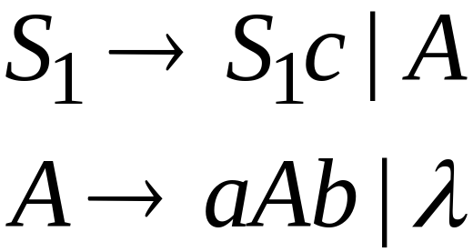
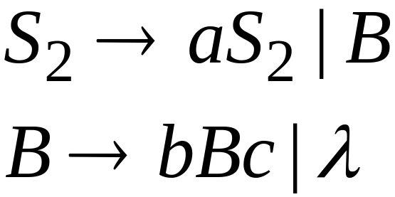
Inherent Ambiguity
Some context free languages
have only ambiguous grammars
Example:

Slide 71
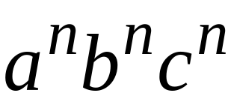



The string
has two derivation trees

Slide 72
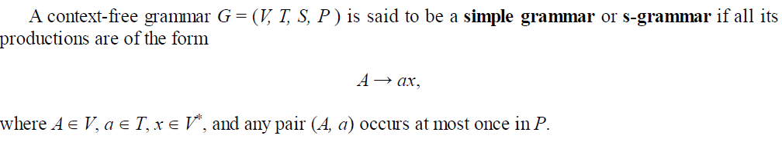
S Grammar

Slide 73
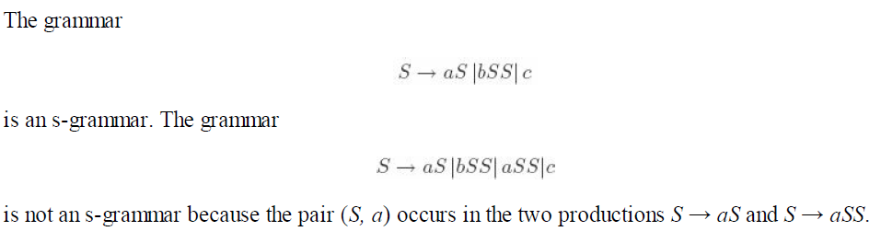

Slide 74
Example for S grammar
S → aABB
A → aA | b
B → bB | a
Find the language for this
Find S grammar for aaa*b + b

Slide 75
S → aA | b
A → aB
B → aB | b
Or
S → aAB | b
A → aA | a
B → b
Is it S grammar?

Slide 76
Find S grammar for L = { a^{n} b^{n} | n >= 1}

Slide 77
S → aA
A → aAB | b
B → b

