Slide 1
Formal Languages
Recursively Enumerable Languages
Recursive Languages

Slide 2
Definition:
A language is recursively enumerable
if some Turing machine accepts it

Slide 3





Let be a recursively enumerable language
and the Turing Machine that accepts it
For string :
if
then halts in a final state
if
then halts in a non-final state
or loops forever

Slide 4
Definition:
A language is recursive
if some Turing machine accepts it
and halts on any input string
In other words:
A language is recursive if there is
a membership algorithm for it

Slide 5
Let be a recursive language
and the Turing Machine that accepts it
For string :
if
then halts in a final state
if
then halts in a non-final state

Slide 6
We will prove:
1. There is a specific language
which is not recursively enumerable
(not accepted by any Turing Machine)
2. There is a specific language
which is recursively enumerable
but not recursive

Slide 7
Non Recursively Enumerable
Recursively Enumerable
Recursive

Slide 8
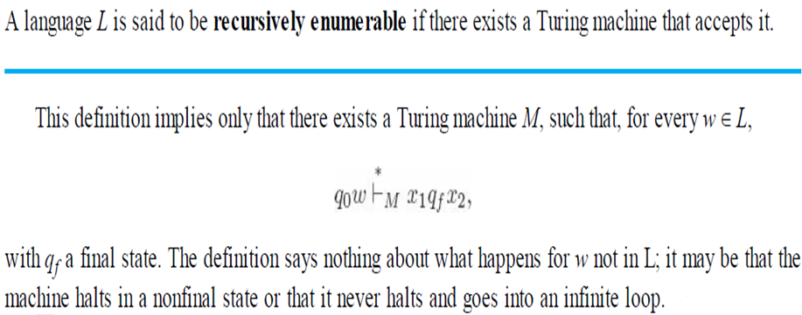

Slide 9
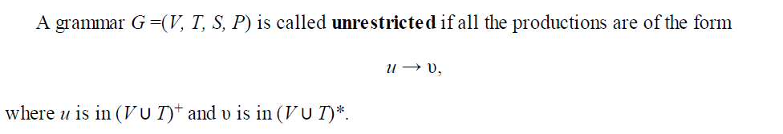
Unrestricted Grammars
In an unrestricted grammar, essentially no conditions are imposed on the productions.
Any number of variables and terminals can be on the left or right, and these can occur in any order.
There is only one restriction: λ is not allowed as the left side of a production.

Slide 10
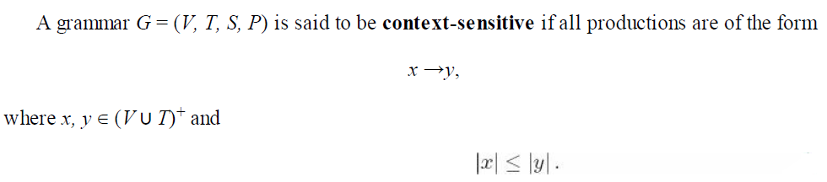
Unrestricted Grammars contd…
Any language generated by an unrestricted grammar is recursively enumerable.
For every recursively enumerable language L, there exists an unrestricted grammar G, such that L = L(G).
Context-Sensitive Grammars and Languages

Slide 11
Context-Sensitive Languages
A language L is said to be context-sensitive if there exists a context-sensitive grammar G, such that L = L (G) or L = L (G) ∪{λ}.
Why λ included in language but not in grammar…..
According to the definition of Context Sensitive Grammar it implies
that x → λ is not allowed.
So that a context-sensitive grammar can never generate a language
containing the empty string.
Yet, every context-free language without λ can be generated by a
special case of a context sensitive grammar, say by one in Chomsky or
Greibach normal form.
By including the empty string in the definition of a context-sensitive
language (but not in the grammar), we can claim that the family of
context-free languages is a subset of the family of context-sensitive
languages.

Slide 12
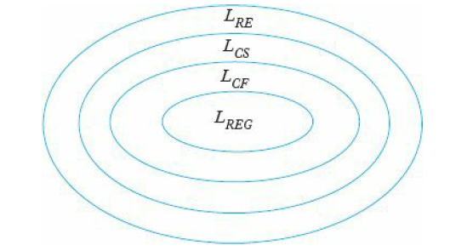
The Chomsky Hierarchy
Type 0 languages are those generated by unrestricted grammars, that is, the recursively enumerable languages.
Type 1 consists of the context-sensitive languages
Type 2 consists of the context-free languages
Type 3 consists of the regular languages.
original Chomsky hierarchy

Slide 13
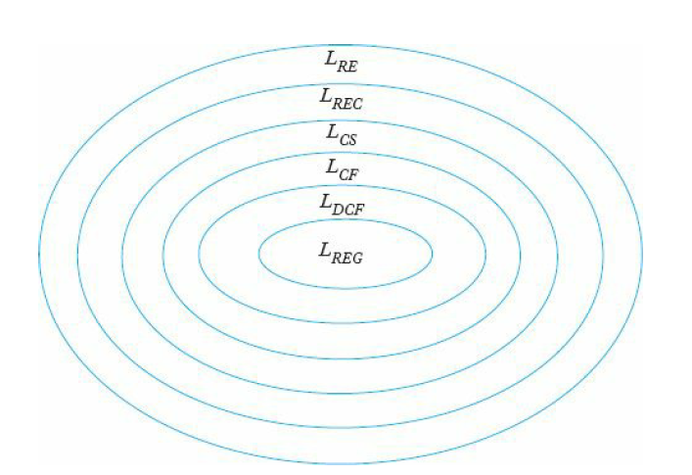
Including the families of deterministic context-free languages(LDCF) and recursive languages (LREC), we arrive at the extended hierarchy shown in
Extended hierarchy
A special subclass of context-free languages are the deterministic context-free languages which are defined as the set of languages accepted by a deterministic pushdown automaton

Slide 14
Chapter - 12
Recursive Language:
A language ‘L’ is said to be recursive if there exist a TM which
will accept all the strings in ‘L’ and reject all the strings not in ‘L’.
The TM will halt every time and give an answer (accepted or rejected)
for each and every string input.
Recursively Enumerable Language:
A language ‘L’ is said to be recursively enumerable language if there
exist a TM which will accept and therefore halt for all input strings
which are in L.
But may or may not halt for the strings which are not in ‘L’.

Slide 15
Chapter - 12
Decidable Language:
A language ‘L’ is said to be decidable if it is a recursive language’.
All decidable languages are recursive languages and vice versa.
Partially Decidable Language:
A language ‘L’ is said to be partially decidable if ‘L’ is recursively
enumerable language.
Undecidable Language:
A language is undecidable if it is not decidable.
An undecidable language may be sometimes partially decidable
but not decidable.
If the language not even a partially decidable then there exist no
turing machine for that language.

Slide 16
So…
A language is called Decidable or Recursive if there is a Turing machine which accepts and halts on every input string w. Every decidable language is Turing-Acceptable.
Decidable problem….
Prime numbers = {2, 3, 5, 7, 11, 13, …………..}
Divide the number ‘m’ by all the numbers between ‘2’ and ‘√m’ starting from ‘2’.
If any of these numbers produce a remainder zero, then it goes to the “Rejected state”, otherwise it goes to the “Accepted state”. So, here the answer could be made by ‘Yes’ or ‘No’.
Hence, it is a decidable problem.

Slide 17
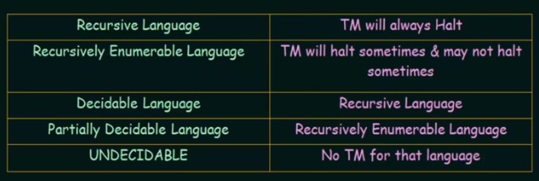
Summary ……

Slide 18
The Turing Machine Halting Problem
Given the description of a Turing machine M and an input w,
does M, when started in the initial configuration q0w, perform a computation that eventually halts?
M applied to w, or simply (M,w), halts or does not halt.
The domain of this problem is to be taken as the set of all Turing machines and all w;
Given the description of an arbitrary M and w, will predict whether or not the computation of M applied to w will halt.

Slide 19
A decision problem P is called “undecidable” if the language L of all accept or reject instances to P is not decidable.
Undecidable languages are not recursive languages, but sometimes, they may be recursively enumerable languages.
Input − A Turing machine and an input string w.
Problem − Does the Turing machine finish computing of the string w in a finite number of steps? The answer must be either yes or no.
Proof − We will call the Turing machine as a Halting machine that produces a ‘yes’ or ‘no’ in a finite amount of time. If the halting machine finishes in a finite amount of time, the output comes as ‘yes’, otherwise as ‘no’.
So all TM that does not accepts or reject as required …..
So halting problem is undecidable…..

Slide 20
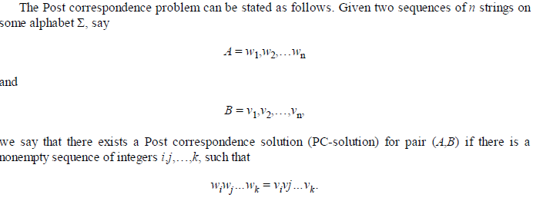
Post Correspondence Problem
The Post Correspondence Problem (PCP), introduced by Emil Post in 1946, is an undecidable decision problem.
It is cumbersome to work with halting problem directly
So an intermediate result is established to bridge a gap between halting problem and other problems.
One such intermediate result is the post correspondence problem

Slide 21

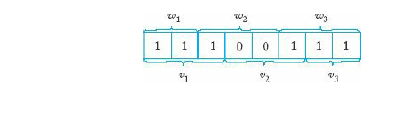
Example 1
 | w1 / v1 | w2/v2 | w3/ v3
A | 11 | 100 | 111
B | 111 | 001 | 11
We can see that w₁w₂w₃ = v₁v₂v₃
Hence, the solution is i = 1, j = 2, and k = 3.

Slide 22

Example 2
| w₁w₂w₃ | ≠ | v₁v₂v₃ | (Lengths are not same)
Hence, it can be said that this Post Correspondence Problem is undecidable.

Slide 23
Example 3
Find whether the lists M = (abb, aa, aaa) and N = (bba, aaa, aa)
have a Post Correspondence Solution?
 | X1 / y1 | X2/y2 | X3/ y3
M | abb | aa | aaa
N | bba | aaa | aa
Here,
x₂x₁x₃ = ‘aa abb aaa’
y₂y₁y₃ = ‘aaa bba aa’
x₂x₁x₃ = ‘aaabbaaa’
y₂y₁y₃ = ‘aaabbaaa’
We can see that x₂x₁x₃ = y₂y₁y₃
Hence, the solution is i = 2, j = 1, and k = 3.

