Slide 1
Pushdown Automaton -- PDA
Input String
Stack
States

Slide 2
Pushdown Automaton
Stack
Push, Pop
input memory
Pushdown
Automaton
output memory
Example: Compilers for Programming Languages
(medium computing power)

Slide 3
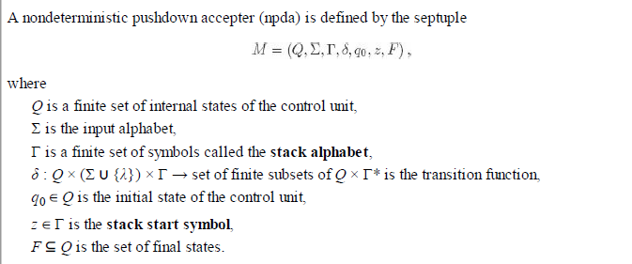
M = (Q, Σ, Γ, δ, q₀, z, F)
7 tuple or septuple
Definition of PDA:

Slide 4
Pushdown Automaton
  Note: If δ(q₀, a, z) = (q₁, β) means if NPDA is in state q₀ with input symbol a and z the top symbol on the stack can enter state q₁, replace symbol z by string β.

Slide 5
Language accepted by a PDA
Two types of acceptance: Acceptance by final state or Acceptance by empty stack
Definition: Let M = (Q, Σ, Γ, δ, q₀, z, F) be a NPDA. We define L(M), the language accepted by final state is the set
L(M) = { w Є Σ* : (q₀, w, z) |-_{M} (p, λ, u), p Є F, u Є Γ*}
In other words, the language accepted by M is the set of all strings that can put M into a final state.

Slide 6
Definition:
Let M = (Q, Σ, Γ, δ, q₀, z, F) be a NPDA. We define L(M), the language accepted by empty stack is the set
L(M) = { w Є Σ* : (q₀, w, z) |-_{M} (p, λ, λ), p Є Q}
When acceptance is by empty stack, the set of final states is to be empty set.

Slide 7

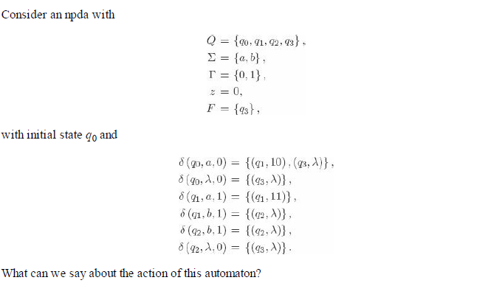
Example 1:

Slide 8
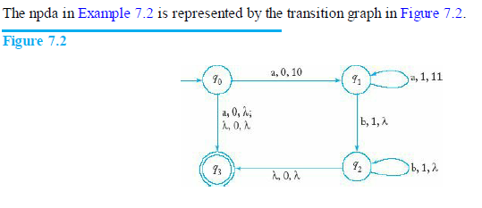

Instantaneous Description:
The triplet where q is the state of the control unit, w is the unread part of the input string, and u is the stack contents (with the leftmost symbol indicating the top of the stack), is called an instantaneous description of a pushdown automaton.

Slide 9
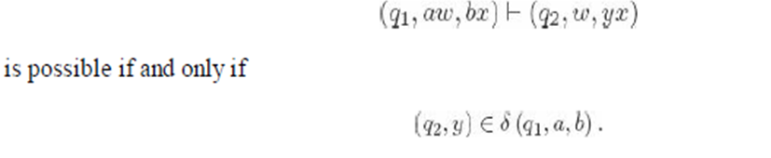
A move from one instantaneous description to another will be denoted by the symbol |-thus

Slide 10

Example: Instantaneous description for language , Q ={ qo, q1, q2, q3}
Take string w = aabb
(qo, aabb, Z) (q1, abb, aZ) (q1, bb, aaZ)
(q2, b, aZ) (q2, λ, Z) (q3, λ, Z)

Slide 11

Use Q ={ qo, q_{f})
δ(qo, a ,z) = (q_{0,} az)
δ(qo, b ,z) = (q_{0,} bz)
δ(qo, a ,a) = (q_{0,} aa)
δ(qo, b ,b) = (q_{0,} bb)
δ(qo, a ,b) = (q_{0,} λ)
δ(qo, b ,a) = (q_{0,} λ)
δ(qo, λ ,z) = (q_{f,} λ)

Slide 12
Use Q ={ qo, q_{f})
δ(qo, a ,z) = (q_{0,} 0z)
δ(qo, b ,z) = (q_{0,} 1z)
δ(qo, a ,0) = (q_{0,} 00)
δ(qo, b ,1) = (q_{0,} 11)
δ(qo, a ,1) = (q_{0,} λ)
δ(qo, b ,0) = (q_{0,} λ)
δ(qo, λ ,z) = (q_{f,} λ) (shows empty stack)
Or δ(qo, λ ,z) = (q_{f,} z) ( not an empty stack)
When a is read insert 0 in the stack
When b is read insert 1 in the stack
Stack top symbol is z

Slide 13
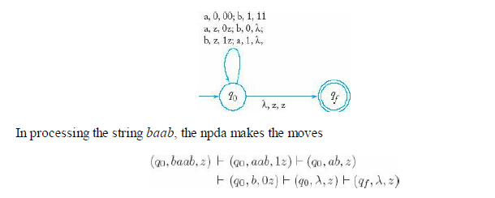
a, 0, 00 & b,1,11
a, z, 0z & b, z,1z
b, 0, λ & a, 1, λ

Slide 14
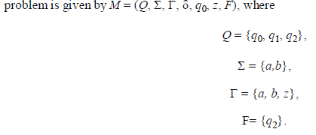
To construct an npda for accepting the language
L = { ww^{R} : w ∈ {a, b}+ }

Slide 15
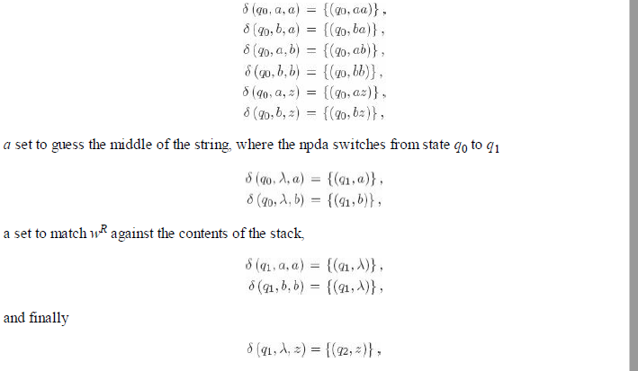

Slide 16

Try for the language L = {w c w^{R} | w ϵ (a,b)*}
Q = { q0, q1, q2}, stack top symbol be z, τ = {a, b, z}

Slide 17
Tyr these examples….
1. L = { w | w ϵ ( a, b)* and n_{a} (w) > n_{b}(w)}, Q= q0, q1 , Γ - {a,b, z}
2. L = { w | w ϵ ( a, b)* and n_{a} (w) < n_{b}(w)} Q= q0, q1 , Γ - {a,b, z}
3. L = { a^{n} b^{2n} | n > =1} Q= q0, q1, q2 , Γ - {a, z}
4. Check for balanced parenthesis
check for [ ()()([ ])] Q= q0, q1 , Γ - {(,[, z}

Slide 18
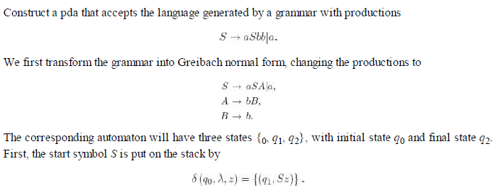
Pushdown Automata for Context-Free Languages

Slide 19
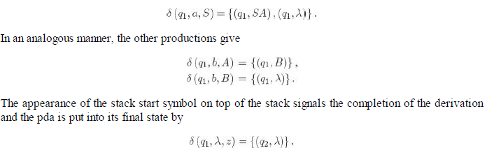

Slide 20
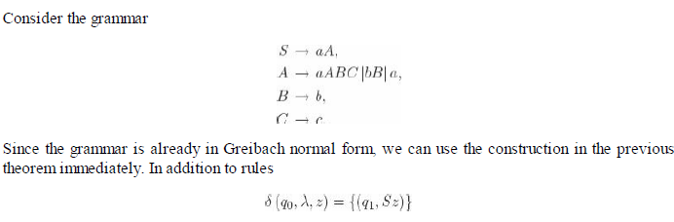

Slide 21
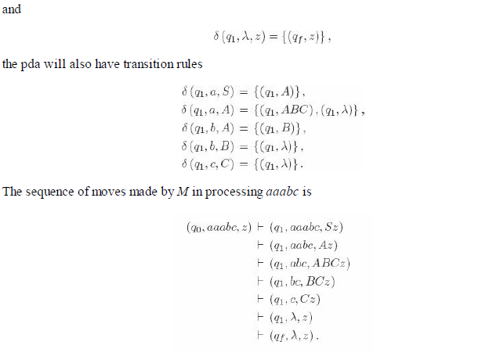

Slide 22
Deterministic Pushdown Automata and Deterministic Context-Free Languages
A deterministic pushdown accepter (dpda) is a pushdown automaton that never has a choice in its move
A pushdown automaton M = (Q, Σ, Γ, δ, q0, z, F) is said to be deterministic if it is an automaton as defined that, for every q ∈ Q, a Σ ∪{λ} and b ∈ Γ,
1. δ(q, a, b) contains at most one element,
2. if δ (q, λ, b) is not empty, then δ (q, c, b) must be empty for every c ∈ Σ.

Slide 23
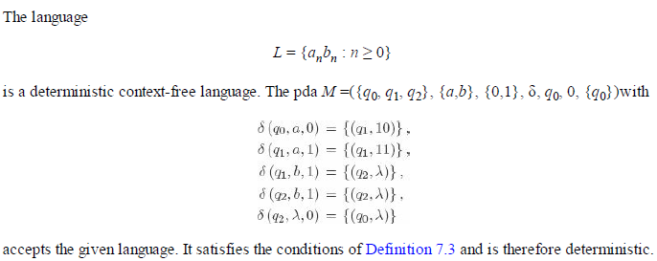

Slide 24


Initial Stack Symbol
Extra material for reference
Stack
Stack
stack
head
top
bottom
special symbol
Appears at time 0

Slide 25
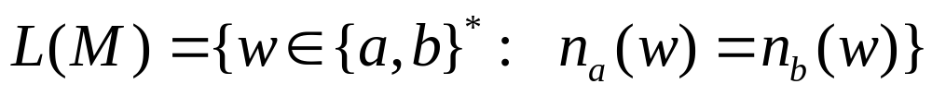







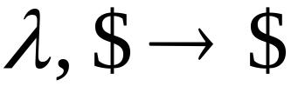


Another PDA example
PDA

Slide 26


Execution Example:
Time 0
Input
Stack
current
state

Slide 27

Time 1
Input
Stack

Slide 28

Time 3
Input
Stack

Slide 29

Time 4
Input
Stack

Slide 30
Time 5
Input
Stack

Slide 31
Time 6
Input
Stack

Slide 32
Time 7
Input
Stack

Slide 33
Time 8
Input
Stack
accept

Slide 34
PDAs: Formal Definition

Slide 35

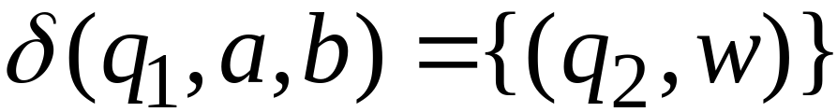
Transition function:

Slide 36
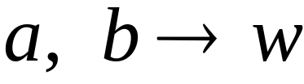

Transition function:

Slide 37
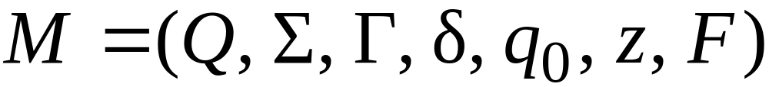
Formal Definition
Pushdown Automaton (PDA)
Final
states
States
Input
alphabet
Stack
start
symbol
Transition
function
Initial
state
Stack
alphabet

