Slide 1
Formal Languages
Turing’s Thesis

Slide 2
Variations of the
Turing Machine

Slide 3
Equivalence of Classes of Automata
Two automata are equivalent if they accept the same language.
Consider two classes of automata C1 and C2. If for every automaton M1 in C1 there is an automaton M2 in C2 such that L (M1)= L (M2).
Let M be an automaton. We say that another automaton M’ can simulate a computation of M if M’ can mimic the computation of M.

Slide 4
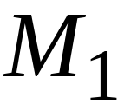
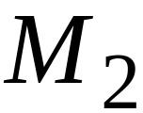
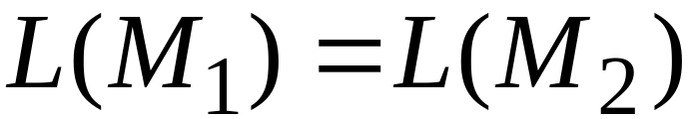
Same Power of two classes means:
For any machine of first class
there is a machine of second class
such that:
And vice-versa

Slide 5
Variations of the Standard TM Model
Turing machines with:
Stay-Option
Semi-Infinite Tape
Off-Line
Multitape
Multidimensional
Nondeterministic

Slide 6
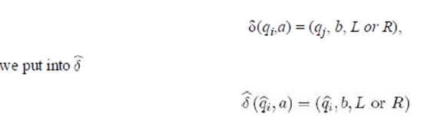
Turing Machine with Stay Option:
Standard Turing machine, the read-write head must move either to the right or to the left.
Sometimes it is convenient to provide a third option, to have the read-write head stay in place after rewriting the cell content.
δ : Q × Γ→ Q × Γ ×{L, R, S}
For each transition

Slide 7
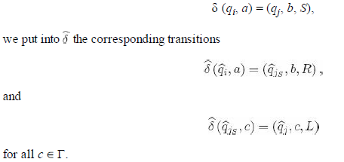
Turing Machine with Stay Option:
Now for the transition with stay option……

Slide 8




Turing Machines with Stay-Option
The head can stay in the same position
Left, Right, Stay
L,R,S: moves

Slide 9



Example:
Time 1
Time 2

Slide 10


Example
Stay-Option Machine:
1
2
Simulation in Standard Machine:
1
2
3

Slide 11
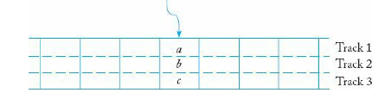
we have divided each cell of the tape into three parts, called tracks, each containing one member of the triplet.
Based on this visualization, such an automaton is sometimes called a Turing machine with multiple tracks.
Multiple Tracks in TM

Slide 12
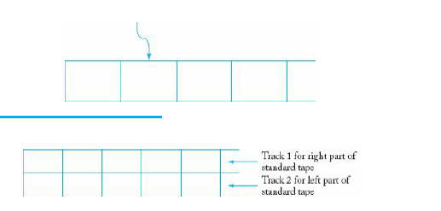
To simulate a standard Turing machine M by a machine with a semi-infinite tape, we use the arrangement.
The simulating machine has a tape with two tracks.
On the upper one, we keep the information to the right of some reference point on M’s tape
Standard TM
Semi Infinite tape TM

Slide 13
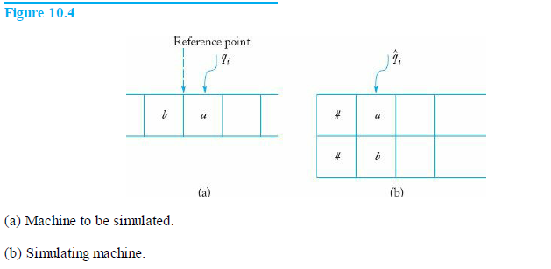
The reference point can be the position of the read-write head at the start of the computation.
The lower track contains the left part of M’s tape in reverse order.
Assume that the machine to be simulated and the simulating machine are in the respective configurations shown in Figure 10.4 and that the move to be simulated is generated by δ (qi, a) = (qj, c, L).

Slide 14
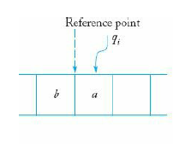
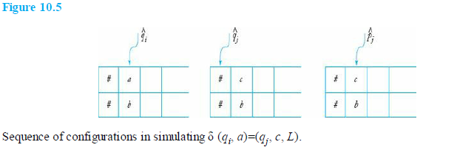




where
and
and Pj will work on the lower track.

Slide 15
Semi-infinite tape machines simulate
Standard Turing machines:
Standard machine
.........
.........
Semi-infinite tape machine
.........

Slide 16



Standard machine
.........
.........
reference point
Semi-infinite tape machine with two tracks
Right part
.........
Left part

Slide 17
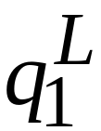
Time 1
Standard machine
.........
.........
Semi-infinite tape machine
Right part
.........
Left part

Slide 18

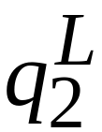
Time 2
Standard machine
.........
.........
Semi-infinite tape machine
Right part
.........
Left part

Slide 19
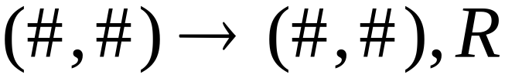
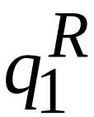
At the border:
Semi-infinite tape machine
Right part
Left part

Slide 20
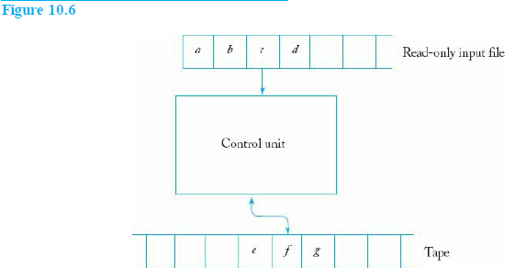
The Off-Line Turing Machine
If we put the input file back into the picture, then it is known as an off-line Turing machine .
In such a machine, each move is governed by the internal state, what is currently read from the input file, and what is seen by the read-write head.
A schematic representation of an off-line machine is shown in Figure 10.6.

Slide 21
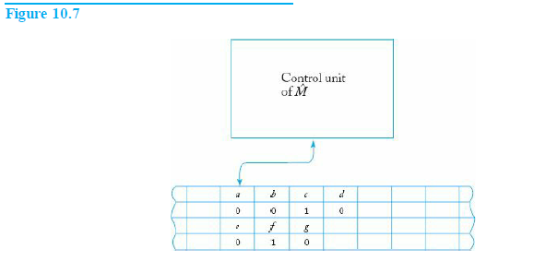
A standard machine can simulate the computation of an off-line machine by using the four-track arrangement shown in Figure 10.7.
The first track has the input, the second marks the position at which the input is
read, the third represents the tape of M, and the fourth shows the position of M’s
read-write head.

Slide 22

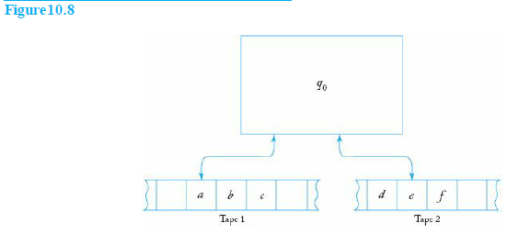
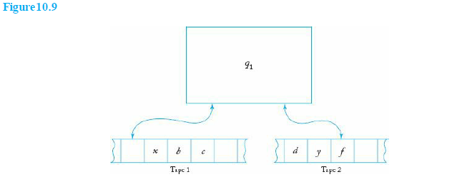

Turing Machines with More Complex Storage
A) Multitape Turing
A multitape Turing machine is a Turing machine with several tapes, each with its own independently controlled read-write head (Figure 10.8 and Figure 10.9 ).

Slide 23
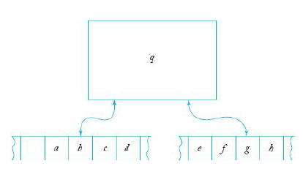
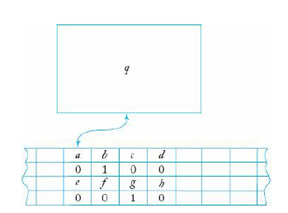
The representation of a multitape machine by a single-tape machine is similar to that used in the simulation of an off-line machine.
Multitape TM
Simulated in
single tape

Slide 24
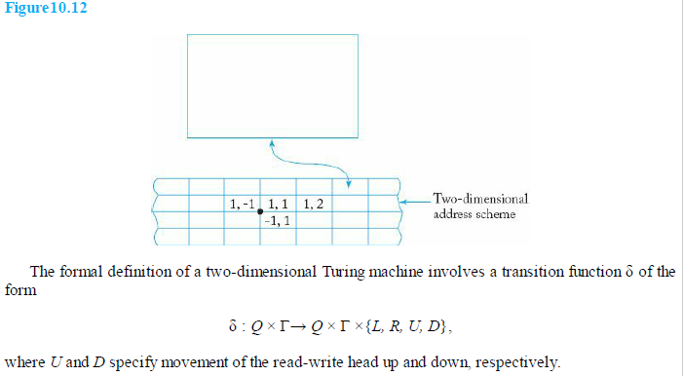
Multidimensional Turing Machines
A multidimensional Turing machine is one in which the tape can be viewed as extending infinitely in more than one dimension.
A diagram of a two-dimensional Turing machine is shown in Figure 10.12

Slide 25
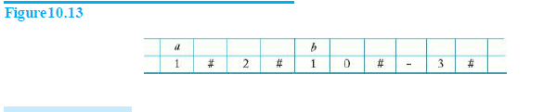
To simulate this machine on a standard Turing machine, we can use the two-track model depicted i n Figure 10.13 and the configuration in which cell (1, 2) contains a and cell (10, – 3) contains b is shown as
The two-track tape of the simulating machine will use one track to store cell contents and the other one to keep the associated address.

Slide 26
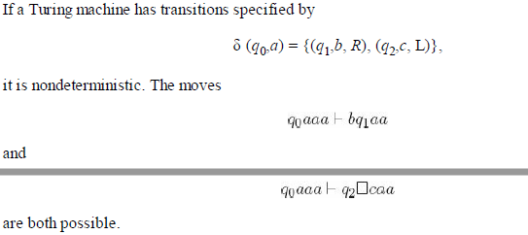
Nondeterministic Turing Machines
A nondeterministic Turing machine is an automaton as given by a function
δ : Q × Γ → 2^{Q×Γ×{L, R}.}

Slide 27
A nondeterministic Turing machine M is said to accept a language L if, for all w ∈ L, at least one of the possible configurations accepts w.
There may be branches that lead to nonaccepting configurations, while some may put the machine into an infinite loop.
A nondeterministic Turing machine M is said to decide a language L if, for all w ∈ Σ*, there is a path that leads either to acceptance or rejection.

Slide 28
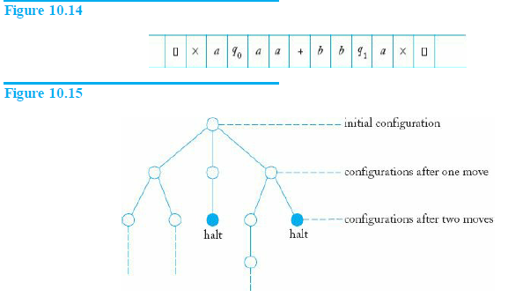
One way to visualize the simulation is to use a standard Turing machine, keeping all possible instantaneous descriptions of the nondeterministic machine on its tape, separated by some convention.
The symbols × are used to delimit the area of interest, while + separates individual instantaneous descriptions.
Decision tree

Slide 29
A Universal Turing Machine
A universal Turing machine Mu is an automaton that, given as input the
description of any Turing machine M and a string w, can simulate the computation of M on w.
Assume that Q = {q1,q2,…,qn}, with q1 the initial state, q2 the single final state, and Γ = {a1,a2,…am}, where a1 represents the blank.
We then select an encoding in which q1 is represented by 1, q2 is represented by 11, and so on.
Similarly, a1 is encoded as 1, a2 as 11, etc. The symbol 0 will be used as a separator between the 1’s.
For L - encoded as 1 and Right – encoded as 11

Slide 30
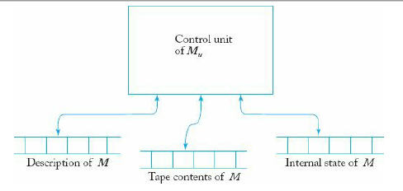
For example, δ (q1, a2) = (q2, a3, L) might appear as
…10110110111010….
It follows from this that any Turing machine has a finite encoding as a string on {0,1}+
A universal Turing machine Mu then has an input alphabet that includes {0, 1} and the structure of a multitape machine, as shown in Figure 10.16.

Slide 31
For any input M and w, tape 1 will keep an encoded definition of M.
Tape 2 will contain the tape contents of M, and tape 3 the internal state of M.
Mu looks first at the contents of tapes 2 and 3 to determine the configuration of M.
It then consults tape 1 to see what M w would do in this configuration.
Finally, tapes 2 and 3 will be modified to reflect the result of the move.

Slide 32
Linear Bounded Automata
Linear bounded automaton, like a standard Turing machine, has an unbounded tape.
But how much of the tape can be used is a function of the input.
In particular, we restrict the usable part of the tape to exactly the cells taken by the input.
To enforce this, we can envision the input as bracketed by two special symbols, the left-end marker [ and the right-end marker ].
For an input w, the initial configuration of the Turing machine is given by the instantaneous description q0 [w].
The end markers cannot be rewritten, and the read-write head cannot move to the left of [ or to the right of ].

Slide 33
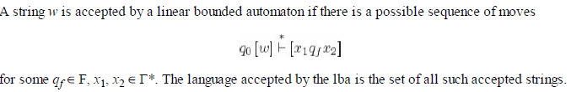
A linear bounded automaton is a nondeterministic Turing machine M = (Q, Σ, Γ,δ, q0, ,F), subject to the restriction that Σ must contain two special symbols [ and ], such that δ (qi,[) can contain only elements of the form (qj, [,R), and δ (qi, ]) can contain only elements of the form (qj, ],L).
Definition:

