Slide 1
An Introduction to Formal Languages and Automata
Peter Linz

Slide 2
Finite automata are a useful model as……
1. Software for designing and checking the behaviour of digital circuits
2. The lexical analyser of a typical compiler, that is, the compiler component that breaks the input text into logical units
3. Software for scanning large bodies of text, such as collections of Web pages, to find occurrences of words, phrases or other patterns
4. Software for verifying systems of all types that have a finite number of distinct states, such as communications protocols for secure exchange information

Slide 3
Automata theory teaches you the very important equivalence between….
a language: some -- usually -- infinite set of strings
a grammar: the finite set of rules to generate that language
→an automaton: the abstract processing device that can recognize that language

Slide 4
Automata theory and formal languages are the base of current
→compilers,
→regular expressions,
→parsers,
web-scrappers,
natural language processing (NLP),
Automata play a major role in theory of computation, compiler construction, artificial intelligence, parsing and formal verification.

Slide 5
Theory of computation deals with how efficiently problems can be solved on a model of computation - that describes how a set of outputs are computed for a given a set of inputs….
A compiler is a computer program that transforms computer code written in one programming language (the source language) into another programming language (the target language).
Parsing, syntax analysis, or syntactic analysis is the process of analysing a string of symbols, either in natural language, computer languages or data structures, conforming to the rules of a formal grammar
Formal verification helps in proving the correctness of systems such as: cryptographic protocols, combinational circuits, digital circuits with internal memory, and software expressed as source code.

Slide 6
Automaton that contains all features of a digital computer . It accepts input, produces output, and have temporary storages and can make decisions in transforming the input into output.
Formal Language is the general characteristics of programming language which consist of set of symbols and some rules where symbols can be combined into sentences.
Finally we formalize the concept of mechanical computation by giving a precise definition of the term algorithm.

Slide 7
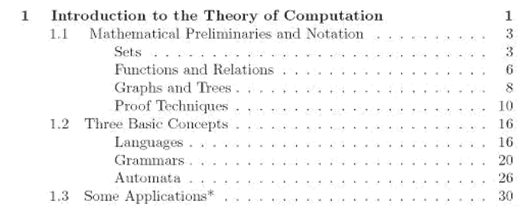
Chapter - 1

Slide 8



Set: A collection of elements without any structure other than membership.
To indicate x belongs to S
To indicate x not belongs to S
Set of all lower case alphabets → {a,b,c,….z}
Set of all positive even integers → { 2, 4, 6…}

Slide 9

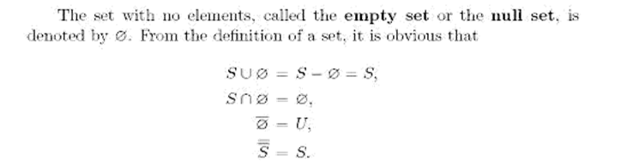
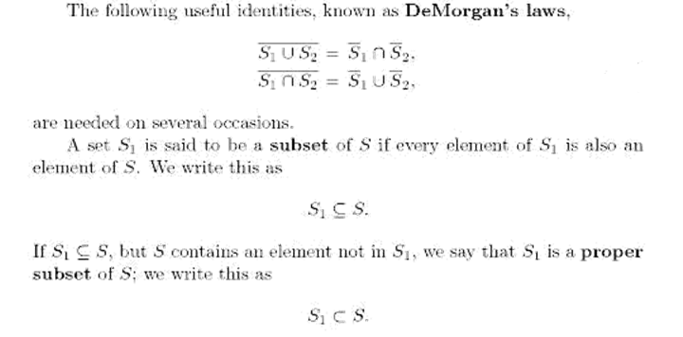
Another basic operation is complementation
{1, 2, 3} is a subset of {1, 2, 3}, but is not a proper subset of {1, 2, 3}.
{1, 2, 3} is a proper subset of {1, 2, 3, 4} because the element 4 is not in the first set.

Slide 10
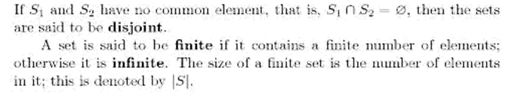
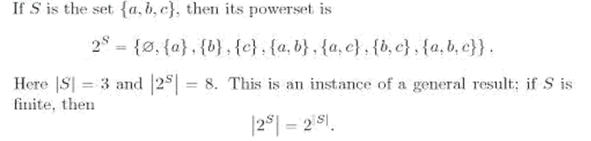
Power Set – Set of all subset of S…..

Slide 11

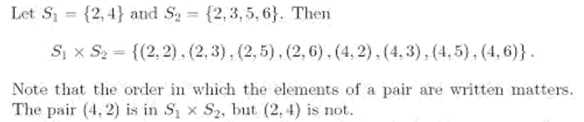
Cartesian Product….

Slide 12
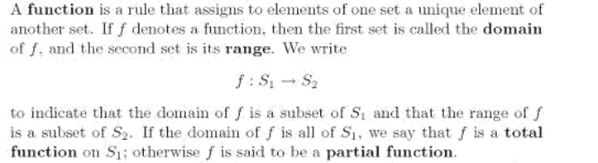
Functions and Relations:

Slide 13
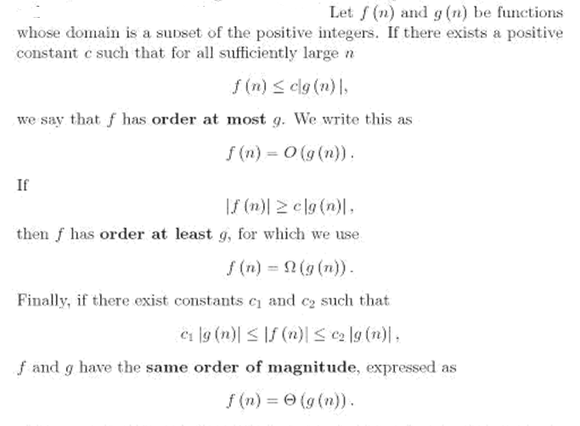
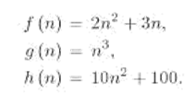
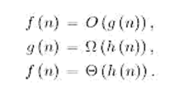

Slide 14
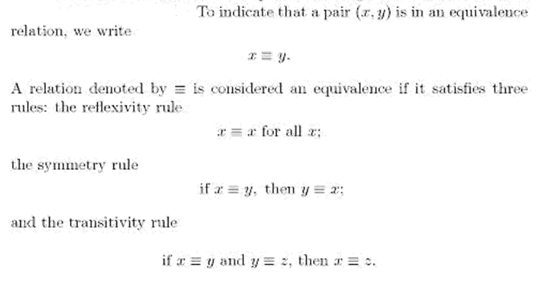
Example 1: Let us define Relation R on Set A = {1, 2, 3}. Now, let us check reflexive, symmetric and transitive relation in this.
Let R = {(1 , 1),(2 , 2),(3 , 3),(1, 2),(2 , 3), (1 , 3)}
CHECK REFLEXIVE :If the relation is reflexive , then (a , a) ∈ R for every a ∈ {1,2,3}. Since (1 , 1) ∈ R , (2 , 2 ) ∈ R and (3 , 3) ∈ R. Therefore, R is reflexive.
CHECK SYMMETRIC : To check whether a relation is symmetric or not, if (a , b) ∈ R, then (b , a) ∈ R. Here,(1 , 2) ∈ R , but (2 , 1) ∉ R.Therefore, R is not symmetric.
CHECK TRANSITIVE : To check whether a relation is transitive or not, if (a, b ) ∈ R and (b ,c) ∈ R then (a , c ) ∈ R. Here, as you can see that if (1, 2 ) ∈ R and (2 ,3) ∈ R then (1 , 3 ) ∈ R. Therefore, R is transitive.

Slide 15


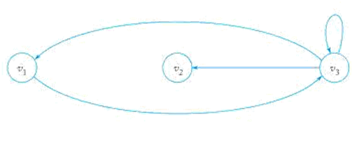

Graphs and Trees
Vertices….
E_{i} is the edge from V_{j} to V_{k}
Loop is v3 to v3
In digraph or directed graph we associate a direction with each edge.

Slide 16
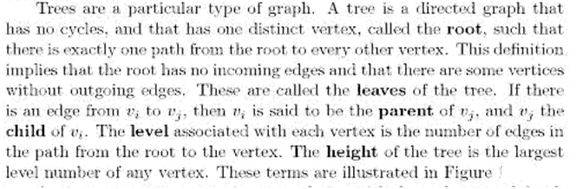
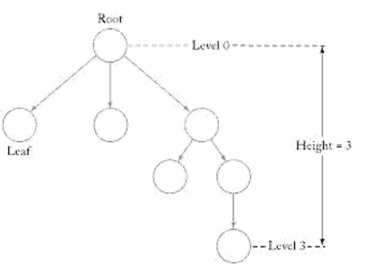
Trees

Slide 17
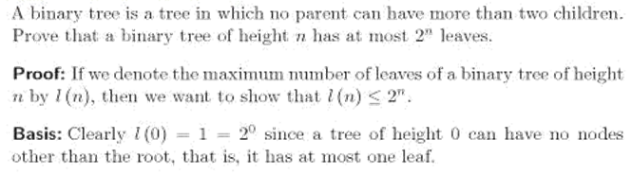
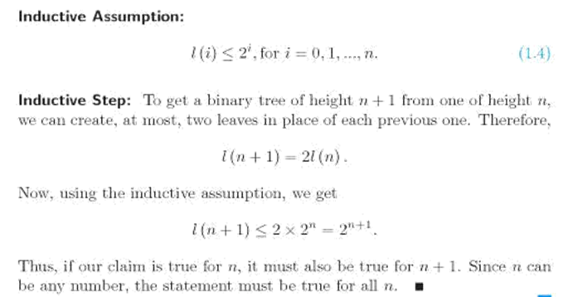
Mathematical Induction:

Slide 18
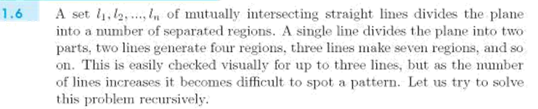
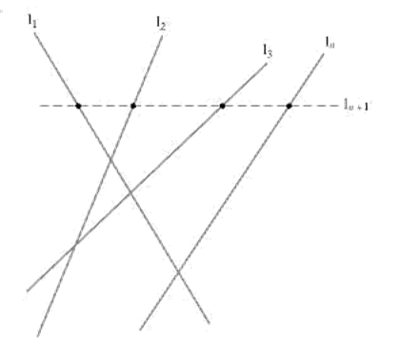

Slide 19
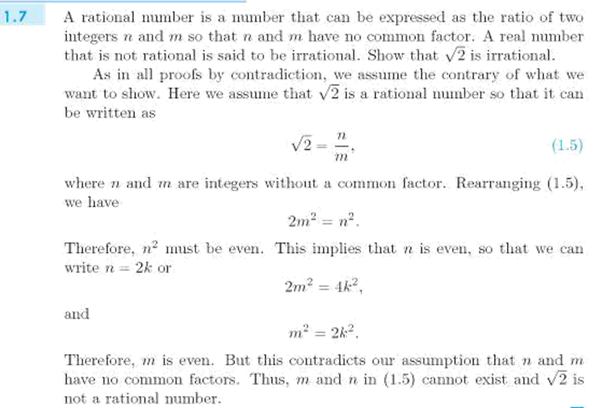
Proof by Contradiction

Slide 20
Assignment week
Assignment 1: Jan 21 to Jan 25
Assignment 2 : Feb 20 to Feb 26
Assignment 3: Mar13 to Mar 19
Assignment 4: Apr 8 to Apr 13

Slide 21
Sessional 1
Feb 14th , 15th and 19th
Feb 18th Class will be held and Tuesday Time table

Slide 22
Three Basic Concepts
Languages
Grammar
Automata
Finite non empty sets Ʃ of symbols called alphabets
From individual symbols we construct strings which are finite sequence of symbols from the alphabet.
If Ʃ = { a,b} then abab, aaabbba are some of the strings on Ʃ
We use lowercase letters a, b, c… for elements of Ʃ
We use u, v , w for string names
Example w = abaaa

Slide 23
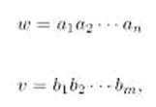

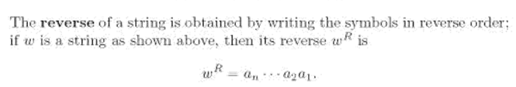

Empty string is the string with no symbols and denoted by λ

Slide 24
If w = vu then the substrings v and u are prefix and suffix of w
Example 1: w = abbab
Prefix : { λ, a,ab,abb,abba, abbab} is the prefixes of w
Suffix : {abbab, bbab, bab, ab, b, λ }
Example 2: w = aabcd
Prefix : { λ, a,aa,aab,aabc, aabcd}
Suffix : {aabcd, abcd, bcd, cd,d, λ }

Slide 25

Recursive Definition of Length:
If u and v are strings, then the length of their concatenation is the sum of the individual length.
ie.
Theorem: Let u and v be any two strings defined on Ʃ, then
for all u, v on Ʃ.
Proof by Induction:
Let n be the length of v
Basis:
Let |v| = 1 Then n= 1
Let v=a
|uv| = |ua|
= |u| + 1 [ by recursive definition of length]
= |u| + |v|

Slide 26
Inductive Assumption:
Now assume n=k
Inductive step:
we prove the result for next higher value n = k+1
Let v = wa where w is any string of length k and a is a symbol.
|v| = |w|+1
|uv| = |uwa|
= |(uw)a|
= |u(wa)|
=|u| + |wa|
= |u| + |w| + 1
= |u| + |v|
Thus Proved.

Slide 27
If w is a string, then w^{n} stands for string obtained by repeating w, n times.
w⁰ = λ.
Ʃ* ➔ includes λ and Ʃ⁺ → Ʃ* - λ
Ʃ is finite where Ʃ* and Ʃ⁺ are always infinite.
Let L = { a, aa, ab, abb} on Ʃ then
= Ʃ* - L
L* = L⁰ U L¹ U L² U ….. (star closure)
L⁰ = {λ}
L¹ = L
L² = L . L
L⁺ = L¹ U L² U….. (positive closure)

Slide 28
If L = {λ, ab, abab …..} then find L²
L² = L.L = {λ, ab, abab …..} {λ, ab, abab …..}
= {λ, ab, abab …..}
= L
Therefore L² = L
If L₁ and L₂ are 2 languages the
L₁L₂ ₌ { xy : x ϵ L₁ , y ϵ L₂ }

Slide 29
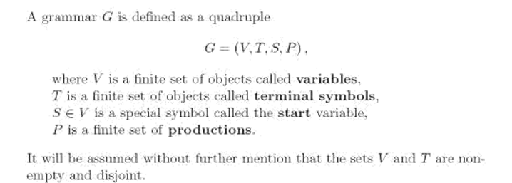

Grammars

Slide 30

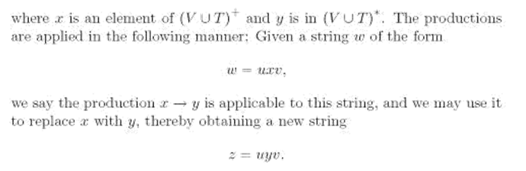

Slide 31

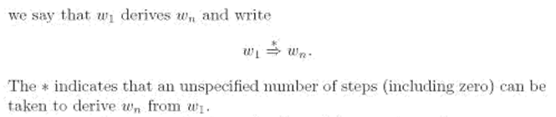
The production x → y implies
w ➔ z
ie. w derives z or z is derived from w
If

Slide 32
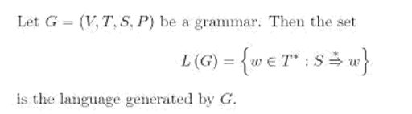
If the strings contains variables and terminals then they are called as sentential form
Example:
S → aAb | λ productions
A → aAb | λ
S → aAb → aaAbb → aabb in this aaAbb and aAb are in sentential form
a , b are terminals
A - Variables
aabb is a string ie. w

Slide 33
G = ( {S}, {a,b}, S, P) with P given by
S → aSb | λ
Option 1:
S → λ
S → aSb S→ a λb
S → ab
Option 2:
S → aSb
S → a aSbb
S → aa λbb
S → aabb
The language generated by this grammar is
L= { a^{n}b^{n} | n >= 0}
L = { λ, ab, aabb, aaabbb…..}

Slide 34
Language Definition:
If G = (V, T, S P) is a grammar then language L generated by grammar G is
L (G) = { w ϵ T * | S → w}
Example 1:
G = ( { S,A}, {a,b}, S, P}
S → Ab
A → aAb
A → λ
S → Ab → aAbb → aaAbbb → aa A bbb → aaa A bbbb → aaa λ bbbb → aaabbbb
So
L = { a^{n} b^{n+1} | n >= 0}

Slide 35
Let G be a grammar G = ( {S}, {a,b}, S, P)
S → SS
S → aSb
S → bSa
S → λ
So The language generated by this grammar is
L = { w | n_{a} (w) = n_{b} (w) }
S → SS → aSbS → aaSbbS → aabbS → aabb
S → SS → SaSb → S abSa b → abSab → abab

Slide 36
Equivalent Grammar
Let G1 and G2 be any 2 grammars. Then if L (G1) = L (G2) then 2 grammars are equivalent.
Let G1 be…..
S → aSb | λ
S→ aSb → aaSbb → aa λ bb → aabb
L = { a^{n}b^{n} | n >= 0}
Let G2 be…..
S → aAb | λ
A → aAb | λ
S→ aAb → aaAbb → aa λ bb → aabb
L = { a^{n}b^{n} | n >= 0}
So L (G1) = L (G2)

Slide 37
Some Examples
Find the Language generated by this grammar
G = ( {S}, {a,b}, S,P)
S → SS | aSb | bSa | λ
Find the Grammar for the Language
2. L = { (01)^{n} | n >=0}
3. L = { ww^{r} | w ϵ {a,b}*}
4. L = { (0^{n} 1^{2n} | n >=0}
L = { (a^{n} b^{n - 3} | n >=3}
L = { w | |w| mod 3 = 0 }

Slide 38
Automata
Abstract model of digital computer
Input file is divided into cells each can hold one symbol
Read the input file from left to write one at a time
Temporary storage device with unlimited no. of cells each capable of holding one symbol
Automaton can read and change the content of storage cells
Input file
Storage
Control unit
output

Slide 39
Control unit will be in some internal state
The internal state of CU at the next time step is determined by transition function
Transition function gives the next state in terms of current state, current input symbol, current information in the storage.
The term configuration is used to refer to a particular state of CU, input file and temporary storage.
The transition of automaton from one configuration to next is called a move.

Slide 40
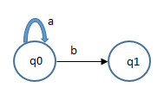
Two types of Automata
Deterministic Automata (DFA)
Nondeterministic Automata (NFA)
DFA – In this each move is uniquely determined by the current configuration.
δ (q0 ,a) = q0
δ (q0 ,b) = q1

Slide 41
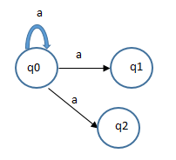
NFA – It has several possible moves. So we can predict a set of possible actions.
Accepter: An automaton whose output response is limited to sample “Yes” or “No” is called accepter ie. Either accept the string or rejects it.
Transducer: Automaton capable of producing strings of symbols as output .
δ (q0 ,a) = { q0, q1, q2 }

Slide 42
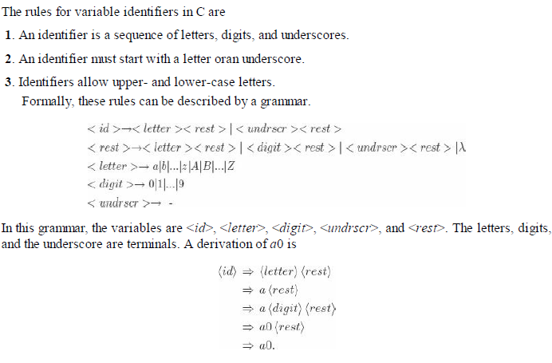
Some Applications

Slide 43

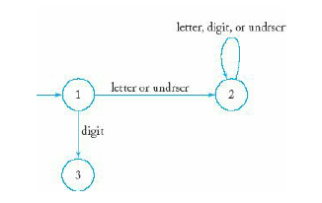
An automaton can be represented by a graph in which the vertices give the internal states and the edges give the transitions. The labels on the edges show what happens (in terms of input and output) during the transition.
The above Figure represents a transition from State 1 to State 2, which is taken when the input symbol is a.
This is an automaton that accepts all legal C identifiers. When the first
symbol is a letter or an underscore, the automaton goes into State 2, after which the rest of the string is immaterial. State 2 therefore represents the “yes” state of the accepter. Conversely, if the first symbol is a digit, the automaton will go into State 3, the “no” state, and remain there.

Slide 44
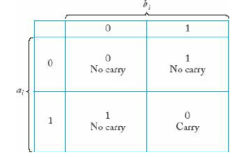
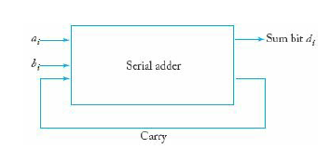
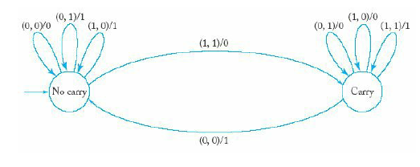
Serial Binary Adder:
→ A binary addition table summarizes the process
We represent the automaton by a graph now labeling the edges (ai, bj)/di.

