Slide 1
Formal Languages
Non-Regular Languages

Slide 2
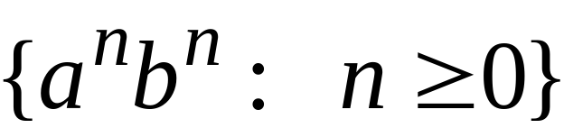
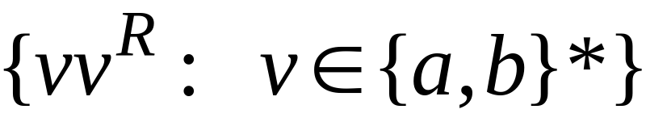


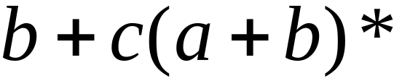

Non-regular languages
Regular languages

Slide 3

How can we prove that a language
is not regular?
Prove that there is no DFA that accepts
Problem: this is not easy to prove
Solution: the Pumping Lemma !!!

Slide 4

The Pigeonhole Principle

Slide 5


pigeons
pigeonholes

Slide 6
A pigeonhole must
contain at least two pigeons

Slide 7



pigeons
...........
pigeonholes
...........

Slide 8
The Pigeonhole Principle
pigeons
pigeonholes
There is a pigeonhole
with at least 2 pigeons
...........

Slide 9
The Pigeonhole Principle and
DFAs

Slide 10




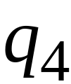


DFA with states

Slide 11
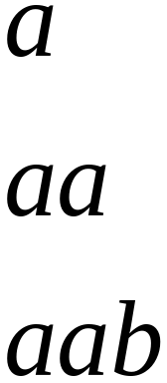
In walks of strings:
no state
is repeated

Slide 12
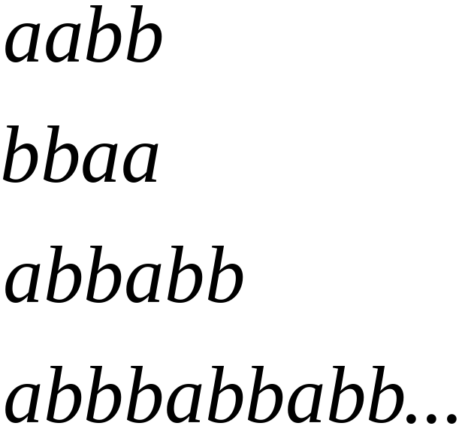
In walks of strings:
a state
is repeated

Slide 13
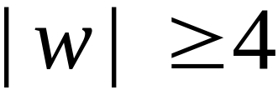

If string has length :
Then the transitions of string
are more than the states of the DFA
Thus, a state must be repeated

Slide 14



In general, for any DFA:
String has length number of states
A state must be repeated in the walk of
walk of
......
......
Repeated state

Slide 15
In other words for a string :
transitions are pigeons
states are pigeonholes
walk of
......
......
Repeated state

Slide 16
The Pumping Lemma

Slide 17

Take an infinite regular language
There exists a DFA that accepts
states

Slide 18

Take string with
There is a walk with label :
.........
walk

Slide 19
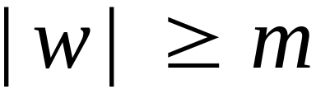
If string has length
(number
of states
of DFA)
then, from the pigeonhole principle:
a state is repeated in the walk
......
......
walk

Slide 20
Let be the first state repeated in the
walk of
......
......
walk

Slide 21




Write
......
......

Slide 22


Observations:
length
number
of states
of DFA
length
......
......

Slide 23

Observation:
The string
is accepted
......
......

Slide 24

Observation:
The string
is accepted
......
......

Slide 25

Observation:
The string
is accepted
......
......

Slide 26
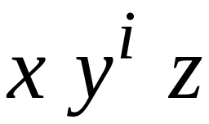

In General:
The string
is accepted
......
......

Slide 27
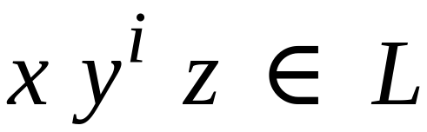
In General:
Language accepted by the DFA
......
......

Slide 28
In other words, we described:
The Pumping Lemma !!!

Slide 29


The Pumping Lemma:
Given an infinite regular language
there exists an integer
for any string with length
we can write
with and
such that:

Slide 30
Applications of the Pumping Lemma

Slide 31

Theorem:
The language
is not regular
Proof:
Use the Pumping Lemma

Slide 32
Assume for contradiction
that is a regular language
Since is infinite
we can apply the Pumping Lemma

Slide 33

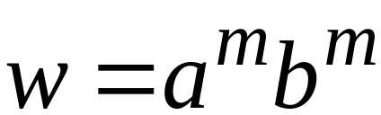
Let be the integer in the Pumping Lemma
Pick a string such that:
length
We pick

Slide 34
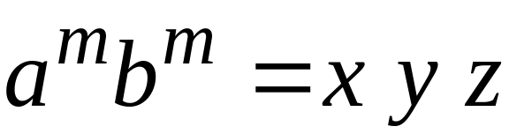

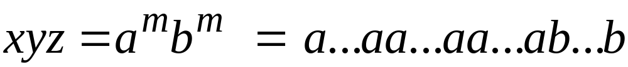
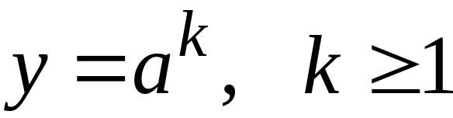
Write:
From the Pumping Lemma
it must be that length
Thus:

Slide 35
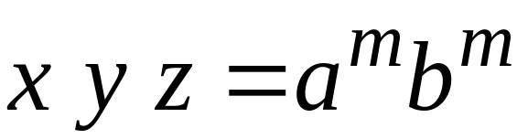

From the Pumping Lemma:
Thus:

Slide 36

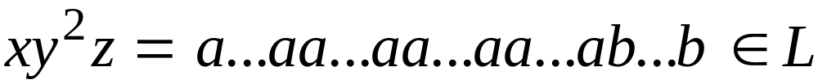
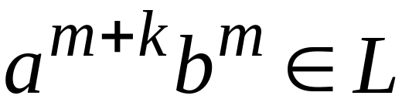
From the Pumping Lemma:
Thus:

Slide 37
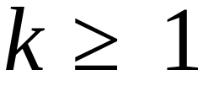
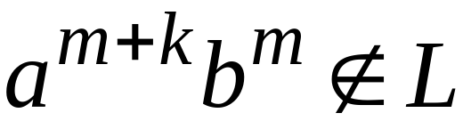
BUT:
CONTRADICTION!!!

Slide 38
Therefore:
Our assumption that
is a regular language is not true
Conclusion:
is not a regular language

