Slide 1
Formal Languages
Simplifications of CFGs

Slide 2
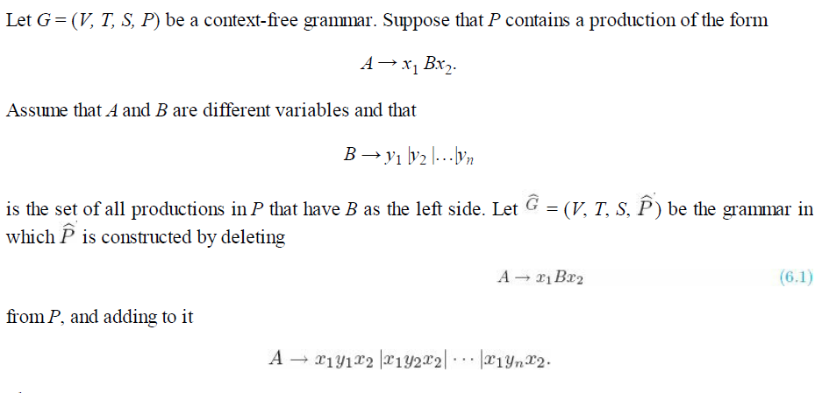

A Useful Substitution Rule
then

Slide 3
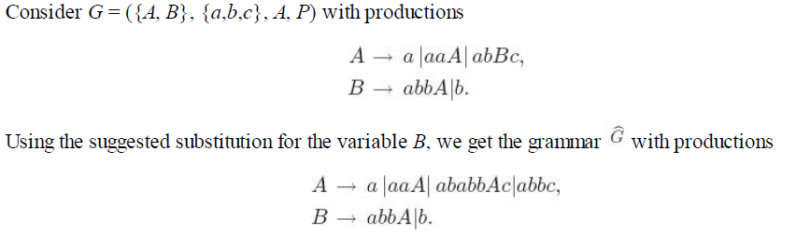




Example 1:

Slide 4

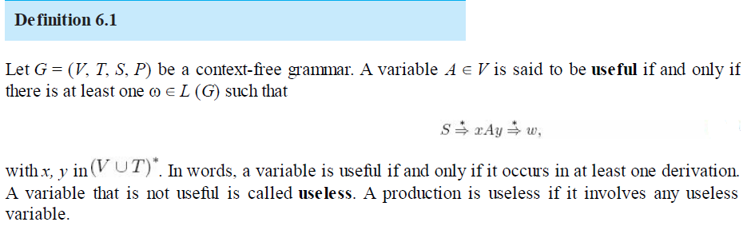
Removing Useless Productions
the production S → A clearly plays no role, as A cannot be transformed into a terminal string. While A can occur in a string derived from S, this can never lead to a sentence. Removing this production leaves the language unaffected and is a simplification by any definition.

Slide 5
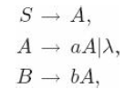
Exampe 2:
The two reasons why a variable is useless:
→ It cannot be reached from the start symbol
→ It cannot derive a terminal string.

Slide 6
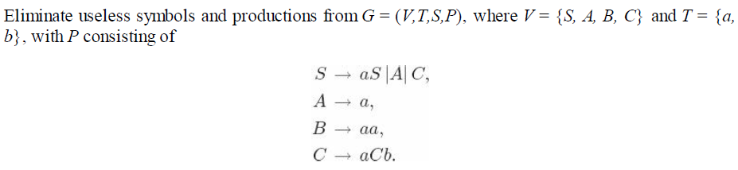
Example 3: Eliminating useless productions
First, we identify the set of variables that can lead to a terminal string.
A → a and B → aa, the variables A and B belong to this set. So does S, because S ⇒ A ⇒ a. All leads to terminals.
Here C is useless bcos it is not giving a sentence.
S → C C → aCb ( remains in sentential form…)

Slide 7
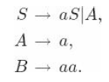
Removing C and its corresponding productions, we are led to the grammar G1 with variables V1 = {S, A, B}, terminals T = {a}, and productions
Next we want to eliminate the variables that cannot be reached from the start variable. For this,
We can draw a dependency graph for the variables.
→ A variable is useful only if there is a path from the
vertex labeled S to the vertex labeled with that variable

Slide 8
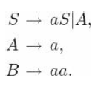
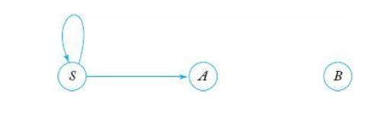
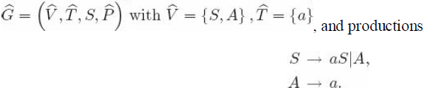
Dependency graph for the production
So after removing the useless production we get

Slide 9
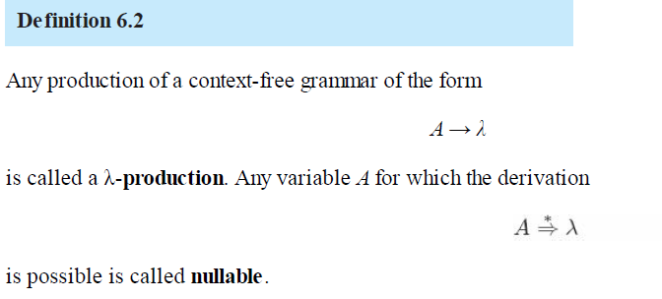
Removing λ-Productions

Slide 10
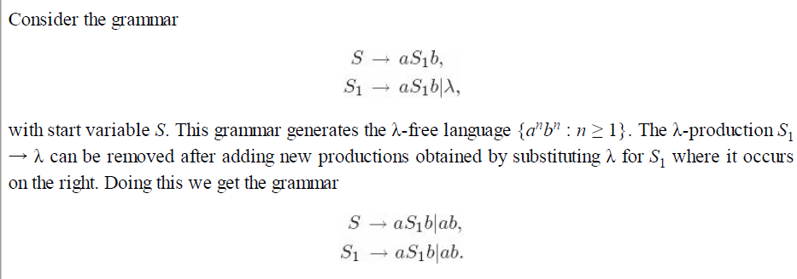
A grammar may generate a language not containing λ, yet have some λ- productions or nullable variables. In such cases, the λ-productions can be removed.

Slide 11
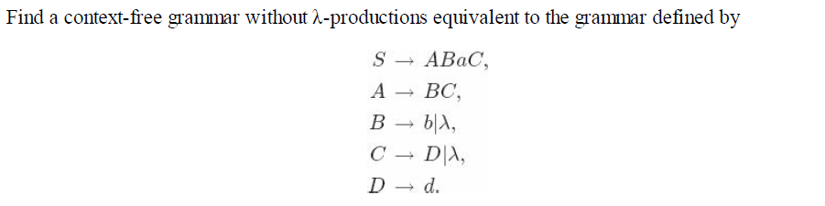
Example 4:
Find all nullable variables
Here we have B → λ, C → λ, A → λ
So A, B and C are nullable variables

Slide 12
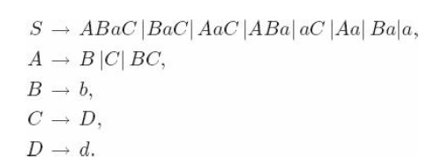
After removing λ productions using substitution
rule the new grammar is given as

Slide 13
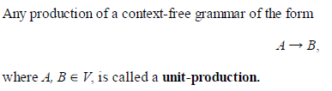
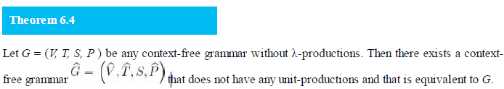
Removing Unit-Productions

Slide 14

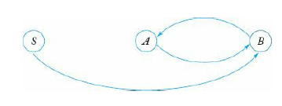
Proof: Obviously, any unit-production of the form A → A can be removed from the grammar without effect, and we need only consider A → B, where A and B are different variables.
The new grammar is generated by first putting into all non-unit productions of P.
Then draw dependency graph only with unit productions.
S → B
B → A
A → B

Slide 15
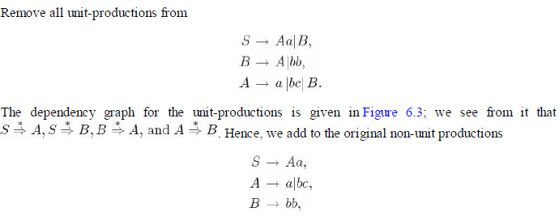


Example 5:
After including non unit productions
we get a new grammar

Slide 16
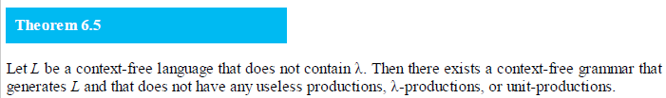
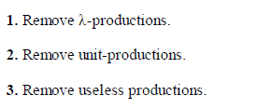
We can remove all undesirable productions using the following sequence of steps:

Slide 17
Example 6:
Eliminate useless productions from the following
S → aA | bB
A → aA | a
B → bB
D → ab | Ea
E → aC | d
1)
4)
S → aA
A → a | aA
Productions Only
with terminals
2)
3)
A→ a
D → ab
E → d
S → aA (remove B)
A → aA |a
D → ab| E not reachable from A
E → aC |d
S also derives
terminal thru A
and B not

Slide 18
Example 6:
Eliminate λ productions from the following
1)
3)
S → BAAB
A → 0A2| 2A0 | λ
B → AB | 1B | λ
S → BAAB | AAB| BAB| BAA|
AB| BB| BA| AA| B | A
A → 0A2| 2A0| 02| 20
B → AB| 1B| A| 1
2)
S → BAAB | AAB| BAB| BAA| AB| BB| BA| AA| B | A
A → 0A2| 2A0| 02| 20
B → AB| 1B| A|B| 1 can be removed

Slide 19
Example 7:
Eliminate unit productions from the following
1)
4)
S → AB
A → a
B → C | b
C → D
D → E | bC
E → d | Ab
S→ AB
A→ a
B → b | bC | d | Ab
C → bC | d | Ab
D → d | Ab| bC
E → d | Ab
2)
3)
B → C
C → D
D → E
B
C
D
E

Slide 20
Remove all unit, useless and λ
1)
S → aA | aBB
A → aaA | λ
B → bC | bbC
C → B
2)
S → aA | aBB
A → aaA | λ
B → bB | bbC
C → B

Slide 21
Two Important Normal Forms
Chomsky Normal Form
Greibach Normal Form

Slide 22
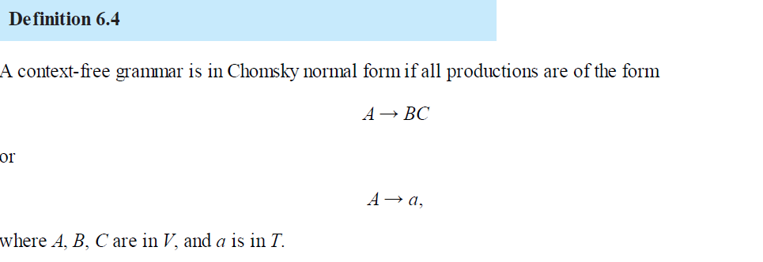
Chomsky Normal Form
In this CNF , the number of symbols on the right of a production is strictly limited.
The string on the right of a production consist of no more than two symbols

Slide 23
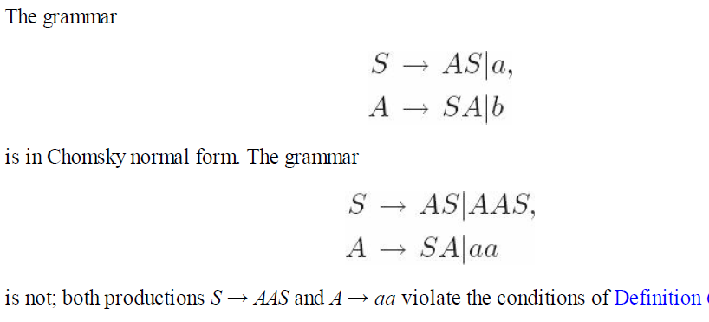
Example 1:

Slide 24
Any context-free grammar G = (V, T, S, P) with λ ∉ L (G) has an equivalent grammar in Chomsky normal form.
Proof: Because of Theorem 6.5, we can assume without loss of generality that G has no λ- productions and no unit-productions. The construction of will be done in two steps.

Slide 25
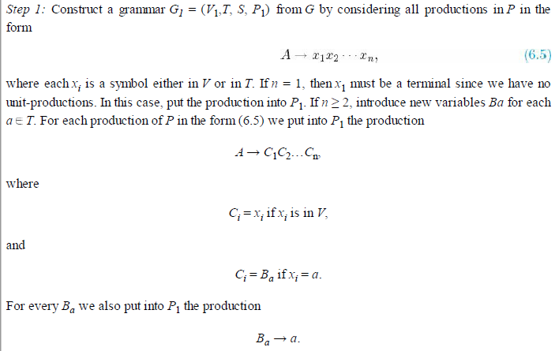

Slide 26
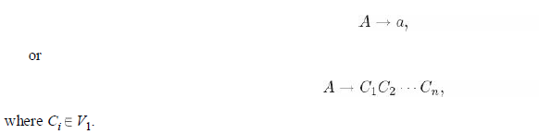
This part of the algorithm removes all terminals from productions whose right side has length greater than one, replacing them with newly introduced variables.
→ At the end of this step we have a grammar G1 all of whose productions have the form

Slide 27
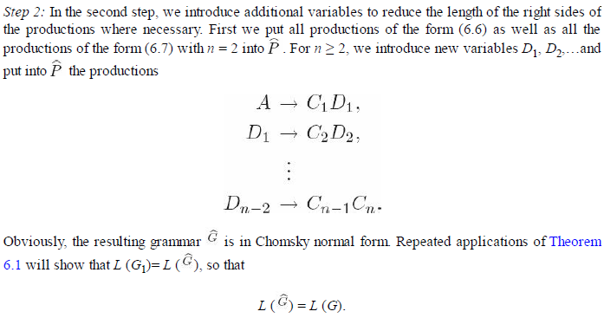

Slide 28
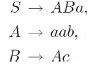
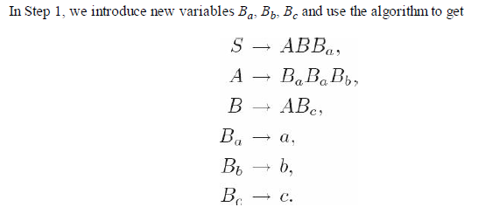
Example 2:
Convert the grammar with productions
to Chomsky normal form.

Slide 29
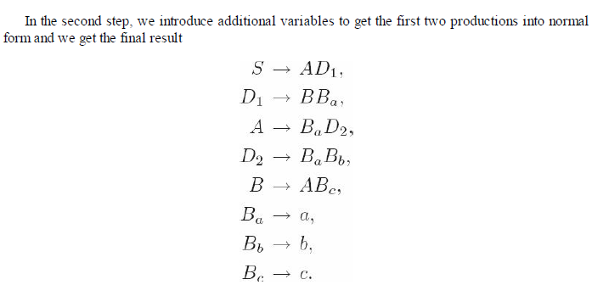

Slide 30
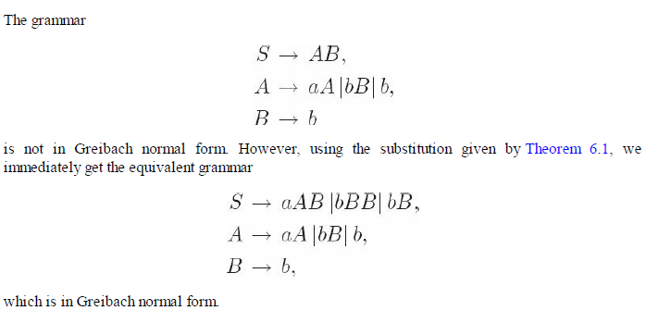
Greibach Normal Form
Another useful grammatical form is the Greibach normal form. Here we put restrictions not on the length of the right sides of a production, but on the positions in which terminals and variables can appear.
Definition 6.5
A context-free grammar is said to be in Greibach normal form if all productions have the form A → ax, where a ∈ T and x ∈ V*

Slide 31
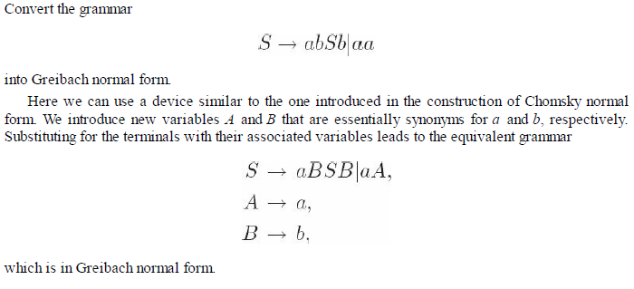
Example 3:

Slide 32
Convert the following to CNF
1] S → 0A | 1B
A → 0AA | 1S | 1
B → 1BB | 0S | 0
3] S → abAB
A → bAB | λ
B → Baa|A| λ
2] S → AB | aB
A → aab | λ
B → bbA

Slide 33
Convert the following to GNF
1] S → aSb |bSa | a|b
2] S → aSb | a|b
3] S → ab | aS | aaS
4] S → ABb | a
A → aaA | B
B → bAb

Slide 34
Slides downloaded from peter linz
just go thru all the slides

Slide 35
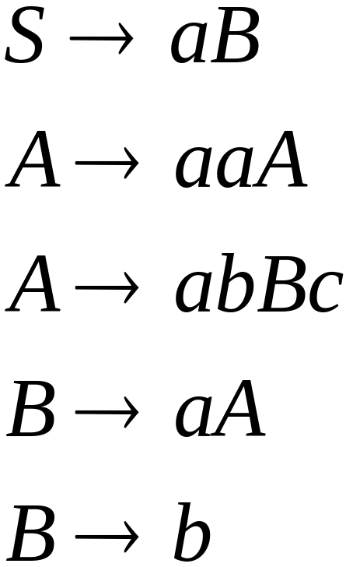
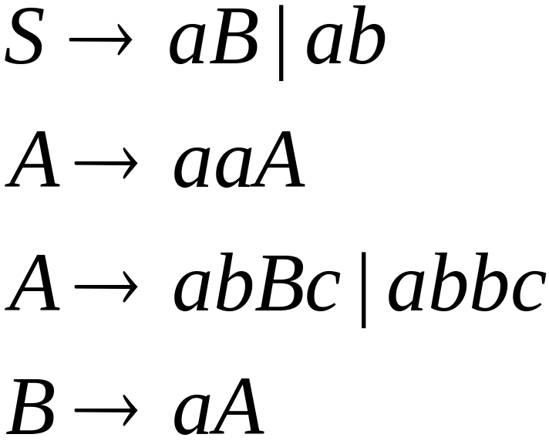

A Substitution Rule
Equivalent
grammar
Substitute

Slide 36

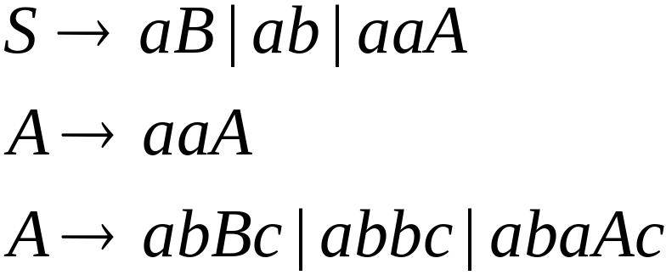
A Substitution Rule
Substitute
Equivalent
grammar

Slide 37
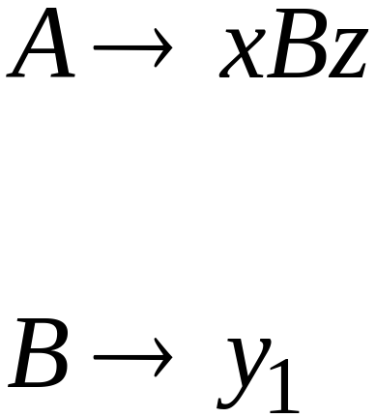
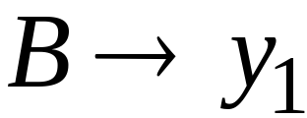
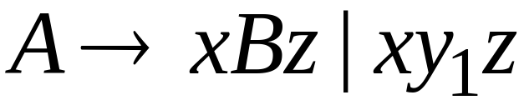
In general:
Substitute
equivalent
grammar

Slide 38
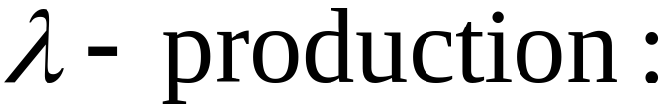


Nullable Variables
Nullable Variable:

Slide 39
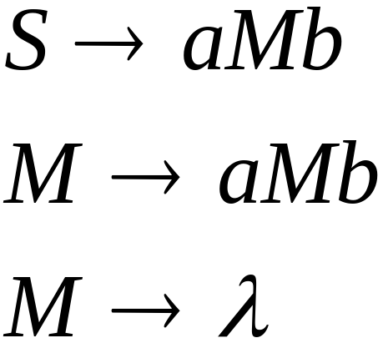
Removing Nullable Variables
Example Grammar:
Nullable variable

Slide 40
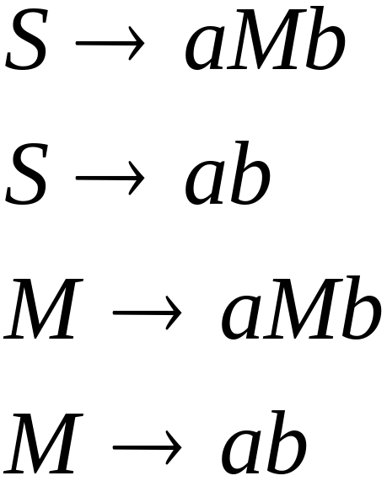

Final Grammar
Substitute

Slide 41

Unit-Productions
Unit Production:
(single variables on both sides)

Slide 42

Removing Unit Productions
Observation:
Is removed immediately

Slide 43
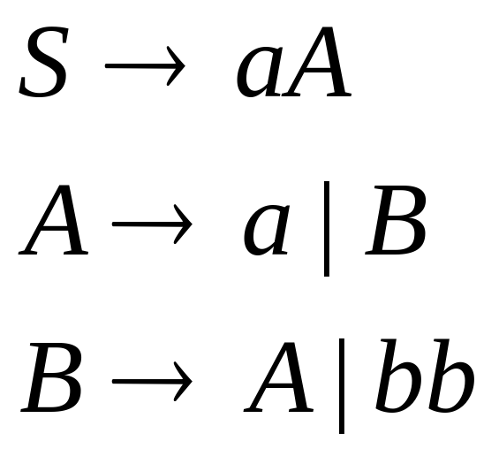
Example Grammar:

Slide 44
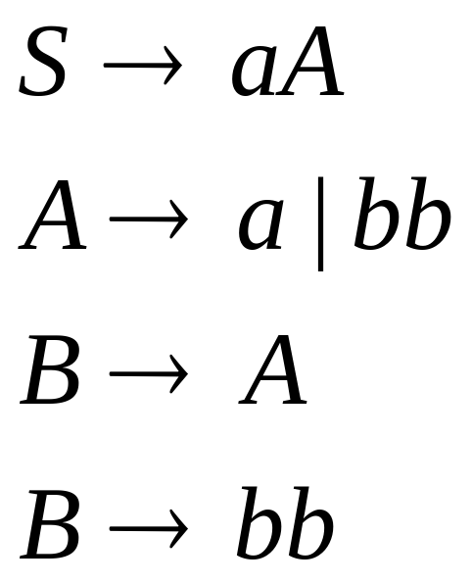
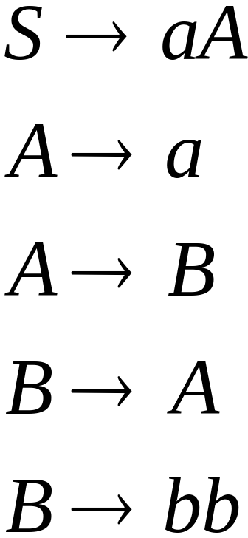

Substitute

Slide 45
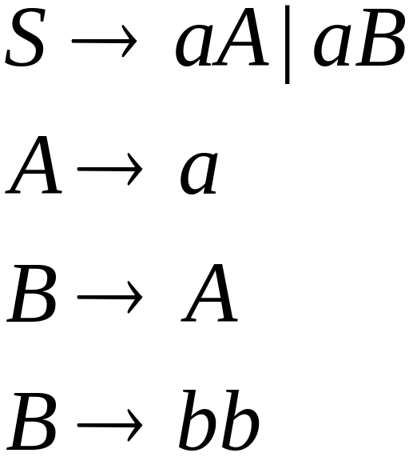
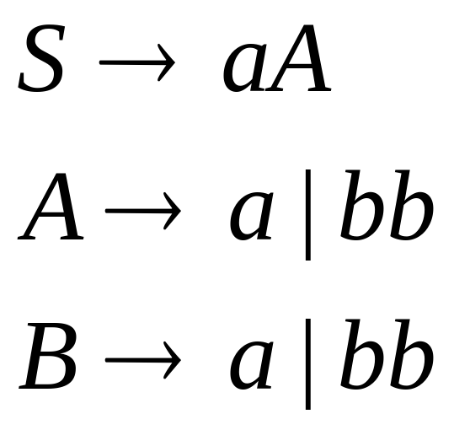

Substitute

Slide 46
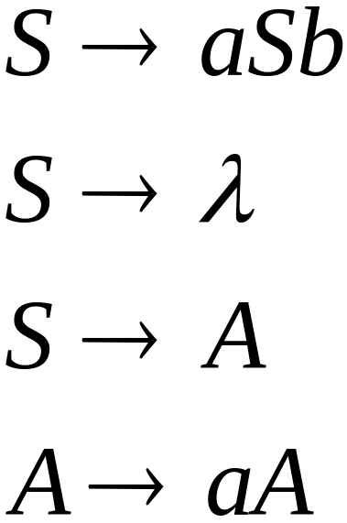
Useless Productions
Useless Production
Some derivations never terminate...

Slide 47
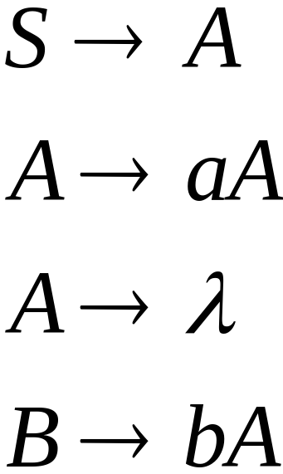
Another grammar:
Useless Production
Not reachable from S

Slide 48



In general:
contains only
terminals
if
then variable is useful
otherwise, variable is useless

Slide 49

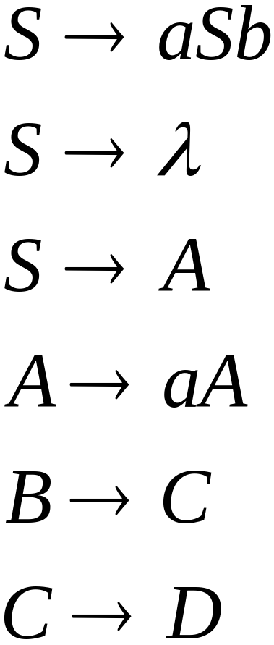
A production is useless
if any of its variables is useless
Productions
Variables
useless
useless
useless
useless
useless
useless
useless

Slide 50
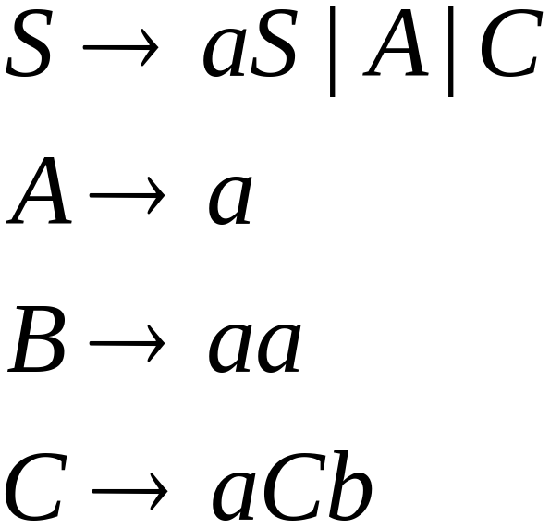
Removing Useless Productions
Example Grammar:

Slide 51
Remove useless productions

Slide 52
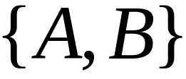

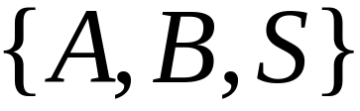
First:
find all variables that can produce
strings with only terminals
Round 1:
Round 2:

Slide 53
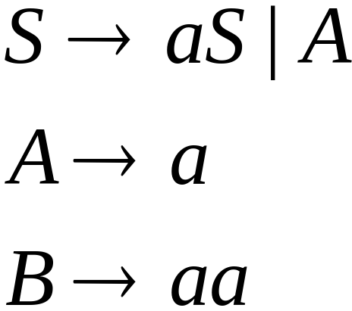
Keep only the variables
that produce terminal symbols:
(other variables are useless)
Remove useless productions

Slide 54




Second:
Find all variables
reachable from
Use a Dependency Graph
not
reachable

Slide 55

Keep only the variables
reachable from S
(the other variables are useless)
Final Grammar
Remove useless productions

Slide 56
Removing All
Step 1: Remove Nullable Variables
Step 2: Remove Unit-Productions
Step 3: Remove Useless Variables

Slide 57
Normal Forms for
Context-free Grammars

Slide 58


Chomsky Normal Form
Each production has form:
or
variable
variable
terminal

Slide 59


Examples:
Chomsky
Normal Form
Not Chomsky
Normal Form

Slide 60

Conversion to Chomsky Normal Form
Example:
Not Chomsky
Normal Form

Slide 61


Introduce variables for terminals:

Slide 62


Introduce intermediate variable:

Slide 63


Introduce intermediate variable:

Slide 64
Final grammar in Chomsky Normal Form:
Initial grammar

Slide 65

In general:
From any context-free grammar
(which doesn’t produce )
not in Chomsky Normal Form
we can obtain:
An equivalent grammar
in Chomsky Normal Form

Slide 66
The Procedure
First remove:
    Nullable variables
    Unit productions

Slide 67



Then, for every symbol :
Add production
In productions: replace with
New variable:

Slide 68



Replace any production
with
New intermediate variables:

Slide 69
Theorem:
For any context-free grammar
(which doesn’t produce )
there is an equivalent grammar
in Chomsky Normal Form

Slide 70
Observations
Chomsky normal forms are good
for parsing and proving theorems
It is very easy to find the Chomsky normal
form for any context-free grammar

Slide 71


Greibach Normal Form
All productions have form:
terminal
variables

Slide 72


Examples:
Greibach
Normal Form
Not Greibach
Normal Form

Slide 73

Conversion to Greibach Normal Form:
Greibach
Normal Form

Slide 74
Theorem:
For any context-free grammar
(which doesn’t produce )
there is an equivalent grammar
in Greibach Normal Form

