Slide 1



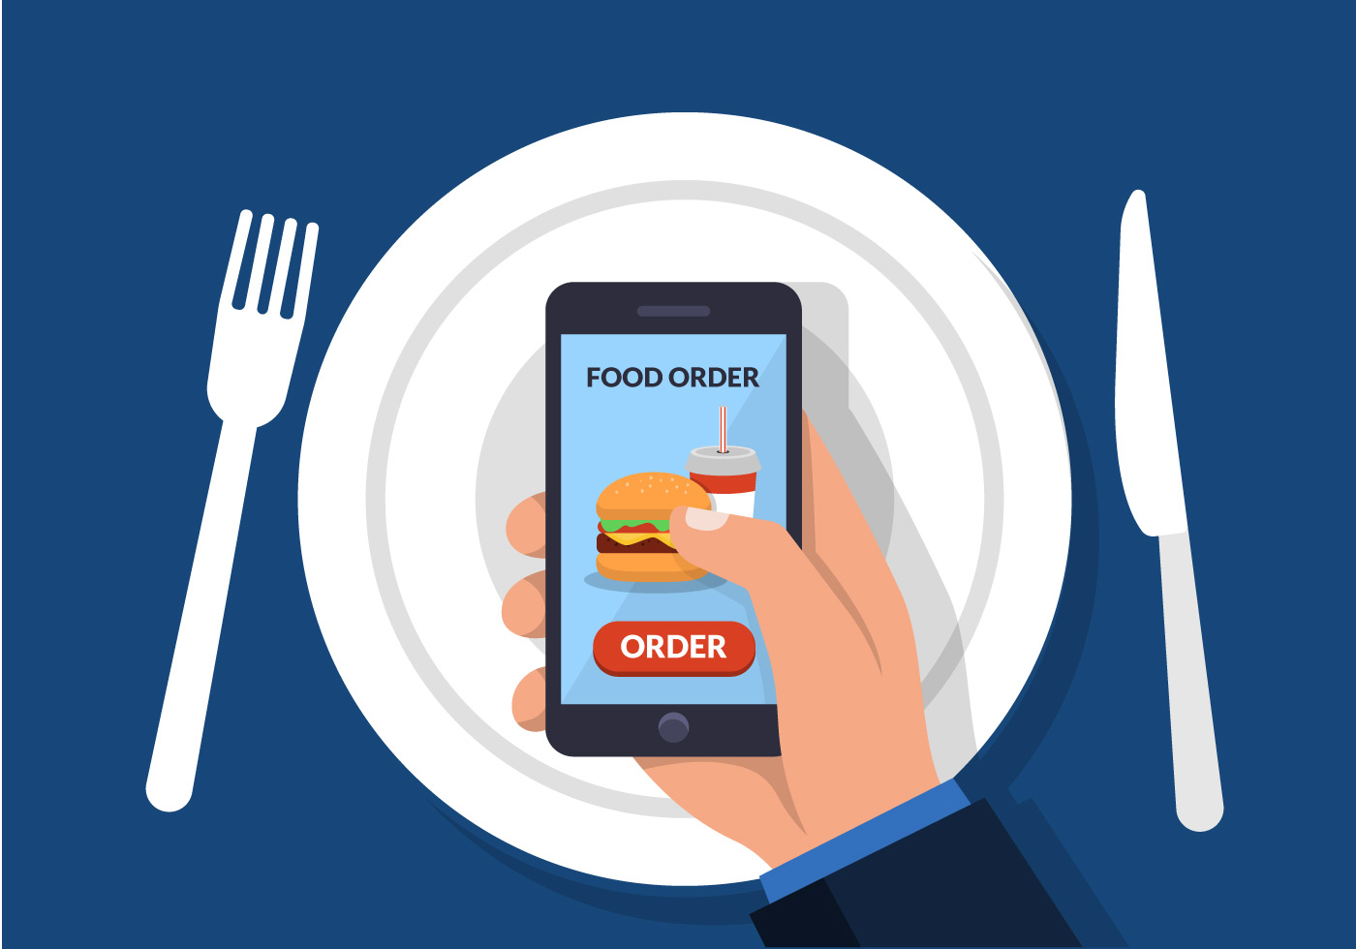
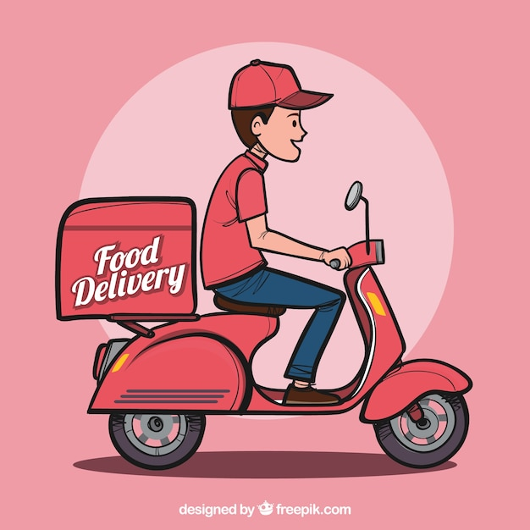
Zomata Food Delivery Management System
Restaurants
Delivered
Food Order
Delivery_Person

Slide 2
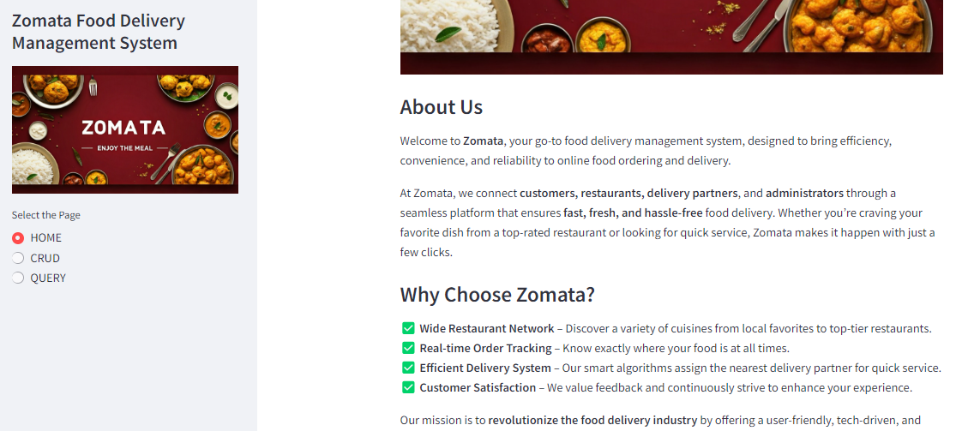
Overview
Zomata is a food delivery management system designed to streamline online food ordering, delivery tracking, and restaurant management.
Web-based interface built with Streamlit to enable CRUD (Create, Read, Update, Delete) operations and to view some insights.

Slide 3
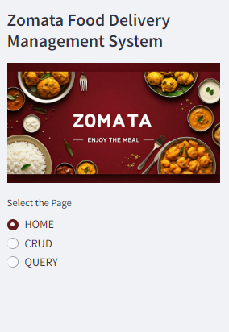
Application Structure
Home Page
Overview of Zomata
Page – 1
CRUD Page
Database operations
Page – 2
QUERY Page
Analytical queries.
Page – 3

Slide 4

Approach Used in Code
Database Initialization and Population
MySQL database with five tables: Customers, Restaurants, Orders, Deliveries, and Delivery_Person.
Data generated using Faker.
Database interactions handled with pymysql.
Customer
Delivery
Orders
Restaurants

Slide 5
Database Creation
Importing all the required packages required like pymysql, faker, etc.
Connecting the code with MySQL using Pymysql.connector.
db = pymysql.connect(host="localhost",user="root",password="root")
Creating the Tables mentioning Table Name having all the value of Column Name.
Table Creation
cursor.execute("CREATE TABLE Customers (customer_id INT AUTO_INCREMENT PRIMARY KEY,name VARCHAR(255), email VARCHAR(255), phone VARCHAR(50), location TEXT, signup_date DATE, is_premium BOOLEAN, preferred_cuisine VARCHAR(50), total_orders INT, average_rating FLOAT)")

Slide 6
Generating and adding the values in the Database
Using the Faker package to generate the Synthetic data.
fake = Faker("en_IN") #Generating Synthetic Data with respect to India in English.
Code to generate synthetic data and add the values in the database.
customers = [
(
fake.name(),
fake.email(),
fake.phone_number(),
fake.address(),
fake.date_this_decade(),
random.choice([True, False]),
random.choice(['Indian', 'Chinese', 'Italian', 'Mexican', 'Thai']),
random.randint(1, 50),
round(random.uniform(3.0, 5.0), 1)
)
for _ in range(100)
]
cursor.executemany('''
INSERT INTO Customers (name, email, phone, location, signup_date, is_premium, preferred_cuisine, total_orders, average_rating)
VALUES (%s, %s, %s, %s, %s, %s, %s, %s, %s)
''', customers)

Slide 7

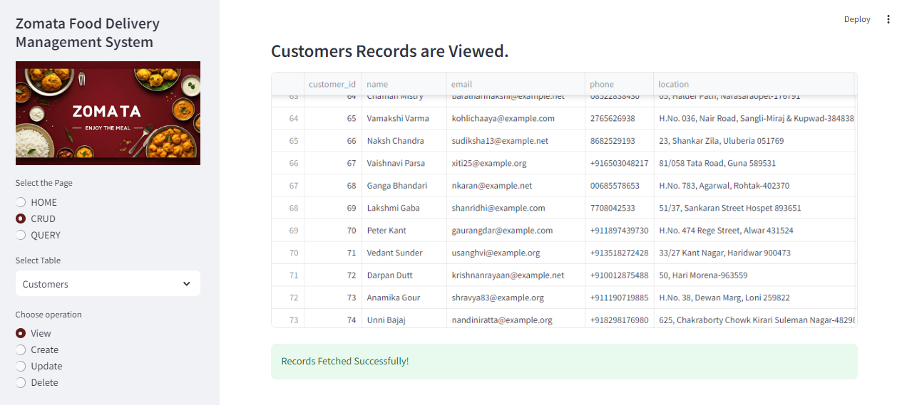
CRUD Operations
We will perform CRUD (Create, Read, Update, Delete) operations on tables in the Zomata database for the following Tables. Customers, Restaurants, Orders, Deliveries, and Delivery Personnel tables.

Slide 8
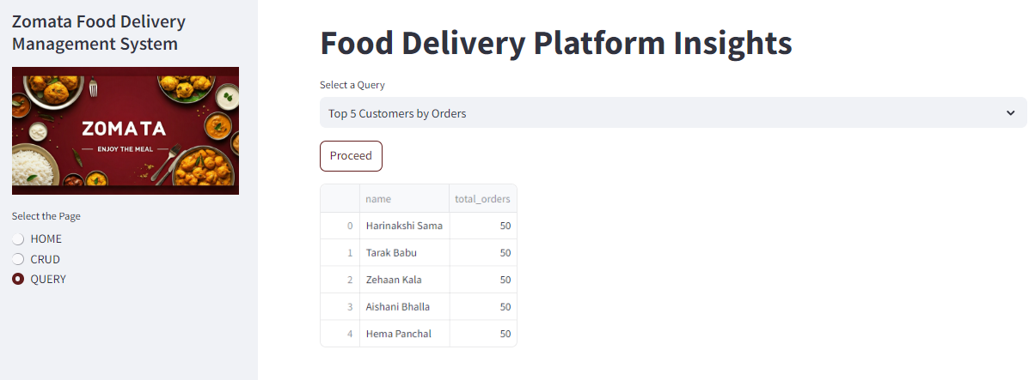
Zomata Insights
We will analyze and display valuable insights derived from the 'Zomata' database using MySQL. These insights will help in understanding customer behavior, restaurant performance, and order trends. The final results and visualizations will be presented using the interactive Streamlit platform.

Slide 9

Thank You.

