Slide 1
Pet Adoption Stories
Real Pets from Alexandria, VA Looking for Forever Homes

Slide 2
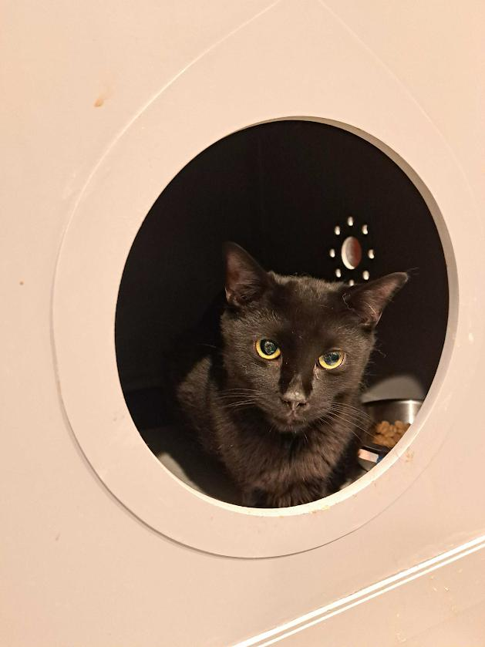
Pepper: Alexandria's Curious Detective 🕵️‍♀️
Cracking cases, charming hearts.
Meet Pepper, the mysterious black cat detective who has appointed herself as the neighborhood's Chief Security Officer. Her daily routine includes conducting thorough investigations of suspicious paper bags, interrogating dust bunnies, and filing detailed reports (by knocking things off tables).
Pepper's greatest case was 'The Mystery of the Disappearing Treats,' which she solved by catching the dog red-pawed. She's seeking a family who appreciates her investigative skills and doesn't mind her habit of leaving 'evidence' (toy mice) in shoes as case files.
Ready to meet your new partner-in-crime-solving? Pepper awaits your companionship!
Story Illustration (GPT-Image-1)
Badge (Generated)
Learn more about Pepper on Petfinder: https://www.petfinder.com/cat/pepper-76247650/va/alexandria/marlees-misfits-va935/?referrer_id=41bf5875-18ad-4831-b3b5-3cace1f4568f&utm_source=api&utm_medium=partnership&utm_content=41bf5875-18ad-4831-b3b5-3cace1f4568f

Slide 3
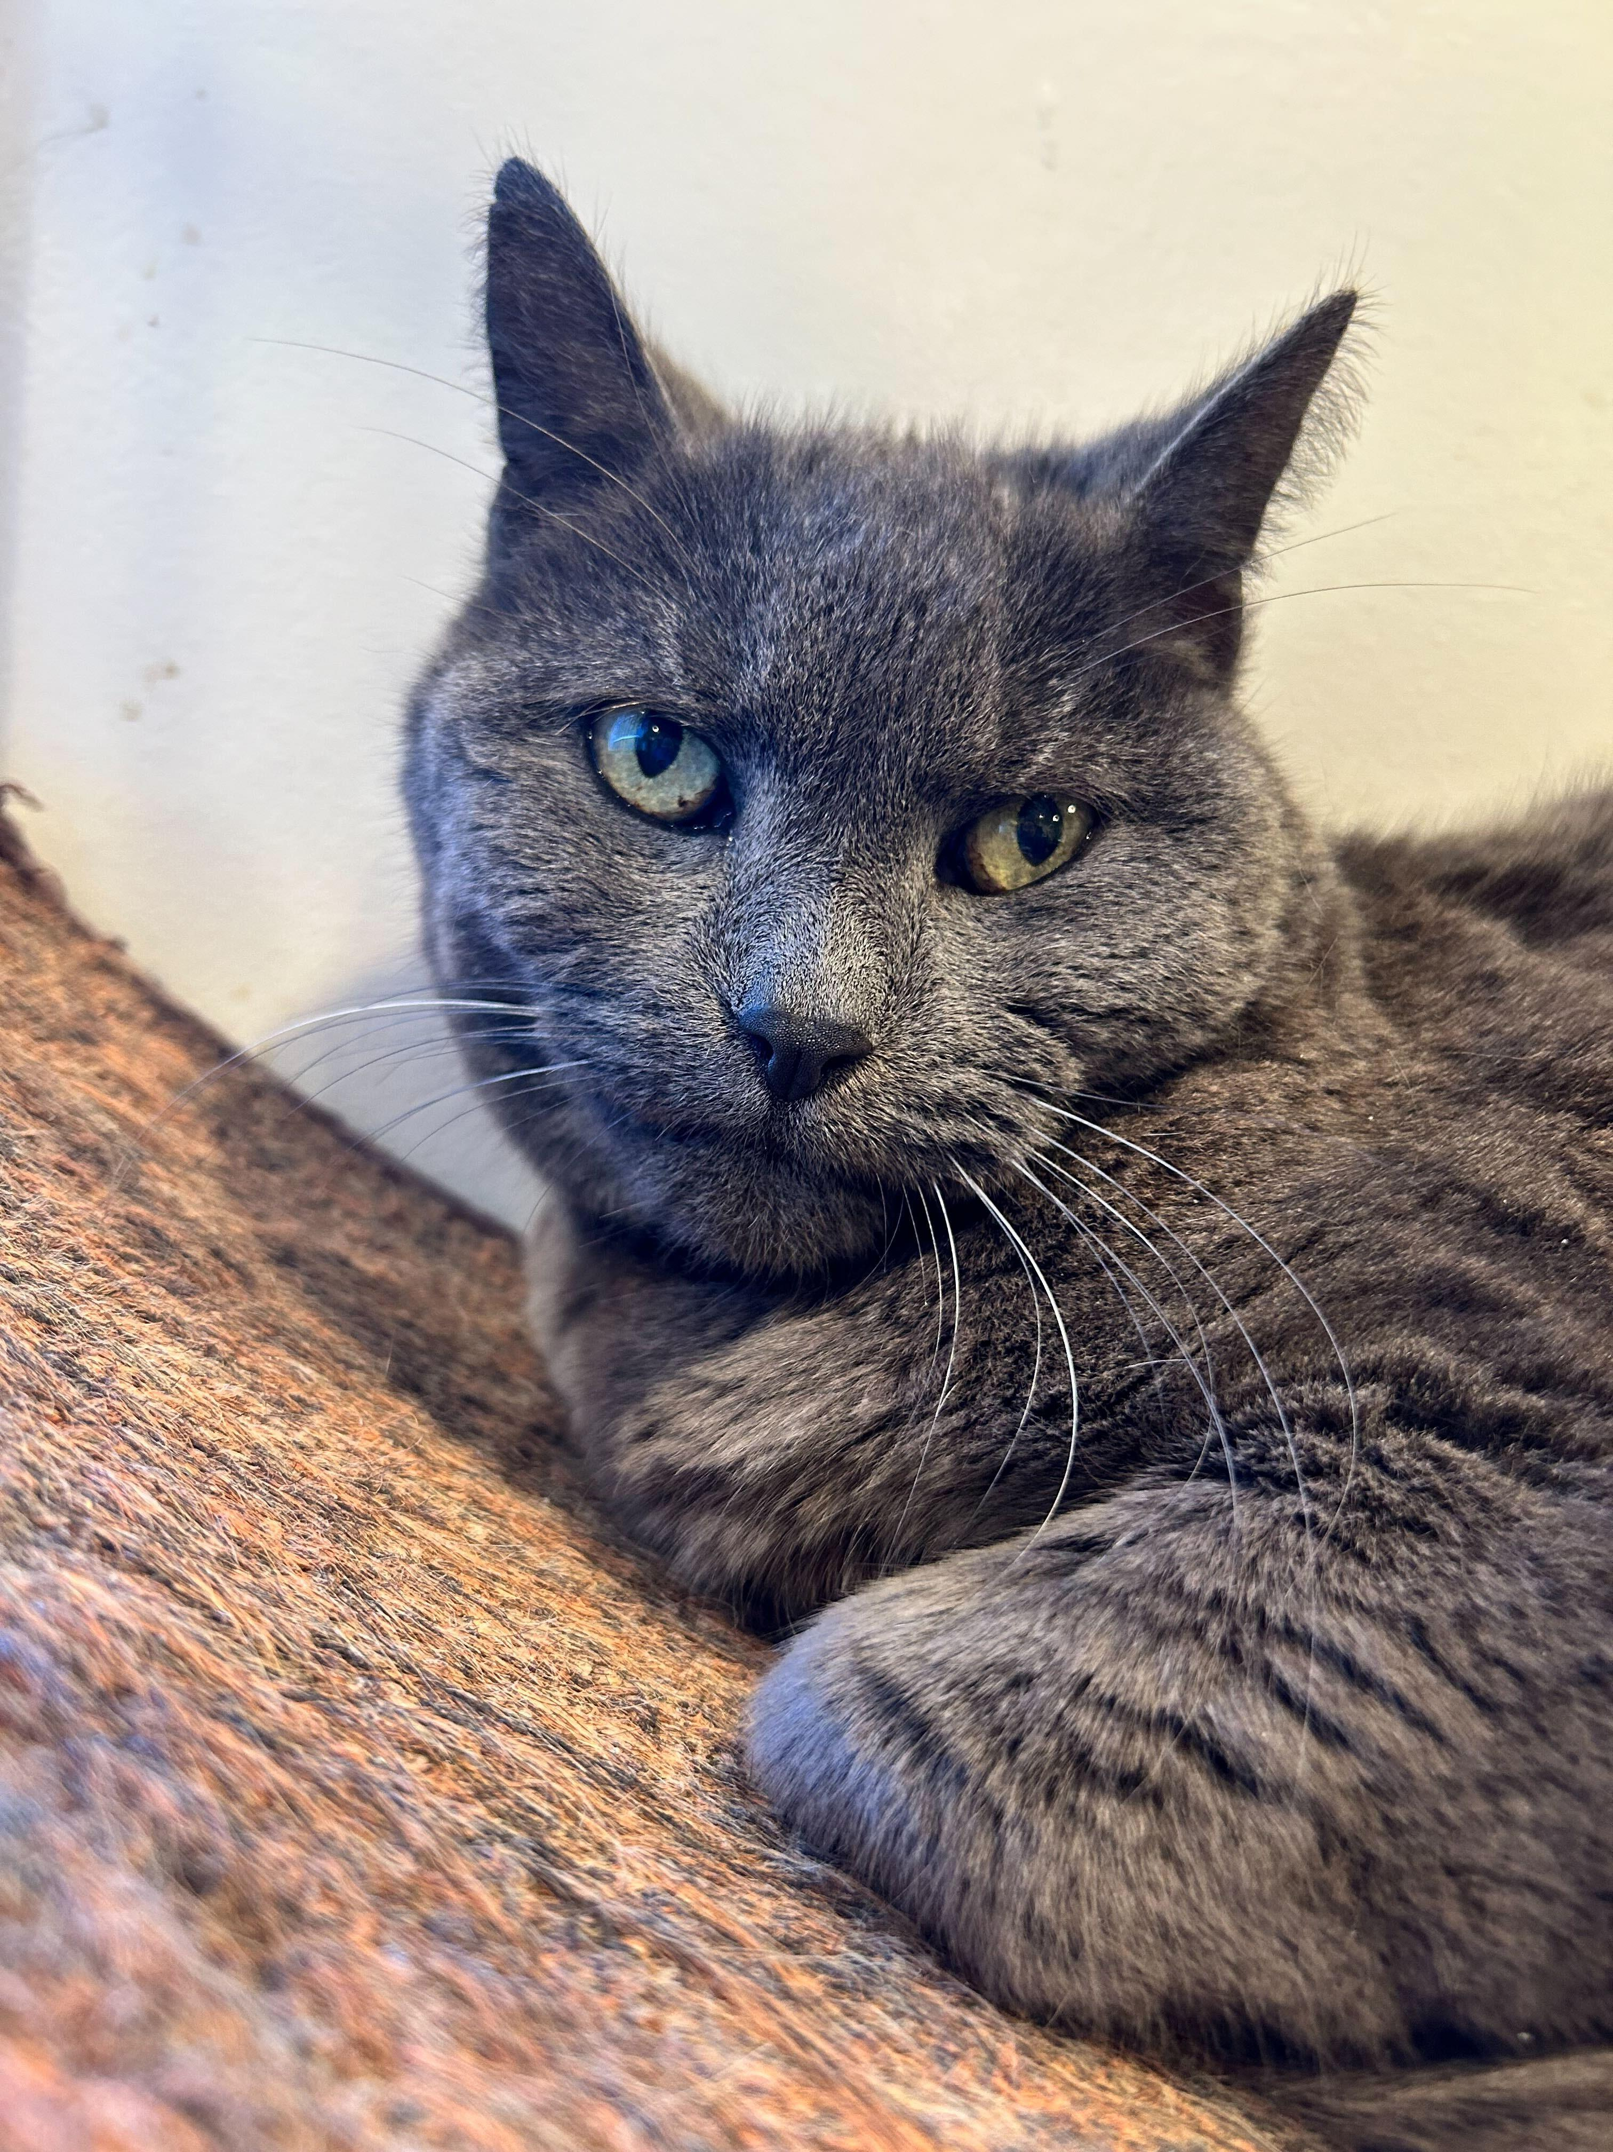
Winnie: Alexandria's Elegant Philosopher 👑
Wisdom, grace, and perfect naps.
Winnie, the distinguished Russian Blue, has established herself as Alexandria's most refined feline socialite. At her age, she's mastered the art of dignified living and hosts daily 'Whisker & Wisdom' sessions where she shares life advice with younger cats.
Her philosophy: 'Naps are not optional, they're essential.' Winnie is looking for a retirement home where she can continue her legacy as the neighborhood's most elegant philosopher, preferably with a sunny windowsill and premium catnip service.
Ready to learn from the master of sophisticated living? Winnie is accepting applications for her retirement home!
Story Illustration (GPT-Image-1)
Badge (Generated)
Learn more about Winnie on Petfinder: https://www.petfinder.com/cat/winnie-75992220/va/alexandria/marlees-misfits-va935/?referrer_id=41bf5875-18ad-4831-b3b5-3cace1f4568f&utm_source=api&utm_medium=partnership&utm_content=41bf5875-18ad-4831-b3b5-3cace1f4568f

Slide 4
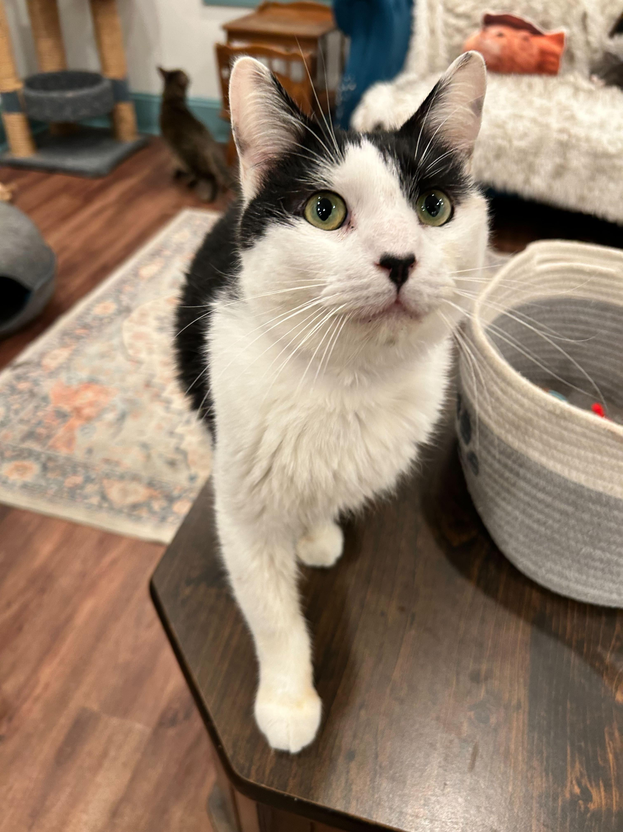
Zebra: The Identity-Confused Greeter 🐾
Part cat, part dog, all personality.
Zebra, the tuxedo cat with a name that confuses everyone, has decided to embrace his identity crisis by becoming the shelter's official Welcome Committee of One. He greets every visitor with enthusiastic head bumps and purr-negotiations, convinced he's actually a dog trapped in a cat's body.
His daily schedule includes: morning tail-wagging practice, afternoon visitor greeting, and evening 'How to Be More Dog' workshops for confused cats. He's seeking a family who won't mind his existential crisis and will love his over-the-top personality.
Ready for a cat who thinks he's a dog? Zebra promises to greet you with enthusiasm every single day!
Story Illustration (GPT-Image-1)
Badge (Generated)
Learn more about Zebra on Petfinder: https://www.petfinder.com/cat/zebra-75816540/va/alexandria/marlees-misfits-va935/?referrer_id=41bf5875-18ad-4831-b3b5-3cace1f4568f&utm_source=api&utm_medium=partnership&utm_content=41bf5875-18ad-4831-b3b5-3cace1f4568f

Slide 5
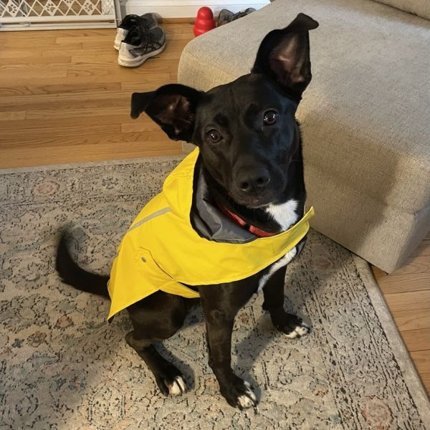
Rebekah: Chief Happiness Officer 🌈
Professional tail-wagger and joy inspector.
Rebekah, the German Shepherd mix, has appointed herself as Alexandria's Chief Happiness Officer and Professional Tail-Wagger. She takes her job seriously, conducting daily joy inspections throughout the neighborhood and organizing impromptu play sessions for anyone who looks remotely sad.
Her resume includes: Expert Treat Tester, Certified Good Girl, and Advanced Belly Rub Recipient. She's looking for a family who needs a professional happiness consultant and doesn't mind her over-enthusiasm for making everyone's day better.
Need a professional happiness consultant? Rebekah is ready to make your every day brighter!
Story Illustration (GPT-Image-1)
Badge (Generated)
Learn more about Rebekah on Petfinder: https://www.petfinder.com/dog/rebekah-76738666/va/alexandria/operation-paws-for-homes-va600/?referrer_id=41bf5875-18ad-4831-b3b5-3cace1f4568f&utm_source=api&utm_medium=partnership&utm_content=41bf5875-18ad-4831-b3b5-3cace1f4568f

Slide 6
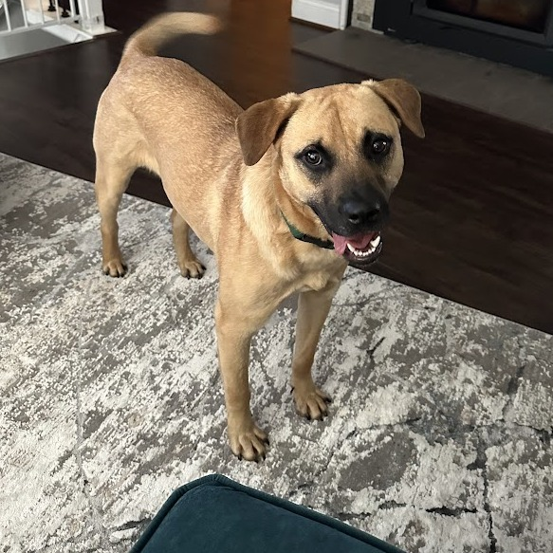
Crouton *Adoption Pending*: Amazing Pet 🐾
Looking for a loving home.
Crouton *Adoption Pending* is an amazing dog looking for a loving home!
Ready to meet Crouton *Adoption Pending*? Contact us today!
Story Illustration (GPT-Image-1)
Badge (Generated)
Learn more about Crouton *Adoption Pending* on Petfinder: https://www.petfinder.com/dog/crouton-star-adoption-pending-star-76850107/va/alexandria/operation-paws-for-homes-va600/?referrer_id=41bf5875-18ad-4831-b3b5-3cace1f4568f&utm_source=api&utm_medium=partnership&utm_content=41bf5875-18ad-4831-b3b5-3cace1f4568f

