Slide 1

KESHAV MEMORIAL ENGINEERING COLLEGE A unit of Keshav Memorial Technical Educational Society (KMTES) (Approved by AICTE, New Delhi & Affiliated to Osmania University, Hyderabad)
DEPARTMENT OF COMPUTER SCIENCE & ENGINEERING
(CSE – C)
Mini Project Presentation on
Urban Nest
By
Bandaru Somi – 245522733134
Bembadi Ruchira Reddy – 245522733136
Chinmayi T – 245522733141
Guide:
Mrs.K. Prajwala
(Assistant Professor)

Slide 2
Index
Batch No:C8 “ Urban Nest "
Abstract
Introduction
Literature Survey
Problem Statement
Methodology
Design
Software Requirements
Hardware Requirements
Implementation
Conclusion & Future Scope
References

Slide 3
Abstract
Batch No:C8 " Urban Nest "
Developed a full-stack E-commerce web application using the MERN stack (MongoDB, Express.js, React.js, Node.js), enabling users to browse, search, and purchase products across multiple categories. Implemented role-based access control where customers can manage carts and orders, while admins handle inventory, user management, and product listings. Integrated JWT-based authentication to ensure secure user sessions. Built real-time stock and order updates along with user profile and order history features. Designed and consumed RESTful APIs to enable seamless communication between frontend and backend. The platform includes cart and order management, product search with category filtering, and a dedicated admin dashboard for content control.
Keywords : MERN Stack, RESTful APIs, JWT Authentication, RBAC, MongoDB, Express.js, React.js, Node.js, Cart & Order Management, Admin Dashboard, Product Filtering, Responsive UI.

Slide 4
1. Introduction
Batch No:C8 " Urban Nest "
Urban Nest is a full-stack E-commerce platform built using the MERN stack (MongoDB, Express.js, React.js, Node.js). It offers a clean, responsive interface for users to browse, filter, and purchase clothing and fashion items with ease.
Key Features:
Search by keyword and filter by category (Men, Women, Kids)
Cart and order management
User profiles with order history
Role-Based Access Control (RBAC)
Customers manage their carts and orders
Admins manage inventory, users, and product listings
Secure JWT Authentication
RESTful API architecture for maintainability and scalability

Slide 5
2. Literature Survey
Batch No:C8 " Urban Nest "
Patil et al. (2025) built a scalable e-commerce site using MERN, focusing on modular design, cart and payment features, and backend–frontend integration for performance and security.
De Silva et al. (2022) created a chocolate shop site using MERN, integrating CRUD, search, and testing tools like Selenium and SonarQube to support quality and DevOps.
Verma & Kale(2025) developed a fashion-focused MERN e-commerce platform, highlighting UX, responsive design, and visual appeal, with brief mentions of AR and user personalization.
Huang & Benyoucef (2018) performed a systematic review of 407 papers on social commerce, developing a taxonomy covering definitions, technologies, benefits, and research gaps in platforms integrating social media and e-commerce
Esmaeili & Hashemi (2019) reviewed 81 studies in social commerce, identifying core themes like customer behavior, platform design, and adoption trends. They observed growth in research from 2007 onwards and highlighted user engagement as central to success

Slide 6
3. Problem Statement
Batch No:C8 " Urban Nest "
Gaps in Existing Systems:
No role-based access – lacks proper admin/user separation
Inefficient image handling – local storage limits scalability
Rigid category structure – no flexibility for product categories
Basic discovery – search and filter options are limited or static
Proposed Solution:
Implement Role-Based Access Control (RBAC) for users and admins
Store and manage product images efficiently with scalable methods
Support dynamic category management via admin dashboard
Enable keyword-based search and category-based filtering for easy navigation

Slide 7
4. Methodology
Batch No:C8 " Urban Nest "
Client-Server Separation React frontend communicates with Express backend, which interacts with MongoDB.
RESTful API Design Core CRUD endpoints implemented: GET /products, POST /products, PUT /products/:id, DELETE /products/:id
Schema Modeling Mongoose models define structure for products, users, orders, and categories.
Middleware Usage Used express.json() for JSON parsing, cors() for cross-origin requests, and custom error-handling middleware.
CRUD Operations Managed using async/await in controllers for clean database interaction.
Frontend Integration React components use Axios for API calls. State handled via useState, useEffect, and navigation using React Router.

Slide 8
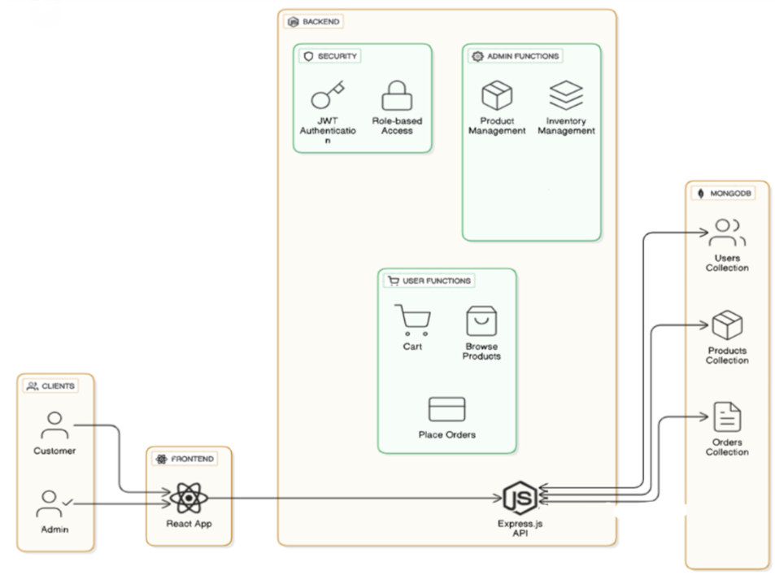
5. Design
Batch No:C8 " Urban Nest ”
Architecture Diagram:

Slide 9
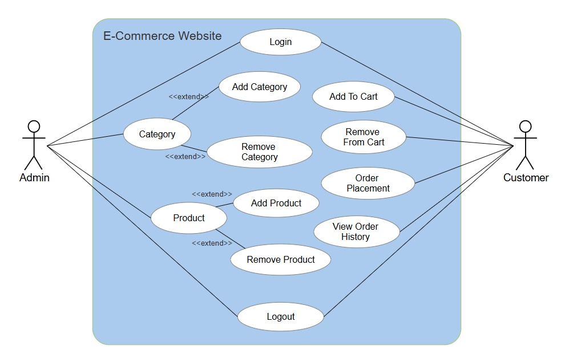
5. Design(contd.)
Batch No:C8 " Urban Nest "
Use case diagram:

Slide 10
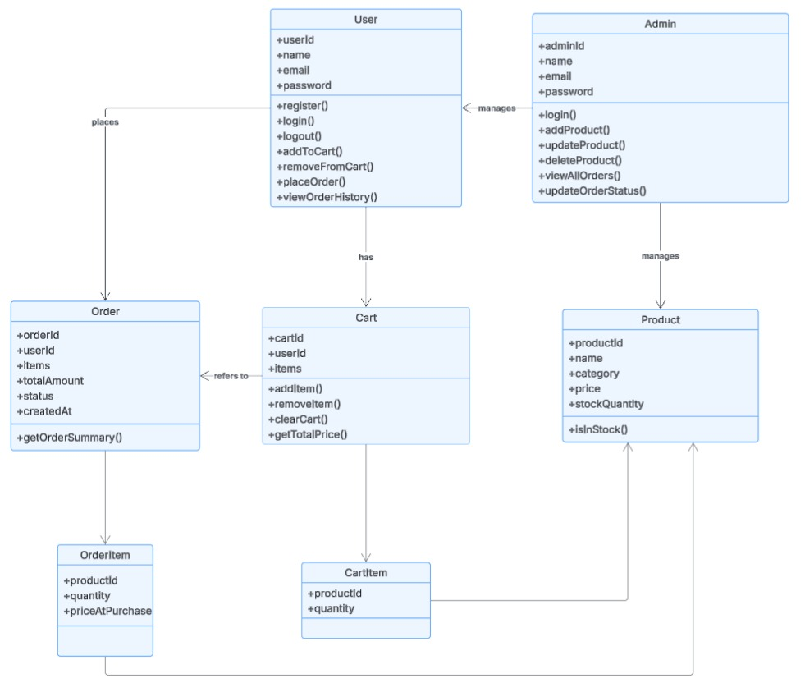
5. Design(contd.)
Batch No:C8 " Urban Nest ”
Class Diagram:

Slide 11
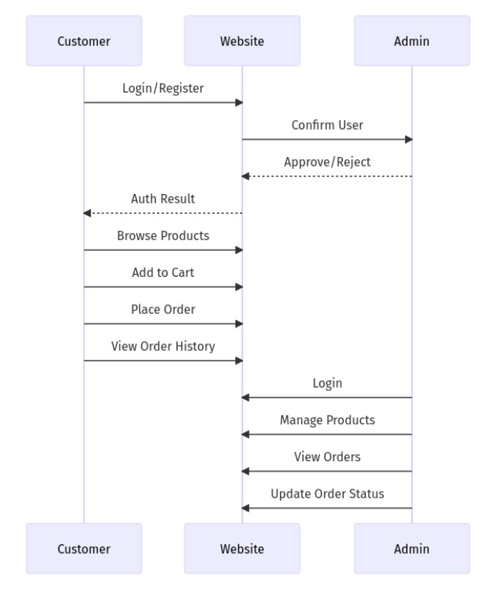
5. Design(contd.)
Batch No:C8 " Urban Nest ”
Sequence Diagram:

Slide 12
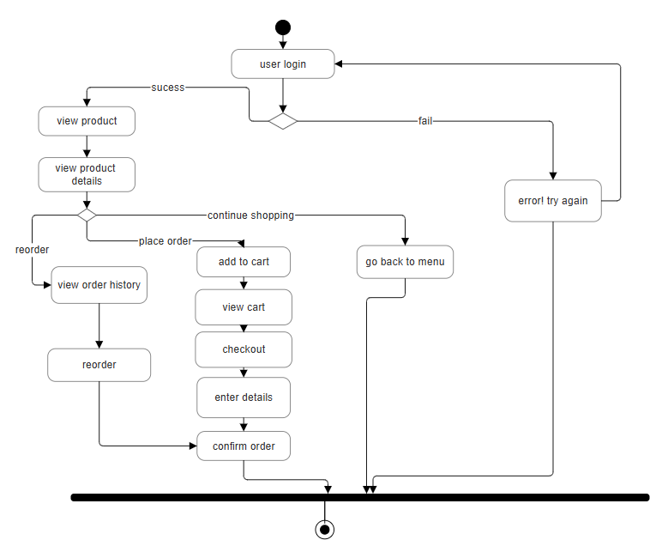
5. Design(contd.)
Batch No:C8 " Urban Nest ”
Activity Diagram:

Slide 13
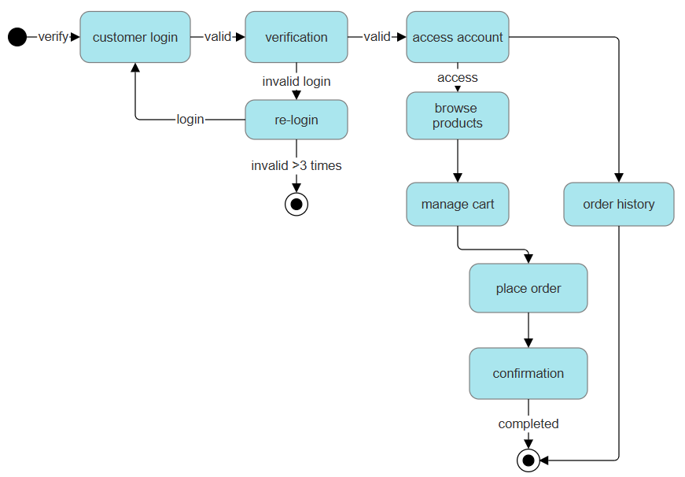
5. Design(contd.)
Batch No:C8 " Urban Nest ”
State Chart Diagram:

Slide 14
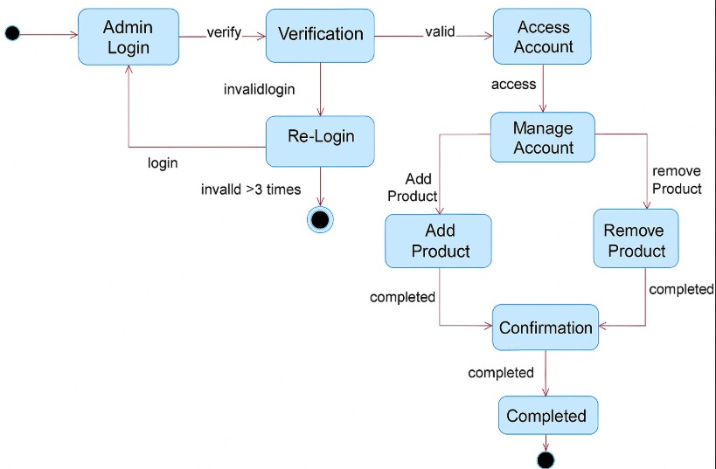
5. Design(contd.)
Batch No:C8 " Urban Nest ”
State Chart Diagram:

Slide 15
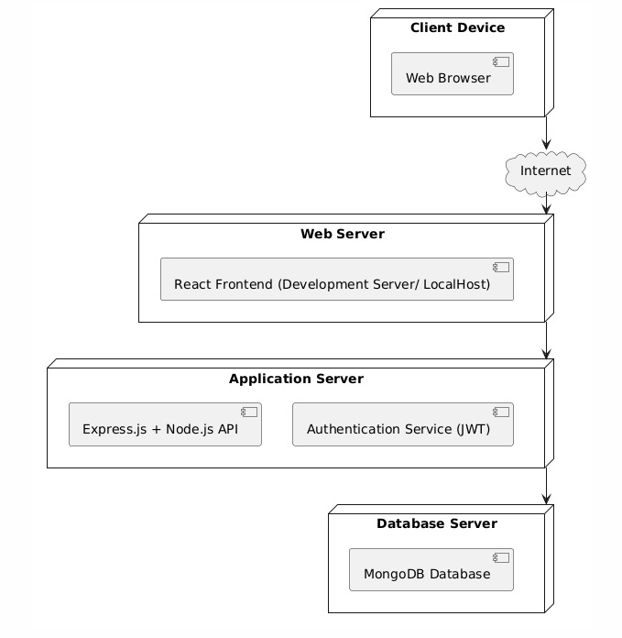
5. Design(contd.)
Batch No:C8 " Urban Nest ”
Deployment Diagram:

Slide 16
6. Software Requirements
Batch No:C8 " Urban Nest "
Frontend: React.js, Axios, HTML, CSS
Backend: Node.js with Express.js
Database: MongoDB (NoSQL)
Authentication: JSON Web Token (JWT)
Version Control: Git and GitHub
IDE (Editor): Visual Studio Code
Browser Support: Chrome, Firefox, Microsoft Edge
APIs Used: RESTful API architecture.

Slide 17
7.Hardware Requirements
Batch No:C8 " Urban Nest "
Processor: Intel Core i3 or equivalent
RAM: Minimum 4 GB
Storage: At least 500 MB for local files
Operating System: Windows / Linux
Internet: Required for hosting, media uploads,
and external API access

Slide 18
8. Implementation
Batch No:C8 " Urban Nest "
Project Setup
Initialized React.js for the frontend and Node.js with Express.js for the backend.
Organized the folder structure to separate frontend, backend, and configuration files for maintainability.
Database Design
Designed Mongoose schemas for users, products, carts, and orders.
Included fields like product name, description, price, stock quantity, category, user details, and order status.
API Development
Developed RESTful endpoints for core functionalities:
POST /register – User registration
POST /login – User authentication
GET /products – Fetch all products
POST /cart – Add products to cart
POST /orders – Place new orders
PUT /products/:id – Update product details (admin)
DELETE /products/:id – Delete a product (admin)

Slide 19
8. Implementation (contd.)
Batch No:C8 " Urban Nest "
Frontend Development
Built React components for product browsing, cart management, order placement, and account handling.
Created admin views for product management and inventory control.
Used React Router for smooth navigation across pages.
Backend Development
Set up the Express.js server with routes for user authentication, product management, cart operations, and order handling.
Integrated JWT-based authentication and role-based access control (customer and admin).
Implemented controllers for CRUD operations on products, carts, and orders.
Connected to MongoDB using Mongoose with proper schema validation.
Added middleware for authentication, error handling, and request logging.

Slide 20
8. Implementation (contd.)
Batch No:C8 " Urban Nest "
Integration
Connected the frontend with backend APIs using Axios.
Managed dynamic data fetching, state updates, and submission flows with useState and useEffect.
Testing & Validation
Tested APIs to verify all endpoints using ThunderClient.
Validated frontend forms for login, registration, and checkout.
Implemented error handling and user feedback for better usability.

Slide 21
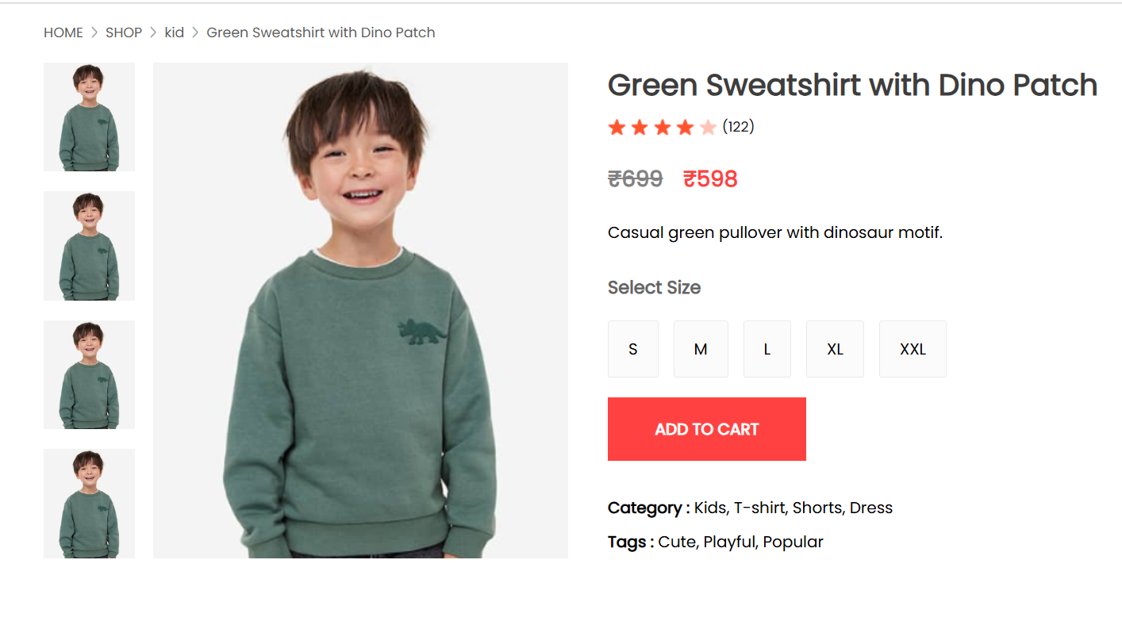
9. Result

Slide 22
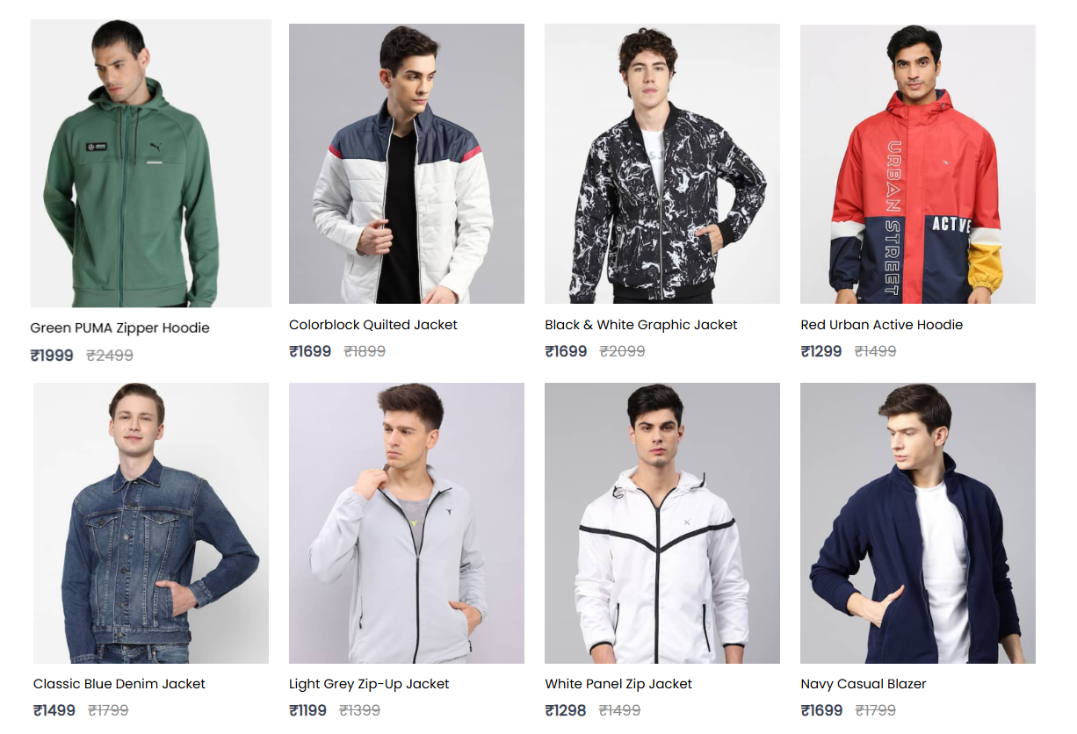
9. Result(contd.)

Slide 23
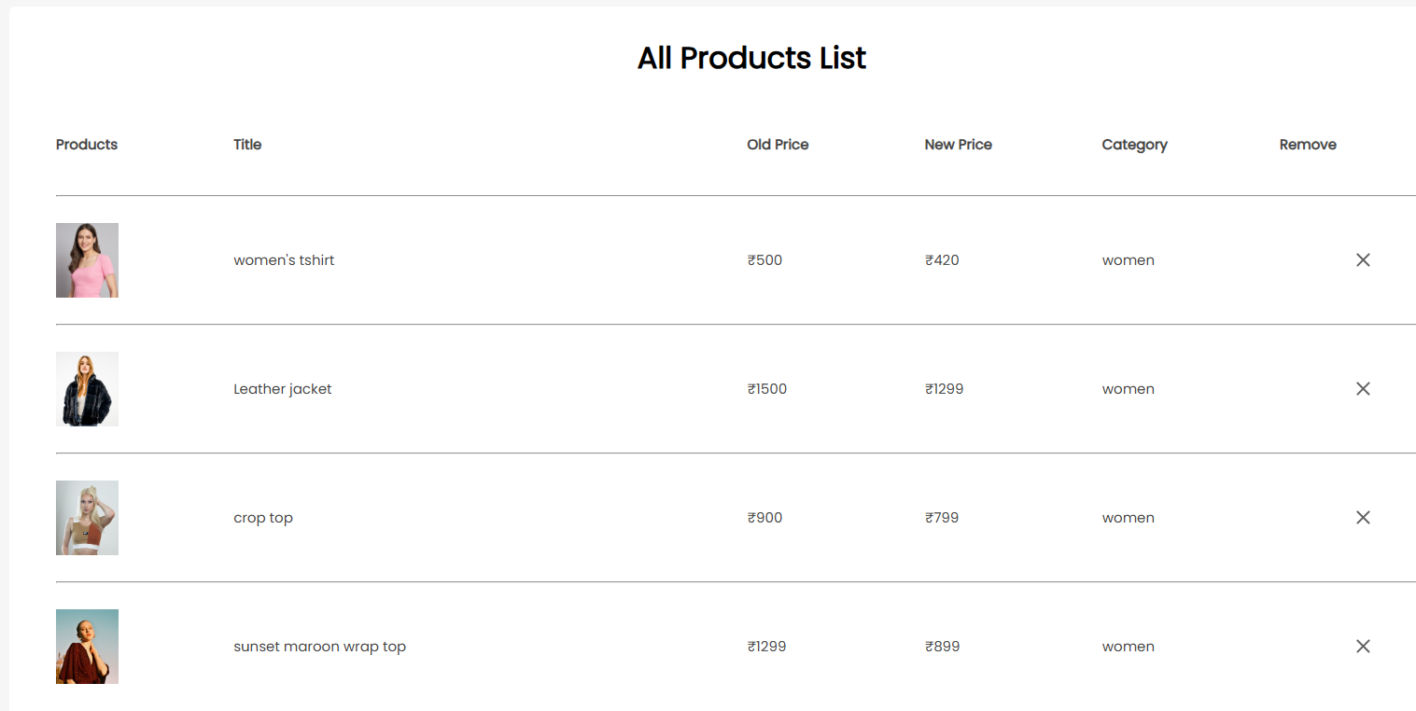
9. Result(contd.)

Slide 24
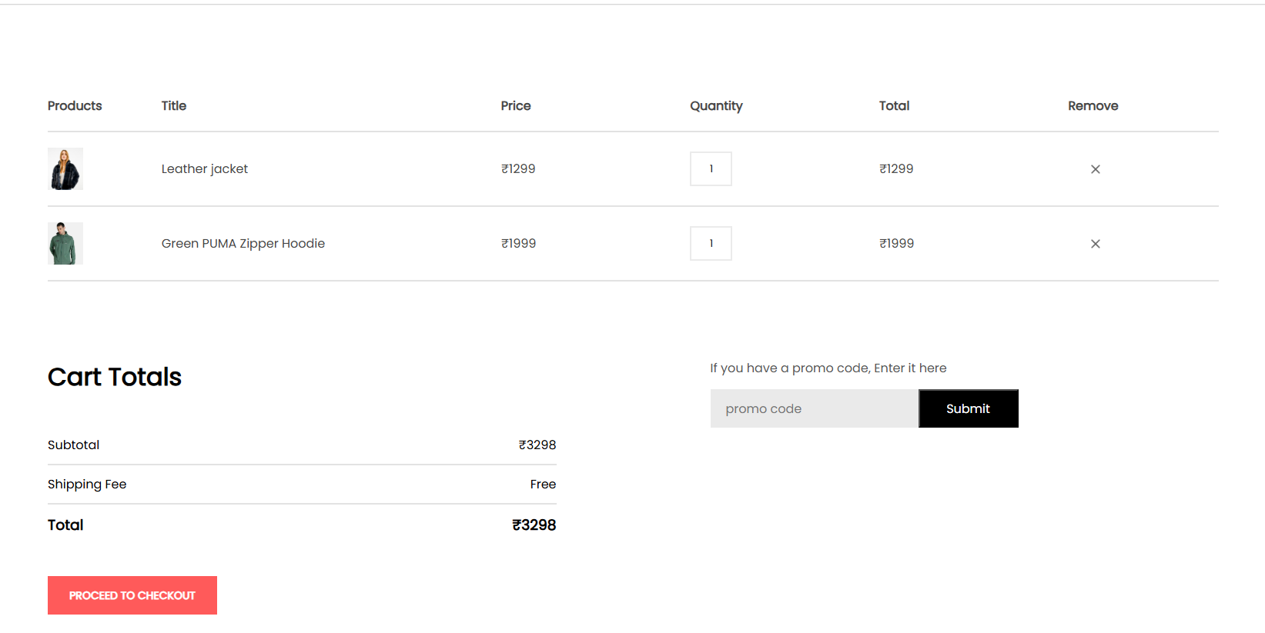
9. Result(contd.)

Slide 25
9.Conclusion & Future Scope
Batch No:C8 " Urban Nest "
Conclusion:
This project successfully demonstrates the development of an e-commerce clothing shopping platform using the MERN stack. The application allows users to browse products, manage a shopping cart, and place orders, while admin users can add, update, and delete products. It provides a secure, responsive, and user-friendly experience across devices.
React.js was used to build a dynamic frontend, while Node.js and Express.js handled backend logic and API routing. MongoDB ensured flexible and scalable data storage. The use of JWT for authentication adds a layer of security to protect user data.
Overall, the project meets the goals of building a functional, scalable, and maintainable full-stack web application. It also provided hands-on experience in using modern technologies and design principles for real-world applications.

Slide 26
9.Conclusion & Future Scope(contd.)
Batch No:C8 " Urban Nest "
Future Scope:
Mobile Application Development: Launching Android and iOS apps to provide a more accessible and seamless shopping experience on mobile devices.
AI-Powered Product Recommendations: Integrating machine learning models to suggest personalized products based on user browsing and purchase history.
Advanced Search and Filtering: Implementing AI-driven or voice-enabled search, along with more granular filters like price range sliders and category tags.
Multi-Vendor Marketplace Expansion: Allowing third-party sellers to list and manage products, turning Urban Nest into a marketplace platform.
Improved Analytics Dashboard: Offering admins advanced sales analytics, inventory predictions, and customer behavior insights.
Enhanced Security Measures: Adding two-factor authentication, fraud detection, and more robust data encryption techniques.

Slide 27
10. References
Batch No:C8 " Urban Nest "
1. Patil et al.(2025)
Harnessing the MERN stack for scalable E-commerce website design: A full- stack approach with MongoDB, Node.js, Express.js, and React.js https://pubs.thesciencein.org/journal/index.php/jist/article/view/a1116
2. De Silva et al.(2022)
Efficiency of an E-Commerce Web Application with MERN Stack and modern tools
https://ijemr.vandanapublications.com/index.php/j/article/view/928
3. Verma & Kale (2025)
Revolutionizing Online Fashion: A MERN Stack-Based E-commerce Platform
https://ijsrem.com/download/revolutionizing-online-fashion-a-mern-stack-based-e-commerce-platform
4. Huang & Benyoucef (2018)
Social commerce: A systematic review and data synthesis
https://www.sciencedirect.com/science/article/abs/pii/S1567422318300450
5. Esmaeili & Hashemi (2019)
A systematic review on social commerce https://www.tandfonline.com/doi/full/10.1080/0965254X.2017.1408672

Slide 28
Batch No:C8 " Urban Nest "
THANK YOU

