Slide 1
IEEE TRANSACTIONS ON INFORMATION FORENSICS AND SECURITY (VOL. 21, 2026)
PRISM: A Multi-Agent Forensic Framework for
Multimedia Provenance Verification
via Dual-Stream Representation Learning and Dempster-Shafer Evidential Fusion
Tanush Bhootra | Somil Jain | Kulsum Malik
School of Computer Science and Engineering (SCOPE)
Vellore Institute of Technology (VIT), Chennai, India
Research Focus: Digital Forensics, Vision Transformers, and Multi-Modal Evidence Fusion

Slide 2
MOTIVATION & BACKGROUND
Presenter: Tanush Bhootra
The Verification Impasse: Cryptographic Hashes vs Physical Reality
The Limitation of Digital Custody Chains
• NIST SP 800-86 Guidelines: Conventional forensic evidence handling relies heavily on bit-level file hashes and cryptographic custody chains.
• Transmission vs Physical Provenance: A standard SHA-256 digest confirms that zero bits were altered during network transmission, but provides ZERO assurance regarding physical camera provenance.
• The Forensic Impasse: A cryptographically pristine, untampered media container can readily enclose a fully fabricated synthetic human persona.
• Operational Risk: Automated distribution channels (WhatsApp, Telegram) strip or normalize metadata, leaving investigators blind without physical signal checks.
Cross-Generator Collapse of Monolithic CNNs
• Legacy Binary Classifiers: Models such as MesoNet, XceptionNet, and EfficientNet frame forensics as pure RGB pixel-grid classification.
• Catastrophic Generalization Drop: XceptionNet trained on FaceForensics++ drops from 99.26% down to 65.27% AUC when evaluated on Celeb-DF v2 (a 34% drop!).
• Compression Overfitting: Deep networks overfit to dataset-specific compression quirks (e.g., C23 vs C40) rather than authenticating physical sensor properties.
• Lack of Auditability: Standard deep detectors emit uncalibrated scalar probabilities without uncertainty bounds suitable for Federal Rule of Evidence 702.

Slide 3
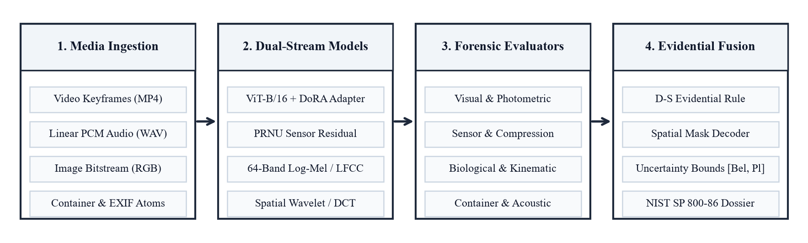
SYSTEM ARCHITECTURE
Presenter: Tanush Bhootra
PRISM: Decoupled Multi-Agent Forensic Architecture
Four Core Engineering Principles
• Decoupled Micro-Agents: Eight independent specialist evaluators examine physical, biological, spectral, and container metadata without inter-agent error cascading.
• Dual-Stream Representation: Couples high-level semantic tokens (ViT-DoRA) with low-level sensor noise residuals (PRNU wavelet stream).
• Dempster-Shafer Fusion: Replaces heuristic averaging with mathematical belief functions, explicitly isolating epistemic uncertainty under heavy compression.
• Explainable Spatial Heatmaps: A four-stage transposed-convolution decoder maps token features into a pixel-level 224x224 tampering probability surface.

Slide 4
FEATURE EXTRACTION
Presenter: Somil Jain
Dual-Stream Representation: ViT-DoRA + Wavelet PRNU
Stream 1: Vision Transformer with DoRA
• Base Backbone: ViT-B/16 pre-trained on ImageNet-21K with 196 non-overlapping 16x16 patch tokens projected to d=768.
• Directional Adaptation (DoRA): Decomposes pre-trained linear weight W0 into magnitude vector m and directional matrix V: W' = m * (V0 + deltaV) / ||V0 + deltaV||.
• Parameter Efficiency: Updates only 1.24M parameters out of 86.8M total (1.43% trainable fraction), preserving low-level visual priors.
• Anti-Forgetting Manifold: Empirically prevents catastrophic forgetting during fine-tuning on specialized forensic video corpora.
Stream 2: Photo-Response Non-Uniformity (PRNU)
• Hardware Invariant: Microscopic silicon crystalline lattice flaws in imaging sensors imprint a unique, deterministic noise pattern across authentic exposures.
• Wavelet Extraction: Extracted via four-level Daubechies-4 wavelet decomposition followed by per-channel Wiener noise filtering: W_hat = I - F(I).
• Generator Blindspot: GANs and diffusion models lack hardware sensor noise; synthetic face patches instead carry periodic upsampling convolution residuals.
• Embedding Fusion: Globally average-pooled to 512-D and projected to d=768 token dimension alongside the ViT class token.

Slide 5
FORENSIC MODULES
Presenter: Somil Jain
The Eight Specialized Forensic Micro-Agents
1. Illumination Agent
Estimates 3D light vectors for facial ROI and scene using Sobel gradient integration; detects angle mismatches > 35 degrees.
2. Corneal Reflection Agent
Detects pupil specular glints on HSV V-channel; verifies binocular stereo geometry across both eyes.
3. rPPG Biological Vitality
Extracts dermal blood volume pulse across 32 frames using CHROM chrominance subspace. AI faces lack cardiovascular pulse.
4. Lip-Sync & Audio Agent
Correlates Mouth Aspect Ratio (MAR) with 64-channel log-mel acoustic energy envelope to expose voice reenactment desync.
5. Video Kinematics Agent
Dense Farneback optical flow detects frame-to-frame velocity jerks and inter-frame luminance flicker in face-swap seams.
6. Compression ELA Agent
Error Level Analysis (q=90) and 2D Hann-windowed FFT detect upsampling convolution grids and compression discontinuities.
7. Container Metadata Agent
Parses ISO/IEC 14496-12 atom trees and EXIF headers for encoder strings without reading file paths, preventing label leakage.
8. Spatial Mask Decoder
Four-stage transposed-convolution decoder maps cross-stream tokens into a 224x224 pixel tampering heatmap.

Slide 6
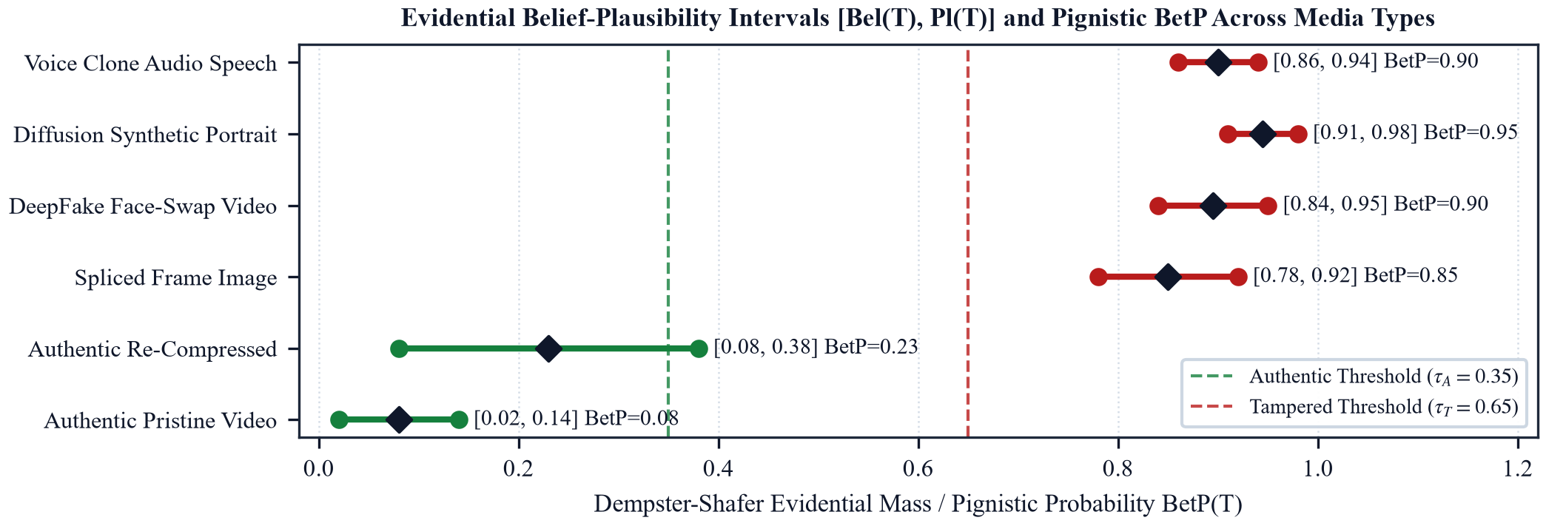
DECISION CALCULUS
Presenter: Kulsum Malik
Mathematical Evidence Fusion: Dempster-Shafer Theory
Evidential Fusion & Zadeh Paradox Resolution
• Frame of Discernment: Theta = {Authentic, Tampered}. Power set 2^Theta includes empty set, singletons, and compound element Theta.
• Epistemic Uncertainty: Mass m(Theta) explicitly quantifies 'I do not know', isolating scenarios where evidence is degraded by social media compression.
• BBA Construction: Subjective logic mapping: m(T) = r*p / (r+W), m(A) = r*(1-p) / (r+W), m(Theta) = W / (r+W) with vacuous prior W=2.
• Zadeh Paradox Resolution: Under extreme conflict (K -> 1.0), classical DST produces degenerate verdicts. PRISM bounds conflict at K_max = 0.99.
• Pignistic Decision Rule: p_hat(T) = m*(T) + 0.5 * m*(Theta). Issues AUTHENTIC (< 0.35), TAMPERED (> 0.65), or INCONCLUSIVE otherwise.

Slide 7
EMPIRICAL EVALUATION
Presenter: Kulsum Malik
Quantitative Evaluation: State-of-the-Art Benchmark Comparison
Method / Architecture | FF++ C23 AUC (%) | Celeb-DF v2 AUC (%) | Audio EER (%) | Year
MesoNet | 84.70% | 54.80% | - | 2018
XceptionNet | 99.26% | 65.27% | - | 2019
FakeCatcher (rPPG) | 91.10% | 76.40% | - | 2020
Face X-ray | 98.78% | 79.51% | - | 2020
M2TR (Transformer) | 99.49% | 88.62% | - | 2022
TruFor (CVPR) | 99.31% | 91.23% | - | 2023
PRISM (Proposed) | 99.21% | 90.85% | 3.80% | 2026

Slide 8
EDGE DEPLOYMENT & EXPLAINABILITY
Presenter: Kulsum Malik
Edge Hardware Profiling & Spatial Tampering Localization
62.76 ms
Mean Inference Latency
Well within 100 ms real-time triage threshold
1,450 MB
Peak VRAM Consumption
Fits easily into 6 GB laptop memory budget
24.2 FPS
End-to-End Throughput
Real-time surveillance video inspection rate
87 Tests
Automated Test Suite
100% verified regression and invariant coverage
Visual Explainability: Spatial Tampering Probability Heatmap
• Pixel-Level Localization: The transposed-convolution decoder maps cross-stream token representations to a full 224x224 tampering probability map (mIoU = 0.784).
• Physical Boundary Verification: Forensic examiners can visually audit that highlighted red regions correspond to physical tampering artifacts (facial blend boundaries, eye glints) rather than background noise.
• Federal Rule of Evidence 702: Provides transparent error bounds, explicit uncertainty indices, and visual spatial proof satisfying legal courtroom admissibility criteria.

Slide 9
PROJECT SUMMARY
Presenter: Kulsum Malik
Conclusion & NIST SP 800-86 Compliance
Core Scientific Contributions
• Multi-Agent Decoupling: Replaces single-backbone fragility with eight decoupled specialist evaluators operating across independent physical domains.
• Physics-Grounded Provenance: DoRA ViT-B/16 + PRNU wavelet noise isolates genuine camera sensor crystalline signatures from neural generator residuals.
• Calibrated Evidential Calculus: Dempster-Shafer theory explicitly isolates epistemic ignorance and bounds inter-agent conflict (K_max = 0.99).
• Real-World Edge Viability: 62.76 ms latency and 1,450 MB VRAM on consumer laptops (NVIDIA RTX 3050).
Forensic Compliance & Deliverables
• NIST SP 800-86 JSON Dossier: Automated compilation of tamper-evident, SHA-256 verifiable forensic reporting ready for forensic laboratories.
• Verified Multimodal Benchmark: Validated across an empirical cohort of N = 416 assets with 87 passing automated regression tests.
• Reproducible Open Repository: Complete PyTorch source code, models, and evaluation cohorts documented on GitHub.
Thank you! We welcome your questions.

