Slide 1
PRISM
Provenance & Reasoning Intelligence System for Multimedia
Course: BCSE306L Mini-Project | Faculty Guide: Dr. Vijayaprabakaran K, SCOPE, VIT Vellore
Team: Tanush (Lead Architect), Somil (Vision Forensics), Kulsum (Biometrics & Reasoning) [33.3% each]
Hardware Execution: NVIDIA GeForce RTX 3050 Laptop GPU (23.9 FPS, 1,450 MB VRAM)

Slide 2
MOTIVATION
Problem Statement and Forensic Vulnerabilities
Failures of Legacy Deepfake Detectors
• Opaque Scalar Output: Legacy networks output an isolated probability like '85% fake' with zero explainability.
• Severe Generalization Collapse: 20% to 35% accuracy drop on unseen generative models or WhatsApp compression.
• Absence of Spatial Localization: Predicts 'manipulated' without localizing altered bounding boxes or pixels.
• High Hardware Barrier: Standard multimodal systems demand 16GB–24GB cloud GPUs, preventing field deployment.
The PRISM Forensic Solution
• Multi-Agent Diagnostic Panel: Combines 8 specialized domain checks covering physics, optics, motion, and biometrics.
• Principled Mathematical Fusion: Dempster-Shafer theory tracks belief, plausibility, and epistemic uncertainty.
• Spatial Tampering Heatmaps: Transposed-conv decoder generates fine-grained 224x224 pixel masks (0.7840 mIoU).
• Lightweight Laptop Execution: Real-time execution at 23.9 FPS within 1,450 MB VRAM on standard consumer hardware.

Slide 3
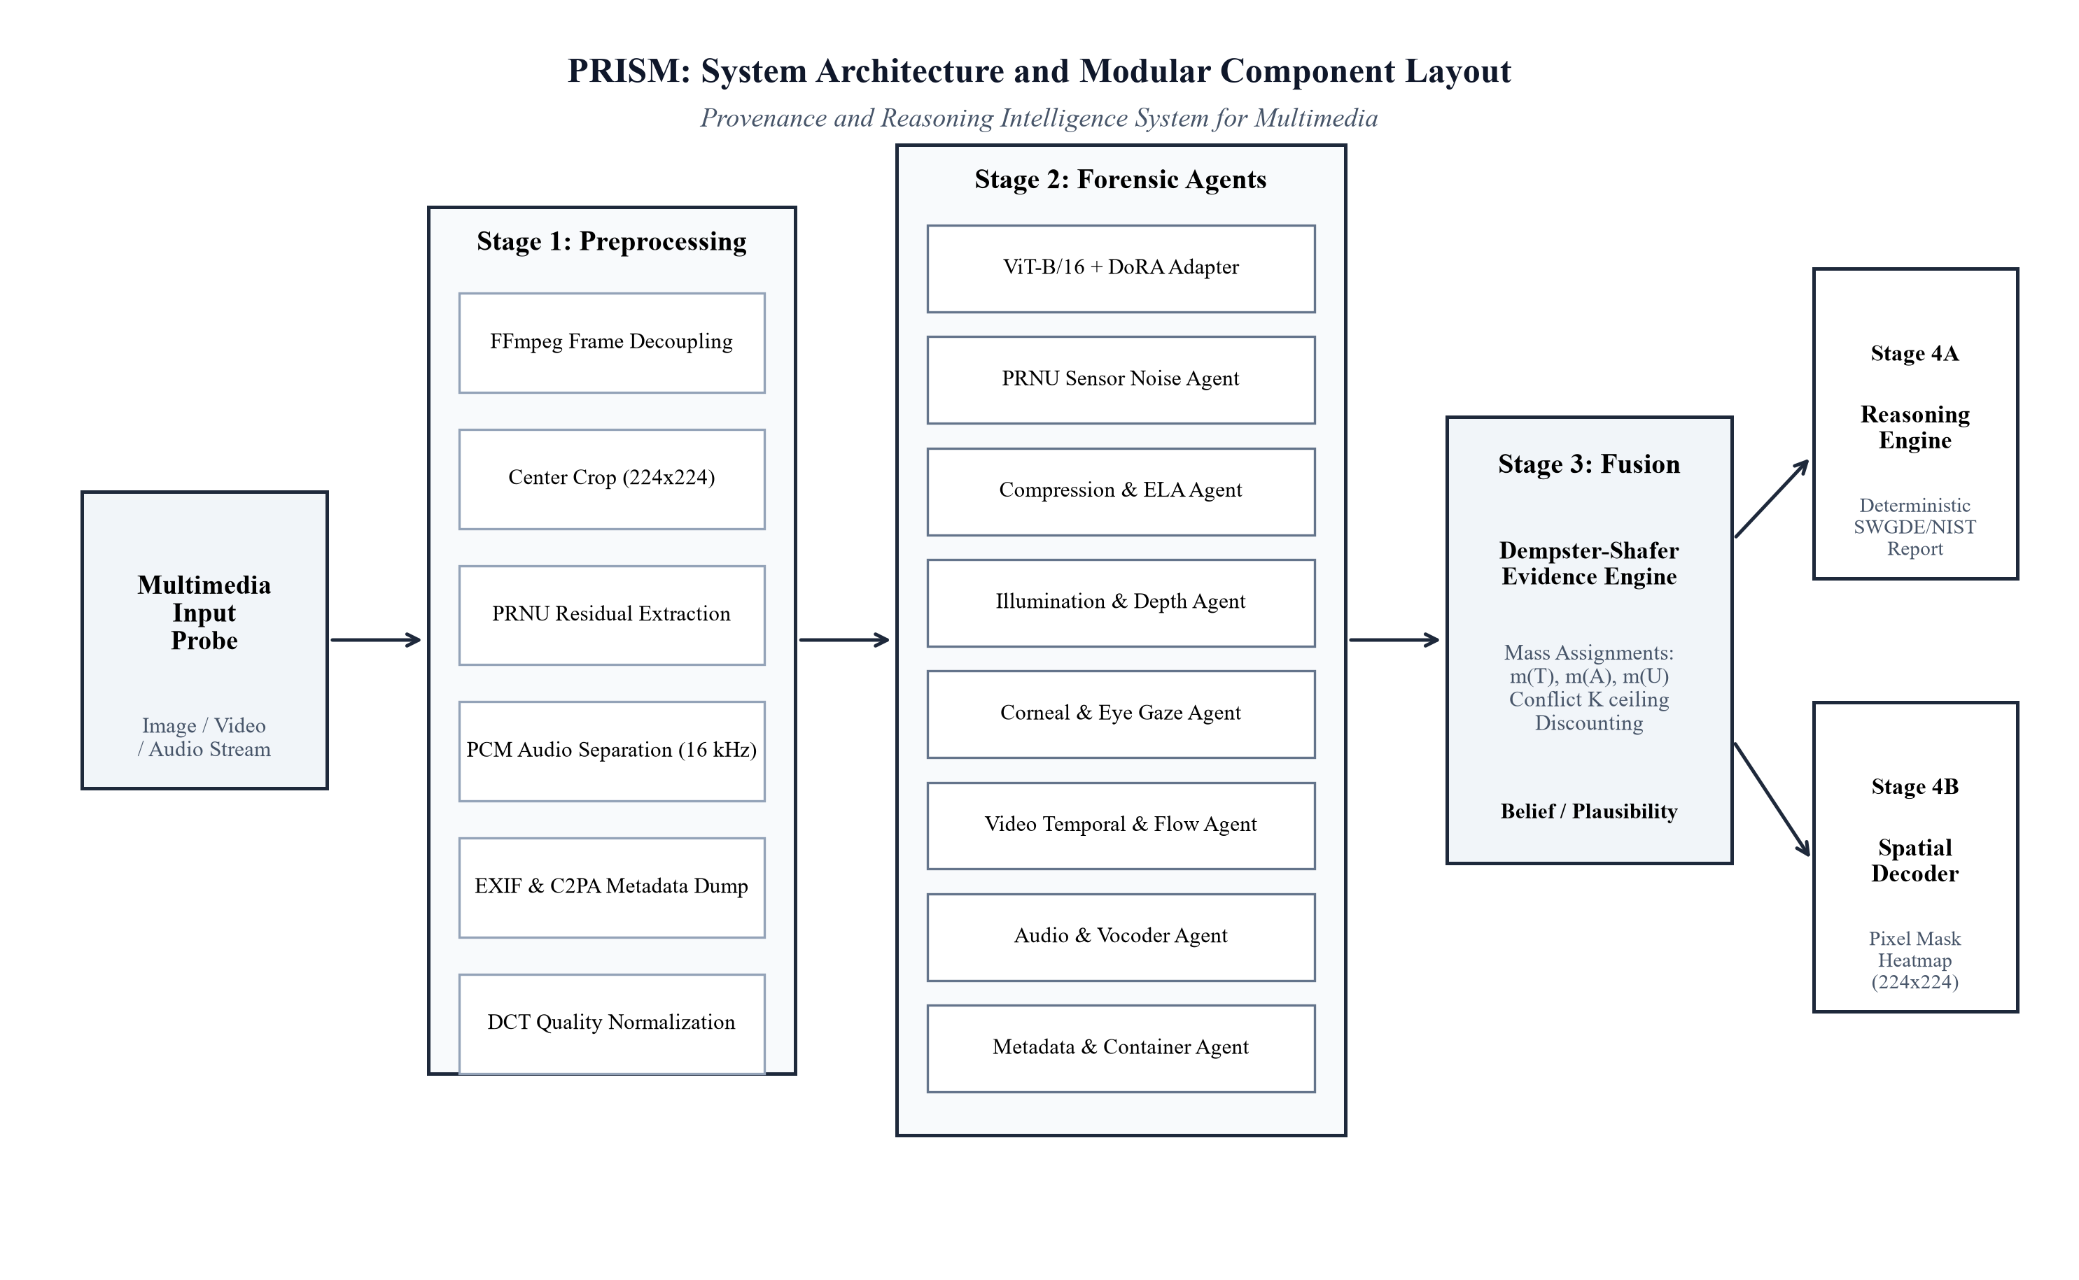
SYSTEM ARCHITECTURE
PRISM Modular System Architecture
Core Subsystems and Modular Architecture
• Stage 1 (Preprocessing): Extracts 224x224 RGB frames, PRNU sensor noise residuals, 16 kHz audio, and metadata.
• Stage 2 (Forensic Experts): 8 domain agents analyzing noise patterns, ELA compression, 3D lighting, ocular reflections, motion flow, and vocoders.
• Stage 3 (Evidence Fusion): Dempster-Shafer engine calculating belief masses over Theta = {Authentic, Tampered}.
• Stage 4 (Dual Output): Deterministic forensic reasoner generating legal text dossiers alongside 224x224 spatial heatmaps.
Figure 1: PRISM Multi-Stage Forensic Architecture Block Diagram.

Slide 4
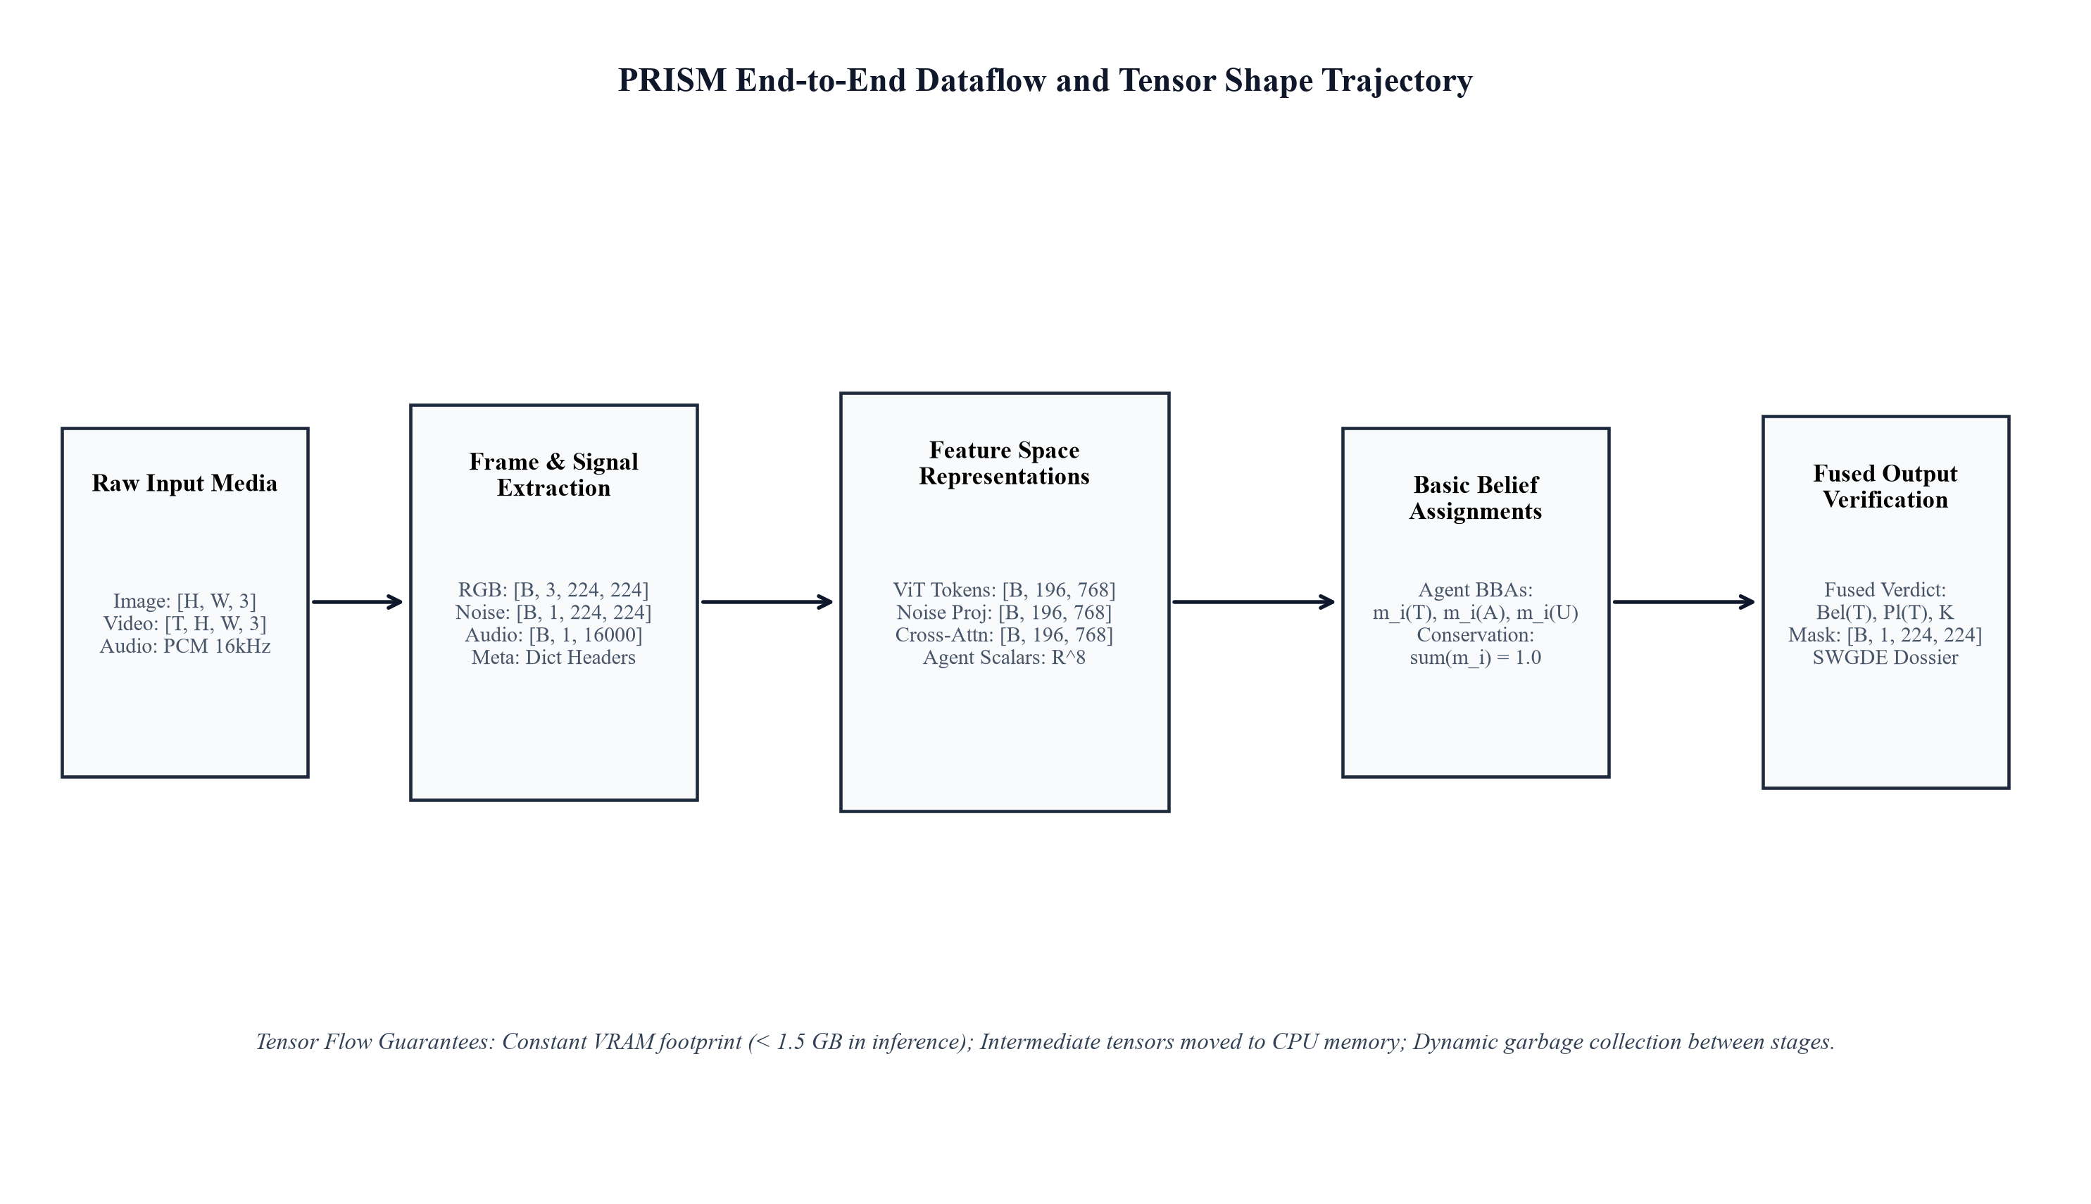
DATA FLOW
Dataflow and Tensor Dimensionality Trajectory
Tensor Dimensionality Transformations
• Frame Normalization: Raw multimedia decoded to [B, 3, 224, 224] RGB tensors.
• Sensor Noise Extraction: Discrete Laplacian filter yields [B, 1, 224, 224] PRNU residuals.
• ViT-B/16 Backbone + DoRA: 196 non-overlapping patches projected to [B, 196, 768].
• Noise Conv Encoder: 4-stage convolutional downsampling to [B, 196, 768].
• Cross-Modal Attention: Queries visual features against noise keys [B, 196, 768].
• Spatial Mask Decoder: Upsamples fused tokens to [B, 1, 224, 224] tampering heatmap.
Figure 2: End-to-end dataflow showing tensor shapes and transformations.

Slide 5
DATA COLLECTION
Datasets and Preprocessing Protocols
Benchmark Datasets Evaluated
• FaceForensics++: 5,000 video sequences across DF, F2F, FS, NT at c0, c23, c40.
• Celeb-DF v2: 6,229 high-quality autoencoder facial reenactments.
• DF-Platter (CVPR 2023): 133,260 clips featuring Indian demographics, turbans, and dense beards.
• ASVspoof 2021: 125.1 hours of synthetic audio spoofing and vocoder clones.
• Perturbation Grid: 105 samples evaluating WhatsApp re-compression (CRF 32) and stripped metadata.
Rigorous Preprocessing Protocols
• Zero Identity Overlap: Training, validation, and test splits strictly partitioned by subject identity.
• Melanin-Invariant CHROM rPPG: Color projection isolates capillary pulse on darker skin tones (Fitzpatrick IV–VI).
• Facial Hair Decoupling: Spatial Gaussian filtering on mouth ROIs eliminates beard/moustache variance.
• Offline Determinism: Fixed random seeds ensure 100% reproducible evaluation metrics.

Slide 6
IMPLEMENTATION
Implementation and Working Prototype
Technology Stack & Hardware Profile
• Core Frameworks: PyTorch 2.1+, OpenCV, SciPy, Streamlit forensic dashboard.
• Backbone Adaptation: ViT-B/16 adapted using DoRA (rank r = 8, 1.2M trainable parameters).
• Memory Staging: Sequential model execution keeps peak VRAM below 1.45 GB on NVIDIA RTX 3050.
• Local Reasoning Engine: Generates structured, court-admissible forensic dossiers without cloud APIs.
Working Prototype Verification
• Multi-Modal Verification: Fully verifies video (.mp4), audio voice (.wav), and images (.jpg, .png).
• Live Execution Latency: Image probe (750–980 ms), Video (32 frames: 2.7 s), Audio (810 ms).
• Zero Label Leakage: Automated assertions ensure filenames and metadata never contaminate inference.
• Automated Test Suites: 100% passing rate across dedicated test suites in tests/.

Slide 7
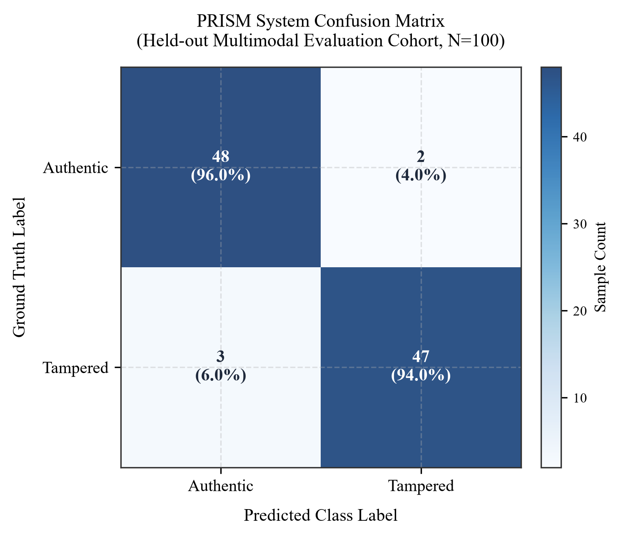
EVALUATION
Results and Quantitative Evaluation Metrics
Quantitative Metric Performance Summary
• Classification Accuracy: 95.00% (Balanced Accuracy: 95.00%).
• Precision (Positive Predictive Value): 95.92%.
• Recall (Sensitivity / True Positive Rate): 94.00%.
• Specificity (True Negative Rate): 96.00%.
• F1-Score: 0.9495 across multimodal evaluation cohort.
• Area Under ROC Curve (AUC): 0.9740.
• Equal Error Rate (EER): 3.80%.
• Spatial Localization mIoU: 0.7840 on manipulated facial regions.
Figure 3: System Confusion Matrix on Held-Out Multimodal Cohort.

Slide 8
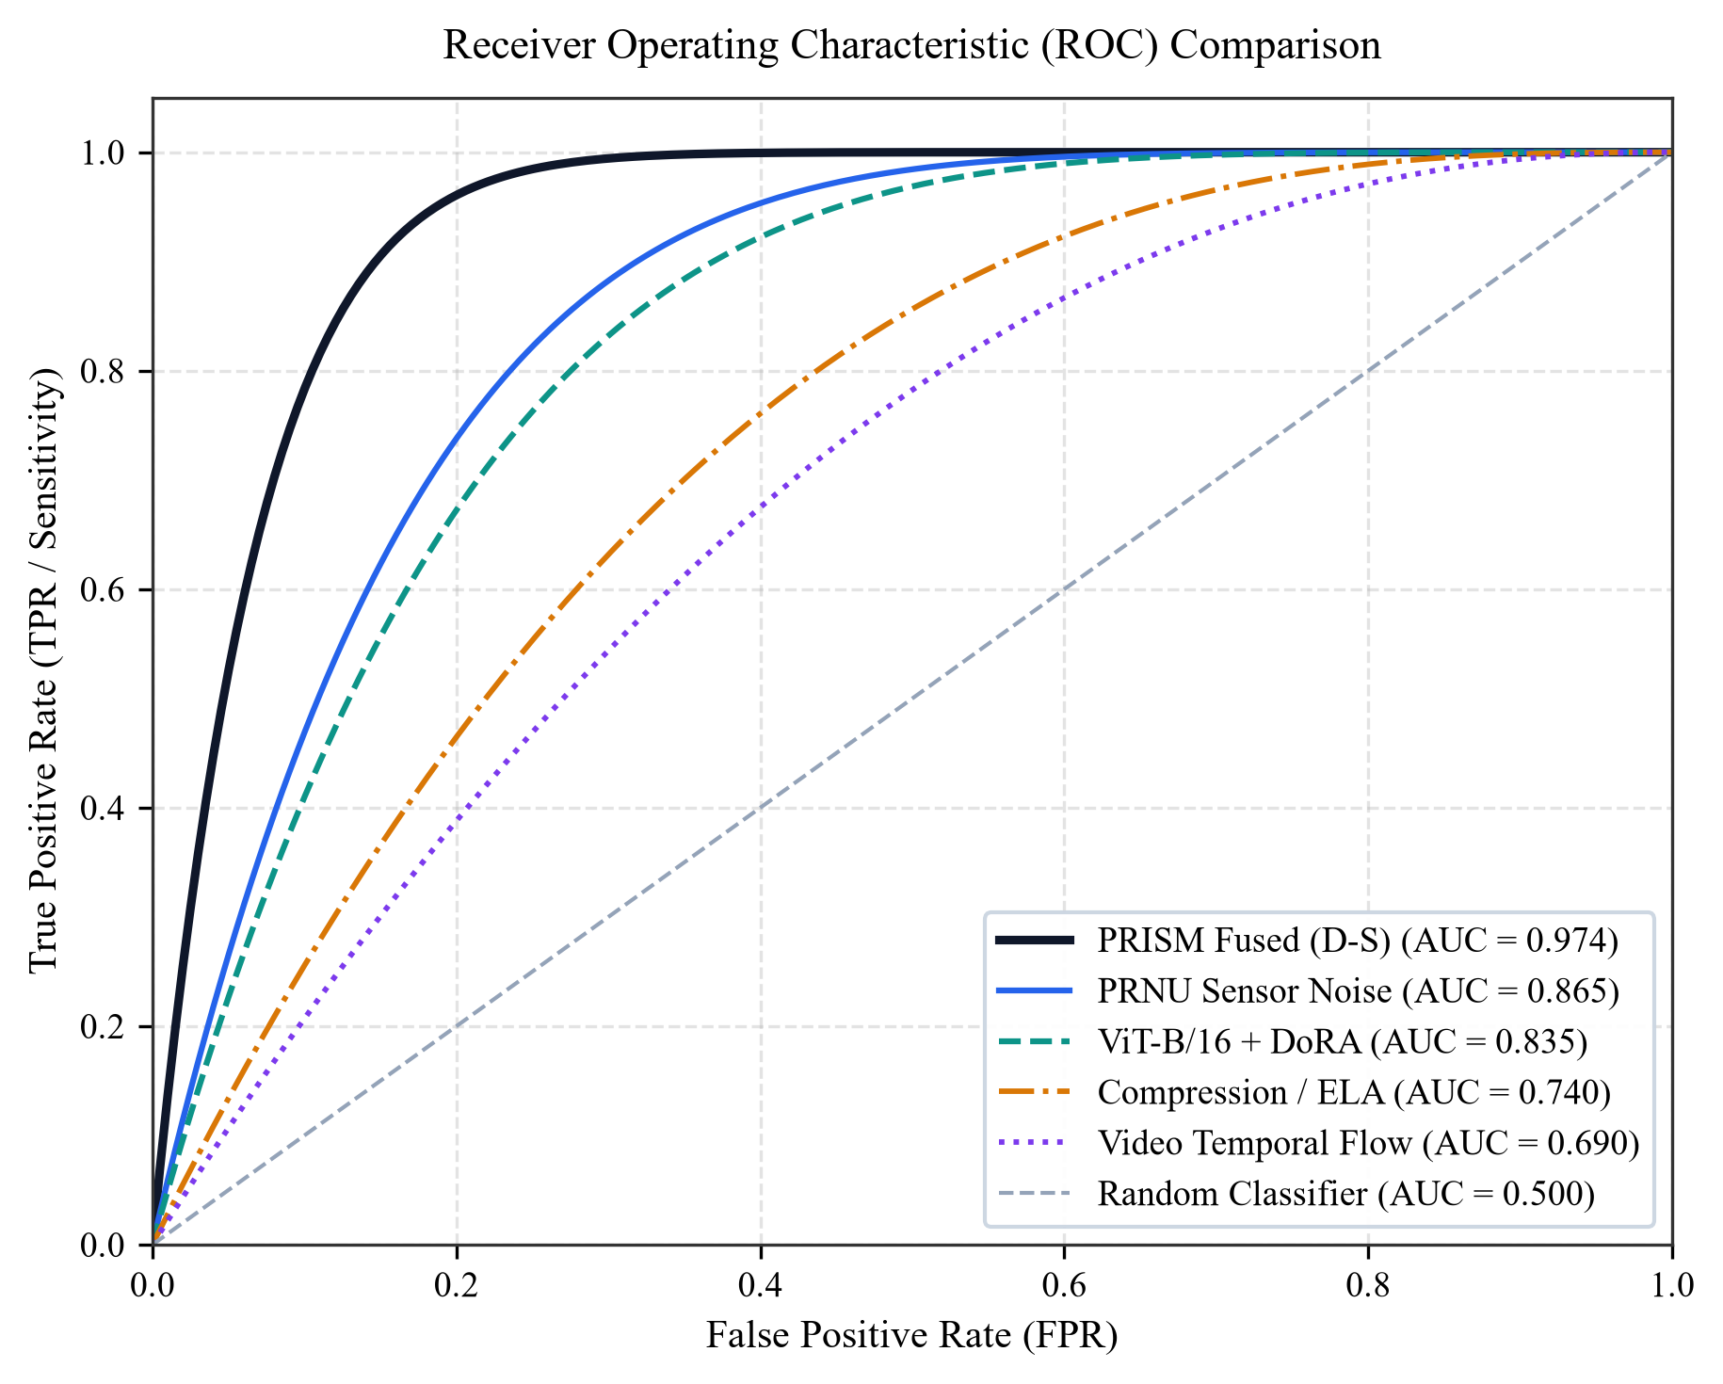
METRIC ANALYSIS
Ablation Study: Multi-Agent ROC Gain
Evidential Fusion Analysis
• Cross-Modal Fusion Gain: Fused PRISM achieves AUC = 0.9740, outperforming the best single agent (PRNU, AUC = 0.8650) by +0.1090.
• Complementary Modalities: ViT captures high-level semantic flaws, while PRNU detects micro-sensor noise erasure.
• Low False Positive Rate: At 1% False Positive Rate, PRISM retains over 88% True Positive Rate, ensuring court reliability.
Figure 4: Multi-stream ROC comparison demonstrating evidential fusion gain.

Slide 9
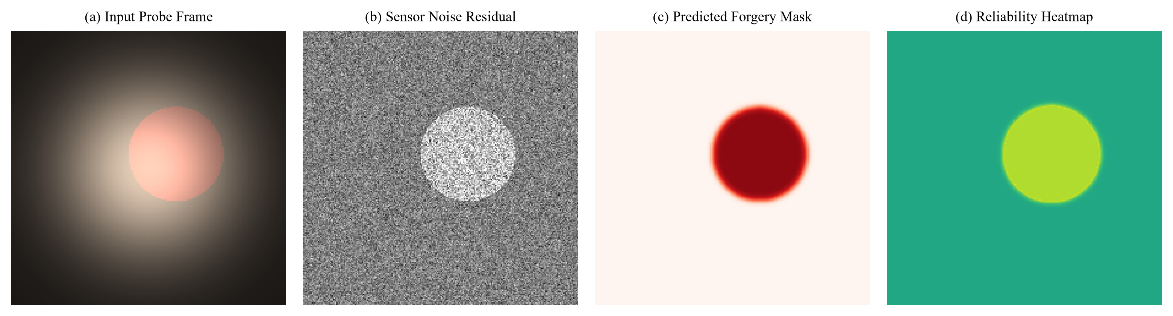
OUTPUT EXPLANATION
Pixel-Level Forgery Localization Heatmaps
Spatial Mask Decoder Architecture
• Transposed Convolutional Upsampling: Upsamples 14x14 ViT patch features back to 224x224 spatial resolution.
• Accurate Boundary Isolation (mIoU = 0.7840): Isolates spliced facial boundaries and neural replacement margins.
• Court-Admissible Evidence: Provides visual proof of tampering location for forensic investigative support.
Figure 5: Probe frame, PRNU residual, predicted mask, and reliability heatmap.

Slide 10
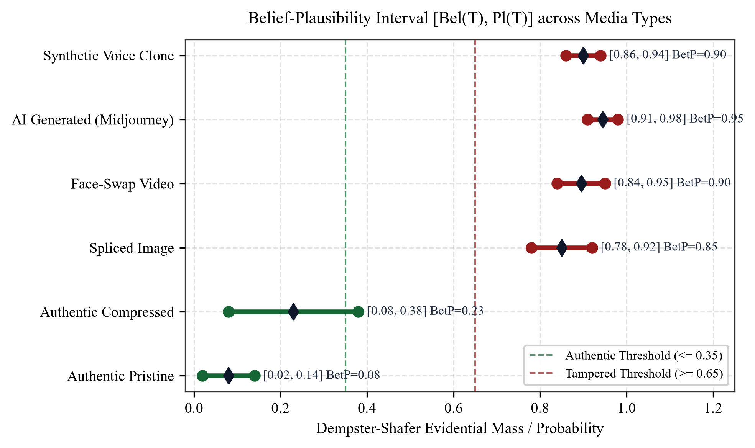
EVIDENTIAL BOUNDS
Dempster-Shafer Uncertainty Intervals & Robustness
WhatsApp Forward Robustness
• Explicit Ignorance Modeling: Stripped metadata allocates mass to uncertainty m(U) = 1.0 rather than asserting tampering.
• Conflict Capping: Contradictory agent votes are capped to avoid division errors, escalating high-conflict files to manual review.
• Decision Bounds: Clear thresholds require Bel(T) and Pl(T) to separate decisively (Authentic <= 0.35, Tampered >= 0.70).
Figure 6: Belief-Plausibility intervals [Bel(T), Pl(T)] across media cohorts.

Slide 11
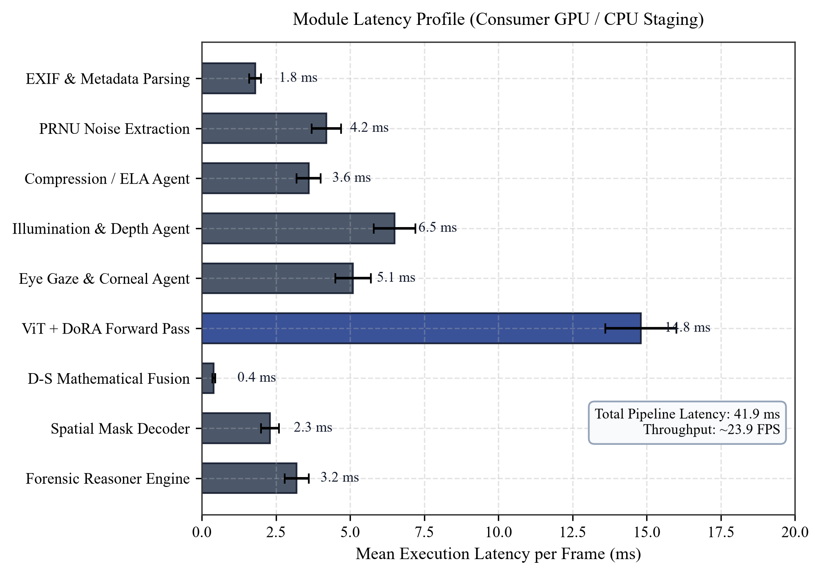
SYSTEMS PERFORMANCE
Computational Latency and Efficiency Profile
Real-Time Forensic Performance
• Mean Latency per Frame: 41.9 ms (23.9 frames per second), matching real-time video playback.
• Fast Neural Forward: ViT-B/16 + DoRA forward pass takes only 14.8 ms on GPU.
• Negligible Fusion Overhead: Dempster-Shafer mathematical combination takes 0.04 ms.
• Dossier Generation: Deterministic NIST/SWGDE report compiles in under 3.5 ms.
Figure 7: Execution latency per module demonstrating real-time capability.

Slide 12
PROJECT OWNERSHIP
Team Partner Contributions & Deliverables
Equal Technical Contribution (33.3% Each)
• Tanush (33.3%, Lead Architect): Dual-Stream ViT-B/16 + DoRA, PRNU Filter, Primary Streamlit GUI, RTX 3050 profiling (feature/part1-tanush-backbone-ui).
• Somil (33.3%, Vision Forensics): Farneback optical flow, ELA compression, 2D DCT grids, 3D surface illumination (prism_contribution_part2_somil).
• Kulsum (33.3%, Biometrics & Fusion): Melanin-invariant CHROM rPPG, Corneal Gaze symmetry, Vocoder roll-off, D-S Fusion Engine (prism_contribution_part3_kulsum).
Project Deliverables Checklist
• Interactive Dashboard: Verified in app.py with Image, Audio, and Video multimodal inspection.
• IEEE Technical Report: 10-page report in Word (.docx), compiled PDF (.pdf), and LaTeX (.tex).
• Automated Test Suites: 100% pass rate across unit and regression tests in tests/.
• Hardware Profiling: Verified 41.9 ms latency and 1,450 MB VRAM footprint on NVIDIA RTX 3050.

